Slide 1
NumPy Basics
for Data Analysis
By Armin Khayati

Slide 2
NumPy Basics:
Arrays and Vectorized Computation
NumPy, short for Numerical Python, is one of the most important foundational packages for numerical computing in Python.
Here are some of the things you’ll find in NumPy at next slide.

Slide 3
NumPy Basics:
Arrays and Vectorized Computation
ndarray, an efficient multidimensional array providing fast array-oriented arithmetic operations and flexible broadcasting capabilities.
Mathematical functions for fast operations on entire arrays of data without having to write loops.
Tools for reading/writing array data to disk and working with memory-mapped files.
Linear algebra, random number generation, and Fourier transform capabilities.
A C API for connecting NumPy with libraries written in C, C++, or FORTRAN.

Slide 4
NumPy Basics:
Arrays and Vectorized Computation
While NumPy by itself does not provide modeling or scientific functionality, having an understanding of NumPy arrays and array-oriented computing will help you use tools with array-oriented semantics, like pandas, much more effectively.
For most data analysis applications, the main areas of functionality we’ll focus on are in next slide

Slide 5
NumPy Basics:
Arrays and Vectorized Computation
Fast vectorized array operations for data munging and cleaning, subsetting and filtering, transformation, and any other kinds of computations
Common array algorithms like sorting, unique, and set operations
Efficient descriptive statistics and aggregating/summarizing data
Data alignment and relational data manipulations for merging and joining together heterogeneous datasets
Expressing conditional logic as array expressions instead of loops with if-elif-else branches
Group-wise data manipulations (aggregation, transformation, function application)

Slide 6
NumPy Basics:
Arrays and Vectorized Computation
There are a number of reasons for why NumPy is so important :
NumPy internally stores data in a contiguous block of memory, independent of other built-in Python objects. NumPy’s library of algorithms written in the C language can operate on this memory without any type checking or other overhead. NumPy arrays also use much less memory than built-in Python sequences.
NumPy operations perform complex computations on entire arrays without the need for Python for loops.

Slide 7
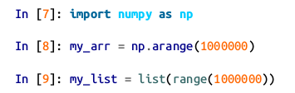
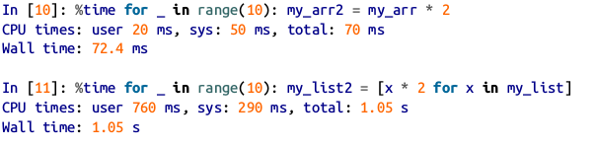
NumPy Basics:
Arrays and Vectorized Computation
To give you an idea of the performance difference, consider a NumPy array of one million integers, and the equivalent Python list.

Slide 8
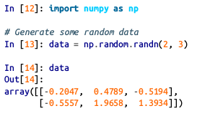
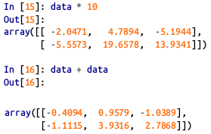
The NumPy ndarray: A Multidimensional Array Object
To give you a flavor of how NumPy enables batch computations with similar syntax to scalar values on built-in Python objects, I first import NumPy and generate a small array of random data and then I write mathematical operations with that data:

Slide 9
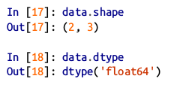
The NumPy ndarray:
A Multidimensional Array Object
n ndarray is a generic multidimensional container for homogeneous data; that is, all of the elements must be the same type.
Every array has a shape , a tuple indicating the size of each dimension, and a dtype , an object describing the data type of the array

Slide 10
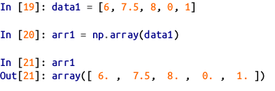
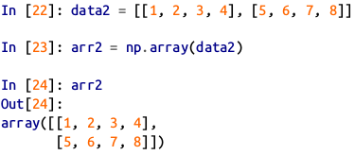
The NumPy ndarray:
Creating ndarrays
The easiest way to create an array is to use the array function.
This accepts any sequence-like object (including other arrays) and produces a new NumPy array containing the passed data.

Slide 11
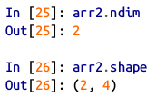

The NumPy ndarray:
Creating ndarrays
We can confirm arr2 dimensions and shape by inspecting the ndim and shape attributes
np.array tries to infer a good data type for the array that it creates.

Slide 12
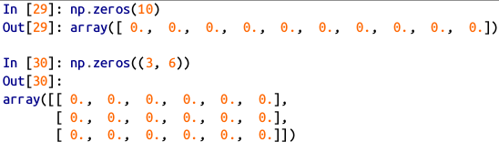
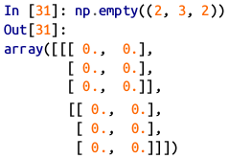
The NumPy ndarray:
Creating ndarrays
zeros and ones create arrays of 0s or 1s, respectively, with a given length or shape.
empty creates an array without initializing its values to any particular value.

Slide 13
The NumPy ndarray:
Creating ndarrays
It’s not safe to assume that np.empty will return an array of all zeros. In some cases, it may return uninitialized “garbage” values.
arange is an array-valued version of the built-in Python range function.

Slide 14
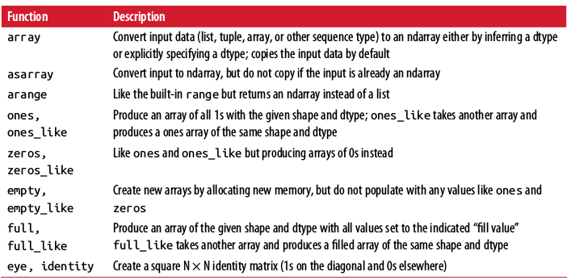
The NumPy ndarray:
Array creation functions

Slide 15
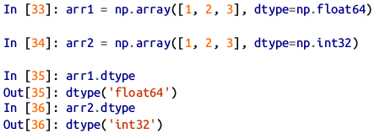
The NumPy ndarray:
Data Types for ndarrays
The data type or dtype is a special object containing the information (or metadata, data about data) the ndarray needs to interpret a chunk of memory as a particular type of data.

Slide 16
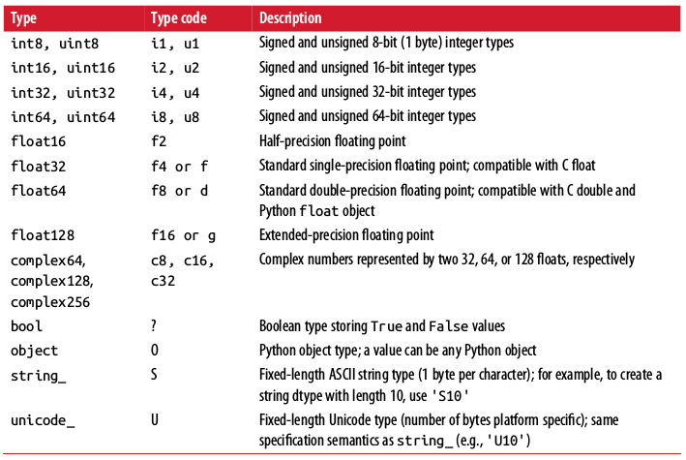
The NumPy ndarray:
Data Types for ndarrays

Slide 17
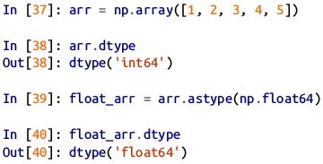
The NumPy ndarray:
Data Types for ndarrays
You can explicitly convert or cast an array from one dtype to another using ndarray’s astype method. In this example, integers were cast to floating point.

Slide 18
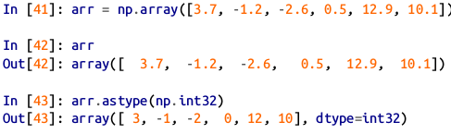
The NumPy ndarray:
Data Types for ndarrays
If I cast some floating-point numbers to be of integer dtype, the decimal part will be truncated.

Slide 19

The NumPy ndarray:
Data Types for ndarrays
If you have an array of strings representing numbers, you can use astype to convert them to numeric form.

Slide 20
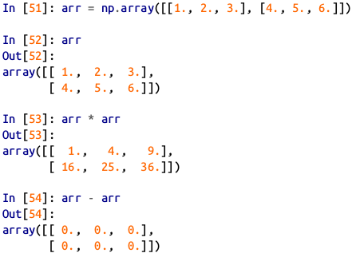
The NumPy ndarray:
Arithmetic with NumPy Arrays
Arrays are important because they enable you to express batch operations on data without writing any for loops. NumPy users call this vectorization.
Any arithmetic operations between equal-size arrays applies the operation element-wise.
.

Slide 21
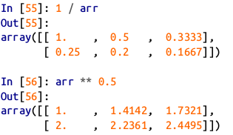
The NumPy ndarray:
Arithmetic with NumPy Arrays
Arithmetic operations with scalars propagate the scalar argument to each element in the array.

Slide 22
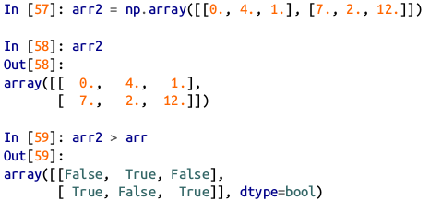
The NumPy ndarray:
Arithmetic with NumPy Arrays
Comparisons between arrays of the same size yield boolean arrays.
Operations between differently sized arrays is called broadcasting and we won’t discuss it here. You can search about it at home :)
.

Slide 23
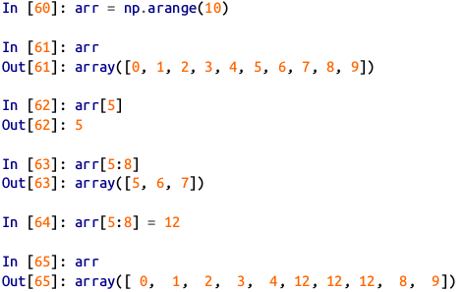
The NumPy ndarray:
Basic Indexing and Slicing
NumPy array indexing is a rich topic, as there are many ways you may want to select a subset of your data or individual elements.
One-dimensional arrays are simple; on the surface they act similarly to Python lists.
.

Slide 24
The NumPy ndarray:
Basic Indexing and Slicing
As you can see, if you assign a scalar value to a slice, as in arr[5:8] = 12 , the value is propagated (or broadcasted henceforth) to the entire selection.
An important first distinction from Python’s built-in lists is that array slices are views on the original array.
This means that the data is not copied, and any modifications to the view will be reflected in the source array.

Slide 25

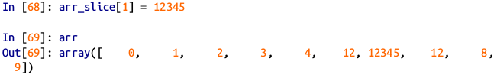
The NumPy ndarray:
Basic Indexing and Slicing
To give an example of this, I first create a slice of arr.
Then I change values in arr_slice , the mutations are reflected in the original array arr.

Slide 26

The NumPy ndarray:
Basic Indexing and Slicing
The “bare” slice [:] will assign to all values in an array:
If you want a copy of a slice of an ndarray instead of a view, you will need to explicitly copy the array—for example, arr[5:8].copy()

Slide 27

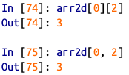
The NumPy ndarray:
Basic Indexing and Slicing
In a two-dimensional array, the elements at each index are no longer scalars but rather one-dimensional arrays.
You can pass a comma-separated list of indices to select individual elements. So these are equivalent:
.

Slide 28
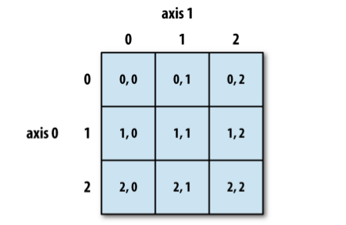
The NumPy ndarray:
Basic Indexing and Slicing
See figure bellow for an illustration of indexing on a two-dimensional array. I find it helpful to think of axis 0 as the “rows” of the array and axis 1 as the “columns.”

Slide 29
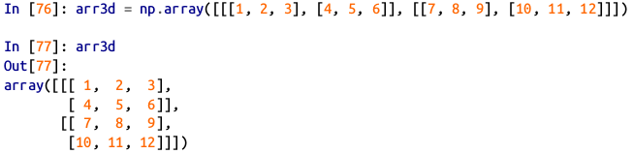

The NumPy ndarray:
Basic Indexing and Slicing
Example of a 3d (2 × 2 × 3) array:
arr3d[0] is a 2 × 3 array

Slide 30
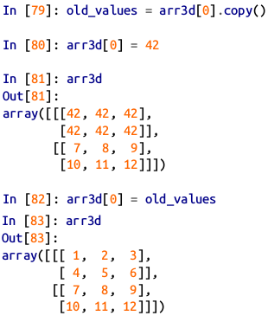
The NumPy ndarray:
Basic Indexing and Slicing
Both scalar values and arrays can be assigned to arr3d[0]

Slide 31

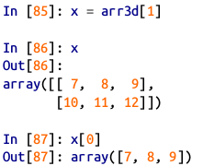
The NumPy ndarray:
Basic Indexing and Slicing
Similarly, arr3d[1, 0] gives you all of the values whose indices start with (1, 0) , forming a 1-dimensional array:
This expression is the same as though we had indexed in two steps

Slide 32
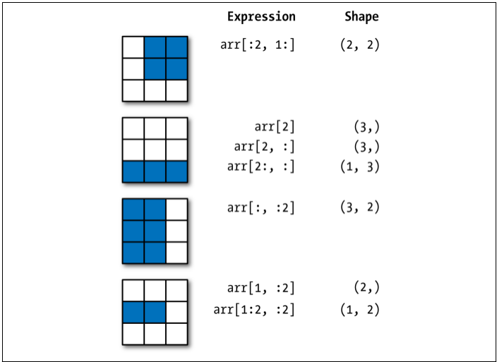
The NumPy ndarray:
Basic Indexing and Slicing

Slide 33
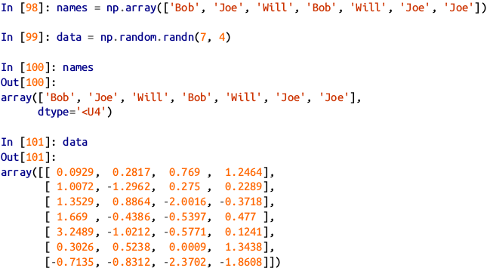
The NumPy ndarray:
Boolean Indexing
Let’s consider an example where we have some data in an array and an array of names with duplicates.
We’re going to use here the randn function in numpy.random to generate some random normally distributed data.
.

Slide 34

The NumPy ndarray:
Boolean Indexing
Like arithmetic operations, comparisons (such as == ) with arrays are also vectorized. Thus, comparing names with the string 'Bob' yields a boolean array:
Suppose each name corresponds to a row in the data array and we wanted to select all the rows with corresponding name 'Bob' .This boolean array can be passed when indexing the array.
.

Slide 35
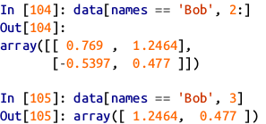
The NumPy ndarray:
Boolean Indexing
In these examples, I select from the rows where names == 'Bob' and index the columns, too.

Slide 36
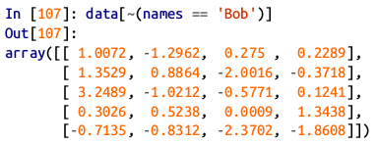
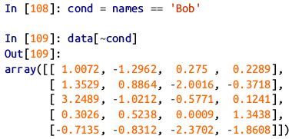
The NumPy ndarray:
Boolean Indexing
To select everything but 'Bob' , you can either use != or negate the condition using ~ :

Slide 37
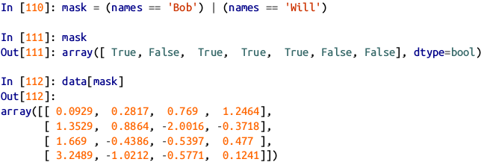
The NumPy ndarray:
Boolean Indexing
Selecting two of the three names to combine multiple boolean conditions, use boolean arithmetic operators like & (and) and | (or)

Slide 38
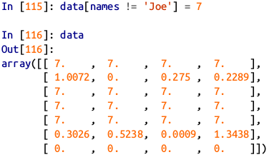
The NumPy ndarray:
Boolean Indexing
Setting values with boolean arrays works in a common-sense way. To set all of the negative values in data to 0 we need only do.
Setting whole rows or columns using a one-dimensional boolean array is also easy.

Slide 39
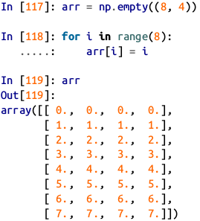
The NumPy ndarray:
Fancy Indexing
Fancy indexing is a term adopted by NumPy to describe indexing using integer arrays. Suppose we had an 8 × 4 array.

Slide 40
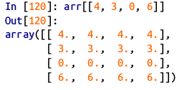
The NumPy ndarray:
Fancy Indexing
To select out a subset of the rows in a particular order, you can simply pass a list or ndarray of integers specifying the desired order.

Slide 41
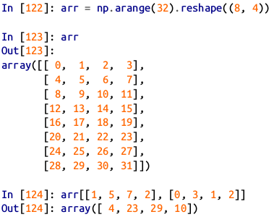
The NumPy ndarray:
Fancy Indexing
Passing multiple index arrays does something slightly different; it selects a one-dimensional array of elements corresponding to each tuple of indices.

Slide 42
The NumPy ndarray:
Fancy Indexing
Here the elements (1, 0), (5, 3), (7, 1) , and (2, 2) were selected. Regardless of how many dimensions the array has (here, only 2), the result of fancy indexing is always one-dimensional.

Slide 43
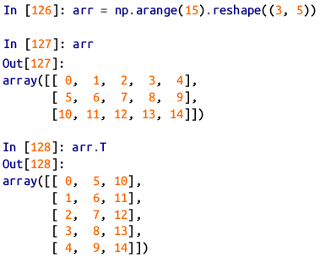
The NumPy ndarray:
Transposing Arrays and Swapping Axes
Transposing is a special form of reshaping that similarly returns a view on the underlying data without copying anything. Arrays have the transpose method and also the special T attribute.

Slide 44
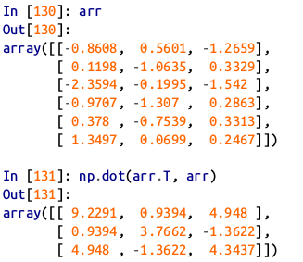
The NumPy ndarray:
Transposing Arrays and Swapping Axes
When doing matrix computations, you may do this very often—for example, when computing the inner matrix product using np.dot

Slide 45
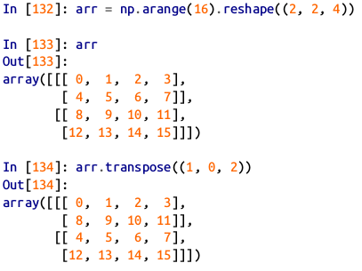
The NumPy ndarray:
Transposing Arrays and Swapping Axes
For higher dimensional arrays, transpose will accept a tuple of axis numbers to permute the axes (for extra mind bending)
Here, the axes have been reordered with the second axis first, the first axis second, and the last axis unchanged.
.

Slide 46
The NumPy ndarray:
Transposing Arrays and Swapping Axes
Simple transposing with .T is a special case of swapping axes. ndarray has the method swapaxes , which takes a pair of axis numbers and switches the indicated axes to rear range the data.

Slide 47
Universal Functions:
Fast Element-Wise Array
Functions
A universal function, or ufunc, is a function that performs element-wise operations on data in ndarrays. You can think of them as fast vectorized wrappers for simple functions that take one or more scalar values and produce one or more scalar results.

Slide 48
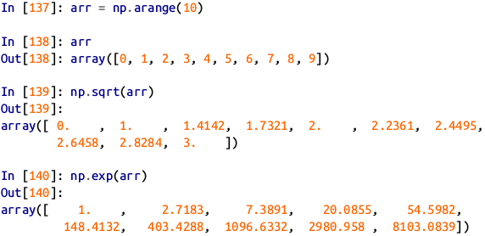
Universal Functions:
Fast Element-Wise Array
Functions
Many ufuncs are simple element-wise transformations, like sqrt or exp. These are referred to as unary ufuncs.

Slide 49
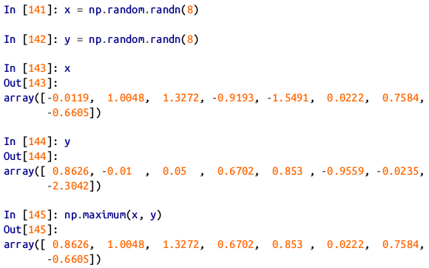
Universal Functions:
Fast Element-Wise Array
Functions
Others, such as add or maximum , take two arrays (thus, binary ufuncs) and return a single array as the result.

Slide 50
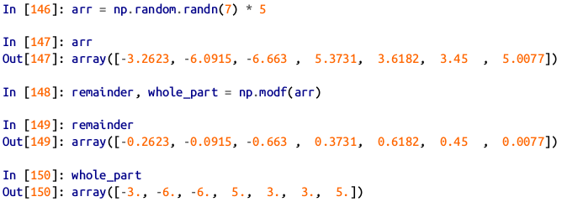
Universal Functions:
Fast Element-Wise Array
Functions
While not common, a ufunc can return multiple arrays. modf is one example, a vectorized version of the built-in Python divmod ; it returns the fractional and integral parts of a floating-point array.

Slide 51
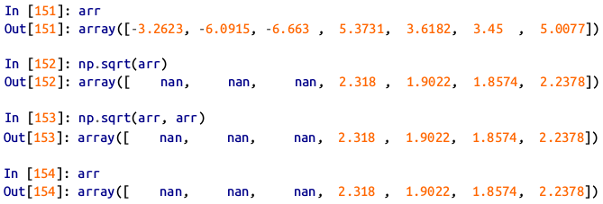
Universal Functions:
Fast Element-Wise Array
Functions
Ufuncs accept an optional out argument that allows them to operate in-place on arrays.

Slide 52
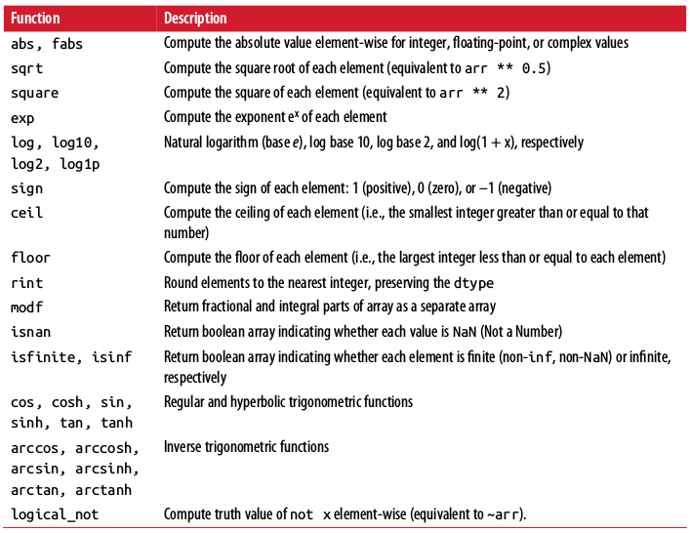
Unary universal functions

Slide 53
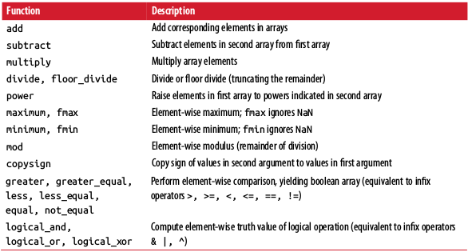
Binary universal functions

Slide 54
Array-Oriented Programming with Arrays
Using NumPy arrays enables you to express many kinds of data processing tasks as concise array expressions that might otherwise require writing loops.
This practice of replacing explicit loops with array expressions is commonly referred to as vectorization.

Slide 55
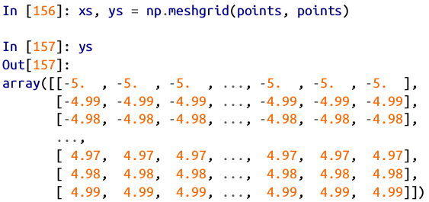
Array-Oriented Programming with Arrays
As a simple example, suppose we wished to evaluate the function sqrt(x^2 + y^2) across a regular grid of values.
The np.meshgrid function takes two 1D arrays and produces two 2D matrices corresponding to all pairs of (x, y) in the two arrays.
.

Slide 56
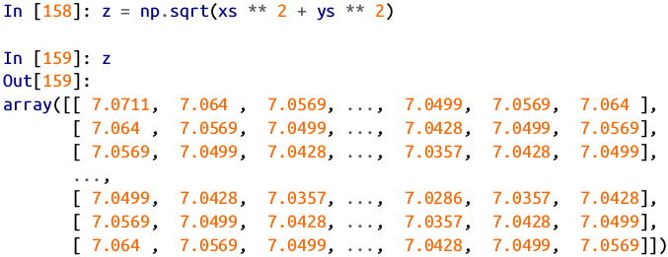
Array-Oriented Programming with Arrays
Now, evaluating the function is a matter of writing the same expression you would write with two points:

Slide 57
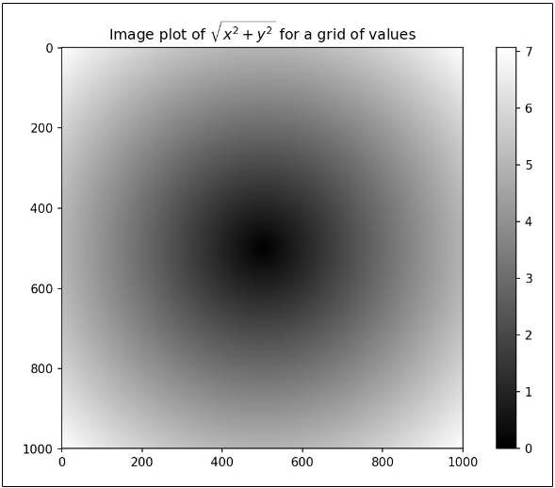
Array-Oriented Programming with Arrays
As a preview , I use matplotlib to create visualizations of this two-dimensional array:

Slide 58
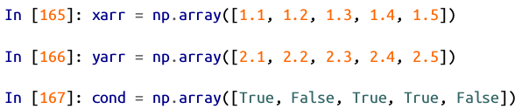
Expressing Conditional Logic as Array Operations
The numpy.where function is a vectorized version of the ternary expression x if condition else y . Suppose we had a boolean array and two arrays of values

Slide 59
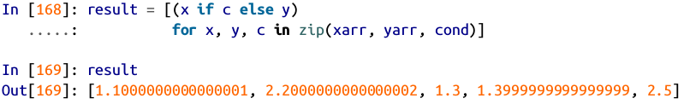
Expressing Conditional Logic as Array Operations
Suppose we wanted to take a value from xarr whenever the corresponding value in cond is True , and otherwise take the value from yarr .
A list comprehension doing this might look like:

Slide 60
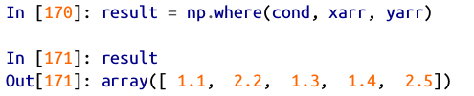
Expressing Conditional Logic as Array Operations
This has multiple problems. First, it will not be very fast for large arrays (because all the work is being done in interpreted Python code).
Second, it will not work with multidimensional arrays.
With np.where you can write this very concisely:

Slide 61
Expressing Conditional Logic as Array Operations
The second and third arguments to np.where don’t need to be arrays; one or both of them can be scalars.
A typical use of where in data analysis is to produce a new array of values based on another array.
Suppose you had a matrix of randomly generated data and you wanted to replace all positive values with 2 and all negative values with –2.

Slide 62


Expressing Conditional Logic as Array Operations
This is very easy to do with np.where :

Slide 63

Expressing Conditional Logic as Array Operations
You can combine scalars and arrays when using np.where .
For example, I can replace all positive values in arr with the constant 2 like so:

Slide 64
Mathematical and Statistical Methods
A set of mathematical functions that compute statistics about an entire array or about the data along an axis are accessible as methods of the array class.
You can use aggregations (often called reductions) like sum , mean , and std (standard deviation) either by calling the array instance method or using the top-level NumPy function.

Slide 65

Mathematical and Statistical Methods
Here I generate some normally distributed random data and compute some aggregate statistics:

Slide 66

Mathematical and Statistical Methods
Functions like mean and sum take an optional axis argument that computes the statistic over the given axis, resulting in an array with one fewer dimension:

Slide 67

Mathematical and Statistical Methods
Here, arr.mean(1) means “compute mean across the columns” where arr.sum(0) means “compute sum down the rows.”
Other methods like cumsum and cumprod do not aggregate, instead producing an array of the intermediate results.

Slide 68

Mathematical and Statistical Methods
In multidimensional arrays, accumulation functions like cumsum return an array of the same size, but with the partial aggregates computed along the indicated axis according to each lower dimensional slice.
.

Slide 69

Table of basic array statistical methods

Slide 70

Methods for Boolean Arrays
Boolean values are coerced to 1 ( True ) and 0 ( False ) in the preceding methods.
Thus, sum is often used as a means of counting True values in a boolean array:

Slide 71

Methods for Boolean Arrays
There are two additional methods, any and all , useful especially for boolean arrays.
any tests whether one or more values in an array is True , while all checks if every value is True :

Slide 72

Sorting
Like Python’s built-in list type, NumPy arrays can be sorted in-place with the sort method:

Slide 73

Sorting
You can sort each one-dimensional section of values in a multidimensional array in-place along an axis by passing the axis number to sort :

Slide 74

Sorting
The top-level method np.sort returns a sorted copy of an array instead of modifying the array in-place.
A quick-and-dirty way to compute the quantiles of an array is to sort it and select the value at a particular rank:

Slide 75

Unique and Other Set Logic
NumPy has some basic set operations for one-dimensional ndarrays.
A commonly used one is np.unique , which returns the sorted unique values in an array:

Slide 76

Unique and Other Set Logic
Another function, np.in1d , tests membership of the values in one array in another, returning a boolean array:

Slide 77

Table of array set operations

Slide 78

File Input and Output with Arrays
NumPy is able to save and load data to and from disk either in text or binary format.
In this section I only discuss NumPy’s built-in binary format, since most users will prefer pandas and other tools for loading text or tabular data.
np.save and np.load are the two workhorse functions for efficiently saving and loading array data on disk.
Arrays are saved by default in an uncompressed raw binary format with file extension .npy

Slide 79

File Input and Output with Arrays
You save multiple arrays in an uncompressed archive using np.savez and passing the arrays as keyword arguments:
When loading an .npz file, you get back a dict-like object that loads the individual arrays lazily.

Slide 80
File Input and Output with Arrays
If your data compresses well, you may wish to use numpy.savez_compressed instead:

Slide 81
Linear Algebra
Linear algebra, like matrix multiplication, decompositions, determinants, and other square matrix math, is an important part of any array library.
Unlike some languages like MATLAB, multiplying two two-dimensional arrays with * is an element-wise product instead of a matrix dot product.

Slide 82

Linear Algebra
Thus, there is a function dot , both an array method and a function in the numpy namespace, for matrix multiplication:

Slide 83


Linear Algebra
x.dot(y) is equivalent to np.dot(x, y) :
A matrix product between a two-dimensional array and a suitably sized one-dimensional array results in a one-dimensional array:

Slide 84

Linear Algebra
The @ symbol (as of Python 3.5) also works as an infix operator that performs matrix multiplication:
numpy.linalg has a standard set of matrix decompositions and things like inverse and determinant.
These are implemented under the hood via the same industry-standard linear algebra libraries used in other languages like MATLAB and R, such as BLAS, LAPACK, or possibly (depending on your NumPy build) the proprietary Intel MKL (Math Kernel Library)

Slide 85

Linear Algebra

Slide 86

Linear Algebra

Slide 87

Table of Commonly used numpy.linalg functions
The expression X.T.dot(X) computes the dot product of X with its transpose X.T .

Slide 88

Pseudorandom Number Generation
The numpy.random module supplements the built-in Python random with functions for efficiently generating whole arrays of sample values from many kinds of probability distributions.
For example, you can get a 4 × 4 array of samples from the standard normal distribution using normal :

Slide 89

Pseudorandom Number Generation
Python’s built-in random module, by contrast, only samples one value at a time.
As you can see from this benchmark, numpy.random is well over an order of magnitude faster for generating very large samples:

Slide 90
Pseudorandom Number Generation
We say that these are pseudorandom numbers because they are generated by an algorithm with deterministic behavior based on the seed of the random number generator.
You can change NumPy’s random number generation seed using np.random.seed :

Slide 91

Pseudorandom Number Generation
The data generation functions in numpy.random use a global random seed.
To avoid global state, you can use numpy.random.RandomState to create a random number generator isolated from others:

Slide 92

Table of Partial list of numpy.random functions

