Slide 1

Drug Persistency Project
Virtual Internship: Week 11 Presentation on EDA on the Dataset
Group Name: Attack on Data
Group Members:
Armin Khayati (United Arab Emirates)
Ezzuldin Zaky (United Arab Emirates)
Orcun Sami Tandogan (Turkey) Date: 10-May-2022

Slide 2
Background – Drug Persistency case study
Problem description
One of the challenges for all pharmaceutical companies is to understand the persistency of drug as per the physician prescription. To solve this problem ABC pharma company approached an analytics company to automate this process of identification.
Objective : Find important features and prepare them by Feature Engineering and Feature Selection techniques for training with machine learning algorithms.
The analysis has been divided into several parts:
Data Understanding
Data Cleaning
Data insights and visualization
Recommendations

Slide 3
Data Exploration
68 Features, two numerical and 66 categorical, including :
General features such as (Patient general info)
Diseases/Drugs Factors
Clinical Factors
Total number of patients : 3424
Assumptions:
Dataset is imbalanced.
It follows a normal distribution.
Patients’ data were gathered accurately without any errors in testing or examination.

Slide 4
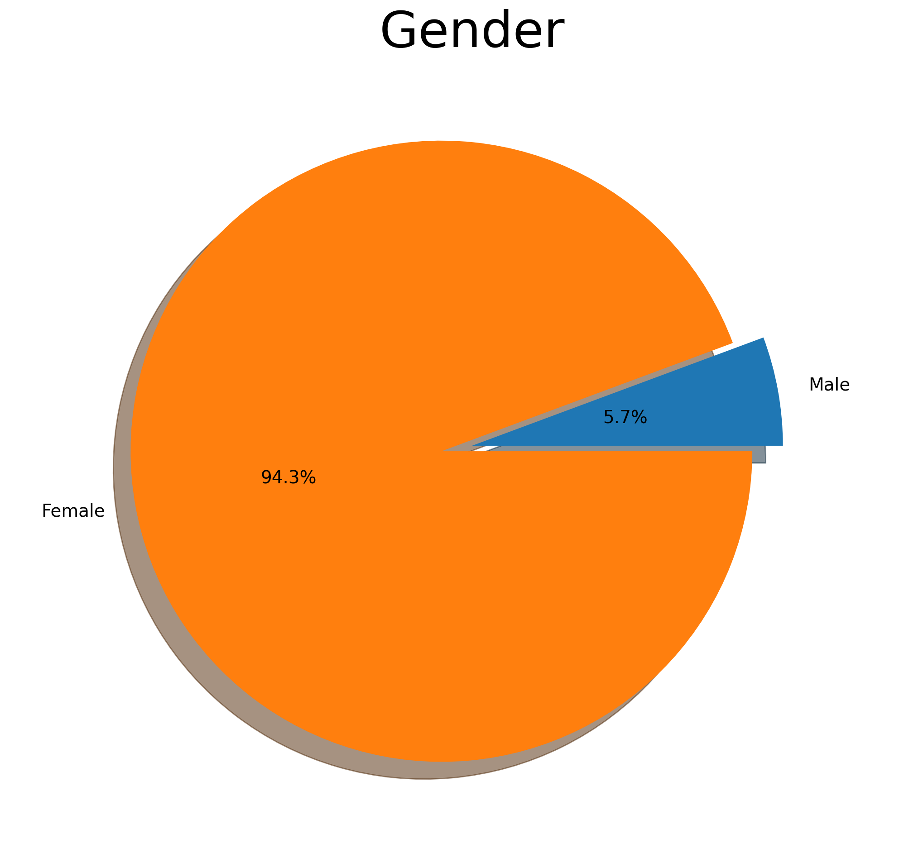
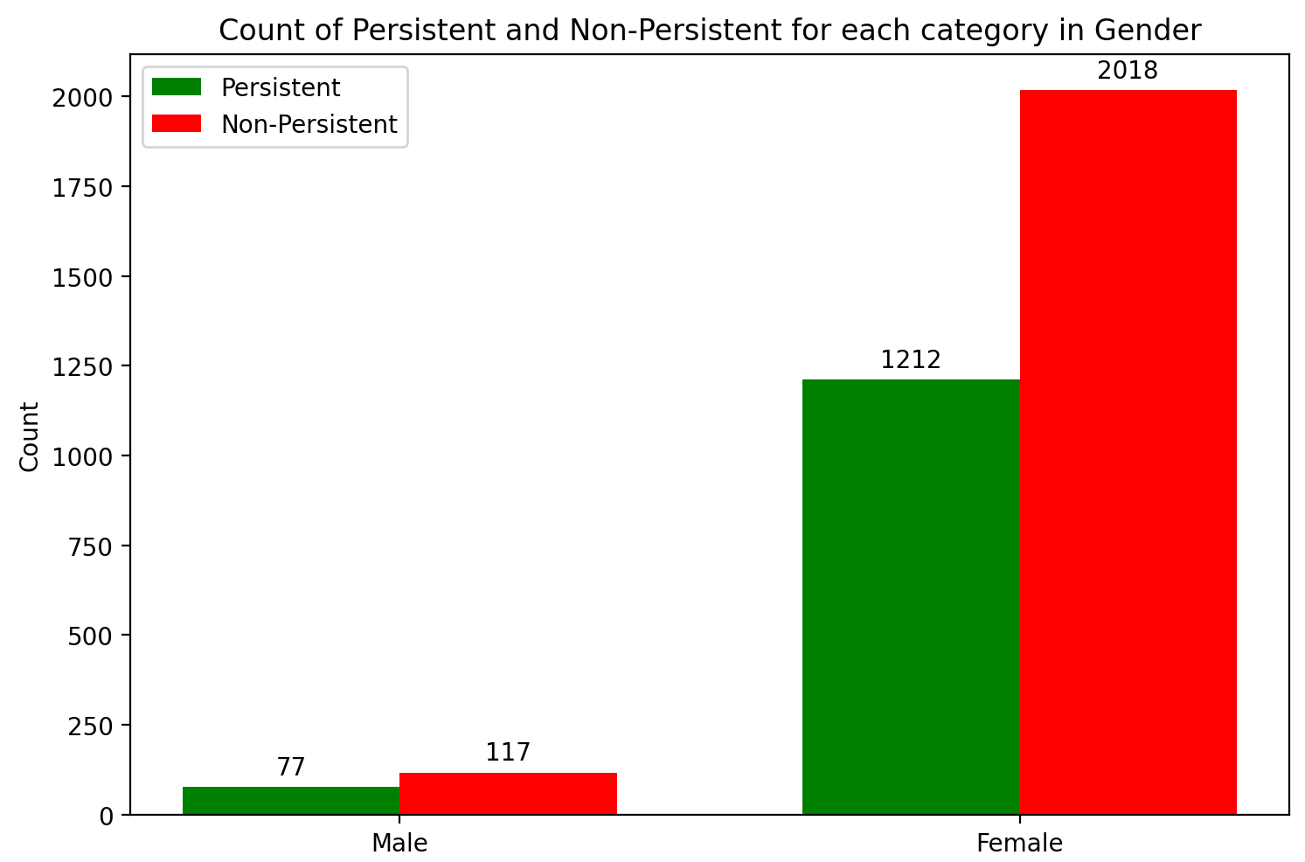
Profit Analysis
Patients General Info Analysis
Gender Ratio
Gender Ratio vs. Persistency Flag

Slide 5
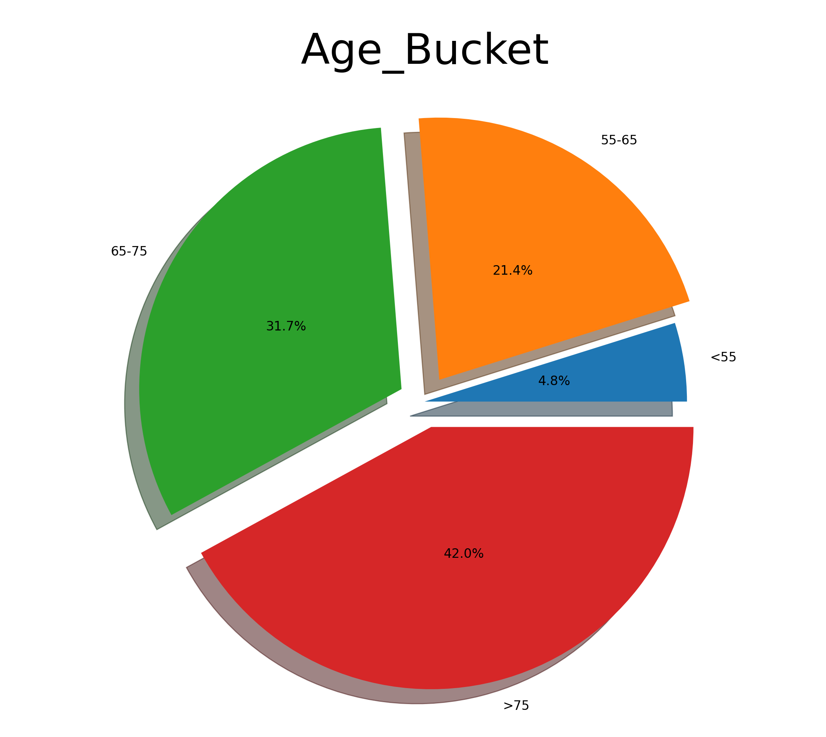
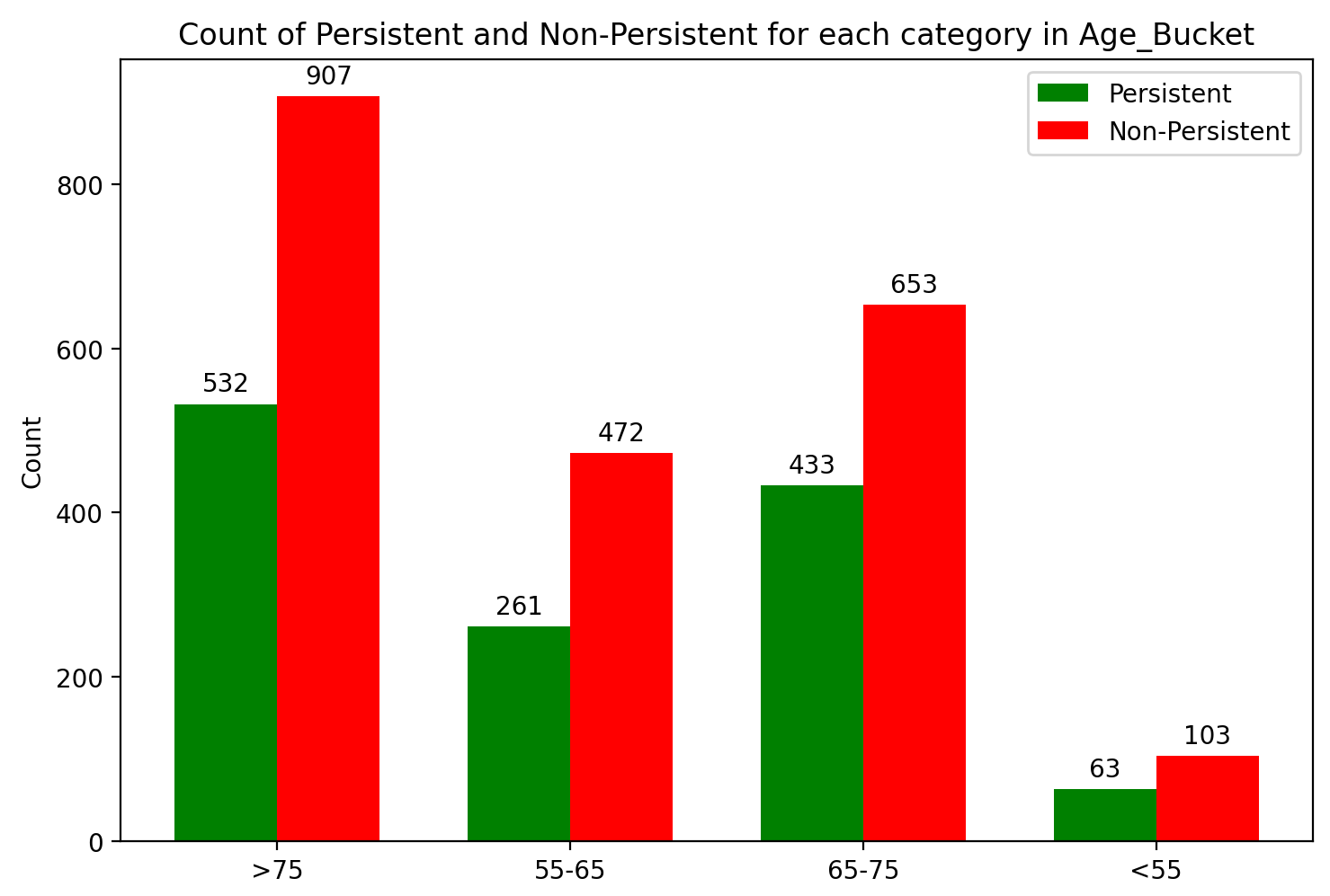
Profit Analysis
Patients General Info Analysis
Age Ratio
Age Bucket vs. Persistency Flag

Slide 6
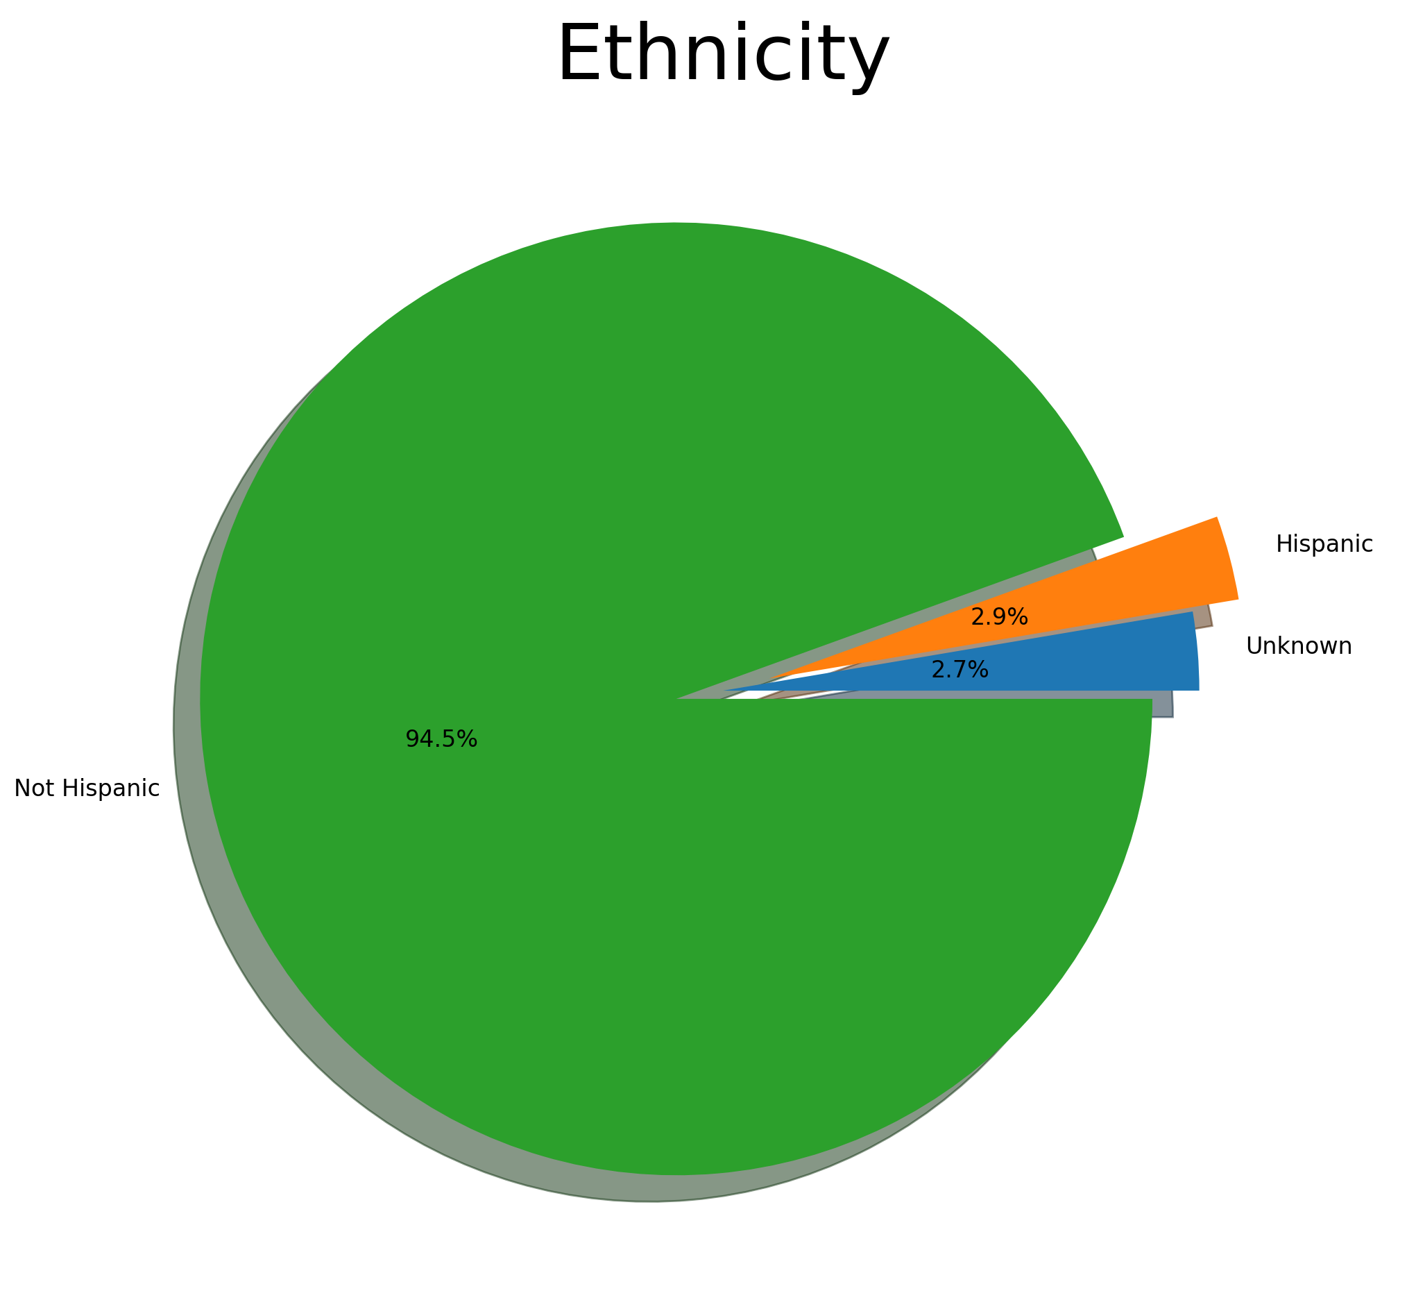
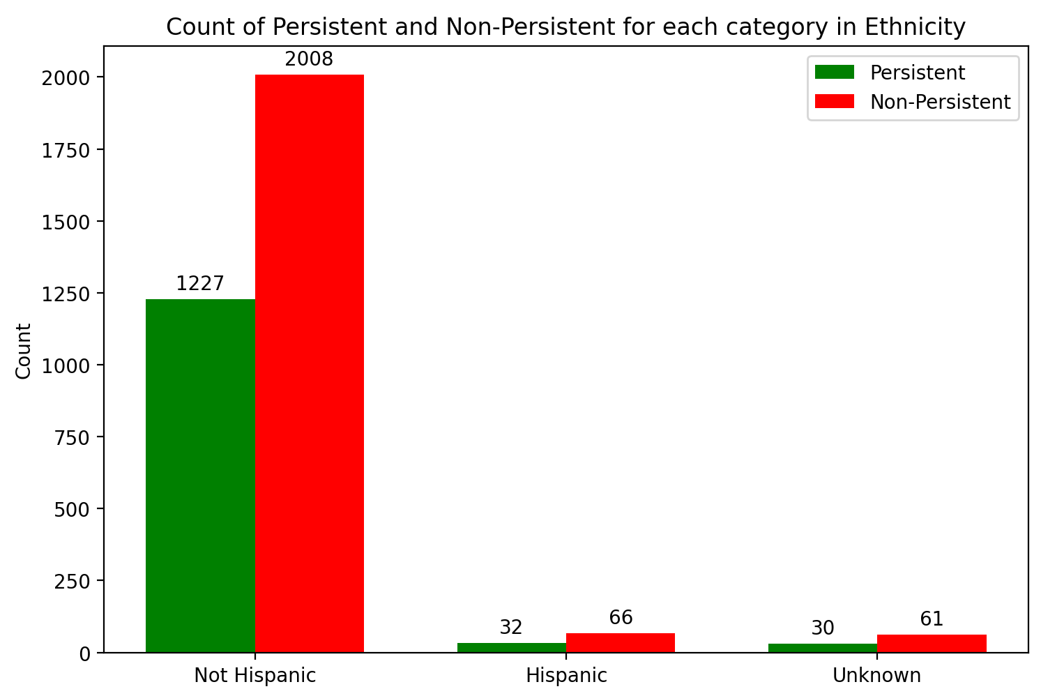
Profit Analysis
Patients General Info Analysis
Ethnicity Ratio
Ethnicity vs. Persistency Flag

Slide 7
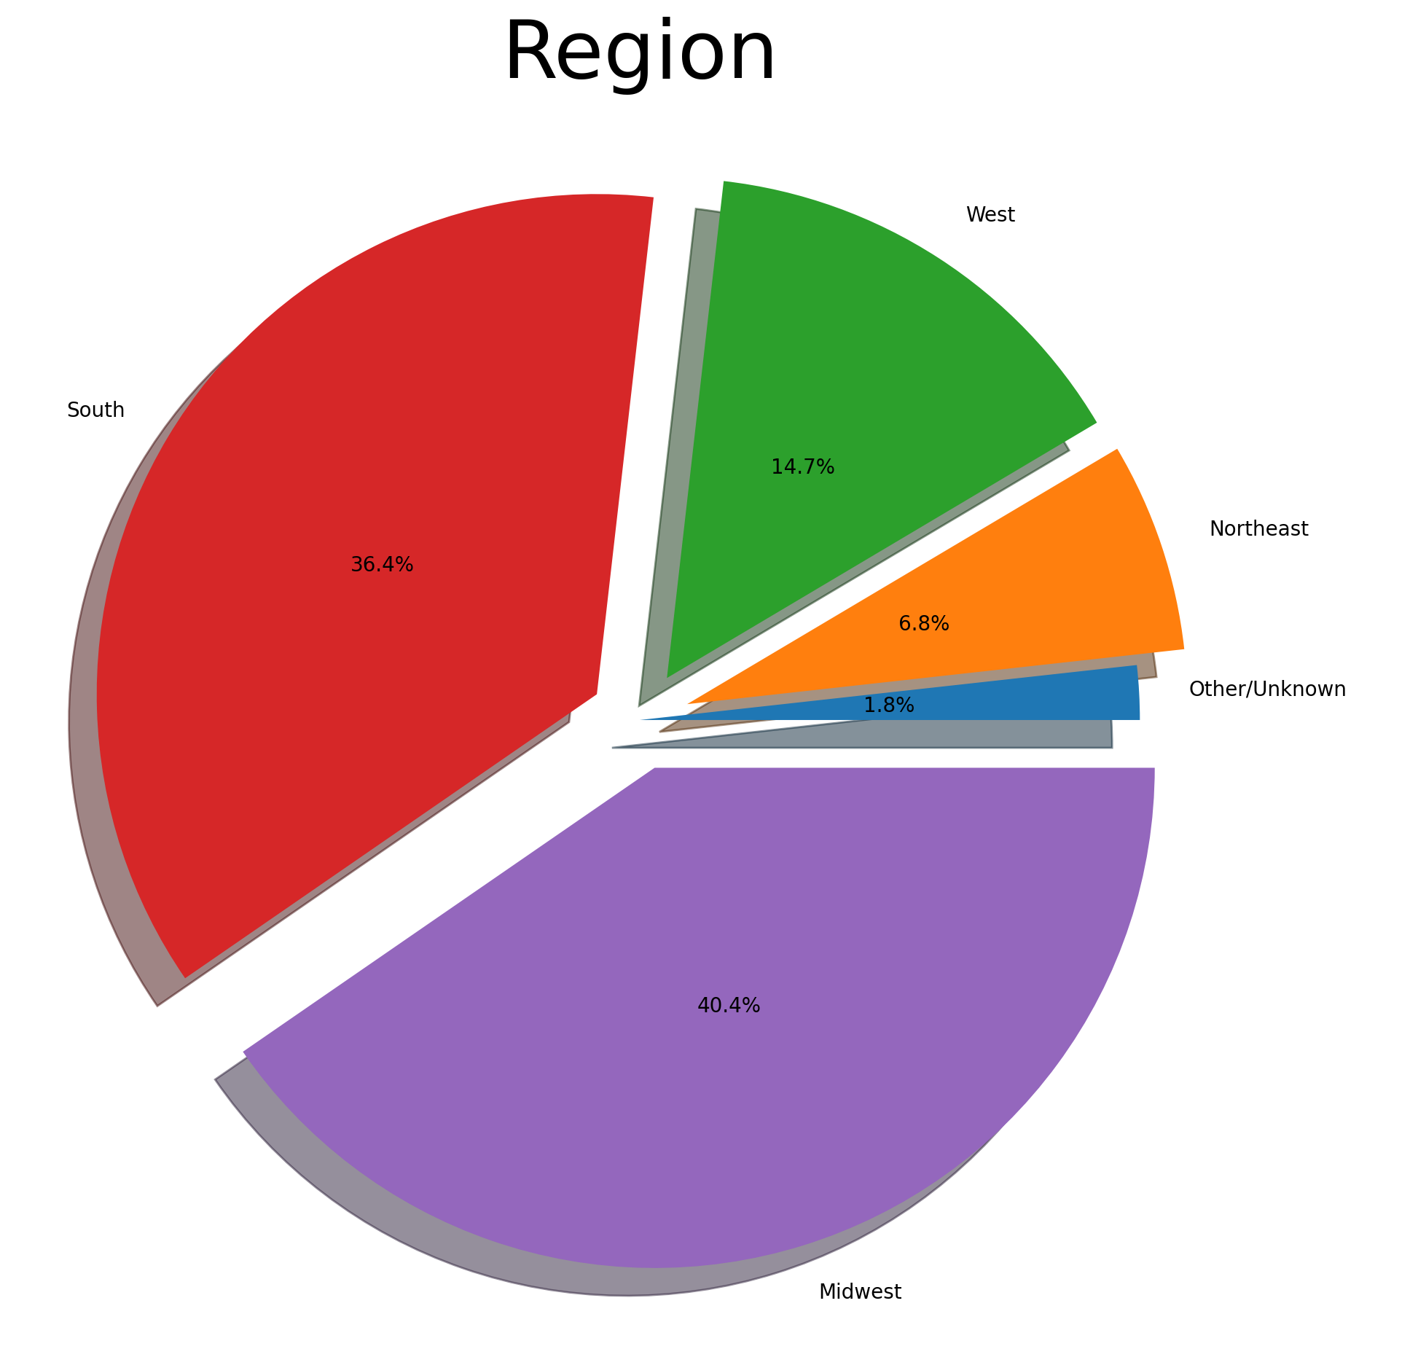
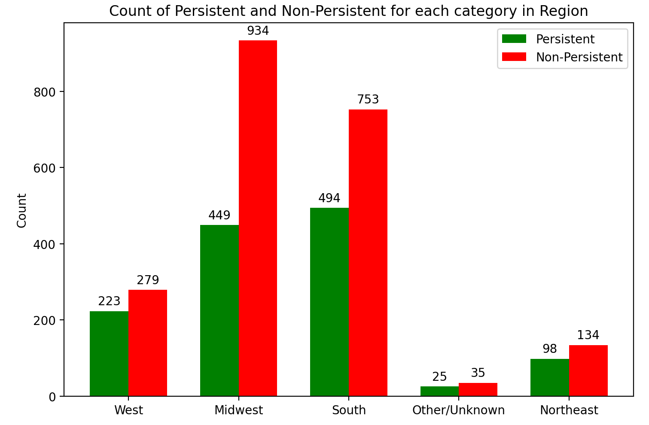
Profit Analysis
Patients General Info Analysis
Region Ratio
Region vs. Persistency Flag

Slide 8
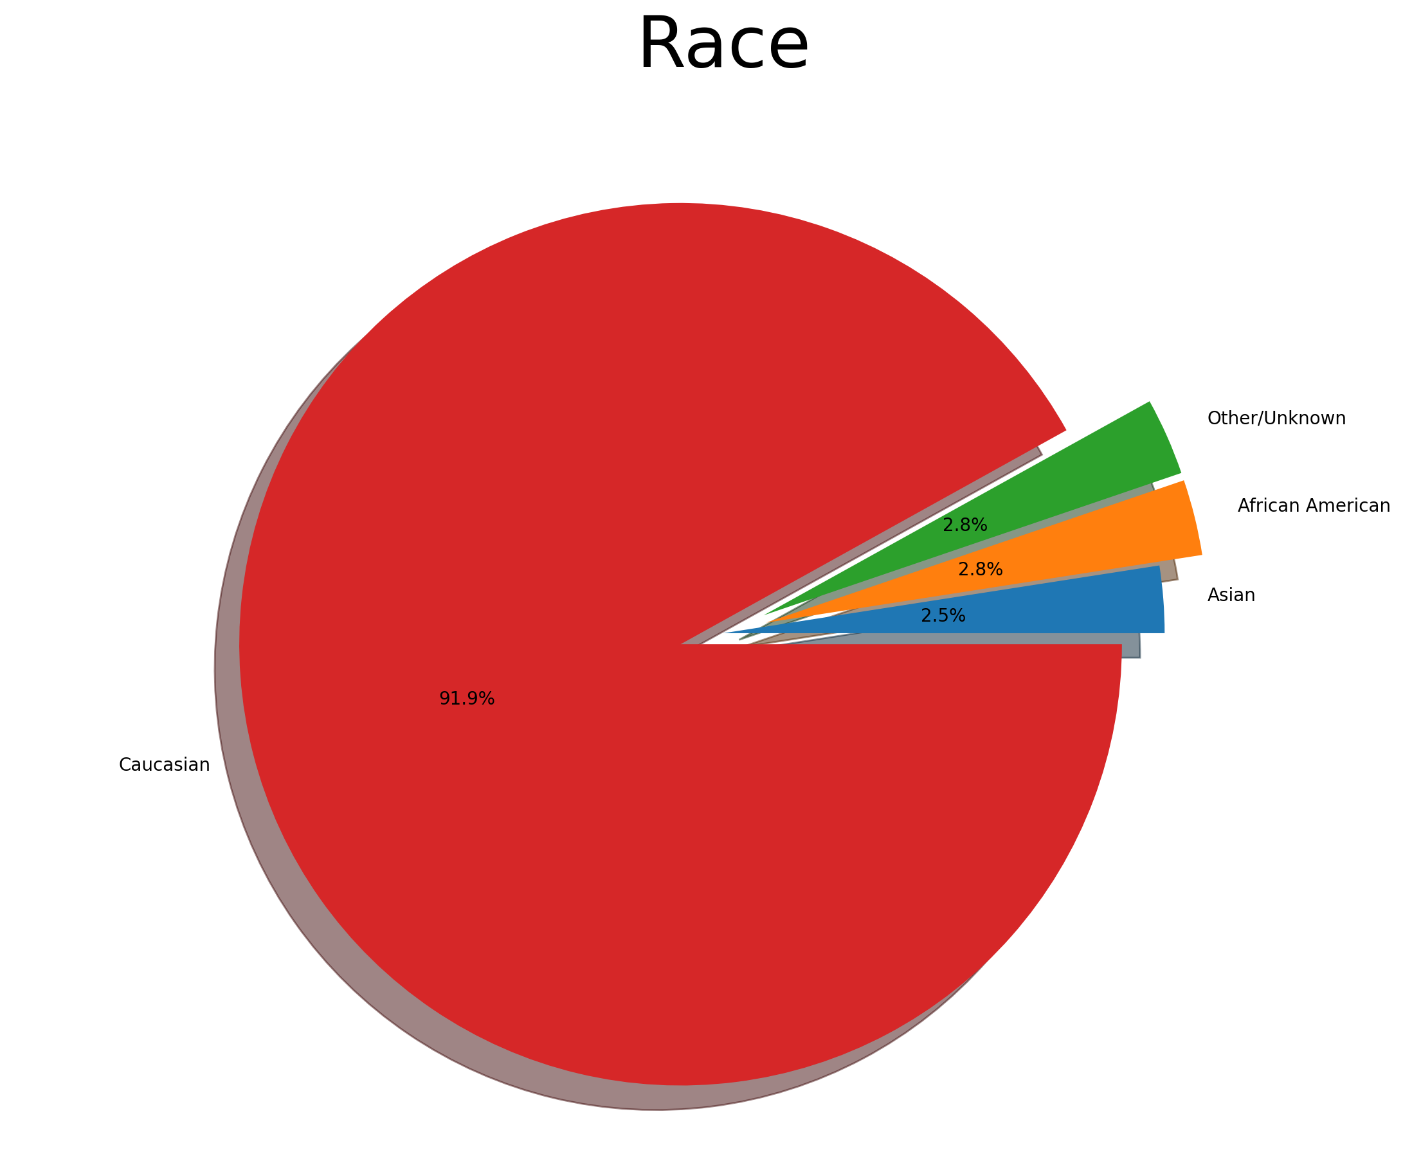
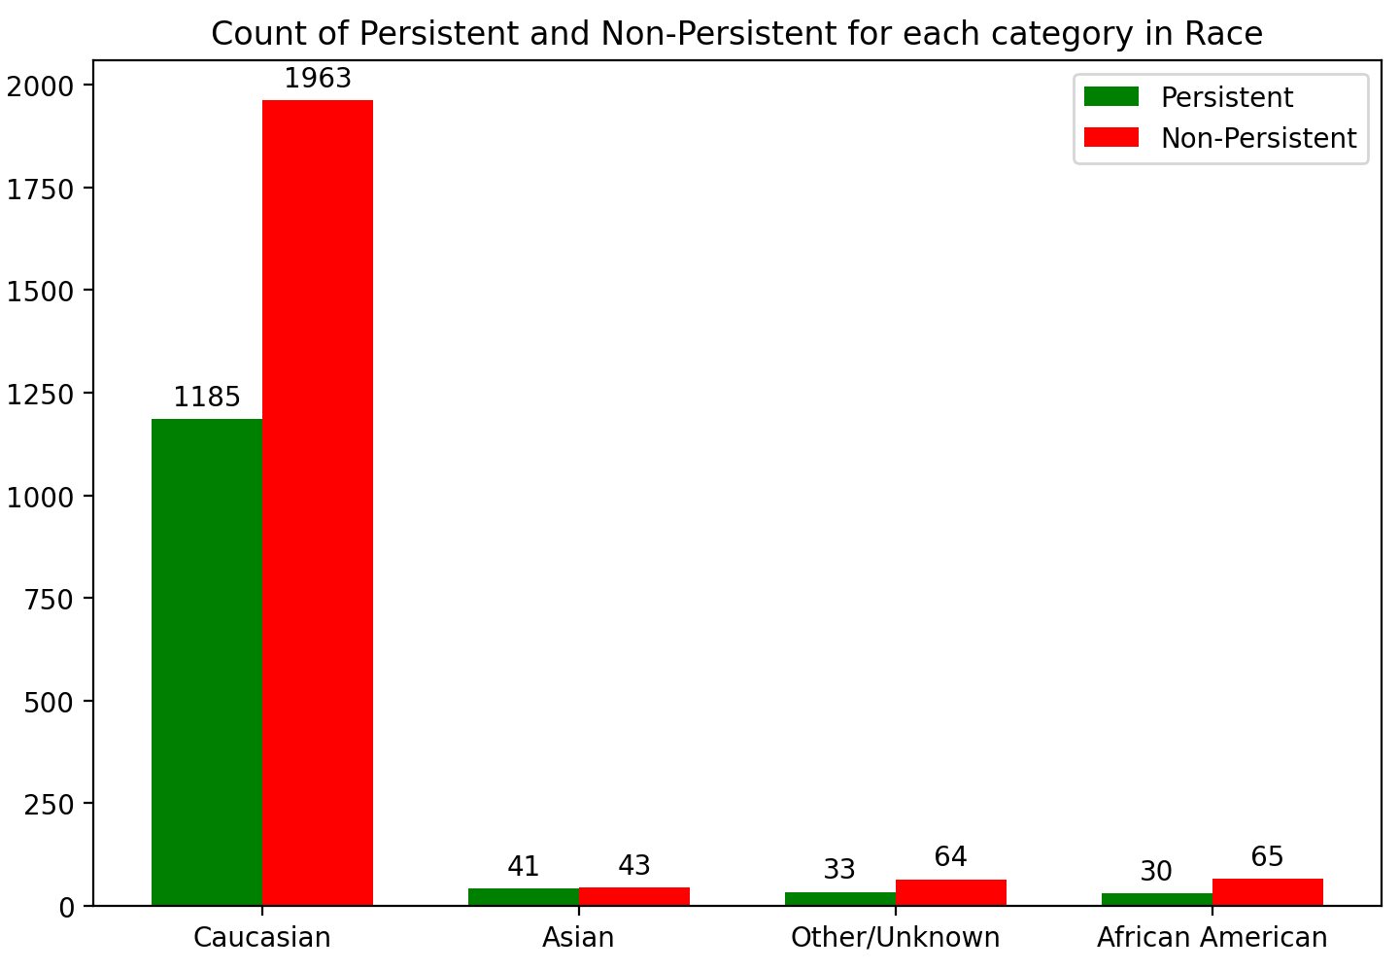
Profit Analysis
Patients General Info Analysis
Race Ratio
Race vs. Persistency Flag

Slide 9
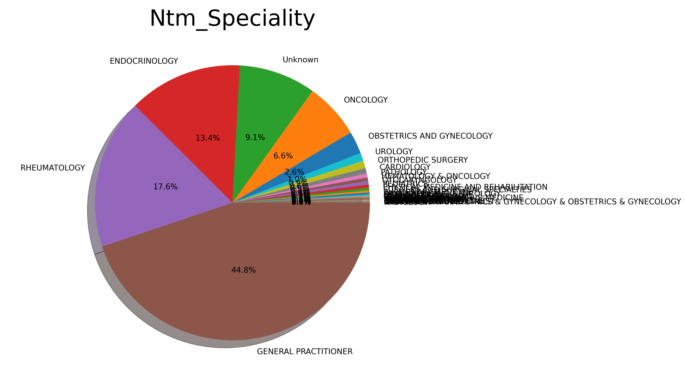
Profit Analysis
Patients General Info Analysis
NTM_Speciality Ratio

Slide 10
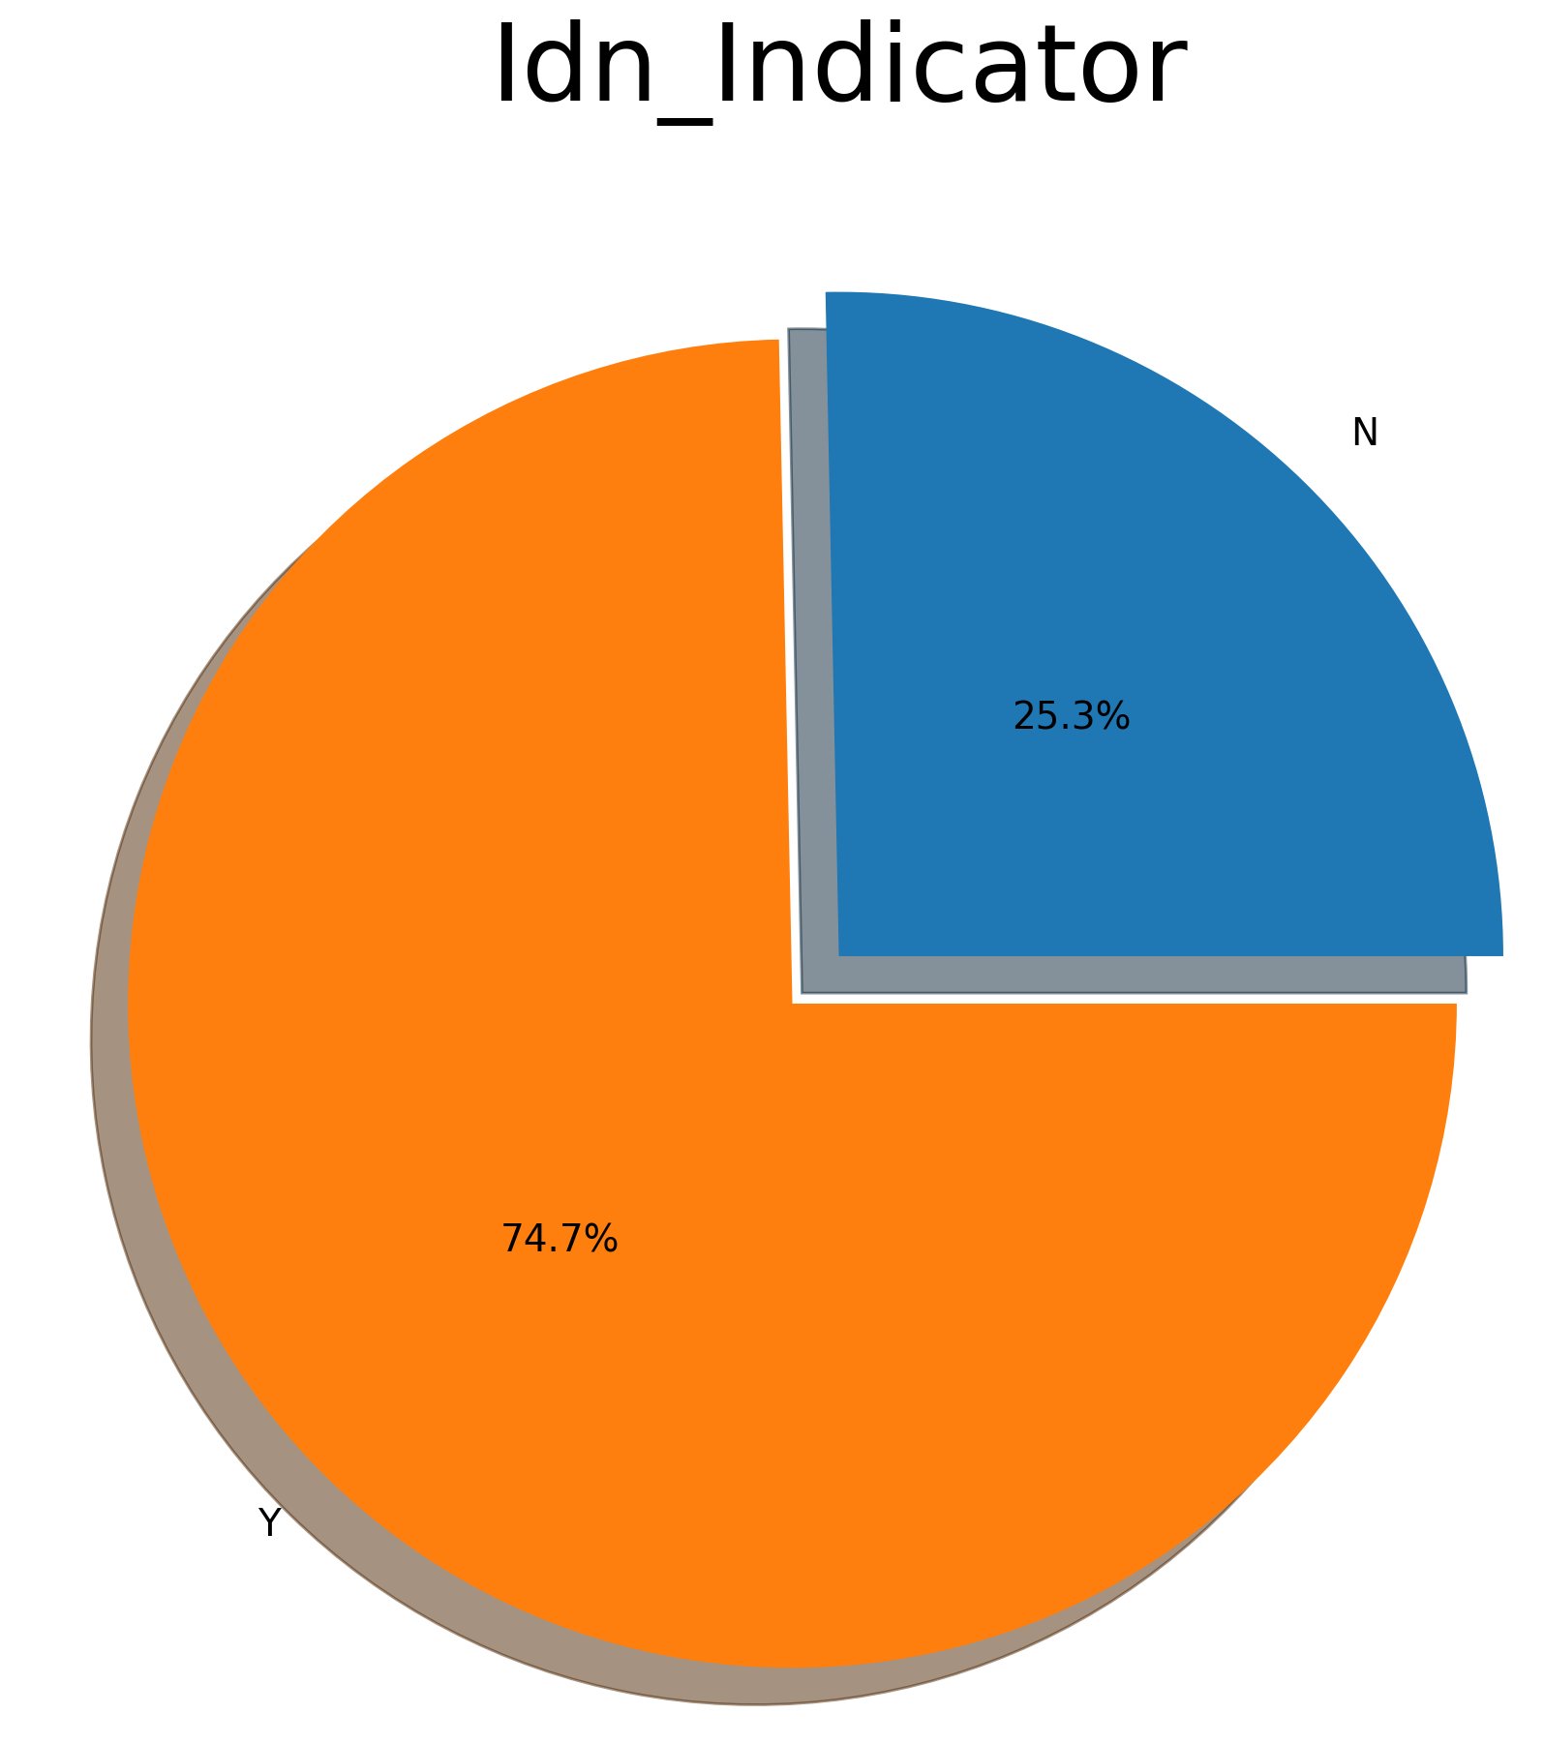
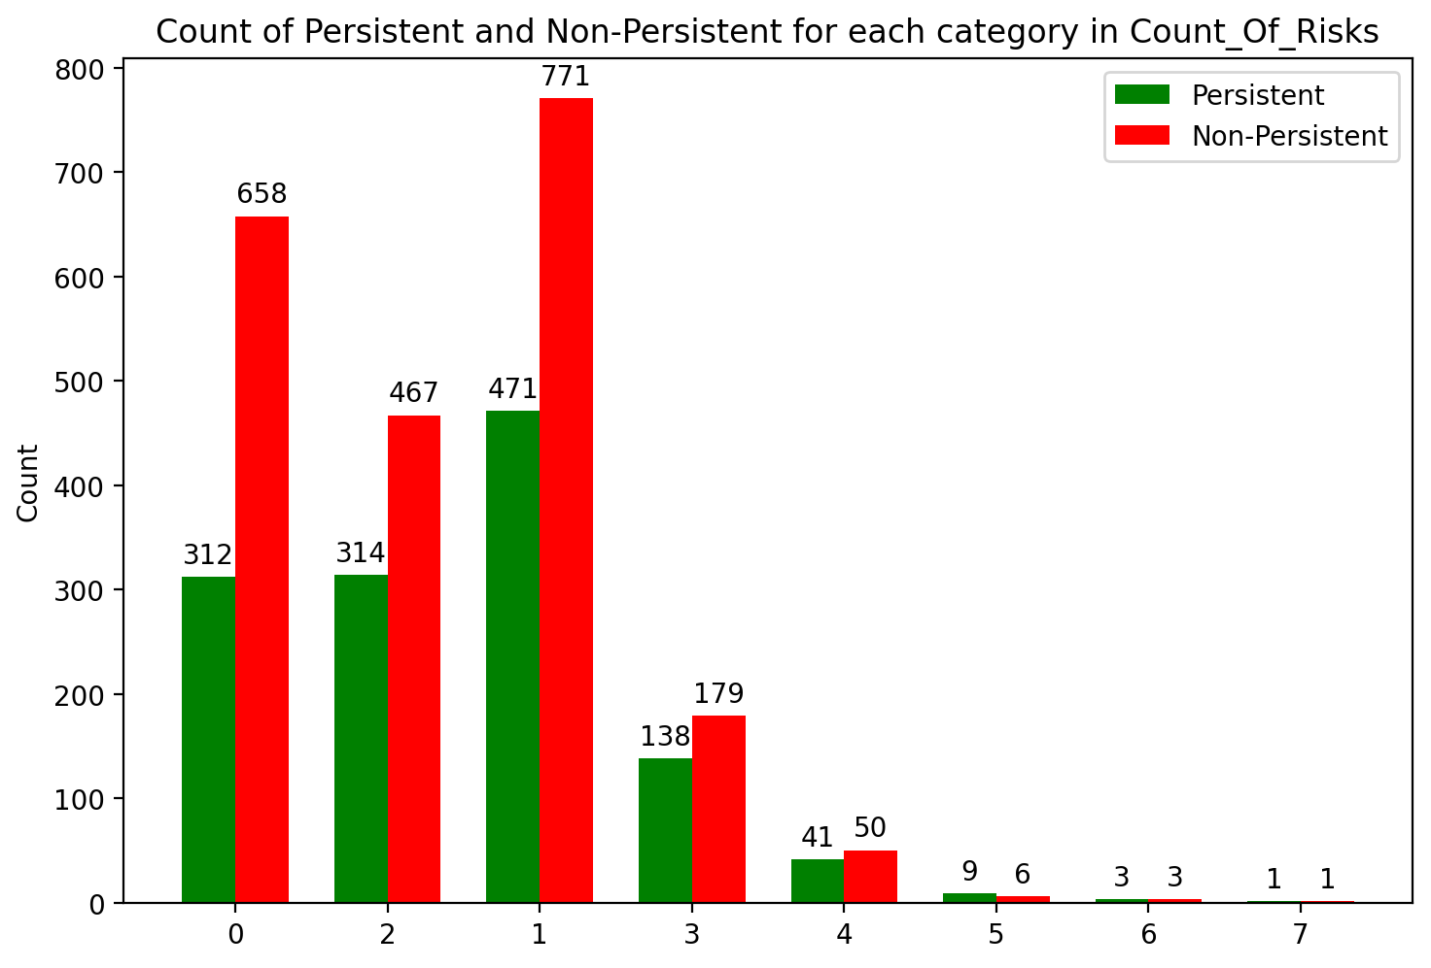
Profit Analysis
Patients General Info Analysis
IDN Indicator Ratio
Count of Risk vs . Persistency Flag

Slide 11
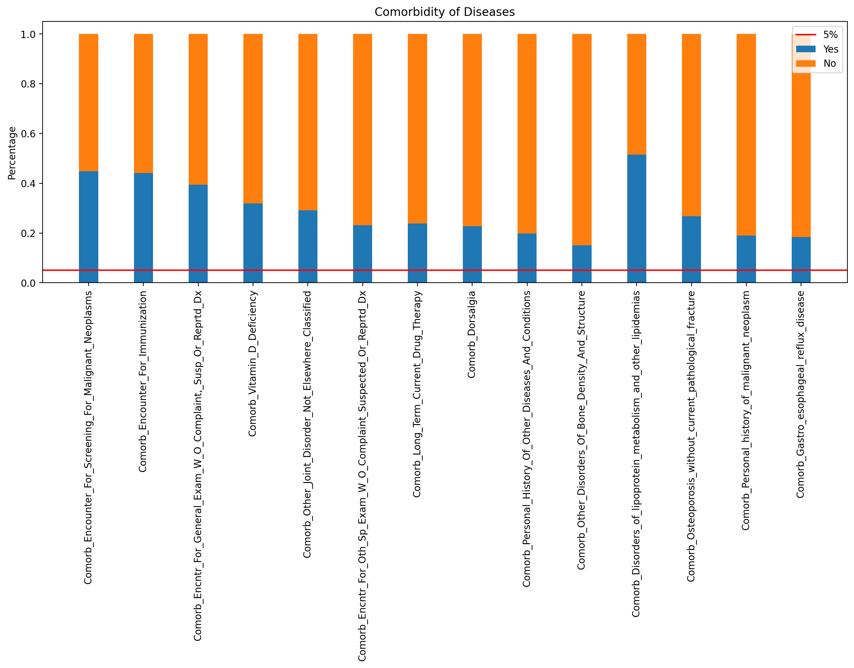
Concomitancy of Drugs
Concomitancy of Drugs

Slide 12
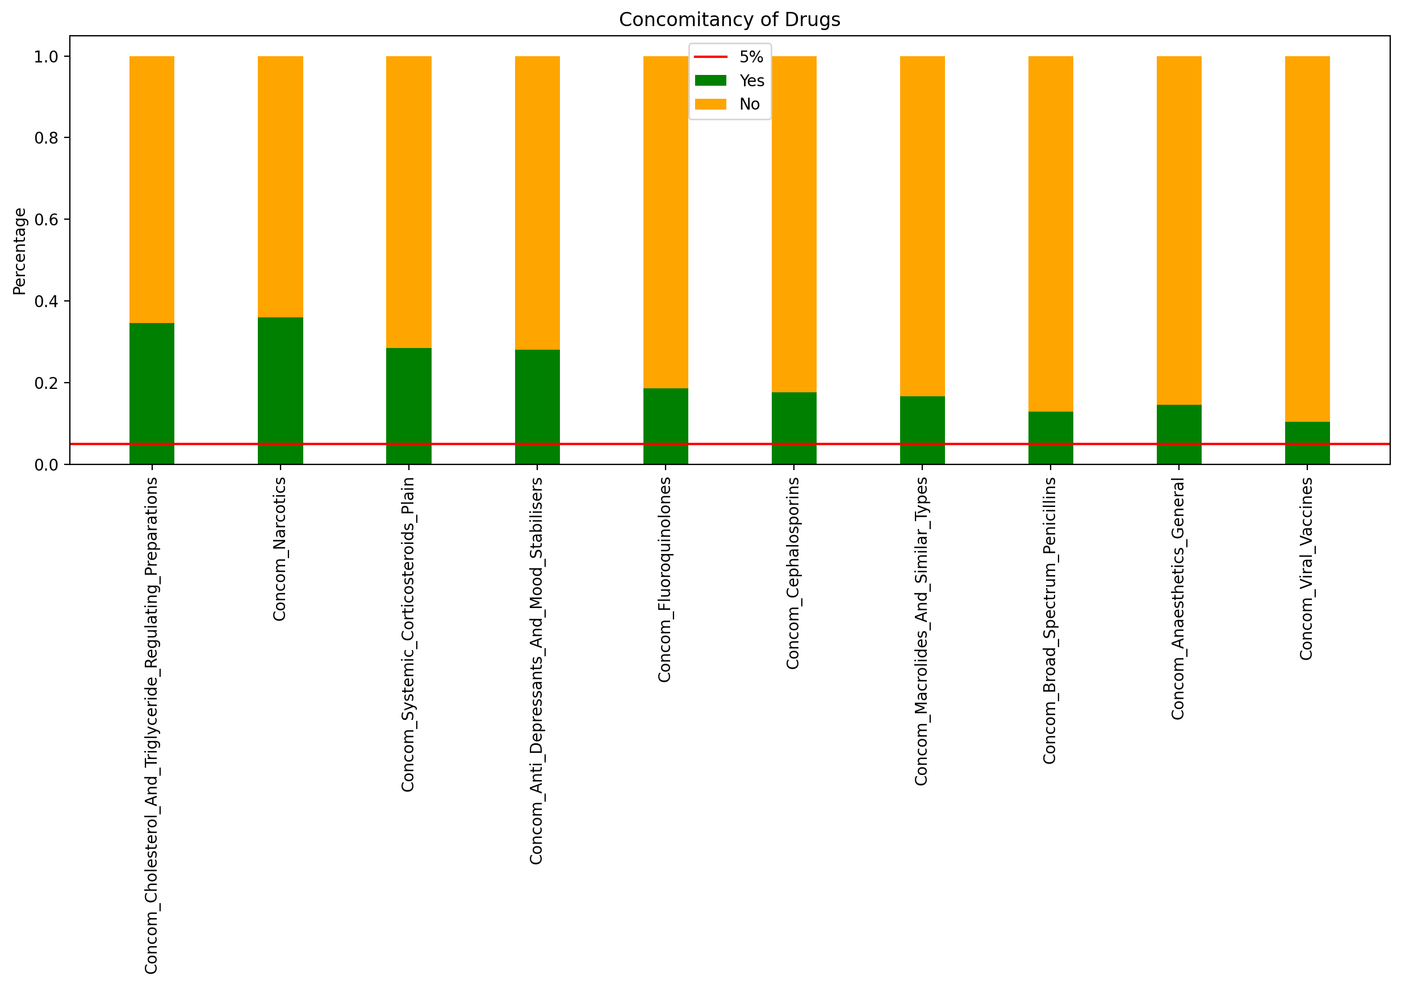
Comorbidity of Diseases
Comorbidity of Diseases

Slide 13
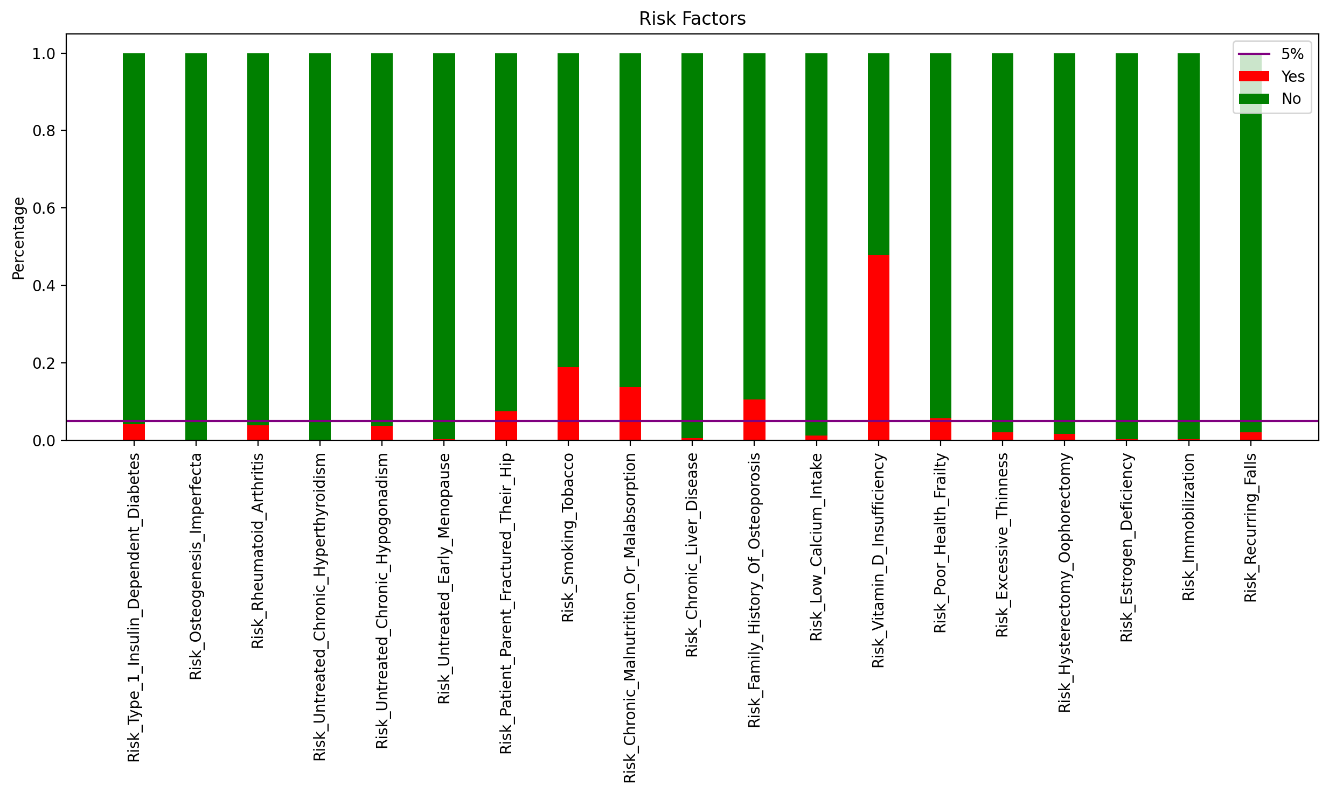
Risk Factors
Risk Factors

Slide 14
Risk Factor Analysis
Number of non-persistency is higher in lower counts of risks.
Patients with zero count of risk have the highest Non-Persistent Ration
Low risk patients were found to be less persistent than the high-risk ones.
Risk Counts Vs Persistency Flag

Slide 15
Risk Factors
Among the risk factors most of them have less than 5% chance to endanger treatment.
The risk factor with highest chance is Vitamin D Insufficiency and others above 5% are:
Poor Health Frailty
Family History Of Osteoporosis
Chronic Malnutrition Or Malabsorption
Smoking Tobacco
Patient Parent Fractured Their Hip
Rest of the factors have less than 5% risk to endanger treatment.
Risk Factors

Slide 16
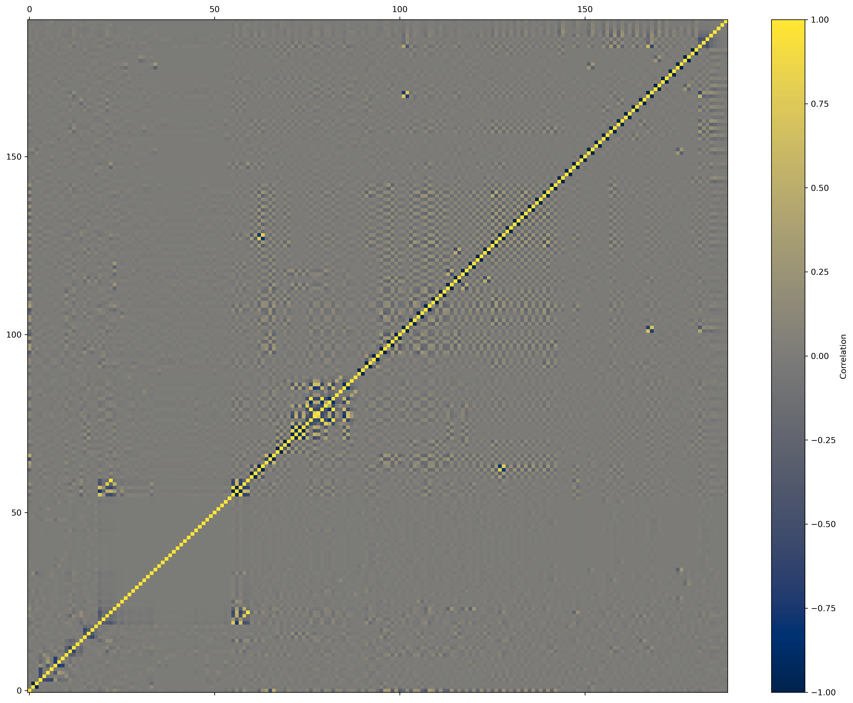
Features Correlation
We will be Removing variables with more than 98% correlation.
Correlation Matrix

Slide 17
EDA Recommendations
From the Exploratory Data Analysis (EDA) done on the dataset, we will recommend these instructions:
Handling Unknown values for Race, Region, and Ethnicity Variables
Using mode as an imputer as an imputer on Race and Ethnicity variables.
For Region variable, because most of the people with Unknown Region have Not Hispanic Ethnicity, and Most of people with Not Hispanic Ethnicity, have Midwest Region, we will replace Unknown Regions with Midwest.
Handling Rare Labels: Finding categories less than 5 percent in each variable, then merging those categories into one or drop them if the variable only has 2 categories (e.g., Y/N) and cardinality of one them is less than 5 percent.
Grouping integer values of Count_Of_Risks variable into two bins: Bin 1 is [0,1,2,3] and Bin 2 is [4,5,6,7].
One hot encoding all the variables after doing above tasks
Removing variables with more than 98% correlation.

Slide 18
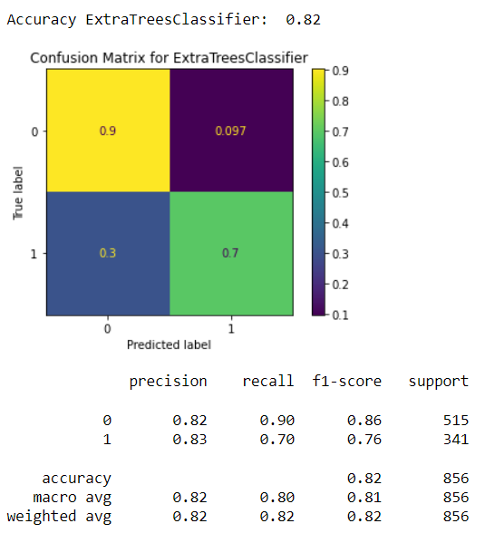
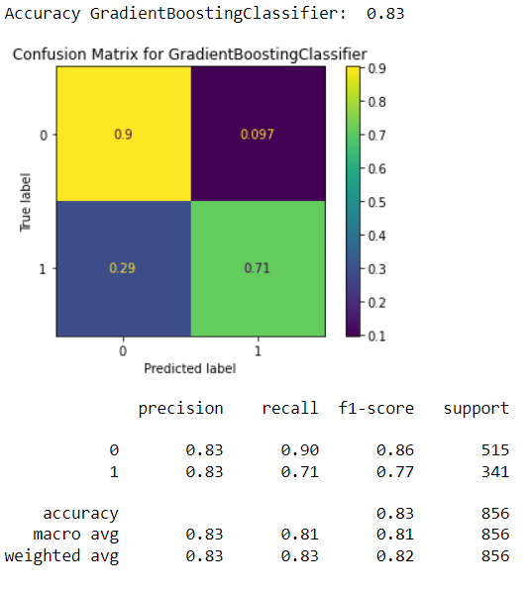
Model selection and building

Slide 19
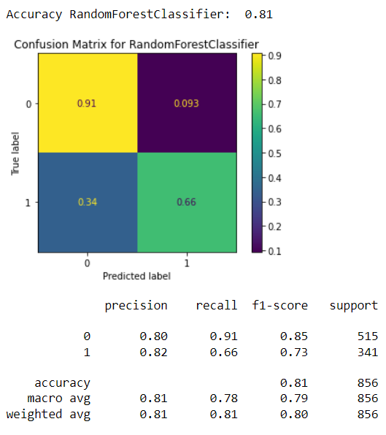

Model selection and building

Slide 20
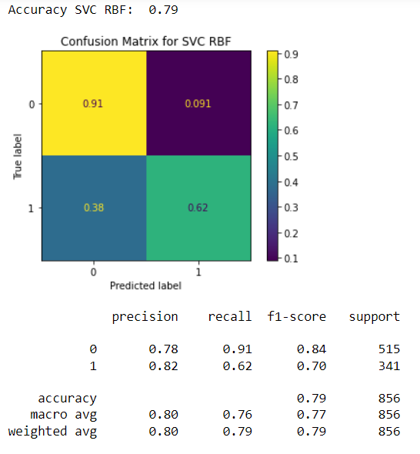
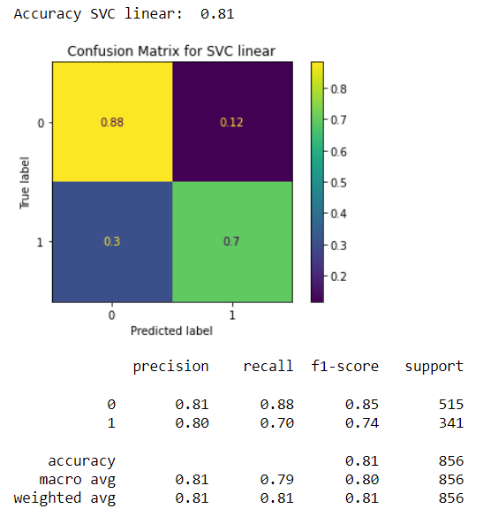
Model selection and building

Slide 21
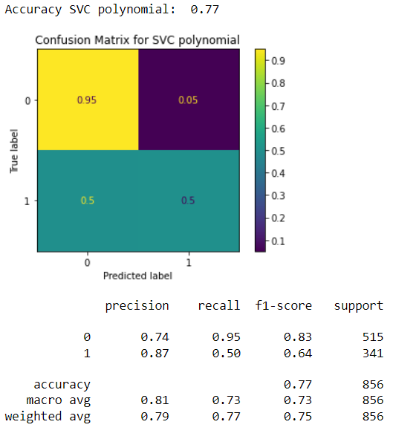
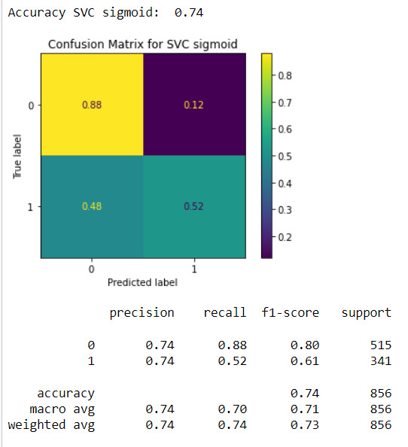
Model selection and building

Slide 22

Model selection and building

Slide 23
Final Recommendation
Then Based on previous slides, we recommend these machine learning techniques:
Gradient Boosting
Extra trees classifier
Random forest classifier
Justification: They are the most accurate techniques and best predictors of drug non persistency, which is a safer error to make than the contrary

Slide 24
Thank You

