Slide 1
پروژه
File created on: 5/13/2022 7:13:02 PM

Slide 2
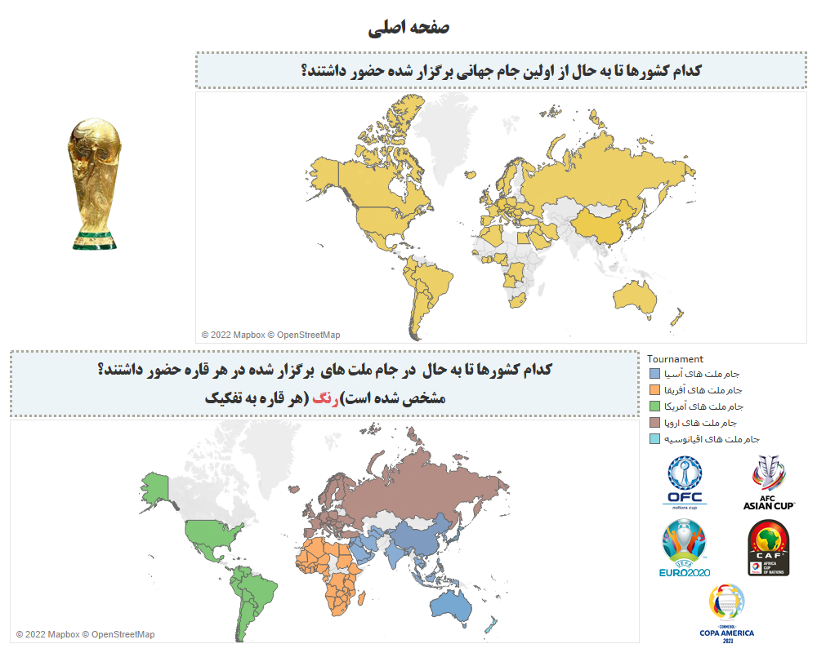

Slide 3
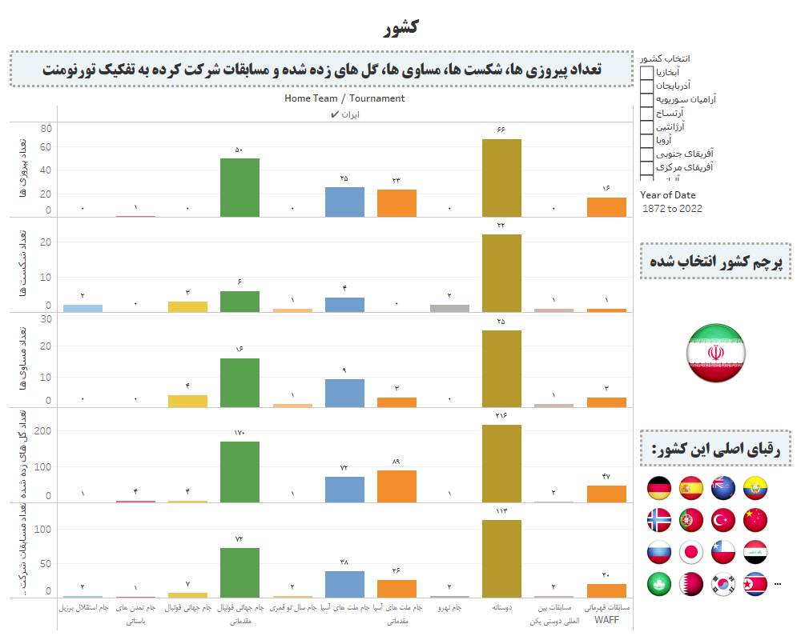

Slide 4
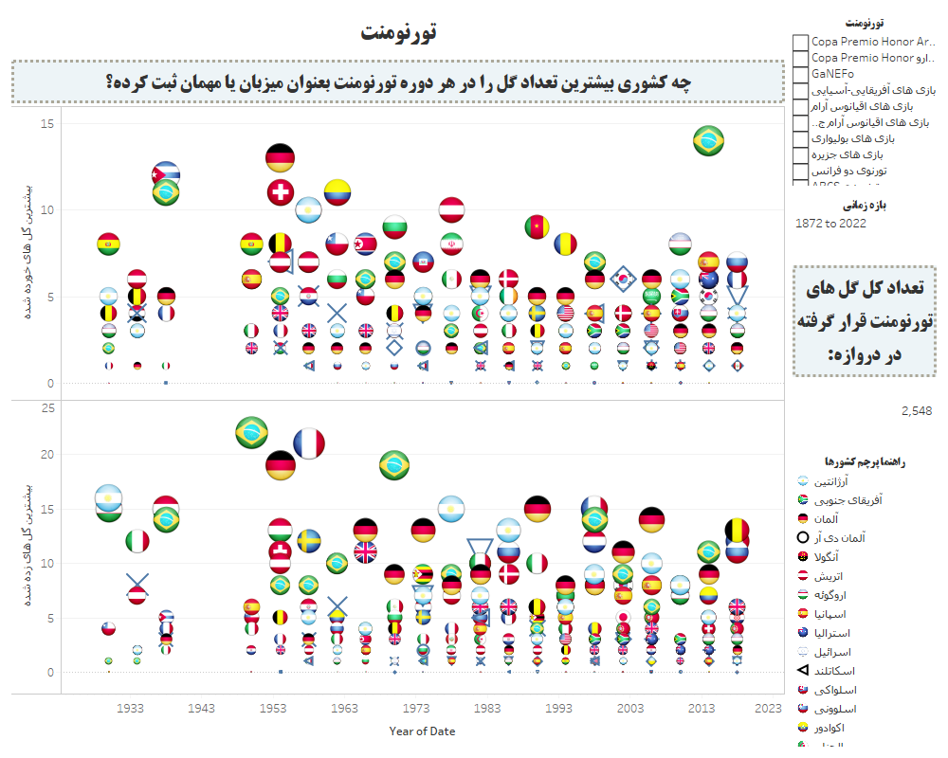

Slide 5
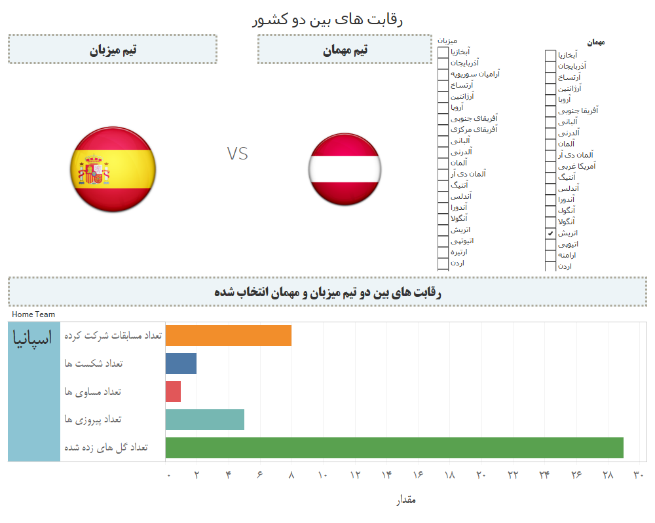

Slide 6
