Slide 1
Campground Booking
G. ก็มาอยู่นะ

Slide 2
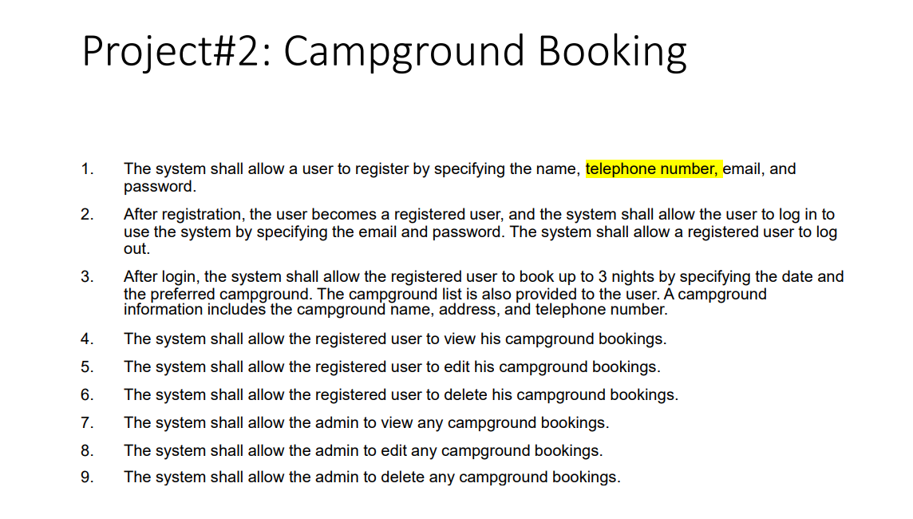

Slide 3

Campground
Booking
VacQ
Hospital
Campground
Appointment
Booking

Slide 4
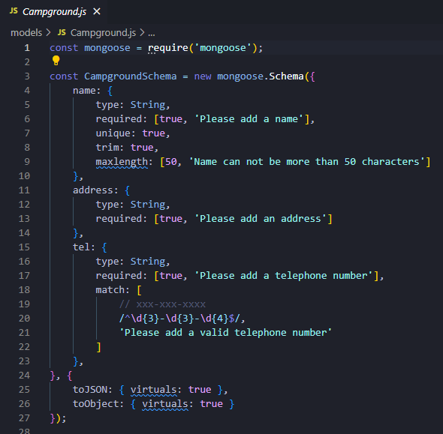
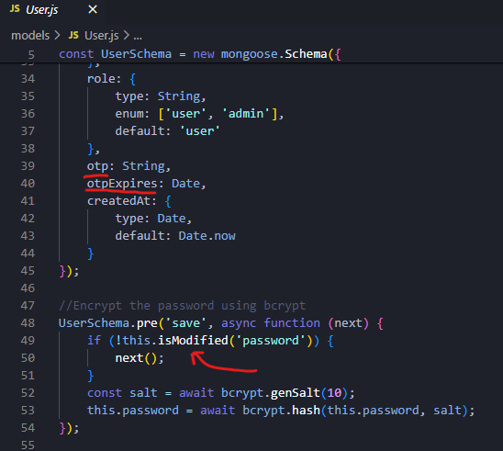
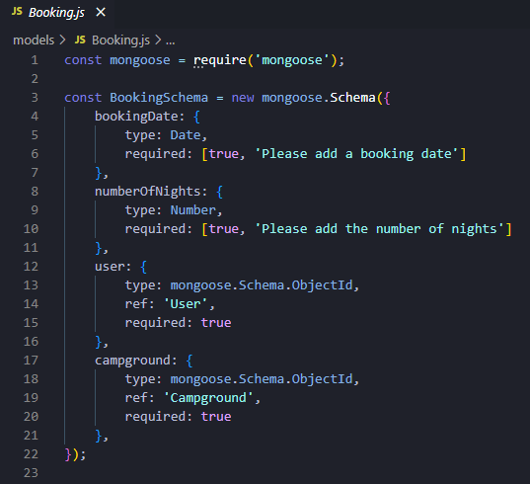
Code

Slide 5
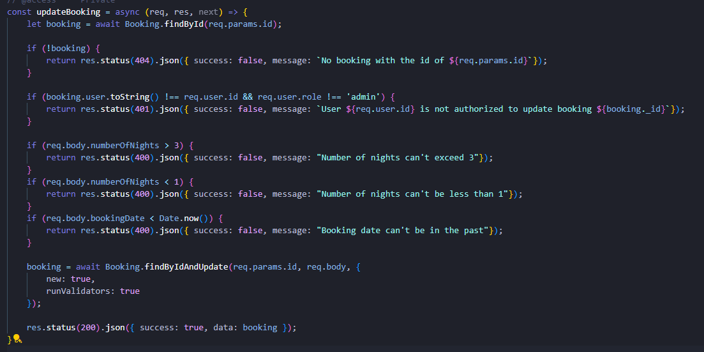
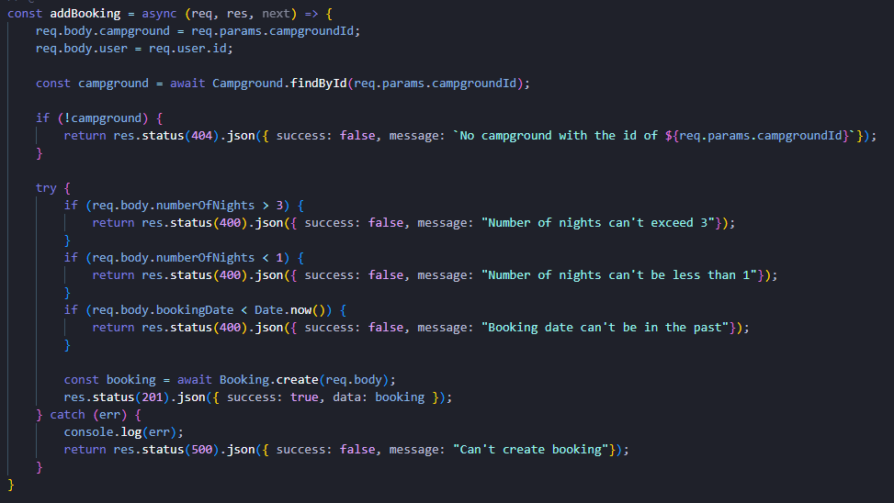
Code

Slide 6
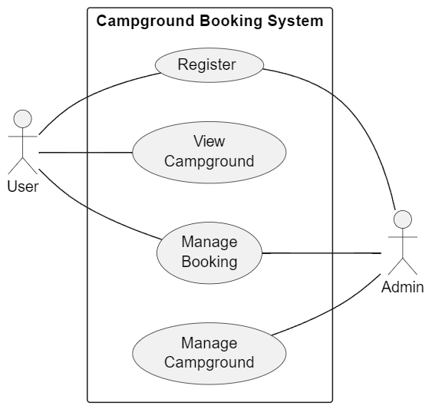
Use Case Diagram

Slide 7


Slide 8
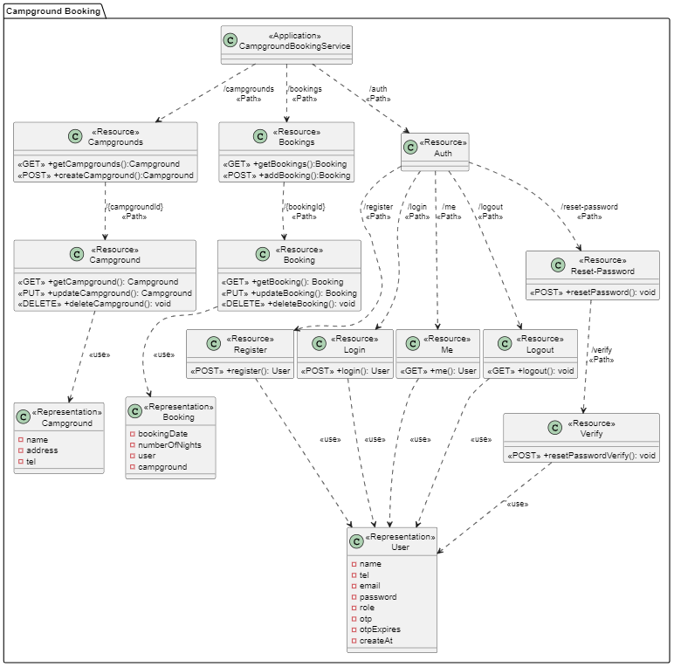
Class Diagram

Slide 9
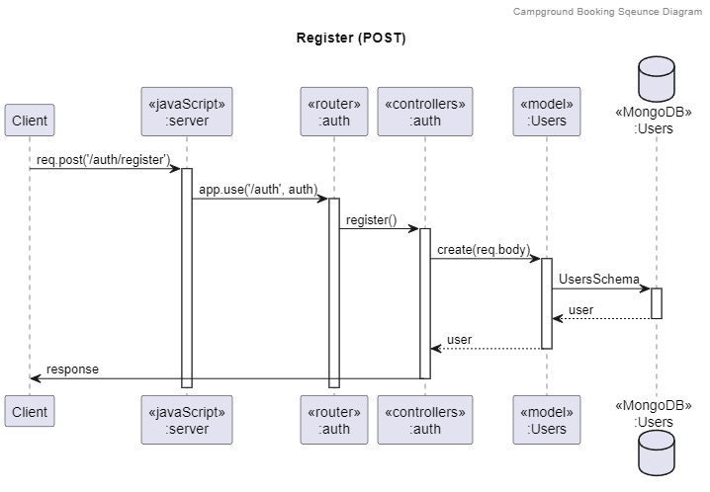
Sequence Diagram

Slide 10
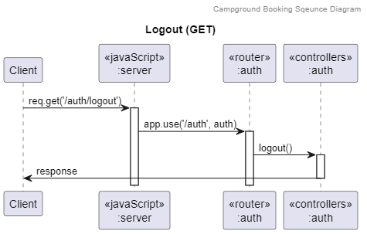
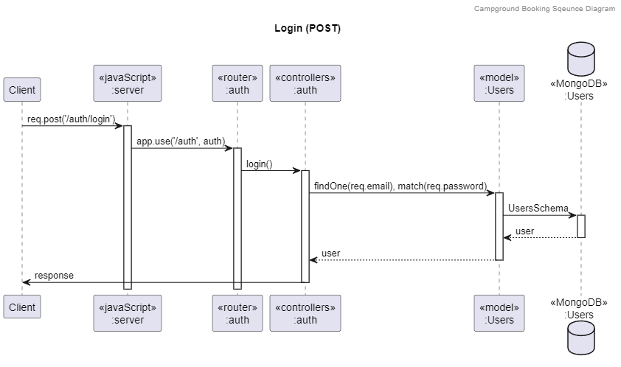
Sequence Diagram

Slide 11
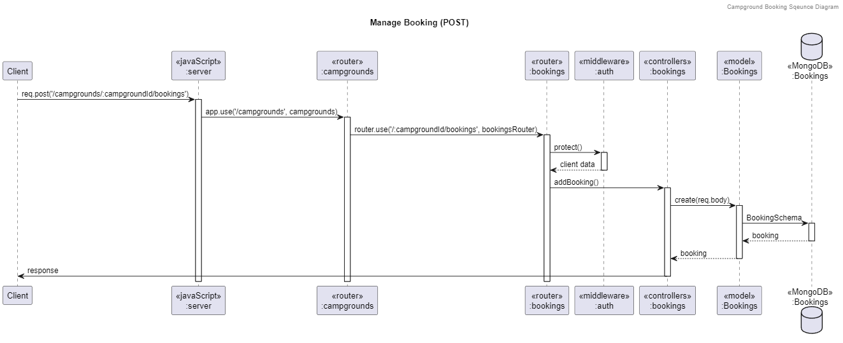
Sequence Diagram

Slide 12
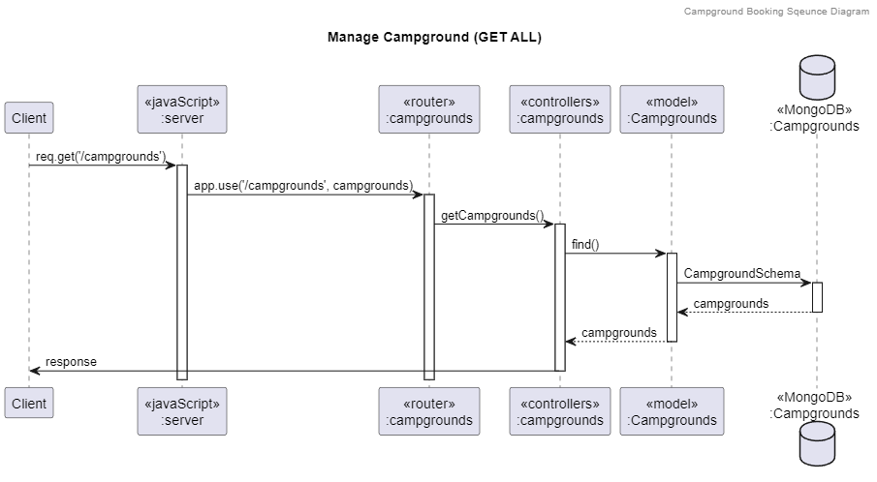
Sequence Diagram

Slide 13
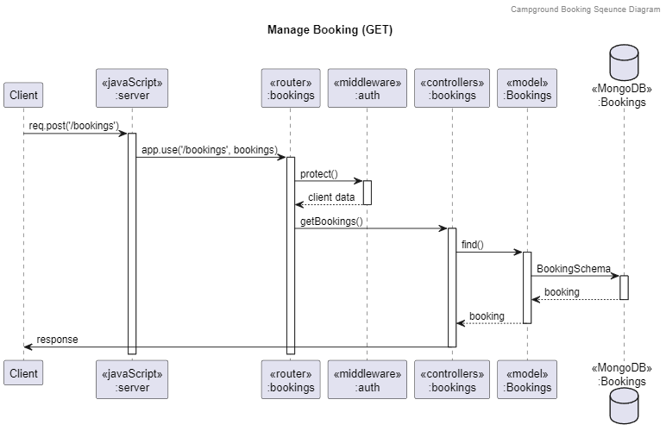
Sequence Diagram

Slide 14
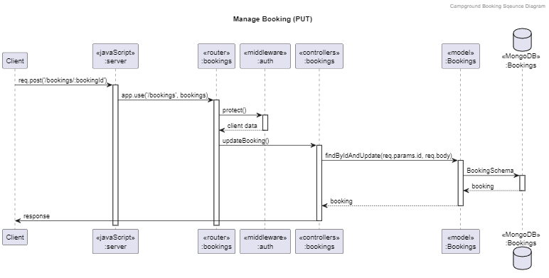
Sequence Diagram

Slide 15
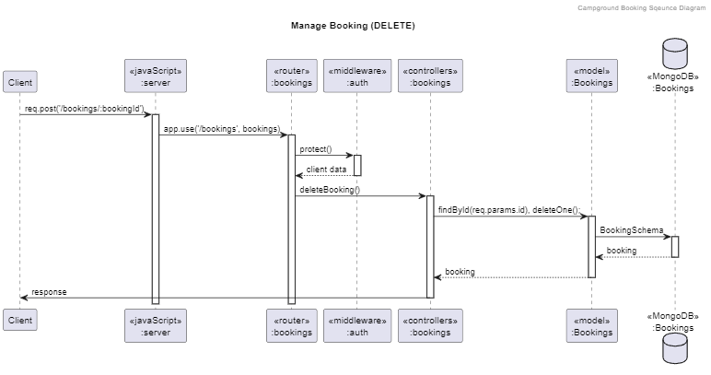
Sequence Diagram

Slide 16



Sequence Diagram

Slide 17

Additional Requirement
VDO Link

Slide 18
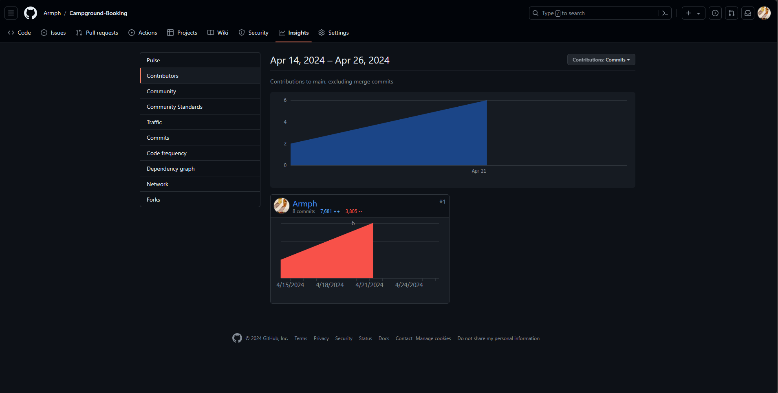
GITHUB REPO

Slide 19
Thanks!
Do you have any questions?

