Slide 1
IBM University Engagement Project Submission
“Exploring the Power of Agentic AI with IBM Granite and IBM Bob”

Slide 2

Project Tile – Fitness-buddy (AI-Powered Personal Fitness Companion)
Domain of Project – Fitness & Healthcare
Student Name | Recent Passport Photo | Email ID | Mobile number [WhatsApp]
Arnab Chowdhury |  | arnabthe07@gmail.com | 7908746346

Slide 3
Problem Statement -
Problem Statement - Fitness Buddy
The challenge - In today’s fast-paced world, many individuals struggle to maintain a healthy lifestyle due to lack of personalized guidance, time constraints, and inconsistent motivation. Traditional fitness solutions often require expensive subscriptions, in-person consultations, or rigid schedules that don't adapt to personal preferences or daily routines.
There is a growing need for an accessible, friendly, and intelligent virtual assistant that can provide on demand fitness advice, healthy lifestyle suggestions, and basic nutrition guidance—all tailored to individual needs and available at any time.
Fitness Buddy aims to solve this problem by offering a conversational, AI-powered health and fitness coach that can:
Recommend home workouts and routines based on user input.
• Provide motivational tips and daily fitness inspiration.
• Suggest simple, nutritious meal ideas.
• Encourage habit-building and consistency.

Slide 4
Proposed Solution -
Proposed Solution: Fitness Buddy — Your AI-Powered Personal Fitness Companion
Fitness Buddy turns AI into a simple, personalized fitness companion that helps users work out, eat better, stay motivated, and build healthy habits—right from home
AI-Powered Personalization: Uses IBM Granite via watsonx to generate fitness, nutrition, motivation, and habit-building guidance based on each user’s profile.
Personalized Home Workouts: Creates workouts tailored to the user’s goal, fitness level, available time, equipment, and preferences.
Simple Nutrition Guidance: Provides practical, healthy meal suggestions with ingredients, preparation steps, and basic nutritional information.
AI Fitness Chat: Users can ask natural-language questions such as “Give me a 20-minute workout” or “I only have dumbbells” and receive relevant guidance.
Habit & Progress Tracking: Helps users build consistency through daily habit checklists, streaks, and progress indicators using browser localStorage.
Lightweight & Accessible: Built with HTML5, CSS3, Vanilla JavaScript, FastAPI, Python, and Pydantic, making the application fast, simple, and easy to run locally.
Safety First: Provides general wellness guidance with clear safety disclaimers and avoids diagnosis, medication advice, or medical treatment claims.

Slide 5
Technology Used
IBM Bob platform -For designing and orchestrating multi-agent workflows visually
IBM Grainte model - ibm/granite-4-h-small – For natural language understanding, reasoning, and personalization
IBM Cloud – It provides the infrastructure to build Fitness Buddy efficiently. IBM Cloud enables a reliable, secure, and scalable environment for deploying the Fitness Agent.
IBM Watsonx.ai - AI model integration and inference
Git / GitHub – Version control and project management

Slide 6
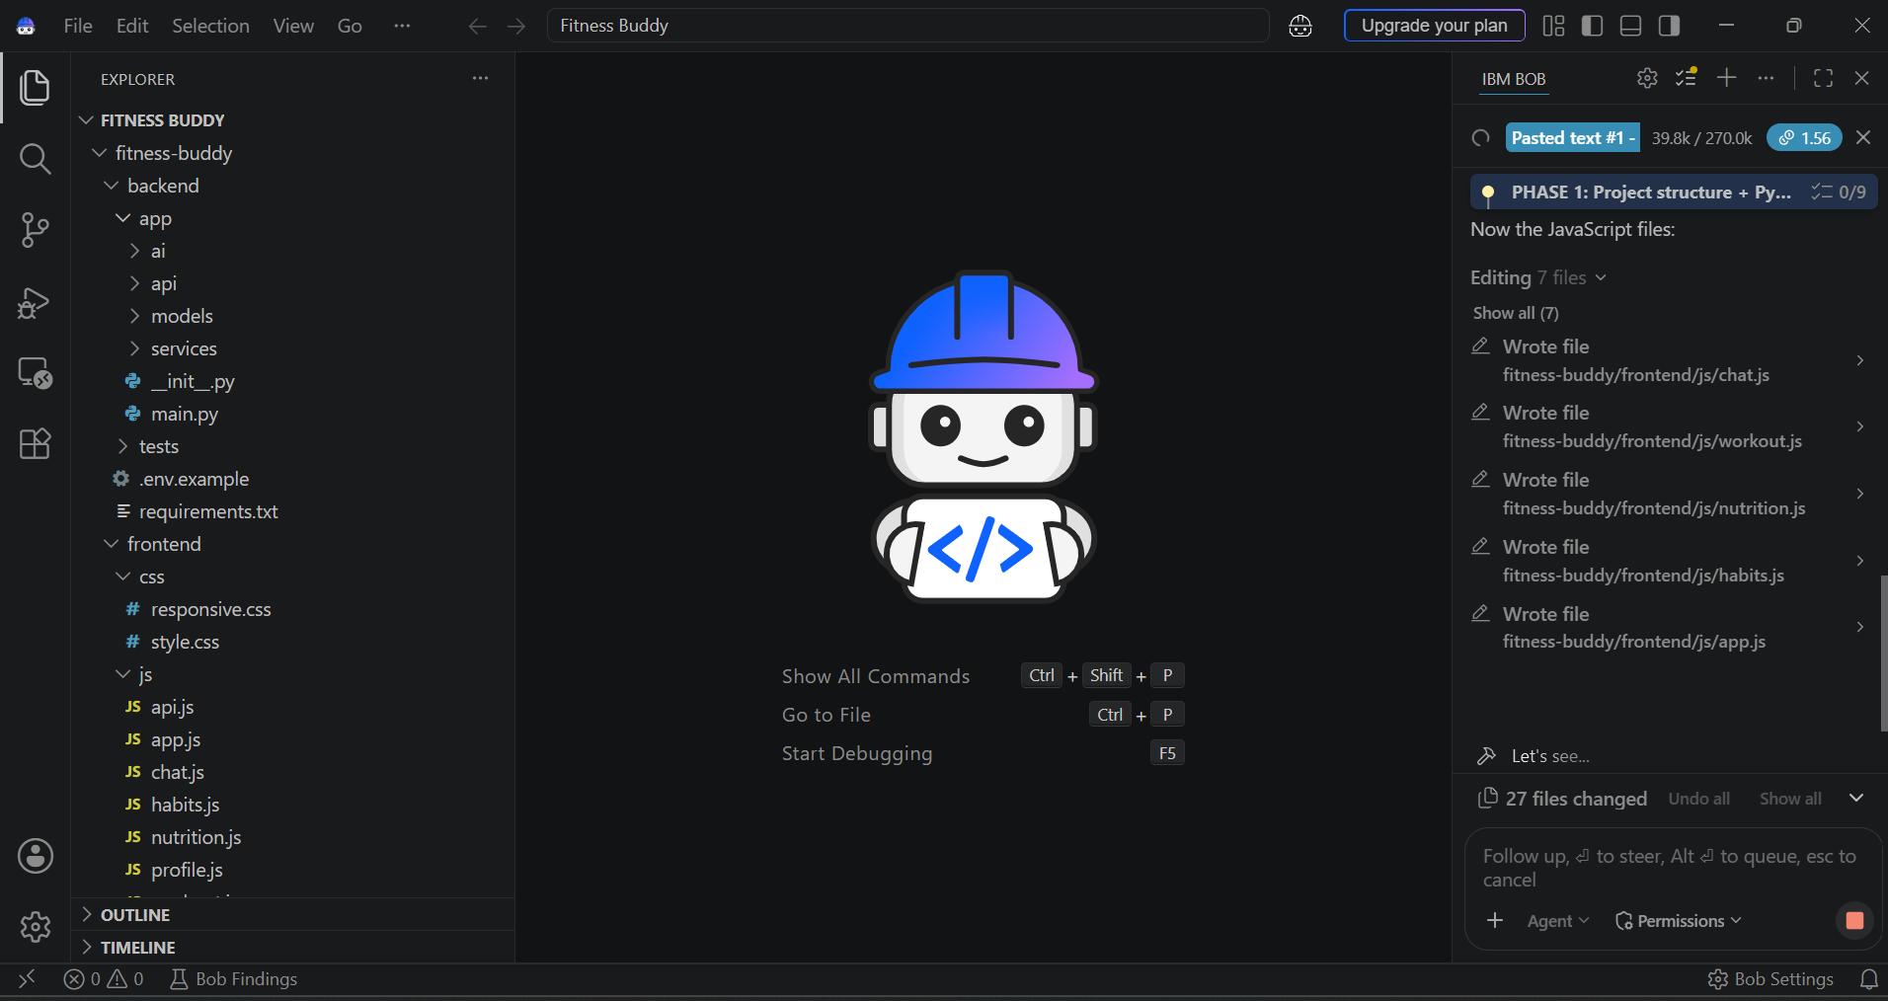
Required Files created using IBM bob -
App.py
Requirements.txt
Style.css
.env
Index.html

Slide 7
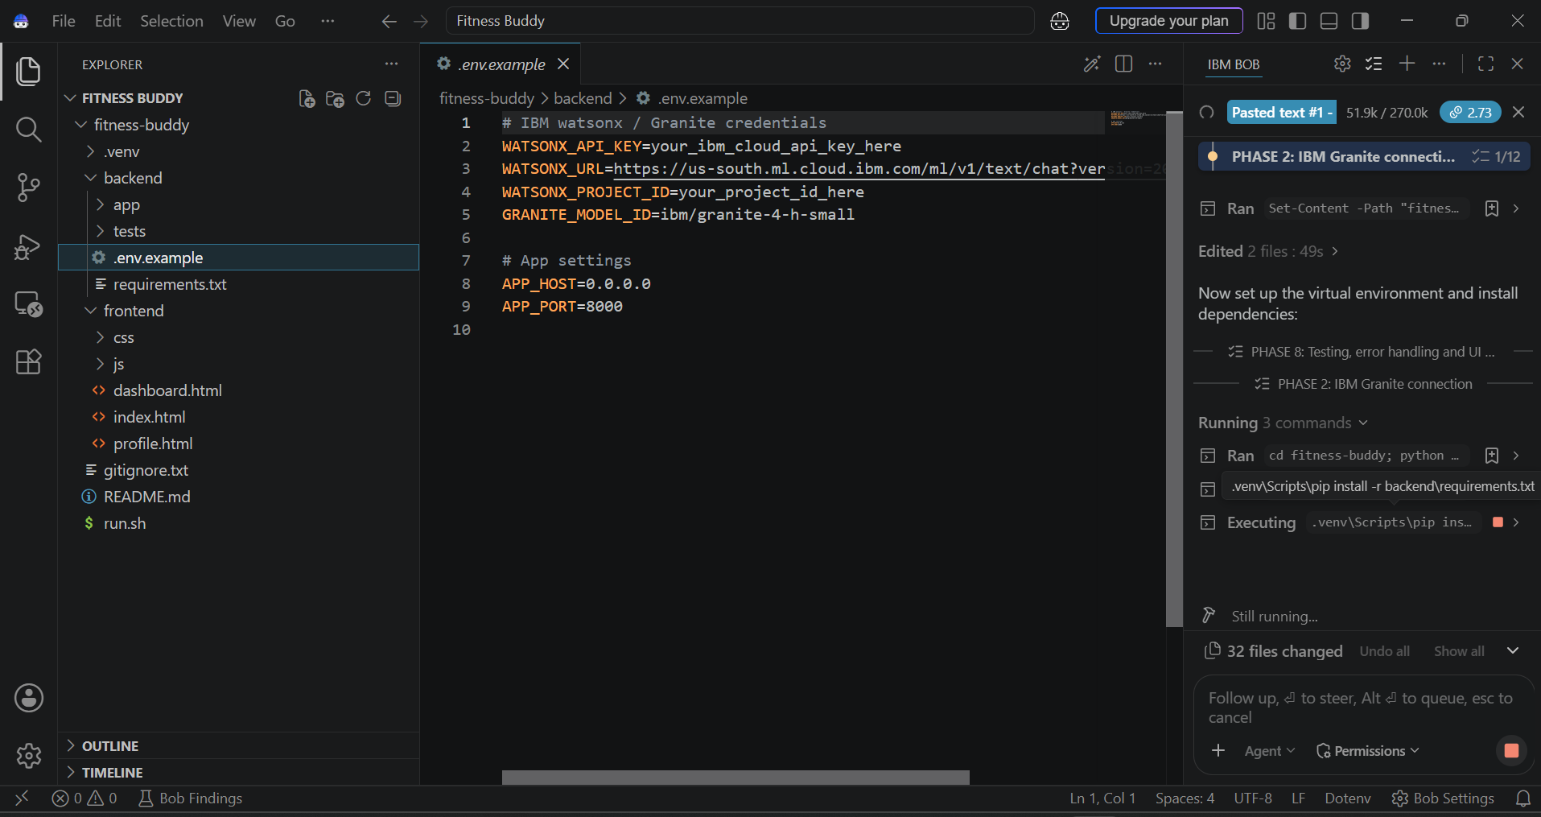
IBM Bob Screenshots:

Slide 8
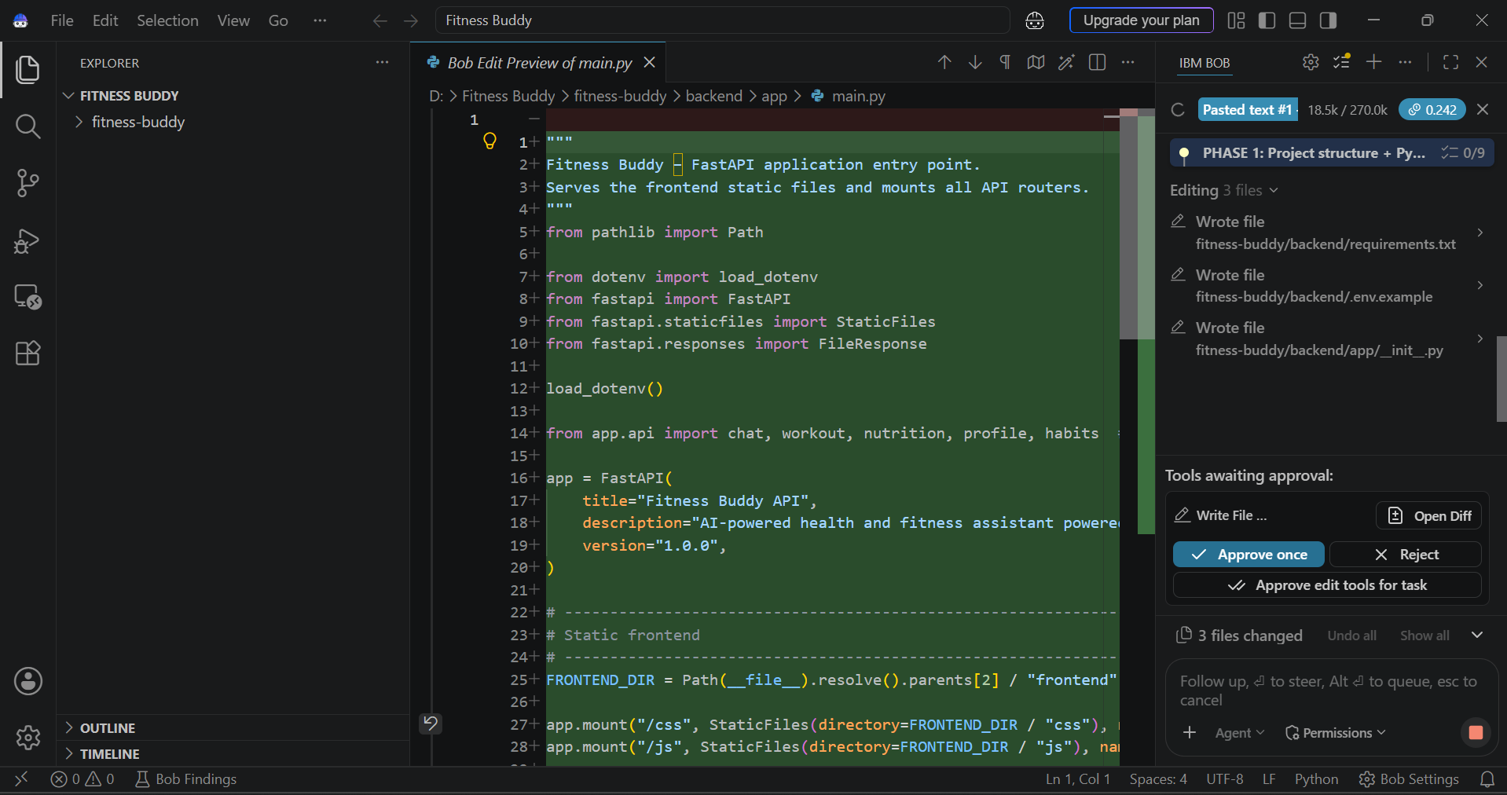

Slide 9
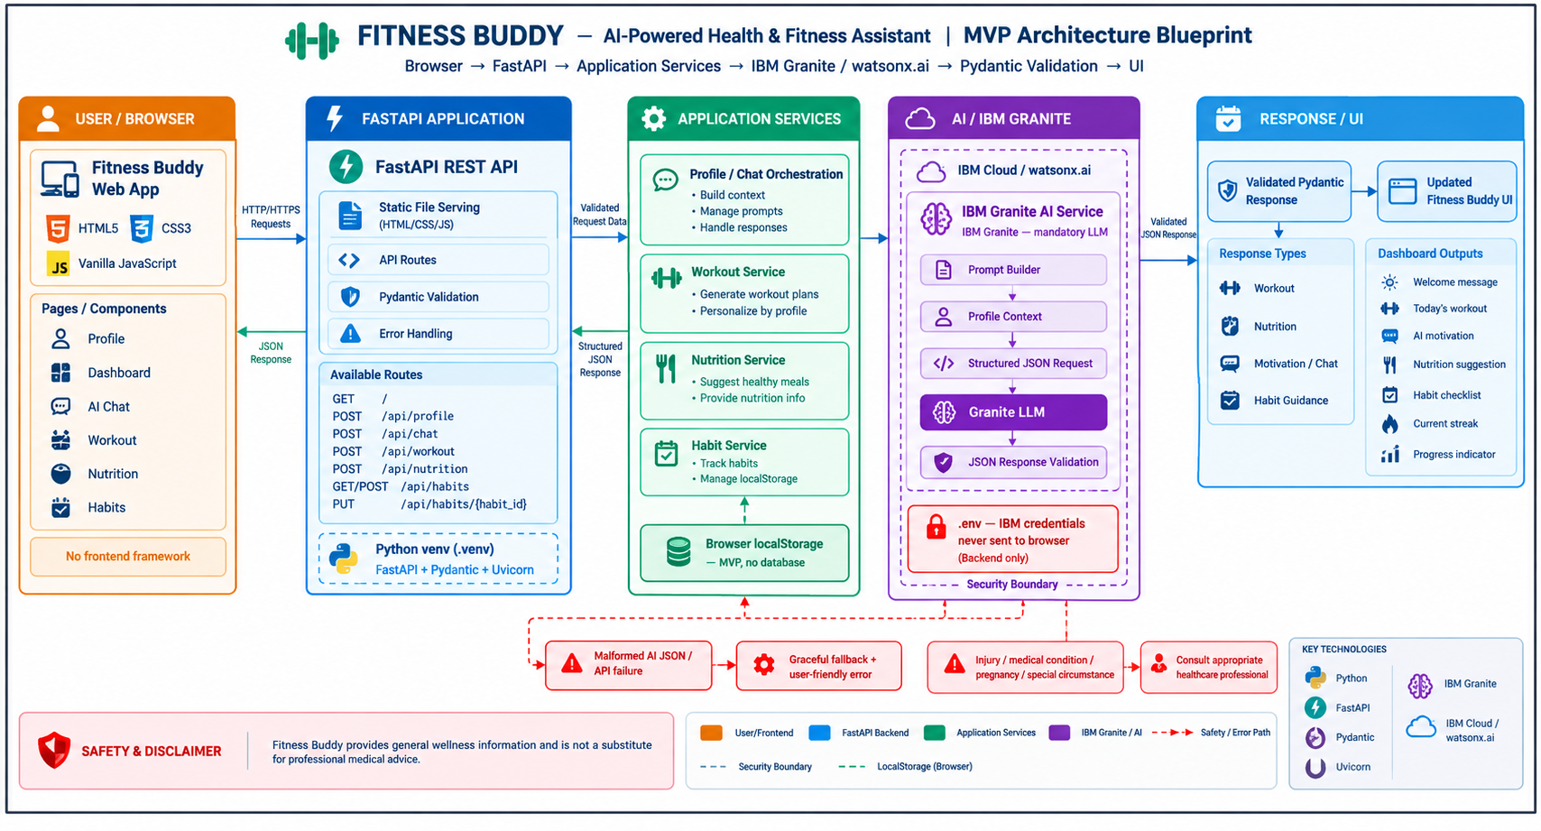
Architecture blueprint for IBM bob:

Slide 10

Role of Agentic AI in the solution
Fitness Buddy uses IBM Granite as the intelligence layer to act as a personalized fitness assistant rather than just a static chatbot.
Understand User Intent: Interprets natural-language requests such as “Give me a 20-minute beginner workout.”
Personalized Decision-Making: Combines the user’s goal, experience, available time, equipment, diet, and activity level to determine suitable recommendations.
Context-Aware Responses: Uses profile information and the user’s request to generate relevant workouts, meals, motivation, and habit guidance.
Task Planning: Converts broad goals into actionable steps—for example, turning “I want to get fitter” into a suitable workout and habit routine.
Continuous Guidance: Supports users across multiple activities—workout → nutrition → motivation → habit tracking—creating a unified fitness experience.
Safe & Structured Output: AI-generated responses are validated through Pydantic schemas before being displayed, with safety guidance included where appropriate.
Human-Friendly Interaction: Users can communicate naturally without needing to navigate complex fitness plans or technical settings.
“Agentic AI bridges the gap between user intent and personalized action by understanding, planning, generating, and validating fitness recommendations.”

Slide 11
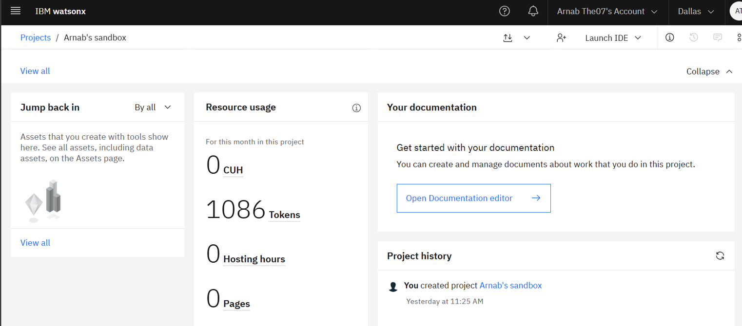
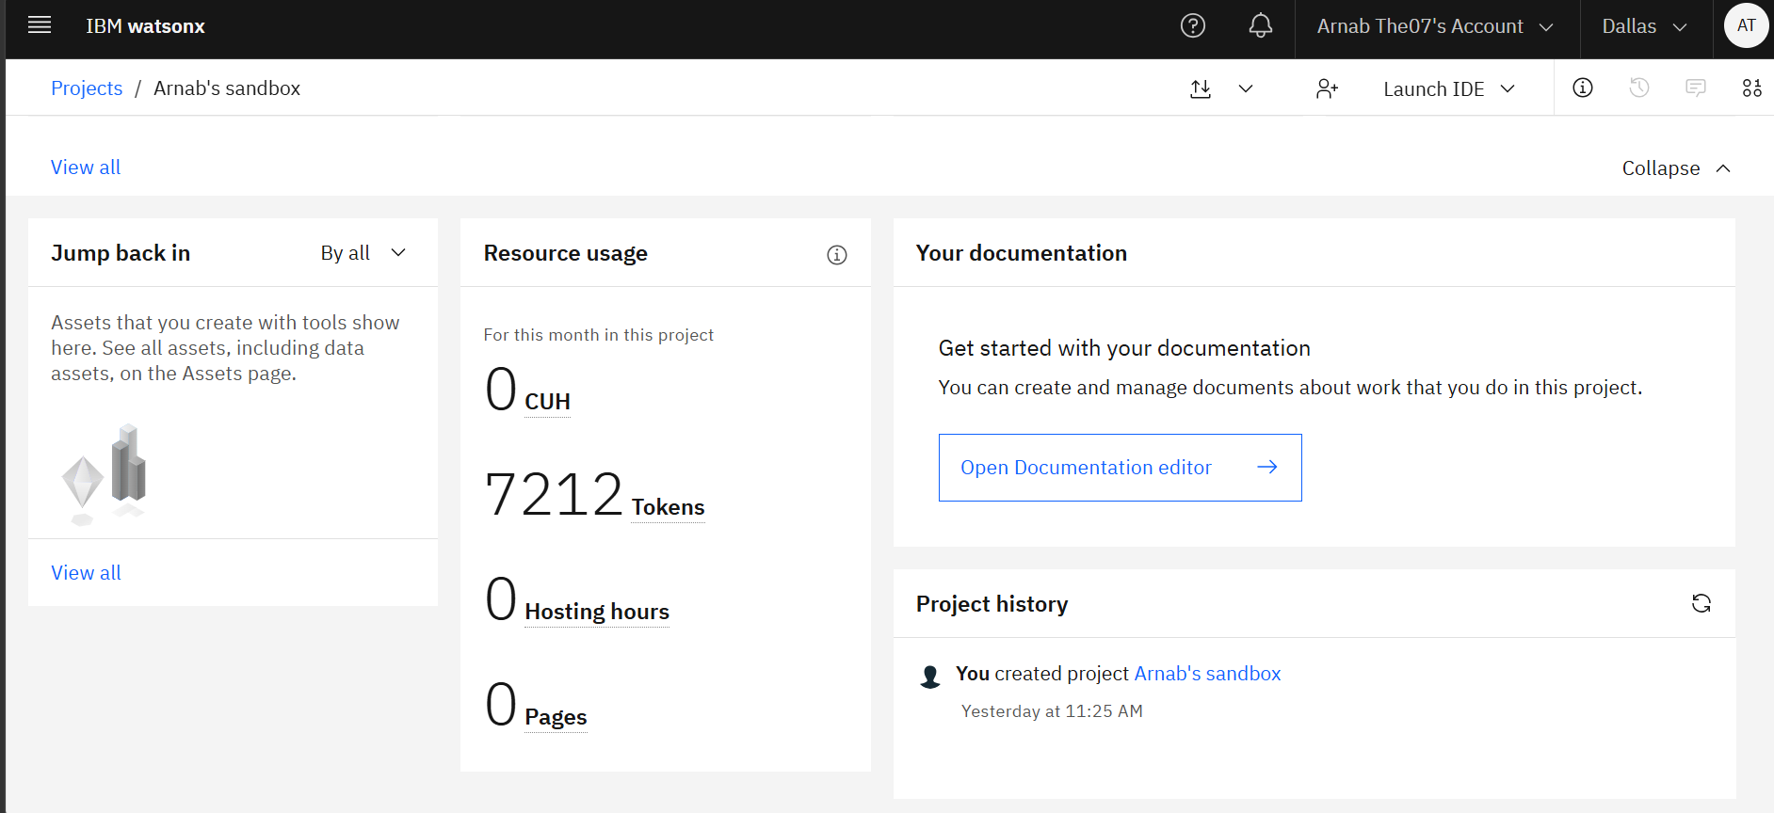
Token Usage
6,126 token are used
Before Prompt
After the Prompt

Slide 12
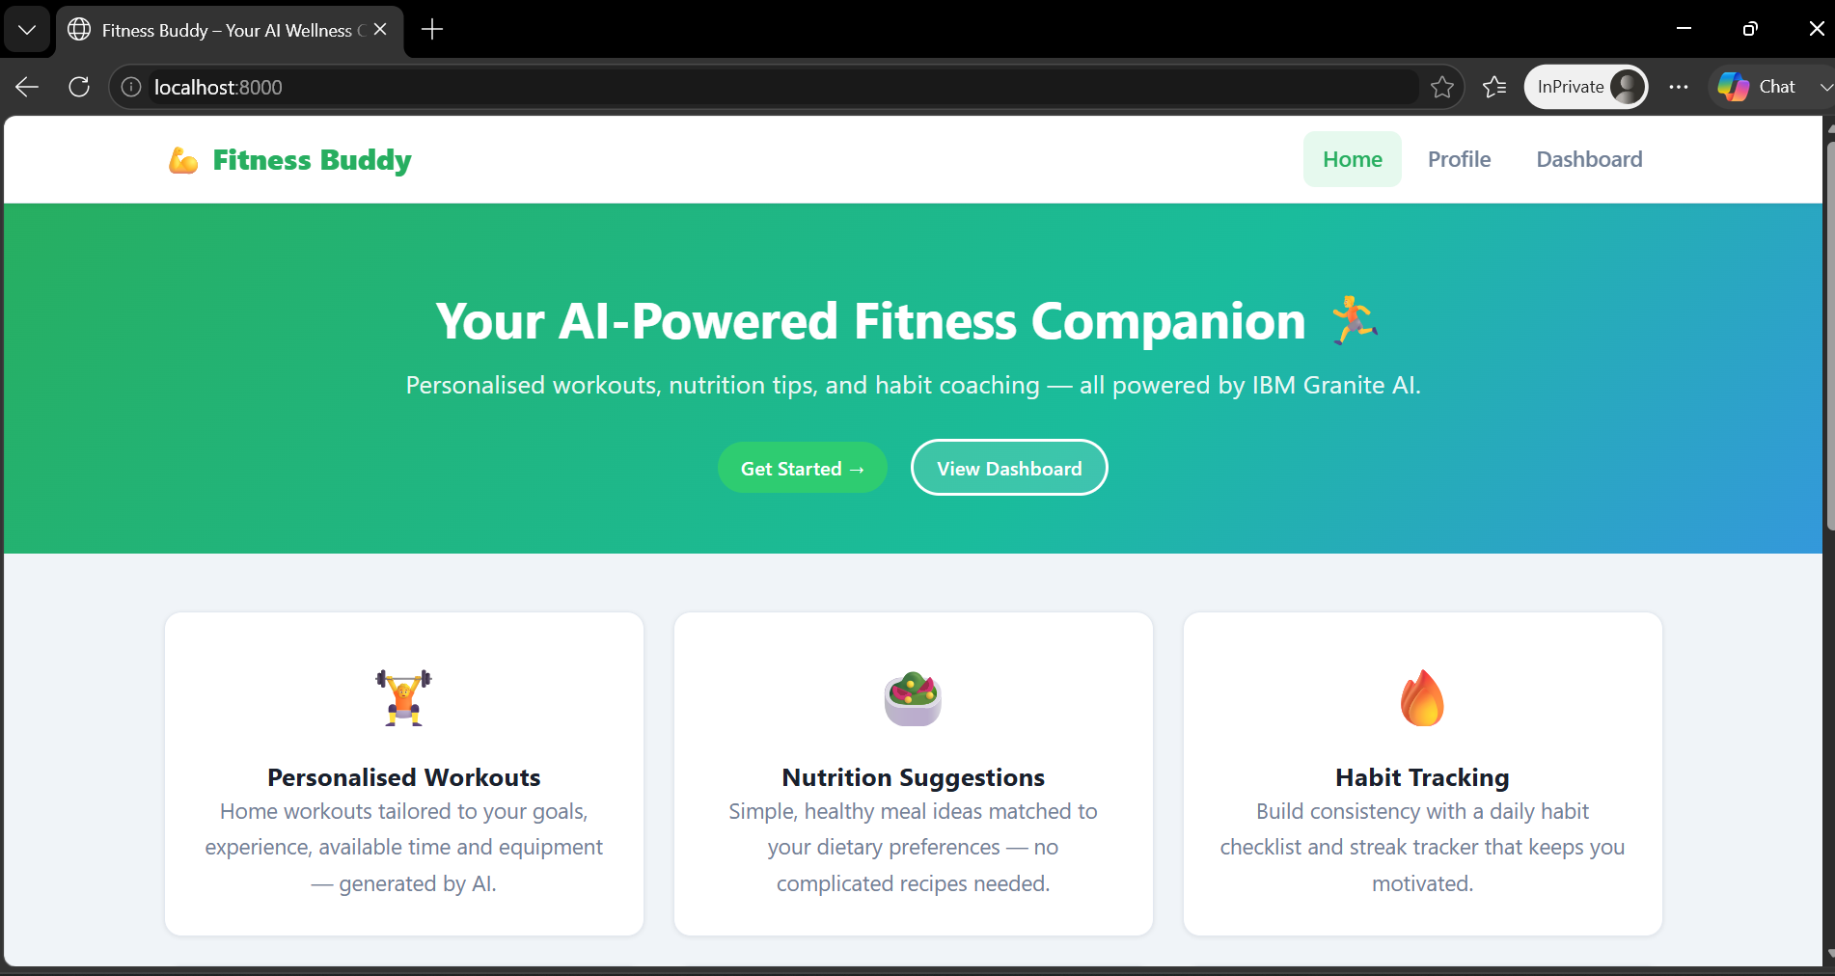
Project Output Screenshot
·
·
·

Slide 13
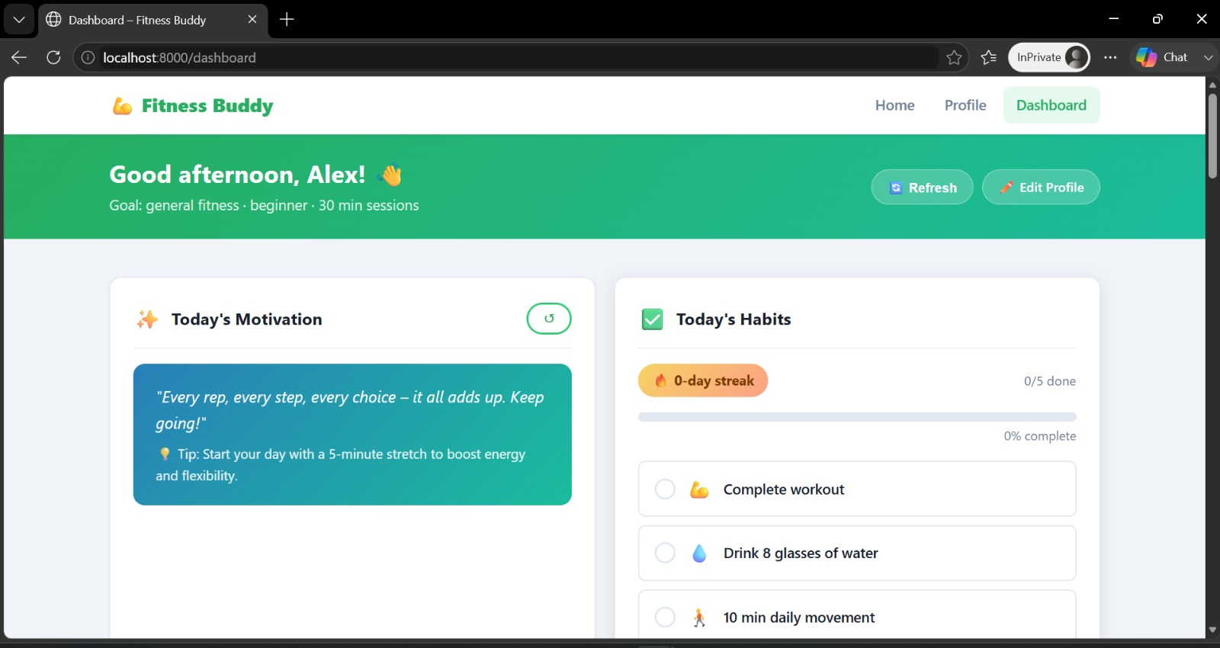
Project Output Screenshot
Please put IBM Bob output screenshots with 2-3 prompts.
You can take 2-3 more slides for each screenshot
·
·
·

Slide 14
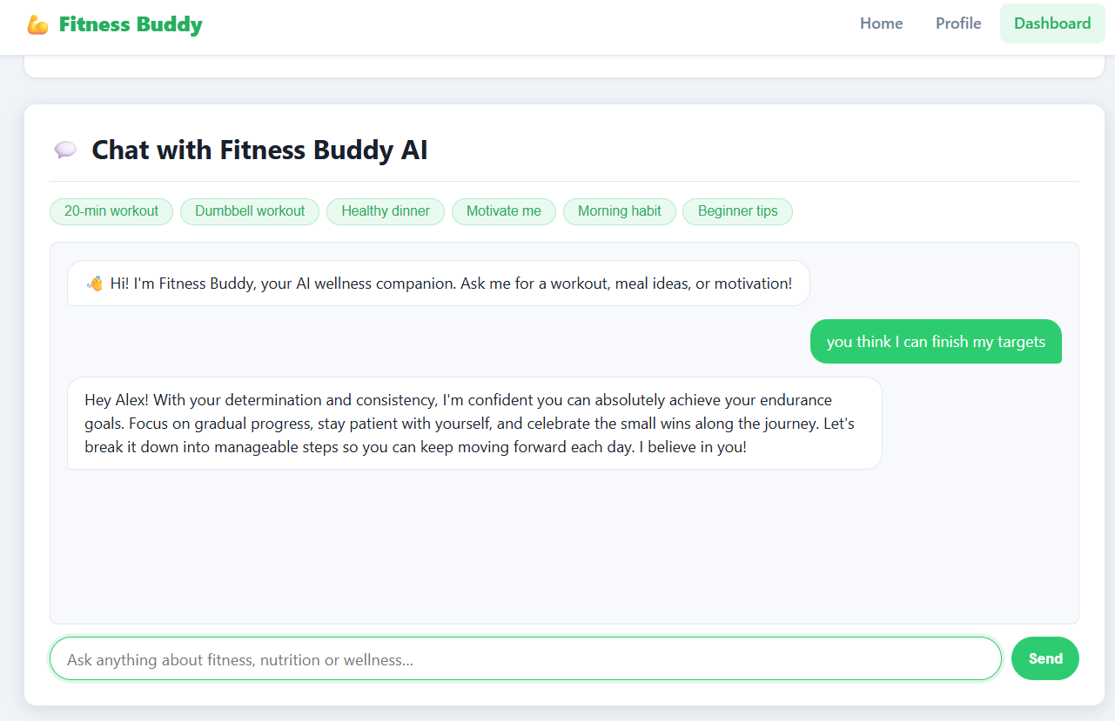
Project Output Screenshot

Slide 15
Novelty and Uniqueness
Personalized AI Fitness Companion: Goes beyond generic fitness apps by using IBM Granite to generate recommendations based on each user’s individual profile and needs.
Natural-Language Fitness Interaction: Users can simply describe what they need—“I only have dumbbells” or “Motivate me today”—instead of following rigid menus.
One AI for Multiple Needs: Combines workouts, nutrition, motivation, and habit building in a single assistant rather than treating them as separate features.
Dynamic Recommendations: Workout plans adapt to available time, equipment, fitness goal, and experience level, making home fitness more practical.
Action-Oriented AI: Converts conversations into actionable fitness routines, meal suggestions, and daily habits rather than providing information alone.
Habit + AI Integration: Connects AI-generated guidance with streaks, habit checklists, and progress tracking to encourage long-term consistency.
Responsible AI Approach: Uses structured AI outputs, validation, and safety guidance to provide useful wellness recommendations while avoiding medical diagnosis or treatment claims.
Fitness Buddy combines conversational AI, personalized fitness planning, nutrition guidance, and habit formation into one lightweight home-fitness companion powered by IBM Granite.

Slide 16
Git Hub Link
The working Github URL – https://github.com/Arnab-13/IBM_SkillsBuild_AICTE_Internship
Repository Contents:
Fitness-buddy (AI-Powered Personal Fitness Companion)[project folder]
Problem_statement No.-13 Fitness Buddy.pdf [pfd]
AICTE_IBM_BOB_Project_Submission.pptx [Presentation Deck]
README.md [For Documentation(understanding)]
·
·
·

Slide 17
Future Scope
1. Integration with Wearables & Health Devices
The system can be integrated with smartwatches and fitness trackers to collect real-time data such as steps, calories burned, heart rate, and sleep patterns. This will enable Fitness Buddy to provide more accurate and dynamic workout, nutrition, and habit recommendations based on actual user activity.
2. AI-Powered Voice Assistant & Multilingual Support
A voice-enabled AI assistant with multilingual capabilities can make Fitness Buddy more accessible and inclusive. Users will be able to interact naturally through voice and receive fitness guidance in their preferred language, supporting diverse users and regional populations.
3. Adaptive & Predictive Fitness Planning
Future versions can analyze workout history, progress, habits, and user feedback to automatically adapt fitness plans. The AI could proactively suggest changes to workout intensity, routines, and daily goals to improve consistency and personalization.
4. Advanced Progress Analytics & Smart Recommendations
The platform can introduce weekly/monthly fitness reports, goal tracking, progress visualization, and personalized insights. By combining historical data with IBM Granite, Fitness Buddy could identify patterns and provide more meaningful recommendations.
·
·
·

Slide 18
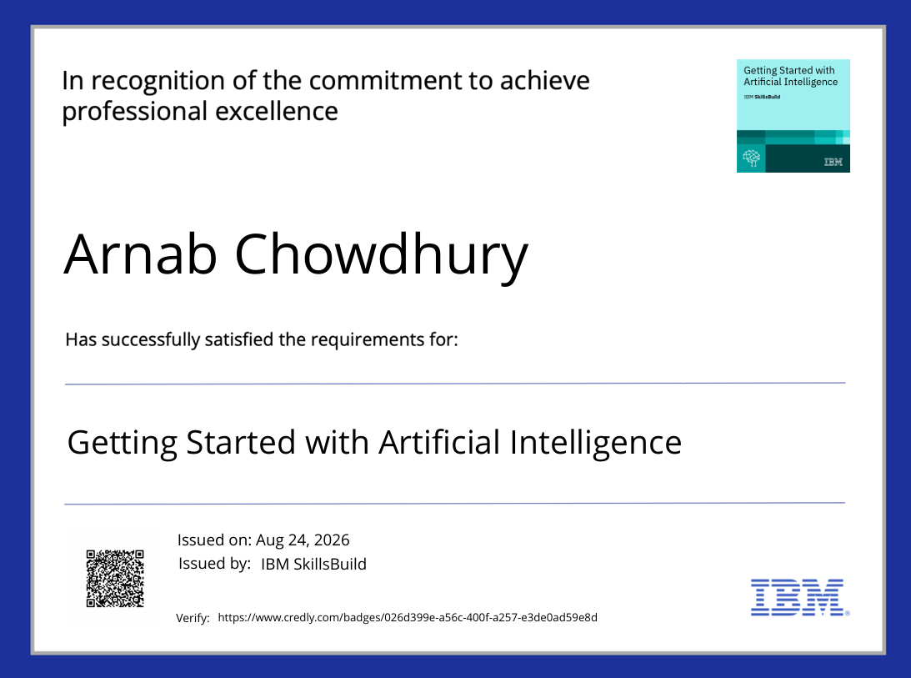
Certificates Earned:
Credly certificate(Getting Started with Artificial Intelligence)

Slide 19
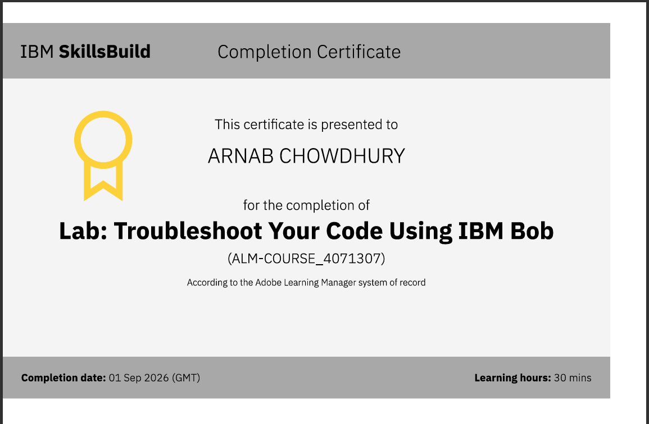
Certificates Earned:​
IBM BOB Certificate

Slide 20


