Slide 2

Welcome to OTAP 2.0
+
Open Existing Project
Create new Project
Browse
Select File
New Project
Enter Project Name :

Slide 3


+
x
Project Name
Case 1 : ………
Case 1 : Name
Text (OTAP Version)
Text (As new Files)
GUI based
Case 2 : Name
Cold Wall/Thermal Response
Convective Flux
Transition option
Radiative Flux
Geometry & Analysis Location
Cp Data/Real/Ideal behaviour
Heat Flux method
X Atmospheric Table
X Perturbation on parameters
X Time details
X Temperature details
X Thermal Response details
TPS Optimization
! Summary
…
Open
View
Case N : Name
Run : Batch File Option
Upload Script
Unit of Output
Run selected case
Combined Comparator Plots
Contour
Animation
choose cases
Parameters to compare
(Plot, Excel)
Detailed result
Choose case
(select Case)

Slide 4
Cold Wall Flux / Thermal Response
Cold wall Flux Thermal response
Enter Wall Temp:
K
FDM
Network Method
Back to homepage
Next

Slide 5
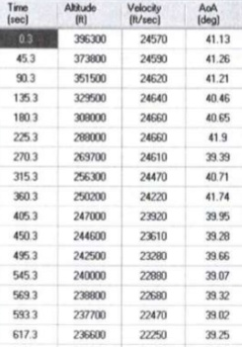
Convective Flux
Convective Flux through :
Trajectory Wind tunnel data CFD Data Input h,Tg
In Time,Alt,Velocity form
In Time,Alt,Mach form
Data input :
Initial γ:
Add Row
Delete Row
Browse
Back to homepage
Next
NOTE: All options should be made possible via Insert from table, txt or manual in several possible units

Slide 6
Transition Option
Flow turbulent throughout
Transition option
Re Reθ
Enter Re transition
Enter Re at station where transition started transition
Back to homepage
Next

Slide 7
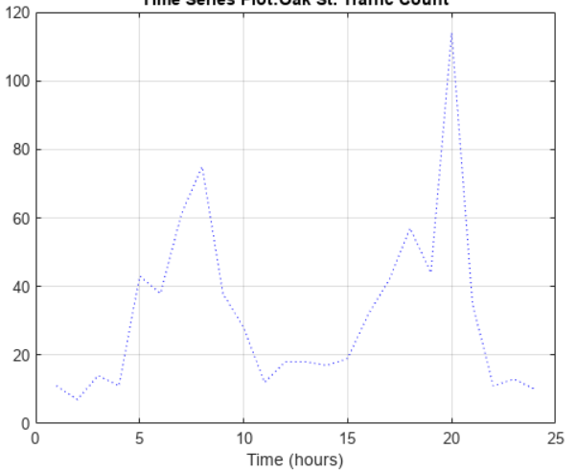
Radiative Flux
Radiative Flux :
Yes
No
Measured HF
Want IR alone
IR/Albedo/Solar
FV: 1
a:0.9 FV: 1
a_{IR}:0.9 a_{SOLAR}:0.7 FV: 1
Add Row
Delete Row
Browse
Back to homepage
Next

Slide 8
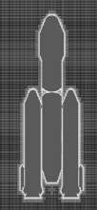
Geometry and Analysis Location
Axisymmetric 2-D
No of Components
Visualize Input geometry
R
θ
L
α
λ
Rc
Analysis Location
Only if Analysis Loc:0
Geometry (For Stagnation point case, as drop down menu)
Back to homepage
Next

Slide 9
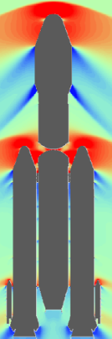
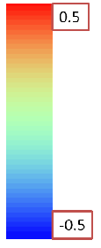
Flow Details
Full Pressure Recovery
Cp Computed from Shock relation
Cp file
Visualize Cp data
Cp file
(Cp as function of M and length, α)
Xaxis: Vehicle length
Yaxis: Mach number
Cp: as contour
Browse
Real Shock Ideal Shock No Shock
Property Table Drop down (Hansen, Mollier, which Fluid, etc)
Back to homepage
Next

Slide 10
Heat Flux method
Drop down option of Heat Flux computation Method
Back to homepage
Next

Slide 11
Atmospheric/Ambient Properties
Atmospheric Table :
Dropdown menu (Indian LB,UB,Nom,User,Other)
Space Temperature:
as table variation or constant value
Back to homepage
Next

Slide 12

Time Details
Add Row
T_{start} Dt T_{end}
Print Interval
Table print interval
Iteration Print Yes No
Iteration print between T1 & T2
Delete Row
Add Row
Delete Row
Add Row
Delete Row
T1
T2
Back to homepage
Next

Slide 13

Parameter Perturbation
Perturbation on Properties: Yes No
If yes, which properties (16 options from Drop down menu, variation with Temperature/Time or constant )
K
Cp
Ρ
...
h
K perturbation
Constant
Table
Add Row
Delete Row
Browse
Back to homepage
Next

Slide 14
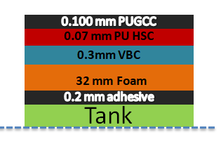
Thermal Response Inputs…
Will show only if Thermal Response option active:
Thermal Response Coordinate:
No of layers:
(From top to bottom):
Nodes in each Layer:
Material Each Layer:
(by comma space separated), can create (any units) or choose
Thickness Each Layer:
Thinlayer option to be exercised: X1thin: X2thin
Ablation/Charring Occurring : Yes No
First Layer sublime: Yes No
Cartesian
Cylindrical
Spherical
Specify Outer radius
Mat. Layer 1
Mat. Layer 2
Library, Create New
Back to homepage
Next

Slide 15
…Thermal Response Inputs
Will show only if Thermal Response option active:
Propellant to be taken: Yes No
Propellant mass:
Air layer/Gap Present between :
Contact conductance Present between :
Any Internal Heat generation:
First Layer sublime: Yes No
Constant
Table
Add Row
Delete Row
Browse
Choose Layers with H , L , emi1, emi2
Choose Layers with value of conductance
Layer no generating
Constant
Table
Add Row
Delete Row
Browse
Back to homepage
Next

Slide 16
Initialization/Tolerance Inputs…
Will show only if Thermal Response option active:
MPD (Initial char rate)
MCD (Initial ablation rate)
*OTAP has it hardcoded as 0
Tinitial :
Upper limit for convergence in temp
Upper limit for convergence in Charring/Ablation rates
Constant
Expression
Table
Add Row
Delete Row
Browse
Back to homepage
Next

Slide 17
TPS Optimization
Will show only if Thermal Response option active:
TPS Optimization: Yes No
If Yes:
Index of interface node where temp constraint is maintained :
Material layer index whose thickness is to be optimized :
Temp constraint :
Tolerance for convergence on temp constraint :
Initial trial variation in thickness of layer to be optimized :
Back to homepage
Next

Slide 18
Summary of Inputs
Analysis Type: Cold wall/ Thermal response
Convective Flux : Option
Transition Option : Re/Retheta/Retransition
Radiative Flux : Option
Anlaysis Geometry: Stagnation Point, Cap, Cone, Cylinder
Axial Length
Surface Length
Flow Details : Real/Ideal/No Shock, Cp from File, Hansen Table for Air
Heat Flux Method
Atmospheric Table, Space temp
Parameter Perturbation: Yes/No, on k,h,Cp, etc
If Thermal Response active: Material Details
Time start/end
Temperature initial
Optimization Active/Inactive
Back to homepage
Next

