Slide 1

UEE2818 – Project Phase - 2
Project Review - 2
DESIGN AND IMPLEMENTATION OF AN AI BASED TECHNIQUE FOR HUMAN ELEPHANT CONFLICT MITIGATION
Batch No: A2
Presented by
G.G Jegadheeshwaran(3122213001040),
Hamebantei K Tangsang(3122213001304),
Arnab Sheoran(3122213001801)
Project Guide (Internal): Dr. Rajasi Mandal, Asst Prof./EEE, SSNCE
Co-Supervisor(Internal): Dr. R. Jayaparvathy, /Prof./EEE, SSNCE

Slide 2
Objectives of the Project
To develop an AI-based real-time system that accurately detects elephant using advanced deep learning techniques.
To reduce human–elephant conflict by providing early warning alerts before elephants enter human-populated areas.
To implement an integrated alert mechanism using an alarm buzzer and mobile notifications for immediate response.
To deploy the detection system on an edge-computing platform to achieve low-latency and offline-capable operation.
To ensure reliable performance of the system under varying environmental and lighting conditions.
To design a scalable and cost-effective solution suitable for large-scale deployment in forest-border regions.

Slide 3
Problem Formulation & Justification
PROBLEM:
Increasing incidents of human–elephant conflict due to habitat loss and human encroachment have resulted in significant threats to human life, agriculture, and wildlife conservation.
Existing mitigation methods such as manual patrolling, fencing, and conventional alarm systems are reactive, labor-intensive, and often fail to provide timely warnings.
There is a lack of an automated, real-time, and intelligent monitoring system capable of accurately detecting elephants and issuing immediate alerts in forest-border regions.
SOLUTION:
An AI-based elephant detection and alert system enables early warning, thereby reducing casualties, crop damage, and unsafe human–elephant encounters.
Deploying the system on an edge-computing platform ensures low latency, real-time operation, and functionality in remote areas with limited internet connectivity.
The proposed solution is cost-effective, scalable, and supports long-term wildlife conservation while enhancing public safety and forest management efficiency.

Slide 4
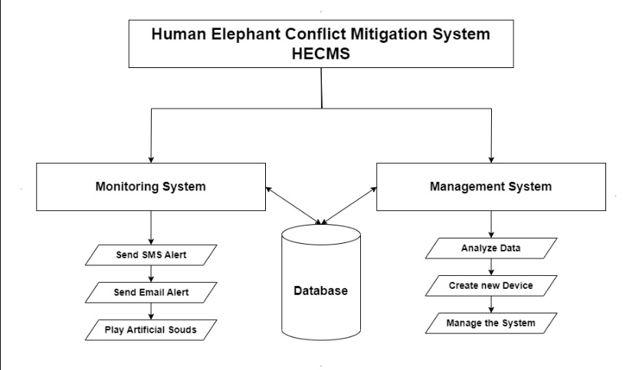
Block Diagram of the Project

Slide 5
Explanation of the Project
Jetson Nano:
Jetson Nano is a small, powerful AI computer developed by NVIDIA.
It is designed to run artificial intelligence and deep learning models on real-time data.
It works like a mini computer but is optimized for AI tasks such as image and video processing.
Low latency, meaning alerts are generated quickly.
Offline capability, so the system works even without internet connectivity.
Compact and portable, making it easy to deploy in forest or rural areas.

Slide 6
Explanation of the Project
Using Jetson Nano in our project:
We use Jetson Nano to run the YOLO AI model for real-time elephant detection.
It allows live video processing directly at the location without sending data to the cloud.
It can control external devices like buzzers and alert systems using GPIO pins.
It supports edge computing, which is important in forest areas with limited internet access.

Slide 7
Explanation of the Project
The proposed system focuses on detecting elephants from images in real time, enabling effective monitoring during night-time and low-visibility conditions to reduce human–elephant conflict.
A deep learning–based object detection model (YOLO) is employed to analyze video frames and identify the presence of elephants with high confidence.
The camera feed is continuously captured and processed, where each frame is resized and passed to the trained YOLO model for simultaneous object classification and localization.
A confidence-based decision logic is implemented to ensure that only high-confidence elephant detections are considered, thereby minimizing false alerts.
Upon successful detection, the system generates visual detection outputs and initiates alert mechanisms for early warning and preventive action.

Slide 8
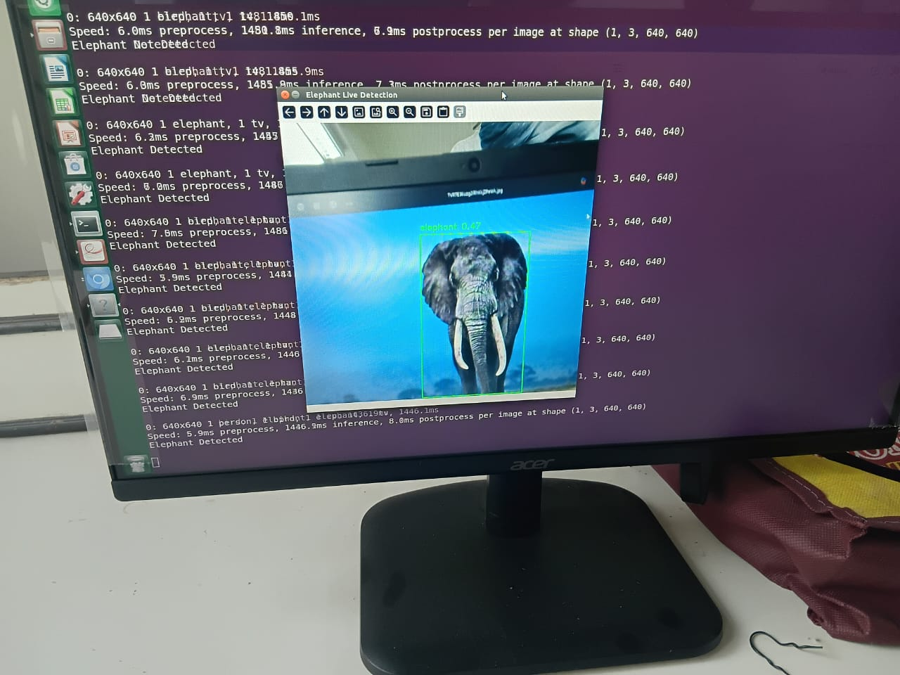
Explanation of the Project

Slide 9
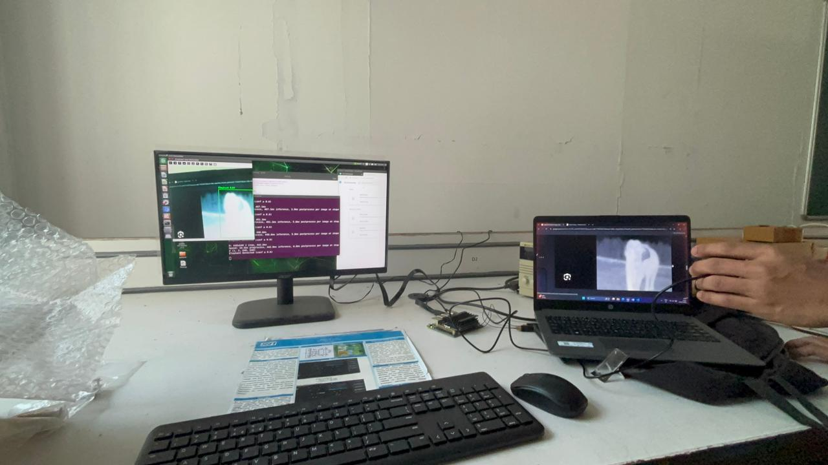
Explanation of the Project

Slide 10
Literature Review
S.N0 | Author | Journal Details | Paper Title | Contribution | Remarks
1. | Moorthy & Rukkumani 2025 | Published in Materials Today: Proceedings, Elsevier, 2023 | Deep vision-based wildlife intrusion detection with colour distribution preserved generative adversarial networks (DV-WID-CDPGAN) | The paper introduced Color Distribution Preserved GANs with Red Panda Optimization, achieving 99% accuracy in real-time elephant detection. | It marks a shift from traditional sensor-based methods to AI-driven solutions, enhancing accuracy, speed, and reliability for HEC mitigation.

Slide 11
Literature Review
S.N0 | Author | Journal Details | Paper Title | Contribution | Remarks
2. | Haixia Xu, Luguang Jiang, Ye Liu | Ecological Informatics, Volume 80, 2024, Article 102518, Elsevier | Mapping the potential distribution of Asian elephants: Implications for conservation and human–elephant conflict mitigation in South and Southeast Asia | The study applied MaxEnt with Google Earth Engine to map Asian elephant habitats and identify key environmental factors influencing distribution. | It highlights major HEC hotspots by overlapping elephant habitats with human populations, offering a strong foundation for conservation and conflict mitigation planning.

Slide 12
Literature Review
S.N0 | Author | Journal Details | Paper Title | Contribution | Remarks
3. | R. Dutta, A. Mondal, B. Banerjee, A. Ghosh, B. R. Kiran, C. Anand, K. S. Anoop Das, K. S.Anoop, A. M. Azeez | Published in Current Science, Volume 120, Issue 11, June 2021 | Elephant detection system using wireless sensor networks for mitigating human–elephant conflict in Kerala | Developed a wireless sensor network-based system integrating PIR sensors, seismic sensors, and acoustic sensors to detect elephant presence near human settlements. | This paper shows the effectiveness of multi-sensor fusion for elephant detection, but its limitations in scalability and accuracy underline the need for AI-driven real-time systems like your project.

Slide 13
Literature Review
S.N0 | Author | Journal Details | Paper Title | Contribution | Remarks
4. | M. Moorthy, V. Rukkumani | Published in Materials Today: Proceedings, Elsevier, 2025 | Human-elephant conflict in Xishuangbanna Prefecture, China: Distribution, diffusion, and mitigation | The study applied ENFA and Circuit Theory models to identify risk factors and predict elephant movement in Xishuangbanna. It mapped that 22.77% of the area is at high risk of HEC, especially in agricultural and garden lands near elephant zones. | This research emphasizes the urgent need for HEC management to protect both elephants and local communities. It provides a scientific basis for ecological corridor planning and compensation strategies in high-risk areas.

Slide 14
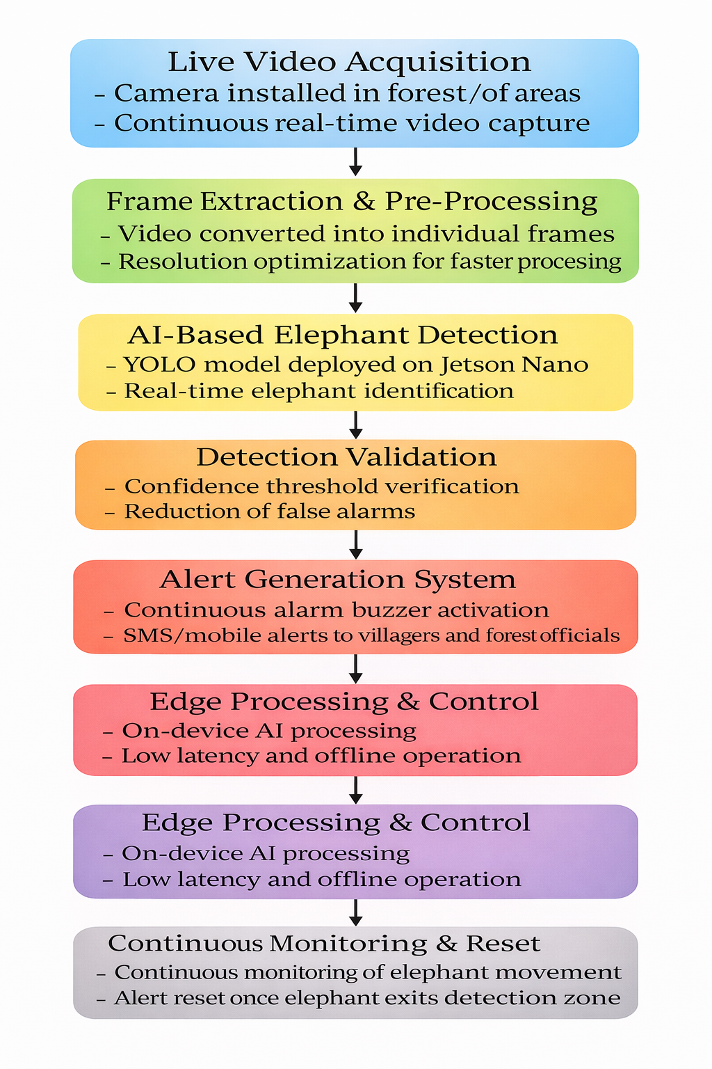
Methodology / Work Flow

Slide 15
Approaches Planned to Execute the Project
A data-driven AI approach is planned by collecting, annotating, and training elephant images for accurate real-time detection.
2. An edge-computing approach is adopted by deploying the trained AI model on Jetson Nano to achieve low-latency and offline operation.
3. A computer vision–based monitoring approach is implemented using continuous live video capture and frame-by-frame analysis.
4. A multi-alert response approach is designed using a buzzer and mobile notification system for immediate warning generation.
5. An iterative testing and optimization approach is followed to improve detection accuracy and reduce false alarms under real-world conditions.

Slide 16
Work completed and Work plan Review 3
Collected and prepared a image dataset of elephants for training and validation.
Trained a YOLO-based deep learning model specifically for elephant detection using images.
Performed data preprocessing and augmentation to improve model generalization and robustness.
Optimized training parameters to improve detection accuracy and reduce false detections.
Evaluated the trained model and achieved improved accuracy in detecting elephants under low-light and night-time conditions.

Slide 17
Work Progress after Review 1
The Jetson Nano edge-computing platform was successfully selected, configured, and validated for real-time AI-based elephant detection.
The YOLO deep learning model was deployed and executed on Jetson Nano to perform real-time elephant detection from live video streams.
Live video capture and frame-by-frame processing were implemented using OpenCV on the Jetson Nano platform.
End-to-end real-time testing of the detection pipeline was carried out to ensure correct model inference and system stability.
The alert triggering mechanism was validated to confirm successful detection-to-alert flow during elephant detection events.

Slide 18
Design Improvements
YOLO model optimized using ONNX, achieving 83% detection accuracy in real-time inference.
High confidence threshold reduces false detections and improves accuracy.
Fixed frame resizing enhances detection stability and processing speed.
Single-event alert logic avoids repeated SMS and call notifications.
Multi-alert outputs ensure reliable early warning based on 83% accuracy.

Slide 19
Hardware Development
A Jetson Nano is used as the core processing unit to run the YOLO-based deep learning model for real-time elephant detection.
A camera module (USB camera) is interfaced with the Jetson Nano to capture live video frames for continuous monitoring.
The prototype supports basic hardware interfacing, with provisions to connect an external buzzer for on-site alert generation.
The system is powered using a regulated power supply, suitable for laboratory and prototype-level testing.
The complete hardware setup is developed as a functional prototype to validate real-time detection and alert mechanisms before large-scale deployment.

Slide 20
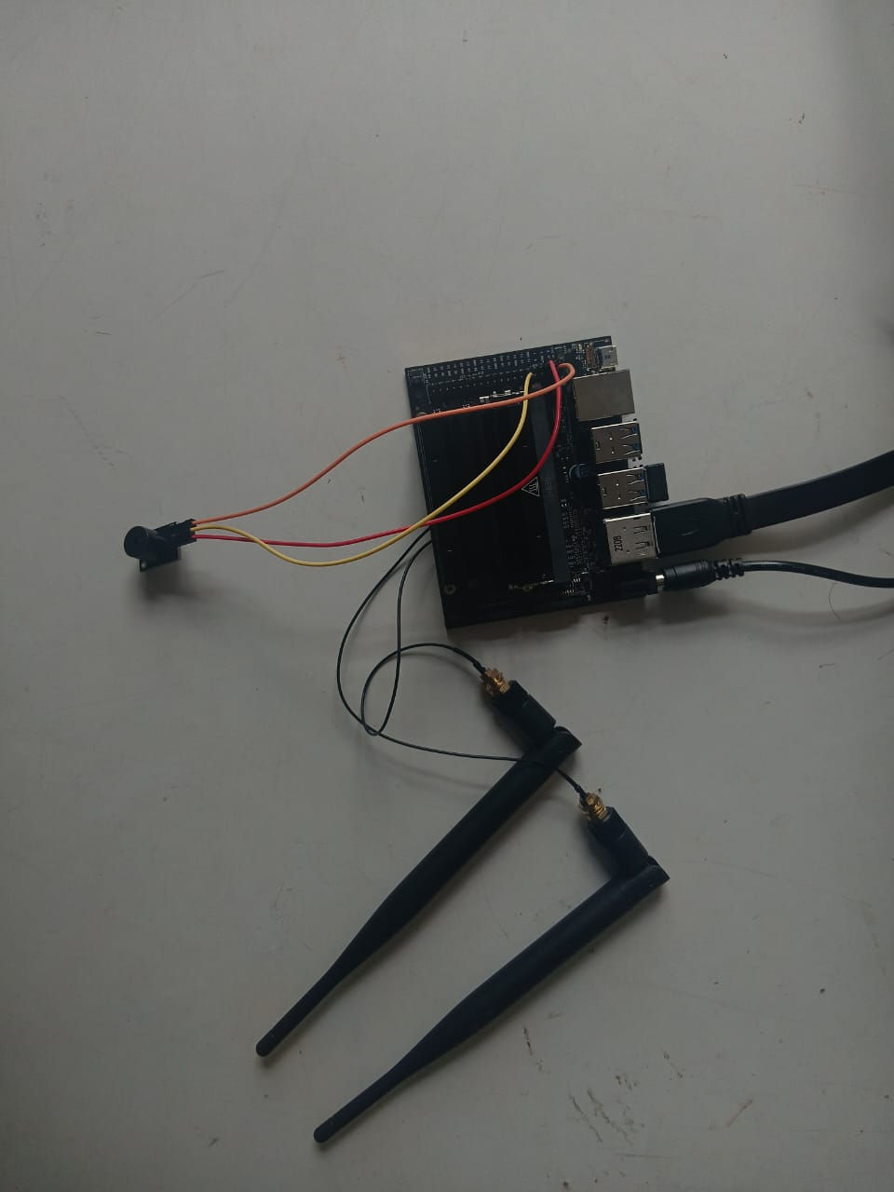
Hardware Development

Slide 21
Components used & Justification of their selection
Component | Justification for Selection
Jetson Nano | Chosen as the main processing unit due to its GPU-accelerated deep learning capability, enabling real-time YOLO model execution with low latency on an edge platform.
Camera Module | Selected to capture images, allowing reliable elephant detection during night-time and low-visibility conditions.
YOLO Deep Learning Model | Used for its real-time object detection performance, high accuracy, and efficient deployment on edge devices like Jetson Nano.
Buzzer (Alert Unit) | Provides immediate on-site audio alerts when elephant presence is detected, ensuring rapid local warning.

Slide 22
Experimental Results
Elephants were successfully detected from live video in real time.
Detection accuracy improved after training and optimization of the YOLO model.
High-confidence thresholds reduced false alerts.
The system ran stably on Jetson Nano with low latency.
Visual outputs and alert mechanisms were triggered correctly upon detection.

Slide 23
Analyses of experimental results/data
Training the YOLO model with images resulted in a noticeable improvement in detection accuracy.
The use of a high confidence threshold effectively reduced false detections during testing.
Real-time inference on Jetson Nano showed low latency and stable performance.
The system performed reliably under low-light and night-time conditions using thermal inputs.
End-to-end testing confirmed correct coordination between detection, visualization, and alert triggering.

Slide 24
Work plan for Review 3
Design and develop the user interface (UI) for real-time monitoring and alerts in the human–elephant conflict mitigation system.
Integrate the alert interface to display elephant detection status, location, and warning notifications.
Design and implement the alarm/buzzer module for immediate on-site warning when elephant presence is detected.
Interface the buzzer system with the detection logic to ensure automatic triggering during threat conditions.
Test and validate the UI responsiveness and buzzer alert functionality under simulated detection scenarios.

Slide 25
Financial Plan
Equipment/Component
JETSON NANO | 37000
CAMERA | 700

Slide 26



Mapping of the Project with SDGs
SDG 9 – Industry, Innovation, and Infrastructure:
Applies modern technologies like AI, sensors, and data-driven solutions to solve real-world ecological problems.
SDG 11 – Sustainable Cities and Communities:
Provides a safer living environment for communities living near forests by reducing unexpected elephant intrusions.
Strengthens community resilience and preparedness through early warning systems and education
SDG 15 – Life on Land:
The project directly contributes to protecting, restoring, and promoting the sustainable use of terrestrial ecosystems.
By reducing human-elephant conflict, it helps in the conservation of the endangered Asian elephant and their natural habitats.

Slide 27
Team Dynamics (includes team member contributions, team member recognition, team motivation)
Team Member | Contribution | Recognition | Motivation
G.G Jegadheeshwaran | Prepared the dataset by extracting frames from elephant and stock videos, labeling them across varied poses, lighting, and environments. This created a diverse dataset that strengthened the model’s training and reliability. | Recognized as the dataset specialist for ensuring the training data was clean and diverse. | Motivated by contributing to the foundation that improves the model’s accuracy and robustness.

Slide 28
Team Dynamics (includes team member contributions, team member recognition, team motivation)
Team Member | Contribution | Recognition | Motivation
Hamebantei K Tangsang | Led the transition from image-based detection to video-based detection. Took initiative in exploring video datasets and ensuring that real-time performance requirements were addressed. | Recognized as the strategic planner who guided the shift toward a more practical solution. | Motivated by the vision of building a system that works effectively in real-world scenarios.

Slide 29
Team Dynamics (includes team member contributions, team member recognition, team motivation)
Team Member | Contribution | Recognition | Motivation
Arnab Sheoran | Implemented and fine-tuned the deep learning model (YOLO/Mobile Net) for real-time detection and prepared it for integration with surveillance systems. | Recognized as the technical expert who ensured the model could run efficiently in real-time. | Motivated by the challenge of achieving reliable detection and building an early warning system that benefits communities.

Slide 30
Societal Impact of the Project
Enhances safety for villagers living near forest areas by reducing sudden human-elephant encounters.
Protects agricultural livelihoods by preventing crop destruction and property damage caused by elephant intrusions.
Provides timely alerts to both local communities and forest officials, allowing quick response and damage control.
Improves psychological well-being of residents by reducing fear and anxiety related to wildlife conflicts.
Supports peaceful coexistence between humans and wildlife, encouraging a balanced and sustainable environment.
Aligns with SDGs, especially in wildlife protection, sustainable communities, and responsible innovation.
Scalable and replicable model for other regions in India and globally facing similar human-wildlife conflict issues.

Slide 31
References
Morrison, J., Chatterjee, M., Ramkumar, K., Tiwari, S., Walker, S. L., Wilson, S., & Zimmermann, A. (2025). Spatiotemporal distribution of negative human-elephant interactions in Wayanad district, Kerala, India. Global Ecology and Conservation, 62, e03742. https://doi.org/10.1016/j.gecco.2025.e03742
M. Jothibasu, M. Sowmiya, R. Harsha, K.S. Naveen, T.B. Suriyaprakash, Improvement of computer vision-based elephant intrusion detection system (EIDS) with deep learning models, Innov. Eng. AI Appl. (2023) 131–153.
Gunaratna, C., Rajendran, M., Sundaram, S., & Prasad, R. (2024). Deep learning for real-time wildlife intrusion detection with colour distribution preserved GANs. Ecological Informatics, 78, 102362. https://doi.org/10.1016/j.ecoinf.2024.102362
Rathnayake, C. W., Jones, S., Soto-Berelov, M., & Wallace, L. (2020). A geospatial approach for mapping and predicting human–elephant conflict. Ecological Informatics, 56, 101065. https://doi.org/10.1016/j.ecoinf.2020.101065
Dutta, S., Ghosh, S., & Kumar, A. (2021). Intelligent detection and alert system to prevent railway accidents due to elephant crossing. Materials Today: Proceedings. https://doi.org/10.1016/j.matpr.2021.01.161

Slide 32
Thank You !

