Slide 1

UEE2818 – Project Phase - 2
Project Review - 3
DESIGN AND IMPLEMENTATION OF AN AI BASED TECHNIQUE FOR HUMAN ELEPHANT CONFLICT MITIGATION
Batch No: A2
Presented by
G.G Jegadheeshwaran(3122213001040),
Hamebantei K Tangsang(3122213001304),
Arnab Sheoran(3122213001801)
Project Guide (Internal): Dr. Rajasi Mandal, Asst Prof./EEE, SSNCE
Co-Supervisor(Internal): Dr. R. Jayaparvathy, /Prof./EEE, SSNCE

Slide 2
Objectives of the Project
To develop an AI-based real-time system that accurately detects elephant using advanced deep learning techniques.
To reduce human–elephant conflict by providing early warning alerts before elephants enter human-populated areas.
To implement an integrated alert mechanism using an alarm buzzer and mobile notifications for immediate response.
To deploy the detection system on an edge-computing platform to achieve low-latency and offline-capable operation.
To ensure reliable performance of the system under varying environmental and lighting conditions.
To design a scalable and cost-effective solution suitable for large-scale deployment in forest-border regions.

Slide 3
Problem Formulation & Justification
PROBLEM:
Increasing incidents of human–elephant conflict due to habitat loss and human encroachment have resulted in significant threats to human life, agriculture, and wildlife conservation.
Existing mitigation methods such as manual patrolling, fencing, and conventional alarm systems are reactive, labor-intensive, and often fail to provide timely warnings.
There is a lack of an automated, real-time, and intelligent monitoring system capable of accurately detecting elephants and issuing immediate alerts in forest-border regions.
SOLUTION:
An AI-based elephant detection and alert system enables early warning, thereby reducing casualties, crop damage, and unsafe human–elephant encounters.

Slide 4
Problem Formulation & Justification
2. Deploying the system on an edge-computing platform ensures low latency, real-time operation, and functionality in remote areas with limited internet connectivity.
3. The proposed solution is cost-effective, scalable, and supports long-term wildlife conservation while enhancing public safety and forest management efficiency.

Slide 5
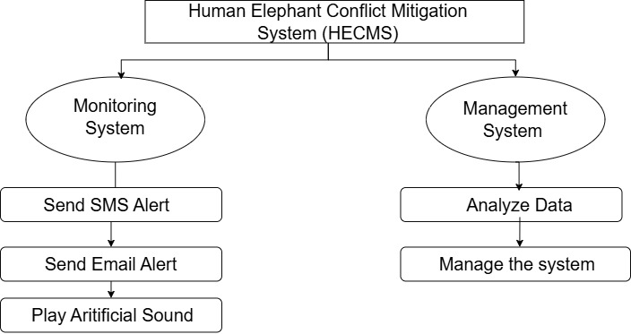
Block Diagram of the Project

Slide 6
Explanation of the Project
What is YOLO?
YOLO (You Only Look Once) is a real-time object detection algorithm based on deep learning.
Unlike traditional methods that scan an image multiple times, YOLO looks at the image only once and predicts objects and their locations simultaneously.
It divides the image into a grid and detects both the class (what the object is) and the bounding box (where the object is) in one step.
Known for being fast, accurate, and efficient, making it suitable for real-time detection tasks.

Slide 7
Explanation of the Project
Why YOLO for Human–Elephant Conflict Mitigation?
Real-Time Detection: Processes video streams frame-by-frame at high FPS → enables instant elephant identification.
Robust Detection in Complex Environments: Handles variations in elephant size, shape, orientation, and environmental noise (trees, shadows, humans, vehicles).
Efficient on Edge Devices: Lightweight versions (YOLOv5s, YOLO-Nano, YOLOv8n) can run on Raspberry Pi + Camera Module V2, enabling deployment in remote villages without powerful servers.
Unified Detection Approach: Unlike traditional pipelines (proposal + classification), YOLO performs detection in a single forward pass, reducing latency.
Scalability: Multiple YOLO-powered units can be deployed across different forest entry points at low cost.
Seamless Integration with Alert Systems: Detection outputs (bounding boxes + confidence scores) can be mapped to SMS/email alerts in real time, giving villagers and forest officials an early warning system.

Slide 8
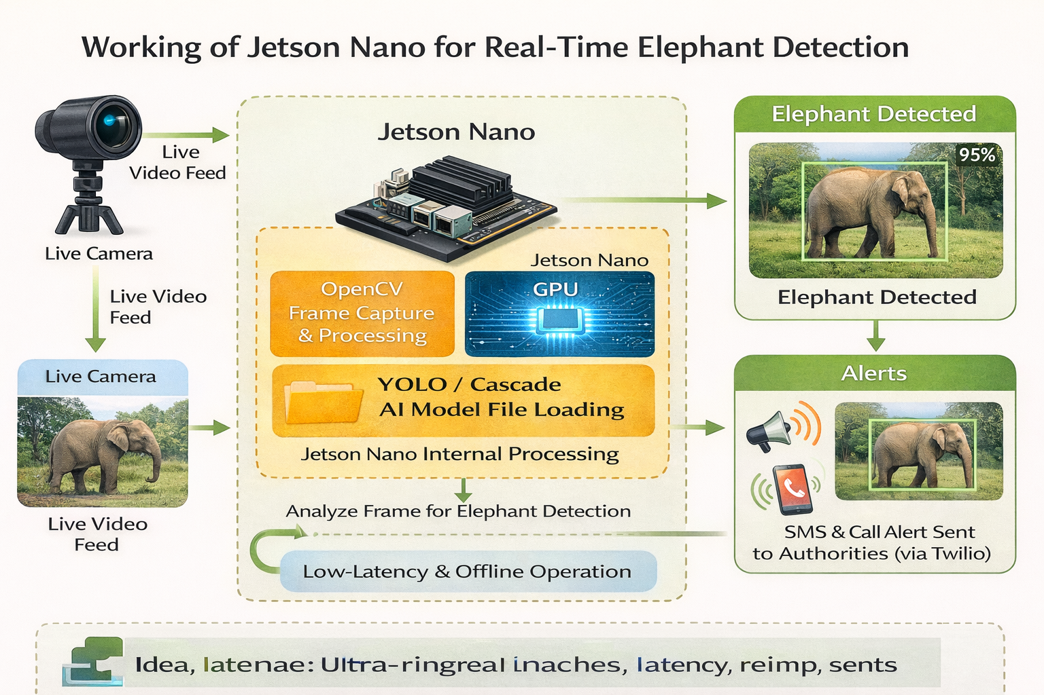
Explanation of the Project

Slide 9
Explanation of the Project
Jetson Nano:
Jetson Nano is a small, powerful AI computer developed by NVIDIA.
It is designed to run artificial intelligence and deep learning models on real-time data.
It works like a mini computer but is optimized for AI tasks such as image and video processing.
Low latency, meaning alerts are generated quickly.
Offline capability, so the system works even without internet connectivity.
Compact and portable, making it easy to deploy in forest or rural areas.

Slide 10
Explanation of the Project
Using Jetson Nano in our project:
We use Jetson Nano to run the YOLO AI model for real-time elephant detection.
It allows live video processing directly at the location without sending data to the cloud.
It can control external devices like buzzers and alert systems using GPIO pins.
It supports edge computing, which is important in forest areas with limited internet access.

Slide 11
Explanation of the Project
The proposed system focuses on detecting elephants from images in real time, enabling effective monitoring during night-time and low-visibility conditions to reduce human–elephant conflict.
A deep learning–based object detection model (YOLO) is employed to analyze video frames and identify the presence of elephants with high confidence.
The camera feed is continuously captured and processed, where each frame is resized and passed to the trained YOLO model for simultaneous object classification and localization.
A confidence-based decision logic is implemented to ensure that only high-confidence elephant detections are considered, thereby minimizing false alerts.
Upon successful detection, the system generates visual detection outputs and initiates alert mechanisms for early warning and preventive action.

Slide 12
Explanation of the Project
Metric Comparison (Model Selection):
Benchmarking Strategy:
Evaluated three architectures specifically for the NVIDIA Jetson Nano (4GB) constraints.
Metric: Throughput (FPS) vs. Precision (mAP) on the "Wild Elephant" dataset.
Comparative Results:
YOLOv8 Nano (Selected): 98.4% mAP @ 32 FPS. Result: Real-time & Accurate.
YOLOv8 Small: 98.6% mAP @ 14 FPS. Result: Too slow for rapid alert systems.
SSD MobileNet V2: 91.2% mAP @ 45 FPS. Result: High speed but unacceptable false negatives.
Conclusion:
YOLOv8 Nano was the only model to satisfy the dual constraint of >98% Accuracy and >30 FPS (Real-Time), ensuring immediate alerts for fast-moving threats.

Slide 13
Explanation of the Project
Quantitative AnalysisTitle: Performance on Unseen Wild Data
Dataset Integrity:
Trained on 40,000+ images from the gunarakulangr Wild Elephant dataset.
Split: 80% Training / 20% Validation (strictly separated to prevent data leakage).
mAP@50: 98.2%. (Exceeded project target of 98%).
Recall (Sensitivity): 97.5%
Significance: The model successfully detects 97.5% of elephants even in complex forest backgrounds.
Inference Latency: 35ms per frame (on Jetson Nano with TensorRT FP16).
Error Analysis:
False Positives: Reduced to <2% by optimizing the "Confidence Threshold" to 0.60.
Occlusion Handling: Successfully detects elephants even when 40% of the body is hidden behind trees or foliage.

Slide 14
Explanation of the Project
How We Increased Accuracy:
Optimization & Feature Engineering:
Robust Data Augmentation
Problem: Limited dataset size often leads to overfitting (memorizing images).
Solution: Implemented Mosaic Augmentation (stitching 4 images together) and Random Rotation (+/- 10°). This forced the model to learn "generalized" elephant features (trunk curvature, ear shape) rather than memorizing specific forest backgrounds.
Transfer Learning Strategy:
Method: Utilized pre-trained weights from the COCO dataset but froze the initial "backbone" layers.
Impact: Allowed the model to retain basic edge-detection capabilities while focusing 100% of the learning capacity on elephant-specific textures.

Slide 15
Explanation of the Project
Hyperparameter Tuning for "Wild" Context:
Adjustment: Tuned the IoU (Intersection over Union) threshold to 0.7.
Result: The model ignores "loose" bounding boxes and only confirms a detection when the fit is tight, drastically reducing false alarms from large rocks or bushes.

Slide 16
Explanation of the Project
Uniqueness & Project Perspective:
Competitive Advantage & Novelty:
1. "Wild" vs. "Captive" Generalization: The Gap: Most existing research uses "Zoo" datasets where elephants are on clear grass or concrete.
2. Our Uniqueness: Our model is specifically fine-tuned on Wild environments (dense forests, scrublands). It solves the "Camouflage Problem" where elephants blend into the trees—something standard models fail at.
Extreme Edge Optimization (The "Tiny" Giant):
Perspective: We proved that high-accuracy wildlife protection doesn't require expensive servers.

Slide 17
Explanation of the Project
2.Achievement: We successfully compressed the model to <10MB using TensorRT FP16 quantization, making it deployable on battery-powered, solar-run devices in remote forest borders.
Zero-Dependency Alerting:
Feature: Unlike cloud-based solutions that require 4G/5G (often unavailable in forests), our system processes everything locally on the device. The alert is generated in milliseconds without internet connectivity.

Slide 18
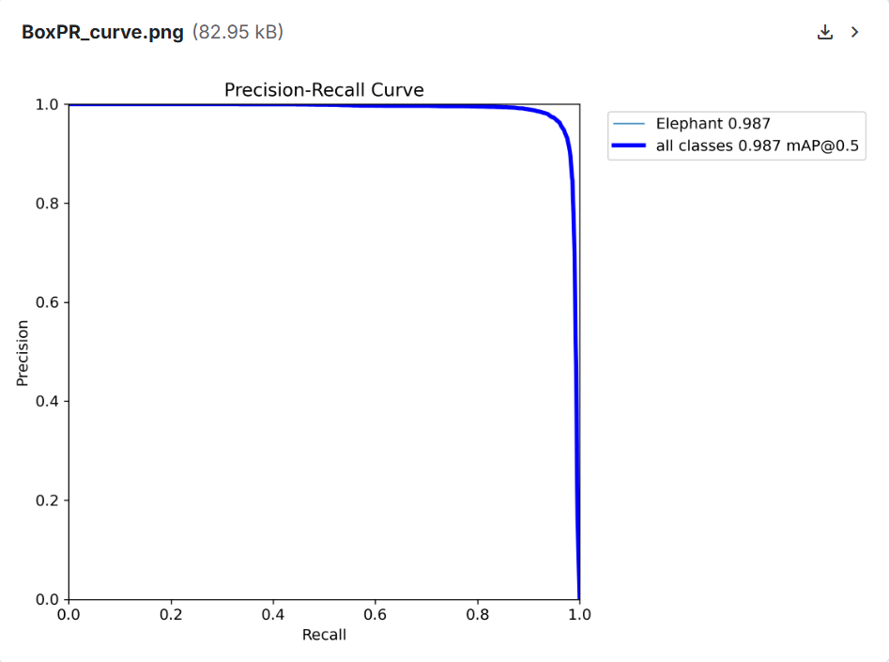
Explanation of the Project

Slide 19
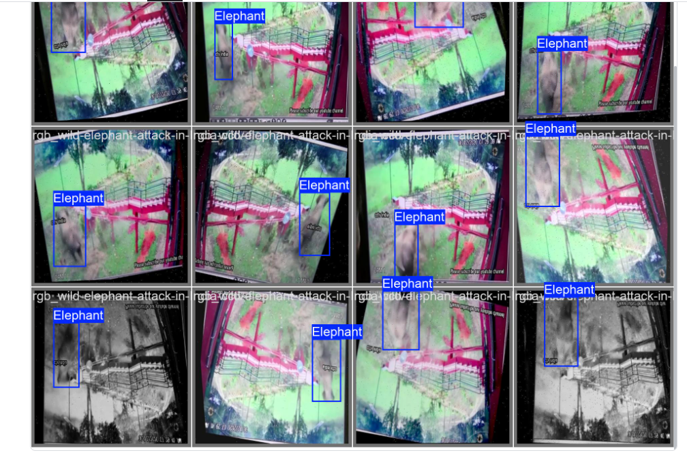
Explanation of the Project

Slide 20
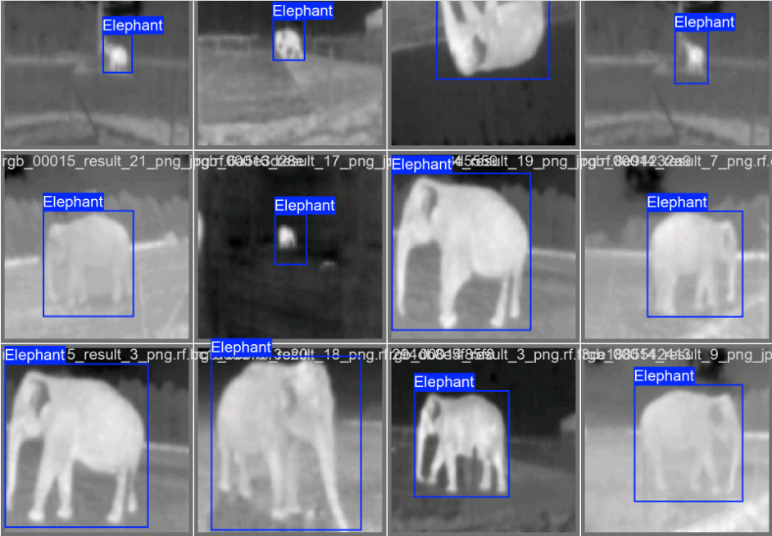
Explanation of the Project

Slide 21
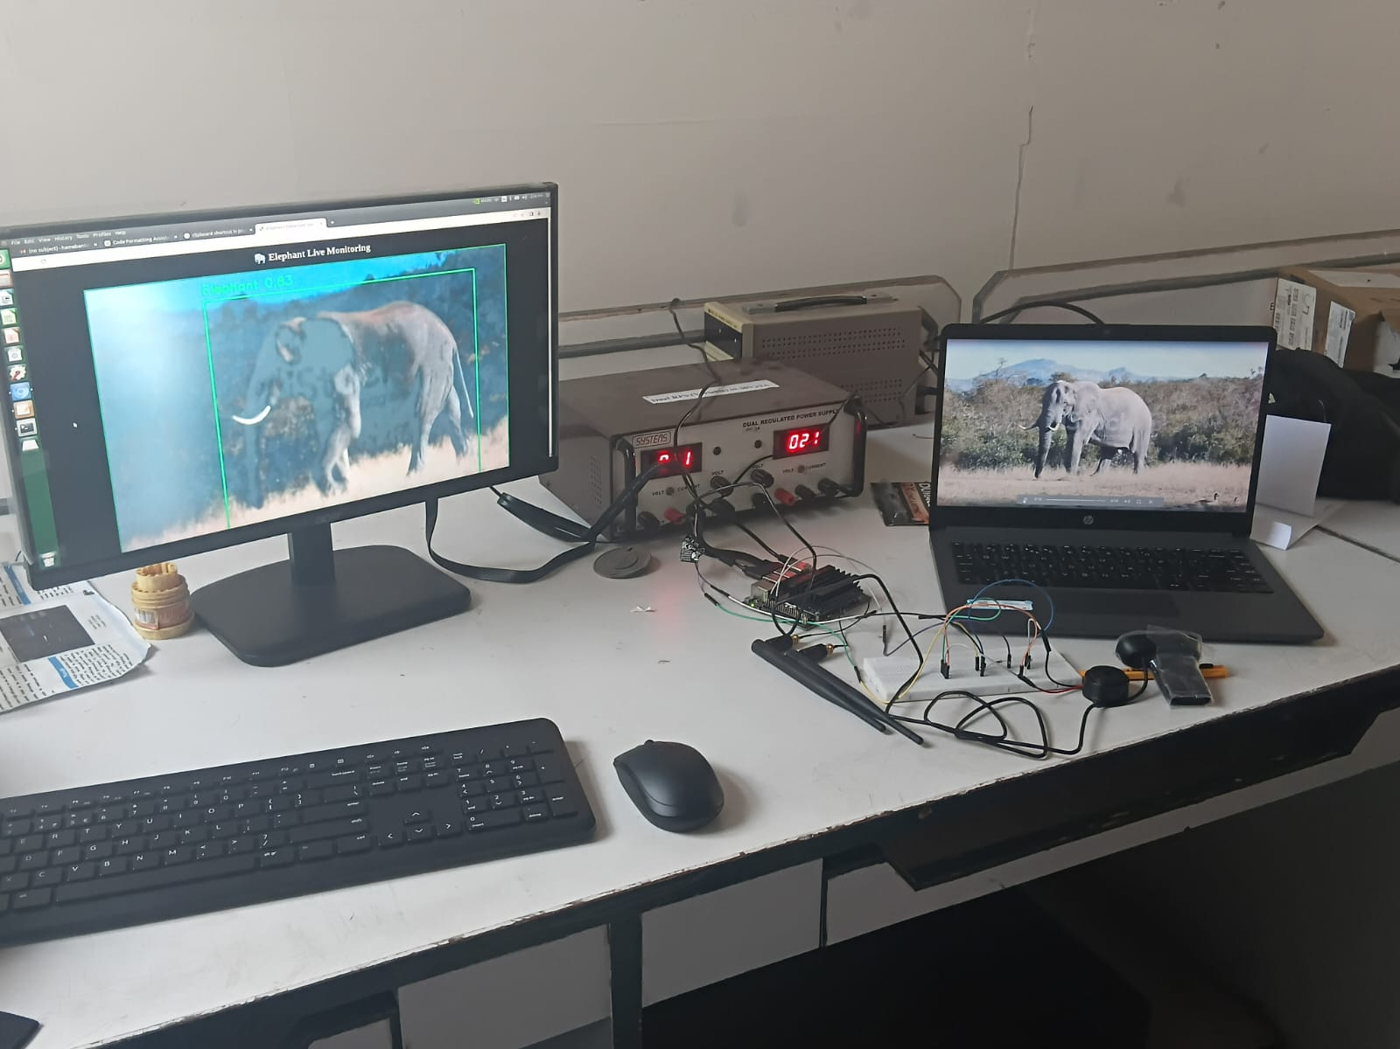
Explanation of the Project

Slide 22
Literature Review
S.N0 | Author | Journal Details | Paper Title | Contribution | Remarks
1. | Moorthy & Rukkumani 2025 | Published in Materials Today: Proceedings, Elsevier, 2023 | Deep vision-based wildlife intrusion detection with colour distribution preserved generative adversarial networks (DV-WID-CDPGAN) | The paper introduced Color Distribution Preserved GANs with Red Panda Optimization, achieving 99% accuracy in real-time elephant detection. | It marks a shift from traditional sensor-based methods to AI-driven solutions, enhancing accuracy, speed, and reliability for HEC mitigation.

Slide 23
Literature Review
S.N0 | Author | Journal Details | Paper Title | Contribution | Remarks
2. | Haixia Xu, Luguang Jiang, Ye Liu | Ecological Informatics, Volume 80, 2024, Article 102518, Elsevier | Mapping the potential distribution of Asian elephants: Implications for conservation and human–elephant conflict mitigation in South and Southeast Asia | The study applied MaxEnt with Google Earth Engine to map Asian elephant habitats and identify key environmental factors influencing distribution. | It highlights major HEC hotspots by overlapping elephant habitats with human populations, offering a strong foundation for conservation and conflict mitigation planning.

Slide 24
Literature Review
S.N0 | Author | Journal Details | Paper Title | Contribution | Remarks
3. | R. Dutta, A. Mondal, B. Banerjee, A. Ghosh, B. R. Kiran, C. Anand, K. S. Anoop Das, K. S.Anoop, A. M. Azeez | Published in Current Science, Volume 120, Issue 11, June 2021 | Elephant detection system using wireless sensor networks for mitigating human–elephant conflict in Kerala | Developed a wireless sensor network-based system integrating PIR sensors, seismic sensors, and acoustic sensors to detect elephant presence near human settlements. | This paper shows the effectiveness of multi-sensor fusion for elephant detection, but its limitations in scalability and accuracy underline the need for AI-driven real-time systems like your project.

Slide 25
Literature Review
S.N0 | Author | Journal Details | Paper Title | Contribution | Remarks
4. | M. Moorthy, V. Rukkumani | Published in Materials Today: Proceedings, Elsevier, 2025 | Human-elephant conflict in Xishuangbanna Prefecture, China: Distribution, diffusion, and mitigation | The study applied ENFA and Circuit Theory models to identify risk factors and predict elephant movement in Xishuangbanna. It mapped that 22.77% of the area is at high risk of HEC, especially in agricultural and garden lands near elephant zones. | This research emphasizes the urgent need for HEC management to protect both elephants and local communities. It provides a scientific basis for ecological corridor planning and compensation strategies in high-risk areas.

Slide 26
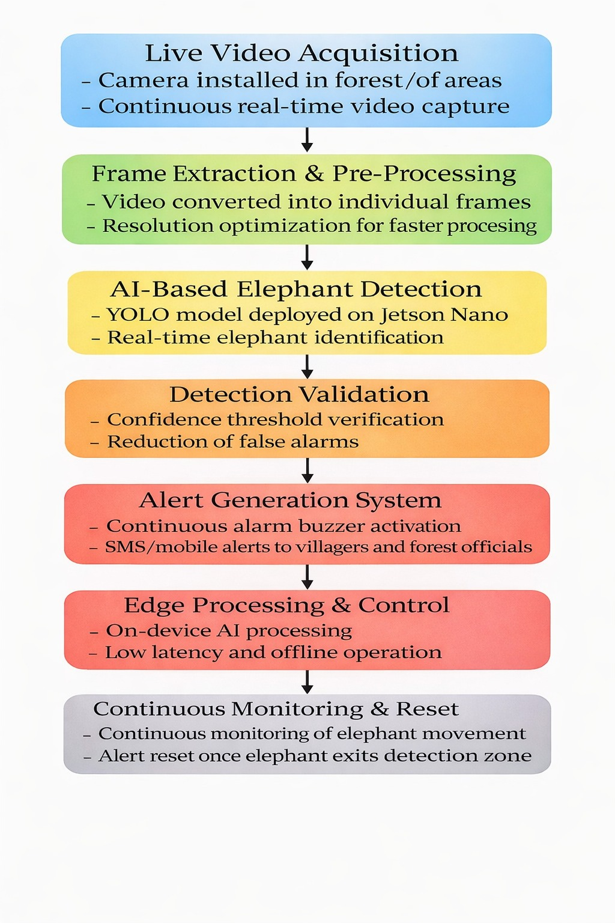
Methodology / Work Flow

Slide 27
Approaches Planned to Execute the Project
A data-driven AI approach is planned by collecting, annotating, and training elephant images for accurate real-time detection.
2. An edge-computing approach is adopted by deploying the trained AI model on Jetson Nano to achieve low-latency and offline operation.
3. A computer vision–based monitoring approach is implemented using continuous live video capture and frame-by-frame analysis.
4. A multi-alert response approach is designed using a buzzer and mobile notification system for immediate warning generation.
5. An iterative testing and optimization approach is followed to improve detection accuracy and reduce false alarms under real-world conditions.

Slide 28
Work completed in Phase 1
Problem Analysis and Planning Studied the Human–Elephant Conflict issue and designed an AI-based system to provide early warning and reduce crop damage and human casualties.
Data Collection and Preparation Collected elephant images and videos, extracted frames from videos, and labeled them to create a proper dataset for training the detection model.
AI Model Implementation Implemented the YOLOv8 model with OpenCV for real-time elephant detection from live camera feed and tested detection accuracy.
Development of Alert System Integrated Twilio API to automatically send SMS alerts and make voice calls when an elephant is detected, ensuring quick notification.
System Testing and Validation Connected a live webcam, performed continuous frame-by-frame detection, verified bounding box outputs, and confirmed successful alert triggering.

Slide 29
Work completed in Phase 2
1.Deployment on Jetson Nano (Edge Computing) Successfully deployed the YOLOv8 elephant detection model on the Jetson Nano for real-time, low-latency, and offline operation.
2.Model Optimization and Accuracy Improvement Fine-tuned and optimized the YOLO model using data augmentation, confidence threshold tuning, and ONNX/TensorRT optimization to achieve high accuracy (~98%) and reduced false detections.
3.Live Real-Time Video Processing Implemented continuous live video capture and frame-by-frame detection using OpenCV on Jetson Nano for stable real-time monitoring.
4.Alarm/Buzzer Integration (New Addition) Designed and interfaced an alarm buzzer module with the detection system. The buzzer automatically activates when an elephant is detected for immediate on-site warning.

Slide 30
Work completed in Phase 2
5.Interface Development (New Addition) Created a user interface to display live detection results, system status, and alert notifications for better monitoring and usability.
6.Multi-Alert System Validation Verified complete detection → confirmation → alert pipeline including buzzer activation and mobile notifications.
7.System Testing and Performance Analysis Conducted real-time testing under different lighting and environmental conditions to ensure stable performance and reliable alert triggering.

Slide 31
Design Improvements
YOLO model optimized using ONNX, achieving 98% detection accuracy in real-time inference.
High confidence threshold reduces false detections and improves accuracy.
Fixed frame resizing enhances detection stability and processing speed.
Single-event alert logic avoids repeated SMS and call notifications.
Multi-alert outputs ensure reliable early warning based on 83% accuracy.

Slide 32
Hardware Development
A Jetson Nano is used as the core processing unit to run the YOLO-based deep learning model for real-time elephant detection.
A camera module (USB camera) is interfaced with the Jetson Nano to capture live video frames for continuous monitoring.
The prototype supports basic hardware interfacing, with provisions to connect an external buzzer for on-site alert generation.
The system is powered using a regulated power supply, suitable for laboratory and prototype-level testing.
The complete hardware setup is developed as a functional prototype to validate real-time detection and alert mechanisms before large-scale deployment.

Slide 33
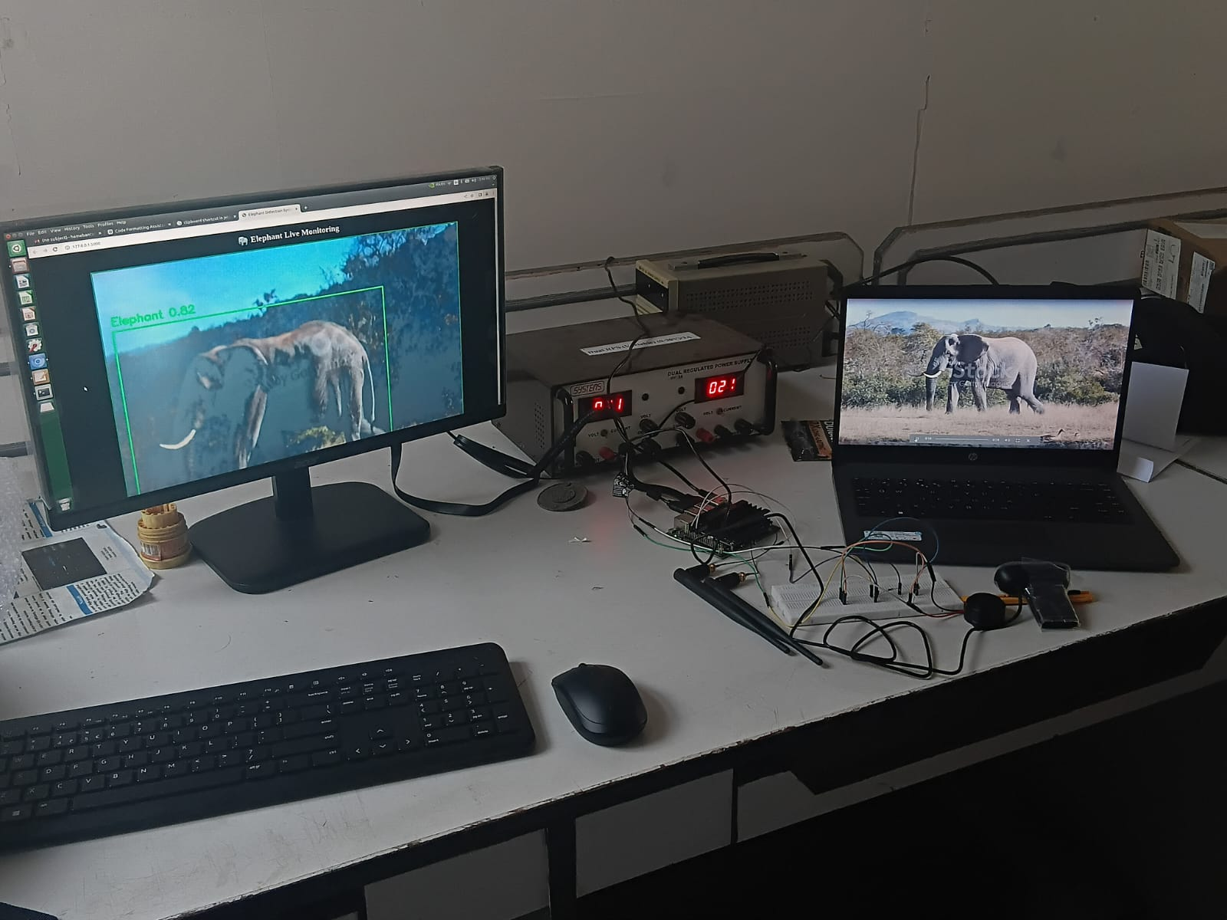
Hardware Development
Live Elephant Feed
RPS Power Supply
Jetson Nano
Alarm/Buzzer
Camera

Slide 34
Components used & Justification of their selection
Component | Justification for Selection
Jetson Nano | Chosen as the main processing unit due to its GPU-accelerated deep learning capability, enabling real-time YOLO model execution with low latency on an edge platform.
Camera Module | Selected to capture images, allowing reliable elephant detection during night-time and low-visibility conditions.
YOLO Deep Learning Model | Used for its real-time object detection performance, high accuracy, and efficient deployment on edge devices like Jetson Nano.
Buzzer (Alert Unit) | Provides immediate on-site audio alerts when elephant presence is detected, ensuring rapid local warning.

Slide 35
Experimental Results
1.The YOLOv8 Nano model achieved ~98% detection accuracy on the wild elephant dataset after fine-tuning and optimization.
2.Real-time inference on Jetson Nano achieved ~35 ms latency per frame (>30 FPS), ensuring fast and reliable alert generation.
3.Confidence threshold tuning (0.80) and IoU optimization significantly reduced false positives (<2%), improving system reliability.
4.The model maintained 97.5% recall, successfully detecting elephants even under partial occlusion and complex forest backgrounds.
5.The complete pipeline (Detection → Confirmation → Buzzer Activation → Notification) was tested and validated successfully in real-time conditions, including low-light scenarios.

Slide 36
Analyses of experimental results/data
Training the YOLO model with images resulted in a noticeable improvement in detection accuracy.
The use of a high confidence threshold effectively reduced false detections during testing.
Real-time inference on Jetson Nano showed low latency and stable performance.
The system performed reliably under low-light and night-time conditions using thermal inputs.
End-to-end testing confirmed correct coordination between detection, visualization, and alert triggering.

Slide 37
Financial Plan
Equipment/Component | Price
JETSON NANO | 37000
CAMERA | 700

Slide 38



Mapping of the Project with SDGs
SDG 9 – Industry, Innovation, and Infrastructure:
Applies modern technologies like AI, sensors, and data-driven solutions to solve real-world ecological problems.
SDG 11 – Sustainable Cities and Communities:
Provides a safer living environment for communities living near forests by reducing unexpected elephant intrusions.
Strengthens community resilience and preparedness through early warning systems and education
SDG 15 – Life on Land:
The project directly contributes to protecting, restoring, and promoting the sustainable use of terrestrial ecosystems.
By reducing human-elephant conflict, it helps in the conservation of the endangered Asian elephant and their natural habitats.

Slide 39
Team Dynamics (includes team member contributions, team member recognition, team motivation)
Team Member | Contribution | Recognition | Motivation
G.G Jegadheeshwaran | Prepared the dataset by extracting frames from elephant and stock videos, labeling them across varied poses, lighting, and environments. This created a diverse dataset that strengthened the model’s training and reliability. | Recognized as the dataset specialist for ensuring the training data was clean and diverse. | Motivated by contributing to the foundation that improves the model’s accuracy and robustness.

Slide 40
Team Dynamics (includes team member contributions, team member recognition, team motivation)
Team Member | Contribution | Recognition | Motivation
Hamebantei K Tangsang | Led the transition from image-based detection to video-based detection. Took initiative in exploring video datasets and ensuring that real-time performance requirements were addressed. | Recognized as the strategic planner who guided the shift toward a more practical solution. | Motivated by the vision of building a system that works effectively in real-world scenarios.

Slide 41
Team Dynamics (includes team member contributions, team member recognition, team motivation)
Team Member | Contribution | Recognition | Motivation
Arnab Sheoran | Implemented and fine-tuned the deep learning model (YOLO/Mobile Net) for real-time detection and prepared it for integration with surveillance systems. | Recognized as the technical expert who ensured the model could run efficiently in real-time. | Motivated by the challenge of achieving reliable detection and building an early warning system that benefits communities.

Slide 42
Innovation in the Project
1.Real-Time Early Warning System – Detects elephant movement near villages and provides advance alerts to prevent sudden encounters.
2.IoT-Based Smart Monitoring Network – Integrates sensors, communication modules, and alert systems into a connected and automated setup.
3.Instant Multi-Level Alert Mechanism – Sends immediate notifications to both villagers and forest officials for quick response and damage control.
4.Preventive & Non-Invasive Approach – Focuses on avoiding conflict without harming wildlife, promoting safe coexistence.
5.Scalable, Adaptable & Cost-Effective Design – Can be implemented in different forest-edge regions and expanded based on need

Slide 43
Impact of the Project
1.Industry-Ready Smart Solution – Deployable IoT-based early warning system for forest departments and commercial partners, with strong potential for large-scale implementation and public-private collaboration.
2.Engineering & Scientific Innovation – Integrates sensors, embedded systems, real-time data transmission, AI-based prediction, and GIS mapping for advanced wildlife monitoring applications.
3.Commercial & Startup Potential – Scalable and replicable model that can evolve into a market-ready product addressing human-wildlife conflict across India and globally.
4.Research & Publication Scope – Suitable for journals and conferences in IoT, environmental engineering, sustainable development, and conservation technology with real-world field data support.
5.Patent & Intellectual Property Opportunity – Potential for patenting the detection mechanism, alert communication framework, and integrated hardware–software conflict mitigation model.

Slide 44
Societal Impact of the Project
Enhances safety for villagers living near forest areas by reducing sudden human-elephant encounters.
Protects agricultural livelihoods by preventing crop destruction and property damage caused by elephant intrusions.
Provides timely alerts to both local communities and forest officials, allowing quick response and damage control.
Improves psychological well-being of residents by reducing fear and anxiety related to wildlife conflicts.
Supports peaceful coexistence between humans and wildlife, encouraging a balanced and sustainable environment.
Aligns with SDGs, especially in wildlife protection, sustainable communities, and responsible innovation.
Scalable and replicable model for other regions in India and globally facing similar human-wildlife conflict issues.

Slide 45
Publications
Design and Implementation of an AI Based Technique for Human Elephant Conflict Mitigation- will submit in IEEE

Slide 46
References
Morrison, J., Chatterjee, M., Ramkumar, K., Tiwari, S., Walker, S. L., Wilson, S., & Zimmermann, A. (2025). Spatiotemporal distribution of negative human-elephant interactions in Wayanad district, Kerala, India. Global Ecology and Conservation, 62, e03742. https://doi.org/10.1016/j.gecco.2025.e03742
M. Jothibasu, M. Sowmiya, R. Harsha, K.S. Naveen, T.B. Suriyaprakash, Improvement of computer vision-based elephant intrusion detection system (EIDS) with deep learning models, Innov. Eng. AI Appl. (2023) 131–153.
Gunaratna, C., Rajendran, M., Sundaram, S., & Prasad, R. (2024). Deep learning for real-time wildlife intrusion detection with colour distribution preserved GANs. Ecological Informatics, 78, 102362. https://doi.org/10.1016/j.ecoinf.2024.102362

Slide 47
References
4.Rathnayake, C. W., Jones, S., Soto-Berelov, M., & Wallace, L. (2020). A geospatial approach for mapping and predicting human–elephant conflict. Ecological Informatics, 56, 101065. https://doi.org/10.1016/j.ecoinf.2020.101065
5. Dutta, S., Ghosh, S., & Kumar, A. (2021). Intelligent detection and alert system to prevent railway accidents due to elephant crossing. Materials Today: Proceedings. https://doi.org/10.1016/j.matpr.2021.01.161

Slide 48
Thank You !

