Slide 1



Title: Water Quality Prediction
Intern: ARNAB SARKAR
AICTE Student ID: STU63f851e659f9a1677218278
Internship ID:INTERNSHIP_1746416864681834e0e35d8

Slide 2

Learning Objectives:
Process and clean water quality datasets
Use multi-output regression for pollutant prediction
Train models and evaluate accuracy
Forecast pollution from 2022 to 2100
Visualize year-wise trends in pollutants
Save models for future use
Apply ML to environmental planning
Highlight ML’s role in sustainability efforts
GOAL
Source :
www.freepik.com/

Slide 3
Tools and Technology used:
Purpose | Tool/Library
Programming Language | Python
Data Handling | pandas, numpy
Machine Learning | scikit-learn (LinearRegression, RandomForestRegressor, MultiOutputRegressor, train_test_split, r2_score)
Model Serialization | joblib
Visualization | matplotlib
Deployment | Streamlit

Slide 4
Methodology:
Implemented a Multi-Output Regression approach to predict multiple pollutants simultaneously
Divided the dataset into 80% training and 20% testing using train_test_split
Used Linear Regression as the initial baseline model
Enhanced prediction accuracy through a Random Forest Regressor
Trained models on historical water quality data to enable long-term pollutant forecasting

Slide 5
Problem Statement:
The project aims to forecast the concentration levels of six major water pollutants — O₂, NO₃, NO₂, SO₄, PO₄, and Cl — across multiple water monitoring stations. By analyzing historical water quality data, the goal is to develop a machine learning model capable of predicting future pollution trends from 2022 to 2100. These insights can support proactive environmental management and policy planning.

Slide 6
Solution:
Data Cleaning & Preprocessing Handled missing values and converted date formats to extract year and month.
Feature Selection Selected station ID and year as input features; pollutants as output targets.
Model Building Used MultiOutputRegressor wrapped around RandomForestRegressor to predict O₂, NO₃, NO₂, SO₄, PO₄, and Cl.
Model Training & Evaluation Trained on 80% of the data; tested on 20%. Assessed performance using Mean Squared Error and R² Score.
Prediction & Serialization Accepted user input for station ID and year, generated future pollutant levels, and saved the model with joblib.

Slide 7
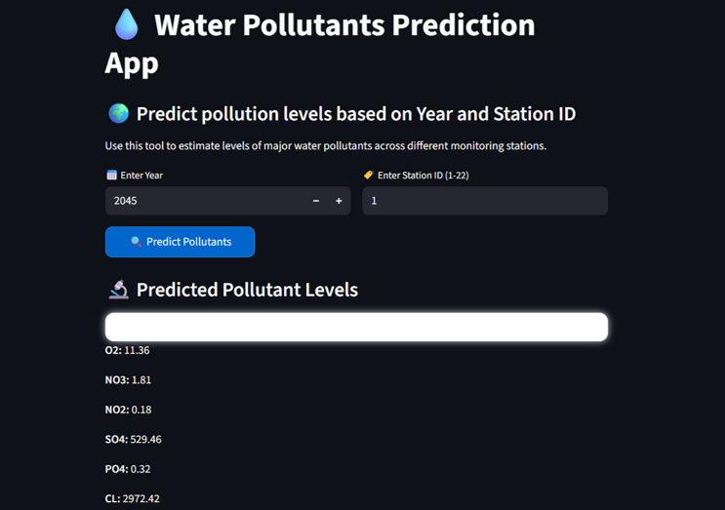
Screenshot of Output:

Slide 8
Conclusion:
The project aims to forecast the concentration levels of six major water pollutants — O₂, NO₃, NO₂, SO₄, PO₄, and Cl — across multiple water monitoring stations. By analyzing historical water quality data, the goal is to develop a machine learning model capable of predicting future pollution trends from 2022 to 2100. These insights can support proactive environmental management and policy planning.

