Slide 1
Hacking Environment Web Application
Detailed Developer Report

Slide 2
Security status – Extremely Vulnerable
Hacker can steal all records in Internshala databases(SQLi).
Hacker can take complete control of server including View, Add, Edit, Delete files and folders (Shell upload).
Hacker can change source code of application to host malware, phishing pages or even explicit content(Shell upload).
Hacker can include client side code into the application and trick the user and force them to give valuable information.
Hackers can execute any commands to extract information from the website and deface it.

Slide 3
Vulnerability statistics
Critical
8
11
Severe
High
4
6
Low

Slide 4
Vulnerability Index
Serial number | Severity | Vulnerabilities | count
1 | Critical | SQL Injections | 2
2 | Critical | Remote file inclusion | 1
3 | Critical | Admin panel access | 1
4 | Critical | Insecure file uploads | 1
5 | Critical | Seller account access | 1
6 | Critical | Default admin password | 1
7 | Critical | Components with known vulnerability | 3

Slide 5
Serial number | Severity | Vulnerabilities | count
8 | Critical | Customer account access | 1
9 | Severe | Forced Browsing | 1
10 | Severe | C.S.R.F. | 2
11 | Severe | Coupon code brute force | 1
12 | Severe | Insecure Direct Object Refer (IDOR) | 1
13 | Severe | Open Redirection | 1
14 | Severe | Cross Site Scripting | 2
15 | High | Client Side Filter Bypass | 1
16 | High | Directory Listing | 1
17 | High | PII Leakage | 2
18 | Low | Default debug pages | 4
19 | Low | Descriptive Error Messages | 2

Slide 6
1. S.Q.L. Injections
SQL | The below mentioned URL is venerable to SQL injections Affected URL http://13.233.3.245/products.php?cat=(here) http://13.233.3.245/search/search.php?q=(here) Affected parameters cat q Payload cat=1’ q=adidas’

Slide 7
Observations
At home page click on any 1 category.
Notice that the get category of cat and add ‘ . Observe the error.

Slide 8
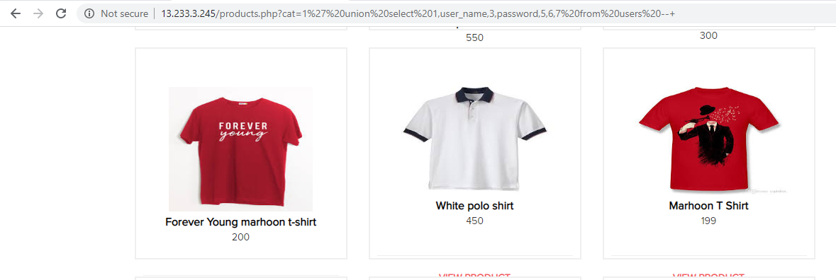
Observations
When we write http://13.233.3.245/products.php?cat=1’--+ the error is removed.
This confirms the SQL INJECTION.

Slide 9
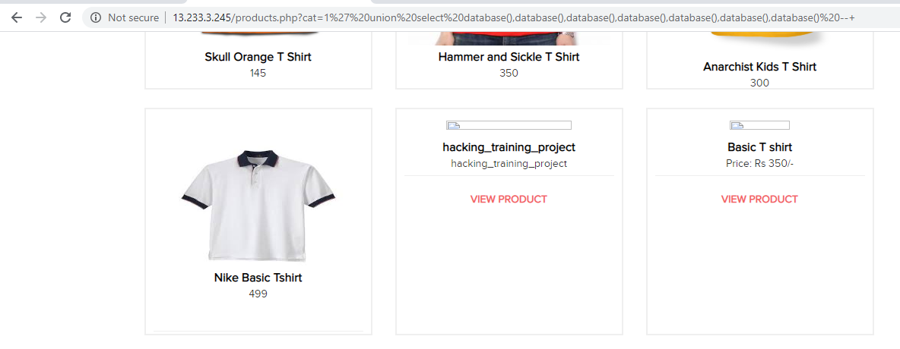
Proof of concept
Attacker can execute the SQL commands as shown below and access confidential data.

Slide 10
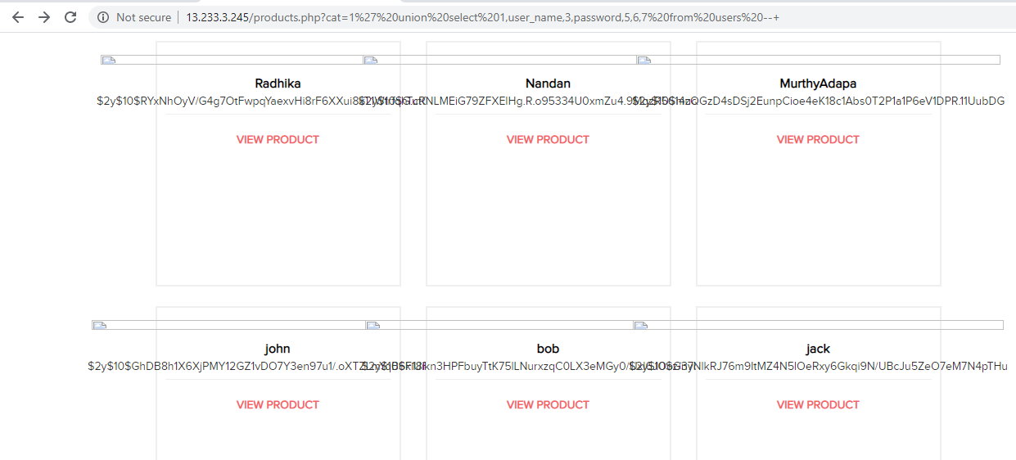
Business Impact- Extremely High
Using this vulnerability attacker can execute arbitrary SQL commands on Lifestyle store server and gain complete access to internal databases along with all customer data inside it.

Slide 11
Recommendations
Take the following precautions to avoid exploitation of SQL Injections:
Whitelist User Input: Whitelist all user input for expected data only. For example if you are expecting a flower name, limit it to alphabets only upto 20 characters in length.If you are expecting some ID, restrict it to numbers only.
Do not store password in plain text. Convert them to hashes using SHA1, SHA256, Blowfish, etc.
Do not run Database Service as admin/root user.
Character encoding : If you are taking input that requires you to accept special characters, encode it. Example- Convert all ‘ to \’ , “ to \” , \ to \\ . It is also suggested to follow a standard encoding for all special characters such as HTML encoding, URL encoding, etc.
Disable or remove defaukt accounts, passwords and databases.
Assign each Database user only the required permission and not all permissions.

Slide 12
References
https://www.owasp.org/index.php/SQL_Injection
https://en.Wikipedia.org/wiki/SQL_injection

Slide 13
2. Remote File Inclusion
RFI | Below mentioned URL is vulnerable to RFI Affected URL http://13.233.3.245/?includelang=(here) Payload ../../../../../../../etc/passwd https ://google.co.in

Slide 14
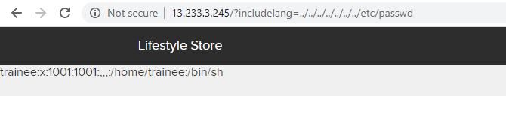
Observations
When you click on change language you get a get parameter of includelang which is vulnerable for file inclusion.
Here if we type ../../../../../../../etc/passwd as the payload after includelang we get the username as shown below.

Slide 15
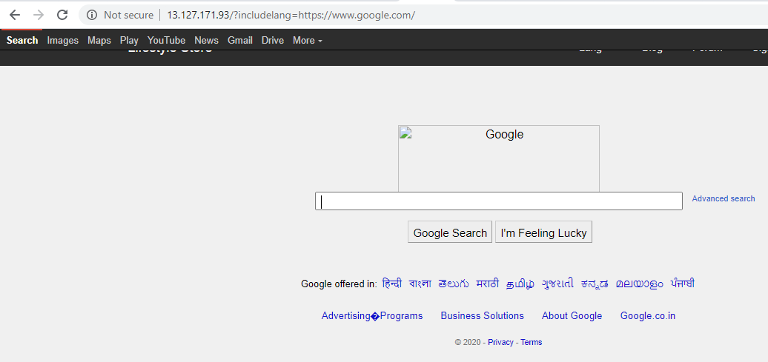
Proof of Concept
Attacker can exploit the referencing function in an application to upload malware (e.g., backdoor shells) from a remote URL located within a different domain.

Slide 16
Business impact – Extremely High
Any attacker can have the root access of your website.
He can execute commands.
Through the website he can have access of the server and can infect other websites hosted on that server.
He can even deface your website.

Slide 17
Recommendations
To safely parse user-supplied filenames it’s much better to maintain a whitelist of acceptable filenames and use a corresponding identifier (not the actual name) tlo access the file. Any request containing an invalid identifier can then simply be rejected. This is the approach that OWASP recommends.

Slide 18
References
https://www.pivotpointsecurity.com/blog/file-inclusion-vulenrabilities/
https://www.netsparker.com/blog/web-security/local-file-inclusion-vulnerability/
https://en.wikipedia.org/wiki/File_inclusion_vulnerability

Slide 19
3. Admin Panel Access
Insecure File Uploads | Admin panel of this website can be easily taken by brute forcing OTP. Affected url http://13.235.17.79/reset_password/admin.php Payloads 100-999 digits

Slide 20
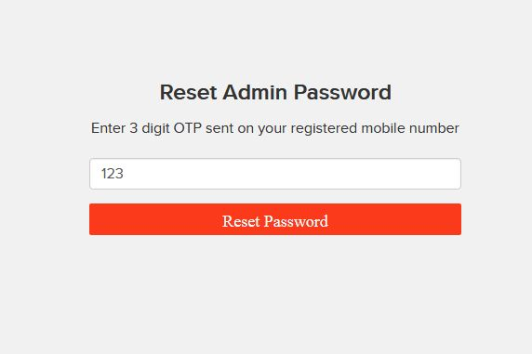
Observations
In the admin login section there is a reset password option which needs a 3-digit OTP.

Slide 21
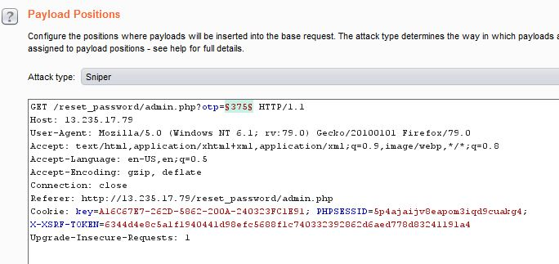
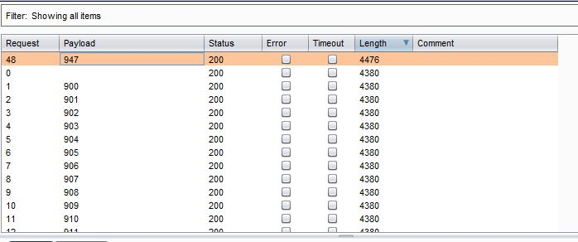
Proof of Concept
By using Burp suit we can easily brute force the OTP.

Slide 22
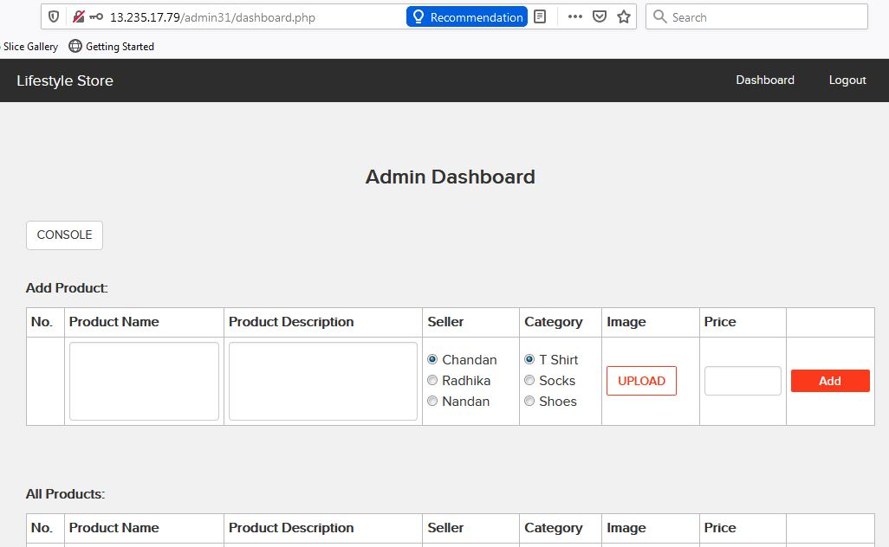
Proof of Concept
Here is the admin dashboard.

Slide 23
Business impact-Extremely High
He can change the rates of the items selling in the website.
He can add and delete the items.
He can change the seller and categories.
He can execute commands on the server using console options, which can further harm the website.

Slide 24
Recommendations
The first is to implement an account lockout policy. For example, after three failed login attempts, the account is locked out until an administrator unlocks it.
Tools such as the free reCAPTCHA can be used to require the user to enter a word or solve a simple math problem to ensure the user is, in fact, a person.
Admin login page should be hidden very securely.
The OTPs should be alpha numeric and at least of 6-letters and digits.

Slide 25
References
https://www.computerweekly.com/answer/Techniques-for-preventing-a-brute-force-login-attack
https://owasp.org/www-community/controls/Blocking_Brute_Force_Attacks

Slide 26
4. Insecure File Uploads
Insecure File Uploads | The url given below is vulnerable to insecure file uploads. Affected url http://13.233.3.245/wondercms/ Uploaded file backdoor shell

Slide 27
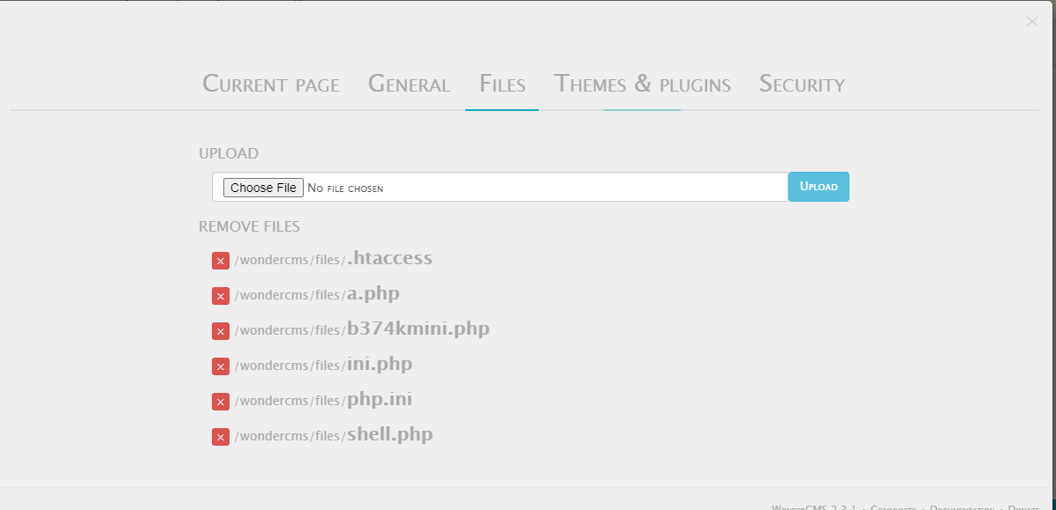
Observations
In the blog page of website there is a upload option in settings.

Slide 28
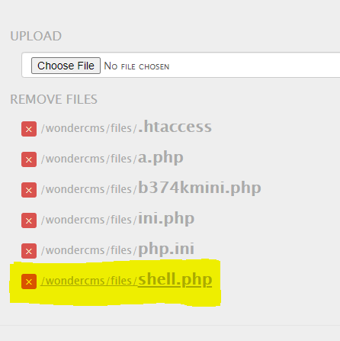
Observations
I tried to upload a shell and I was successful.

Slide 29
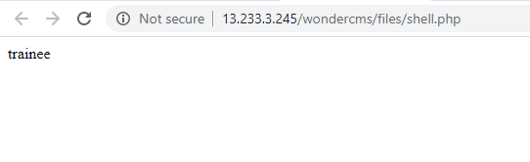
Proof of Concept
The shell was uploaded successfully.

Slide 30
Business impact-Extremely High
The consequences of unrestricted file upload can vary-
including complete system takeover, an overloaded file system or database.
Forwarding attacks to back-end systems.
Client-side attacks, or simple defacement.
It depends on what the application does with the uploaded file and especially where it is stored.

Slide 31
Recommendations
The file types allowed to be uploaded should be restricted to only those that are necessary for business functionality.
Never accept a filename and its extension directly without having a whitelist filter.
All the control characters, Unicode and the special characters should be discarded.

Slide 32
References
IIS 6.0 Security Best
Practices[http://technet.Microsoft.com/en-us/library/cc782762(WS.10).aspx]
Securing Sites with Web Site
Permissions[http://technet.Microsoft.com/en-us/library/cc756133(WS.10).aspx]
IIS 6.0 Operations
Guide[http://technet.Microsoft.com/en-us/library/cc785089(WS.10).aspx]
https://owasp.org/www-community/vulnerabilities/Unrestricted_File_Upload

Slide 33
5. Seller Account Access
Seller Account Access | The default page given below shows the seller accounts and passwords. Affected URL http://13.233.3.245/userlist.txt

Slide 34
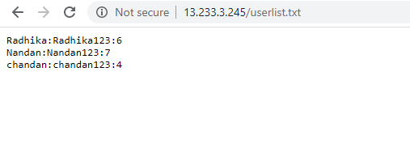
Observations
At the homepage after adding userlist.txt the following page is opened which contains the usernames and passwords of the sellers.

Slide 35
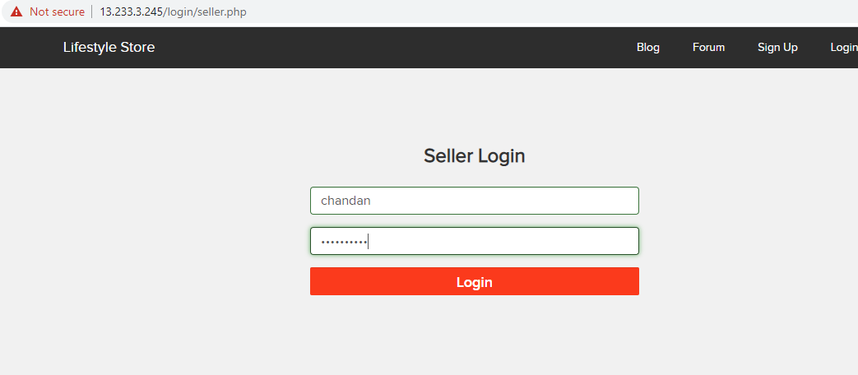
Proof of Concept
On entering the credentials in the seller account login we have accessed the dashboard.

Slide 36
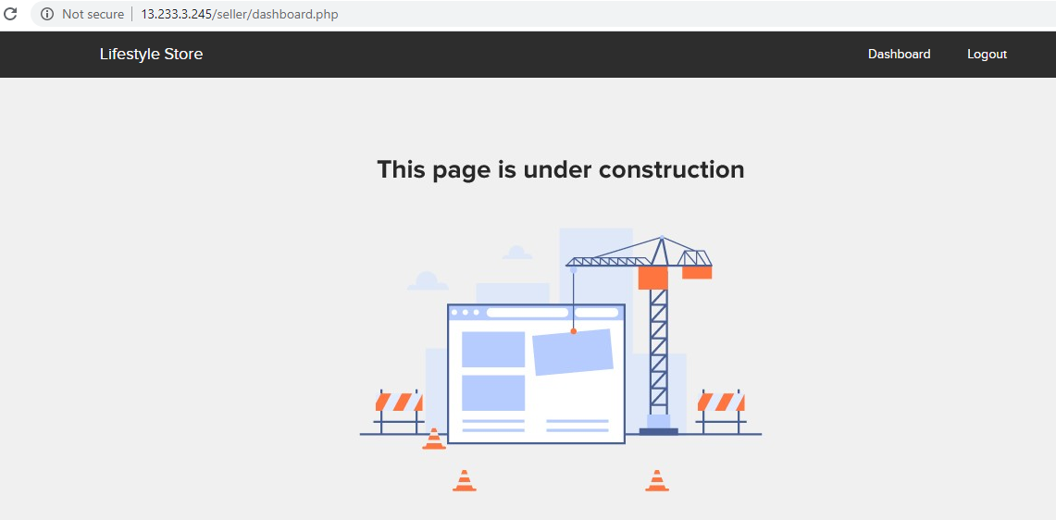
Proof of Concept
We were able to login and see the dashboard of chandan(seller).

Slide 37
Business Impact- Extremely High
Attacker can access the seller dashboard and then can edit the items he is selling

Slide 38
Recommendations
The developer should disable these confidential default pages.

Slide 39
References
https://www.indusface.com/blog/owasp-security-misconfiguration/
https://hdivsecurity.com/owasp-security-misconfiguration

Slide 40
6. Default admin password
Default Admin password | The URL given below is using the default admin credentials Affected URL https://13.23.247.31/ovidentiaCMS/index.php?tg=login&cmd=authform&msg=Connexion&err=&restricted=1 Component name ovedentia content management system.

Slide 41
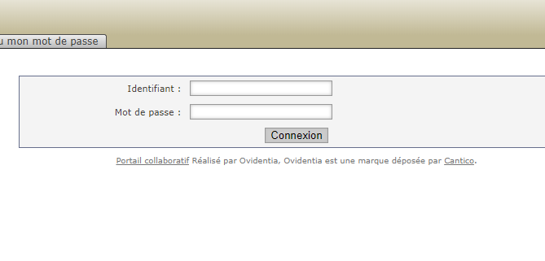
Observations
In the ovidentia cms page there is a login as admin option, and on clicking it we get this page.

Slide 42
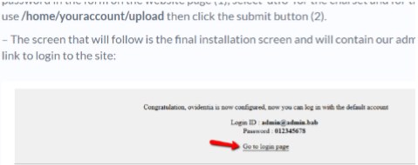
Proof of Concept
In searching for default ovidentia admin credentials we get this.

Slide 43
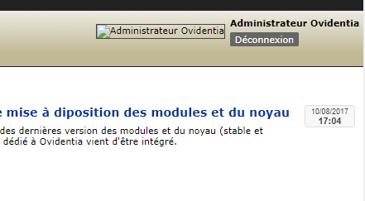
Proof of Concept
We got the admin access by entering those credentials.

Slide 44
Business impact- Extremely High
Attacker will have all admin privileges.
He can easily deface ovidentia CMS.

Slide 45
Recommendations
Disable the default debug pages.
Hide the admin login page.
Disable the default password and use a strong username and password.

Slide 46
References
https://owasp.org/www-project-top-ten/OWASP_Top_Ten_2017_A9-Using_Components_with_Known_Vulnerabitities

Slide 47
7.Components with Known Vulnerability
Components with Known Vulnerability | The URL given below are of the components with known vulnerability Affected URL https://13.23.247.31/wondercms/ http://13.23.247.31/forum/ And PHP

Slide 48


Observations
I checked the versions of these components that were outdated.

Slide 49
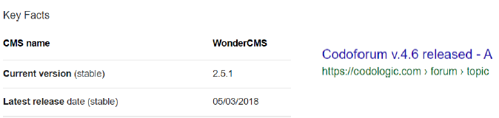
Observations
In 2015 version of codoforum was 3.0

Slide 50
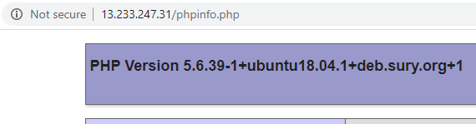
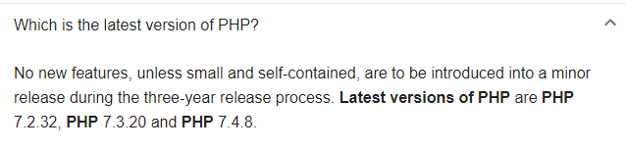
Observations
The php version of this website is 5.6.39-1 which is out dated

Slide 51
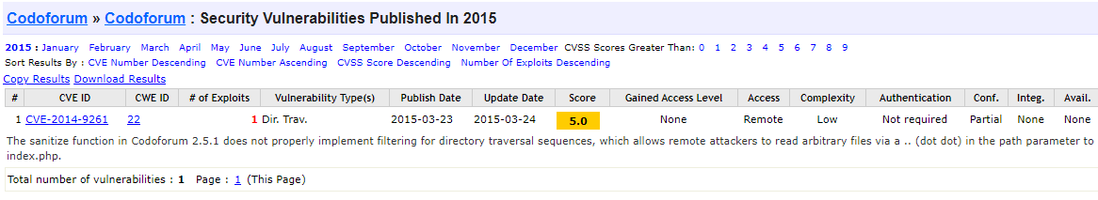
Proof of Concept
Both the components have known public exploits

Slide 52
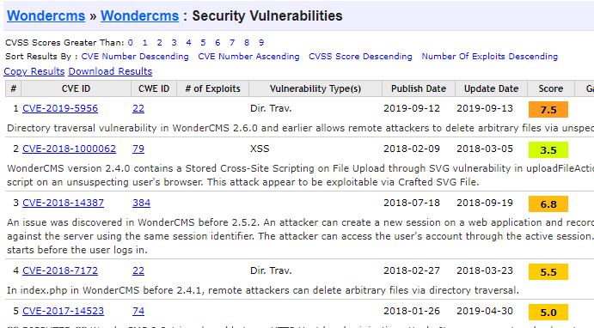
Proof of Concept

Slide 53
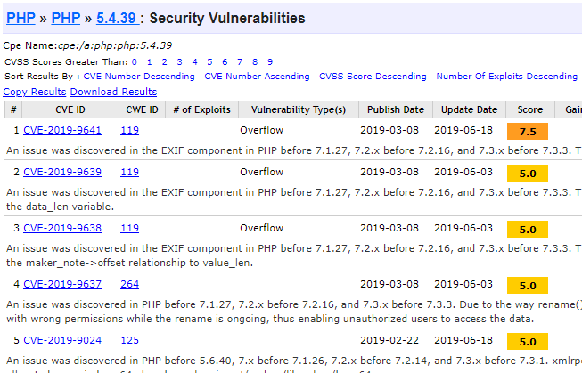
Proof of Concept
The running php version has multiple vulnerabilities as well.

Slide 54
Business Impact- Extremely high
Anyone can perform any attacks(available) as all the exploits are available publicly.
It can cause severe damage to the website.
He may be able to upload backdoor shells.
He will easily deface the website.

Slide 55
Recommendations
Update all the components and the php version which is running on it.
Hide the current versions info from these pages.

Slide 56
References
https://owasp.org/www-project-top-ten/OWASP_Top_Ten_2017/Top_10-2017_A9-Using_Components_with_Known_Vulnerabilities

Slide 57
8.Customer account access
Customer account access | The URL given below are of the components with known vulnerability Affected URL https://13.235.17.79/reset_password/customer.php?username=Donal234 User names Donal234 Pluto98 Popeye786

Slide 58
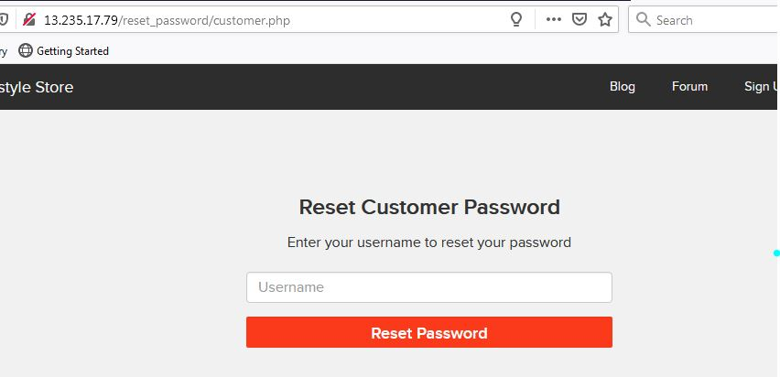
Observations
In the forget password option only username is required to change the password.

Slide 59
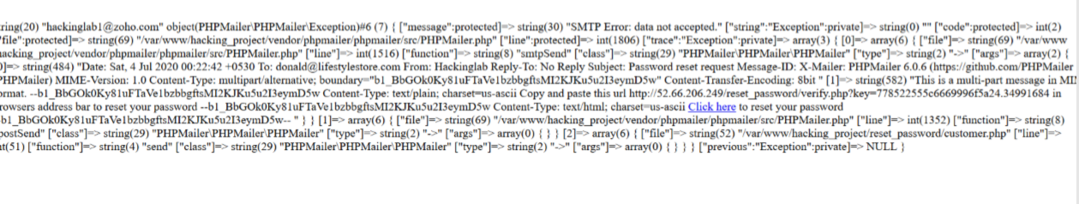
Observations
On entering the username it gives the change password link on email which can be edited by burp suite.

Slide 60
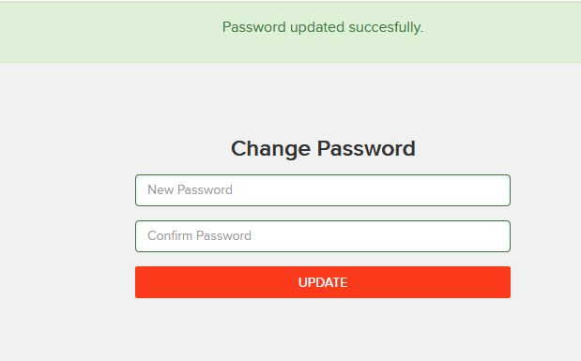
Proof of Concept
After entering another email address password can be changed very easily.

Slide 61
Business impact- Extremely High
Attacker can get the customer account access.
They can also make changes in personal details.
They can also deface the organisation.

Slide 62
Recommendations
OTP option must be present for changing important credentials.
Security checks on the server sides must be done.
Captcha option can also be included.

Slide 63
9. Forced Browsing
Forced Browsing | The below mentioned URL is vulnerable to forced browsing Affected URL http://13.235.17.79/ Forced URL https://13.235.17.79/admin31/dashboard.php

Slide 64
Observations
Successfully entered admin dashboard without logging in with the help of forced browsing.

Slide 65
Proof of Concept
Here is the admin dashboard just by entering the complete URL

Slide 66
Business Impact- Severe
Attacker can have all admin privileges.
He can edit all the items in the website.
He can execute any harmful command through console.

Slide 67
Recommendations
Server side security checks should be performed perfectly.
Make the admin page url complicated so that it couldn’t be guessed

Slide 68
References
https://owasp.org/www-community/attacks/Forced_browsing
https://campus.barracuda.com/product/webapplicationfirewall/doc/42049348/forced-browsing-attack/

Slide 69
10. C.S.R.F.
CSRF | The URL given below is vulnerable to CSRF Affected URL http://13.127.171.93/profile/change_password.php http://13.127.171.93/cart/cart.php

Slide 70
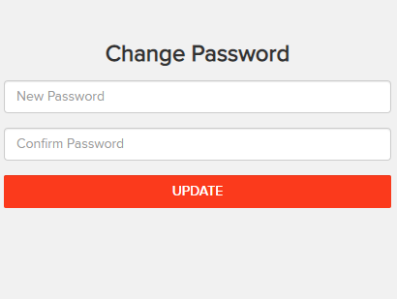
Observations
There is a change password option in profile page

Slide 71
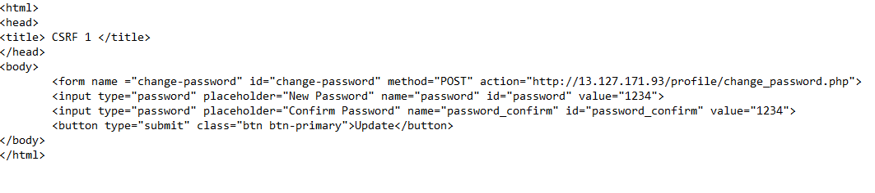
Proof of Concept
Make a html page to change username and password

Slide 72

Proof of Concept
On clicking the update button we get success.

Slide 73
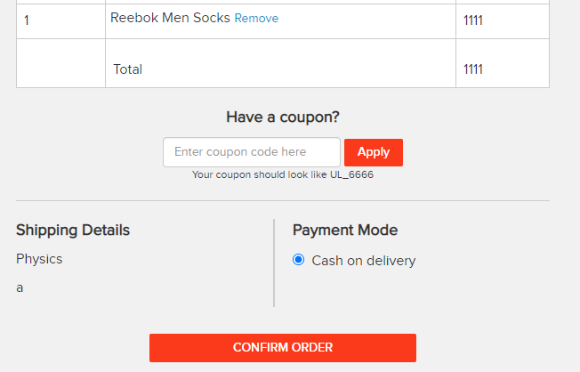
Observations
There is a confirm button in my orders which is also vulnerable to CSRF

Slide 74
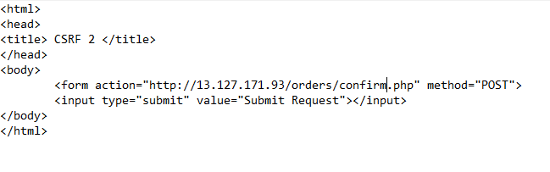
Proof of Concept
Make a html page to confirm order

Slide 75
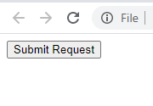
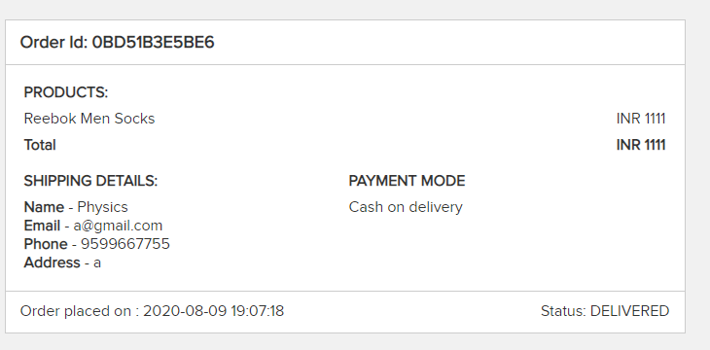
Proof of Concept
On executing the page order is confirmed.

Slide 76
Business Impact- Severe
Attacker can change the password by uploading phishing pages.
Attacker can confirm the order without consent of user.

Slide 77
Recommendations
Use of tokens and session cookies.
Referrer header should be checked at server side.

Slide 78
References
https://owasp.org/www-community/attacks/csrf
https://www.netsparker.com/blog/web-security/csrf-cross-site-request-forgery/

Slide 79
11. Coupon Code Brute Forcing
Coupon Code Brute Forcing | In the below URL brute forcing can be performed for discounts Affected URL http://13.127.76.124/cart/apply_coupon.php

Slide 80
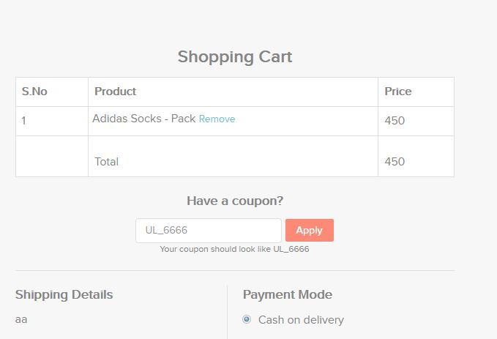
Observations
When we go to the cart we see the apply coupon and coupon example

Slide 81
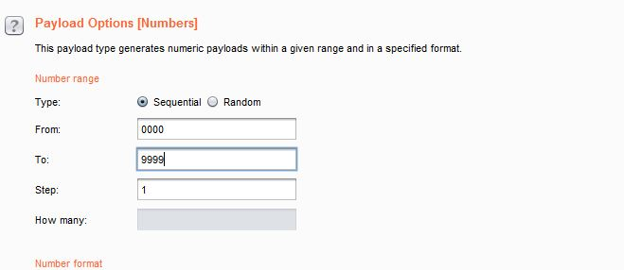
Observations
Brute forcing the coupon code

Slide 82
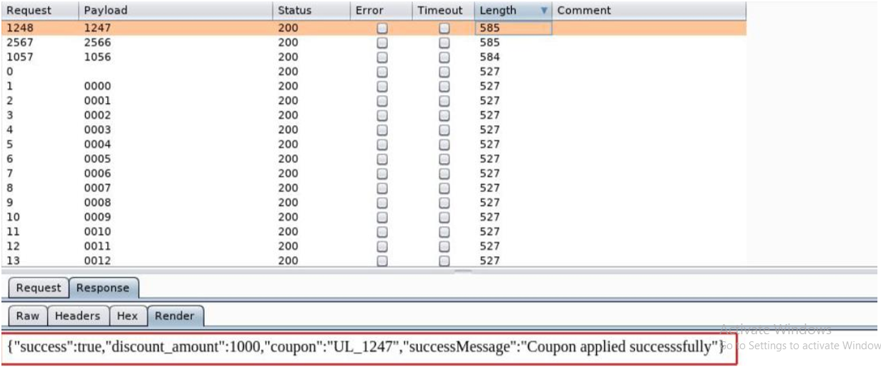
Proof of Concept
We were successful

Slide 83
Business Impact- Severe
Attacker can easily order the items on extreme discounts which will be harmful for the company.

Slide 84
Recommendations
Coupon codes should have limited no of use and regenerated after sometime.
Coupon code should be random alpha-numeric characters.

Slide 85
References
https://www.digitalcommerce360.com/2017/03/17/prevent-fraud-brute-force-online-gift-card-attacks/
https://www.couponxoo.com/brute-force-attack-coupon-code

Slide 86
12. Insecure direct object references(IDOR)
Insecure direct object references | The below mentioned URL is vulnerable to IDOR Affected URL http://13.127.171.93/orders/orders.php?customer=(here) Payload 0-50

Slide 87
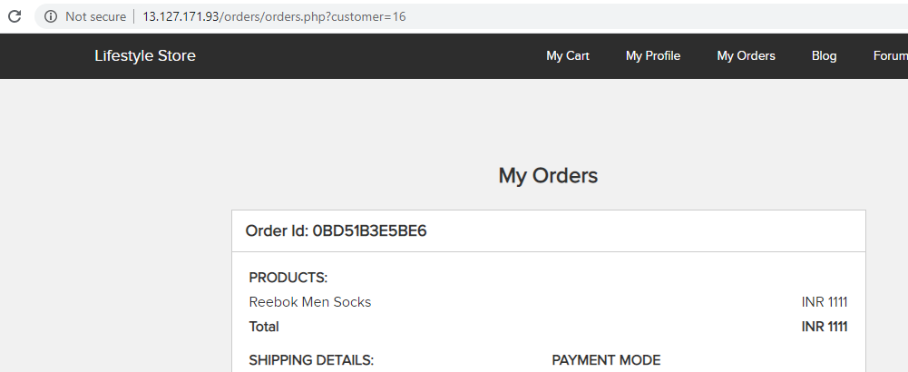
Observations
In the my orders page I saw the customer id given as GET based parameter.

Slide 88
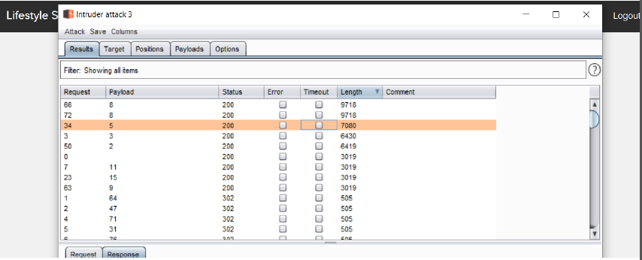
Observations
After brute forcing using burp.

Slide 89
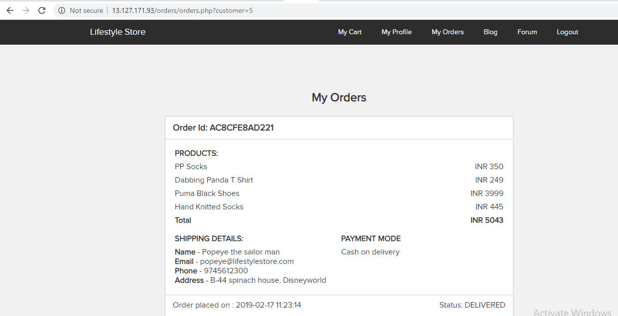
Proof of Concept
I got other customers and their order details.

Slide 90
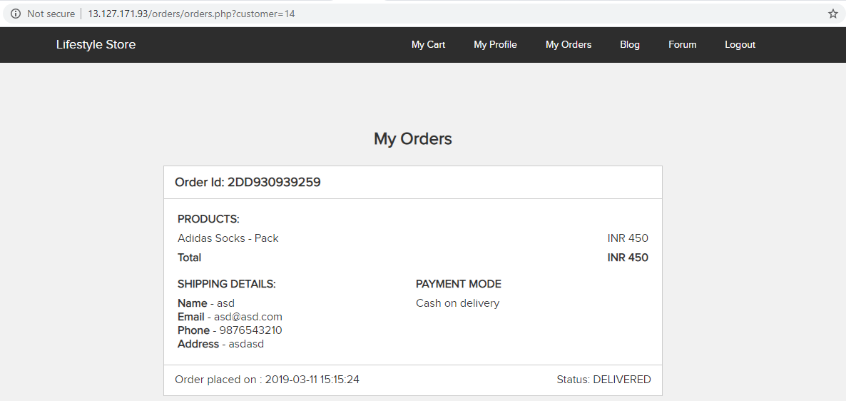
Proof of Concept

Slide 91
Business Impact- Severe
He can access the users personal credentials which would be very harmful.
They can even gather various details.

Slide 92
Recommendations
Instead of requiring the references in the URL , use the information already present in the user’s session on the server to locate the resources to serve.
If it is not possible to avoid exposing the references to objects in the URL , as explained earlier, the indirect reference map technique is helpful. The idea behind it is to substitute the sensitive direct internal reference in URL parameters or form fileds with a random value that is difficult to predict ( such as a GUID) or specify only to the logged-in user.

Slide 93
References
https://www.orellly.com/library/view/securing-node-applications/9781491982426/ch04.html
https://cheatsheetseries.owasp.org/cheatsheets/insecure_Direct_Object_Reference_Prevention_Cheat_Sheet.html

Slide 94
13. Open Redirection
Open Redirection | The below mentioned URL is vulnerable to Open Redirection Affected URL http://13.127.171.93/redirect.php?url=(www.chandanstore.com) In the parentheses.

Slide 95
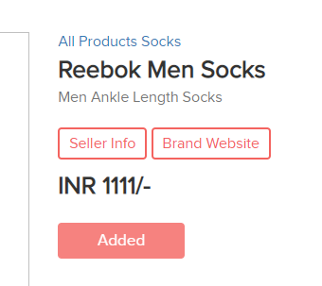
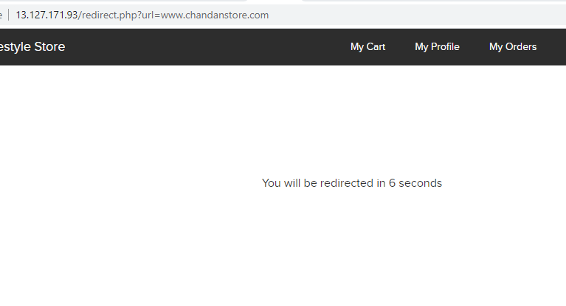
Observations
On clicking the brand website redirection occurs.

Slide 96
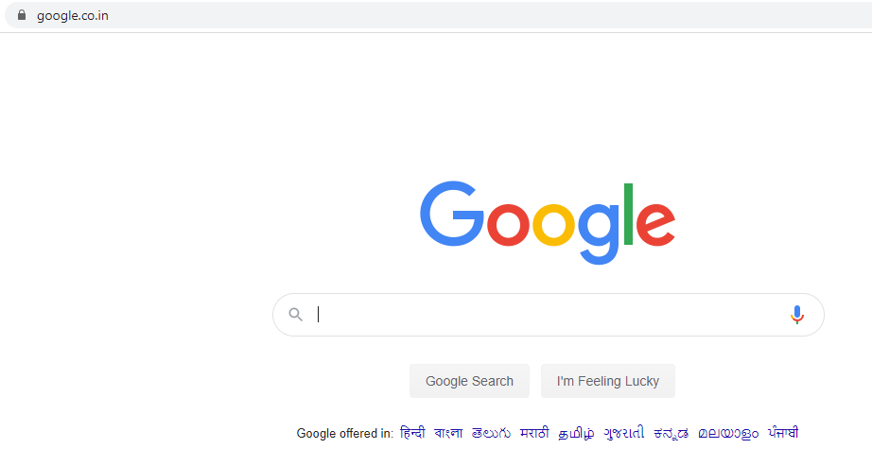
Proof of Concept
On changing the link to google.co.in we get redirected to it.

Slide 97
Business Impact- Severe
He can use the personnel credentials which would be very harmful.
They can redirect your page to a malware site.
They can redirect you to phishing pages.

Slide 98
Recommendations
Design your app to avoid URL redirects or forwards as a best practice. If unavoidable, encrypt the target URL such that the URL:token mapping is validated on the server.
Verify URL patterns using regular expressions to check if they belong to valid URLs. However, malicious URLs can pass that check.
Check your Referrers.

Slide 99
References
https://spanning.com/blog/open-redirection-vulnerability-web-based-application-security-part-1/#:~:text=Understanding%20the%20Unvalidated%20Redirects%20Vulnerability&text=However%2C%20it%20can%20be%20misused,data%20and%20creditbility%20into%20jeopardy
https://www.netsparker.com/blog/web-security/open-redirection-vulnerability-information-prevention/

Slide 100
14. Cross site scripting
Cross site scripting | The URLs given below is vulnerable to tempory and stored XSS Affected URL Temporary - http://13.127.171.93/search/search.php?q=(here) Stored - http://13.127.171.93/products/details.php?p_id=(all id)

Slide 101
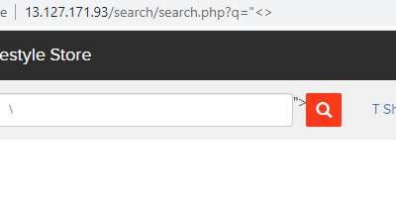
Observations
In the search bar when I entered “<> I found this

Slide 102
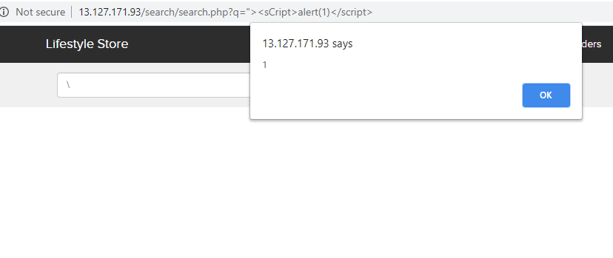
Proof of Concept
When I entered the script popup code it was executed.

Slide 103
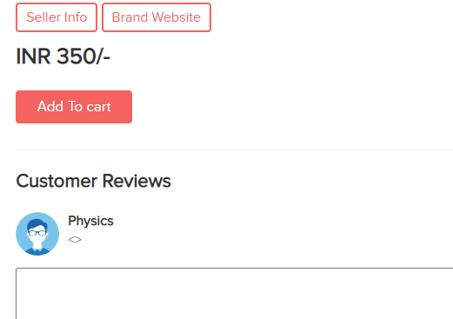
Observations
In the comment section of every product items the comment was stored.

Slide 104
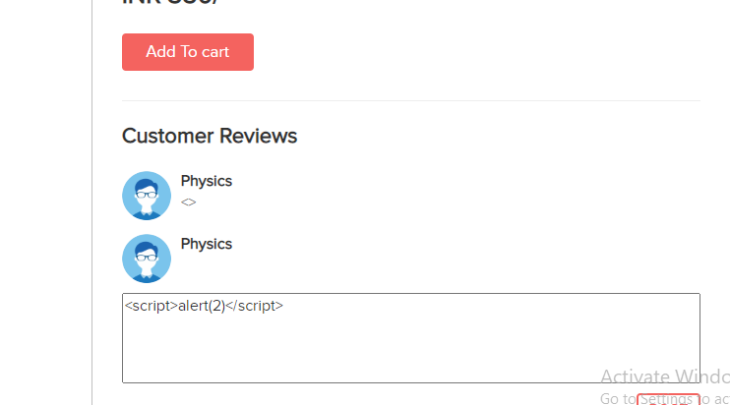
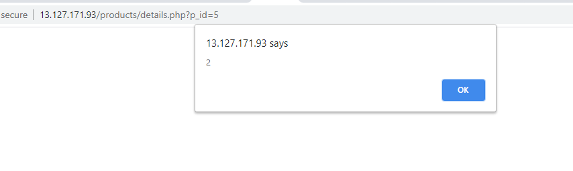
Proof of Concept
When I entered the script pop up code it got executed and stored.

Slide 105
Business Impact- Severe
Hacker can access any user credentials by injecting malicious scripts.
He can even change the html format of website.

Slide 106
Recommendations
By escaping user input. Escaping data means taking the data an application has received and ensuring it’s secure before rendering it to the end user.
Validating input is the process of ensuring an application is rendering the correct data and preventing malicious data from doing harm to the site, database, and users
A third way to prevent cross-site scripting attacks is to sanitize user input. Sanitizing data is a strong defense but should not be used alone to battle XSS attacks.

Slide 107
References
https://www.checkmarx.com/2017/10/09/3-ways-prevent-xss/
https://cheatsheetseries.owasp.org/cheatsheets/Cross_Site_Scripting_Prevention_Cheat_Sheet.html
https://owasp.org/www-community/attacks/xss/

Slide 108
15. Client side filter bypass
Client side filter bypass | The URL given below is vulnerable to client side filter bypass Affected URL http://13.235.17.79/profile/16/edit/

Slide 109
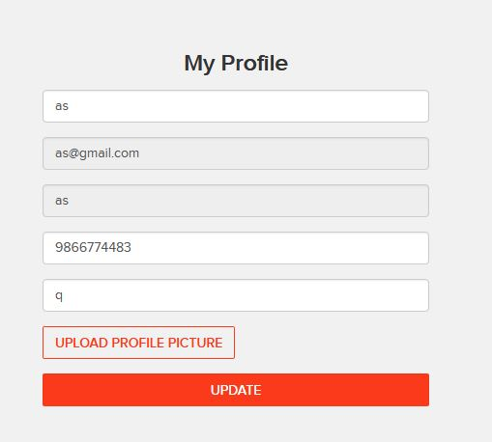
Observations
After changing the information I was able to change it again via client side filter bypass.

Slide 110
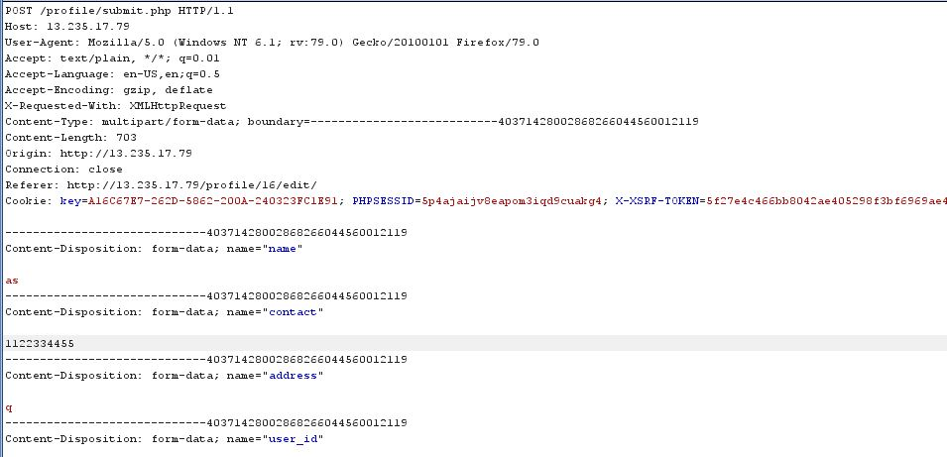
Proof of Concept

Slide 111

Proof of Concept
We successfully changed the original info.

Slide 112
Business Impact- High
This would only trouble the users which will be giving bad feedback about your website.

Slide 113
Recommendations
Cookies should be used.
Referrer headers should be used.
Proper security checks should be done.

Slide 114
References
https://portswinger.net/support/using-burp-to-bypass-client-side-javascript-validation
https://www.slideshare.net/SamBowne/cnit-129s-ch-5-bypassing-clientside-controls

Slide 115
16. Directory Listing
Directory listing | The URL given below is listing the directories Affected URL https://13.127.171.93/static/images/

Slide 116

Observations
In robots.txt file I found static/images/ and /ovidentiaCMS

Slide 117

Proof of Concept
Listed directories

Slide 118
Business Impact- High
These directories will be useful for the attacker to collect information about the website and to plan attack.

Slide 119
Recommendations
Disable these listed directories.

Slide 120
References
https://www.acunetix.com/blog/articles/directory-listing-information-disclosure/

Slide 121
17. Personnel identifiable information leakage
Personnel identifiable information leakage | The URL given below has PII-leakage Affected URLs http://13.127.171.93/products/details.php?p_id=(all) http://13.127.171.93/reset_password/customer.php?username=(here)

Slide 122

Observations
In every product pages the seller info option is available.

Slide 123

Proof of Concept
Pan card details are also shown

Slide 124


Observations
When we enter the forget password we get a page to enter our username. Already some users details are shown in the bottom of the login page. We can get the usernames from here.

Slide 125

Proof of Concept
On entering the username and clicking reset password we get the email ids of the users.

Slide 126
Business Impact- High
Providing the Seller information may uninterest people to buy the item
It may also cause social engineering attacks on seller.
Providing user names openly on the login page and also providing their email ids can reduce the reputation of the website.

Slide 127
Recommendations
Remove the pan card details.
Only show required information about anyone.

Slide 128
References
https://www.imperva.com/learn/data-security/personally-identifiable-information-pii/
https://hackerone.com/reports/374007

Slide 129
18. Default and debug files
Personnel identifiable information leakage | The URL given below has many default and debug files. Affected URLs http://13.127.171.93/ Default pages robots.txt server-status phpinfo.php userlist.txt

Slide 130

Proof of Concept

Slide 131

Proof of Concept

Slide 132

Proof of Concept

Slide 133

Proof of Concept

Slide 134
Business Impact- Low
It does not impact the website directly.
It only helps hacker collect information.

Slide 135
Recommendations
Disable all these default pages.

Slide 136
References
https://www.indusface.com/blog/owasp-security-misconfiguration/
https://hdivsecurity.com/owasp-security-misconfiguration

Slide 137
19. Descriptive error messages
Descriptive error messages | The URL given below shows Descriptive error messages. Affected URLs http://13.127.171.93/forum/admin/index.php?page=login

Slide 138

Proof of Concept
On entering < in place of username and password we got some error messages.

Slide 139

Proof of Concept
On entering ipchicken website on the URL for language change we get this error messages.

Slide 140
Business Impact- Low
It does not impact the website directly.
It only helps hacker collect information.

Slide 141
Recommendations
Block these kind of pages to show up.
Only show simple error pages.

Slide 142
References
https://owasp.org/www-community/Improper_Error_Handling#:~:text=Description,to%20the%20user%20(hacker)
https://cwe.mitre.org/data/definations/209.html

Slide 143
Thank YOU
Name – Arnab Sarkar

