Slide 1

MedIT
An automated diagnostic tool

Slide 2
What is it?
It is a software which analyzes the Chest X-Ray images for the early diagnosis of Congestive Heart disease.
A computer-aided diagnosis (CAD) system can mark suspected areas on CXR for careful examination by medical doctors, and can give alarm in the cases that need urgent attention.
Furthermore, the number of CXR to examine is numerous and far beyond the capability of available medical staff, especially in developing countries like India.

Slide 3
Why is it required?
Heart failure is a very serious disease, and early detection of its symptom is of vital importance.
Preliminary diagnosis currently performed by medical doctors, is mainly based on chest X-ray images (CXR).
In populous countries like India with scarce medical professionals, it is highly unmanageable for doctors to reach out to all and sundry.
Therefore, a Computerized analysis of CXR images is the need of the hour.

Slide 4
What’s in it?
The Water-Shed Algorithm
Find the gray level histogram for the CXR.
Find the minimal and the maximal gray levels respectively using histotrophic Probability distribution functions to find a threshold i.e. the median
Converting the CXR into binary matrix and mark up the gray scale levels above the threshold.
This marked up Contours developed in the above process marks the contour of the lungs .
Horizontal and Vertical scaling would make appropriate boxes segregating the two lungs
Taking the ratio of the differences between them and the whole image following some basic Mathematical treatment with the data obtained above we obtain the required Thoracic Diameter hence the Cardiothoracic Ratio.

Slide 5
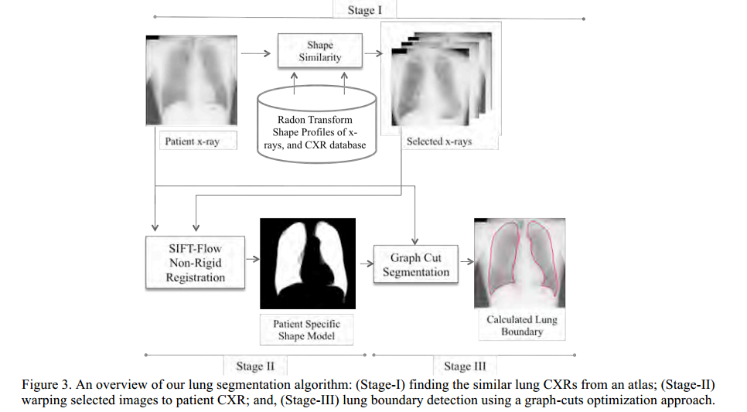

Slide 6
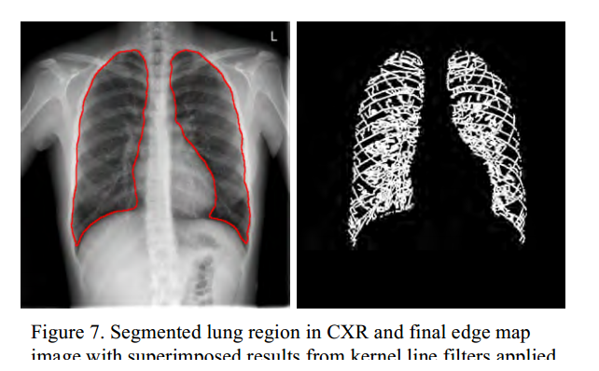

Slide 7
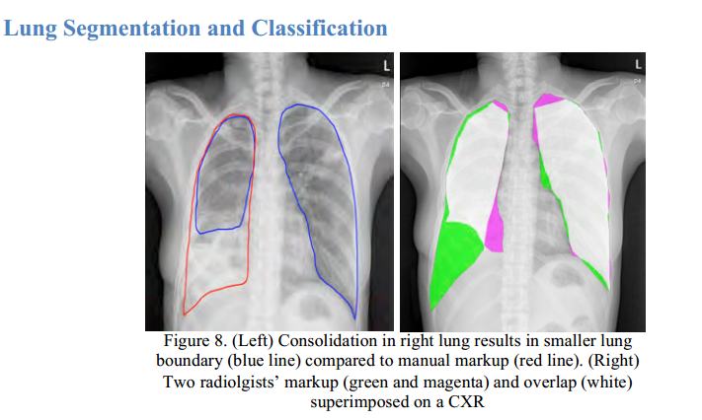

Slide 8
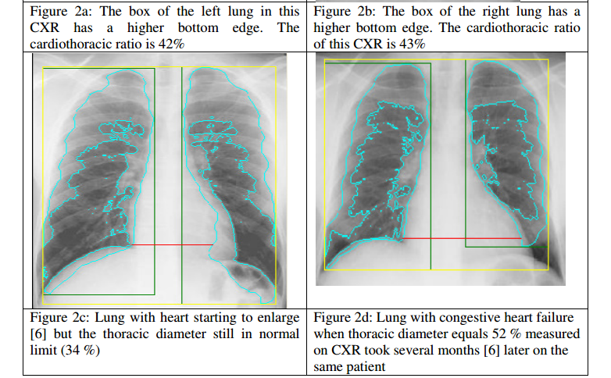
Healthy Unhealthy

Slide 9
The Target Audience:
All the Patients and the Doctors.
This App specially designed to ease the burdens on the Physicians and Patients.
Specifically targeting the population above the age of 45 years who are most prone to Congenial Heart Diseases.
Very easy to use and high performance application.

Slide 10
The Future of the Software
Implementing X-Ray scans for each and every parts of the body.
Focusing on all the age groups ranging fro infants to elders of the family.
Extract all the files in the same folder.
Open the MedIT.m file in Matlab(recommended) or Visual Studios and run it.
There are two images supplied correct one is the X-Ray of a healthy person and defective is of the opposite one.

