Slide 1

Title Page
Problem Statement ID – 17
Problem Statement Title – Automated Littering Detection and Alert System for Public Spaces
Theme – Enviroment
Team Name – Hello PyWorld

Slide 2
Idea Title
Hello PyWorld
IDEA/SOLUTION :
TRACE is a real-time AI surveillance pipeline that plugs directly into existing CCTV cameras and solves this problem end-to-end. The system automatically:
Detects litter using custom-trained YOLOv8s model (mAP50 = 0.81),(Precision:0.84)
Tracks trash across frames with ByteTrack using persistent IDs
Uses a 5-state machine to confirm litter abandonment
Identifies offenders (pedestrian or vehicle) with timestamped photo evidence
Reads Indian license plates using EasyOCR with character correction
Logs confirmed incidents to a FastAPI + SQLite backend with full metadata
Streams live annotated video via MJPEG to a surveillance dashboard
Displays incidents, trash types, pie charts, history, and repeat offenders in a real-time dashboard
PROBLEM STATEMENT :
Littering is a major urban problem that costs cities millions in cleanup and harms public health and the environment. Although CCTV cameras capture incidents, the lack of automation means footage is reviewed manually, offenders remain unidentified, and no actionable data is generated.
THE RESULT – TRACE(Trash Recognition & Automated Civic Enforcement) turns the existing CCTV network into an active enforcement and analytics platform.

Slide 3








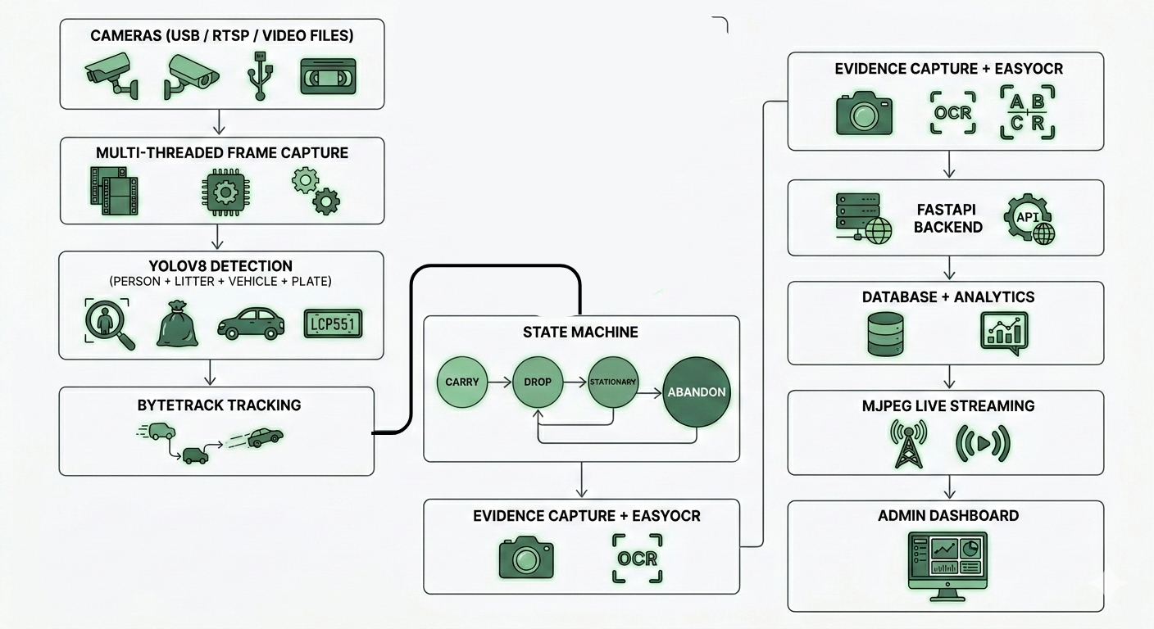

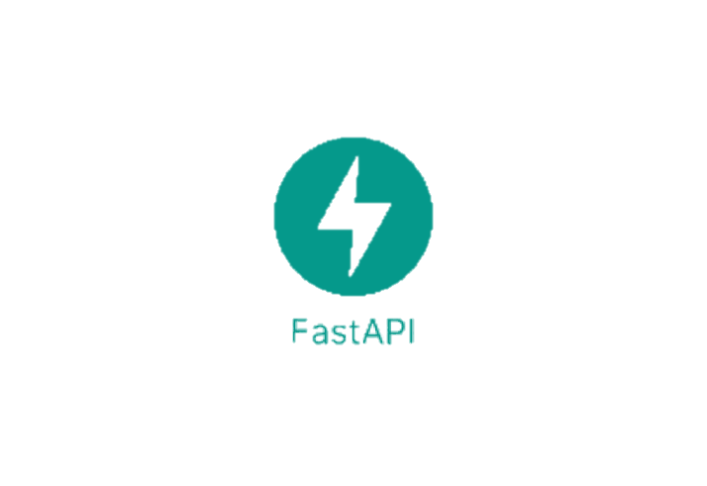
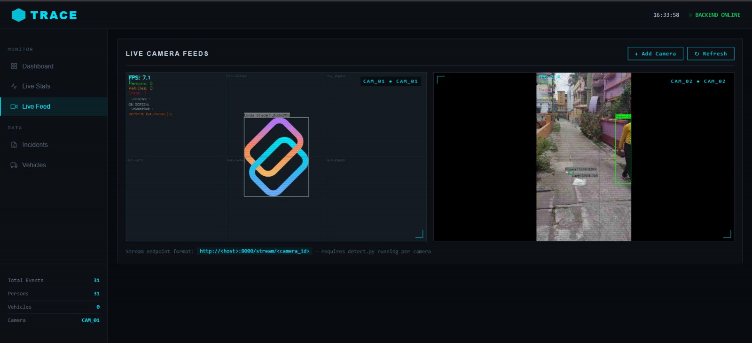
Technical Approach
Hello PyWorld
FLOW DIAGRAM :
TECHNOLOGY STACK :
Python
OpenCV
YOLO v8
Numpy
SQLAlchemy
FastAPI
EasyOCR
HTML
CSS
Java Script
PROTOTYPE IMAGE

Slide 4
Feasibility & Viability
Hello PyWorld
FEASIBILITY :
State-machine-based temporal reasoning correctly distinguishes carrying vs abandonment, with verified false-positive cancellation.
EasyOCR-based Indian license plate recognition with preprocessing and character-position correction.
FastAPI backend with persistent storage (SQLite) handling incident ingestion, stats aggregation, and MJPEG stream relay.
Real-time surveillance dashboard displaying live video feeds, dynamic charts, incident logs, and photographic evidence.
Multi-camera architecture with threaded pipeline design, enabling simultaneous real-time processing of multiple video streams.
Frame streaming fully decoupled from detection loop via multithreading, ensuring zero FPS degradation under network or dashboard.
Highly cost-effective compared to manual surveillance and legacy monitoring systems, requiring no additional hardware
POTENTIAL CHALLENGES :
Reduced detection accuracy under low-light or adverse weather conditions
Variability in CCTV camera angles, positioning, and resolution
OCR inaccuracies due to unclear or damaged license plates
Server load and data storage management during large-scale deployment
Edge cases in object interaction understanding (occlusion, fast motion, partial visibility)
STRATEGIES TO OVERCOME THE CHALLENGES :
Retraining model with diverse datasets
Set CCTV quality and placement standards
Advanced OCR post-processing and character correction algorithms
Cloud scalability with optimized video compression techniques
Routine performance monitoring and periodic system updates

Slide 5
Impact & Benefits
Hello PyWorld
For the Environment :
Visible AI surveillance discourages littering by strengthening enforcement credibility
Faster detection and dispatch reduces litter dwell time, preventing accumulation and entry into storm drains and waterways
Identifies dominant trash categories in each zone to support targeted awareness campaigns
For Municipalities & Urban Bodies :
Automated 24/7 monitoring eliminates dependence on manual CCTV review
Timestamped, geo-tagged photographic evidence is legally admissible for enforcement proceedings.
Repeat offender database enables escalating penalties and targeted enforcement
7-day trend data informs staffing and route planning for cleaning services
Dwell-time tracking shows how long litter remains on streets before being cleaned — a measurable KPI
For Existing Infrastructure :
Zero new hardware required — integrates with any existing CCTV system via RTSP
Open-source stack (Python, FastAPI, EasyOCR) keeps deployment and licensing costs near zero
Maximises ROI on existing city surveillance investments that currently provide no analytical value
Deployable by any municipality IT team — no specialised ML expertise required to operate

Slide 6
Research & References
Hello PyWorld
Datasets
TACO (Trash Annotations in Context) — Pedamonti, J. et al. (2020). 1,500+ real-world outdoor litter images annotated across 60 litter categories. Primary training dataset for the trash detection model. http://tacodataset.org
COCO (Common Objects in Context) — Lin, T. et al. (2014). 330,000 images across 80 object categories. Used via pretrained YOLOv8s weights for person and vehicle detection. https://docs.ultralytics.com/datasets/detect/coco
Key Papers
https://www.nature.com/articles/s41598-024-77118-x
https://www.researchgate.net/publication/388326795_Real-time_detection_and_monitoring_of_public_littering_behavior_using_deep_learning_for_a_sustainable_environment
https://www.irejournals.com/formatedpaper/1712601.pdf
https://www.samvaktijournals.com/system/files/sjrit/2021.02.19/intelligent_garbage_detection_and_alert_system.pdf
https://www.ijert.org/ai-based-camera-systems-for-roadsidel-itter-detection-and-offender-identification-ijertv15is010642

