Slide 1

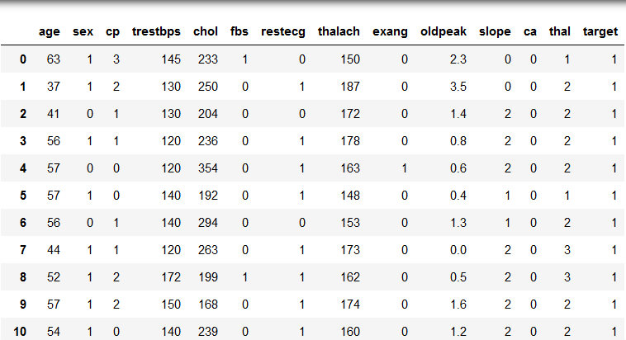

MOTIVATION
Heart Disease dataset (collected at Cleveland, USA)
Objective is to predict whether a patient is at risk of heart disease based on certain diagnostic features.
Dataset has 13 such features like age, sex, cholesterol level, blood pressure , max heart rate, etc.
Data available for 303 patients.

Slide 2
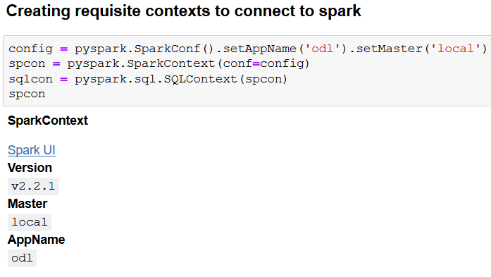
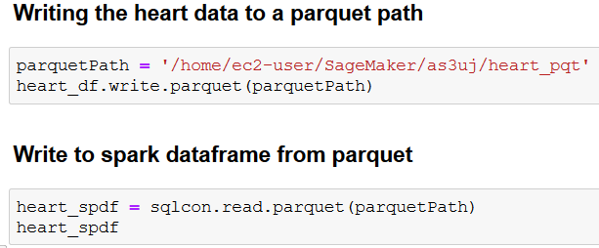
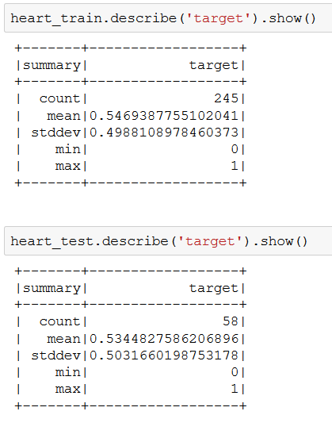
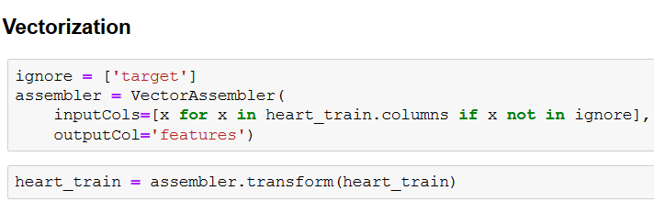
CODE SNIPPETS
Creating Spark Context and reading/writing in parquet format
Using VectorAssembler for multiple features
Dividing data into train and test sets with balanced class distribution

Slide 3
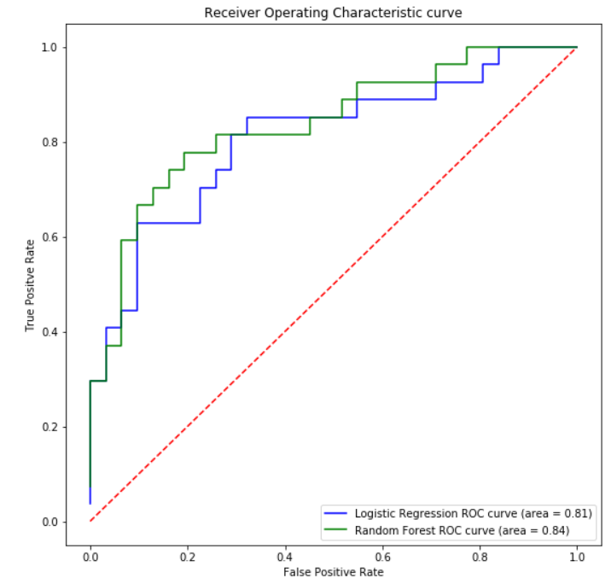
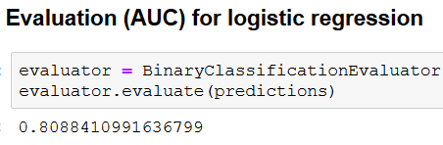
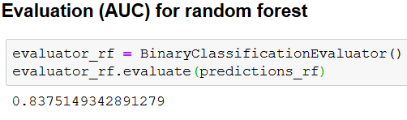
VISUALIZATION

