Slide 1
Data Modelling In PowerBI

Slide 2
Introduction
What is Data Modelling?
It is the process of creating a visual diagram of a software system and the data elements it contains, using symbols and text to represent the data and how it flows.
What is PowerBI?
It is a Microsoft business intelligence tool that combines data visualization, business analytics, and best practices to help organizations make data-driven decisions.
It's made up of a collection of apps, connectors, and software services that work together to turn unrelated data sources into interactive, visually immersive, and coherent insights.

Slide 3
Overview
Introduction to Data Modelling.
Overview of PowerBI.

Slide 4
Data Modelling:
Data modeling is the process of creating a visual representation of either a whole information system or parts of it to communicate connections between data points and structures.
The goal of data modeling to illustrate the types of data used and stored within the system, the relationships among these data types, the ways the data can be grouped and organized and its formats and attributes.
Data models are built around business needs. Rules and requirements are defined upfront through feedback from business stakeholders so they can be incorporated into the design of a new system or adapted in the iteration of an existing one.

Slide 5
PowerBI:
Power BI is a Microsoft business intelligence tool that combines data visualization, business analytics, and best practices to help organizations make data-driven decisions. It's made up of a collection of apps, connectors, and software services that work together to turn unrelated data sources into interactive, visually immersive, and coherent insights.
Power BI allows users to connect to data sources, visualize data in dashboards and reports, and share those with others. Power BI dashboards provide a 360-degree view for business users with their most important metrics in one place, updated in real time, and available on all of their devices.

Slide 6
Data Preparation
Data Preparation in PowerBI

Slide 7
Data Preparation:
Data preparation in Microsoft Power BI is the process of transforming, cleaning, and centralizing data from different sources, and linking data across tables. The goal is to build a common data model that can be used to create visualizations and metrics.
Power BI has a data preparation tool called Power Query, which allows users to access, transform, and shape data from multiple sources. Power Query can also be used to combine data from multiple sources into a single data set.
Power BI also allows users to create relationships between data sources, which allows tables to be connected so that visuals and reports can be created.

Slide 8
Relationships
Creating Relationships between the tables in PowerBI

Slide 9
Creating Relationships:
In Power BI, relationships connect data models that contain data from multiple tables. These relationships allow visualizations to be sliced and diced by data from different tables.
To create a relationship between two tables, you can:
Select Manage Relationships from the Home tab
Click and drag the column that you want the relationship to be formed by from one table onto the column of another table
Power BI relationships can be formed automatically when the data is loaded, or manually. When cardinality is set incorrectly, it can result in missing or duplicate data.

Slide 10
Defining Calculated Columns and Measures
Defining Calculated Columns and Measures in powerBI

Slide 11
Defining Calculated Columns and Measures
In Power BI, calculated columns and measures are both based on DAX formulas, but they differ in how they're used and evaluated. Calculated columns are static and are computed at the row level within the table they belong to. For example, if you use Sales[SalesAmount] in a calculated column, it means the value of the SalesAmount column in the current row.
We can use calculated columns as new Fields in the rows, axes, legends, and group areas of visualizations, while you often use measures in a visualization's Values area, to calculate results based on other fields.
We can create a measure by right clicking on the table you want to create it in, and then selecting New Measure. You can then write the name of the measure and use a DAX function to aggregate the values.

Slide 12
Optimization
Optimizing the Data Model in PowerBI

Slide 13
Optimization:
Here are some ways to optimize data models in Power BI:
Use STAR schema: STAR schemas are commonly used to produce optimal models in Power BI.
Limit data model: This is not an optimizing technique, but it provides information to help with decision making.
Push data transformations upstream: This can help optimize data models.
Move row level logic to Power Query: This can help optimize data models.
Use measures instead of calculated columns: This can help optimize data models.
Convert multiple measures to variables: This can help optimize data models.
Amend dates and column types: This can help optimize data models.
Reduce the cardinality levels of columns: This can improve performance and decrease the size of the data model. You can do this by changing data types or summarizing data.
Disable Power Query load: You can disable loading of data for a query or queries each time the model is refreshed. You should disable this for queries that do not change often or that support data integration.

Slide 14
Best Practices
Best Practices in powerBI

Slide 15
Best Practices:
Here are some best practices for using Power BI:
Know your audience: Consider the audience you're trying to communicate with
Think about data flow and layout: Consider the flow of data and the layout of your dashboard
Choose visualization: Select the right visualization
Avoid poor labeling: Provide context and avoid poor labeling
Focus on color: Consider color
Avoid data clutter: Avoid data clutter
Test dashboards early: Test your dashboards early
Use filters more: Use filters more and slicers sparingly
Select certified visuals: When using custom visuals, select certified visuals when possible
Take away unnecessary visual interactions: Remove unnecessary visual interactions
Organize your report: Keep your report organized logically and easy to navigate

Slide 16
Projects
Implementations in the form od PowerBI Dashboards

Slide 17
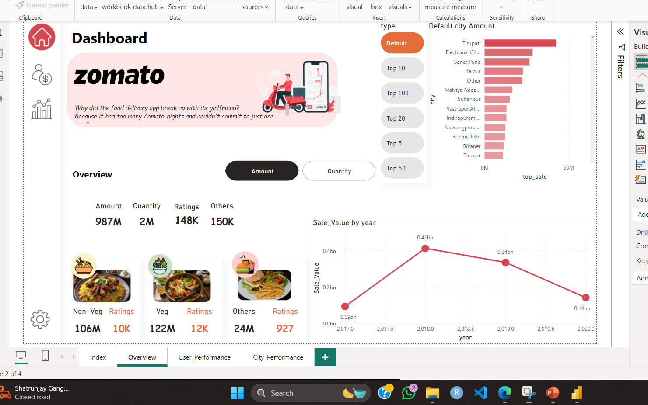
Zomato Dashboard:

Slide 18
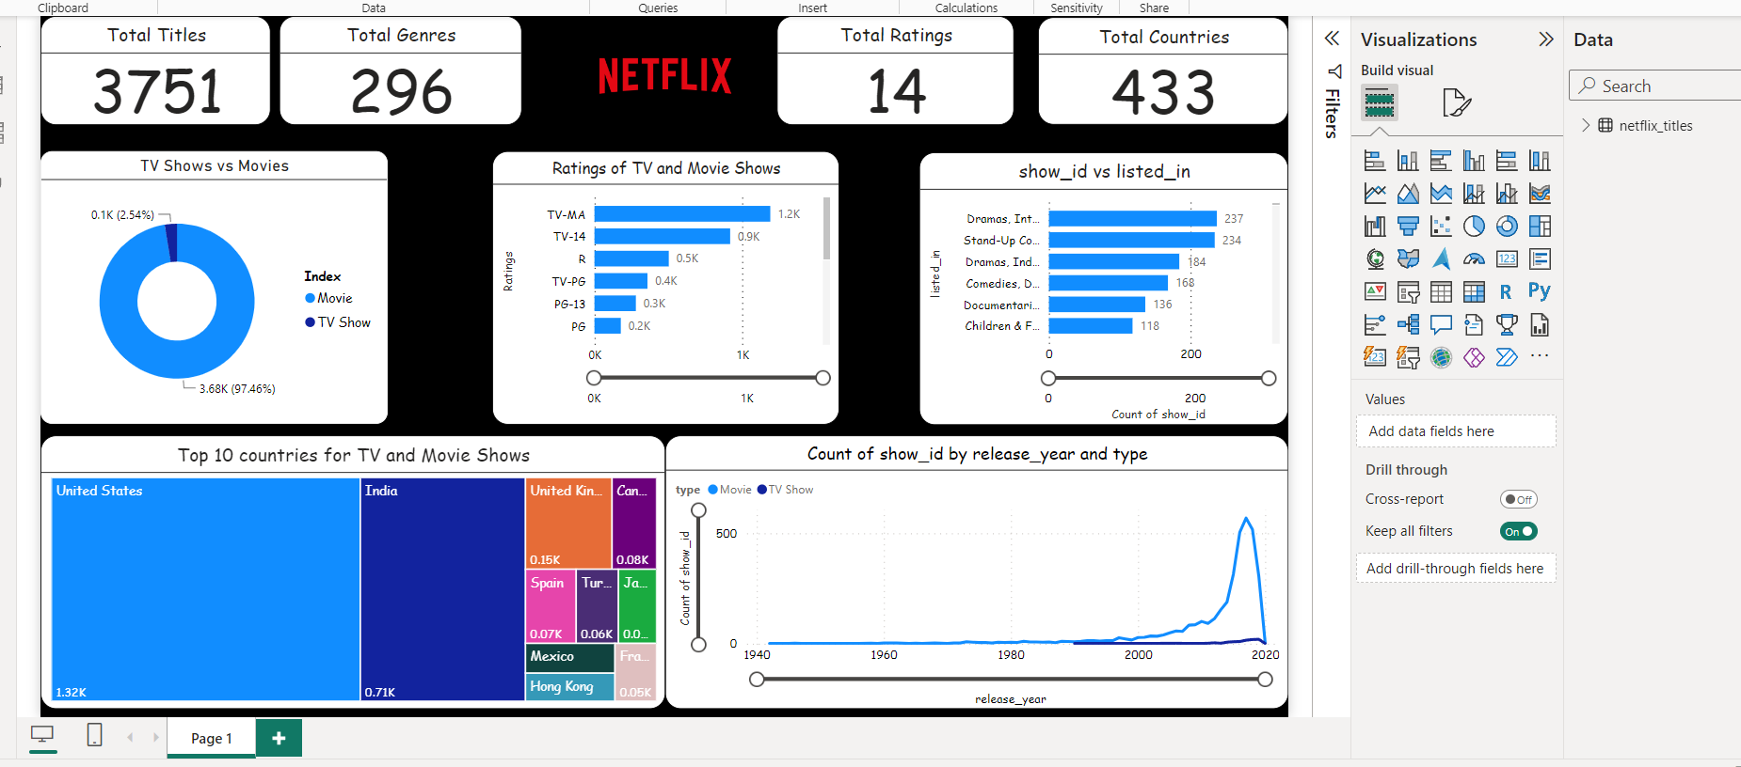
Netflix Dashboard:

Slide 19
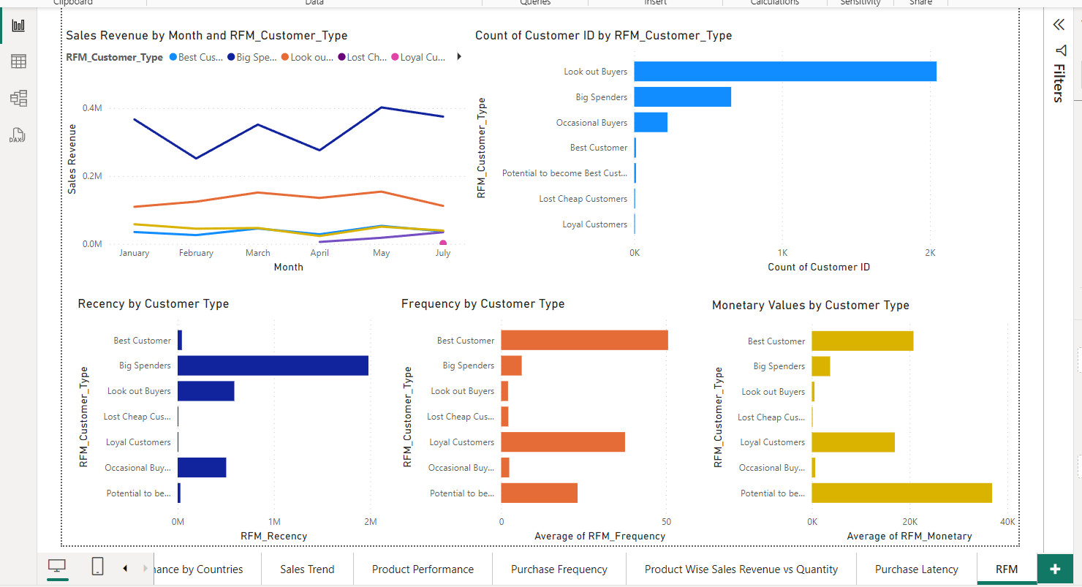
Global Sales Dashboard:

Slide 20
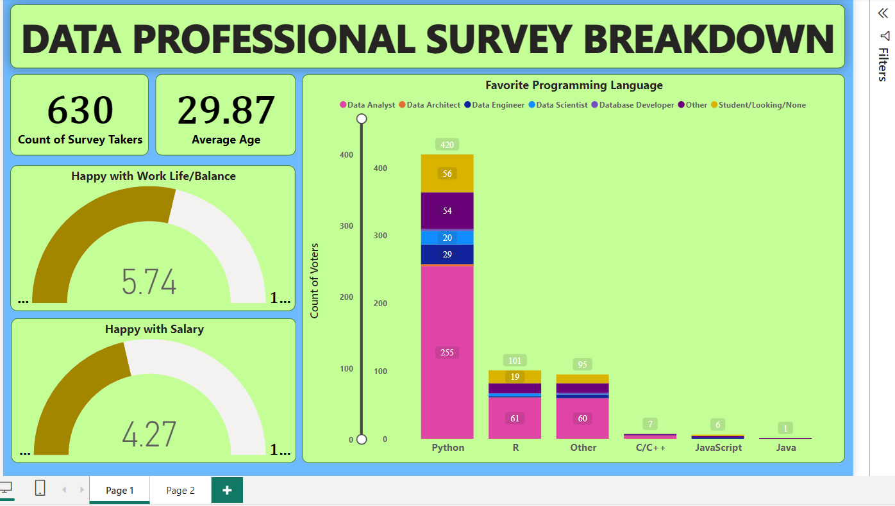
Data Professional Dashboard

Slide 21
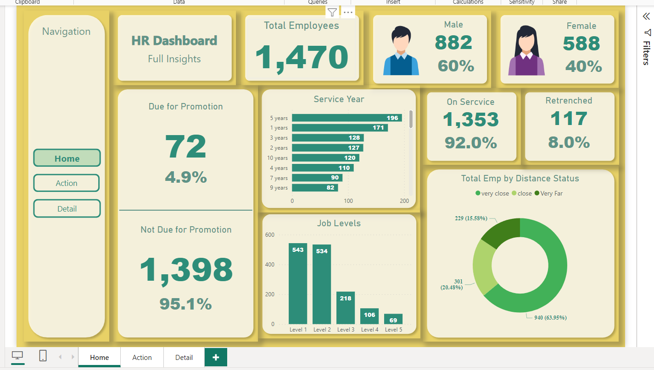
Human Recourse Dashboard

Slide 22
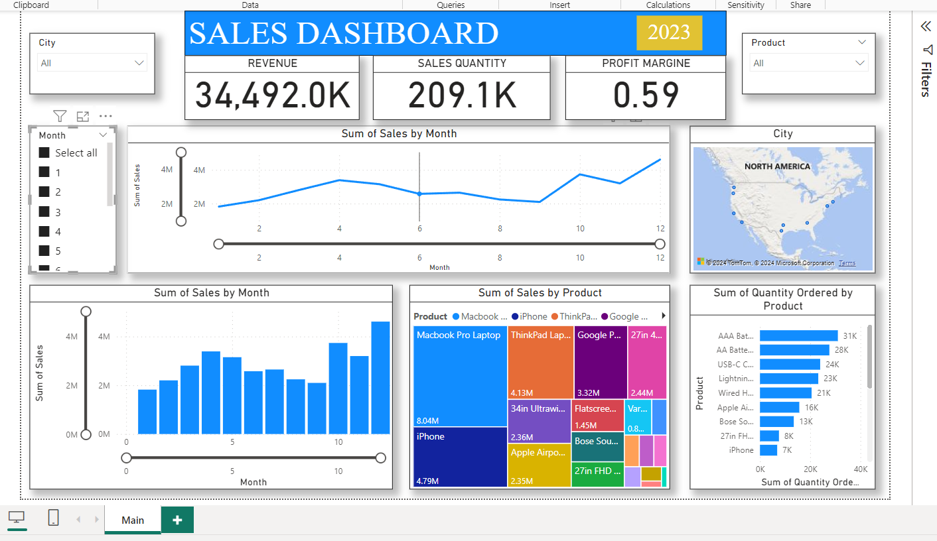
Sales Dashboard

Slide 23
Thanking You😊
-Proudly Presented by-
Mr. Arnab Adhikary
--------------------------------------
Computer Engineering Division- 1
Roll Number= 1

