Slide 1


Exoplanet Detection using Transit method
MSc Research Project
Data Analytics
Arnab Hati
Student ID: x22107321
School of computing
National College of Ireland
Supervisor: Christian Horn

Slide 2


Introduction
The detection of exoplanets is essential for understanding the diversity of the universe, habitability opportunities, and the possibility of alien life outside our solar system. Extraterrestrial life has been the focus of extensive research for decades. To detect exoplanets, many machine learning and deep learning approaches have provided important predictions.
Research Question:
How does feature-based analysis affect exoplanet detection accuracy, with a focus on CatBoost and XGBoost? Compare Deep Learning models (RNNs, Variational Encoders, GRUs) for heterogeneous architectures.
Objective
This research aims to explore different factors related to exoplanet detection and compare the performance of different models on the Kepler dataset. To determine the impact of feature selection and improve the performance of machine learning and deep learning models in exoplanet detection.

Slide 3

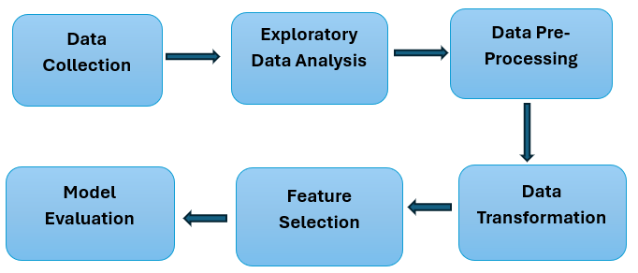
Research Methodology
This project follows a basic approach of Knowledge Discovery in Databases (KDD) methodology, bearing in mind the goal of this study to determine how well the machine learning and the deep learning model can detect two different classes of exoplanets: false positives and confirmed from the Kepler's dataset. KDD methodology is a systematic approach to analyzing the raw data, extracting knowledge from the data, and building and fine-tuning a model with rigorous testing and performance assessment.

Slide 4
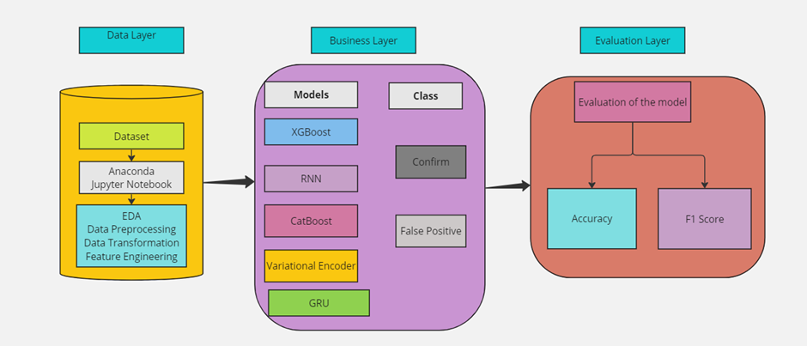
Design Specification

Slide 5
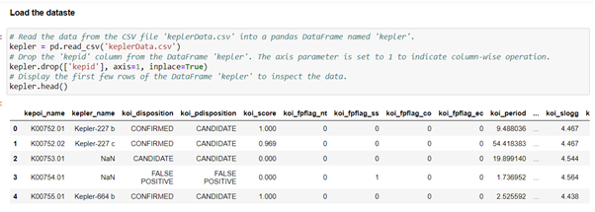
Dataset
The dataset for this thesis is available for download from NASA Directly. Here is the link to download the dataset https://exoplanetarchive.ipac.caltech.edu/cgi-bin/TblView/nph-tblView?app=ExoTbls&config=koi . The dataset consists of 49 columns with 9546 rows.

Slide 6
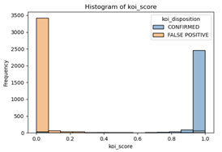
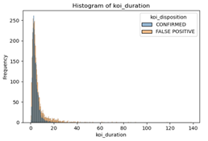
Visualization

Slide 7
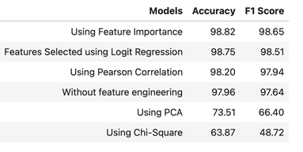
Feature Selection

Slide 8
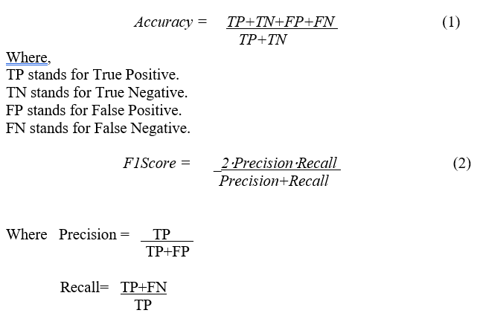
Evaluation
All models are scored based on test accuracy after training the machine model and deep learning model; training and validation loss vs. epoch; training and validation accuracy vs. epoch; and accuracy in the classification report for each model. The accuracy and F1 score can be cal.culated using the equations.

Slide 9

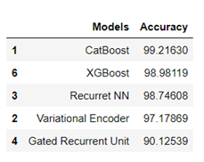
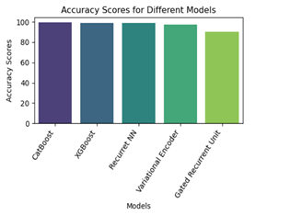
Result

Slide 10

Conclusion and Future Work
Exoplanet detection continues to be a major area of research, with many researchers using various AI and machine learning techniques. However, despite the large amount of work that has been done so far, there is still a lot of room for improvement in this area. To improve the performance of our models we used feature extraction techniques, which remove unwanted artifacts from our data. This research project highlights the use of diverse machine learning models as well as deep learning models to classify the exoplanets accurately. The machine learning model, CatBoost, and XGBoost outperform their deep learning models. By strategically using feature importance techniques to select optimal features, we improved the performance of these models could be the possible reason.
In the quest for future improvements, this project sets the stage for future extensions through careful hyperparameter fine-tuning of proposed deep learning models using a wide range of optimization techniques. Balance of the dataset is one of the most important ways to improve model performance. Based on the findings from this research, predicting the candidate label as false positive or true positive could open the door for more detailed studies using this refined dataset. In addition, the integration of high-level deep learning models (LSTM) and transformer architectures has the potential to yield better results in future research efforts.

Slide 11

Thank you

