Slide 1
TEAM 5

Slide 2
INTRODUCTION
The problem statement is about the competitive analysis of three of the major players of ATM networks in the United States.
ALL POINT
MONEYPASS
CO-OP

Slide 3
Objectives
PREDICT
Revenue of ATM Networks in each zipcode
ESTIMATE
Competitive Strength of the three ATM Networks across California State

Slide 4
framework i
MODEL
POPULATION
INCOME LEVELS
NO.OF TRANSACTIONS
ATM SURCHARGES
REVENUE

Slide 5
FRAMEWORK i
Distribution of market share proportional to the number of ATMs of each operator in every zipcode.
REVENUE
MARKET SHARE OF THESE THREE ATMS
ALL POINT
MONEYPASS
CO-OP

Slide 6
ASSUMPTIONS AND ESTIMATES
ATM Surcharge = $2.00 per Transaction.
Market share of the three ATM Networks is equal to 10%.
Market share in a zipcode is distributed proportional to the no.of ATMs of each operator in that zipcode.
ATM Surcharge is same for transactions of any value.
ATM Surcharge is same for each of the three ATM Networks.

Slide 7
ASSUMPTIONS AND ESTIMATES
Average no.of Transactions per year ranges from about 60-70.
INCOME | NO.OF TRANSACTIONS
No Earnings | 25
Less than $10k | 50
$10k - $20k | 55
$20k - $30k | 65
$30k - $40k | 70
$40k - $50k | 75
$55k - $65k | 65
$65k - $75k | 60
$75k - $100k | 50
More than $100k | 40
Notes:
We estimates the average number of transactions according to Annual Individual Earning slabs based on some research as follows based on some research.
We estimate that the most number of ATM transactions are done by upper middle class section of the society. So initially, the number of transactions increase and decrease at the end. This decrease is because the richer sections would be relying more on other modes of transactions.

Slide 8

FORMULA
$$Revenuei=st × \sum_{j}{ (tj ×P ij)}$$
$Revenuei :$ The total annual revenue generated in zipcode $i$,
$st$ : The ATM Surcharge per Transaction,
$tj$ : The average no.of transactions per year of people with income level $j$,
$P ij$ : The population with income level $j$ in zipcode $i$.

Slide 9

FORMULA
$$Revenuek,i=\left(Revenuei ×α\right) × \frac{nAllpoint,i}{nAllpoint,i+nMoneypass,i+nCoOp,i}$$
$Revenuek,i$ : The annual revenue generated by operator $k$ in zipcode $i$,
$Revenuei$ : The total annual revenue generated in zipcode $i$,
α : The combined market share of the three ATM operators,
$nk,i$: The number of ATMs of operator $k$ in zipcode $i.$

Slide 10
results
Fairly reasonable and probably close to actual values.
Min | Max | Mean | Median
770 | 7682970 | 2236318 | 2125855
Summary of Total Revenue per zipcode
Min | Max | Mean | Median
38.5 | 368934.0 | 32855.4 | 25665.6
Revenue per ATM

Slide 11
DRAWBACKS
Distribution of market share is taken proportional to the number of ATMs of each operator in every zipcode.
ATM surcharge per Transaction is taken INDEPENDENT of:
ATM Network.
Amount of Transaction.
MARKET SHARE OF THESE THREE ATMS
ALL POINT
MONEYPASS
CO-OP

Slide 12
FRAMEWORK II
MODEL
MEDIAN HOUSEHOLD INCOME
NUMBER OF HOUSING UNITS
PER-CAPITA INCOME
POPULATION
TOTAL INCOME
TOTAL MONEYFLOW

Slide 13
FRAMEWORK II
Distribution of market share proportional to the number of ATMs of each operator in every zipcode.
TOTAL MONEY FLOW
REVENUE GENERATED IN ATMS
MARKET SHARE OF THESE THREE ATMS
ALLPOINT
MONEYPASS
CO-OP

Slide 14
Assumptions and estimates
Percentage of total money flow that goes into the ATMs as revenue for each of the three ATM operators is equal.
Market share of these three ATM Networks is equal to 10%.
Percentage of the total income that goes into the ATMs is according to the Annual Individual Earning slabs.
Market share in a zipcode is distributed proportional to the no.of ATMs of each operator in that zipcode.

Slide 15

formula
$$Revenuei=\left(ci ×TPi\right) × \sum_{j}{(βj ×Pij)}$$
$Revenuei$ : The total annual revenue generated in zipcode $i$,
$ci$ : The per capita income of the population of zipcode $i$,
$TPi$ : The total population of zipcode $i$,
$βj$ : The percentage of the total income that goes into the ATMs as revenue of people with income level $j$,
$Pij$ : The population with income level $j$in zipcode $i$,

Slide 16

FORMULA
$$Revenuek,i=\left(Revenuei ×α\right) × \frac{nAllpoint,i}{nAllpoint,i+nMoneypass,i+nCoOp,i}$$
$Revenuek,i$ : The annual revenue generated by operator $k$ in zipcode $i$,
$Revenuei$ : The total annual revenue generated in zipcode $i$,
α : The combined market share of the three ATM operators,
$nk,i$: The number of ATMs of operator $k$ in zipcode $i.$

Slide 17
results
Quite different from those of framework I.
Because of the difference in the approaches to calculate the revenues in the two frameworks.

Slide 18
DRAWBACKS
The percentage of the total income that goes into ATMs as revenue would be the same for all the three ATMs.
Distribution of market share is taken proportional to the number of ATMs of each operator in every zipcode.
MARKET SHARE OF THESE THREE ATMS
ALL POINT
MONEYPASS
CO-OP
Notes:
1)It is also possible that this percentage need not be same for all zipcodes.

Slide 19

comparing the frameworks I AND II
The assumptions of FRAMEWORK I :
The number of transactions.
ATM surcharge per transaction.
The reliability of framework I made us train an optimization model to minimize the difference between two values of revenues.
Thus optimizing the weights $βj$.
$βj$ : Percentage of total income that goes into ATMs based on the income levels.
FRAMEWORK I
FRAMEWORK II

Slide 20
competitive strength
Refers to leverage that a company has over its competitors.
allows to generate greater sales or margins.
allows to retain more customers than its competitors.
Gained by offering customers better and greater value.
Indicates which ATM network is preferred by the customers.
factors
Product offerings
Firms cost structure
Network distribution
location
Customer support
Many more…
Notes:
1.Allows it to generate greater sales or margins, and retain more customers than its competitor
2.Competitive strength is gained by offering customers better and greater value and should indicate whose ATM’s are preferred by the customers over the others and thus depends on the factors such as……

Slide 21
EVALUATION
Need comparison across a common factor.
In sufficient data.
Revenue/number of ATMs in a zip code
Transactions
Cost of the ATMs
Distribution of ATMs
Notes:
1)According to this if a company is able to put more ATM’s its competitive strength is higher but it should not be the case because as said earlier competitive strength should indicate whose ATM’s are preferred by the customers over the others which depends on the factors such as….
2)Since we don’t have any data of the transactions in the ATM’s or the cost of the ATM’s or the micro-level data of the distribution of ATM’s in a zip code , we propose the following method

Slide 22
evaluation
Indicates which ATM operator has placed its ATM’s more optimally.
Common factor
ATM operator with higher revenue per ATM in a county has placed its ATMs in a better way inside that county.
Revenue per ATM county wise
Notes:
1)ATM density of an area should ideally be indicative of the commercial activity and population of that area. Thus , better placement of ATM’s implies placement in populous and commercial areas. Revenue calculated earlier is an indicative of exactly that.
2)Since in a zip code we calculated revenue per ATM by dividing market share of the three ATM operators by total number of ATM’s belong to these three by which if we calculate competitive strength we’ll get equal value for three of them there by we cannot pull out conclusion. So, we calculate revenue per ATM in a county as a measure of competitive strength.

Slide 23

measure
Competitive Strength _{k ,x} = $\frac{\sum_{∀ i in x}{Revenue k, j}}{\sum_{∀ i in x}{n k,j}}$
Competitive Strength _{k ,x} : The competitive strength of operator $k$ in county x,
Revenue _{k ,j} : The annual revenue generated by operator $k$ in zip code j,
n _{k ,j} : The number of ATMs of operator $k$ in zip code j.

Slide 24
inferences
ATM operator who has put their ATMs in the areas with higher population and people with higher income will have higher revenue per ATM.
Putting up more number of ATMs doesn’t necessarily mean that the competitive strength is higher.
Allpoint | Co-Op | MoneyPass | More than 1
26 | 04 | 21 | 05
Number of Counties in which operator has higher competitive strength
Allpoint | Co-Op | MoneyPass | More than 1
39 | 09 | 06 | 02
Number of Counties in which operator has higher number of ATMs

Slide 25
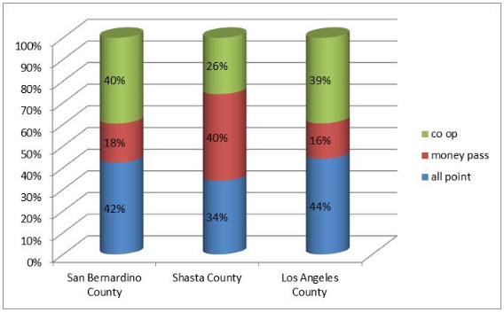
inferences
Higher number of ATMs need not imply higher competitive strength.
ATM operator with higher competitive strength
SanBernardino County:
Moneypass: Lesser no.of ATMs.
Shasta County:
Allpoint: Intermediate no.of ATMs.
Los Angeles County:
Allpoint: Higher no.of ATMs.
Percentage of ATMs of each ATM operator in three Counties

Slide 26
inferences
Co-Op has very high number of ATMs all across the state as compared to Moneypass, But Moneypass has higher competitive strength in more number of counties (21) than Co-Op (04).
Probable reasons
MoneyPass has placed its ATMs optimally across Counties.
Co-Op has higher competitive strength in only a few Counties because:
It has put its ATMs improperly in areas of less population.
It has evenly distributed its ATMs across all Counties.
Allpoint | Co-Op | MoneyPass
5002 | 4353 | 1564
Number of ATMs across California

Slide 27
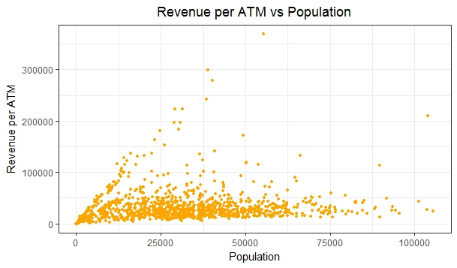
INFERENCES
Population/Commercial value of an area values implies revenue in that county.
Notes:
In the graph it can be observed that there are few zip code’s where the revenue per ATM is very less ($38).This is because the population is very low(in this case 6).In some zip codes the revenue per ATM is as high as $368,934.This is either because the area is highly populous(55431) and has really high commercial value.

Slide 28
Issues with data
Zip codes data missing.
Specific location of ATMs.
Data of distance between zip codes.
Search zip code
Result zip code
Notes:
1)In some cases result zip code is around 120 miles away from search zip code. Thus, we ignored the search zip code. If we could have had the accurate data of the search zip code, we could have used it to map with the result zip code, and employed it to give the ATM operator with more such mapping an advantage.
2)There are few zip codes where ATM’s are placed by the ATM operator’s, but data of those zip codes are missing in population data sheet. Thus, we ignored those zip code’s in our analysis
3)ATMs data sheet contains a column ‘NAME’ of the ATM. There are around 900 places where ATM’s are present. If we could have some more information about specific location of ATM’s, then this could have been an important factor in our analysis.
4)If we would have the data of distances between the zip codes, then we could have considered the factor that population in a zip code can access ATM’s in nearby zip code’s.

Slide 29
conclusions
This analysis helps us to understand how to put up and distribute ATMs optimally in the locations as per:
Population of the area.
Income levels in the area.
This analysis can be of immense help to banks and ATM owners:
Helps banks to decide which ATM network is better and collaborate with such ATMs.
ATM owners can decide about optimal placement of ATMs.

Slide 30
Thank you!
ANY QUESTIONS ?

