Slide 1
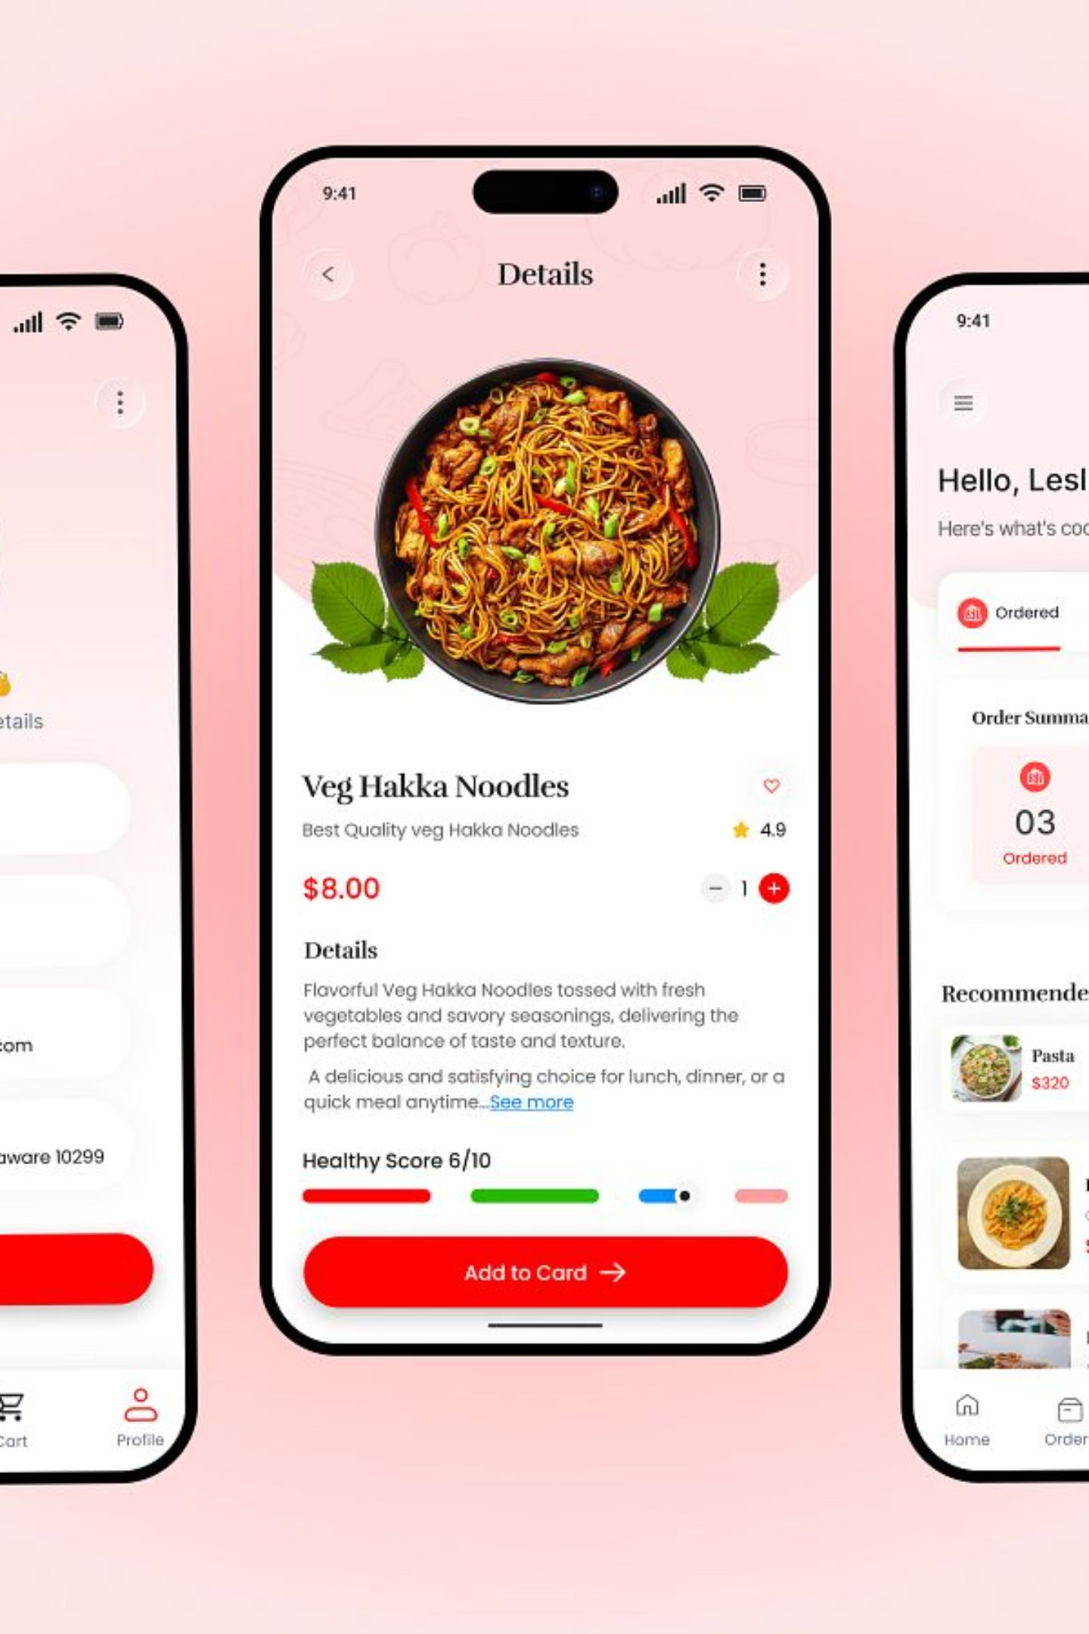
Food Delivery Platform: 2023 Performance Review
A comprehensive look at 200K total orders, ₹165M in revenue, and the operational metrics shaping our delivery business across 15+ cities.

Slide 2
Key Performance Metrics
200K
₹824
Total Orders
Avg Order Value
165M
20K
Total Revenue
Total Customers
50.28%
44.55
Repeat Customer %
Avg Delivery Time (min)

Slide 3
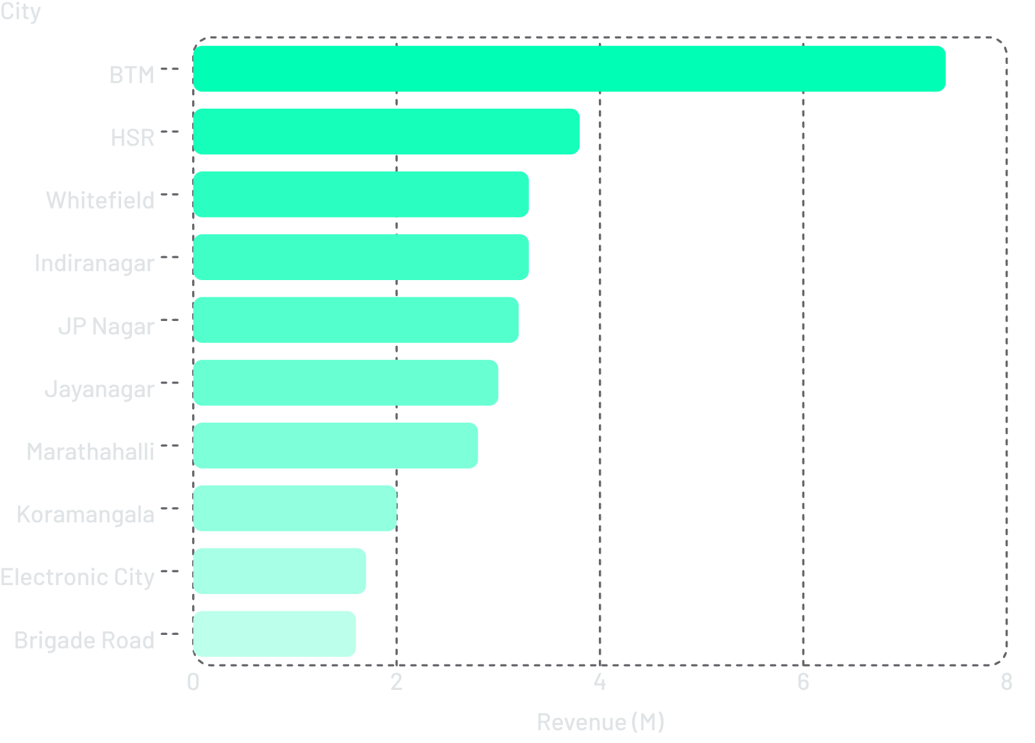
Revenue by City
BTM Leads by a Wide Margin
BTM generates ₹7.4M — nearly double HSR's ₹3.8M. The top 6 cities account for over ₹24M in combined revenue, representing the platform's core urban markets.

Slide 4
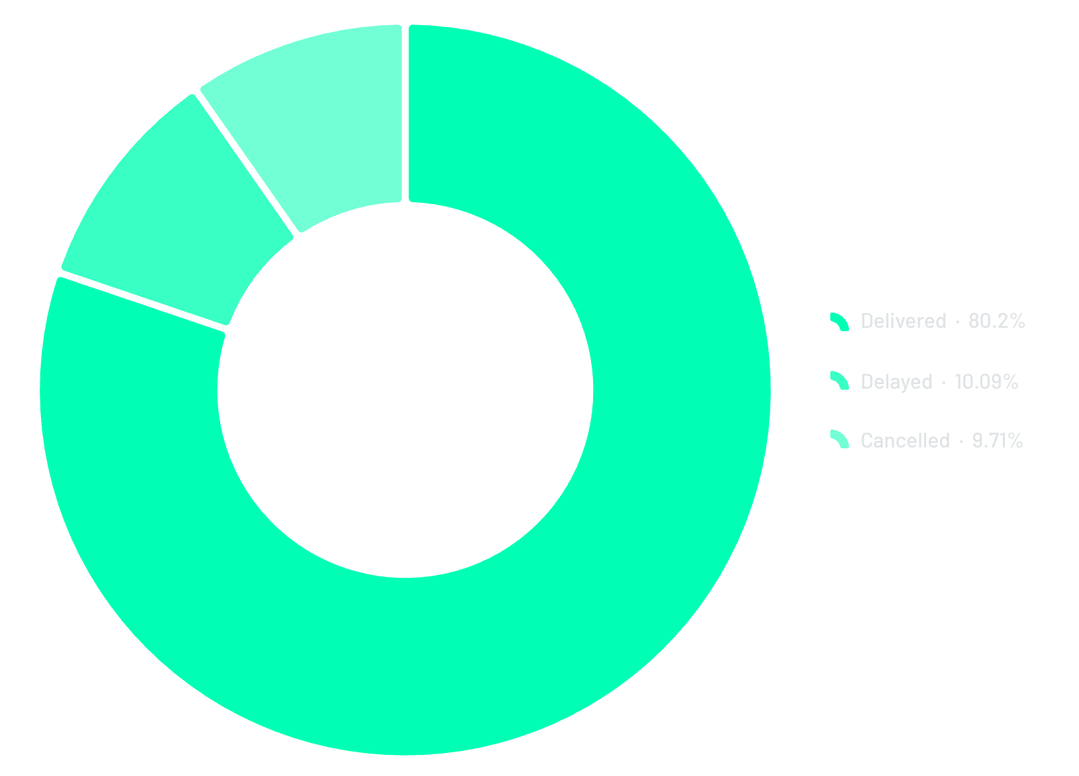
Order Status & Delivery Performance
80.2% Delivery Success Rate
Of 200K total orders: 36.18K delivered, 4.55K delayed (10.08%), and 4.38K cancelled (9.72%).
96K Late Orders
20K Cancelled
48.12% late delivery rate
Across all cities

Slide 5
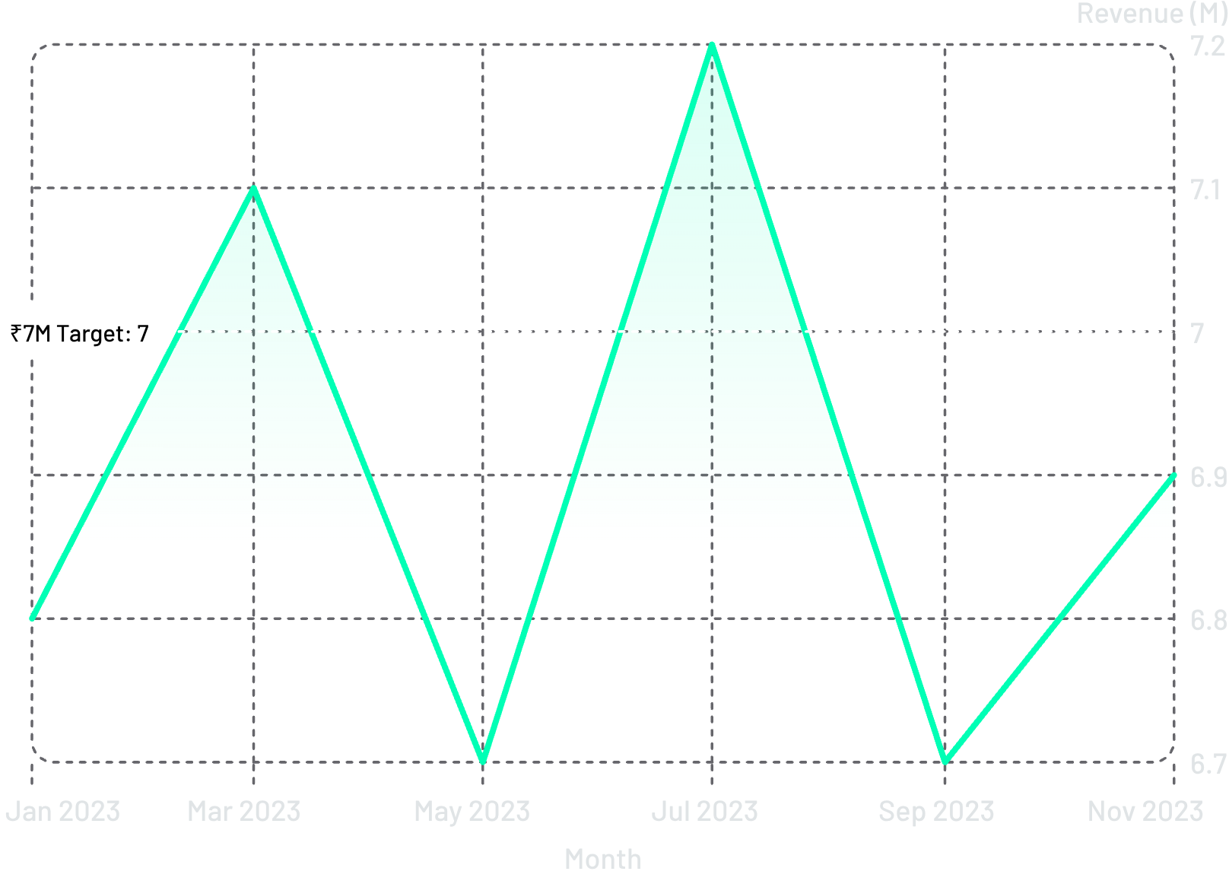
Revenue Trend: Jan – Nov 2023
Stable Revenue with a July Peak
Revenue peaked at ₹7.2M in July, dipping to ₹6.7M in May and September. Overall trend remains stable between ₹6.7M–₹7.2M throughout 2023.

Slide 6
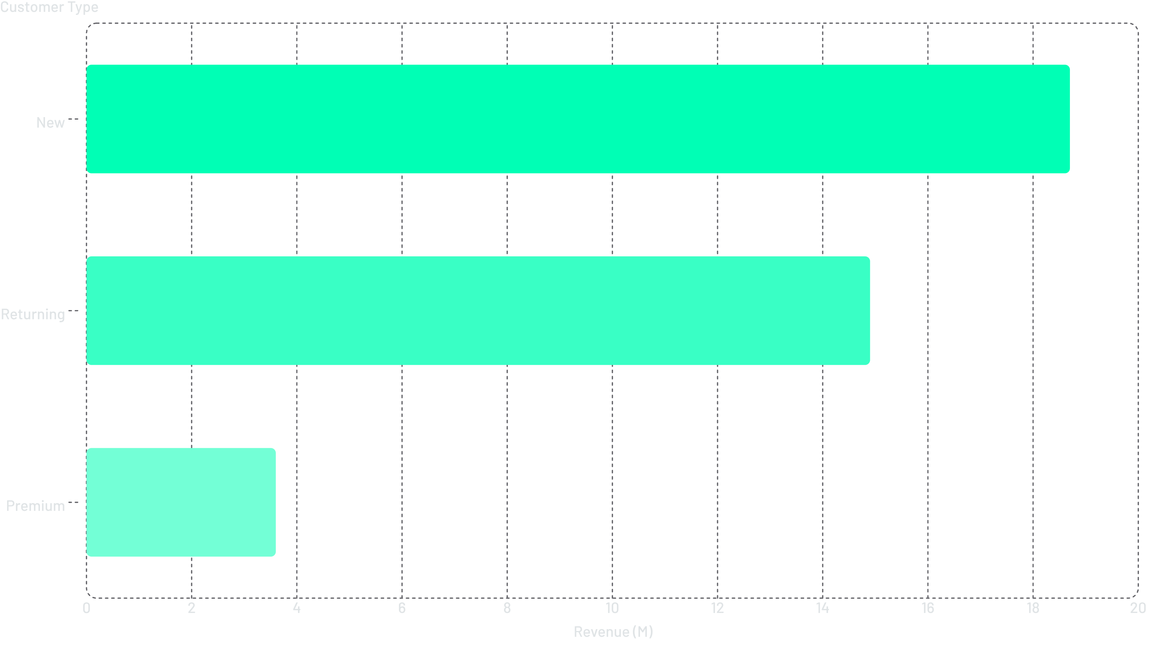


Customer Segmentation
New Customers Drive Revenue
New customers contribute ₹18.7M vs. ₹14.9M from returning and ₹3.6M from premium. With 10 orders per customer on average and 50.28% repeat rate, retention is a key growth lever.
50.4%
49.6%
New Customers
Repeat Customers

Slide 7
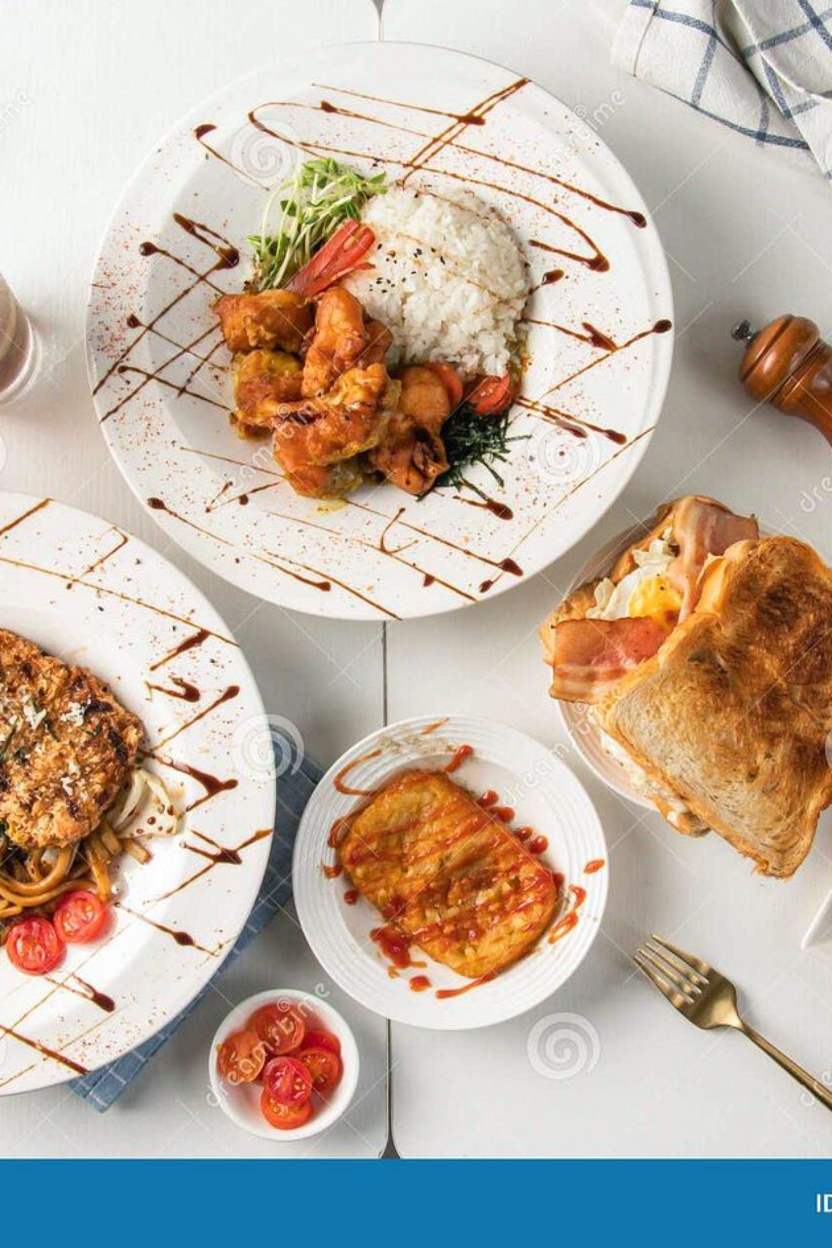
Restaurant & Cuisine Insights
52K Restaurants
Top Cuisine: North Indian
Avg rating 3.70 · ₹3.18K revenue per restaurant
9.8K orders — more than double South Indian (4.1K) and Cafe (3.5K)
Budget Dominates Orders
~10.5K orders vs. Premium (~6.5K) and Mid Range (~1.5K)
Top restaurants by revenue include Cafe Thulp (~₹4.5K), 99 Pancakes (~₹4.2K), and Ande Ka Funda (~₹4.1K).

Slide 8
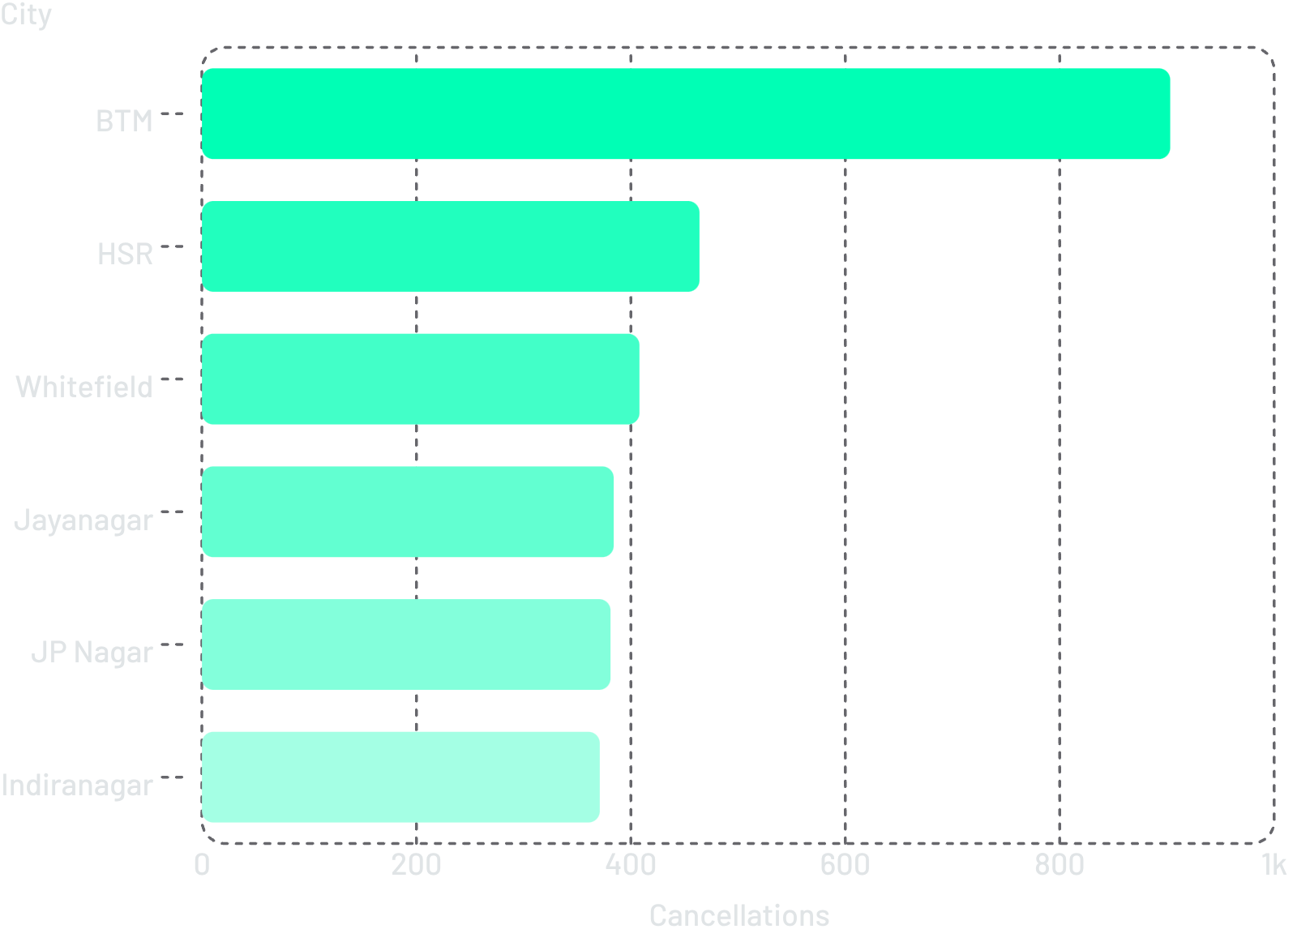

Delivery Performance Deep Dive
BTM Has Highest Cancellations
BTM leads with 903 cancellations, followed by HSR (464) and Whitefield (408). Delivery status shows 63.87% late vs. 36.13% on-time overall.
Avg delivery time of 44.55 min and 48.12% late rate signal operational friction requiring attention.

Slide 9
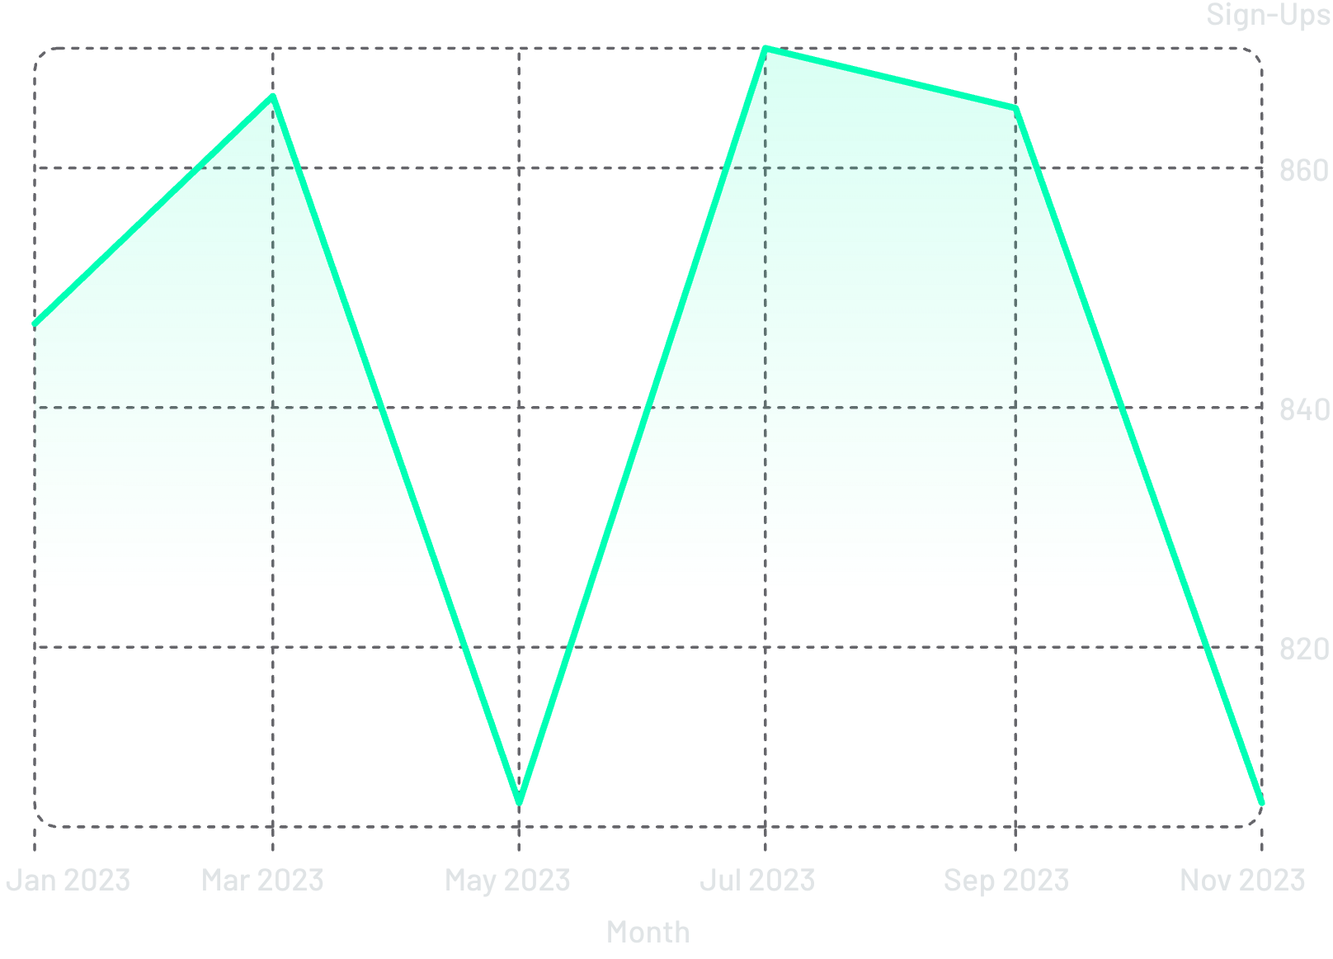
Sign-Up Trend & Restaurant Ratings
Steady User Acquisition
Sign-ups remained consistent between 800–870 per month, peaking in August (872). Platform maintains a 3.70 avg rating across 52K restaurants with 283.70 average votes per restaurant.

Slide 10




Key Takeaways & Opportunities
Strengthen Delivery Operations
48.12% late delivery rate and 96K late orders demand logistics optimization, especially in BTM and HSR.
Convert New Customers to Repeat
New customers drive ₹18.7M in revenue. Improving the 50.28% repeat rate is a high-impact growth lever.
Expand in Top Cities
BTM's ₹7.4M revenue dwarfs smaller cities. Focused investment in HSR, Whitefield, and Indiranagar can close the gap.

