Slide 1
Study Question: To what extent can a product's rating be predicted by the customer's age and the product category?
ARNAB DAS

Slide 2
Objective of this Analysis
Business Scenario: For a modern e-commerce platform, which functions as a complex software product, understanding the key drivers of customer satisfaction is crucial for improving user experience, tailoring product offerings, and ultimately increasing sales. The platform collects a vast amount of data, including customer demographics and product ratings. We aim to investigate if customer age and the category of the product have a combined, predictable effect on customer satisfaction, as measured by product ratings.
Study Question: To what extent can a product's rating be predicted by the customer's age and the product category?
Justification: Answering this question provides significant value by allowing the business to make more informed, data-driven decisions. By understanding the independent contribution of each factor, the business can determine if a low rating is due to the product itself (category), a mismatch with a demographic profile (age), or a combination of both. This allows for targeted improvements in marketing, inventory management, and personalization features within the e-commerce software.

Slide 3
Dataset used for the Analysis
Chosen Dataset: We will analyse the "Women's E-Commerce Clothing Reviews" dataset.
URL: https://www.kaggle.com/datasets/nicapotato/womens-ecommerce-clothing-reviews
Justification for Choice: This dataset is perfectly suited for our study question as it contains all the necessary variables for a multiple regression analysis: a clear dependent variable (Rating), a numerical independent variable (Age), and a categorical independent variable (Department Name). Furthermore, it adheres to the project requirements of being freely accessible on the web and containing no confidential information.
Alternatives Considered: We considered using a more general Amazon reviews dataset. However, we chose this one because its focus on a single domain (clothing) reduces external variables, allowing for a more focused and interpretable analysis of the factors we wish to study.

Slide 4
Analysis Technique used and why?
Chosen Technique: Multiple Linear Regression.
Justification: Our study question aims to predict a numerical outcome (Rating) based on several independent factors (Age and Department Name). Multiple Linear Regression is the most appropriate technique for this task.
  Handles Multiple Predictors: It allows us to model the combined effect of several independent variables on a single dependent variable, which is perfect for our study.
  Quantifies Individual Impact: The model's output provides coefficients that quantify the independent contribution of each variable. This allows us to isolate the effect of Age from the effect of Department Name, providing deeper insights.
  Predictive Capability: The technique is designed to create a predictive formula, which directly aligns with our goal of understanding the drivers of customer ratings.

Slide 5
Results of analysis and Conclution?
Analysis Performed: A multiple linear regression model was built to predict the Rating (dependent variable) based on the customer's Age and the product's Department Name (independent variables). The 'Bottoms' department was used as the baseline for comparison.
Results: The model produced an intercept and a set of coefficients for each independent variable, which are displayed in the table below.
The chart below visualizes these regression coefficients. It is immediately clear that the 'Trend' department has the largest negative impact on predicted ratings, while the effect of 'Age' is negligible.
Variable | Coefficient
Intercept (Baseline: 'Bottoms') | 4.1803
Age | 0.0025
Dept_Dresses | -0.1355
Dept_Intimate | -0.0041
Dept_Jackets | -0.0264
Dept_Tops | -0.1191
Dept_Trend | -0.4761

Slide 6
To provide business context, we also plotted the average rating for each department. This chart confirms the model's findings, showing a noticeable dip in customer satisfaction for the 'Trend' category.
Conclusions:
  Interpretation of Results: The analysis reveals that the product's department is a significant predictor of its rating, while the customer's age is not. The large, negative coefficient for the 'Trend' department (-0.4761) indicates that items in this category are rated, on average, almost half a star lower than items in the 'Bottoms' department.
  Answering the Study Question: Our model shows that product category is a key predictor of ratings. The scatter plot below visually confirms that Age has no meaningful linear relationship with Rating, as the data points form a scattered cloud with no clear trend.
  Business Implication: The business should prioritize an investigation into the 'Trend' department to understand the root cause of this significant customer dissatisfaction. Age, on the other hand, should not be considered a key factor for segmenting customers based on satisfaction.

Slide 7
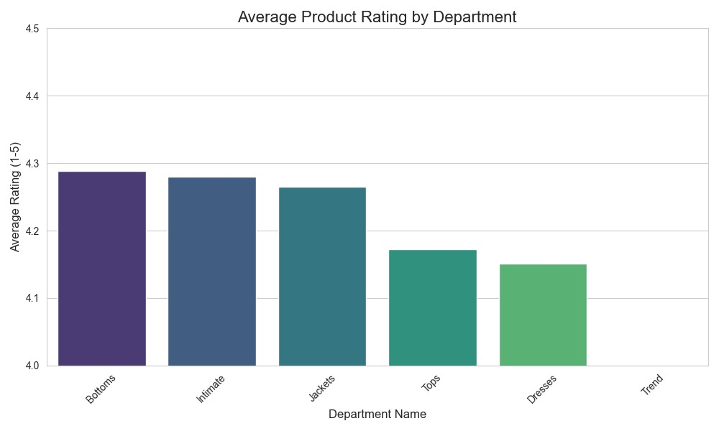

Slide 8
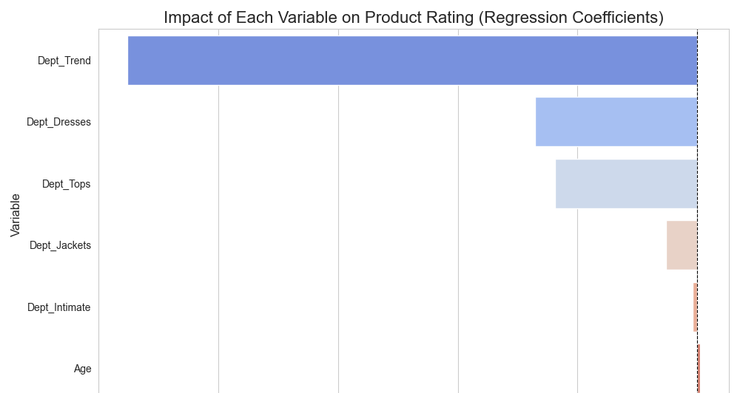
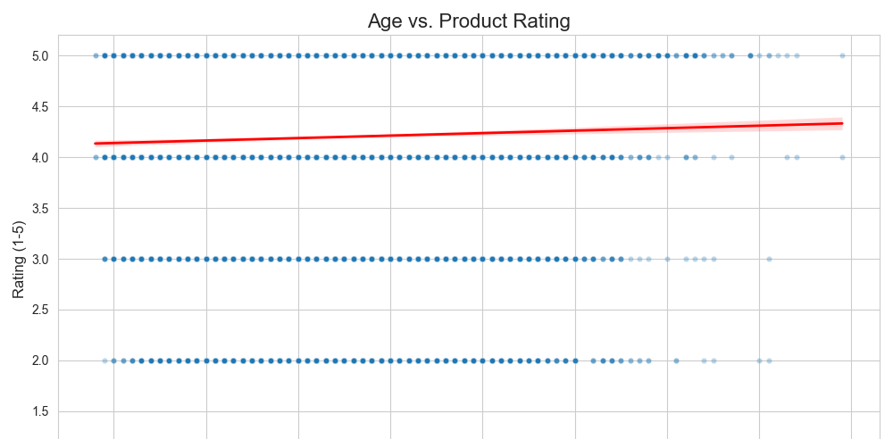

Slide 9
Resources
Dataset:
  Potatoboy, N. (2018). Women's E-Commerce Clothing Reviews. Kaggle. Retrieved October 11, 2025, from https://www.kaggle.com/datasets/nicapotato/womens-ecommerce-clothing-reviews
Technical Guidance:
  W3Schools. (n.d.). Python Machine Learning - Multiple Regression. Retrieved October 11, 2025, from https://www.w3schools.com/python/python_ml_multiple_regression.asp
Software and Libraries:
  Python 3
  Pandas (for data manipulation)
  Scikit-learn (for building the linear regression model)
  Matplotlib & Seaborn (for generating diagrams)

