Slide 1
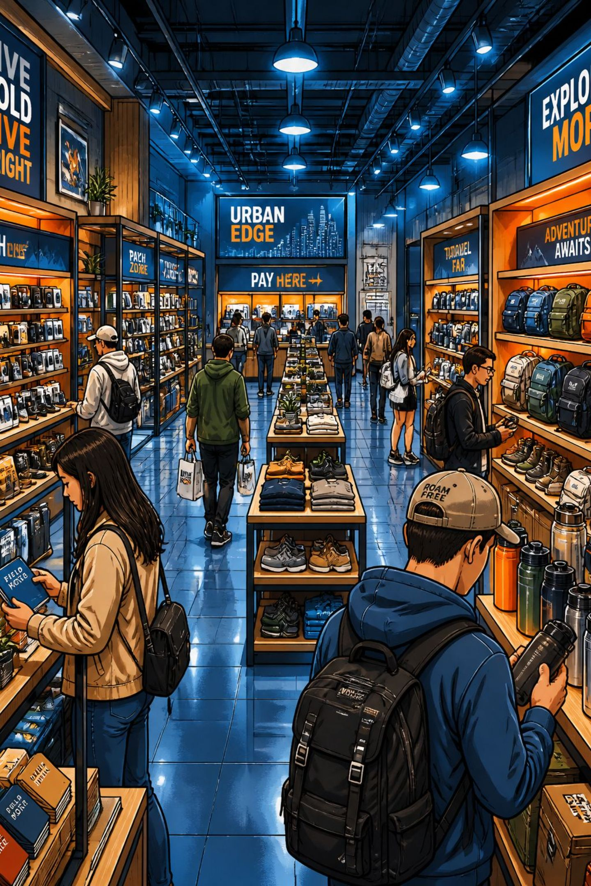
Customer Shopping Behavior Analysis
Analysis of 3,900 retail transactions to uncover purchasing patterns, product performance, and revenue trends using Python, MySQL, and Power BI.

Slide 2

Project Overview
Scope
Objectives
3,900 customer records, 18 columns covering demographics, purchases, payments, shipping, and reviews.
Identify purchasing patterns, product performance, and revenue trends to inform marketing, engagement, and inventory planning.
Tools
Data cleaning & EDA in Python (Pandas), business analysis in MySQL, interactive visualization in Power BI.

Slide 3
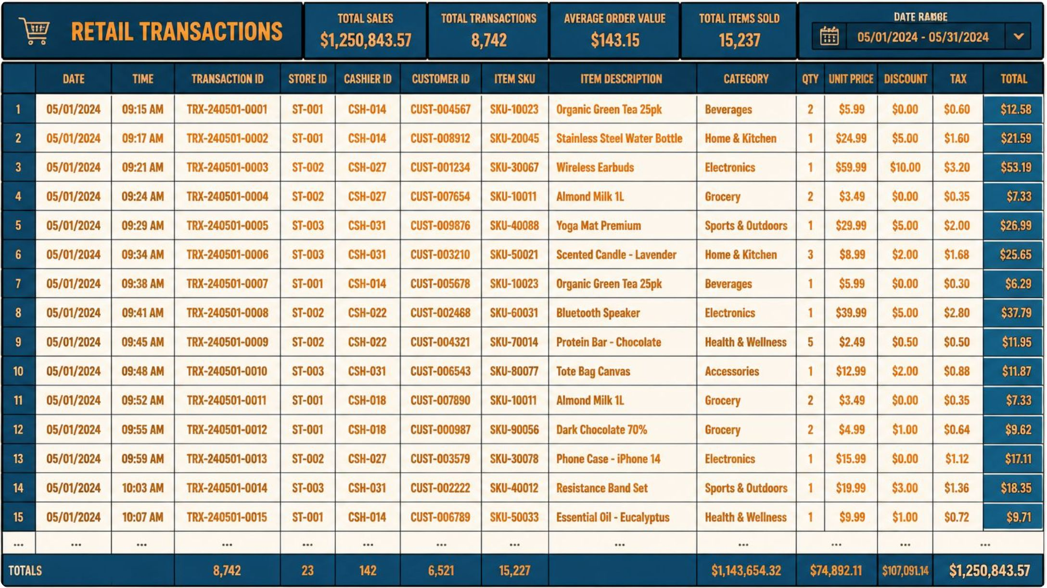
Dataset Summary
Key facts
Total records: 3,900
Total columns: 18
Includes demographics, item, category, purchase_amount, season, review_rating, shipping, discounts
37 missing values in Review Rating (handled)

Slide 4




EDA & Preprocessing (Python)
Data Loading
Missing Data
Imported into Pandas DataFrame; used df.info(), df.describe(), df.isnull().sum().
37 missing review ratings filled via category-wise median imputation to preserve trends.
Standardization
Feature Engineering
Renamed columns to snake_case for readability and SQL friendliness.
Created age_group and purchase_frequency_days to support segmentation and time-based analysis.

Slide 5
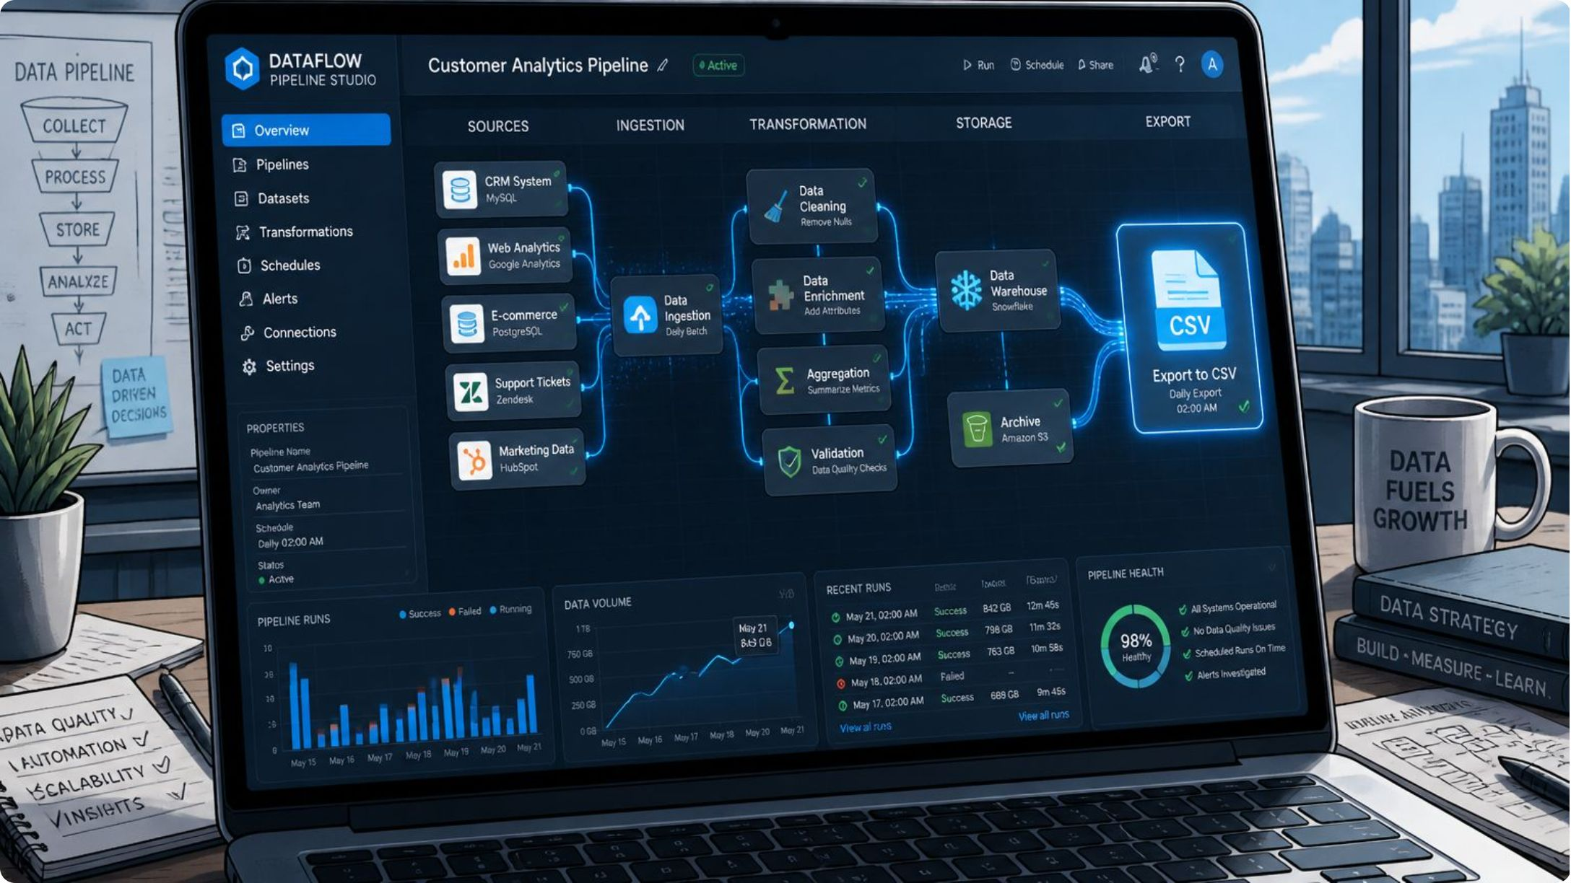
Cleaned Dataset Export
Workflow
Saved cleaned CSV → imported into MySQL for business queries → used as Power BI data source for the interactive dashboard.

Slide 6


SQL Analysis — Revenue & Category Insights
Revenue by Category
Subscribers vs Non-Subscribers
Clothing: 104,264 • Accessories: 74,200 • Footwear: 36,093 • Outerwear: 18,524
Avg purchase: Subscribers $59.49 (total 62,645) • Non-subscribers $59.87 (total 170,436)

Slide 7
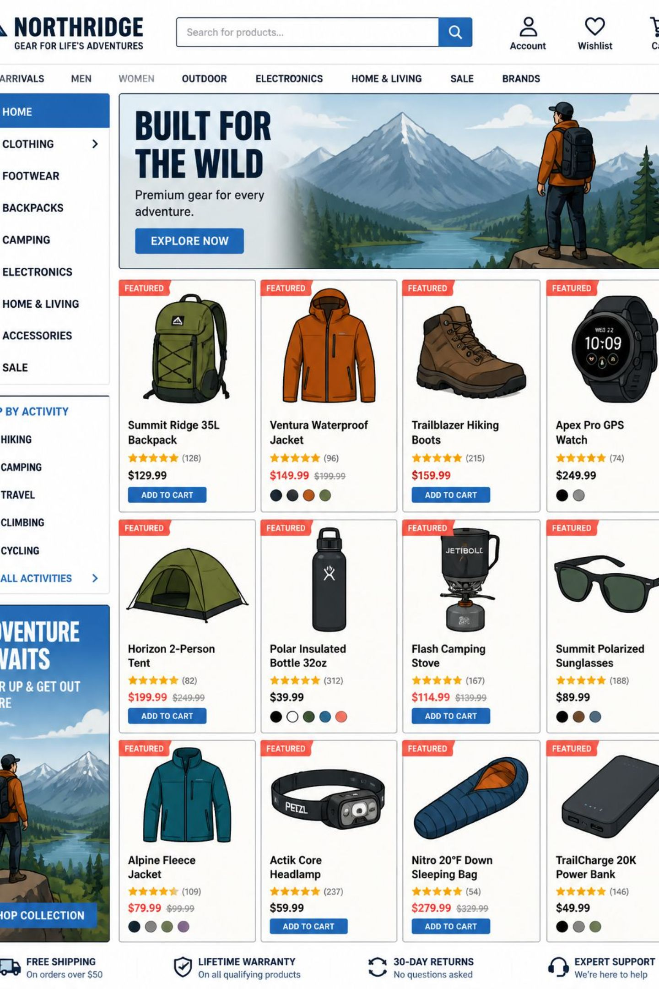



SQL Analysis — Product & Customer Rankings
Top-Rated Products
Gloves 3.86 • Sandals 3.84 • Boots 3.82 • Hat 3.80 • Handbag 3.78
Top Products by Sales
Top items per category identified via DENSE_RANK (e.g., Blouse & Pants top Clothing; Sandals top Footwear).
Top Customers
Top 5 customers tied at total_amount 100 (ranked via ROW_NUMBER).

Slide 8
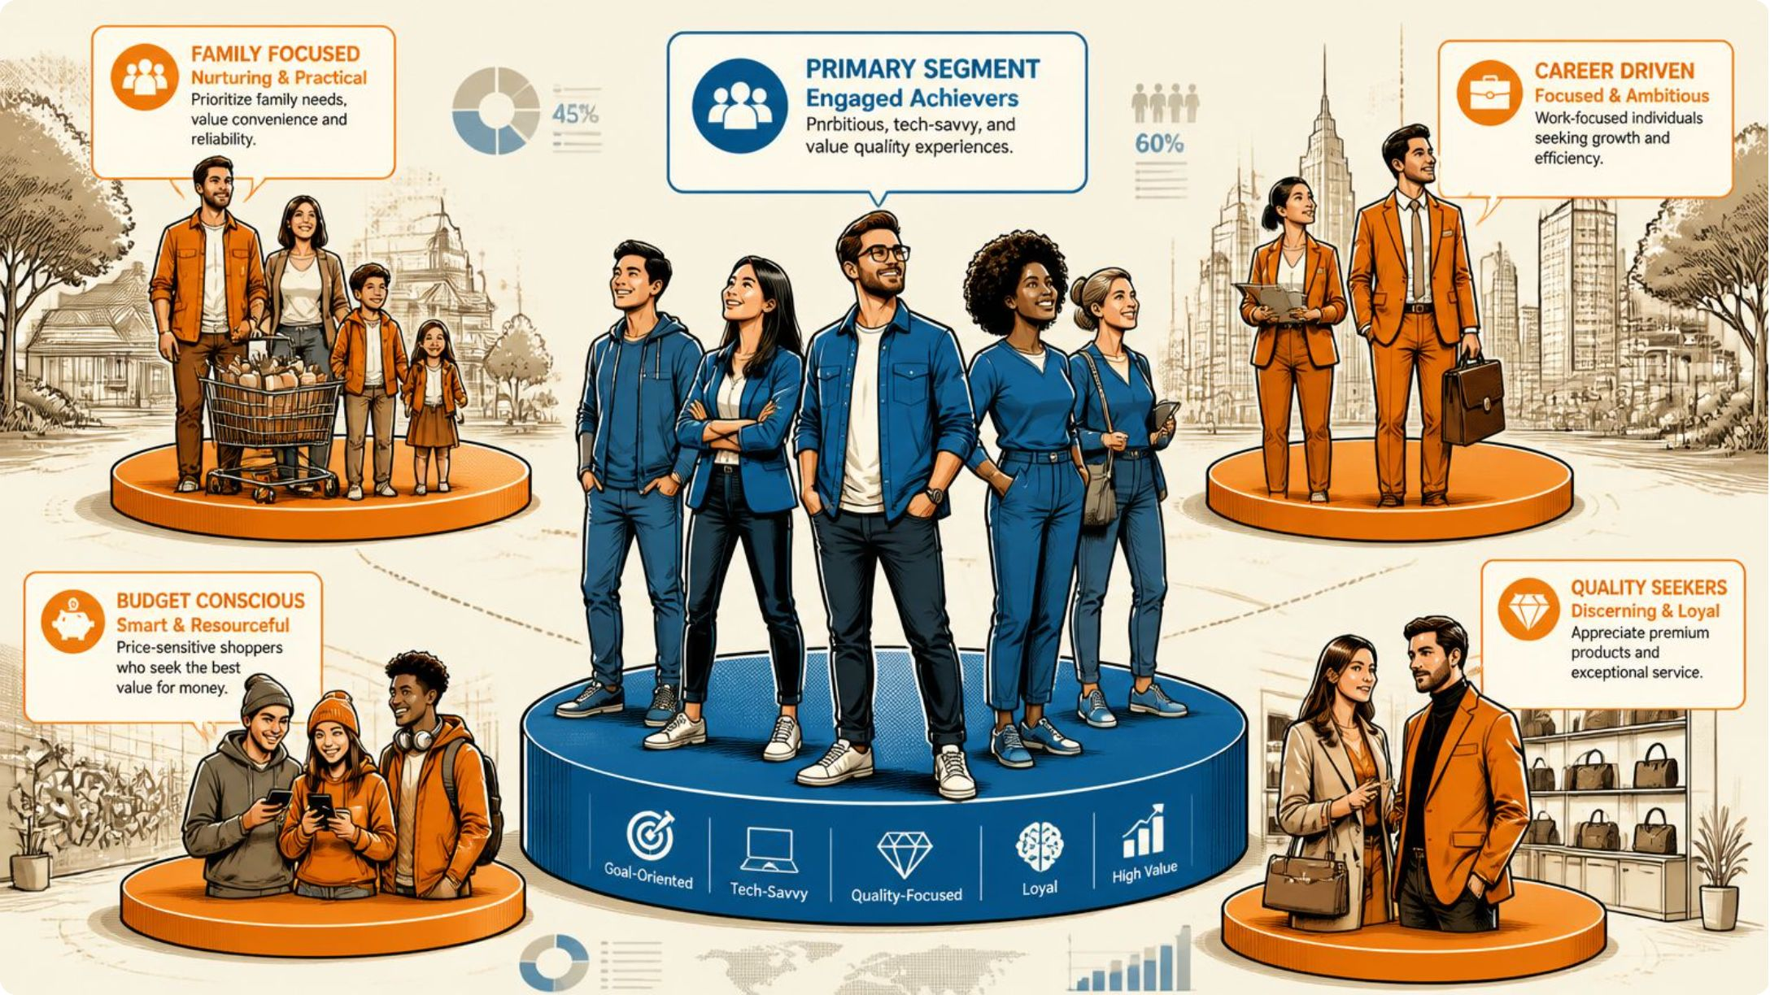
SQL Analysis — Patterns & Segments
High-sales / low-rating products: Blouse, Shirt, Shorts, Dress, Sunglasses, Pants, Scarf — strong sales despite lower average ratings.
Revenue by segment: Loyal $185,517 • Returning $42,711 • New $4,853.
Revenue by gender: Male $157,890 • Female $75,191.

Slide 9
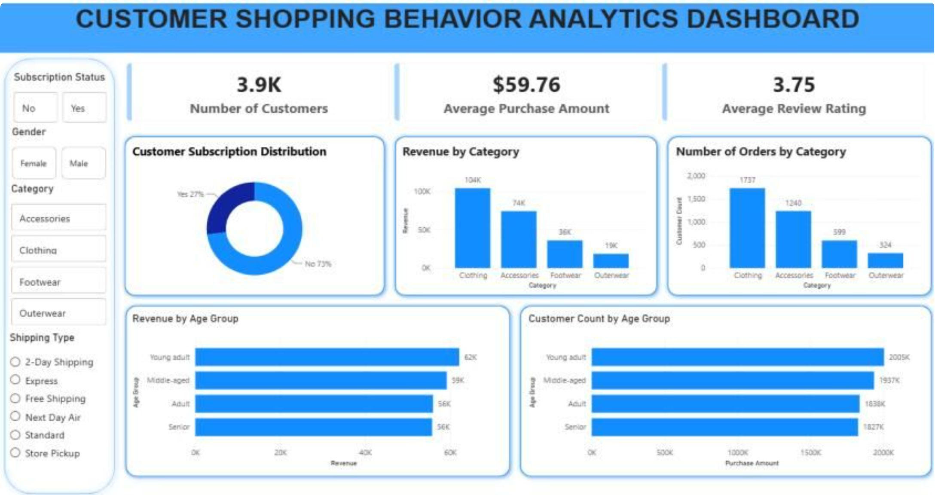
Power BI Dashboard Highlights
Interactive dashboard with KPIs, slicers, and visuals for subscription distribution (Yes 27% / No 73%), revenue by category, orders by category, revenue and customer counts by age group, and average metrics (customers 3.9K, avg purchase $59.76, avg rating 3.75).

Slide 10


Business Recommendations & Conclusion
Strengthen Subscriptions
Prioritize High-Revenue Categories
Reward High-Value Customers
Promote Top-Rated & Best-Sellers
Enhance benefits and promotions to grow subscriber base and retention.
Deploy loyalty tiers (Silver/Gold/Platinum) and exclusive offers to increase LTV.
Boost inventory, marketing, and promotions for Clothing and Accessories.
Feature high-rated items in campaigns to drive satisfaction and sales.
Review Underperformers
Conclusion
Project demonstrated end-to-end analytics: cleaning, SQL analysis, and Power BI dashboarding to inform segmentation, inventory planning, and marketing strategy.
Investigate products with high sales but low ratings for quality improvements.

