Slide 1
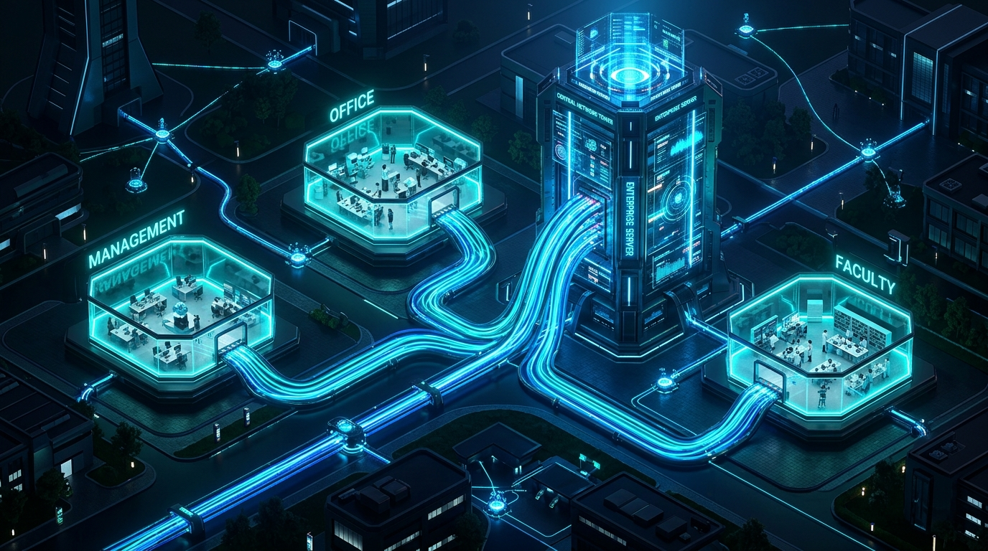
ENTERPRISE NETWORK SIMULATION
COLLEGE CAMPUS
LAN NETWORK
Automated Dynamic Addressing (DHCP) & Mesh Backbone Routing (OSPF Area 0) across Multi-Department Infrastructure.
3
DEPARTMENTS
18
END WORKSTATIONS
100%
FAILOVER SUCCESS
Author: ARNAB RAJU HALDER | Powered by Cisco Packet Tracer

Slide 2
MODULAR CAMPUS DESIGN
Three Dedicated Campus Department Zones
ZONE 01
Management Dept.
Executive Core & Decision Hub
Subnet: 192.168.10.0/24
6 Client PCs wired to Layer-2 Switch. Direct high-priority link to Core Router 1.
✓ Isolated Broadcast Domain
✓ Automated DHCP Leasing
✓ Full OSPF Routing Reach
ZONE 02
Office & Accounts
Administrative & Records Hub
Subnet: 192.168.20.0/24
6 Client PCs handling student records and bursar billing. Connected via Switch 2 to Router 2.
✓ Isolated Broadcast Domain
✓ Automated DHCP Leasing
✓ Full OSPF Routing Reach
ZONE 03
Teaching Faculty
Academic Research & Faculty Desks
Subnet: 192.168.30.0/24
6 Faculty PCs for syllabus & academic systems. Conn ected via Switch 3 to Router 3.
✓ Isolated Broadcast Domain
✓ Automated DHCP Leasing
✓ Full OSPF Routing Reach

Slide 3
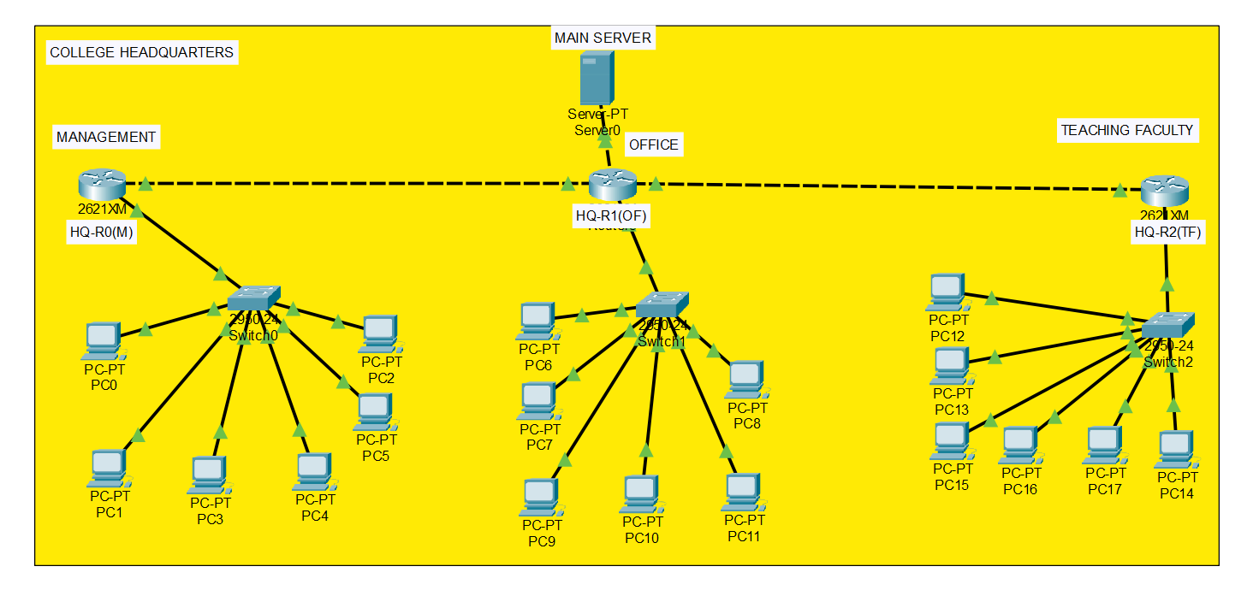
NETWORK IMPLEMENTATION
Cisco Packet Tracer Physical Simulation Topology
Core Routers (3 Units)
Form a resilient mesh core. Each router acts as the default gateway for its local department.
Access Switches (3 Units)
Catalyst 2960 24-port switches distribute wired ethernet to local endpoints with 0 packet loss.
Campus Main Server
Centralized server hosting DHCP scopes for all subnets, preventing IP conflicts across 18 PCs.
Serial & FastEthernet Links
Fast point-to-point connections with dedicated /30 subnets for zero address waste.

Slide 4

ZERO-TOUCH HOST ONBOARDING
Automated IP Provisioning with Central DHCP
THE 4-STEP DORA PROCESS
1. Discover: Client broadcasts 'Who is the DHCP server?'
2. Offer: Central server reserves IP & offers lease unicast.
3. Request: Client formally accepts the offered IP parameters.
4. Acknowledge: Server registers MAC & confirms parameters.
HOW DHCP CROSSES ROUTERS:
Routers block broadcasts (255.255.255.255). We configured 'ip helper-address' to convert broadcasts to unicast destined for our Central Server.
Router-MGMT(config-if)# ip helper-address 192.168.100.2

Slide 5

SELF-HEALING CORE
High-Speed Dynamic Routing: OSPF Area 0
WHY OSPF BEATS STATIC / RIP
• Dijkstra SPF Algorithm: Calculates optimal routes based on link bandwidth/cost, not crude hop counts.
• Area 0 Backbone: Prevents loops and guarantees efficient hierarchical packet transport.
• Fast Convergence: Re-evaluates paths immediately when a link drops using triggered LSAs.
CISCO IOS CONFIGURATION:
Router(config)# router ospf 1
Router(config-router)# router-id 1.1.1.1
Router(config-router)# network 192.168.10.0 0.0.0.255 area 0
Router(config-router)# network 10.0.0.0 0.0.0.3 area 0

Slide 6
NETWORK ADDRESSING
Logical IPv4 Subnetting & Gateway Matrix
Zone / Subnet | Network ID | Subnet Mask | Usable Host Range | Default Gateway
Management Dept. | 192.168.10.0/24 | 255.255.255.0 | 192.168.10.2 - 192.168.10.254 | 192.168.10.1
Office / Admin Dept. | 192.168.20.0/24 | 255.255.255.0 | 192.168.20.2 - 192.168.20.254 | 192.168.20.1
Teaching Faculty Dept. | 192.168.30.0/24 | 255.255.255.0 | 192.168.30.2 - 192.168.30.254 | 192.168.30.1
Central Server Services | 192.168.100.0/24 | 255.255.255.0 | 192.168.100.2 - 192.168.100.254 | 192.168.100.1
Inter-Router WAN Links | 10.0.0.0/30 | 255.255.255.252 | Point-to-point / 2 usable IPs | Direct Interfaces

Slide 7
RESULTS & VERIFICATION
Testing, Validation & Fault Tolerance Proof
DHCP Lease Allocation
18/18 PCs Successfully Leased
Every endpoint received correct IP, subnet mask, default gateway, and DNS directly from the central pool with zero conflicts.
100% LEASED
Intra-Department Switching
< 1 ms Local Response
Full wire-speed switching within departmental LANs. Zero packet loss on ping across all 6 local computers.
100% SUCCESS
Inter-Department OSPF Ping
Full Mesh Reachability
Pings from Management PC0 to Faculty PC12 and Office PC6 yielded 0% loss across all router hops.
0% PACKET LOSS
Live Link Cut Failover Test
Autonomous Route Recovery
Simulated severed cable between Router 1 & Router 2. OSPF dynamically re-converged and redirected packets via Router 3 without drop.
SELF-HEALED

Slide 8
Thank You!
Ready to inspect: project.pkt (Live Topology) | demo.mp4 (Walkthrough Video)
GitHub: github.com/halderarnab827/COLLEGE-CAMPUS-LAN-NETWORK

