Slide 1

Online Mock Test
Online Mock Test

Slide 2

Group Members
ADITYA DUTTA (22CS031003)
ARPAN DAS (22CS031019)
SUKANYA DASH (22CS031069)
ARNAB MAJEE (22CS031096)

Slide 3

INTRODUCTION TO ONLINE MOCK TESTS
In today's educational landscape, play a crucial role in enhancing . They provide students with valuable practice and feedback, allowing for a more eﬀective learning process. This presentation explores the significance of these tools in education.

Slide 4




BENEFITS OF ONLINE MOCK TESTS
Online mock tests oﬀer several such as immediate feedback, the ability to track
, and the convenience of studying
from home. They help in identifying
and improving test-taking strategies, ultimately leading to better
performance.

Slide 5



ENHANCING LEARNING EXPERIENCE
By integrating into the curriculum, educators can create a more interactive and engaging learning environment. These assessments encourage and promote self-assessment, which are vital for student growth and retention of information.

Slide 6

DATA-DRIVEN INSIGHTS
Online mock tests generate valuable data that educators can use to tailor instruction to meet student needs. Analyzing test results helps identify trends and areas for improvement, allowing for more personalized learning experiences.

Slide 7

CHALLENGES AND SOLUTIONS
While online mock tests oﬀer numerous advantages, challenges such as technical issues and student engagement can arise. Solutions include providing adequate training for both students and educators and ensuring reliable technology access.

Slide 8
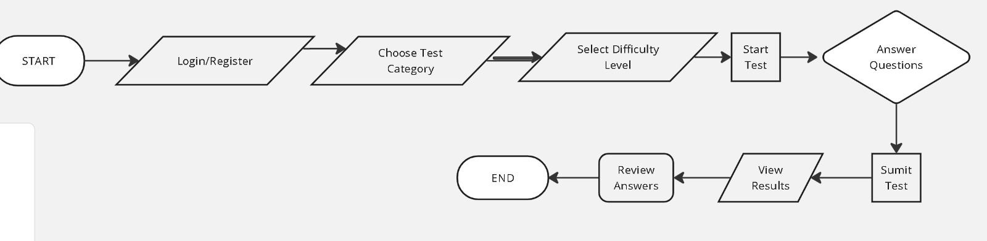
Flowchart :

Slide 9
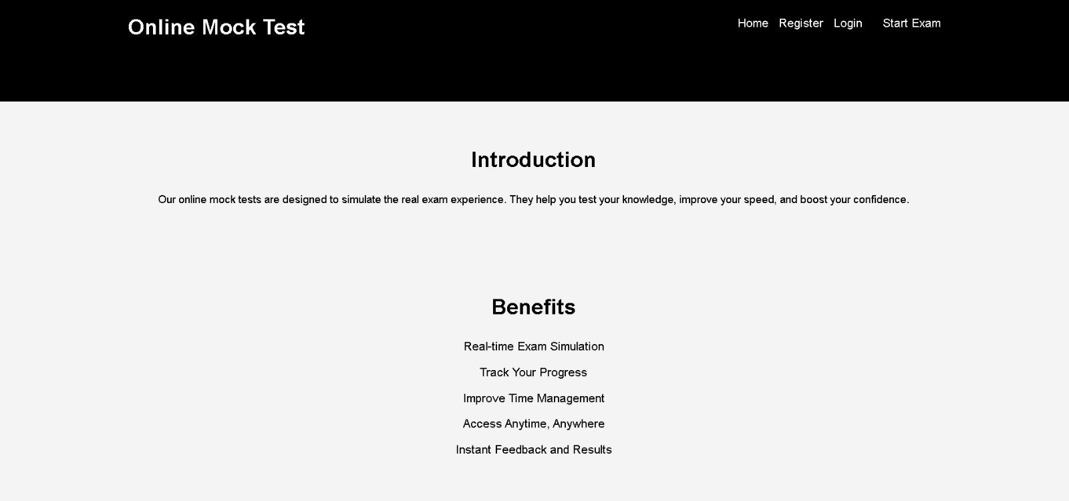
INTERFACE

Slide 10
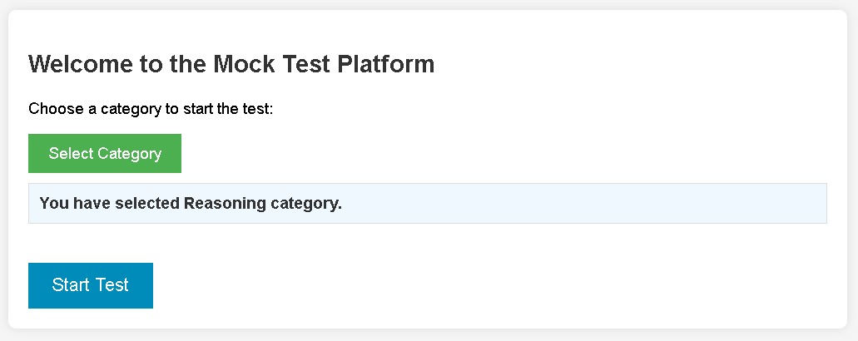
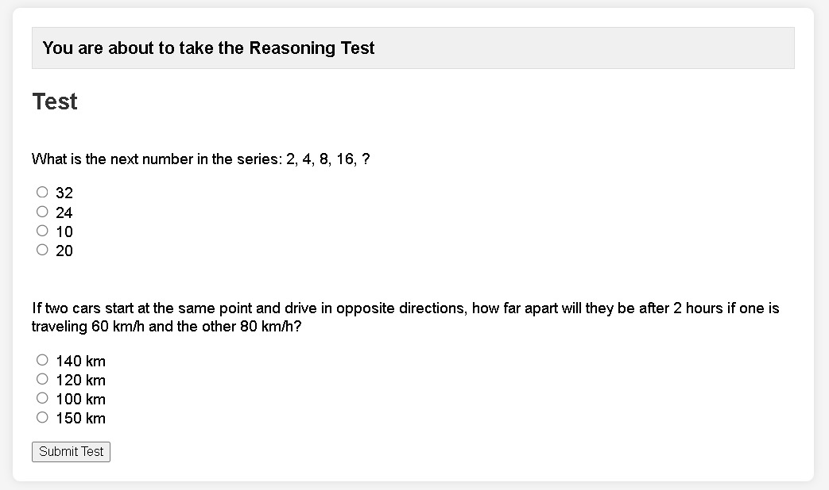

Slide 11
CONCLUSION: FUTURE OF ASSESSMENTS
In conclusion, online mock tests are a powerful tool for enhancing assessment outcomes in education. As technology continues to evolve, their integration into teaching methods will become increasingly vital for fostering student success and engagement.

Slide 12

Thank You!

