Slide 1

Twitter Sentiment Analysis
Project for CS9660B –
Computational Linguistics
Computer Science

Slide 2
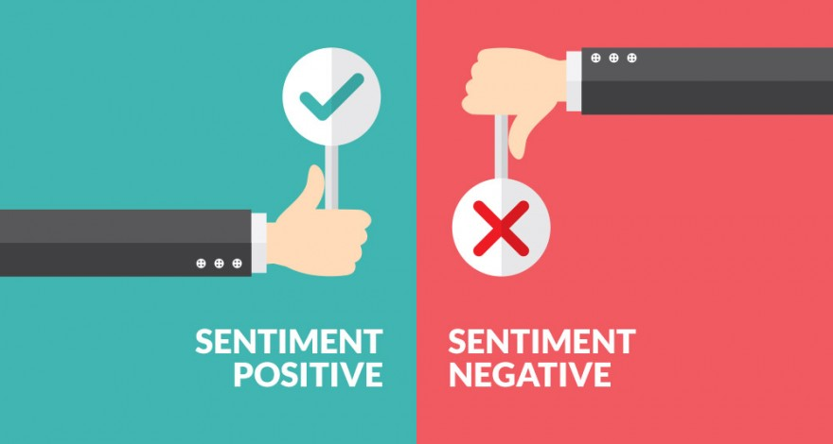
Sentiment
A thought, opinion, or idea based on a feeling about a situation, or a way of thinking about something
Twitter Sentiment Analysis
Notes:
Sentiment is a belief that has emerged from our emotions. Sentiments are generally shared by groups.

Slide 3
Why analyze tweet sentiment?
Twitter has become a popular communication tool
Opinion of the mass is important
Twitter Sentiment Analysis
Notes:
336+ million active users, 500 million tweets are generated everyday
Political party may want to know whether people support their program or not
Research may need to be done on the public’s attitude to specific movements
Investors can leverage the sentiment of the people for a company to find out where it stands before investing the company
A company might want find out the reviews of its products

Slide 4

Problem statement
Twitter Sentiment Analysis

Slide 5
Stats about Training Set
Tweets : Total: 100000, Positive: 56462, Negative: 43538
User Mentions : Total: 88955, Avg: 0.88955
URLs : Total: 3599, Avg: 0.03599
Emojis : Total: 1184, Positive: 997, Negative: 187, Avg: 0.01184
Words : Total: 1192636, Avg: 11.92636
Twitter Sentiment Analysis

Slide 6
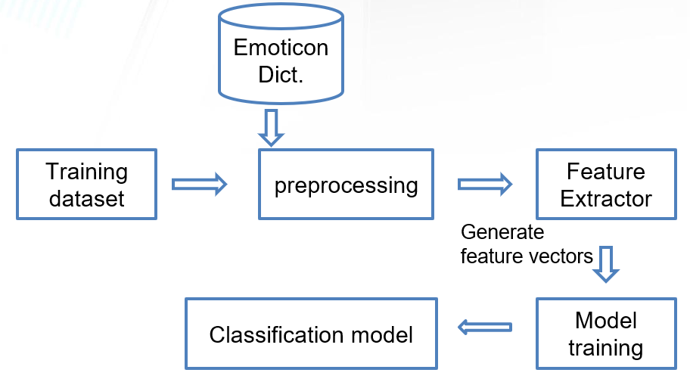
Training Process Flow
Twitter Sentiment Analysis

Slide 7
Data Pre-Processing
Capital words to lower case.
Punctuations are pruned.
Multiple spaces replaced with a single space.
#hello is replaced by hello.
URLs replaced with the word “URL”.
All “@handle” are replaced with “USER_MENTION”.
Twitter Sentiment Analysis

Slide 8
Preprocess Emoticons
Categories | Before | After
Smile | :) : ) :-) (: ( : (-: :') | EMO_POS
Laugh | :D : D :-D xD x-D XD X-D | EMO_POS
Love | <3 :* | EMO_POS
Wink | ;-) ;) ;-D ;D (; (-; | EMO_POS
Sad | :-( : ( :( ): )-: | EMO_NEG
Cry | :,( :'( :"( | EMO_NEG
Twitter Sentiment Analysis

Slide 9
Feature Extraction
Extract single words from the training dataset
Create a frequency distribution
Twitter Sentiment Analysis

Slide 10
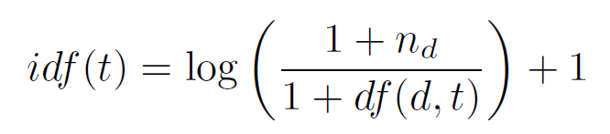
Feature Representation
Sparse vector representation of length 15000
Term frequency–inverse document frequency
scipy.sparse.lil_matrix
Glove used for Dense representation
Twitter Sentiment Analysis

Slide 11
Classifiers
MLP
CNN
LSTM
Twitter Sentiment Analysis

Slide 12
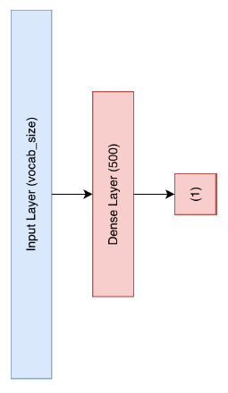
Multi Layer Perceptron
Input layer = 15000
Hidden layer = 500
Output = 1
Activation = Sigmoid
Batch size = 500
Loss = binary_crossentropy
Performance metrics = accuracy
Twitter Sentiment Analysis
Notes:
keras with TensorFlow backend

Slide 13
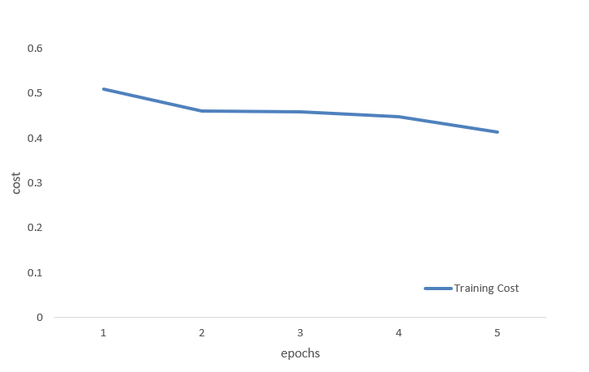
MLP Training Cost
Twitter Sentiment Analysis

Slide 14
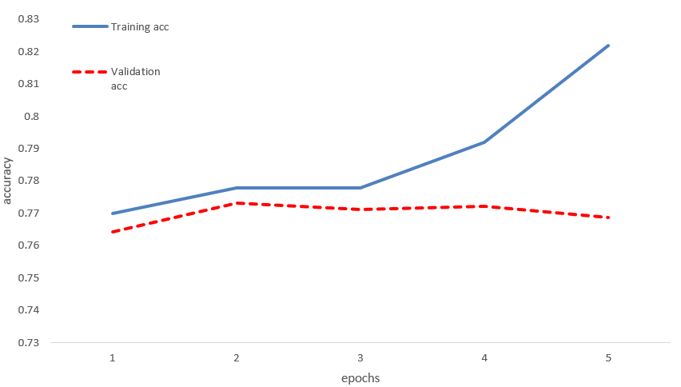
MLP Accuracy
Accuracy = 76.75%
Twitter Sentiment Analysis

Slide 15
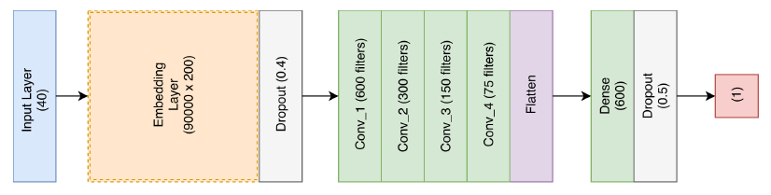
Convolutional Neural Network
vocab_size = 90000
batch_size = 500
Max_length = 40
Activation = relu / sigmoid
Performance metrics = accuracy
Loss = binary_crossentropy
Twitter Sentiment Analysis

Slide 16
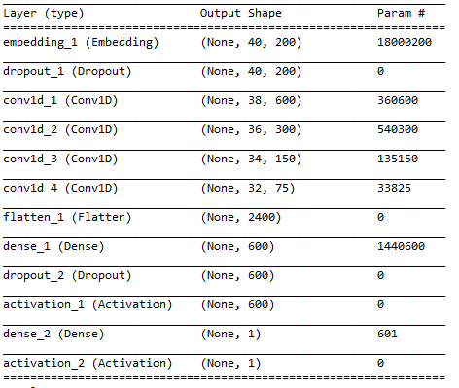
CNN Model
Twitter Sentiment Analysis

Slide 17
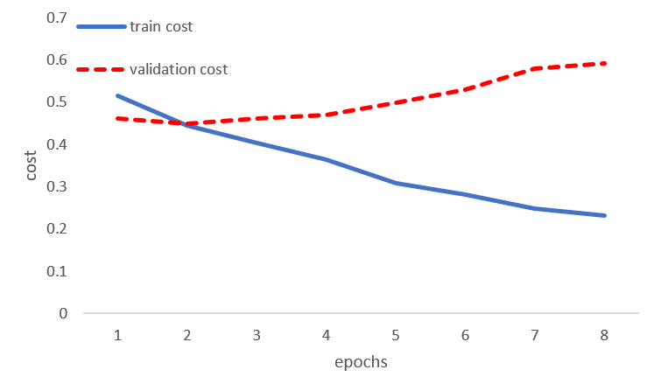
CNN Training Cost
Twitter Sentiment Analysis

Slide 18
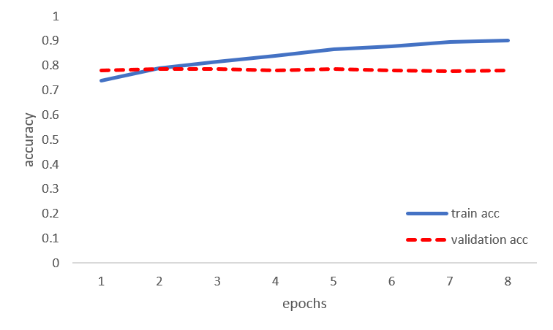
CNN Accuracy
Accuracy = 83.24%
Twitter Sentiment Analysis

Slide 19
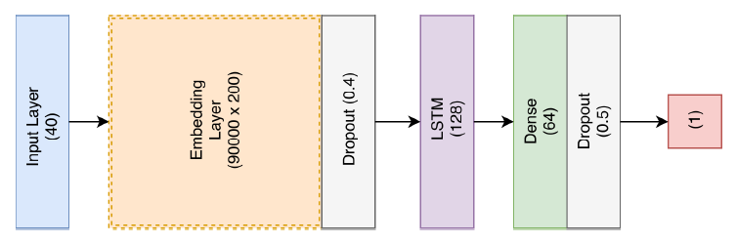
Long Short-Term Memory
vocab_size = 90000
batch_size = 500
Max_length = 40
Activation = relu / sigmoid
Performance metrics = accuracy
Loss = binary_crossentropy
Twitter Sentiment Analysis

Slide 20
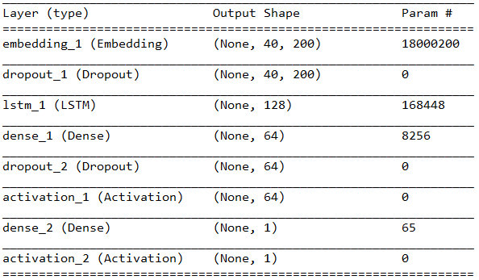
LSTM Model
Twitter Sentiment Analysis

Slide 21
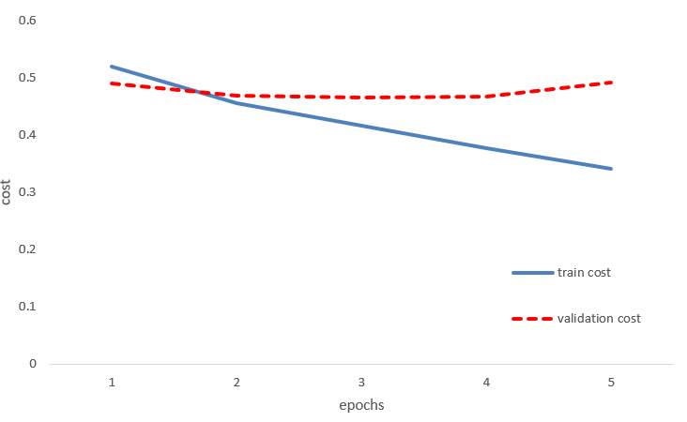
LSTM Training
Twitter Sentiment Analysis

Slide 22
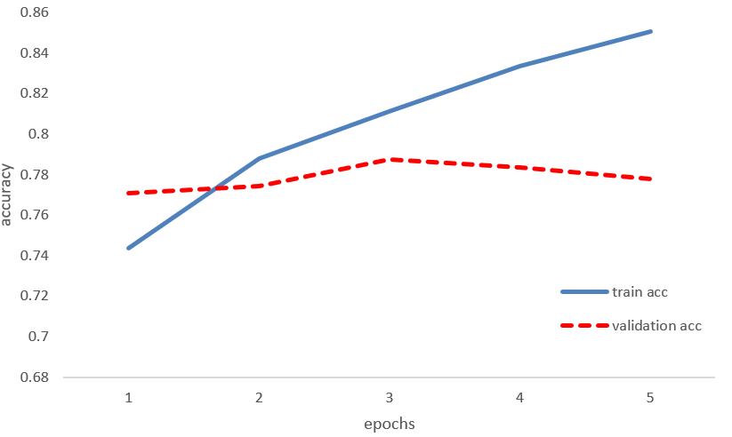
LSTM Accuracy
Accuracy = 83.58%
Twitter Sentiment Analysis

Slide 23
Future Works
Neutral sentiment
More classifiers
Stemmers
Twitter Sentiment Analysis

Slide 24
Thank You!!!
Q & A
Twitter Sentiment Analysis

