Slide 1



Convolution
YOUR NEXT DESTINATION
OF SOFTWARE OUTSOURCING

Slide 2
Convolution

Slide 3
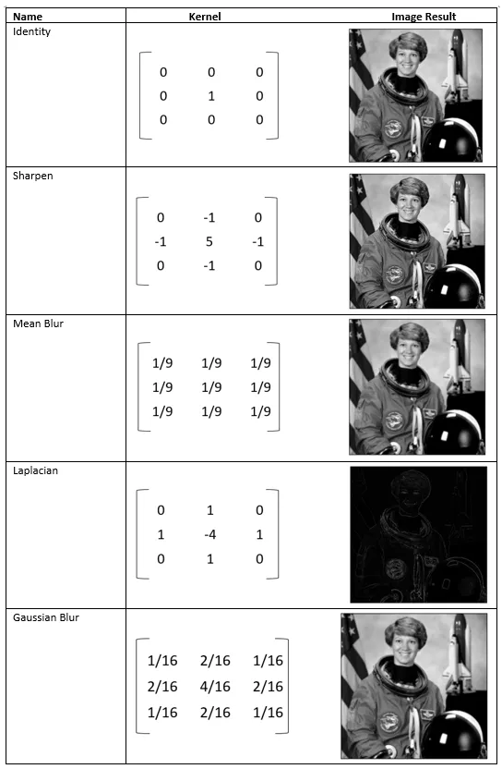
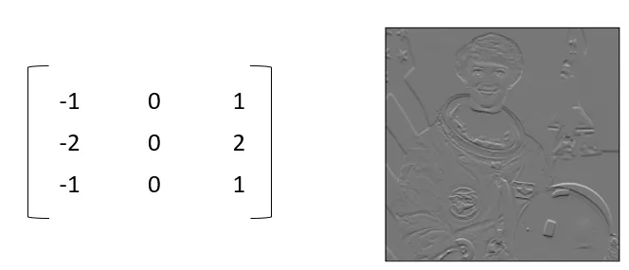

Kernel

Slide 4
Stride
Stride of 1
Stride of 2

Slide 5
Multi Channel Convolution

Slide 6
Padding
Padding of 1
Padding of 2

Slide 7

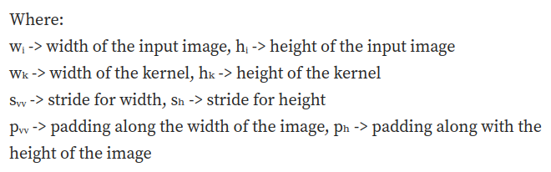
Output Size

Slide 8

Thank You
Get in touch with us:
www.bjitgroup.com

