Slide 1



Dimensionality Reduction
YOUR NEXT DESTINATION
OF SOFTWARE OUTSOURCING

Slide 2
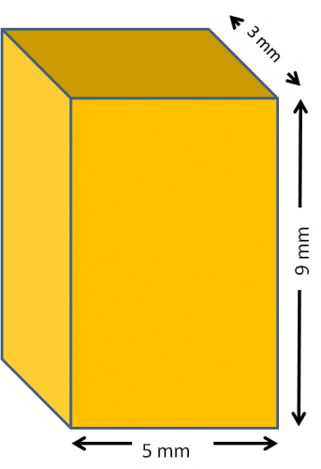
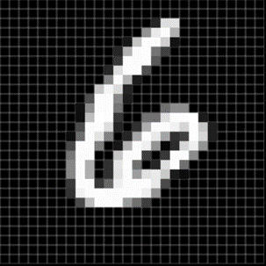
Data Dimensionality
Blood Pressure:
(Systolic, Diastolic)
Example: (80, 120)
Physical Object:
(Length, Width, Height)
Example: (5mm, 3mm, 9mm)
Image:
All pixel values
Vector of size 28x28

Slide 3
Dimensionality Reduction?

Slide 4
Dimensionality Reduction Types
Unsupervised
Supervised

Slide 5
Intuition Unsupervised DR
Unsupervised

Slide 6
Intuition Supervised DR
Supervised

Slide 7
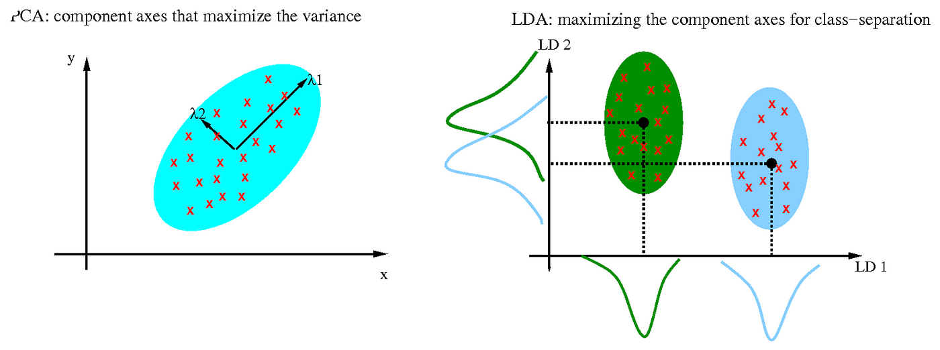
Intuition PCA & LDA

Slide 8
Math Review
YOUR NEXT DESTINATION
OF SOFTWARE OUTSOURCING

Slide 9

Linear Transformation
2 1
0 2
-2
2
-2
4

Slide 10
Covariance
Covariance (XY)
(-3)x(-3) + (-1)x(-1) + 1x1 + 3x3 = 20
20 / (4-1) = 6.67
Covariance (XY)
0x(-3) + 0x(-1) + 0x1 + 0 x3 = 0
0 / (4-1) = 0
Covariance (XY)
(-3)x0 + (-1)x0 + 1x0 + 3x0 = 0
0 / (4-1) = 0
Covariance (XY)
(3)x(-3) + 1x(-1) + (-1)x1 + (-3)x3 = -20
-20 / (4-1) = -6.67

Slide 11
Principal Component Analysis
(PCA)
YOUR NEXT DESTINATION
OF SOFTWARE OUTSOURCING

Slide 12
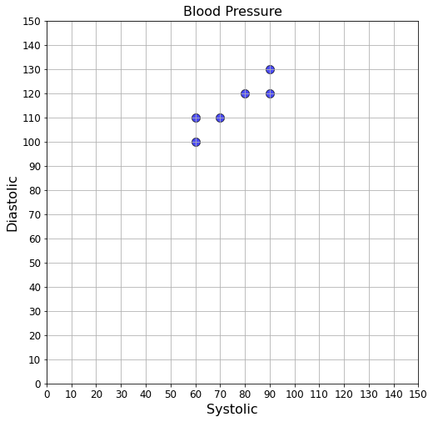
Blood Pressure Data
Systolic | Diastolic
80 | 120
70 | 110
90 | 130
60 | 110
90 | 120
60 | 100

Slide 13
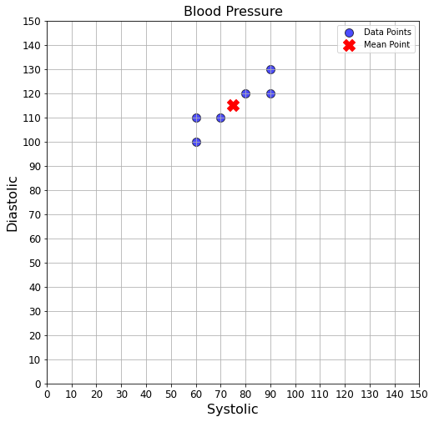
Mean Blood Pressure
Systolic | Diastolic
80 | 120
70 | 110
90 | 130
60 | 110
90 | 120
60 | 100
75 | 115
Mean

Slide 14
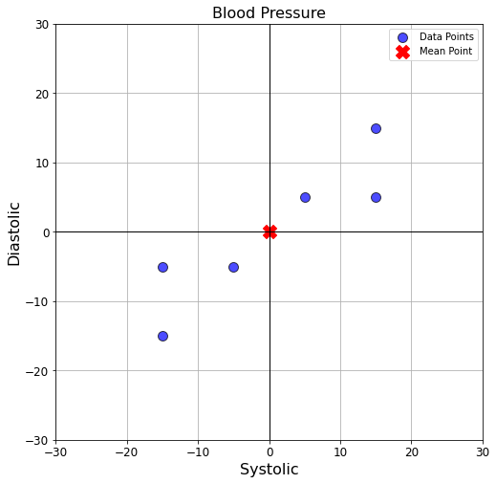
Shift Data to Center
Systolic | Diastolic
80 - 75 | 120 - 115
70 - 75 | 110 - 115
90 - 75 | 130 - 115
60 - 75 | 110 - 115
90 - 75 | 120 - 115
60 - 75 | 100 - 115
Systolic | Diastolic
5 | 5
-5 | -5
15 | 15
-15 | -5
15 | 15
-15 | -5

Slide 15


Covariance Matrix
 | Systolic | Diastolic
Systolic | Var(Systolic) | Cov(Systolic, Diastolic)
Diastolic | Cov(Diastolic, Systolic) | Var(Diastolic)

Slide 16
Covariance Matrix
 | Systolic | Diastolic
Systolic | 190 | Cov(Systolic, Diastolic)
Diastolic | Cov(Diastolic, Systolic) | Var(Diastolic)
15
5
-5
15
Var(Systolic) = 190
-15
-15

Slide 17
Covariance Matrix
 | Systolic | Diastolic
Systolic | 190 | Cov(Systolic, Diastolic)
Diastolic | Cov(Diastolic, Systolic) | 110
15
5
5
-5
-5
-15
Var(Diastolic) = 110

Slide 18
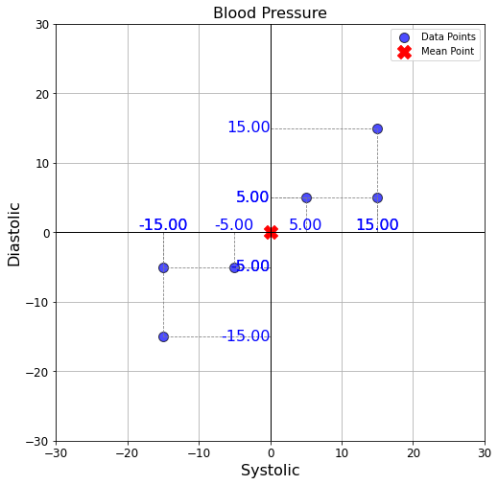
Covariance Matrix
 | Systolic | Diastolic
Systolic | 190 | 130
Diastolic | 130 | 110
Cov(Diastolic, Systolic) = Cov(Systolic, Diastolic) = 130

Slide 19

Eigen Vector & Eigen Value
 | Systolic | Diastolic
Systolic | 190 | 130
Diastolic | 130 | 110
190, 130
130, 110
1, 0
0, 1
det( ) = 0
-
190 - , 130
130, 110 -
det( ) = 0
(190 - ) .
(110 - ) - 130 x 130 = 0
2
- 300 + 4000 = 0

Slide 20
Eigen Vector & Eigen Value
 | Systolic | Diastolic
Systolic | 190 | 130
Diastolic | 130 | 110
2
- 300 + 4000 = 0
= 286.01470509
or
= 13.98529491

Slide 21
Eigen Vector & Eigen Value
Eigenvalues:
[286.01470509 13.98529491]
Eigenvectors:
[ 0.80438978, -0.59410191]
[ 0.59410191, 0.80438978]
0.8, -0.6
0.6, 0.8
V =
0.8, 0.6
-0.6, 0.8
V^{T} =

Slide 22
Projection
V^{T} =
0.8, 0.6
-0.6, 0.8
Systolic
Diastolic
Systolic
Diastolic
= V^{T} .
Systolic
Diastolic
0.8, 0.6
-0.6, 0.8
Systolic
Diastolic
=
.
0.8, 0.6
-0.6, 0.8
-15
-5
=
.
-15
5
=

Slide 23
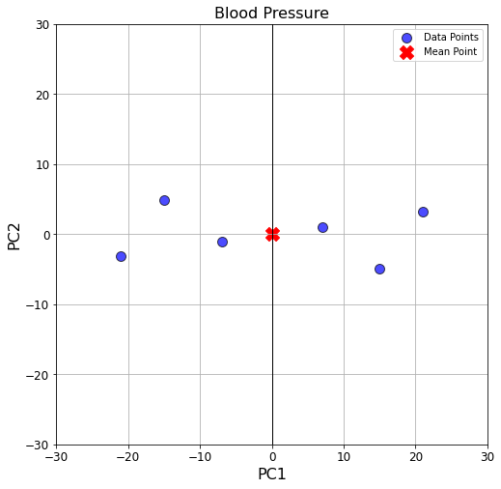
Projection

Slide 24
Linear Discriminant Analysis
(LDA)
YOUR NEXT DESTINATION
OF SOFTWARE OUTSOURCING

Slide 25
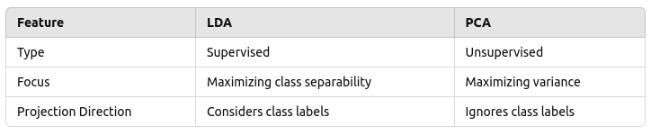
PCA Vs LDA

Slide 26
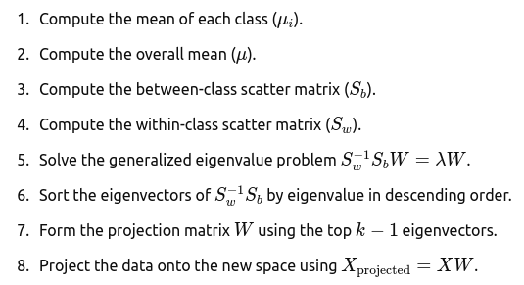
Overview

Slide 27
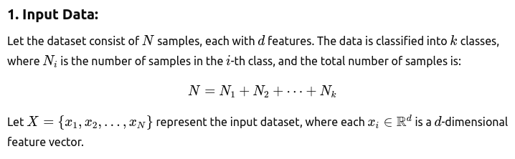
Step 01

Slide 28
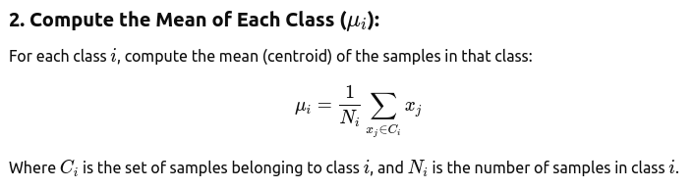
Step 02

Slide 29
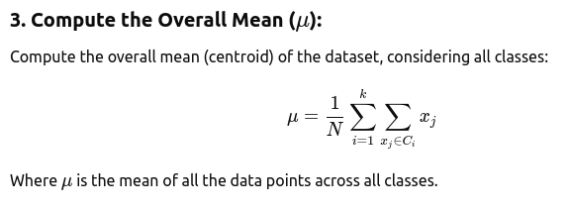
Step 03

Slide 30
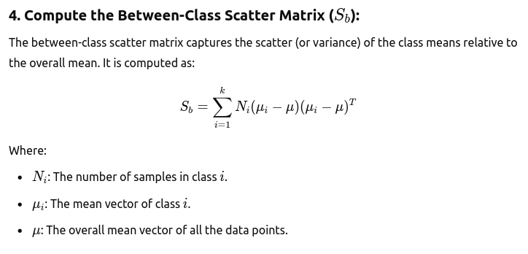
Step 04

Slide 31
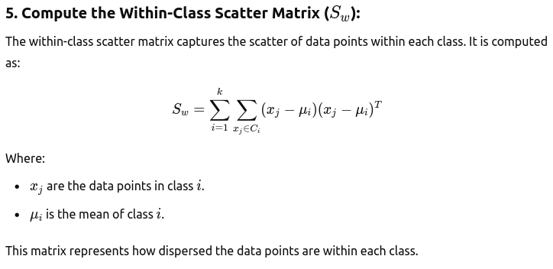
Step 05

Slide 32
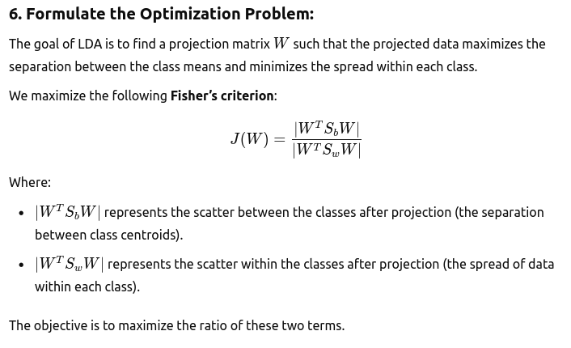
Step 06

Slide 33
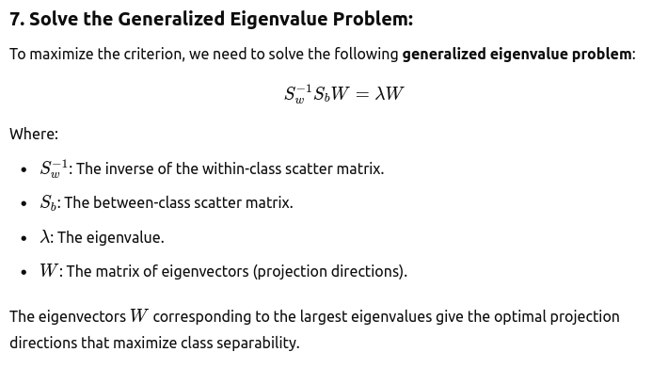
Step 07

Slide 34
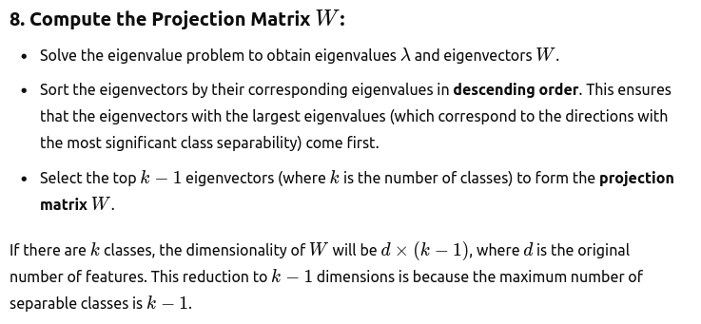
Step 08

Slide 35

Thank You
Get in touch with us:
www.bjitgroup.com

