Slide 1



Backpropagation
YOUR NEXT DESTINATION
OF SOFTWARE OUTSOURCING

Slide 2
Overview
Partial Derivative
Chain Rule
Backpropagation in Output Layer
Backpropagation in Hidden Layer

Slide 3
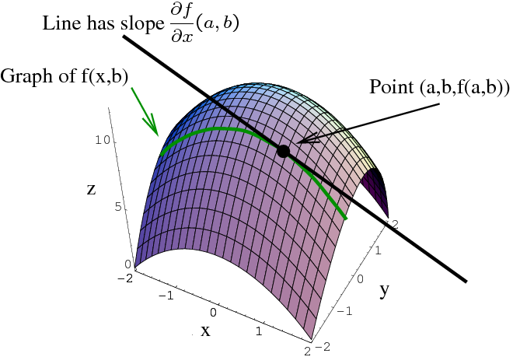
Partial Derivative

Slide 4

Chain Rule

Slide 5
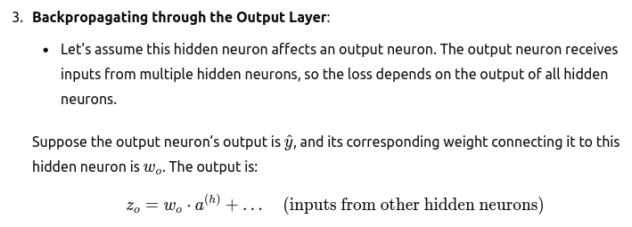
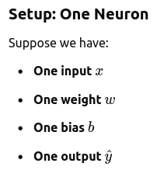
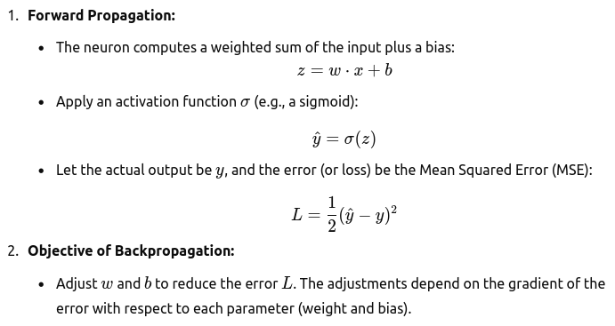
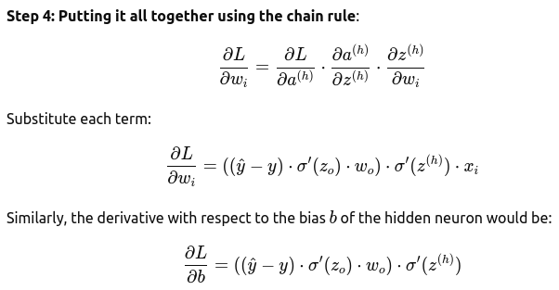
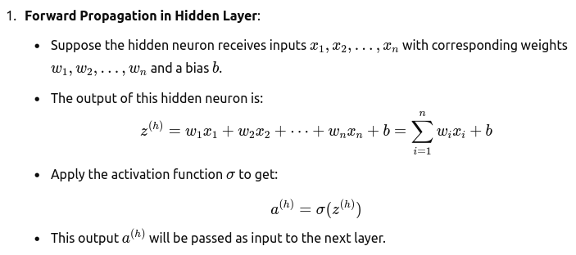
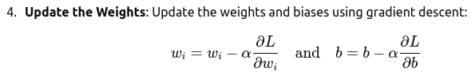
Backpropagation

Slide 6
Backpropagation in Output Layer

Slide 7
Backpropagation in Output Layer.

Slide 8
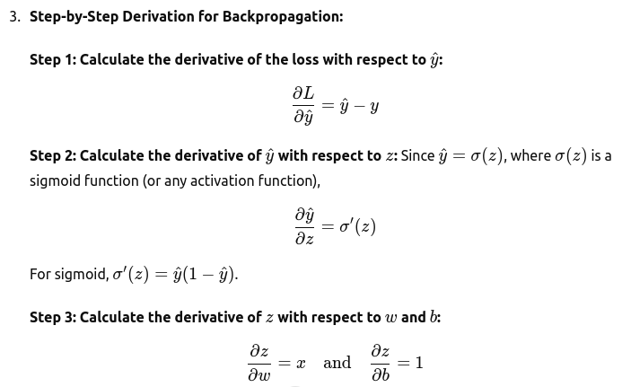
Backpropagation in Output Layer..

Slide 9
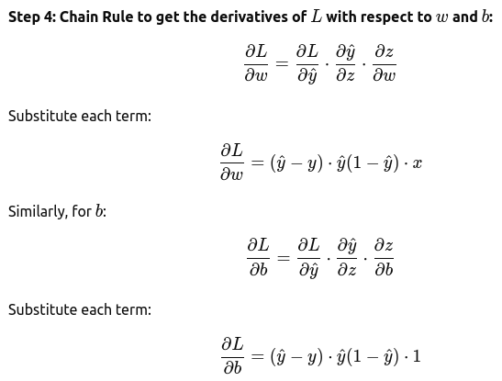
Backpropagation in Output Layer…

Slide 10
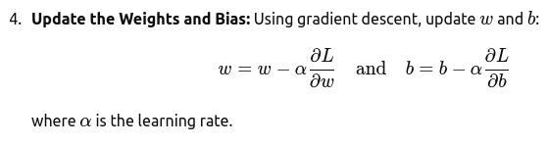
Backpropagation in Output Layer….

Slide 11
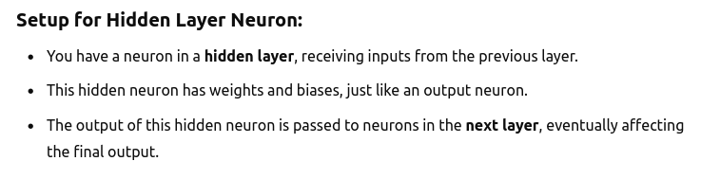
Backpropagation in Hidden Layer

Slide 12
Backpropagation in Hidden Layer.

Slide 13
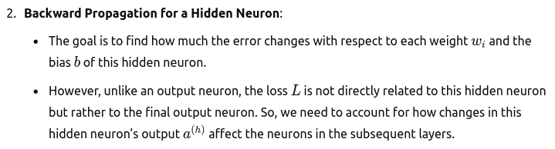
Backpropagation in Hidden Layer..

Slide 14
Backpropagation in Hidden Layer…

Slide 15
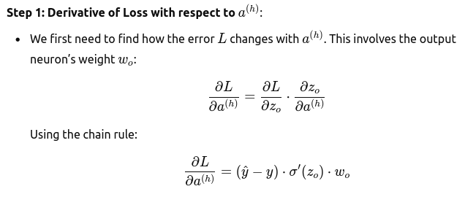
Backpropagation in Hidden Layer….

Slide 16
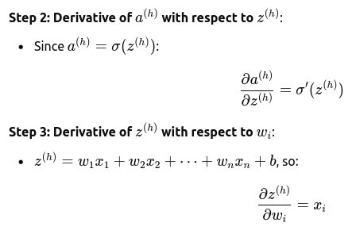
Backpropagation in Hidden Layer…..

Slide 17
Backpropagation in Hidden Layer……

Slide 18
Backpropagation in Hidden Layer…….

Slide 19
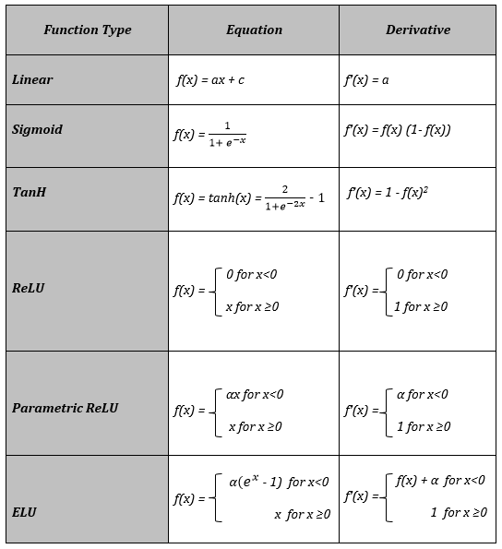
Activations & Derivative

Slide 20

Thank You
Get in touch with us:
www.bjitgroup.com

