Slide 1
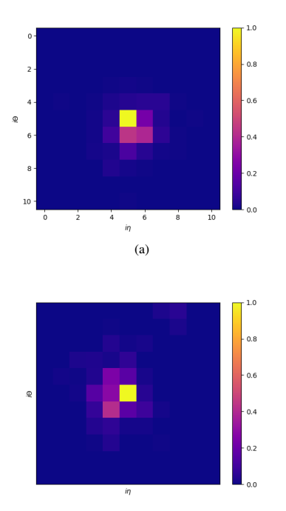
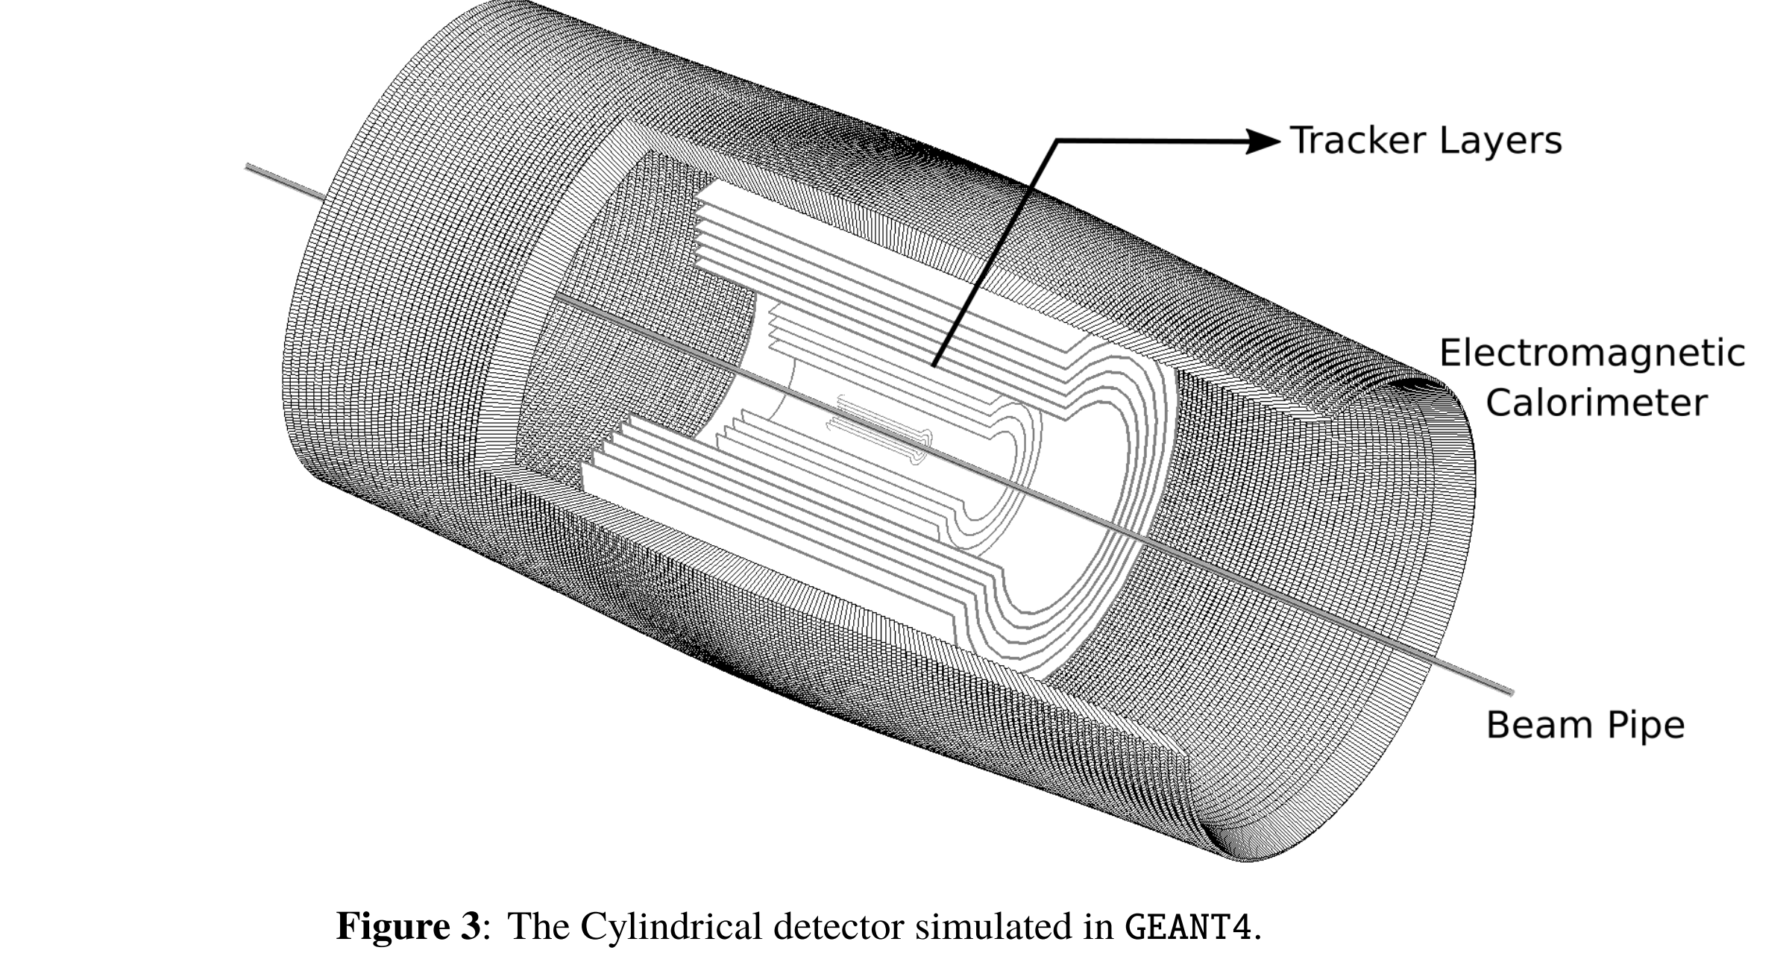
Samples

Slide 2
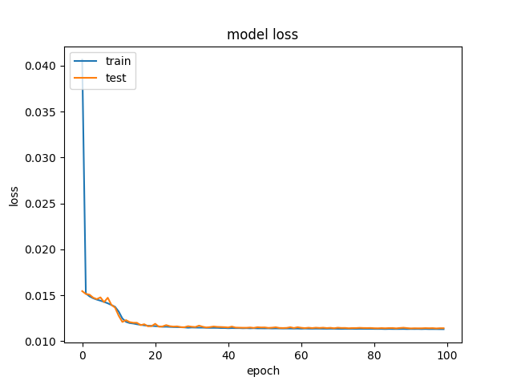
Training loss

Slide 3

Images after training
TOP actual photons fed in
BOTTOM predicted by the network

Slide 4
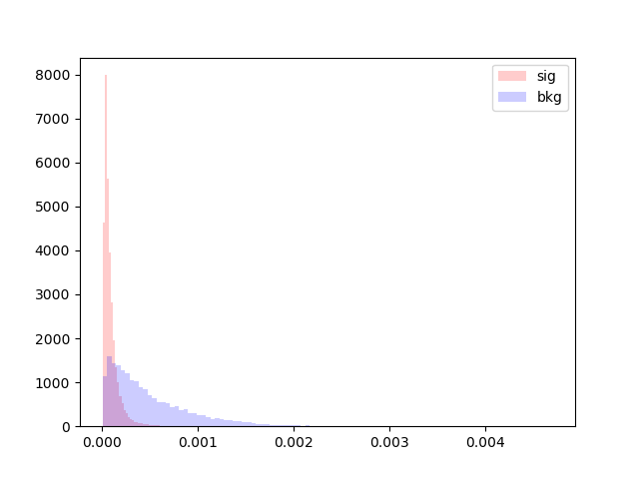
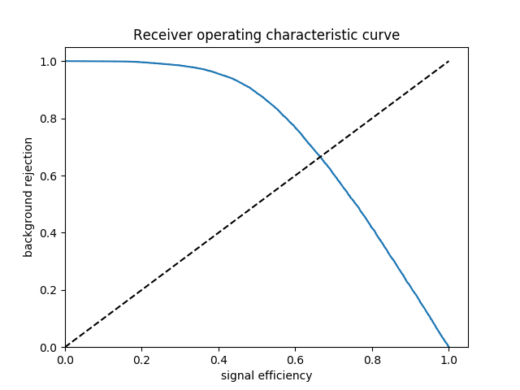
Perf

Slide 5
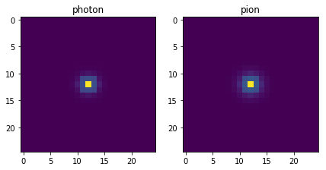
Averaged images (without pre-processing)

Slide 6
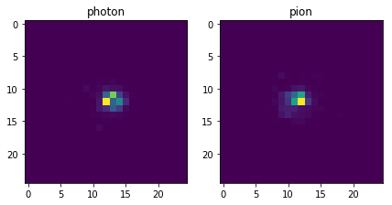
Raw event(using eta-phi info)

Slide 7
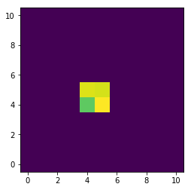
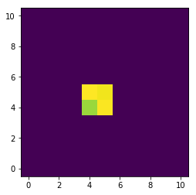
m=0.05 GeV, E=1GeV
Average photon Average pion

Slide 8
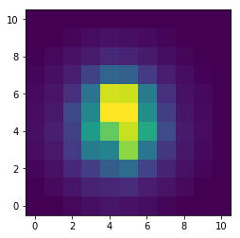
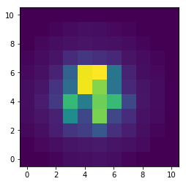
m=0.5 GeV, E = 1GeV
Photon Pion

