Slide 1
Multipurpose LFR
Arnab Saha : 16.02.04.036
Noor Islam Sunny : 16.02.04.038
Saffat Rafiq Raaz : 16.02.04.041
Fakhrul Islam Fahad : 16.02.04.051

Slide 2
Outline
Introduction
Objectives
Impact on Society
Future Implementation
Procedure
Equipment
Hardware
Software
Budget
Contribution
Conclusion

Slide 3
Introduction
A line follower robot(LFR) is basically a robot, designed to follow a path determined by the user. Line follower robot actually senses the line and run over it. It mainly follows a black line on white surface or a white line on black surface. This is done by infrared sensors. Sometimes, a lfr can also detect obstacles using ultrasonic sensor.

Slide 4
Objectives
capable of following a path
stops at many points after going a certain amount of distance according to the keypad input
fetch goods from the points
detect the obstacle while going through its path

Slide 5
Impact on Society
The lfr can be used:
By physically disabled persons
In restaurants
In hospitals
In industries

Slide 6
Future Implementation
capable of taking various degrees of turns
according to the keypad input, the lfr will decide which angle of path it should move
stop and wait for a few moments to get an obstacle free path
the lfr will come back to the starting point

Slide 7
Procedure
LFR follows a black straight line on a white surface. According to the keypad input, it stops after going a certain amount of distance. Suppose, if 1 is pressed through the keypad, it goes about 20 centimetres distance and then stops. If 2 is pressed, it goes about 40 centimetres and stops.
It stops at many points to deliver many lightweight goods or take goods from those points. While going through the path the lfr stops if it detects any kind of obstacles.

Slide 8
Equipment

Slide 9
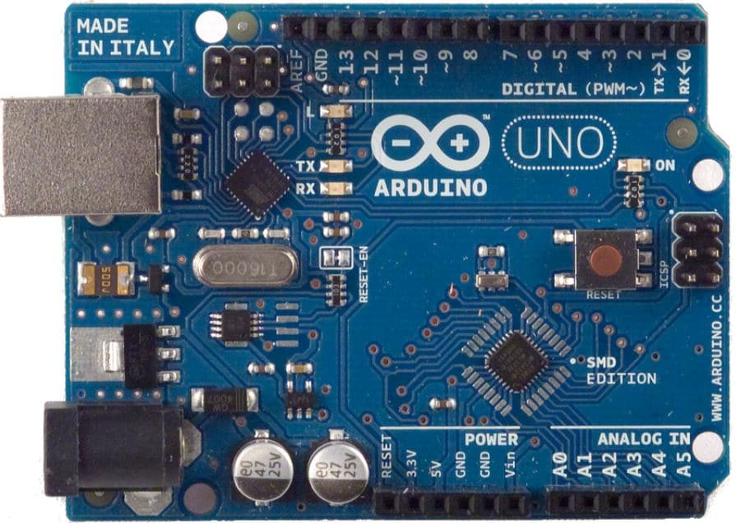
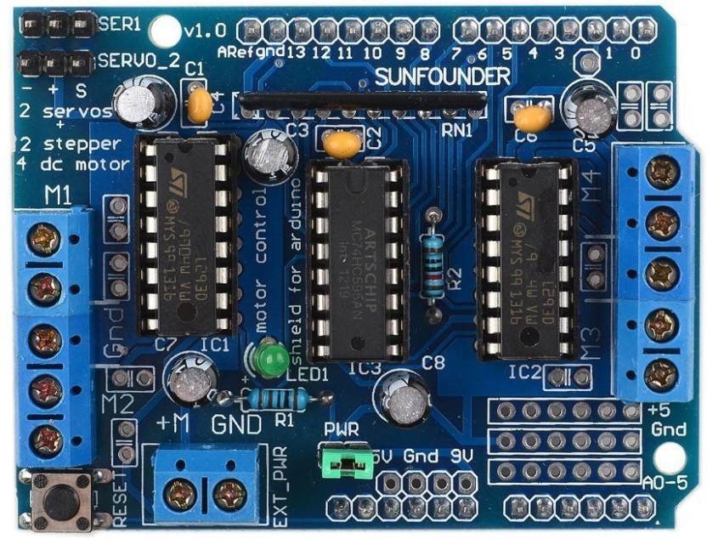
Hardware Components

Slide 10
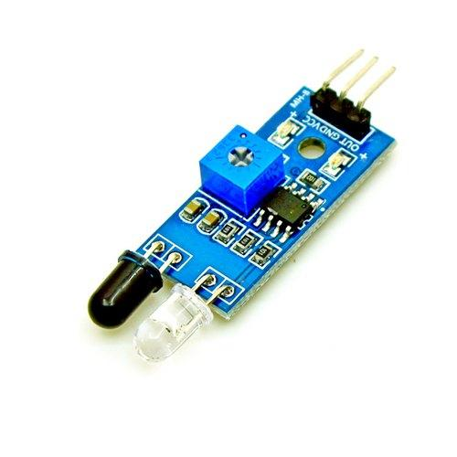
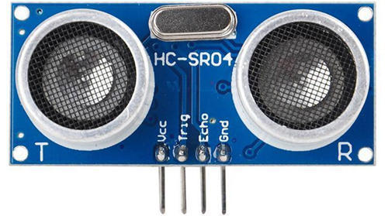
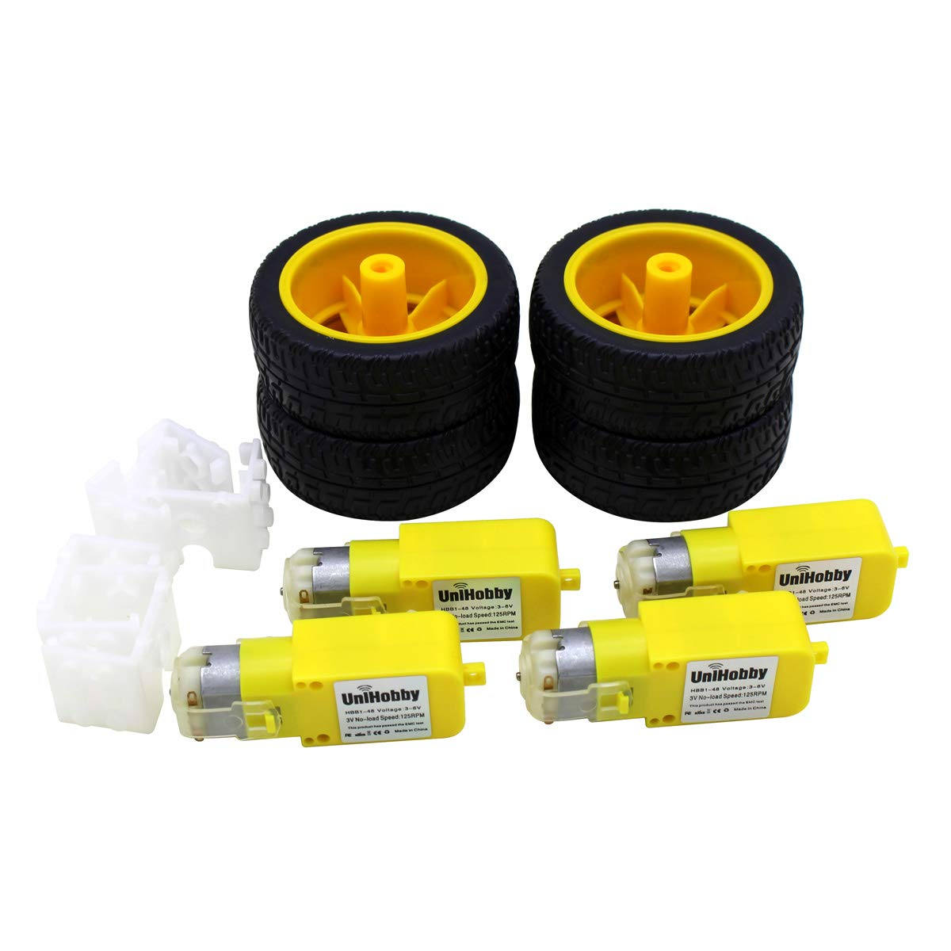

Slide 11
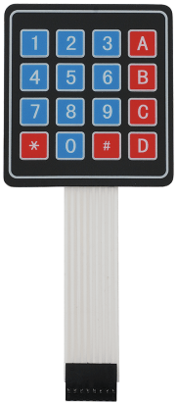
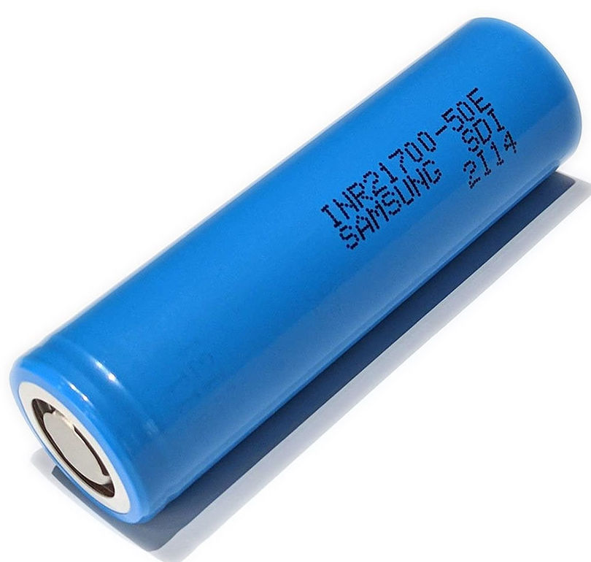
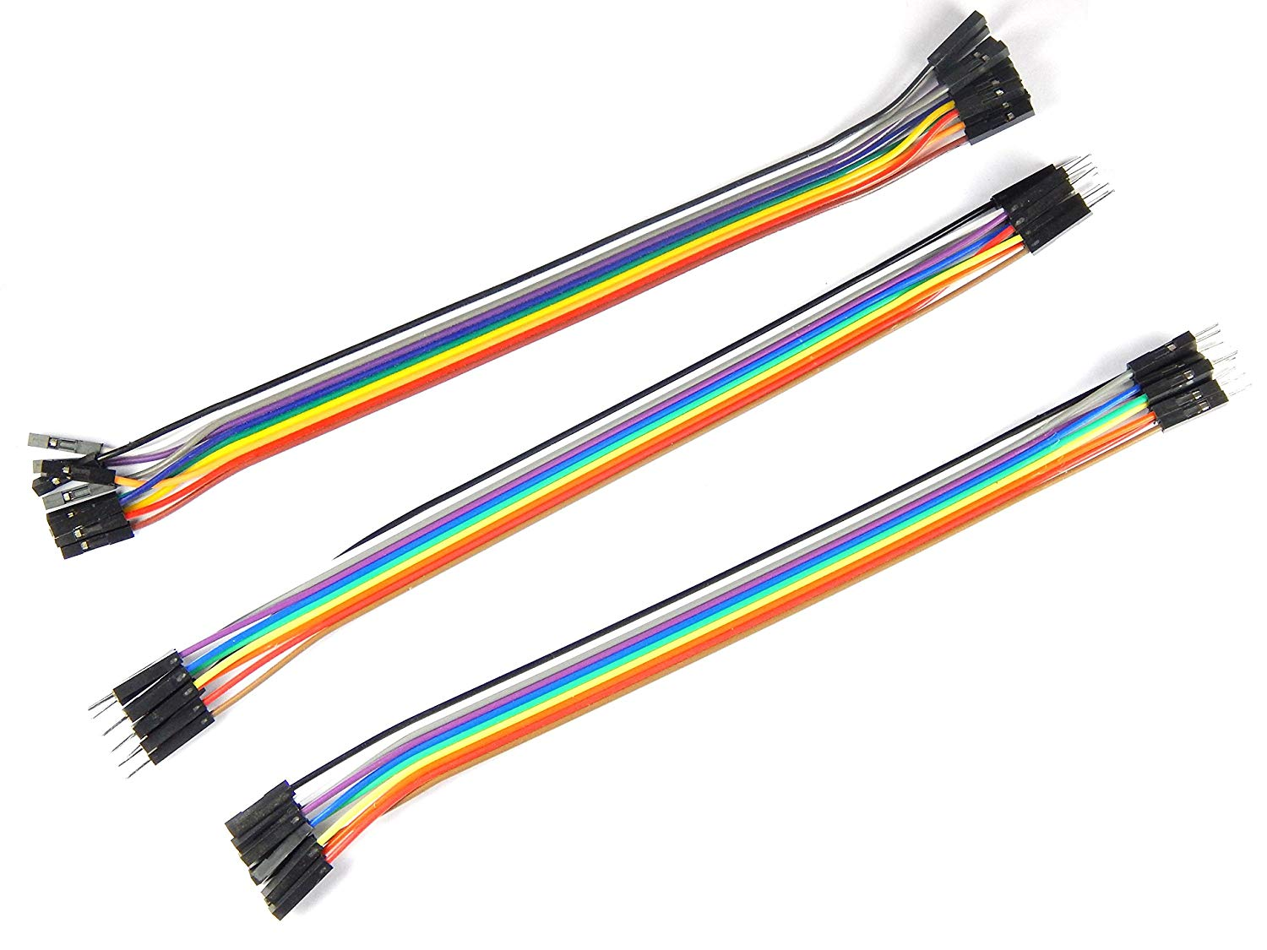

Slide 12

Software Component

Slide 13
Budget
3140 BDT

Slide 14
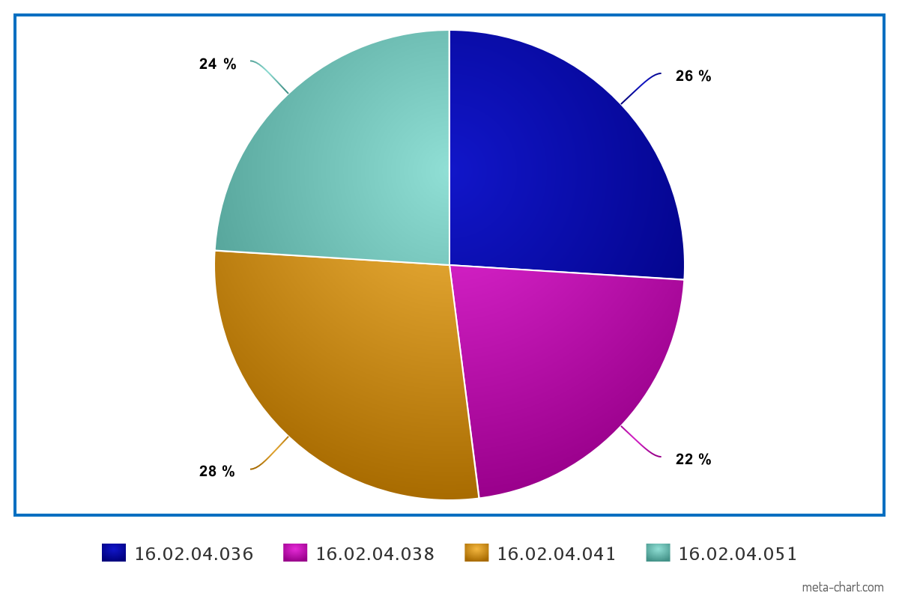
Contribution

Slide 15
Conclusion
The line follower robot can be used for multipurpose deeds. In a very small budget, this lfr can be built. The features of this lfr are very useful for the society. These can reduce the work loads for the people/organization who will apply the system. So, we can say that our project, ‘Multipurpose LFR’ can put a good impact on the society.

Slide 16


