Slide 1
SNAPDRAGON® AI LAB BUILD & PRESENT CHALLENGE
Vaani Khata
Speak your shop's ledger. Hindi, English or Hinglish.
Transcribed on the Snapdragon NPU. Nothing leaves the laptop.
Individual entry · Built and measured on a Snapdragon X laptop (Galaxy Book4 Edge, Windows 11 ARM64)

Slide 2
The khata is still on paper
Paper is fragile
1
Kirana shopkeepers track credit (udhaar) in handwritten books. Entries get lost, disputed, or forgotten.
Apps assume typing and internet
2
Cloud ledger apps need connectivity, an account, and typing in English menus during a rush.
Customer data leaves the shop
3
Who owes what is sensitive. Cloud apps upload it. Voice makes that worse.

Slide 3
Talk to it like you talk to your helper
1
2
3
4
Speak
Whisper on NPU
Understand
Khata
Tap once. "Ramesh ne 500 rupaye udhaar liye."
AI Hub Whisper-Small, Hexagon NPU via QNN
Entry type, person, amount, item, spoken in Hindi or English
Local SQLite. Balances update; ask "Ramesh ka kitna baaki?"
Auto-detects Hindi vs English. Hindi and English spellings of one name (रमेश / Ramesh) merge into one customer.

Slide 4
Why the NPU: measured on this laptop
~50x
faster than the CPU (48.6x and 50.9x in two runs; NPU steady at ~115 ms)
16x
real-time: a 10.8 s spoken clip transcribed end to end in ~0.65 s
0 bytes
of audio or ledger data leave the device
Baseline: open whisper-small encoder (same architecture) on the ONNX Runtime CPU EP. Full runs and caveats in docs/benchmark.md.

Slide 5
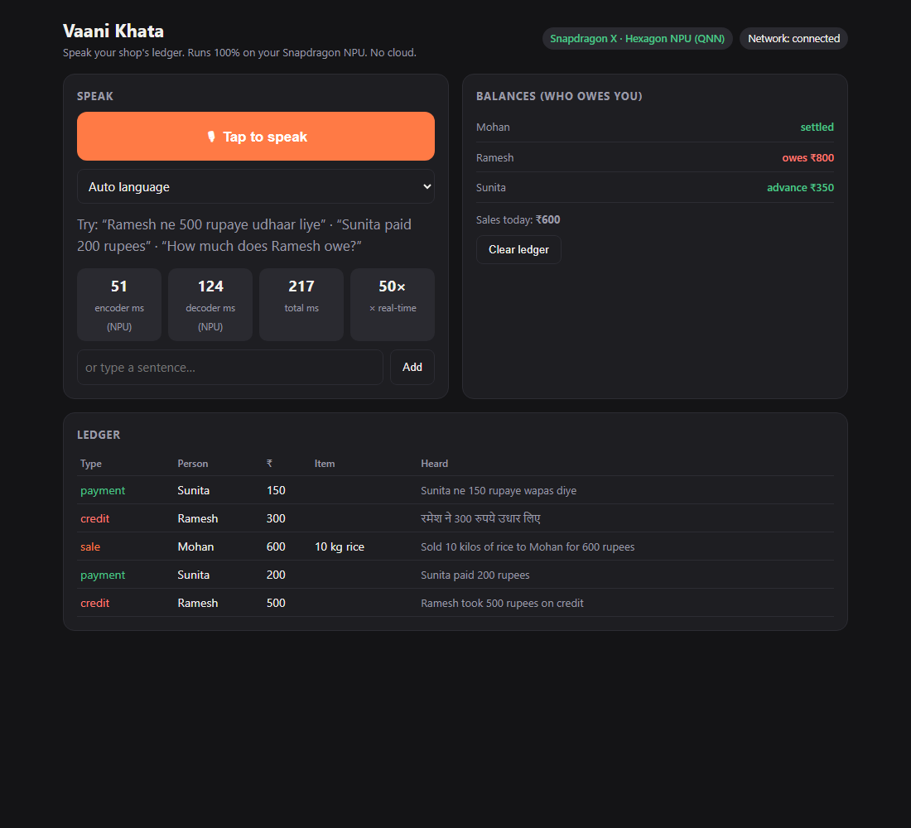
The working app
Tap to speak
Mic in the browser, audio processed by a localhost Python server. No account.
Live ledger and balances
Credit, payment and sale entries with the exact words heard for each.
Ask by voice
"How much does Ramesh owe?" answers from the local database.
Offline badge
Works with Wi-Fi off. Latency shown on screen every time.

Slide 6
Built to actually be deployed
Runs where shops are
Accessible by voice
Private by design
Any Snapdragon X Windows laptop. One setup script downloads the AI Hub model. No GPU, no cloud, no monthly bill.
Hindi, English and Hinglish today. No typing, no menus. Hindi and English spellings of a name merge into one customer.
Server binds to 127.0.0.1. Data lives in one SQLite file on the shopkeeper's own machine.
Next: Llama 3.2 3B on the NPU for free-form sentences, GST-ready sales summaries, and more Indian languages.

Slide 7
What is real today
Working, measured on-device
Known limits
Whisper-Small encoder + decoder on the Hexagon NPU (QNN)
Speech to ledger entries, balances, spoken balance queries
Hindi and Hinglish speech: 6 of 6 test sentences correct (Whisper-Base: 2 of 6)
Reproducible benchmark script and logged results
Sentence parsing is rule-based, so unusual phrasing can be missed
Hindi tested only with synthetic voices; real shop noise and accents will be harder
CPU baseline is the same architecture from an open ONNX export, not the identical file
Vaani Khata: private, instant voice bookkeeping, powered by the Snapdragon NPU.

