Slide 1
Remaining Useful Life Prediction with Uncertainty-Aware AI Copilot
Mid-Semester Progress Report — NASA C-MAPSS Turbofan Engine Dataset
Weeks 1–6 Results • EDA → Baselines → Deep Learning → Uncertainty

Slide 2
Agenda
1. Problem Statement & Motivation
2. Dataset: NASA C-MAPSS FD001
3. Week 1: Exploratory Data Analysis
4. Week 2: ML Baselines (Linear, RF, GBM)
5. Week 3: Health Index Baseline
6. Week 4: LSTM Deep Learning Model
7. Week 5: Paper A — CNN+LSTM + SG Smoothing
8. Week 6: Paper B — CNN-Transformer + MC Dropout UQ
9. Results Comparison & Key Insights
10. Agentic Copilot Demo & Next Steps

Slide 3
Problem Statement
Why RUL Prediction Matters

Slide 4
Motivation
• Unplanned engine failures → safety risk + costly downtime
• Condition-based maintenance requires accurate RUL prediction
• Challenge: models must know WHEN they DON'T know (uncertainty)
• Goal: build a system that predicts, explains, and knows its limits
Our Approach:
Predict RUL → Quantify Uncertainty → Explain → Recommend → Abstain if unsure

Slide 5
Dataset
NASA C-MAPSS FD001

Slide 6
C-MAPSS FD001 Overview
• Simulated turbofan engine run-to-failure data (NASA)
• 100 training engines + 100 test engines
• 1 operating condition, 1 fault mode (HPC degradation)
• 21 sensor channels + 3 operational settings per cycle
• Engine lifetimes: 128–362 cycles (avg 206)
• Test RUL range: 7–145 (mean 76)
• RUL capping: min(raw_rul, 125) — piecewise linear target

Slide 7
Week 1
Exploratory Data Analysis

Slide 8
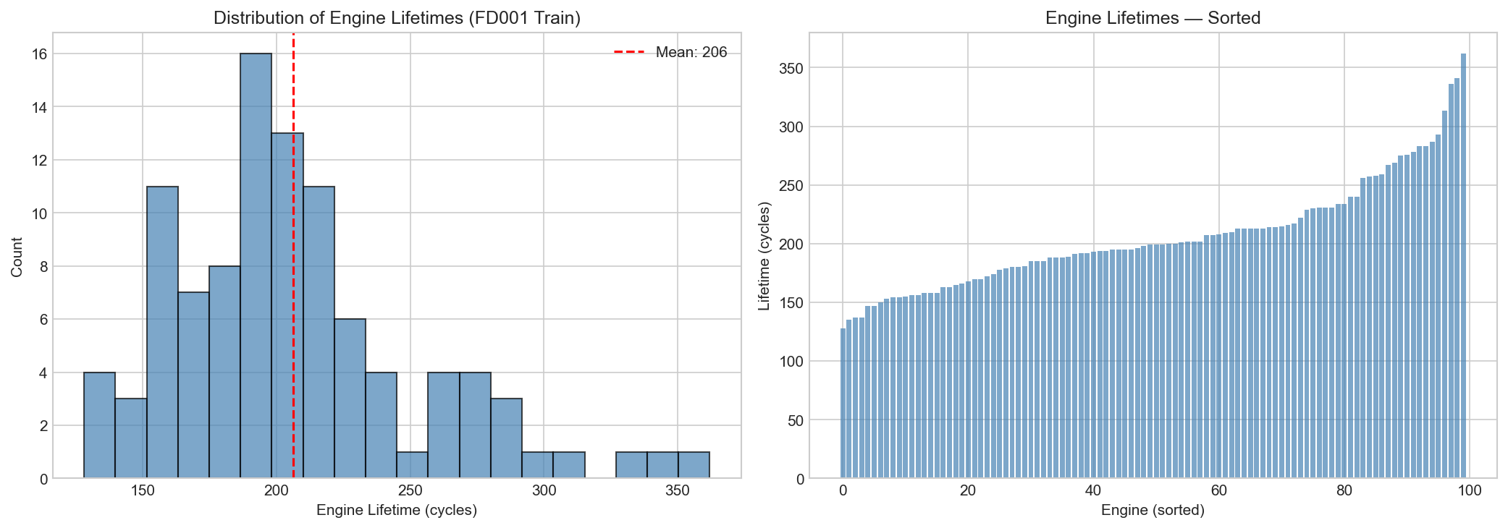
Engine Lifetime Distribution

Slide 9
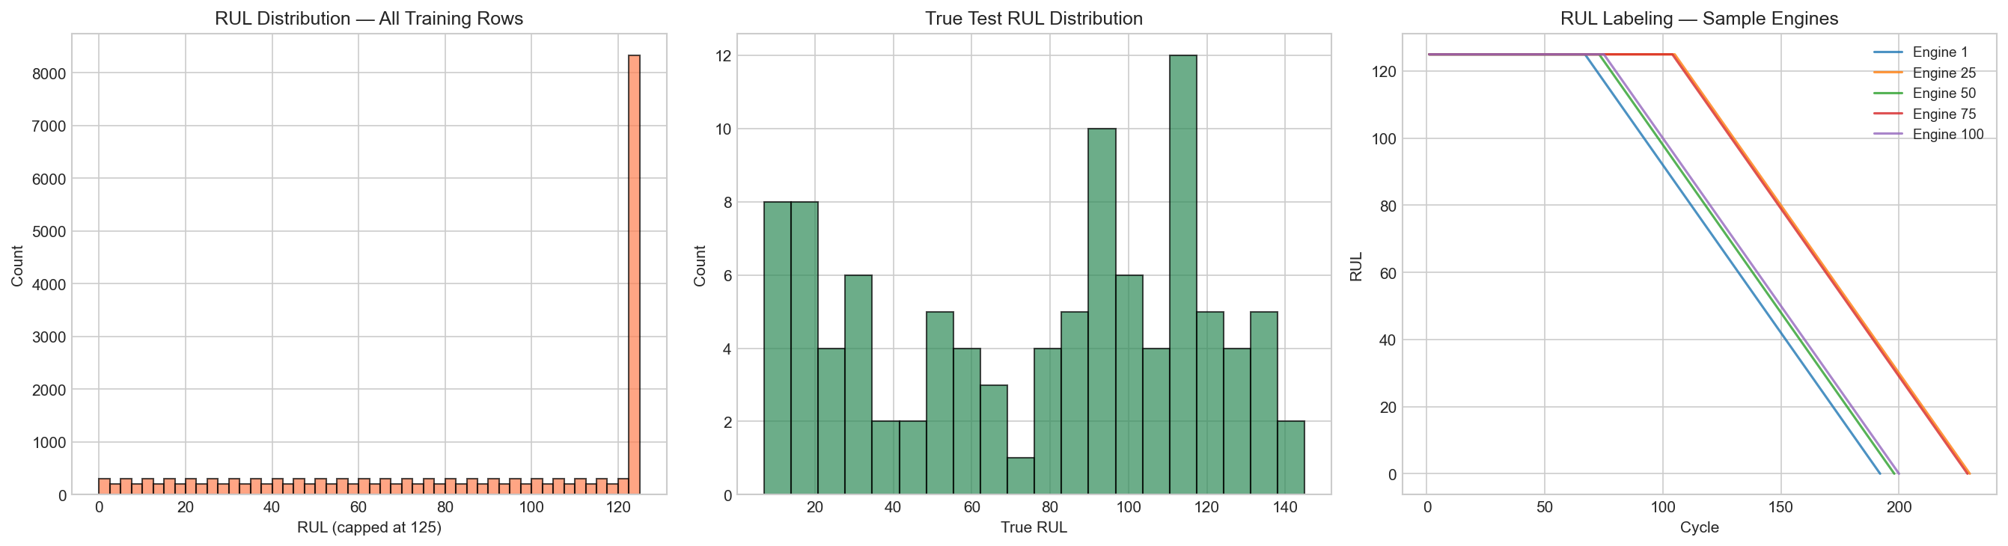
RUL Label Distribution & Piecewise-Linear Target

Slide 10
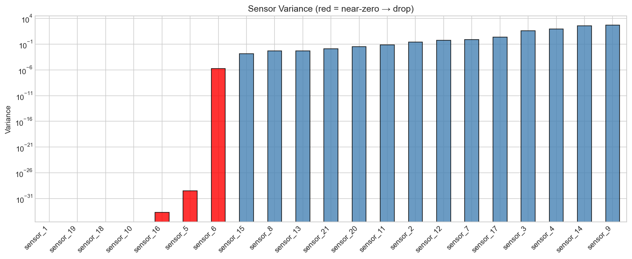
Sensor Variance Analysis — Identifying Informative Sensors

Slide 11
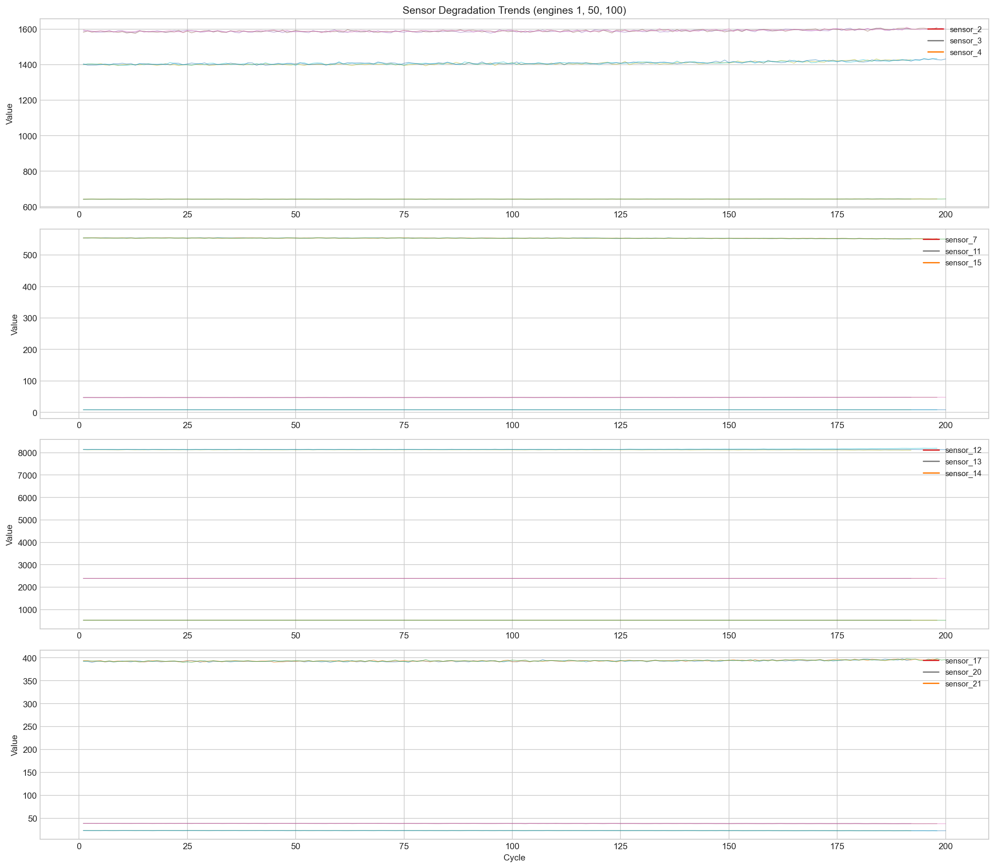
Sensor Degradation Trends Over Engine Lifetime

Slide 12
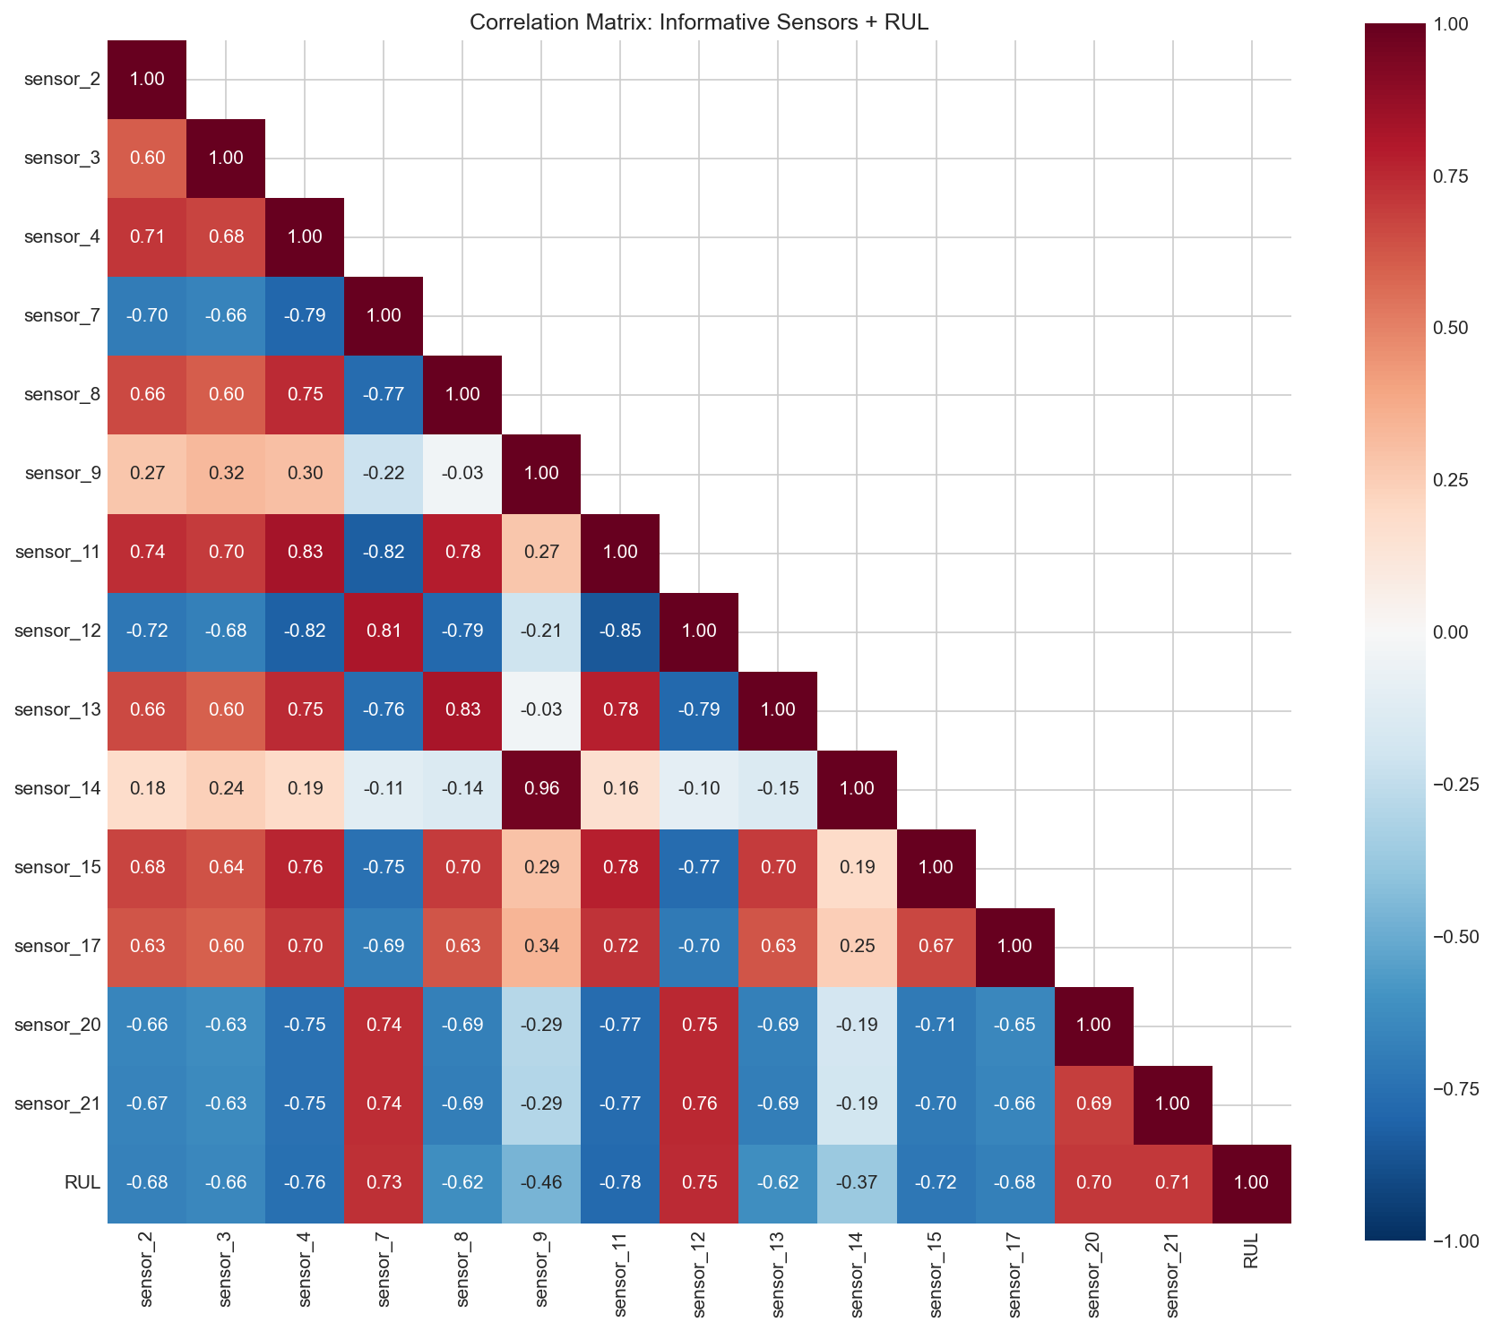
Sensor-RUL Correlation Heatmap

Slide 13
Week 1 Key Findings
• 7 sensors have near-zero variance → dropped (sensor_1, 5, 6, 10, 16, 18, 19)
• 14 informative sensors retained for modeling
• Top correlated sensors with RUL: sensor_11, sensor_4, sensor_12
(|r| = 0.775, 0.757, 0.749)
• Clear degradation trends visible in sensors over engine lifetime
• Decision: Window size=30, MinMax scaling, RUL cap=125

Slide 14
Week 2
ML Baselines with Feature Engineering

Slide 15
Baseline Model Results (FD001 Test)
Model | Test MAE | Test RMSE | NASA Score
Linear Regression | 14.74 | 18.06 | 531
Ridge | 16.14 | 19.62 | 678
Random Forest | 10.84 | 14.39 | 318
Gradient Boosting | 10.38 | 14.31 | 309
Features: rolling stats (mean, std, slope, min, max) + EWM + rate-of-change over last 30 cycles of each engine. Train/val split by engine unit.

Slide 16
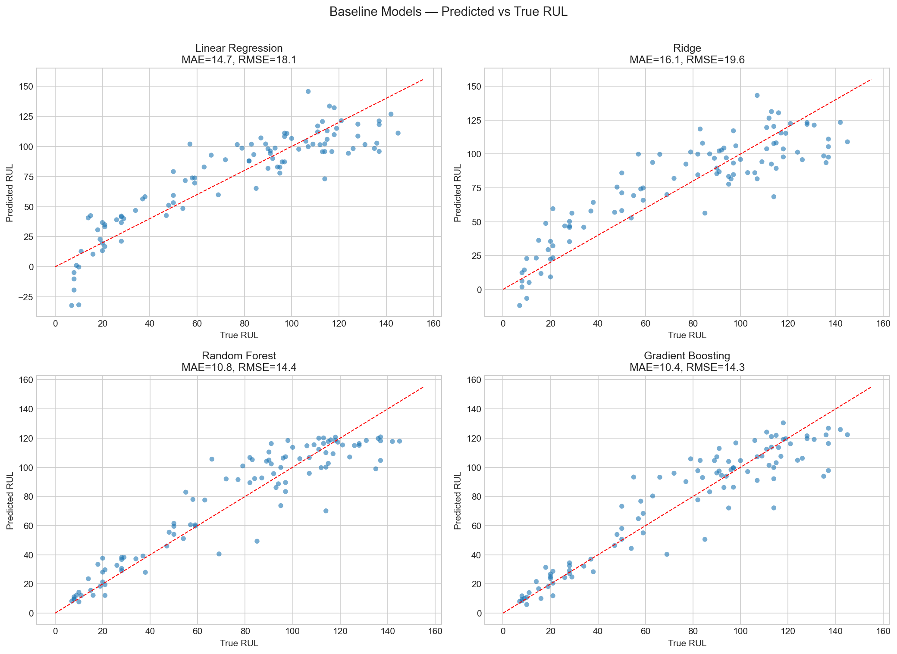
Baseline Predictions — Scatter Plots

Slide 17
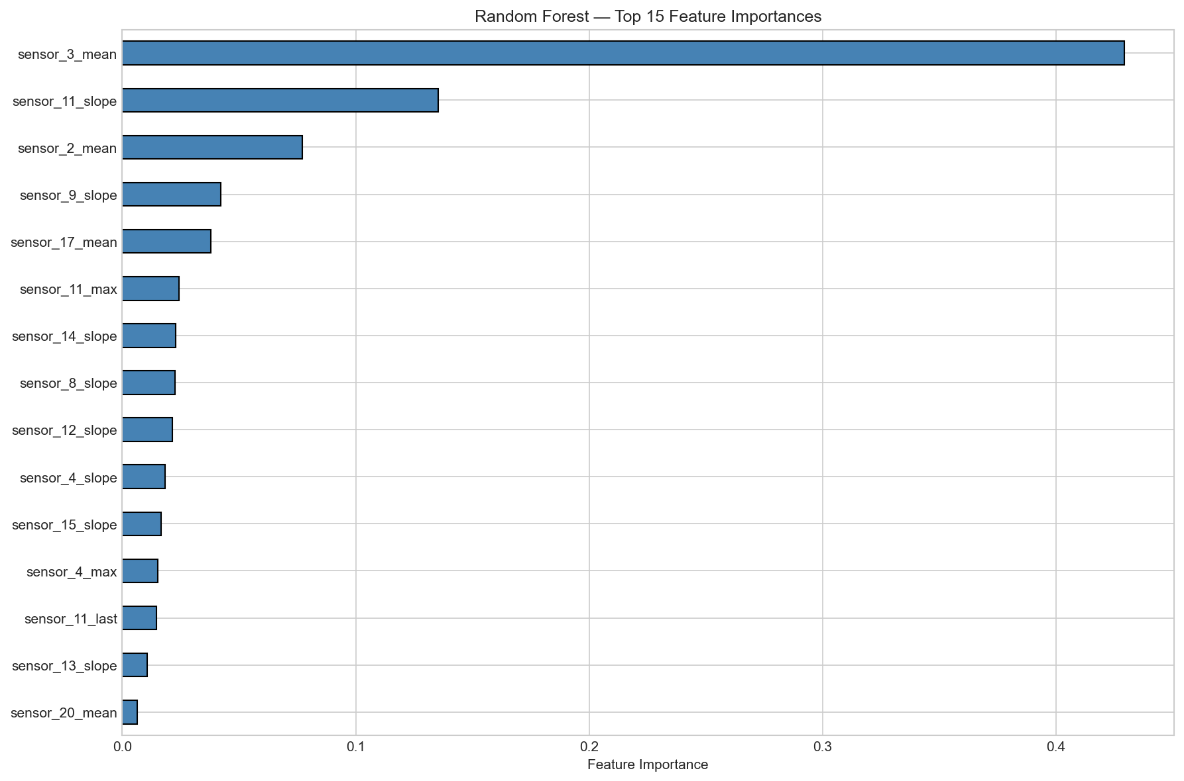
Random Forest Feature Importance

Slide 18
Week 3
Health Index Baseline

Slide 19
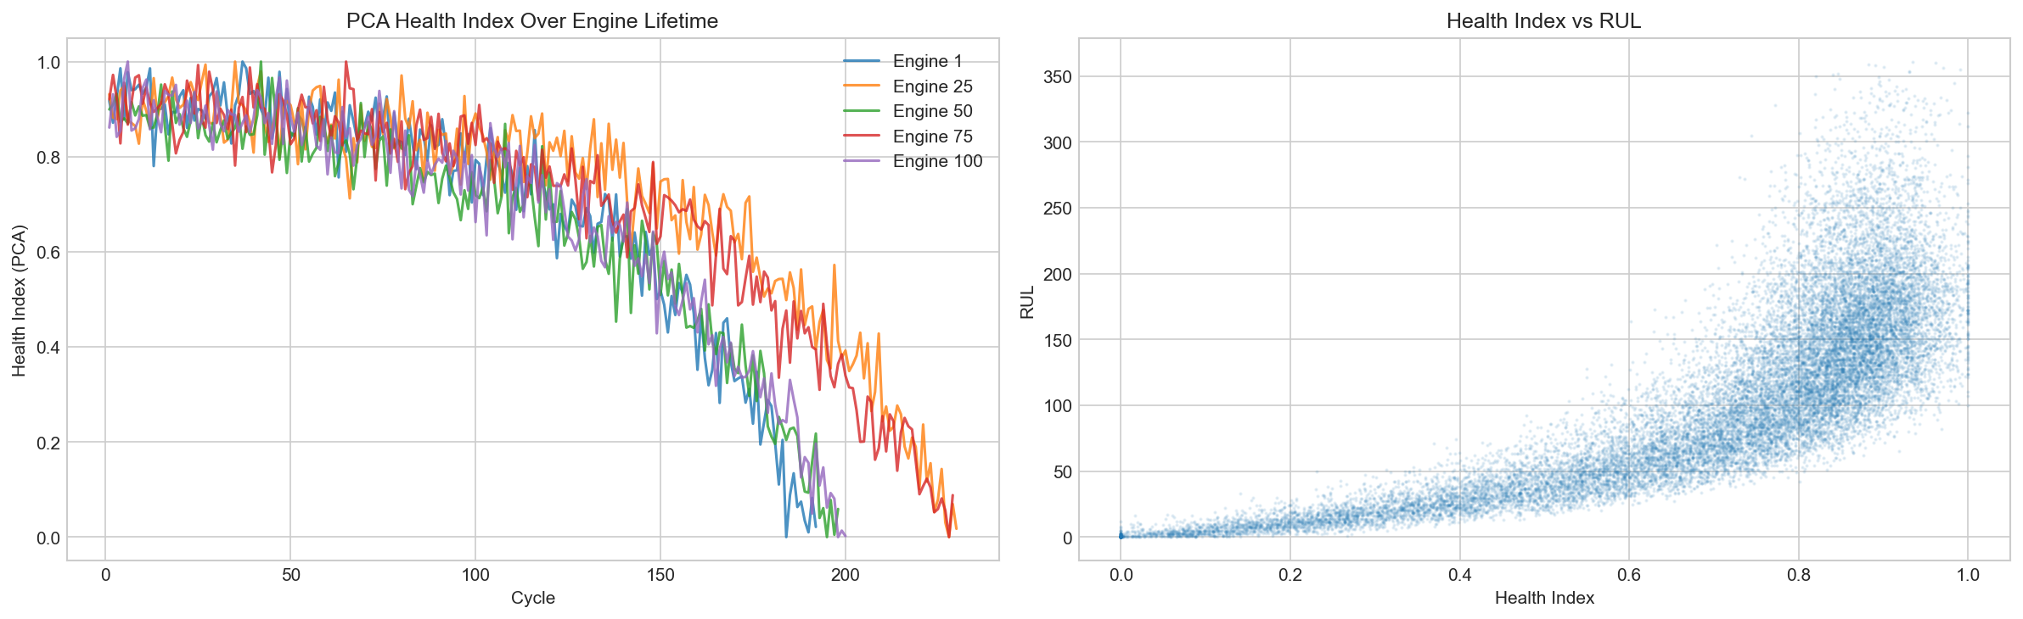
PCA Health Index — Per Engine & Relationship to RUL

Slide 20
Health Index Results
• PCA explained variance: 69.6%
• HI Baseline — MAE: 85.55, RMSE: 95.07
• HI is a physics-inspired approach vs data-driven ML
• Takeaway: Single PCA component captures ~70% of variance
but does not outperform ML baselines (single-point prediction from last cycle)
• ML baselines with window features provide much better RUL estimates

Slide 21
Week 4
LSTM Deep Learning Model

Slide 22
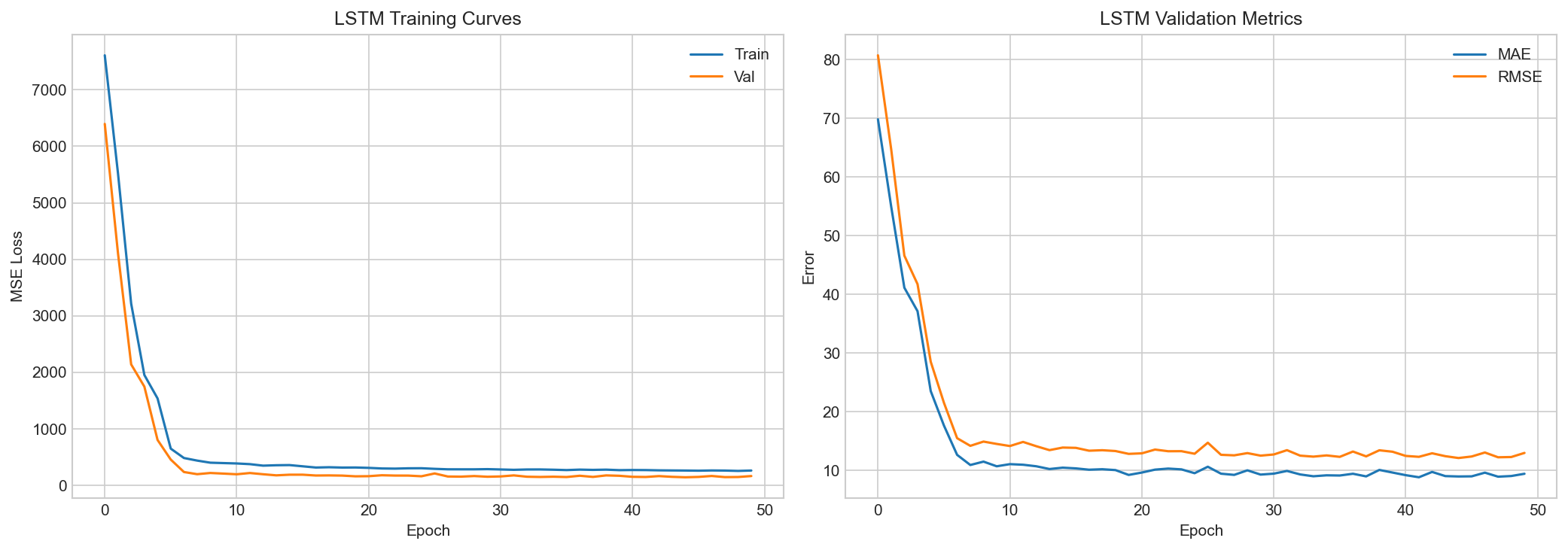
LSTM Training Curves

Slide 23
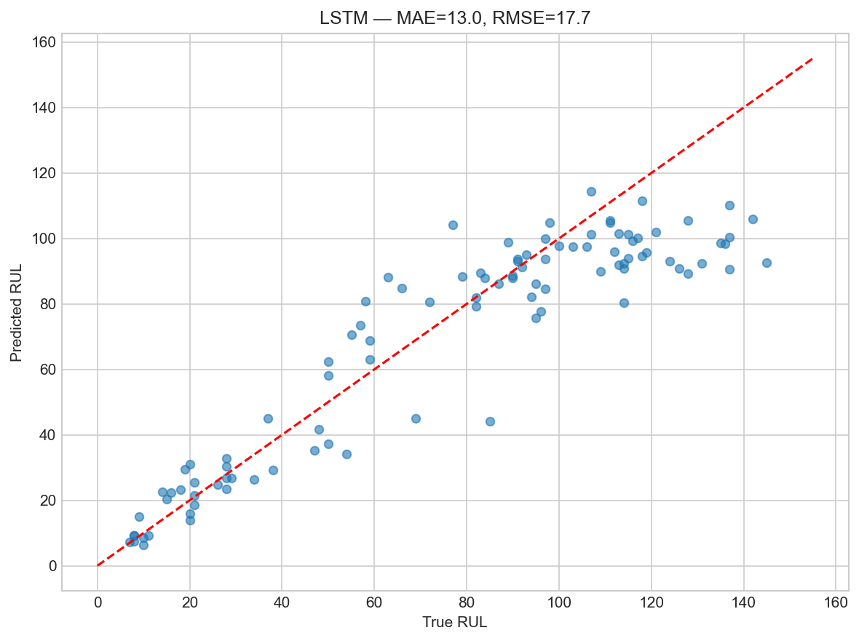
LSTM Predictions — Test Set

Slide 24
LSTM Results & Agent Skeleton
• LSTM (2 layers, hidden=64, dropout=0.3)
• Parameters: 57,985
• Test MAE: 13.00, RMSE: 17.71, NASA: 411
• Input: sliding windows of 30 cycles × 14 sensors
• Also built Copilot agent skeleton:
Tools: predict_rul, explain_prediction, retrieve_knowledge, recommend_action
Orchestrator: rule-based pipeline (predict → explain → retrieve → recommend)

Slide 25
Week 5
Paper A: CNN+LSTM + Savitzky-Golay Smoothing

Slide 26
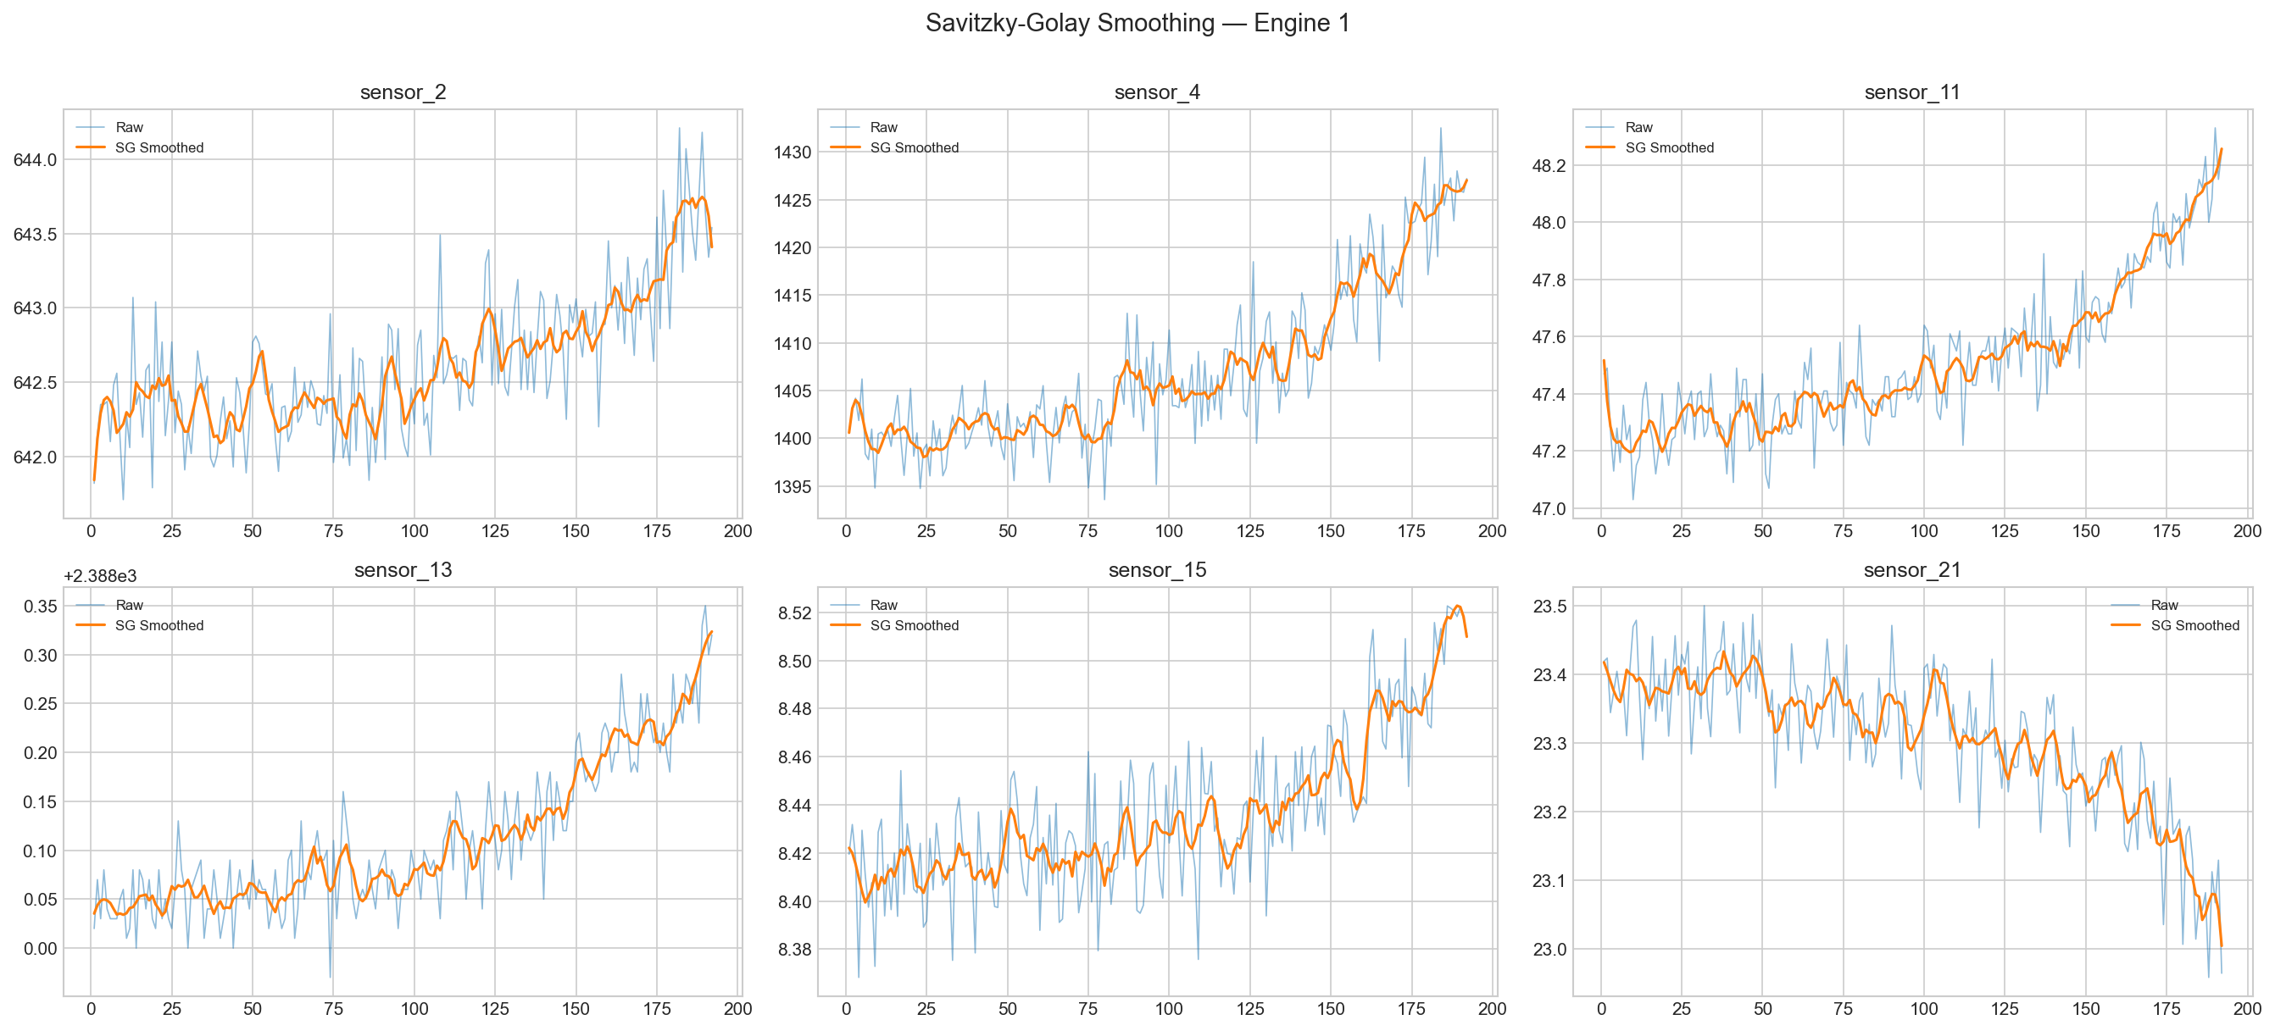
Savitzky-Golay Smoothing Effect on Sensor Signals

Slide 27
Paper A — 2×2 Experiment Results
Configuration | MAE | RMSE | NASA Score
LSTM_raw | 12.70 | 16.96 | 373
LSTM_sg | 12.87 | 16.53 | 366
CNN_LSTM_raw | 24.82 | 29.01 | 1718
CNN_LSTM_sg | 24.76 | 31.02 | 2085
2×2 experiment: {LSTM, CNN+LSTM} × {raw, SG-smoothed} All models trained for 50 epochs with early stopping (patience=10)

Slide 28
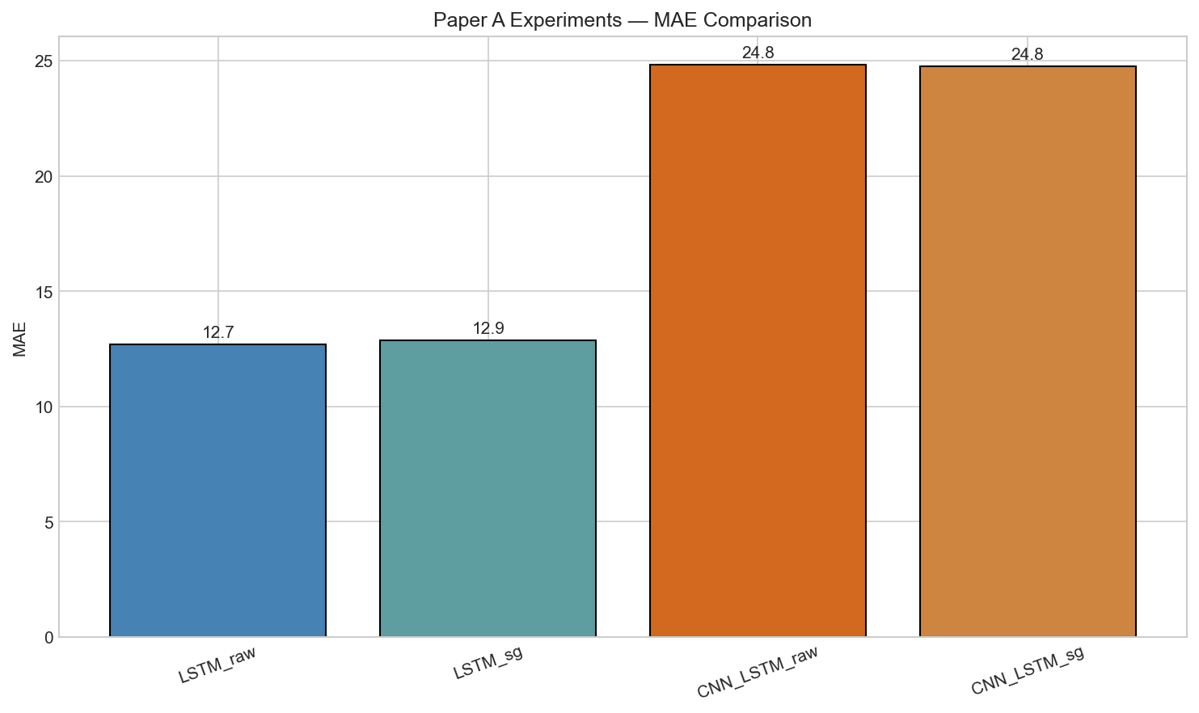
Paper A — MAE Comparison

Slide 29
Week 6
Paper B: CNN-Transformer + MC Dropout UQ

Slide 30
CNN-Transformer Architecture
• 1D-CNN feature extractor (2 conv layers → BatchNorm → ReLU)
• Positional Encoding (sinusoidal)
• Transformer Encoder (2 layers, 4 heads, d_model=64)
• Global Average Pooling → FC regression head
• MC Dropout (rate=0.1) kept active at inference
• 84,417 trainable parameters
• Test MAE: 11.12, RMSE: 14.94, NASA: 350

Slide 31
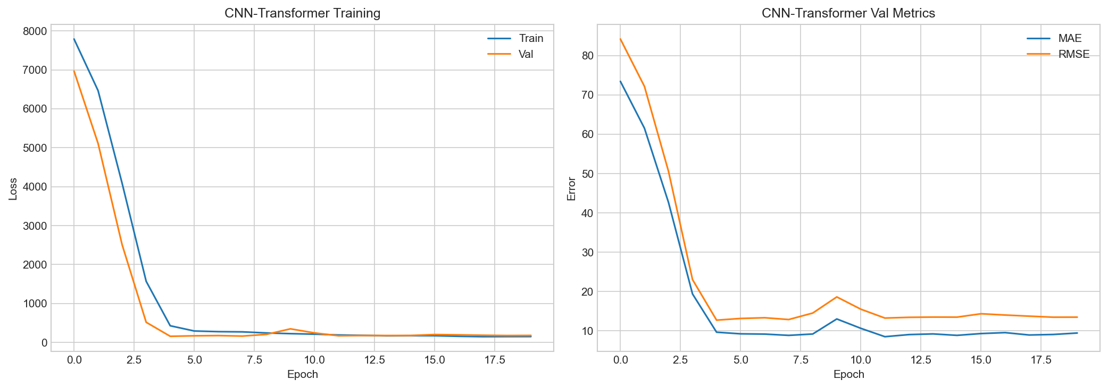
CNN-Transformer Training Curves

Slide 32
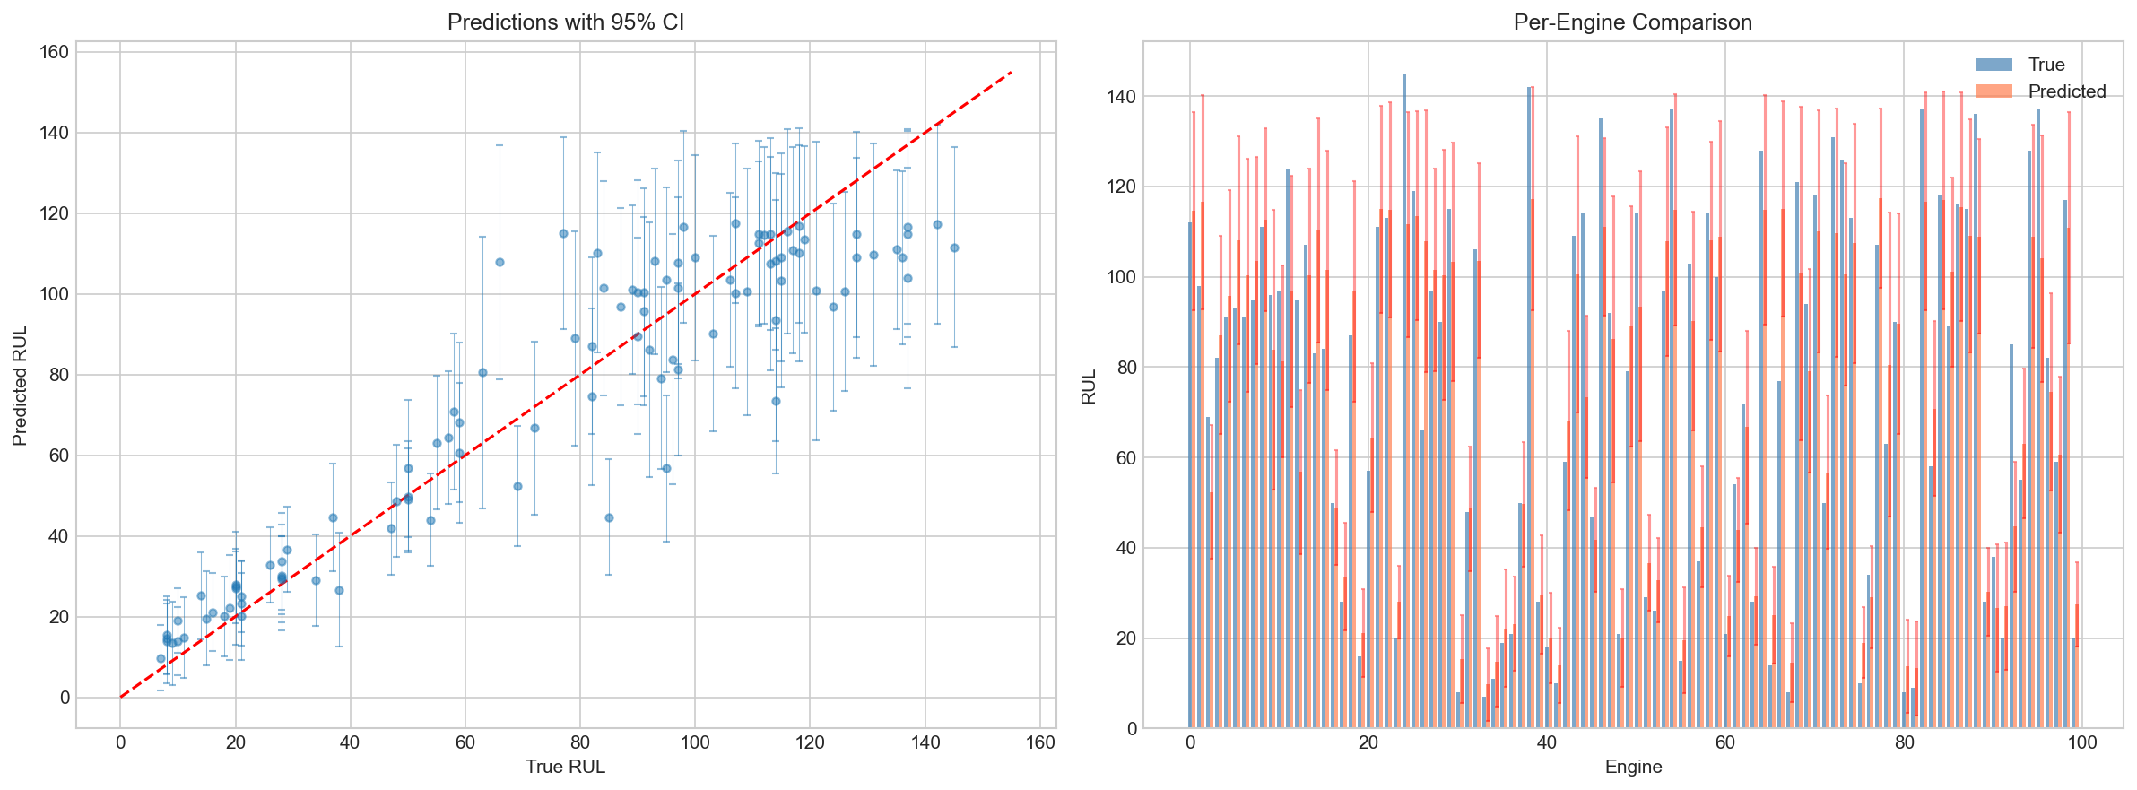
Predictions with 95% Confidence Intervals

Slide 33
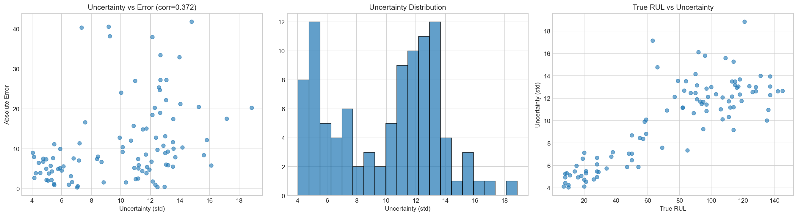
Uncertainty Analysis — Sanity Checks

Slide 34
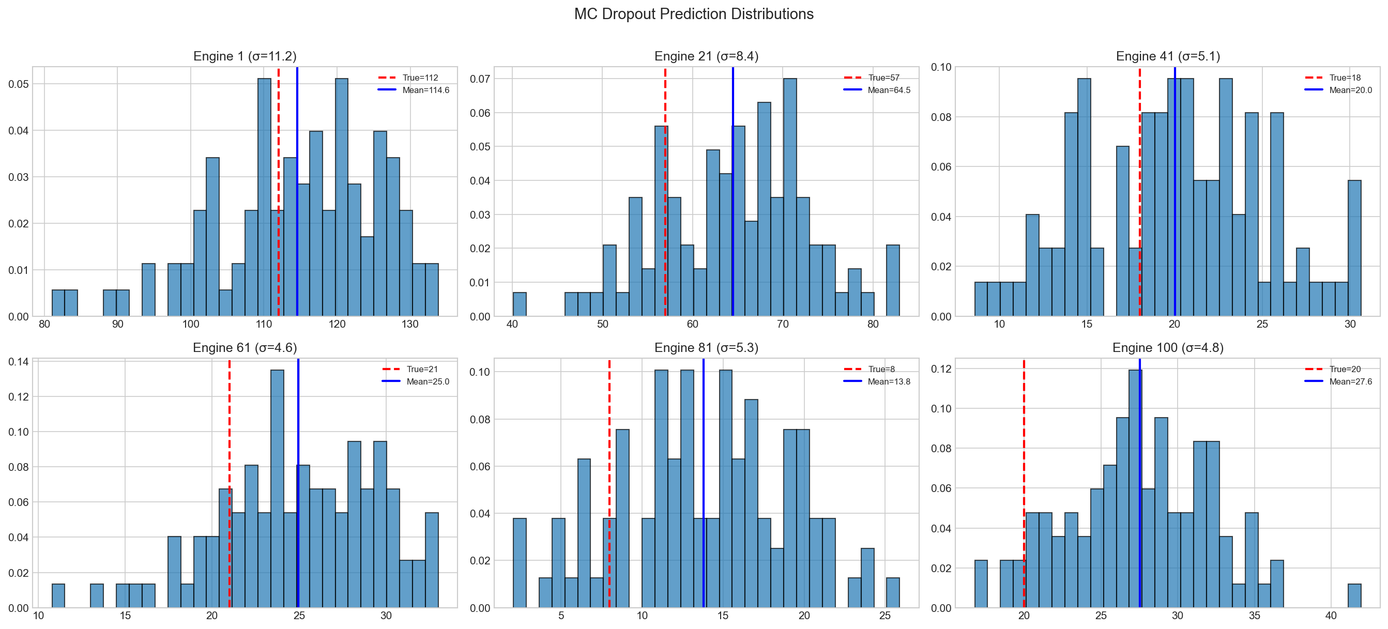
MC Dropout Prediction Distributions (Sample Engines)

Slide 35
Uncertainty Quantification — Key Findings
• MC Dropout with N=100 stochastic forward passes
• Uncertainty-Error Correlation: 0.372
→ Positive correlation = model is more uncertain when it makes bigger errors
• Mean uncertainty (std): 9.96 cycles
• Uncertainty enables:
- Abstention: refuse prediction when uncertainty too high
- Confidence intervals: communicate reliability to operators
- Risk stratification: prioritize engines by uncertainty level

Slide 36
All Results
Model Comparison — FD001 Test Set

Slide 37
Model Comparison — FD001 Test Set
Model | MAE | RMSE | NASA Score
Gradient Boosting | 10.38 | 14.31 | 309
Random Forest | 10.84 | 14.39 | 318
Linear Regression | 14.74 | 18.06 | 531
LSTM | 13.00 | 17.71 | 411
LSTM (raw) | 12.70 | 16.96 | 373
CNN-Transformer (MC) | 11.12 | 14.94 | 350
Lower MAE/RMSE/NASA Score = Better. NASA Score penalizes late predictions more heavily.

Slide 38
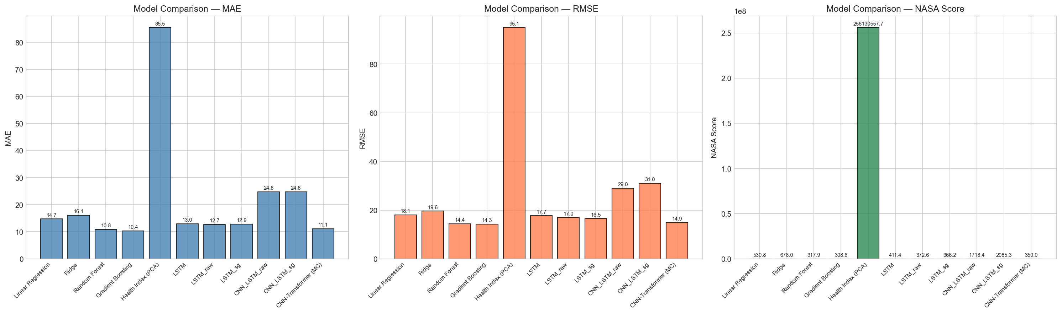
Model Comparison — Bar Charts

Slide 39
Why CNN-Transformer?
Gradient Boosting Has Better Numbers — So Why Not Use It?

Slide 40
Honest Comparison: Gradient Boosting vs CNN-Transformer
Metric | Gradient Boosting | CNN-Transformer (MC) | Winner
MAE | 10.38 | 11.12 | GB (Δ=0.73)
RMSE | 14.31 | 14.94 | GB
NASA Score | 309 | 350 | GB
Uncertainty (std) | ✗ Not available | 9.96 cycles | CT ✓
Confidence Intervals | ✗ Not available | 95% CI per prediction | CT ✓
Abstention / Escalation | ✗ Not possible | ✓ Knows when unsure | CT ✓
Temporal Patterns | Summarized (flat) | Reads raw sequences | CT ✓
Explainability (Grad) | ✗ Feature importance only | ✓ Per-timestep saliency | CT ✓
GB MAE=10.38 vs CT MAE=11.12 (Δ=0.73). GB NASA=309 vs CT NASA=350. CT provides uncertainty, explainability, and abstention that GB cannot.

Slide 41
Why Not Gradient Boosting? — The Safety Argument
Gradient Boosting gives ONE number: 'RUL = 50 cycles.' That's it.
A maintenance engineer must ask: How confident is the model? → No answer.
CNN-Transformer (MC Dropout) gives:
• RUL = 50 cycles ± 5 cycles (95% CI: [40, 60]) — I'm confident
• RUL = 50 cycles ± 30 cycles (95% CI: [0, 110]) — DON'T TRUST ME
In aviation, a wrong confident prediction is catastrophic.
It's BETTER to say 'I don't know' than to say '50 cycles' and be wrong.
The CNN-Transformer is the only model that can do this.
Uncertainty-error correlation: 0.372 — the model IS more uncertain when wrong.

Slide 42
How We Will Improve CNN-Transformer Results
The CNN-Transformer's MAE (11.12) is close to GB (10.38).
Planned improvements to beat GB on raw accuracy too:
Week 10 — Abstention: Skip high-uncertainty predictions →
remaining predictions become MORE accurate (lower MAE on confident subset)
Week 11 — Ablation & Tuning:
• Window size optimization (10/20/30/40/50)
• Attention heads (2/4/8) and model depth tuning
• Learning rate scheduling refinement
• Ensemble: average predictions from multiple MC Dropout runs
Additional ideas: Feature scaling normalization, longer training,
curriculum learning (easy → hard samples), loss function tuning (Huber loss)

Slide 43
Copilot Architecture
How the Ops Copilot Works — Current & Future

Slide 44
Current Copilot: Rule-Based Pipeline (No LLM)
1. PREDICT
2. EXPLAIN
3. RETRIEVE
4. RECOMMEND
→
→
→
predict_rul()
explain_prediction()
retrieve_knowledge()
recommend_action()
CNN-Transformer + MC Dropout → RUL mean, std, 95% CI
Integrated Gradients → Top sensors ranked by attribution
BM25 search over kb/fault_tree.md & glossary.md → KB snippets
Rule-based logic: IF uncertainty > 20 → ESCALATE ELSE → recommend
Current status: 100% rule-based Python. No LLM, no API calls. The orchestrator is a Python class (OpsCopilot) that calls 4 functions in fixed order with if/else logic.

Slide 45
Safety Guardrails — Built Into Every Analysis
Before any recommendation is shown, the Copilot verifies 3 safety checks:
✓ Uncertainty Reported — Never give advice without showing confidence level
If uncertainty is not available → flag as incomplete
✓ Knowledge Base Cited — Recommendations must be grounded in the KB
If no relevant KB entry found → note 'No KB reference available'
✓ No False Reassurance — If uncertainty is high, never say 'all clear'
High uncertainty + 'recommend' + 'high confidence' → BLOCKED
Abstention Decision:
Uncertainty (std) > 20 cycles → ESCALATE to human expert
Uncertainty level = 'high' or 'very_high' → ESCALATE to human expert

Slide 46
Agentic Roadmap
From Rule-Based → LLM-Powered Copilot

Slide 47
Evolution of the Copilot — Week by Week
Week | What Changes | Agent Type
Week 4 | Agent skeleton: 4 tools defined, fixed pipeline | Rule-based
Week 7 | Explainability tools added (saliency, IG, SHAP) | Rule-based
Week 8 | Knowledge base + BM25 retrieval integrated | Rule-based
Week 9 | Full pipeline wired: single-engine + fleet analysis | Rule-based
Week 10 | Novelty detection + abstention logic formalized | Rule-based + OOD
Week 11 | Streamlit demo app with interactive controls | Rule-based (UI)
Stretch | LLM orchestrator: OpenAI function calling via LangChain | LLM-backed
Core tools stay the same. Only the orchestrator changes (if/else → LLM tool calling).

Slide 48
Final Product Vision — The Streamlit Dashboard
Interactive Streamlit app with 3 pages:
1. Single Engine Analysis:
Select engine → Run 4-step Copilot → See prediction, uncertainty,
sensor attribution chart, KB reference, and recommendation / escalation
2. Fleet Dashboard:
Analyze all 100 engines → Heatmap of risk levels → Sorted by urgency
Summary: X critical, Y warning, Z normal, W escalated
3. Ablation & Comparison:
Compare all models side-by-side, toggle UQ on/off, vary MC samples
The tools (predict, explain, retrieve, recommend) will stay rule-based.
LLM integration is a stretch goal — the value is in uncertainty + explanations.

Slide 49
Agentic Copilot
Predict → Explain → Retrieve → Recommend

Slide 50
Ops Copilot — Pipeline
Step 1: Predict RUL + uncertainty (MC Dropout, CNN-Transformer)
Step 2: Explain prediction (gradient saliency / integrated gradients)
Step 3: Retrieve knowledge base (BM25 over curated fault tree)
Step 4: Generate recommendation with KB citation
Safety Guardrails:
• ABSTAIN when uncertainty > threshold → escalate to human
• Verify uncertainty is reported, KB is cited
• No false reassurance when uncertainty is high

Slide 51
Mid-Semester Summary & Key Insights
✓ Comprehensive EDA on C-MAPSS FD001 — 14 informative sensors identified
✓ ML baselines: Gradient Boosting best at MAE=10.38
✓ LSTM sequence model: MAE=13.00
✓ CNN-Transformer with MC Dropout: MAE=11.12 with uncertainty
✓ Uncertainty-error correlation: 0.372 (model knows when unsure)
✓ Copilot agent skeleton built: predict → explain → retrieve → recommend

Slide 52
Remaining Work (Weeks 7–12)
Week 7: Explainability — saliency maps, integrated gradients, SHAP
Week 8: Knowledge Base RAG — BM25 + sentence-transformer retrieval
Week 9: Agentic Copilot — LLM integration with tool calling
Week 10: Novelty detection & abstention policy tuning
Week 11: Ablation studies & Streamlit dashboard
Week 12: Final report & presentation

Slide 53
Thank You
Questions & Demo

