Slide 1
Remaining Useful Life Prediction with Uncertainty-Aware AI Copilot
Mid-Semester Progress Report — NASA C-MAPSS Turbofan Engine Dataset
Weeks 1–6 Results • EDA → Baselines → Deep Learning → Uncertainty

Slide 2
Agenda
1. Problem Statement & Motivation
2. Dataset: NASA C-MAPSS FD001
3. Week 1: Exploratory Data Analysis
4. Weeks 2 & 3: ML Baselines & Health Index
5. Week 4: LSTM Deep Learning Model
6. Week 5: Paper A — CNN+LSTM + SG Smoothing
7. Week 6: Paper B — CNN-Transformer + MC Dropout UQ
8. The Cost of Confidence (Results Comparison)
9. Live Demo: Agentic Copilot

Slide 3
Problem Statement
Why RUL Prediction Matters

Slide 4
Motivation
• Unplanned engine failures → safety risk + costly downtime
• Condition-based maintenance requires accurate RUL prediction
• Challenge: models must know WHEN they DON'T know (uncertainty)
• Goal: build a system that predicts, explains, and knows its limits
Our Approach:
Predict RUL → Quantify Uncertainty → Explain → Recommend → Abstain if unsure

Slide 5
Dataset
NASA C-MAPSS FD001

Slide 6
C-MAPSS FD001 Overview
• Simulated turbofan engine run-to-failure data (NASA)
• 100 training engines + 100 test engines
• 1 operating condition, 1 fault mode (HPC degradation)
• 21 sensor channels + 3 operational settings per cycle
• Engine lifetimes: 128–362 cycles (avg 206)
• Test RUL range: 7–145 (mean 76)
• RUL capping: min(raw_rul, 125) — piecewise linear target

Slide 7
Week 1
Exploratory Data Analysis

Slide 8
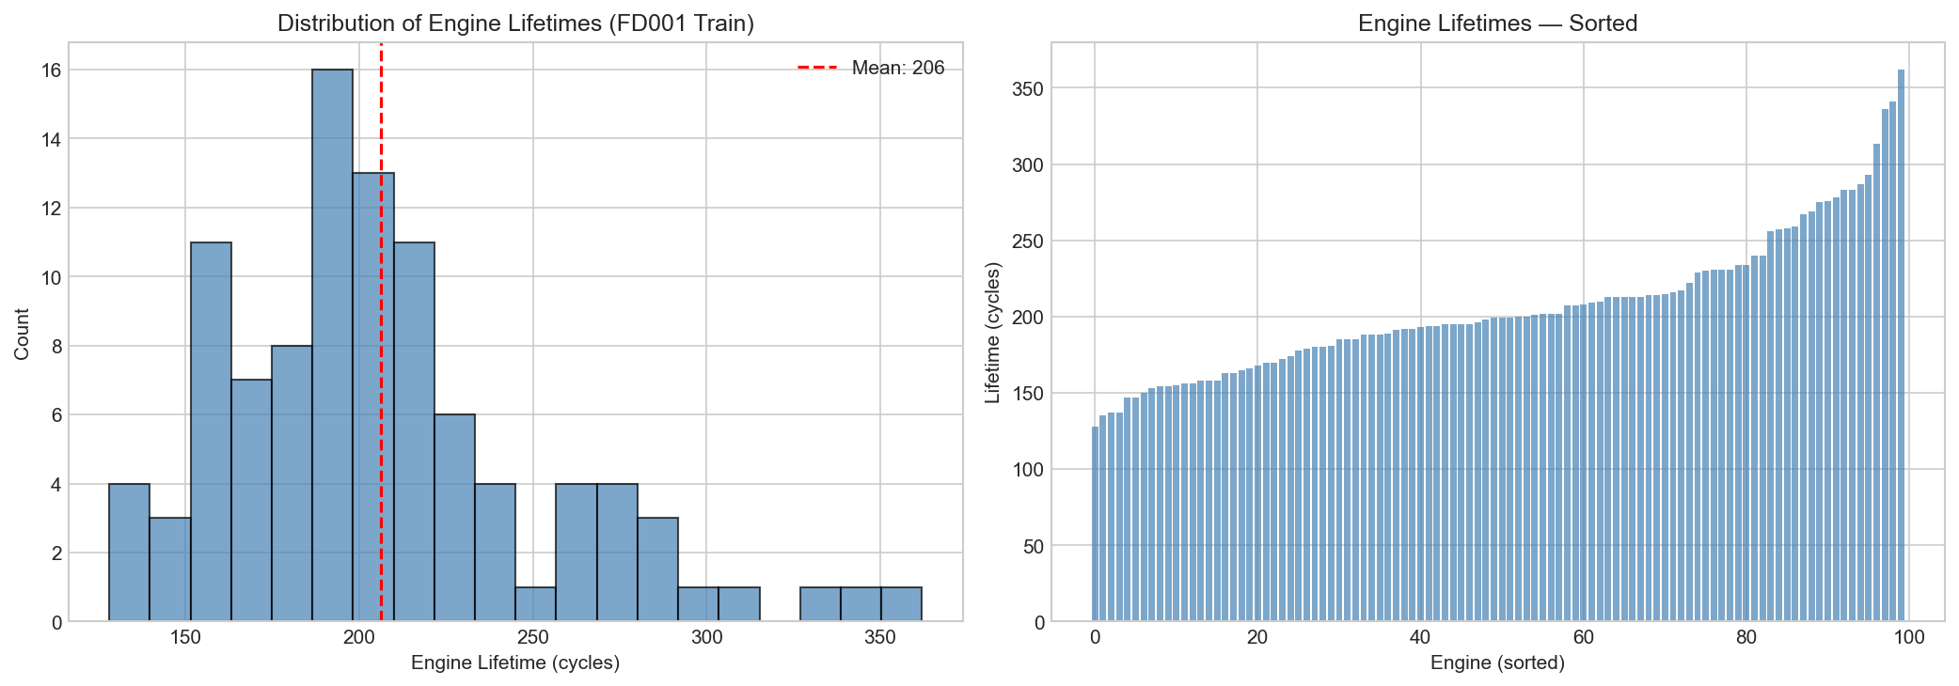
Engine Lifetime Distribution

Slide 9
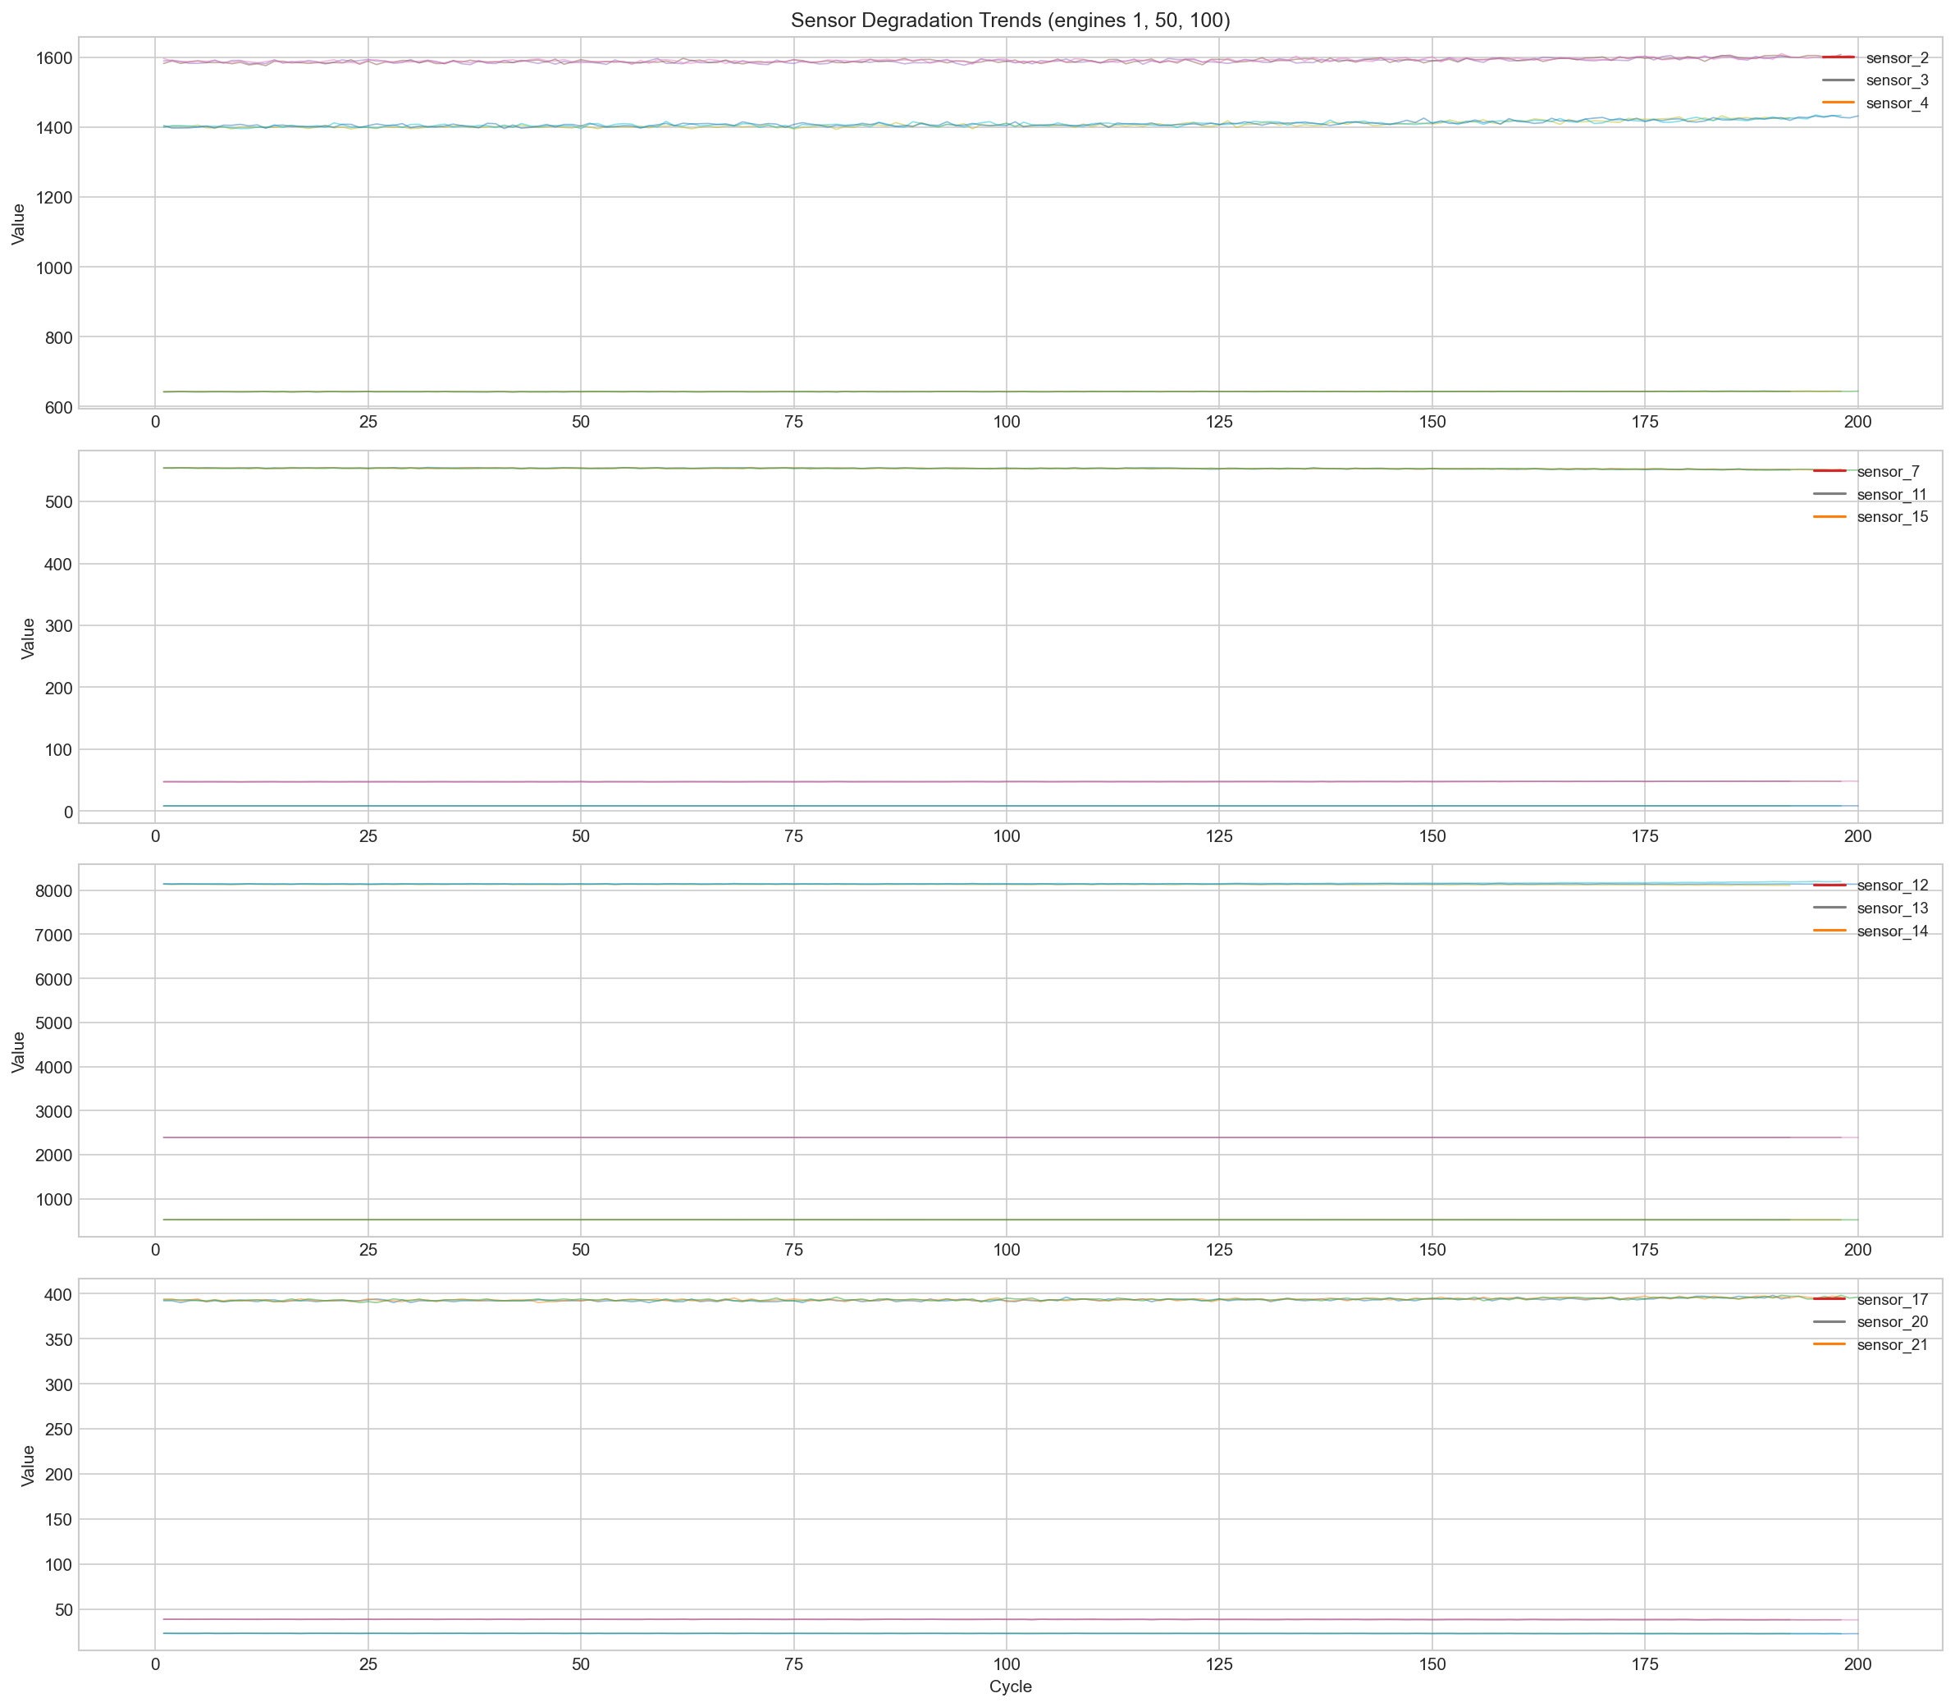
Sensor Degradation Trends Over Engine Lifetime

Slide 10
Week 1 Key Findings
• 7 sensors have near-zero variance → dropped (sensor_1, 5, 6, 10, 16, 18, 19)
• 14 informative sensors retained for modeling
• Top correlated sensors with RUL: sensor_11, sensor_4, sensor_12
(|r| = 0.775, 0.757, 0.749)
• Clear degradation trends visible in sensors over engine lifetime
• Decision: Window size=30, MinMax scaling, RUL cap=125

Slide 11
Weeks 2 & 3
Baselines & Health Index

Slide 12
Baseline Model Results (FD001 Test)
Model | Test MAE | Test RMSE | NASA Score
Linear Regression | 14.74 | 18.06 | 531
Ridge | 16.14 | 19.62 | 678
Random Forest | 10.84 | 14.39 | 318
Gradient Boosting | 10.38 | 14.30 | 307
Features: rolling stats (mean, std, slope, min, max) + EWM + rate-of-change over last 30 cycles of each engine. Train/val split by engine unit.

Slide 13
Weeks 2 & 3 Summary
• ML baselines (Linear, RF, GBM) trained on 30-cycle rolling windows.
• Gradient Boosting achieved best baseline performance (MAE: 10.38).
• Explored PCA-based Health Index (physics-inspired) as an alternative.
• Single PCA component captured ~70% of variance but heavily underperformed ML baselines.
• Takeaway: Moving forward strictly with data-driven models (Deep Learning) over raw PCA indices.

Slide 14
Week 4
LSTM Deep Learning Model

Slide 15
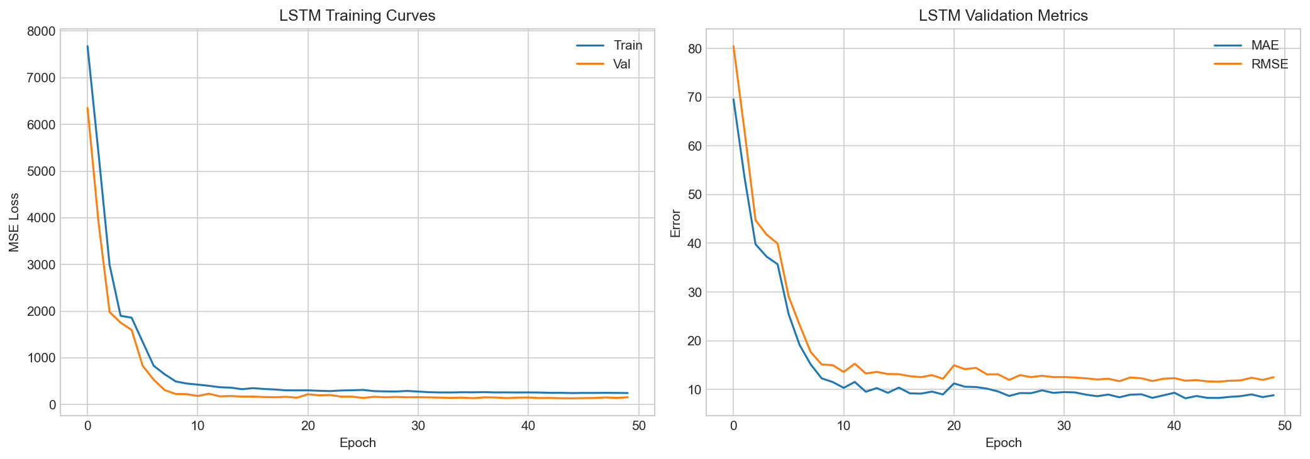
LSTM Training Curves

Slide 16
LSTM Results
• LSTM (2 layers, hidden=64, dropout=0.3)
• Parameters: 57,985
• Test MAE: 10.97, RMSE: 14.90, NASA: 395
• Input: sliding windows of 30 cycles × 14 sensors

Slide 17
Week 5
Paper A: CNN+LSTM + Savitzky-Golay Smoothing

Slide 18
Paper A — 2×2 Experiment Results
Configuration | MAE | RMSE | NASA Score
LSTM_raw | 11.42 | 15.06 | 402
LSTM_sg | 11.45 | 14.82 | 372
CNN_LSTM_raw | 11.80 | 16.07 | 520
CNN_LSTM_sg | 11.94 | 16.21 | 548
2×2 experiment: {LSTM, CNN+LSTM} × {raw, SG-smoothed} All models trained for 50 epochs with early stopping (patience=10)

Slide 19
Week 6
Paper B: CNN-Transformer + MC Dropout UQ

Slide 20
CNN-Transformer Architecture
• 1D-CNN feature extractor (2 conv layers → BatchNorm → ReLU)
• Positional Encoding (sinusoidal)
• Transformer Encoder (2 layers, 4 heads, d_model=64)
• Global Average Pooling → FC regression head
• MC Dropout (rate=0.1) kept active at inference
• 84,417 trainable parameters
• Test MAE: 10.87, RMSE: 15.18, NASA: 357

Slide 21
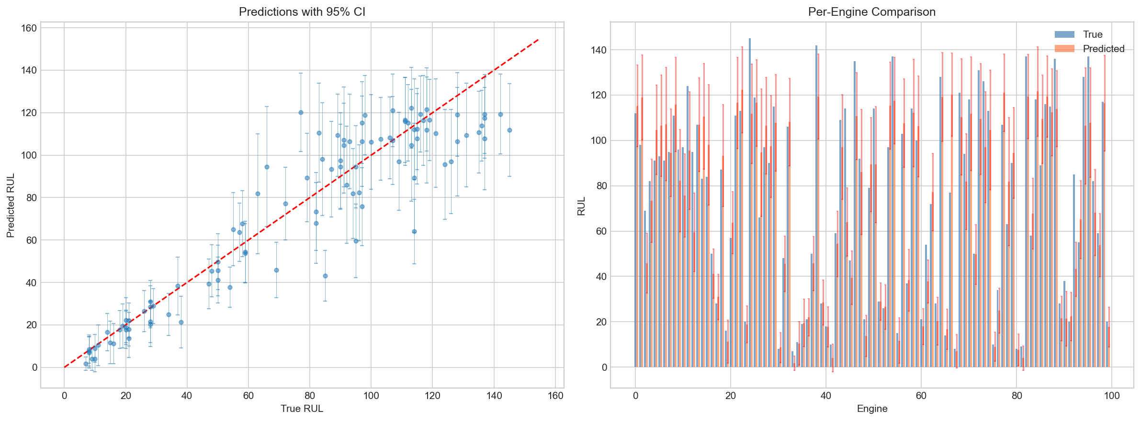
Predictions with 95% Confidence Intervals

Slide 22
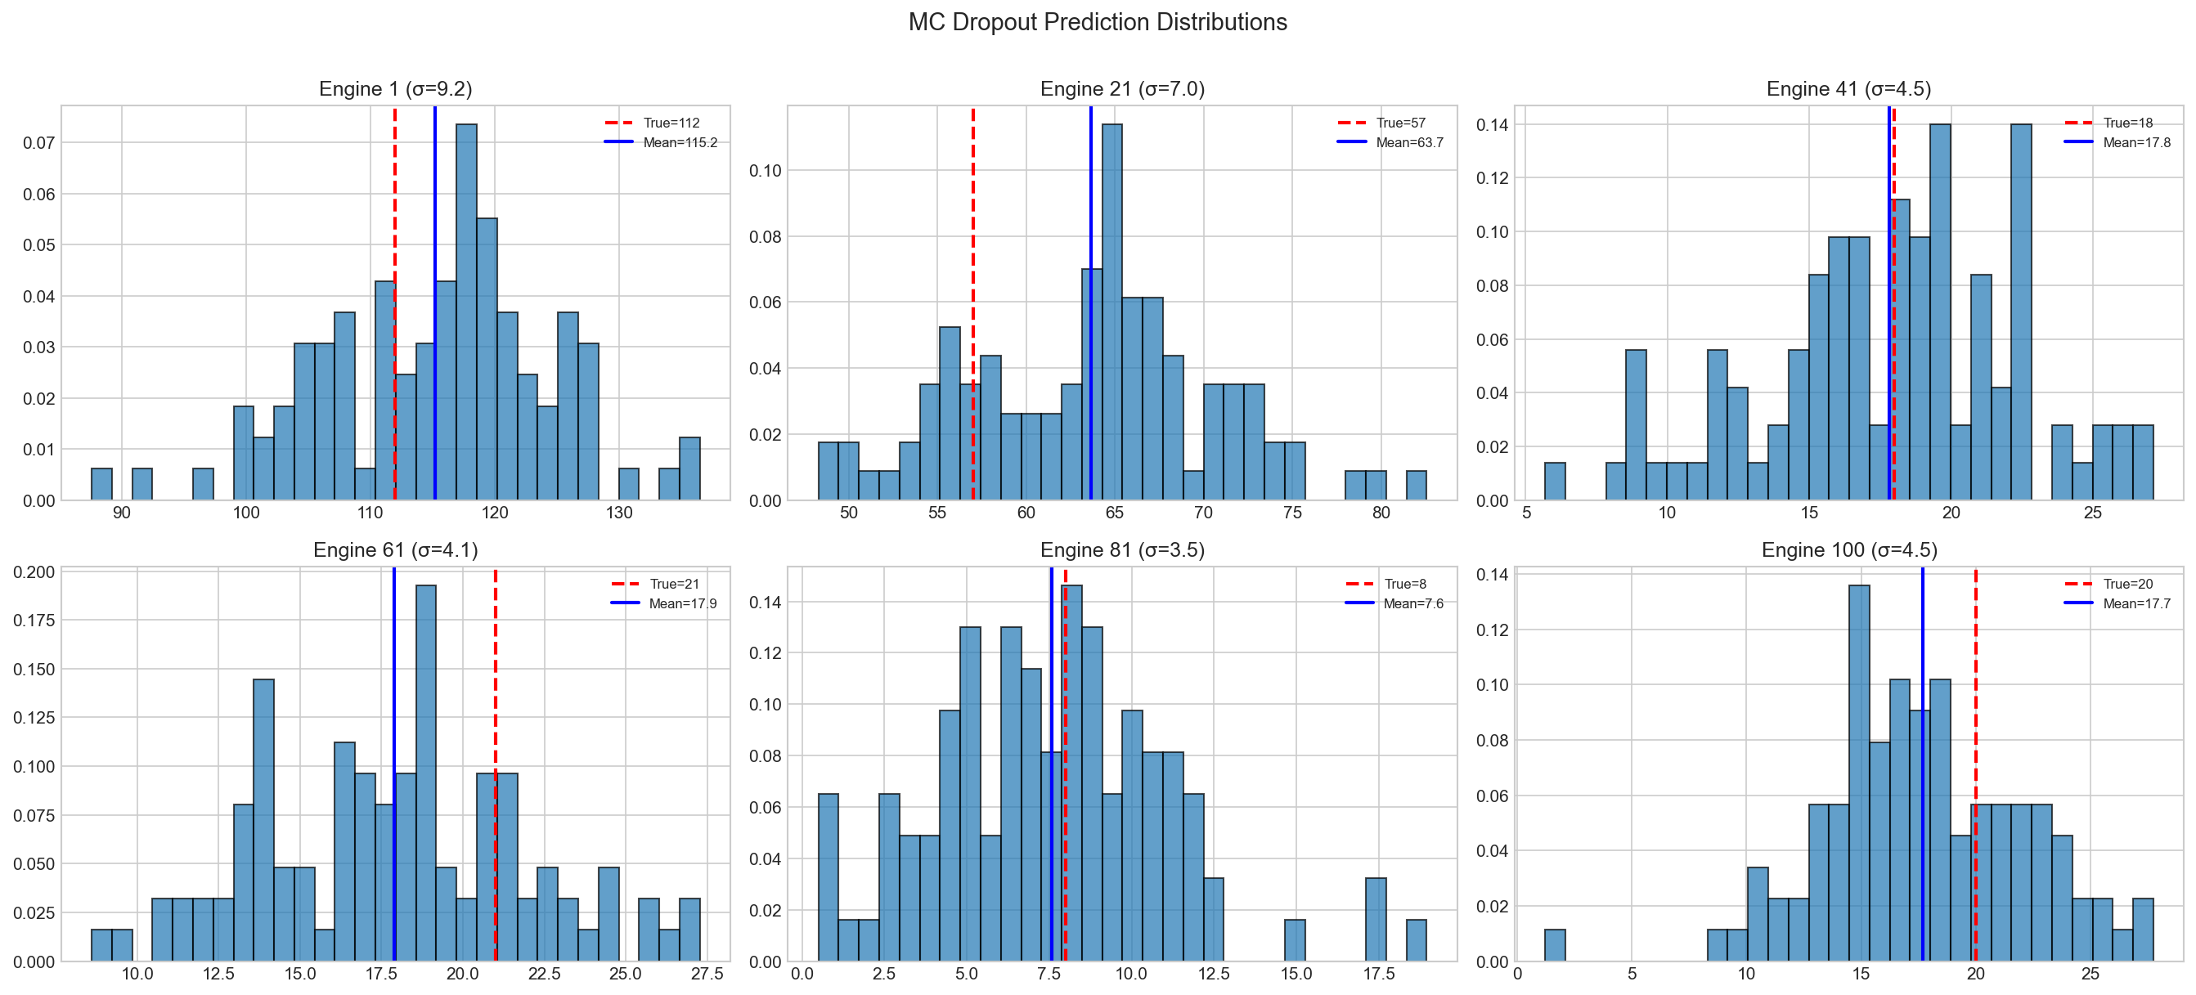
MC Dropout Prediction Distributions (Sample Engines)
Engine 1 (σ=11.2) High Uncertainty → Trigger Copilot Escalation
Engine 61 (σ=4.6) High Confidence → Safe to Recommend

Slide 23
Uncertainty Quantification — Key Findings
• MC Dropout with N=100 stochastic forward passes
• Uncertainty-Error Correlation: 0.397
→ Positive correlation = model is more uncertain when it makes bigger errors
• Mean uncertainty (std): 8.52 cycles
• Uncertainty enables:
- Abstention: refuse prediction when uncertainty too high
- Confidence intervals: communicate reliability to operators
- Risk stratification: prioritize engines by uncertainty level

Slide 24
The Cost of Confidence
Trading 0.73 MAE for Aviation Safety

Slide 25
The Safety Argument: GB vs. CNN-Transformer
We traded 0.73 cycles of MAE for the ability to prevent catastrophic, confident errors.
Gradient Boosting
CNN-Transformer
• MAE: 10.38 • Yields ONE absolute number. • e.g., 'RUL = 50 cycles' • Flaw: No indication of model confidence. • Risk: A confident wrong prediction is catastrophic in aviation.
• MAE: 10.87 • Yields RUL + 95% Confidence Interval. • e.g., 'RUL = 50 ± 5 cycles' (Safe) • e.g., 'RUL = 50 ± 30 cycles' (Abstain) • Benefit: It is BETTER to say 'I don't know' than to be confidently wrong.

Slide 26
Live Demo
Uncertainty in Action — Streamlit Dashboard

Slide 27
Current Copilot: Rule-Based Pipeline (No LLM)
1. PREDICT
2. EXPLAIN
3. RETRIEVE
4. RECOMMEND
→
→
→
predict_rul()
explain_prediction()
retrieve_knowledge()
recommend_action()
CNN-Transformer + MC Dropout → RUL mean, std, 95% CI
Integrated Gradients → Top sensors ranked by attribution
BM25 search over kb/fault_tree.md & glossary.md → KB snippets
Rule-based logic: IF uncertainty > 20 → ESCALATE ELSE → recommend
Current status: 100% rule-based Python. No LLM, no API calls. The orchestrator is a Python class (OpsCopilot) that calls 4 functions in fixed order with if/else logic.

Slide 28
Remaining Work (Weeks 7–12)
Week 7: Explainability — saliency maps, integrated gradients, SHAP
Week 8: Knowledge Base RAG — BM25 + sentence-transformer retrieval
Week 9: Agentic Copilot — LLM integration with tool calling
Week 10: Novelty detection & abstention policy tuning
Week 11: Ablation studies & Streamlit dashboard finalization
Week 12: Final report & presentation

Slide 29
Thank You
Questions & Interactive Dashboard Demo

