Slide 1


Regulation of Stochastic System with Information Cost
Name-Arnab Biswas
Roll-21ec65r01
Branch-vipes
supervisor-ritwik kumar layek

Slide 2
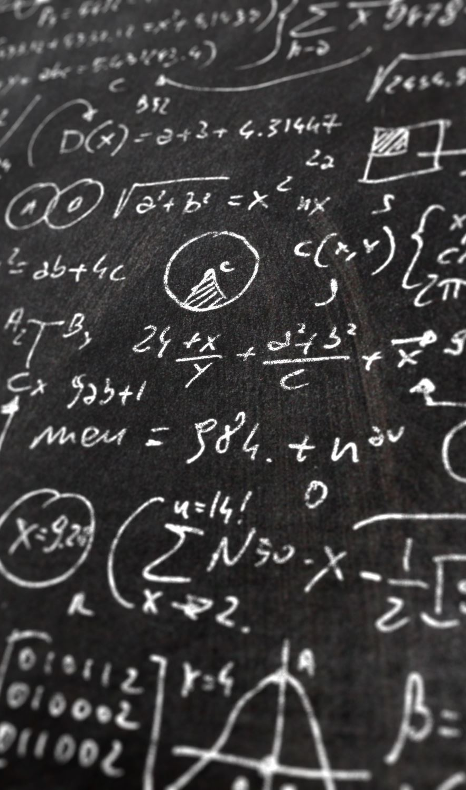
Problem statement
We want to design a system in such a way that in a state space model of a stochastic system, if any state goes to an undesired state, using our control strategy we can change the undesired state to the desired state with minimal information cost.

Slide 3
Approach for analysing information transfer
Through Information Theory: This involves quantifying the amount of information transferred between subsystems using measures such as transfer entropy or mutual information.
Through Control Theory: This involves designing control strategies that influence the behaviour of the system. Control strategies can be based on minimizing certain costs and can be implemented through feedback mechanisms.
Through Symbolic Dynamics: This involves representing the behaviour of the system using discrete symbols or states. This can simplify the analysis of information transfer and processing by reducing the complexity of the system dynamics.

Slide 4
Linear quadratic gaussian
- Linear Quadratic Gaussian control combines Kalman filter and Linear Quadratic Regulator control techniques for optimal control system design.
- LQR algorithm minimizes the expected value of a quadratic cost function by adjusting the control input using a state feedback approach.
- Kalman filter is an estimator that uses noisy measurements to estimate the system's state variables.
- LQG control combines Kalman filter's state estimation capabilities and LQR control's optimal control strategy for a complete control system that is robust to disturbances and noisy measurements.
- LQG control system adjusts the control input based on the current state estimate to minimize the error between the desired and actual system response.
- LQG control is widely used in various fields, but designing an LQG control system can be challenging and requires knowledge of the system's mathematical model, accurate measurement of the system's state variables, and choosing an appropriate cost function.

Slide 5

Linear quadratic regular
- The LQR algorithm minimizes a quadratic cost function with constraints.
- The cost function includes errors between the system's states and setpoints and control effort.
- The algorithm finds a feedback control law by computing the optimal control input based on the current state.
- The algorithm requires a state-space model of the system that describes state evolution over time.
- Weighting matrices are used to specify the relative importance of states and control inputs in the cost function and can be adjusted for trade-off between control effort and state tracking performance.
- Once computed, the feedback control law is applied to the system as a closed-loop control system, which stabilizes and optimizes system performance using feedback from the system's states.

Slide 6

Kalman filter
- The Kalman filter estimates the state of a system based on noisy measurements in control and estimation theory.
- It generates an optimal estimate of the true state of the system by combining a predicted state estimate with a measurement update.
- The predicted state estimate is based on the system's state dynamics and control inputs, while the measurement update incorporates measurements of the system's states with noise and uncertainty.
- The algorithm uses statistical information to adjust the weighting between the predicted state estimate and the measurement update.
- The Kalman filter continuously updates the state estimate as new measurements become available, allowing it to adapt to changes in the system and improve accuracy over time.
- It is useful in applications where the true state of the system is unknown, and measurements are noisy or incomplete.

Slide 7
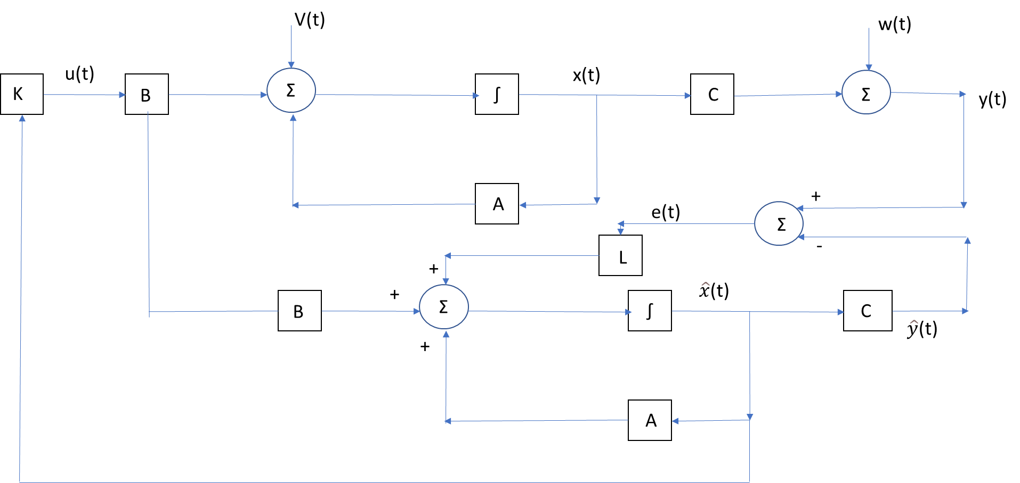
Block diagram
Fig : LQG System

Slide 8
Review of suggested papers
- Entropy measures uncertainty or randomness in a system and is used in information theory.
- Transfer entropy measures the directed flow of information between two time series.
- Transfer entropy calculates the amount of information transferred from one time series to another given their past history.
- The algorithm for estimating transfer entropy is non-parametric and does not make assumptions about the data distribution.
- Transfer entropy is calculated by comparing the joint probability distribution of the past and future values of the two-time series.
- It is a non-negative quantity that measures the amount of information transferred from one series to another.

Slide 9
Continued
- Transfer entropy can be interpreted as a log-likelihood ratio between two statistical models that describe the joint distribution of two-time series.
- This interpretation provides a more intuitive understanding of the measure and its relationship to statistical models.
- It also allows for the use of established statistical techniques for hypothesis testing and model selection.
- The new interpretation of transfer entropy opens up the possibility of extending transfer entropy to more complex models.
- The paper Symbolic Transfer Entropy proposes a new method for estimating transfer entropy based on symbolic dynamics.
- The proposed method can handle high-dimensional and noisy data, as well as nonlinear dependencies, and is computationally efficient, outperforming existing methods in terms of accuracy and computational efficiency.

Slide 10
Limitation of transfer entropy
Limitations of transfer entropy include assuming a linear causal relationship between two-time series, which may not hold in many real-world scenarios leading to incorrect conclusions about information flow
An alternative approach proposed by the authors is to use the concept of causal states to identify causal relationships, which can provide a more robust and accurate measure of information flow compared to transfer entropy.
Another limitation of transfer entropy is that it can be sensitive to the choice of time bin size used in the analysis.

Slide 11
Duality between control theory and information theory
- The concept of dualities in control theory allows different control problems to be transformed into equivalent forms.
- Stochastic optimal control theory aims to design a control strategy that minimizes a cost function while accounting for the stochastic nature of the system's dynamics.
- Information theory focuses on quantifying the amount of information that can be transmitted over a communication channel with limited bandwidth and noisy transmission.
- The duality between these two fields arises because the same mathematical framework can be used to solve both problems.
- The Bellman equation and the Hamilton-Jacobi equation are central tools in stochastic optimal control theory and information theory, respectively, and have a dual form.
- The duality between these two fields allows researchers to use tools from one field to solve problems in the other and can lead to new insights and approaches for solving complex control problems.

Slide 12
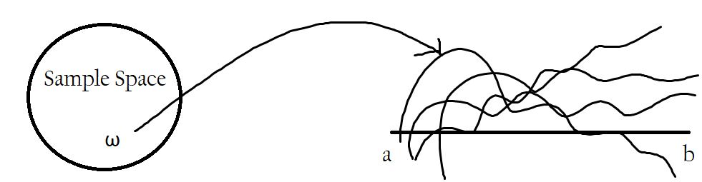
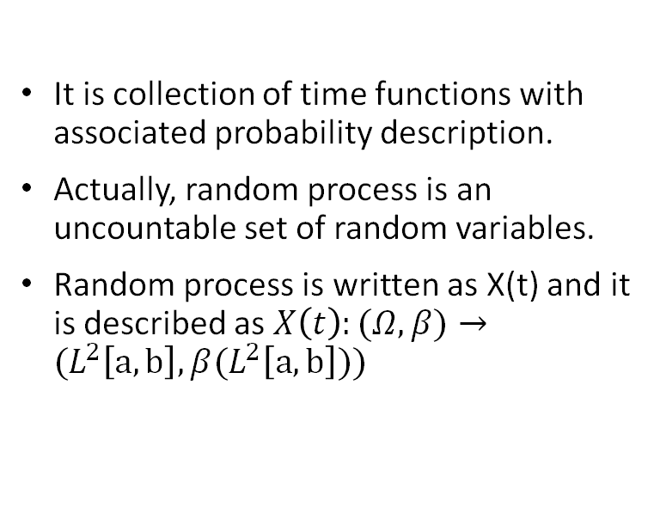
Stochastic Process
It is collection of time functions with associated probability description.
Actually, random process is an uncountable set of random variables.
Random process is written as X(t) and it is described as $X\left(t\right):(Ω,β)→(L^{2}\left[a,b\right],β(L^{2}\left[a,b\right]))$

Slide 13
Markov Chain
Used to find the probability where the probability of the present state is dependent on the probability of past states.
Let, {X_{n}, n=0,1,2,…..} is a process that takes on a finite number of possible values. If X_{n}=i, then the process is said to be in state i at time n. Assume, the process is in state i, there is a fixed probability P_{ij} that it will next be in state j.
P_{ij}={X_{n+1}=j|X_{n}=i, X_{n-1}=i_{n-1}, X_{n-2}=i_{n-2},….., X₀=i₀}=P_{ij}
This process is known as Markov Chain

Slide 14
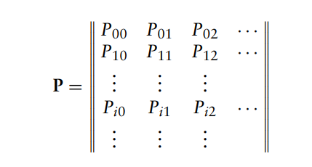
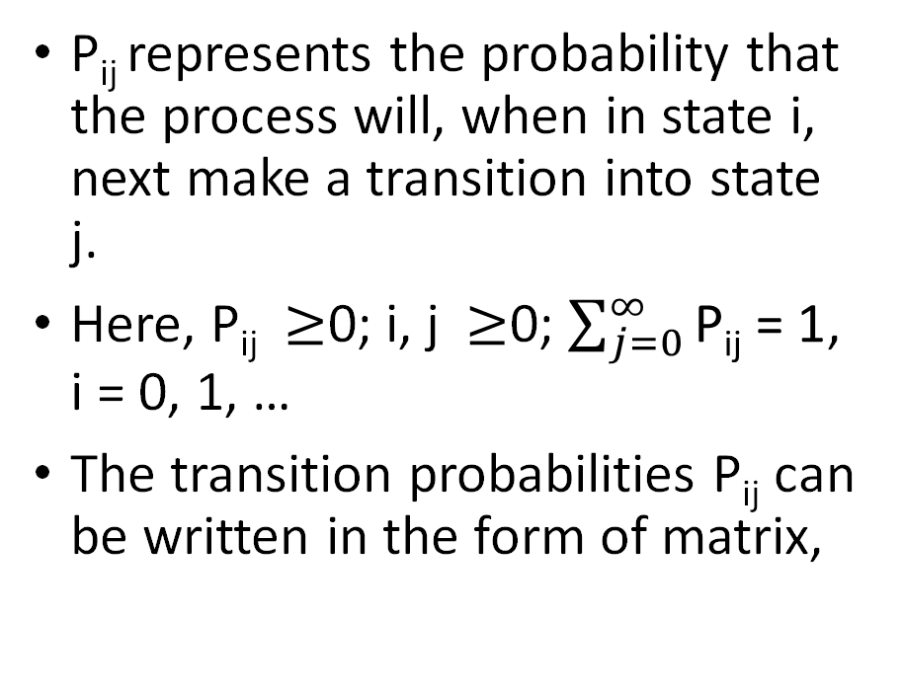
P_{ij} represents the probability that the process will, when in state i, next make a transition into state j.
Here, P_{ij} $≥$0; i, j $≥$0; $\sum_{j=0}^{∞}{\text{P}\text{ij} \text{= 1}}$, i = 0, 1, …
The transition probabilities P_{ij} can be written in the form of matrix,

Slide 15
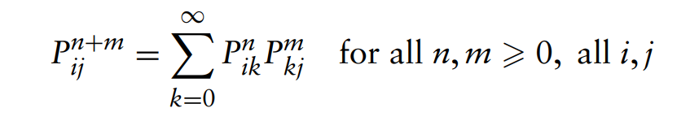

Chapman–Kolmogorov Equations
Till now we have seen only one step-transition probability matrix.
This equation tells us a method to compute n-step transition probability that a process in the state i would go to the state j after n addition steps.
P^{n}_{ij}=P{X_{n+k}=j|X_{k}=i}, n$≥$0, i,j$≥$0
Chapman–Kolmogorov Equations are
By proof, we can say that the n-step transition matrix may be obtained by multiplying the one-step transition probability matrix by itself n times.

Slide 16

Semi-Tensor Product
Semi-tensor product of matrices is a generalisation of conventional matrix product when the two-factor matrices do not meet the dimension matching condition. It was first proposed about twenty years ago.
To design the controlled object, we assume the feedback signal is four bits and the control signal is two bits.
Now, we want to get the steady state using the formula,
$Y_{i}=HA_{i}Y_{i−1}$

Slide 17
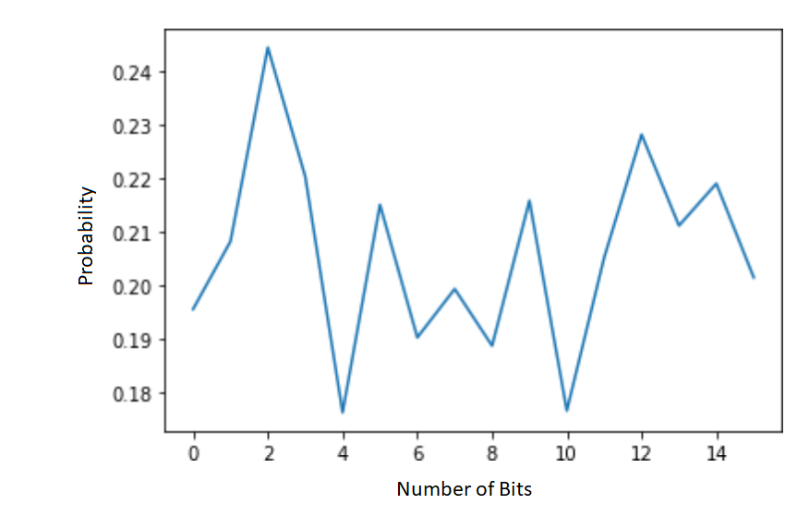
Result 1:
Fig: Probability of output after giving control input

Slide 18
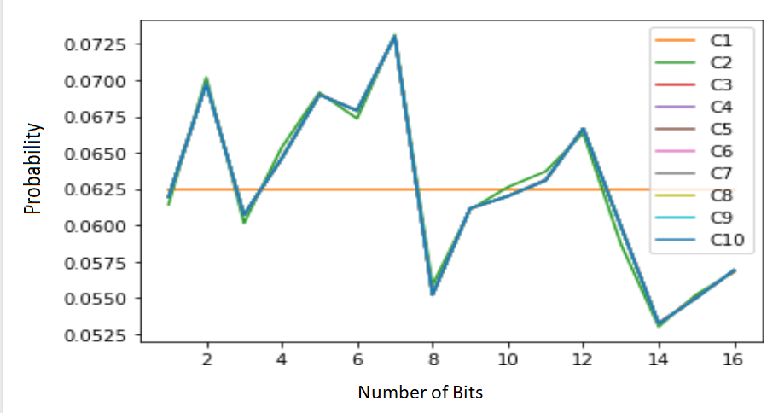
Result 2:​
Fig: Probability of stabilized outputs after ten iterations

Slide 19
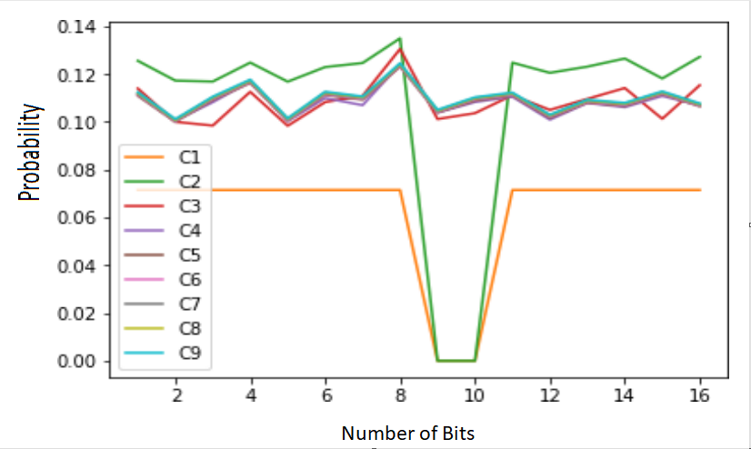
Result 3:​
Fig: Probability of stabilized output with controlled inputs

Slide 20
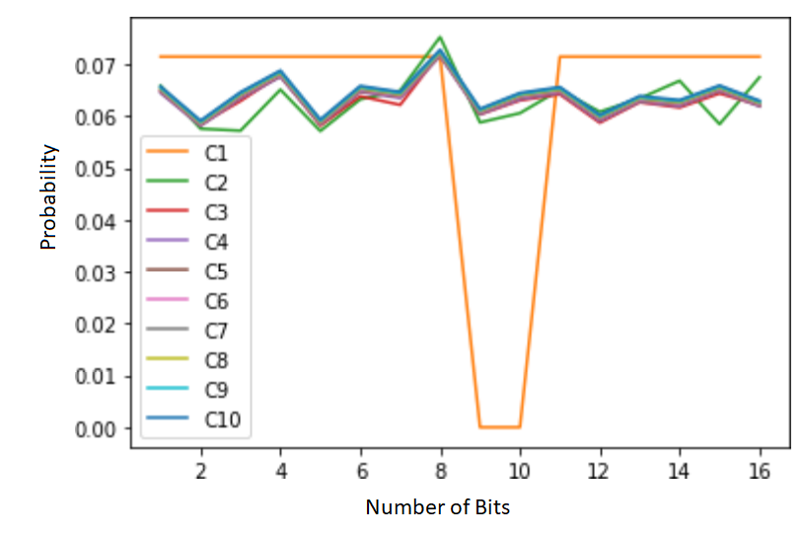
Result 4:​
Fig: Probability of stabilized output with periodic controlled input

Slide 21
Future Work
In this project, we try to design the control policy so that the information cost will be minimum. The work is not complete here. I have designed the control policy. The future work should be to minimise the information cost.

Slide 22
Reference:
1. C. D. Charalambous, C. K. Kourtellaris and I. Tzortzis, "Information Transfer of
Control Strategies: Dualities of Stochastic Optimal Control Theory and Feedback
Capacity of Information Theory," in IEEE Transactions on Automatic Control,
vol. 62, no. 10, pp. 5010-5025, Oct. 2017, doi: 10.1109/TAC.2017.2690147.
2. R. G. James, N. Barnett, and J. P. Crutchfield, ‘Information Flows? A Critique of Transfer Entropies’, Phys. Rev. Lett., vol. 116, p. 238701, Jun. 2016.
3. T. Schreiber, ‘Measuring Information Transfer’, Phys. Rev. Lett., vol. 85, pp. 461– 464, Jul. 2000.
4. L. Barnett and T. Bossomaier, ‘Transfer Entropy as a Log-Likelihood Ratio’, Phys. Rev. Lett., vol. 109, p. 138105, Sep. 2012
5. M. Staniek and K. Lehnertz, ‘Symbolic Transfer Entropy’, Phys. Rev. Lett., vol. 100, p. 158101, Apr. 2008.

Slide 23

Thank You

