Slide 1
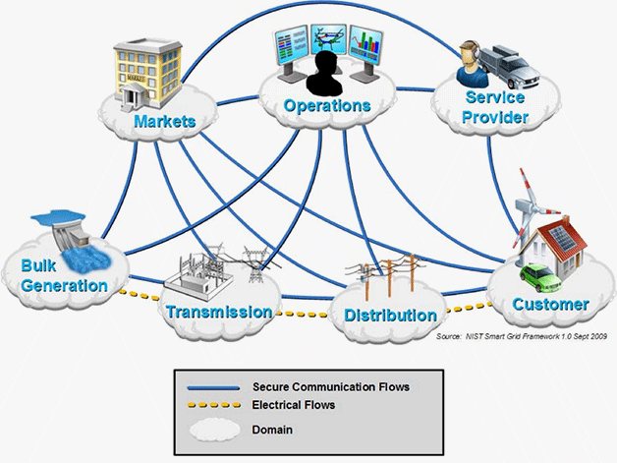
Smart Energy Service Platform(SESP)
--Arnab Kumar Saha

Slide 2
Introduction--
Overview of SESP
Utility company
Support
Work Order generation and progress tracking
SESP
Maintenance
Customer management
Meter Reading and Bill generation
Logistic management

Slide 3
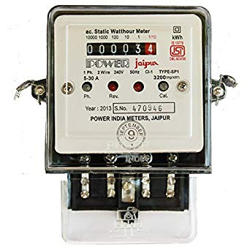
Some key components and Their purpose:
Meter: A Device to record the power consumed by the customer of utility company.
Register:
A+ : Active consumption, when customer is using the power supplier by utility company.
A- : Active Production, when customer is producing power from itself and may sell the power to utility company.
3. R+ and R-: unknown.
Tariff: Details about customer profile, type of connection(domestic or commercial).
Resolution: Details about intervals of meter reading to be taken(monthly basis or daily basis , hourly basis).
Head End System
A small storage where meter readings are kept temporarily from where Sesp Server imports the data from it.
Collection style:
Sporadic: Sesp Request data from Head End System.
Periodic: HES send data to SESP after a defined period.
Unique Device: A device which has unique individual identification. E.g. Meter
Bulk Device: A device which is recognized as a group. E.g. cables

Slide 4
Layers Of SESP:
Core Framework Tire
Server technology
Logging and RMI
Case management
Basic Data Model
Application Specific Tire
UI element to support business process
Meter value reading
Focus Energy platform.
Business Specific Tire for company A
Business Specific Tire
for company B
Business Specific Tire for company C
Customer specific customization.

Slide 5
Import server:
To feed SESP with various types of Data on request. E.g. Work Order Data, Meter Value, Device Data, etc
Message
queue
Input Scanner
Import Handler
DAO Layer
DataBase
File
FTP
Message Parser

Slide 6
Import Server In details:
Input Scanner:
Keeps on scanning at a regular interval from either FTP, MSQ, File etc.
Scanning occurs using scheduler(RSP Scheduler using child thread).
“SCHED_T”- table contains the information about the job to be schedule.
“E_SCHED”- table contains job that are scheduled.
It will also mark the file type that is scanned , with a unique ID. For e.g.
A W.O. file has a unique id which is updated in the data base along with file
detail to help the particular input handler.
File_T_Directory table contains all the exact location of the input file for processing.
Import handler:
Creates an entry in “File” table with →Type of file
→import status of file
→Create Time stamp.
→Receive Time Stamp.
→File size.
Phases :
Import_started → Import_ParserError(if nothing found) → Import_parsed(Id:16)

Slide 7
Transaction server:
Pick up Work Order and prepare cases for W.O. correspondingly. The file from which such work order is fetched
Is generally fetched by import server in data base before hand with all validation checks.
Message Scanner
Data base
DAO
CFT Layer
Case Processor
AST Layer
Task handler
Case handler
Map Message to Case
BST layer

Slide 8
Transaction server in details:
To register handler and schedule jobs
Transaction Server schedules Repeatable jobs using 4 different scanners to scan file from database which already parsed by import server.
Scanners:
File to Message Scanner.
Message To File scanner.
Case Scanner.
Message Scanner.
Then a mapper will try to match the case that is being denoted by case id else if not found then will create a new case for that.
For that specific case a specified case handler will try to process the case, finally a task handler will continue the rest.
The server also looks after logging the error which may occur in application and store it in Database.

Slide 9
Export server:
File
Data Base Scanner
Delivery Handler
Data Base
Dao
M.Q.
FTP
Message content generator

Slide 10
Export Server in details:
After Transaction server marks the file a Import Done(file status id 18) its
Job starts.
It completes the necessary business calculation, prepares a message in either
xml, excel or other format and delivers the data back to SESP framework.
Now SESP can deliver the message deliver the result to specific vendor or recipient.
in the form of mail, ftp, M.Q. , etc.
From Import ready → File Export Ready. Then only Data Base Scanner Fetch those Files.

Slide 11
Reports:
To view various progress in various department of work areas.
16 Types of reports are available.
User having Web Client Role able to view the reports using the web client portal.
Technology Used:
Struts 2
U.I. --- HTML5, CSS 3, JQuery and JavaScript.
Statistics display: Aicharts for displaying charts.
OpenStreetMap for Map
Message Response--- AJAX using Json
Search is done w.r.t. to id or codes.
Strud_STD.xml– is the file containing mapping of JSP with URL mapping.

Slide 12
Some of the reports:
Resource Project- Projection of how many resources are available for a predicted work within
a specified time limit.
Area Progress Report- It shows W.O. status to a specific area.
Logistic Report - Warehouse management, maintaining stock count, reorder of less count stock, etc.
Alarm Management Report- Error Detection in any abnormal situation.
System utilization Report- Overall System performance.
Work Order Process Report - W.O. status
Field work Analysis Report- High level over view of how team are performing.
And many more…….

Slide 13
Data Base Over view:
Sql server is used as a primary data base.
Data base is split into 4 layers as follows:
CFT- core DB objects are stored.
AST- Stores application object. E.g. Measuring point, Meter Values, Stock, etc.
AST_T- Data loaded by import server and used by export server.
BST- Project Specific Implementation tables.
Implementation of cache:
To minimize frequency of database hit, cache is implemented.
Static cache: Things here doesn’t change often.
Dynamic cache: Things change here often.
Some DB tables creation guidelines:
Sequence must be created to auto populate values into tables.
Table name should be in format---[schema name].[table name]
5 columns must be there---
ID – (BIGINT Data Type)
Create_Time_Stamp – (DateTime2 DataType, Not Null)
Create_Signature – (Varchar2 Data type, Not Null)
Change_TimeStamp –(DateTime2 DataType )
Change_Singnature – (Varchar2 Data type)
These stores the value when created and who created.
These stores the value when changed and who changed.

Slide 14
Thank you

