Slide 1
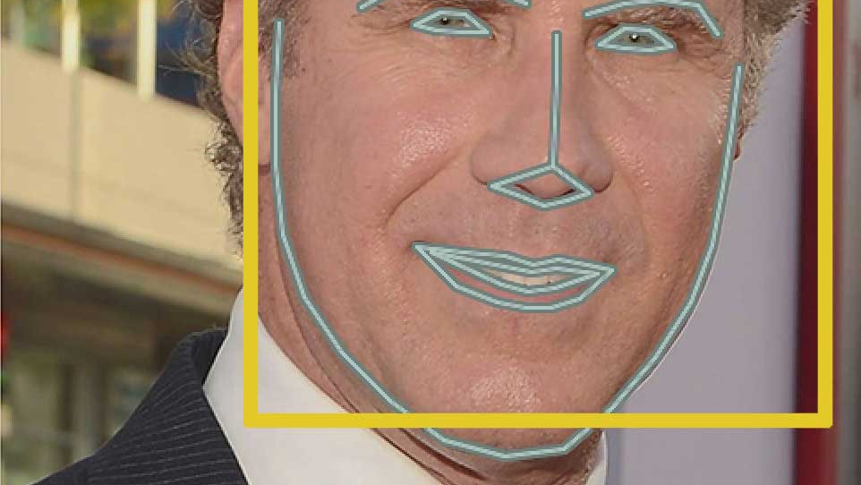
REGISTERING ATTENDANCE USING FACE RECOGNITION
USING PYTHON AND OPEN CV

Slide 2

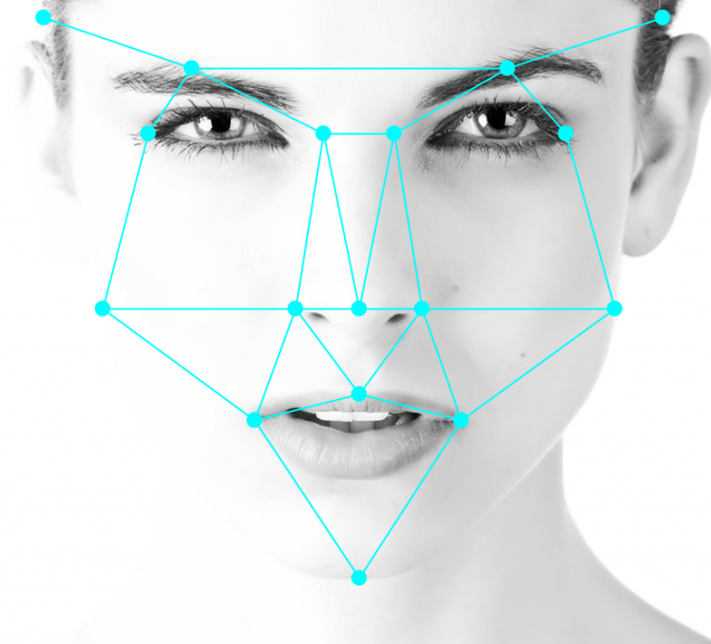
WHAT IS FACE RECOGNITION?
Face detection is the ability of computer technology to identify people’s faces within digital images. Face detection applications employ algorithms focused on detecting human faces within larger images that may contain landscapes, objects etc.

Slide 3
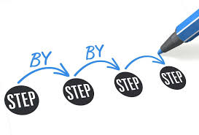
FACE RECOGNITION : STEP BY STEP
First, look at a picture and find all the faces in it
Second, focus on each face and be able to understand that even if a face is turned in a weird direction or in bad lighting, it is still the same person.
Third, be able to pick out unique features of the face that you can use to tell it apart from other people— like how big the eyes are, how long the face is, etc.
Finally, compare the unique features of that face to all the people you already know to determine the person’s name.

Slide 4
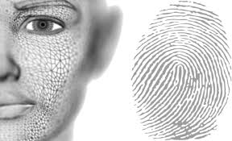
BENEFITS OF FACE RECOGNITION
Greater Accuracy: 3D mapping, deep learning and other advances make FRT more reliable and harder to trick.
Better Security: Research shows a 1-in-50,000 chance of a phone with touch ID being unlocked with the wrong fingerprint. With 3D facial modeling, the probability drops to nearly 1-in-1,000,000.
Convenient and Frictionless: FRT is easy. It can be used passively without a user’s knowledge; or actively, such as having a person “smile for the camera.”
Smarter Integration: Face recognition tools are generally easy to integrate with existing security infrastructures, saving time and cost on software redevelopment.
Automation: Automated and accurate 24/7 security eliminates the need for security guards to visually monitor entry points, perform security checks and view security cameras.

Slide 5
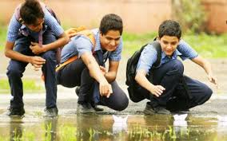
PROBLEMS THAT WILL BE OVERCOMED…
COMFORT
ACCURACY
SAVING TIME
FLEXIBILITY
ALERTS
SMOOTH WORKING

Slide 6
FUTURE SCOPE
With proper resources and knowledge and can further build an app and make it more student friendly.
With this app we can keep an track of the attendance and thus the student wont be confused about their attendance lags.

Slide 7
CONCLUSION
Thus our project will solve the problem of both teachers and students and it will help us to save time and be more productive
At last, we would like to thanks all our teachers and event coordinator for giving us this platform and helping us to complete our project.
-Thank You!!

