Slide 1
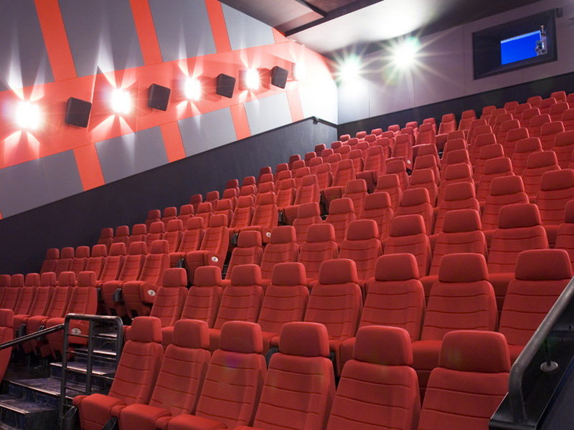
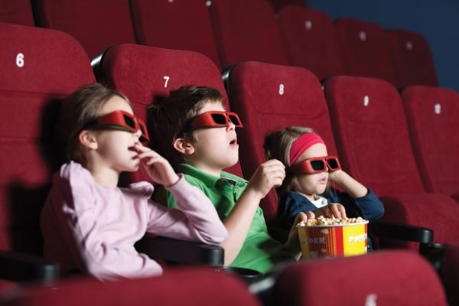
Kinemax
Kinemax – Case Study
Company Presentation

Slide 2
1
Group Structure
3
2
Historical Timeline
4
3
Business Formula
5
4
Geographical Footprint
6
5
Country comparison
7
6
Future Growth Prospects
8
7
Financials at a Glance
9
8
Summary Table
10

Slide 3






Future Growth Prospects
Financials at a Glance
Summary Table
Country Comparison
Geographical Footprint
Business Formula
Historical Timeline
Group Structure
Group Structure
Kinemax Group:
Kinemax Group
Kinemax Sarl was founded in 2009 by a prominent French entrepreneur. The company owns a chain of cinema multiplexes, targeted at children audiences. Kinemax tries to take advantage of the fastest growing niche within the cinema market
International expansion
Soon after the company started its operations in France, it started looking abroad. Currently, the company is present in 5 foreign markets – mainly in Europe
Two of Kinemax’s most recent investments are related to the fast growing markets of Turkey and Brazil. The company owns a majority stake in its investment in Turkey (80%), and decided to form a Joint Venture in order to access the Brazilian market
Structure of the Group
Kinemax Sarl, the French legal entity, is the Group’s owner. The company has direct participation in all of the other companies
Kinemax consolidates fully all of its subsidiaries, given that the company is the major shareholder in all five of them and is able to exercise control
Accounting principles
All legal entities within the Kinemax Group prepare their financial figures under IFRS
Kinemax Sarl
2009
Kinemax
Italia Spa
100%
100%
Kinemax
UK Ltd.
2010
2010
Kinemax Deutschland
Saar
100%
80%
Kinemax
Turkey A S
2011
2011
49%
Kinemax
Brazil LTDA
2012
Legend:
Kinemax Group Perimeter
Subsidiary
Parent Company
Joint Venture

Slide 4










Future Growth Prospects
Financials at a Glance
Summary Table
Country Comparison
Geographical Footprint
Business Formula
Historical Timeline
Group Structure
Historical Timeline
Company was founded
Country
Opening
Country
Opening
Country
Opening
Country
Opening
Country
Opening
Future Developments
June
2009
February
2010
November
2010
March
2011
June
2011
June
2012
Financing 2009
Financing 2010
Financing 2012
New Service
Line, 2014
First Round,
€50 million
Second Round,
€50 million
First Round,
€40 million
Acquisition
Event Rooms
Acquisition of Moviez,
€25 million

Slide 5
Future Growth Prospects
Financials at a Glance
Summary Table
Country Comparison
Geographical Footprint
Business Formula
Historical Timeline
Group Structure
Business Formula
Target a Niche Market
International Presence
Extended Service Line
Access Growth Market
Kinemax’s
Business Model
Partnership with Local Players
Strong Bargaining Power
Organize Promotional Events
Leverage Customer Behavior

Slide 6





Future Growth Prospects
Financials at a Glance
Summary Table
Country Comparison
Geographical Footprint
Business Formula
Historical Timeline
Group Structure
Geographical Footprint
Kinemax UK
Kinemax Deutschland
€52.5m
€43.4m
Total Revenues
Total Revenues
Headcount: 192
Headcount: 134
Kinemax Sarl
€135.7m
Kinemax Turkey
Total Revenues
€24.8m
Headcount: 342
Total Revenues
Headcount: 124
Kinemax Brazil
Kinemax Italia
€4.4m
€46.3m
Total Revenues
Total Revenues
Headcount: 38
Headcount: 156
Kinemax operates on 3 continents and in 6 countries;
The company has a Headcount of 986 employees and its Total Revenues amount to €307.2m

Slide 7

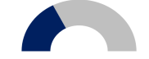

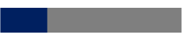

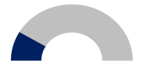














Future Growth Prospects
Financials at a Glance
Summary Table
Country Comparison
Geographical Footprint
Business Formula
Historical Timeline
Group Structure
Country Comparison
Market Penetration
Revenue
Percentage
Cinema Revenues Percentage vs. Others
Customers
Gross Margin
Low
Medium
High
Kinemax
Under
14
14-30
Over
30
0 %
20 %
40 %
60 %
80 %
100 %
France
France
Market Penetration
Market Penetration
Market Penetration
Market Penetration
High
56 % vs. 44 %
56%
12%
32%
26 % Gross Margin
35 % of Revenues
Italy
Market Penetration
Market Penetration
Market Penetration
Market Penetration
France
51 % vs. 49 %
25 % Gross Margin
Medium
50%
15%
35%
17 % of Revenues
UK
Market Penetration
Market Penetration
Market Penetration
Market Penetration
France
54 % vs. 46 %
30 % Gross Margin
Medium
54%
9%
37%
Countries of Operation
18 % of Revenues
Germany
Market Penetration
Market Penetration
Market Penetration
Market Penetration
France
50 % vs. 50 %
32 % Gross Margin
Medium
46%
22%
32%
14 % of Revenues
Turkey
Market Penetration
Market Penetration
Market Penetration
Market Penetration
Low
62 % vs. 38 %
57%
16%
27%
22 % Gross Margin
13 % of Revenues
Brazil
Market Penetration
Market Penetration
Market Penetration
Market Penetration
Low
68 % vs. 32 %
61%
7%
32%
19 % Gross Margin
3 % of Revenues

Slide 8

Future Growth Prospects
Financials at a Glance
Summary Table
Country Comparison
Geographical Footprint
Business Formula
Historical Timeline
Group Structure
Future Growth Prospects
South American Market
New European Markets
The South American Market is one of the prime opportunities ahead of Kinemax
The firm has already acquired some limited experience from its Joint Venture in Brazil
The South American Market is expected to grow in double figures in the next 5 years
Kinemax plans to start operations in the Netherlands, Spain and in Norway
The firm has acquired experience from its activities in other European countries
Kinemax Growth Prospects
Penetration in existing Markets
Extension of offered Services
Kinemax will likely step up its effort to solidify its leadership position in the markets, in which the company is already present
There is significant room for growth in Turkey and in Brazil
Kinemax plans to introduce a new service in its locations: “Event rooms”
Similar service lines reinforce its image as the place to be for children in the “under 14” segment

Slide 9
Future Growth Prospects
Financials at a Glance
Summary Table
Country Comparison
Geographical Footprint
Business Formula
Historical Timeline
Group Structure
Financials at a Glance
Revenues development
Kinemax’s revenues experienced a double digit growth throughout the period under analysis
Both cinema and other revenues grew by more than 10%, although other revenues outpaced the growth of cinema revenues (16% vs. 11%)
It seems that the company’s revenue mix is heading to a 50/50 split between Cinema and Other revenues
Gross Margin
Higher revenues transferred into a higher Gross Margin % (22.7% in FY11 vs. 25.5% in FY13)
Kinemax is able to sell its products at a good margin
Gross Margin % could be further improved by ramping up the investments in Turkey and Brazil
EBITDA
Kinemax improved its EBITDA margin as well in the period under analysis (from 7.6% in FY11 to 10.3% in FY13)
Operating expenses did not increase as fast as Gross Margin, thus EBITDA increased
Cash Conversion Ratio
The ratio between Operating Cash Flow and EBITDA varied between 76.2% and 94.3%
It was lower in FY13 due to investments in new projects

Slide 10
Future Growth Prospects
Financials at a Glance
Summary Table
Country Comparison
Geographical Footprint
Business Formula
Historical Timeline
Group Structure
Summary Table
Legal Entity
Country
Company Type
Owned at
Start of Operation
Fill Rate
%
Avg. Ticket Price
Gross Margin %
Kinemax Group | Kinemax Sarl | France | Holding | Not Applicable | June 2009 | 43.9% | 5.5€ | 26.3%
 | Kinemax Italia Spa | Italy | Subsidiary | 100% | February 2009 | 37.4% | 5.9€ | 24.8%
 | Kinemax UK Ltd. | United Kingdom | Subsidiary | 100% | November 2010 | 37.1% | 6.1€ | 29.8%
 | Kinemax Deutschland Saar. | Germany | Subsidiary | 100% | March 2011 | 42.3% | 6.5€ | 32.3%
 | Kinemax Turkey A.S | Turkey | Subsidiary | 80% | July 2011 | 42.9% | 4.8€ | 22.7%
 | Kinemax Turkey A.S | Brazil | Joint Venture | 49% | November 2012 | 29.3% | 3.9€ | 18.6%

