Slide 1

Project Title - Seasonal Agriculture Performance Analysis
Arnaov Garg
B.Tech CSE Core, SRMIST, Modinagar
AICTE STU ID : STU66fc1fdc7fe6b1727799260

Slide 2

PROBLEM STATEMENT
(Agricultural activities are influenced by seasonal variations in environmental conditions, farming practices, resource availability and market conditions. As a result, agricultural performance may differ from one season to another. However, raw agricultural data does not clearly explain how agricultural performance changes across seasons or what patterns can be observed in different seasonal conditions. The problem is to analyze the given agricultural dataset and investigate seasonal differences in agricultural performance by identifying meaningful patterns, trends, relationships and variations within the available data.

Slide 3
Project Description
This project analyzes a farm-level dataset of 4,000 records covering three Indian cropping seasons - Kharif, Rabi and Zaid - across 8 states, 8 crops and 4 irrigation methods.
The workflow includes data cleaning (handling missing values and outliers), exploratory data analysis, and seasonal comparison of yield, cost, revenue, profit, water efficiency and disease/pest risk.
Statistical testing (one-way ANOVA) is used to confirm whether the seasonal differences observed are significant.
The complete analysis - cleaning, visualizations, statistical tests, insights and recommendations - is documented in a single Jupyter Notebook.

Slide 4

WHO ARE THE END USERS?
Farmers - to choose season-appropriate crops and irrigation methods.
Agricultural extension officers & government departments - for evidence-based seasonal planning and advisories.
Agribusiness & agri-input companies - to plan fertilizer/seed supply by season.
Policy makers & agricultural planners - for regional and seasonal resource allocation.
Banks & crop-insurance providers - to assess seasonal risk and profitability.
Researchers & students - as a reference analysis of seasonal agricultural trends.

Slide 5

Technology Used
Python 3 - core programming language
Pandas & NumPy - cleaning & aggregation
Matplotlib & Seaborn - visualizations
SciPy (stats) - ANOVA significance testing
Jupyter Notebook - full documented analysis
PowerPoint & GitHub - presentation & submission

Slide 6
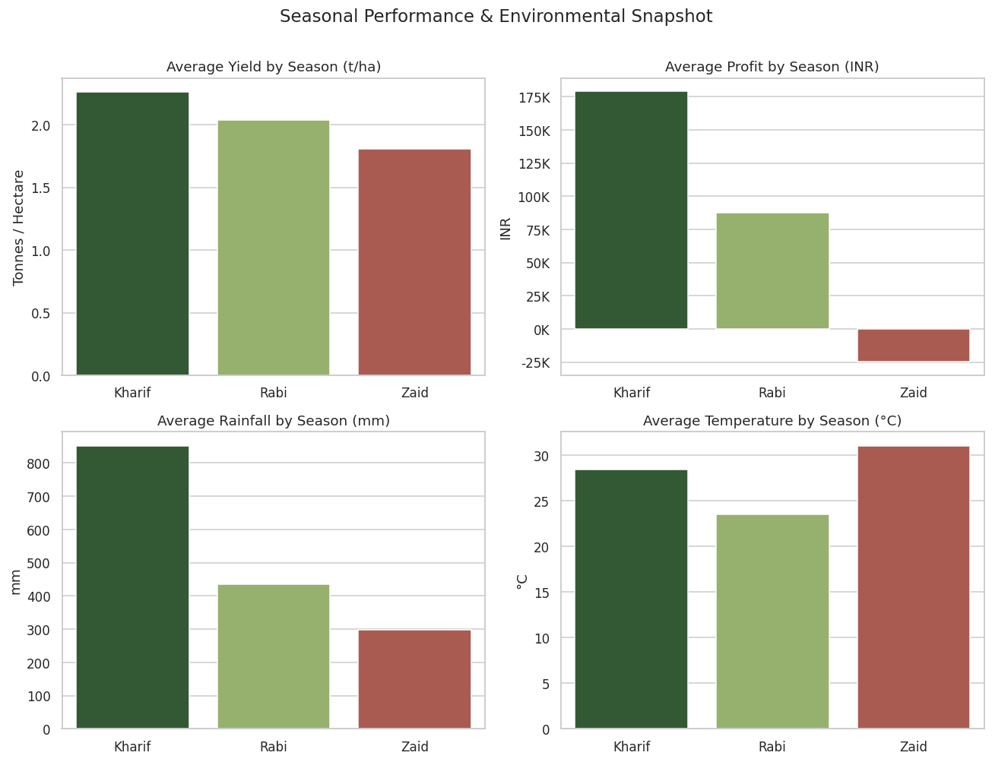
RESULTS
Seasonal Overview
Kharif leads on both yield (2.26 t/ha) and profit (Rs. 1.79L avg)

Slide 7
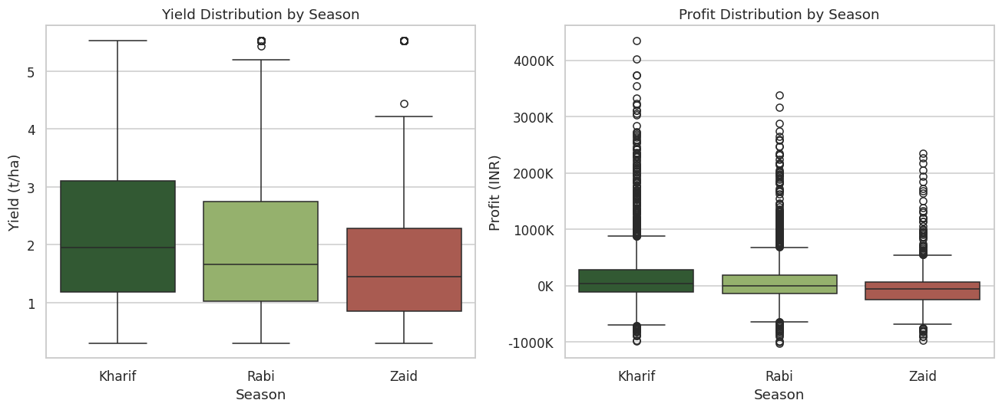
RESULTS
Yield & Profit Distribution
Spread confirms the ranking: Kharif > Rabi > Zaid for both metrics

Slide 8
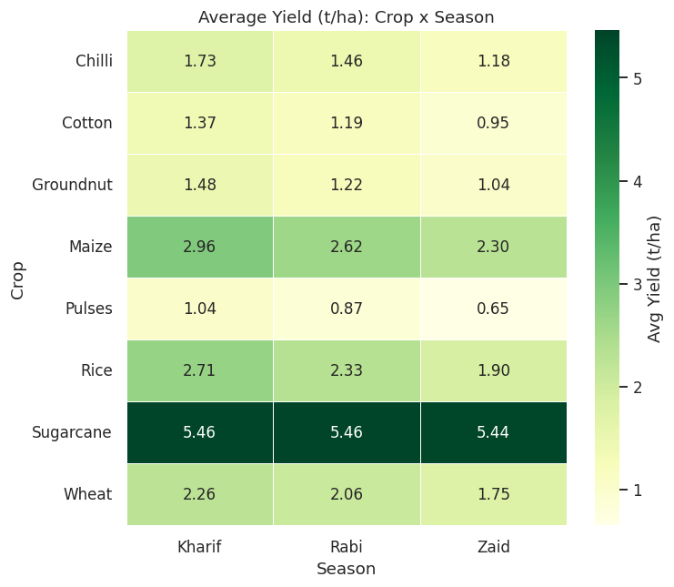
RESULTS
Crop Performance by Season
Heatmap reveals the best-fit crop for each season (darkest cells)

Slide 9
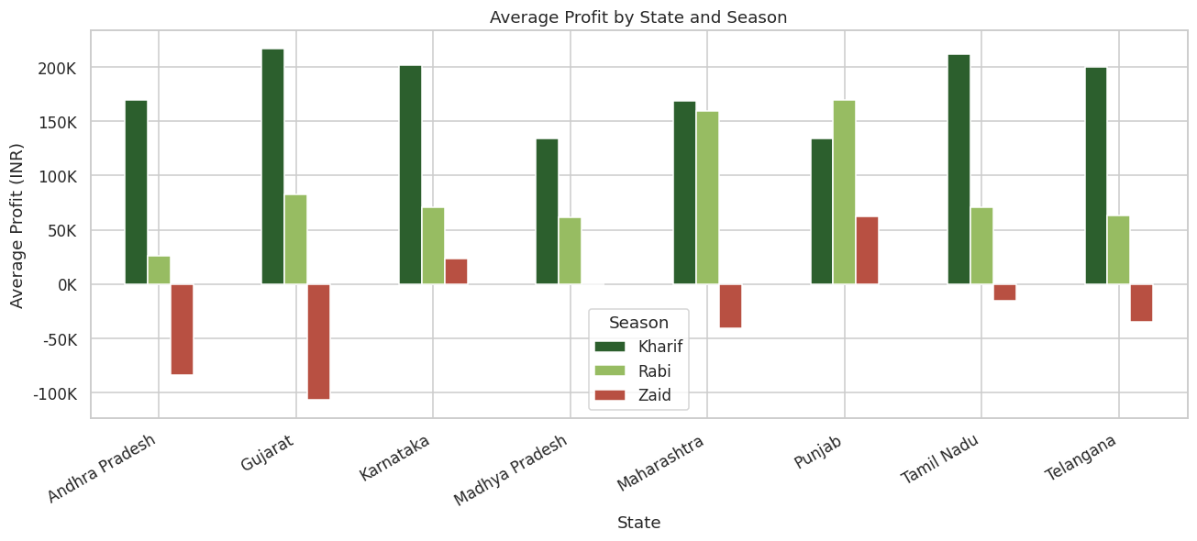
RESULTS
State-wise Seasonal Profitability
Ranking is mostly consistent across states, with a few regional exceptions

Slide 10
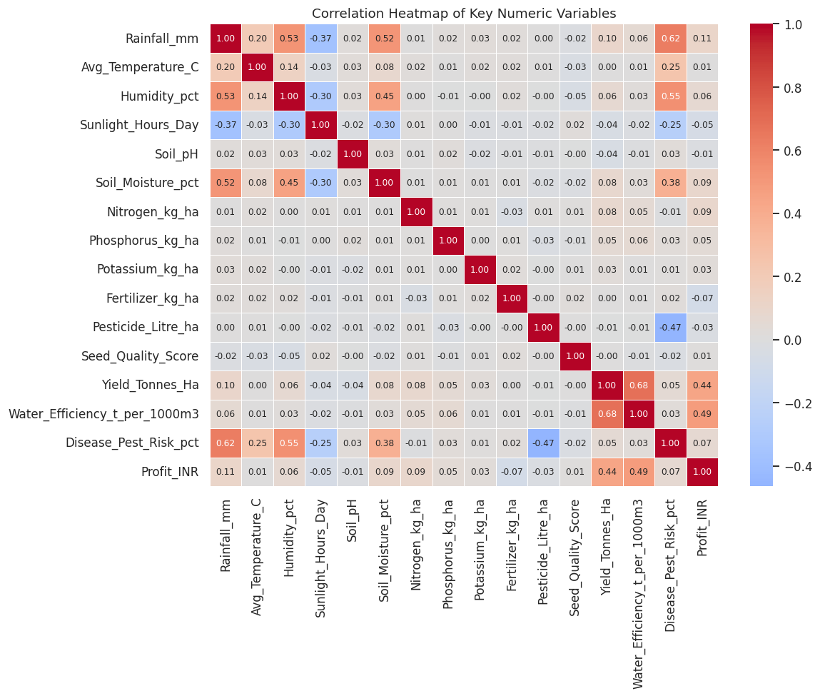
RESULTS
Correlation & Statistical Significance
ANOVA confirms seasonal gaps in yield & profit are significant (p < 0.001)

Slide 11
Future scope
What's next
Extending this analysis toward predictive, farm-level decision support
Build a machine learning model to predict yield/profit for a given season, crop and region, instead of only descriptive comparison.
Incorporate real-time weather and market-price feeds for dynamic, up-to-date seasonal recommendations.
Extend the dataset with more seasons/years to study long-term climate trends, not just a single-year snapshot.
Develop a simple dashboard (e.g. Streamlit/Power BI) so farmers and officers can explore seasonal insights interactively.
Add district-level granularity and satellite/soil-health data to make recommendations more localized.

Slide 12
GitHub Link
https://github.com/ArnaovGarg925/Seasonal-Agriculture-Performance-Analysis.git

Slide 13
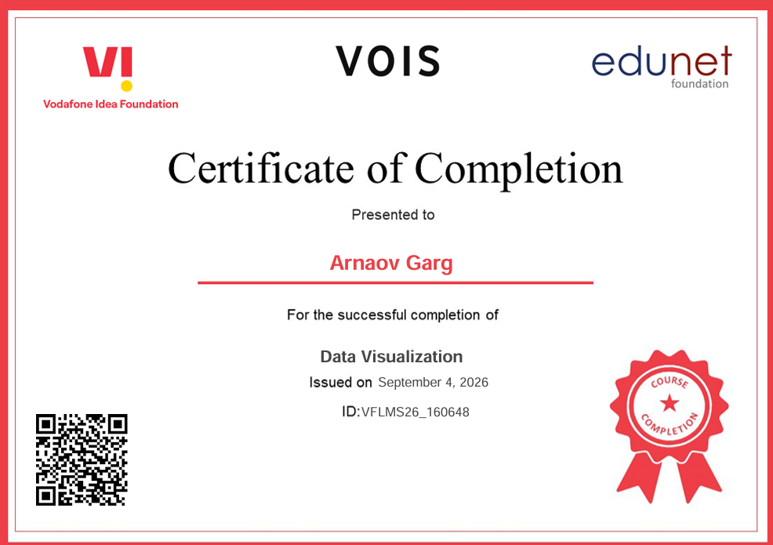
VOIS Course completion certificate - Course name- Data Visualization

Slide 14
Thank you
.
.

