Slide 1
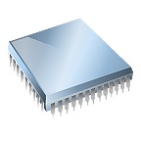

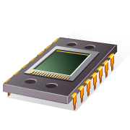




Micr probe
Microprobe

Slide 2
Microprobe
Microprobe
Microprobe
Microprobe
MICROPROBE

Slide 3
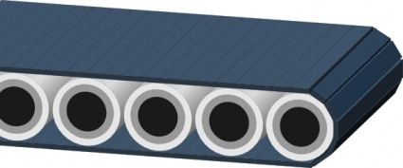


Slide 4
Microprobe
Microbenchmark generation framework
…
c
asm
…
Microprobe
Microbenchmark generation framework

Slide 5


Slide 6




Microprobe
Microbenchmark generation framework
Microprobe
Microbenchmark generation framework

Slide 7
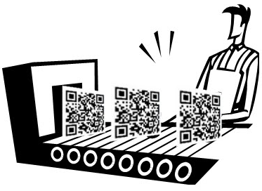
Microprobe
Microbenchmark generation framework
MICRO
PROBE
Microbenchmark generation framework

Slide 8
PROBE
Microbenchmark
generation
framework
MICRO
.c
.asm
…

Slide 9

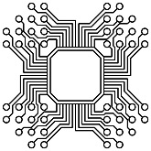
PROBE
Microbenchmark
generation
framework
MICR
.c
.asm
…

Slide 10


PROBE
Microbenchmark
generation
framework
MICR
.c
.asm
…

Slide 11
PROBE
Microbenchmark
generation
framework
MICR
.c
.asm
…
Microprobe
Micro
Probe
Micro
Probe

Slide 12
PROBE
P
Microbenchmark
generation
framework
MICR
.c
.asm
…
Microprobe
Micro
M
Probe
Micro
Probe

Slide 13
M
MICR
.c
.asm
…
Microprobe
PROBE
P
Microbenchmark generation framework
Micro
Micro
Probe
Probe
Micro
Micro
Probe
Probe

Slide 14


PR BE
μ
Micro
Micro
Probe
Probe
Micro
Micro
.c
.asm
…
Microprobe
Probe
Probe
Microbenchmark generation frameworkμ

Slide 15

PR BE
μ
Microbenchmark generation framework
P
μ
.c
.asm
…
Microprobe

Slide 16
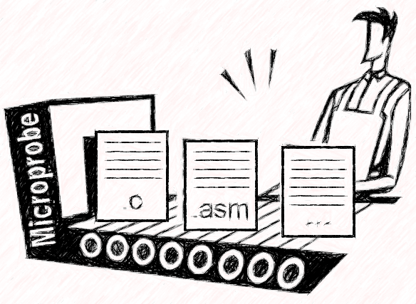

PR BE
μ
Microbenchmark generation framework
P
P
μ
μ

