Slide 1
arnaud.nauwynck@gmail.com
This document: http://arnaud-nauwynck.github.io/docs/Intro-CodeExtract-DB-Jdbc-JPA-SpringData.pdf
Extracts from
Intro to Db - Jdbc - JPA – SpringData

Slide 2
SOURCE Document :
http://arnaud-nauwynck.github.io/docs/
Intro-DB-Jdbc-JPA-SpringData.pdf
~ 150 pages
: lesson to read
THIS Document
~ 80 pages
: slides to present

Slide 3




(4) < Spring Data
Spring JPA
QueryDsl
< JPA API - JPQL
(3) < Hibernate/EclipseLink
Spring JDBC
< JDBC API
(2) < Driver Impl.
SQL Client Driver
(1) < DataBase
< B-Tree File

Slide 4
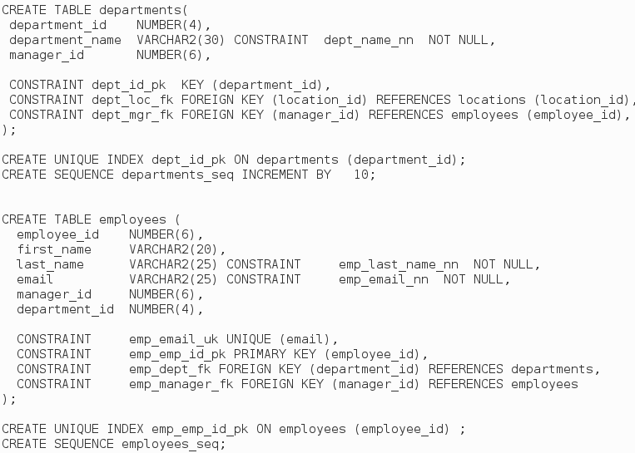
Oracle Sample DataBase https://github.com/oracle/db-sample-schemas/human_resources/hr_cre.sql

Slide 5
UML Employee - Department
* employees
0..1 dept
Employee
Department
0..1 deptManager
0..1 manager

Slide 6
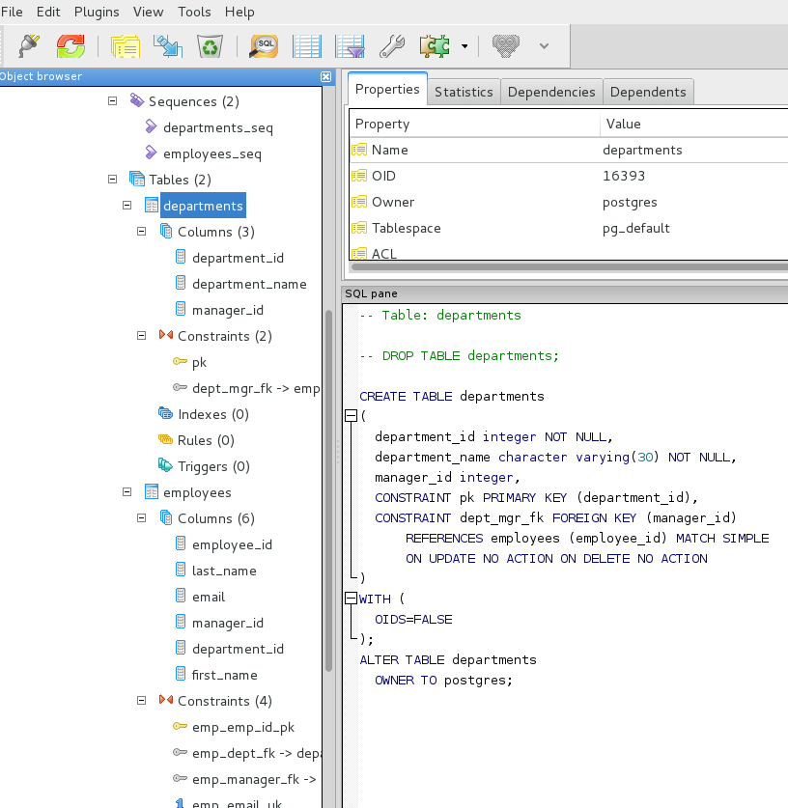
Example using PGAdmin3

Slide 7
Detailed CRUD
CRUD =
Create
Read
Update
Delete
INSERT into <Table..> (col1, col2, …)
VALUES (?0, ?1, 123, ..)
SELECT * from <Table..> where <expr..>
UPDATE col1=value1, col2=…
from <Table..> where <expr..>
DELETE from <Table..>
where <expr..>

Slide 8
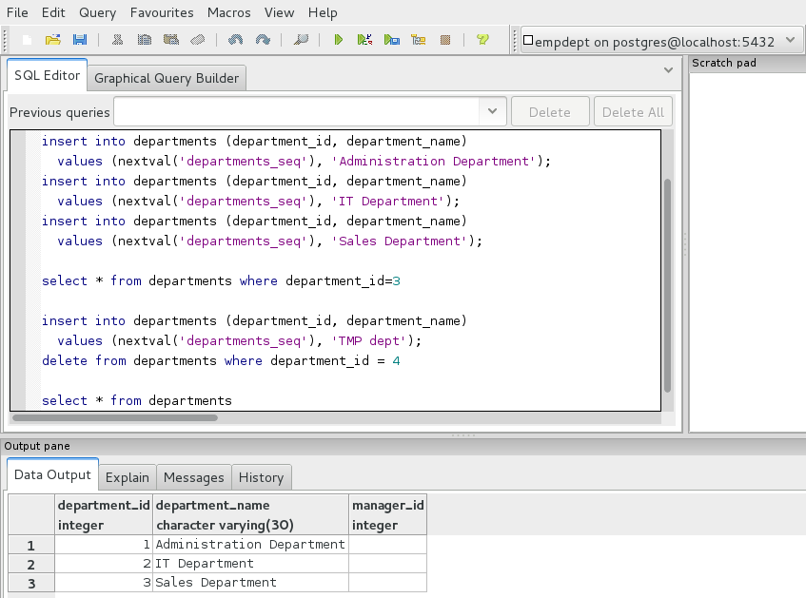
Emp-Dept CRUD Sample

Slide 9
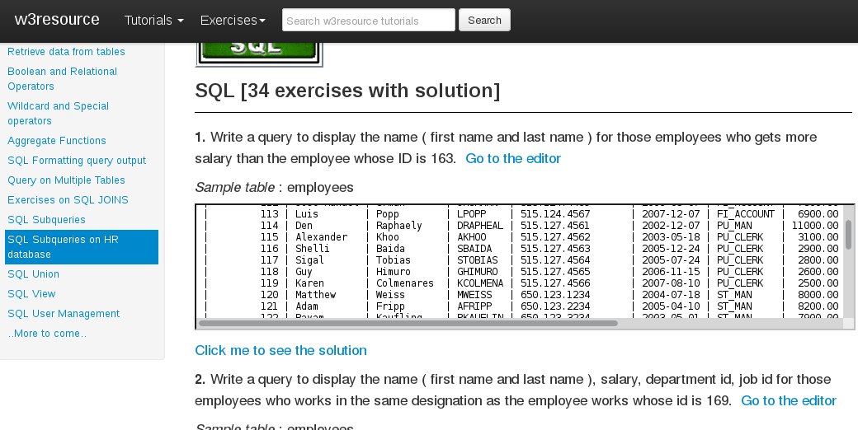
SQL Exercises http://www.w3resource.com/sql-exercises/sql-subqueries-exercises.php

Slide 10
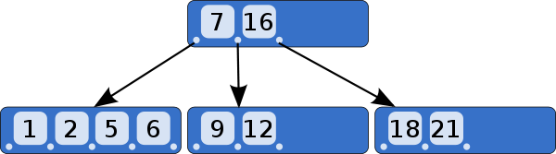
B-Tree = Balanced-Tree
(not only Binary Tree)

Slide 11
B-Tree on (Col1,Col2...) = INDEX
Insert ROW = (ACID : Atomic) Insert Data
+ Insert Index1 + Insert Index2 + ….
PK INDEX : col (ID)
INDEX2 : (Col2,Col3,ID)
INDEX3 : (Col3,Col2,Col6)

Slide 12
Select .. where ID = ?
Execution Plan
Step 1: Index Lookup (Unique) by ID
Log(N) logical reads
=> get “rowId” (=address)
Step 2: table lookup by RowId (=O(1))
=> get other columns

Slide 13
Applicable Index(es) ? for “.. where Col2=? And Col5=?”
PK INDEX : col (ID)
Applicable =
Allow Lexicographical
Top->Down Search
INDEX (Col2,Col6,Col5)
INDEX (Col2,Col5,Col6)
INDEX (Col5,Col2,Col7)
INDEX (Col1,Col2,Col5)

Slide 14

Query Execution Engine
“Select ..
from ..
where .. col1='val1'
and col2=123“
Execute Query
Result : Tabular Data Format = “ResultSet”

Slide 15
Huge Result .. Server-Side “Cursor”
Begin “Execute” Query
Result = Partial Data
+ Cursor (= handle of server-side Partial Data+ Iterator)
Fetch next page
Fetch next page
Fetch next page
CLOSE CURSOR !!

Slide 16
SoftParse – HardParse … PrepareQuery + BindVariable
Compute
Execution Plan
First Seen ?
HARD Parse
“Select ..
from ..
where .. col1=?0
and col2=?1“
Put in Cache
BindVariable:
set(0, “val1”)
set(1, 1234)
Already Seen ?
SOFT Parse
= create Cursor

Slide 17
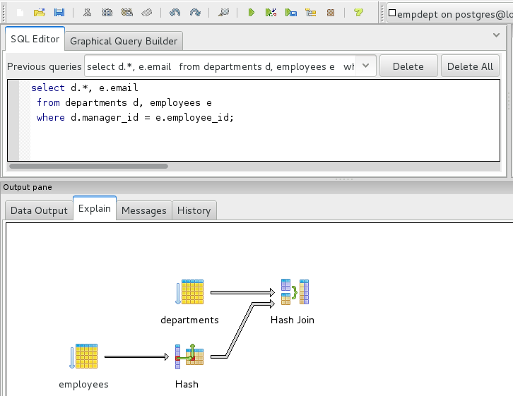
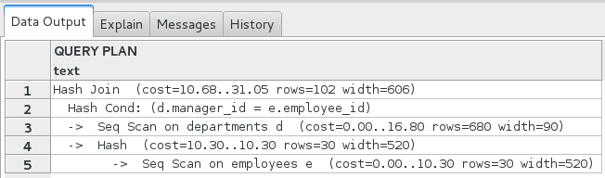
Explain Execution Plan

Slide 18
Query / Prepared Query Execution
Select ..
from ..
where .. col1=?0
and col2=?1
Prepare (SQL)
PreparedStatement
BindVariable:
set(0, “val1”)
set(1, 1234)
ExecuteQuery
ResultSet (page1)
Next row
get col1, get col2 …
next row
...
Fetch next page

Slide 19


Spring JPA
QueryDsl
Spring JDBC

Slide 20
import java.sql.*;
DataSource
Connection
PreparedStatement
ResultSet

Slide 21
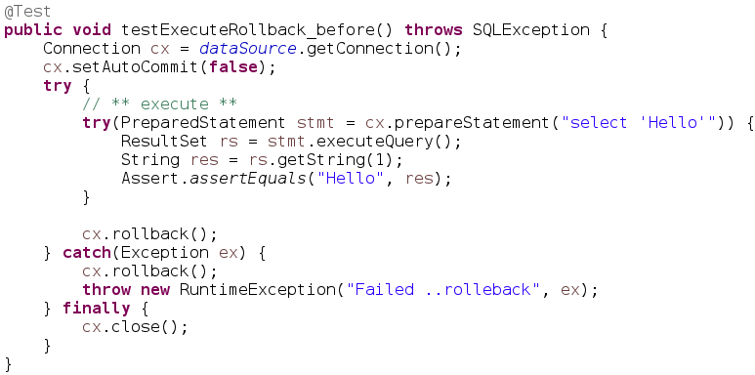
Sample Jdbc (Test with Rollback)

Slide 22
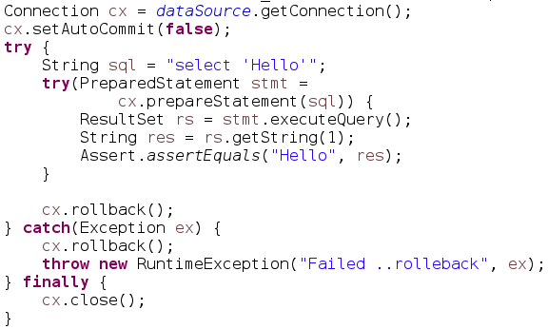
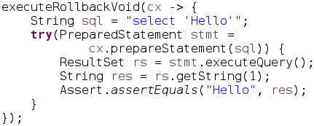
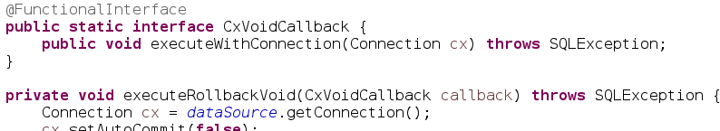
Refactored (1/2)

Slide 23
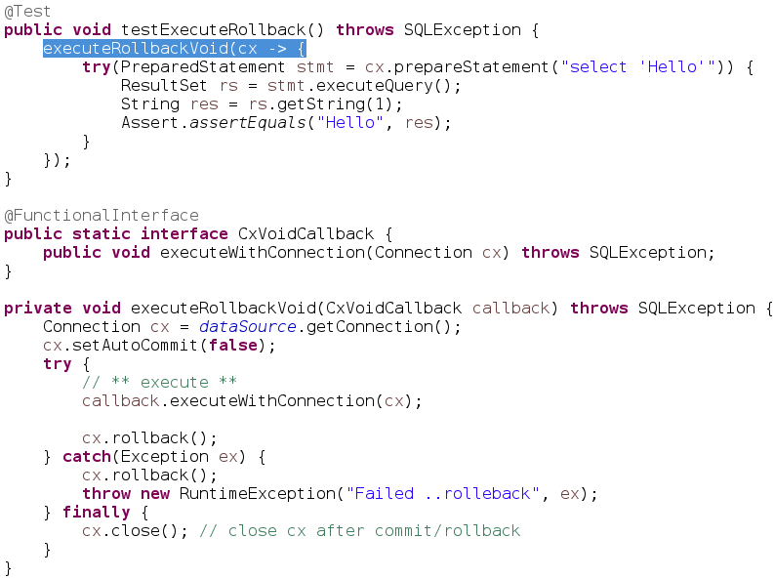
Refactored (2/2)
“Template” + Callback
Code to
run with Cx
+ rollback
Common
Template
Framework
.. similar to
Spring
Template

Slide 24
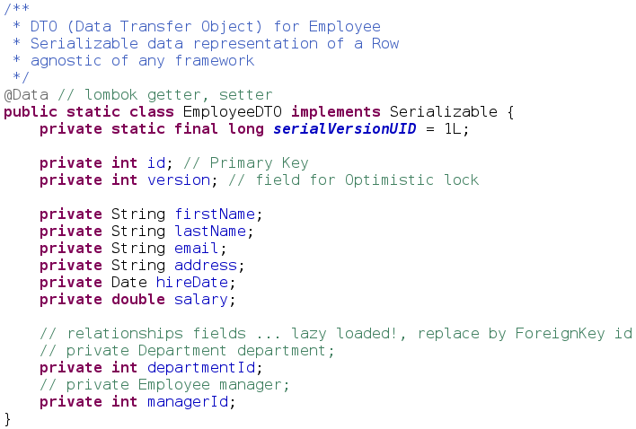
Data Transfer Object for CRUD

Slide 25
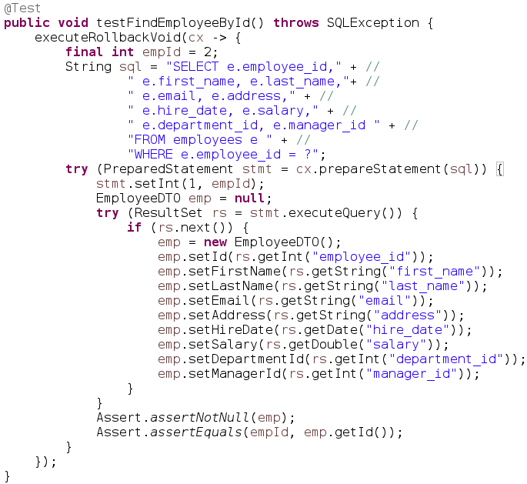
CRUD 1 / 4 : SELECT

Slide 26
Jdbc is As Verbose as Easy ...
Is it DRY ?
D don't
R repeat
Y yourself

Slide 27
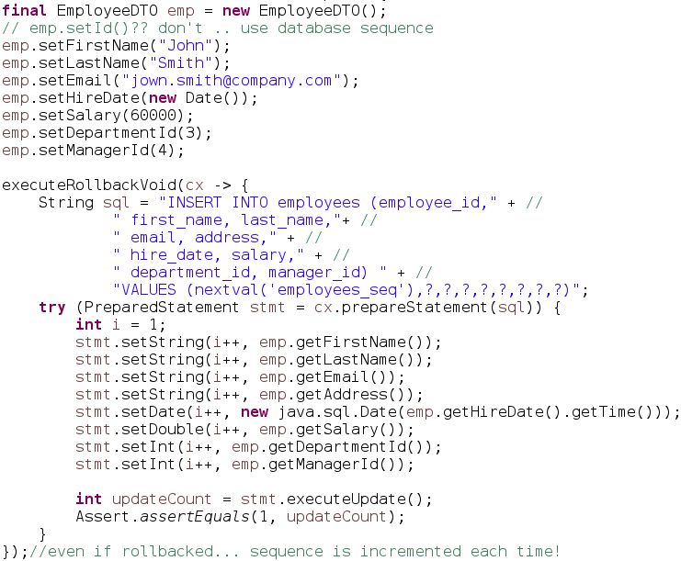
CRUD 2 / 4 : INSERT

Slide 28
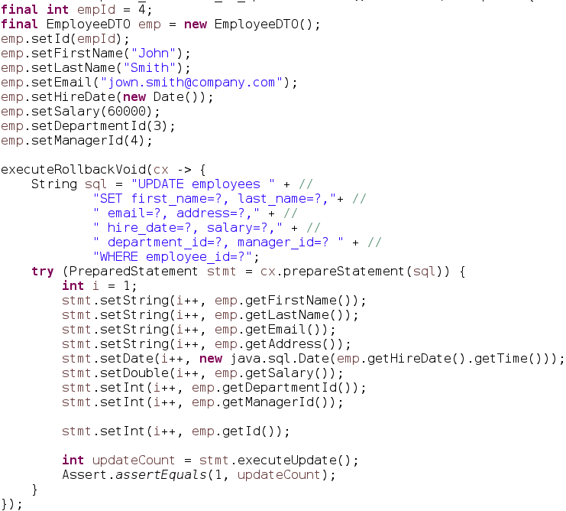
CRUD 3 / 4 : UPDATE (All columns)

Slide 29
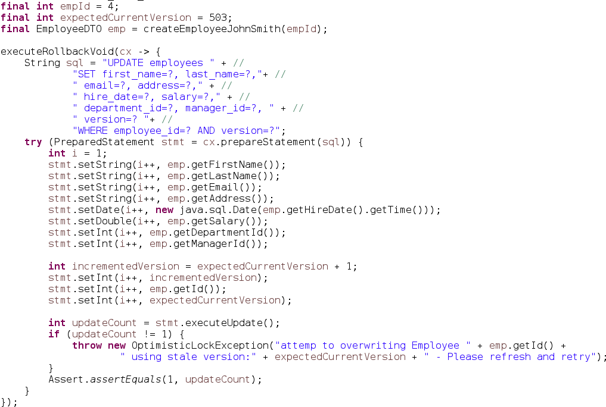
UPDATE with Versioning

Slide 30
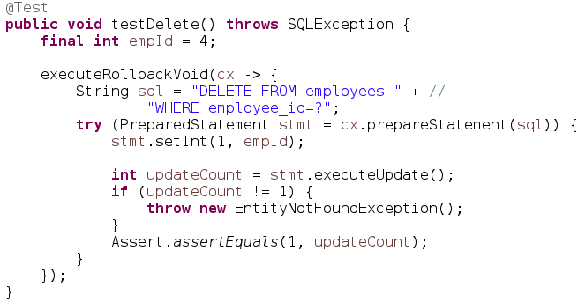
CRUD 4 / 4 : DELETE

Slide 31
import java.sql.*; (full)
DatabaseMetaData
ParameterMetaData
ResultSetMetaData
DataSource
Connection
Statement
ResultSet
PreparedStatement
Driver
CallableStatement
XAResource
XADataSource
XAConnection
Blob
Clob
Array
Struct

Slide 32

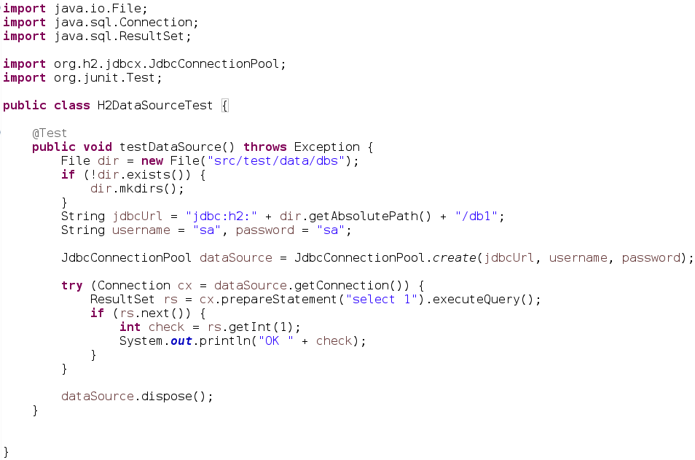
H2 DataSource HelloWorld

Slide 33

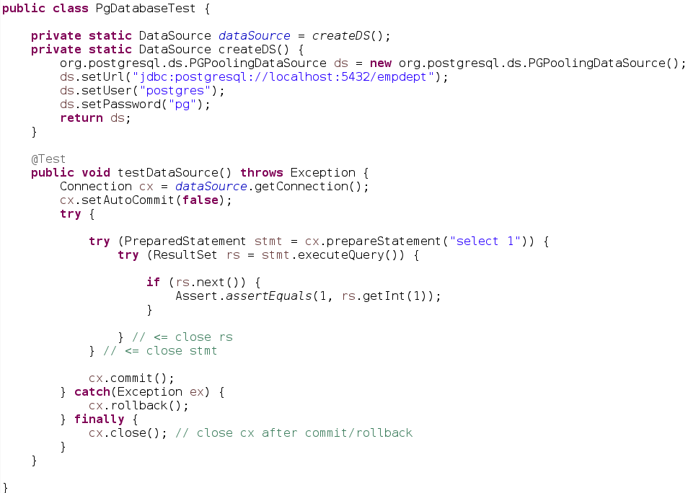
Postgresql HelloWorld

Slide 34
Spring JPA
QueryDsl
Spring JDBC

Slide 35
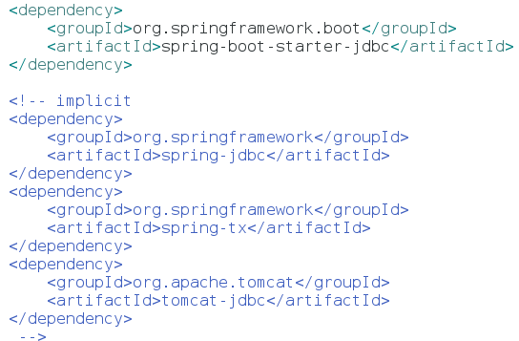
Spring-Jdbc Database App

Slide 36
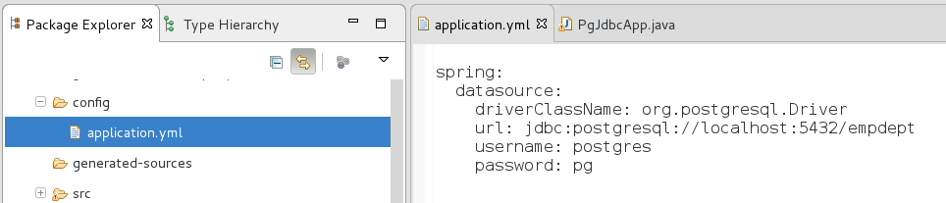
Springboot config/application.yml

Slide 37


Springboot JDBC… “JUST work”

Slide 38
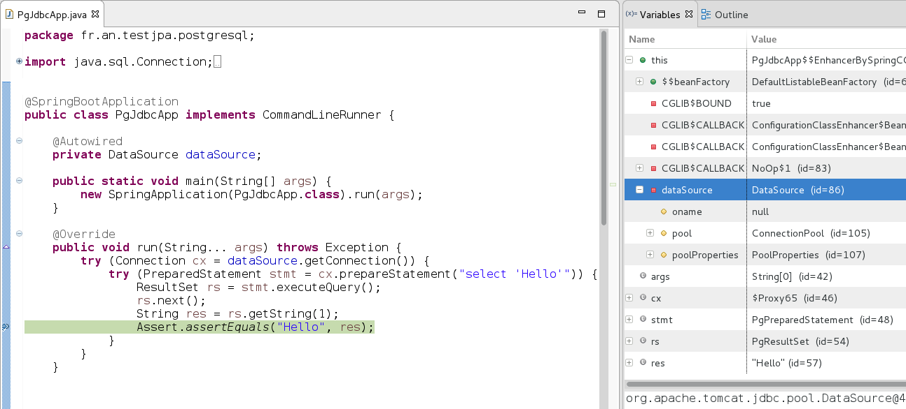
Springboot Jdbc main()
Start Spring
+ inject DataSource
Pooled DataSource injected

Slide 39
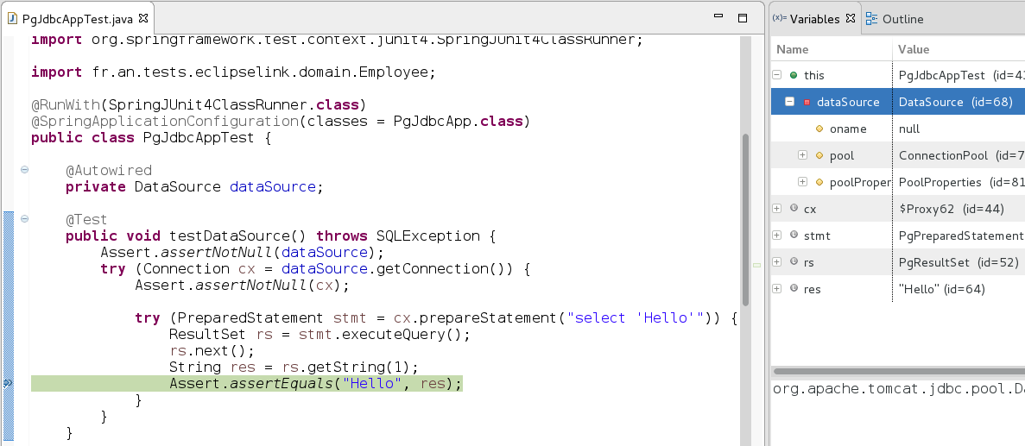
Springboot JUnit
Pooled DataSource injected
DataSource in injected
Start Spring
+ inject DataSource

Slide 40
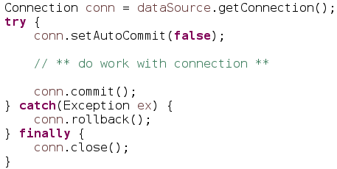


(Reminder) try-finally .close()
Using
explicit Transaction
+ commit/rollback
Using try-close
Rule for ALL Resources :
If You Open It => You Close It

Slide 41
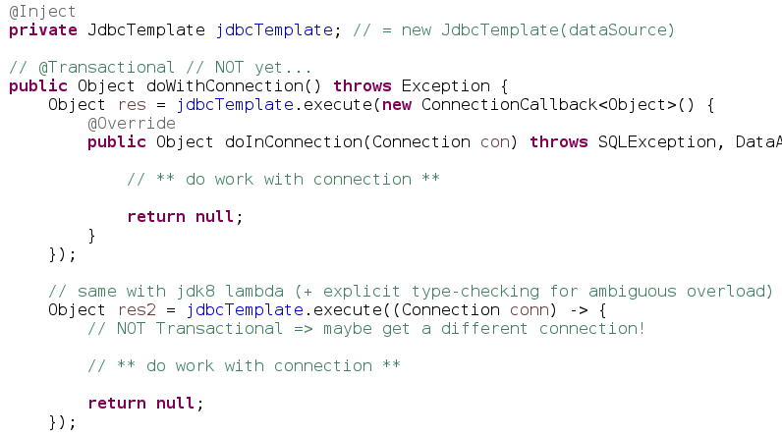
using Template Spring-Jdbc
Equivalent
try-finally
Same with Lambda syntax
2n execution … different connection

Slide 42
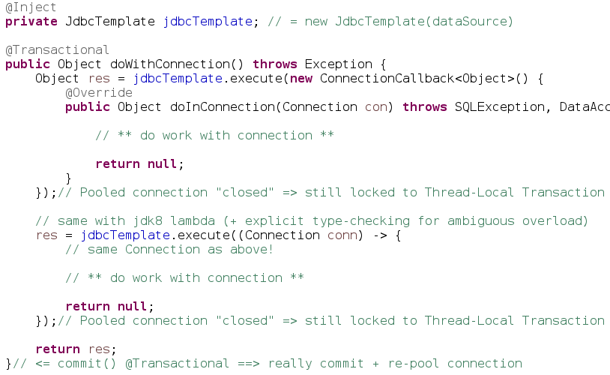
PooledConnection + Transaction
= Thread-Locked : reuse
Thread-12
Conn
XA ..
XA commit/rollback
=> connection commit/rollback
THEN repool

Slide 43
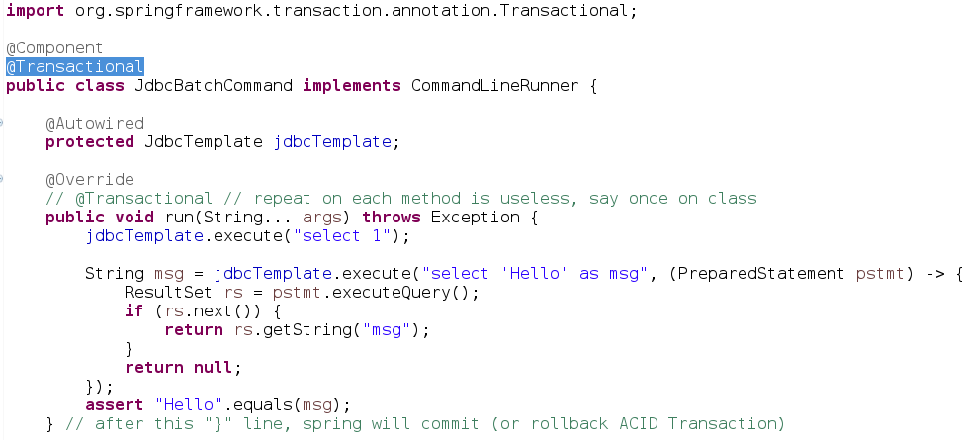
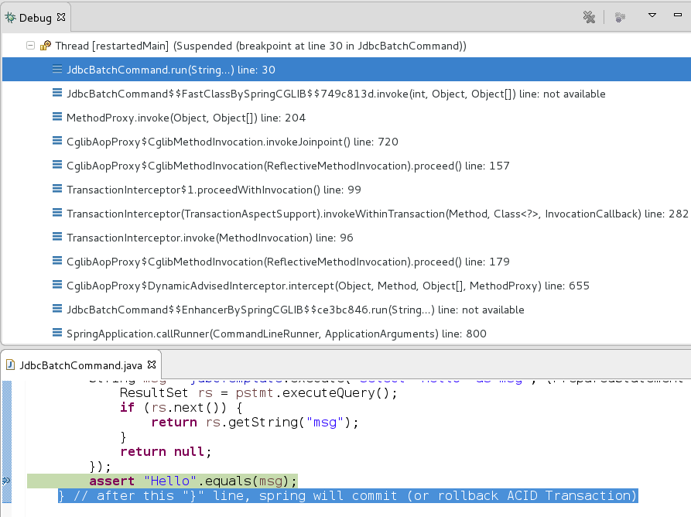
Springboot built-in supports JTA @Transactional

Slide 44
Spring JPA
QueryDsl
Spring JDBC

Slide 45
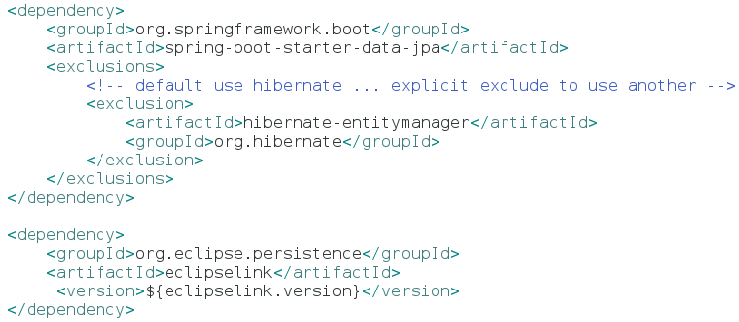
JPA (with springboot data)

Slide 46
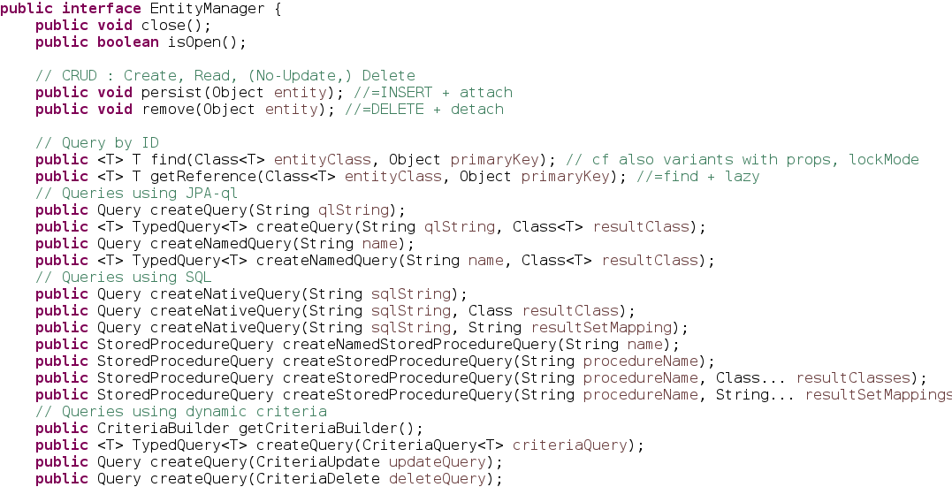
EntityManager

Slide 47
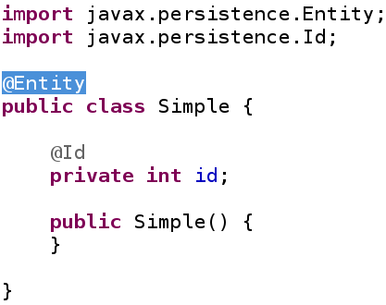
What is an “Entity” ?
A class with @Entity
And an @Id

Slide 48
Sufficient @Annotations to know?
@Entity
@Inheritance
Sub-
Classes
Base
@Id
@GeneratedValue
@SequenceGenerator
@DiscriminatorColumn
@Table
@Version
Custom
@Column
@ManyToOne
For relationships
FK (*) → (1) PK
PK (1) ← (*) FK
@JoinTable
@OneToMany
@JoinColumn

Slide 49
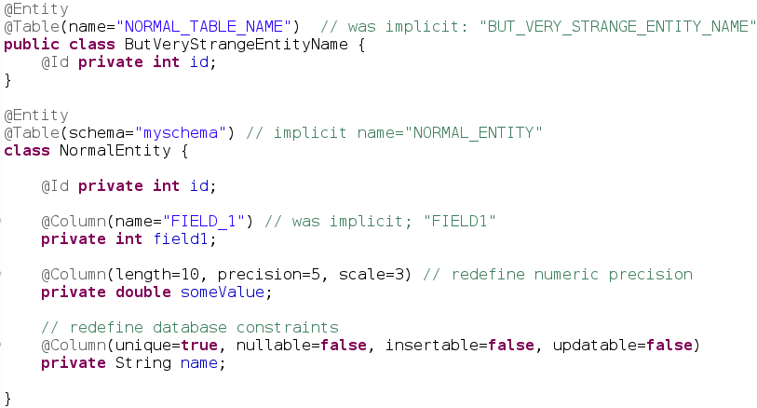
Why putting @Column & @Table ?

Slide 50
@Id with Sequence Generator
SQL:
CREATE SEQUENCE employees_seq INCREMENT BY 10;
Detailed JPA:

Slide 51
@Version ?
whenever overwriting modified value without reading
=>
version=1
(1) (2):
Get data version:1
(5):
REDO fetch
+ update
Wait...
(6):
Save
(on version=2)
OK
(3):
Mofify + Save (on version 1)
OK => increment version=2
(4):
Mofify + Save (on version 1?)
=> OptimisticLockException .. version=2 !

Slide 52
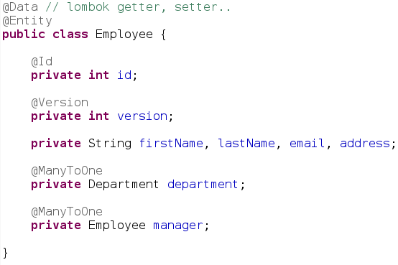
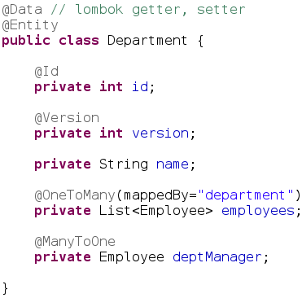
@Entity Employee-Department
Database table “EMPLOYEE”
id (PK), version, first_name, last_name, …. department_id (FK department.id)
manager_id (FK employee.id)
Database table “DEPARTMENT”
id (PK), version, name,
department_manager_id (FK employee.id)

Slide 53
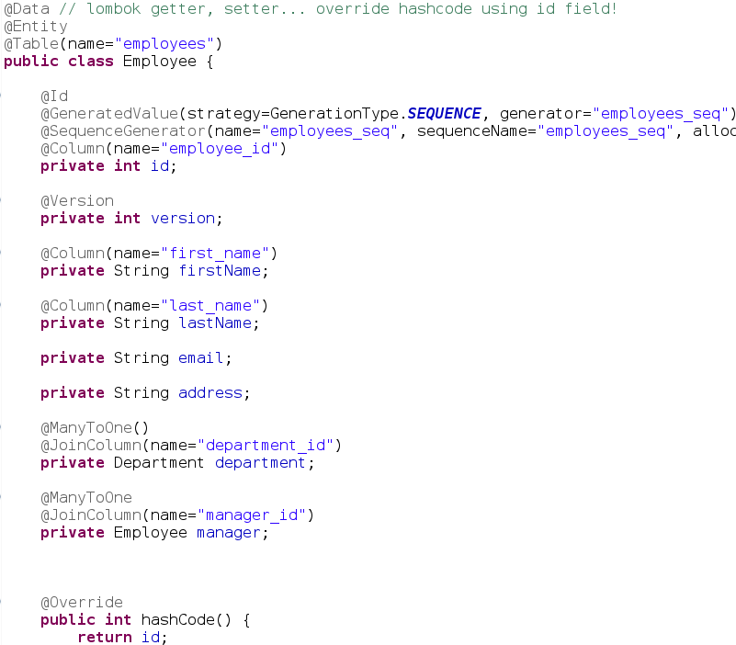
For real with @Column ...

Slide 54
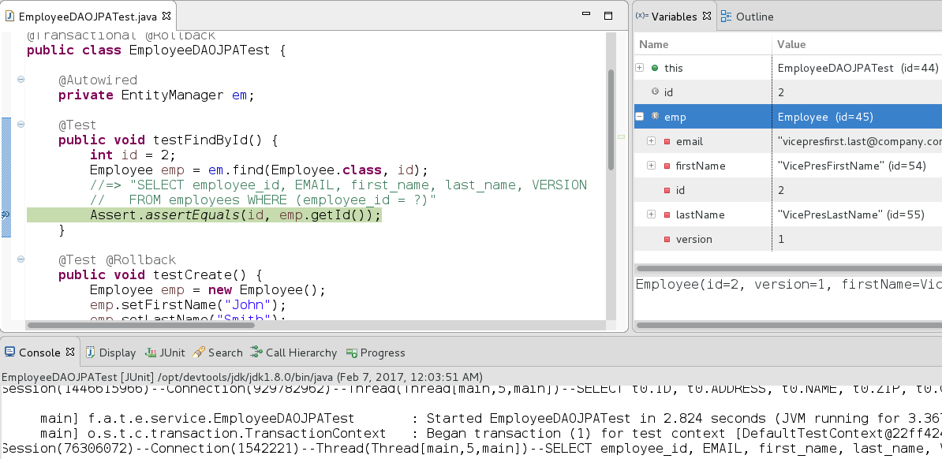
FindById with JPA

Slide 55
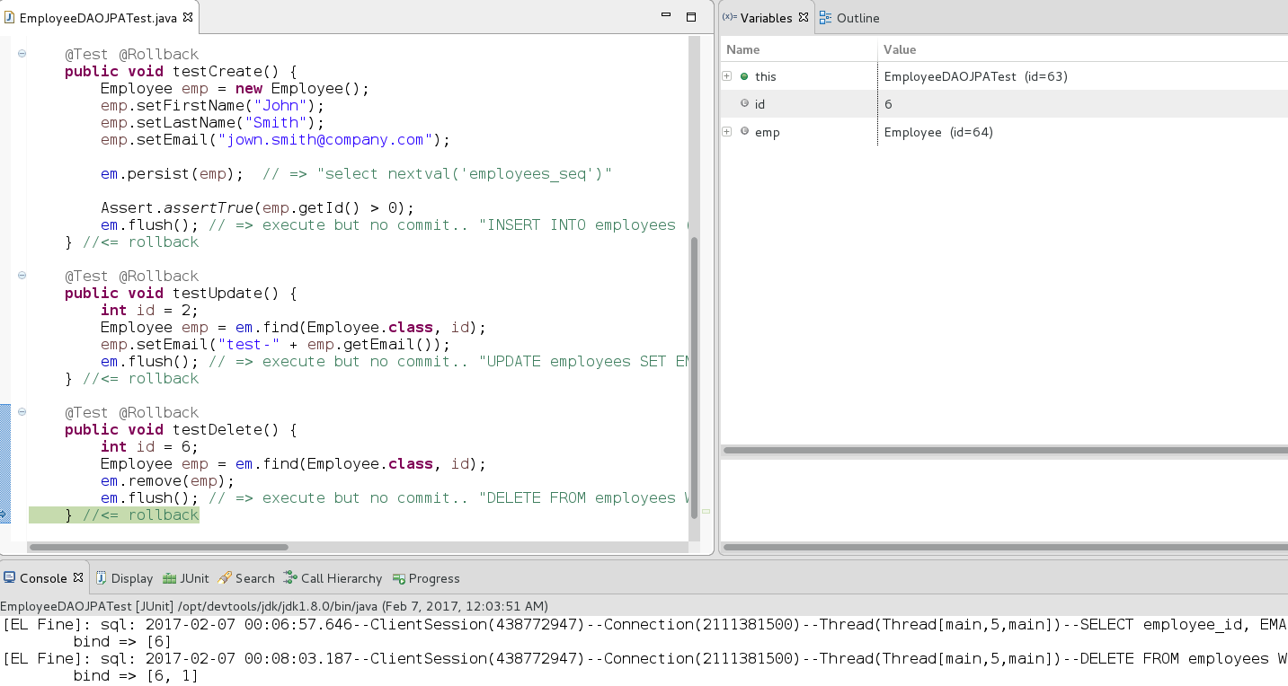
CRUD with JPA

Slide 56
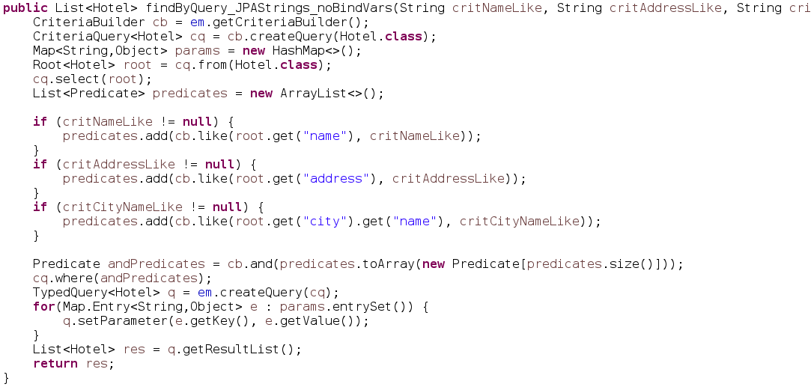
Dynamic Query
( java.persistence.CriteriaBuilder )

Slide 57
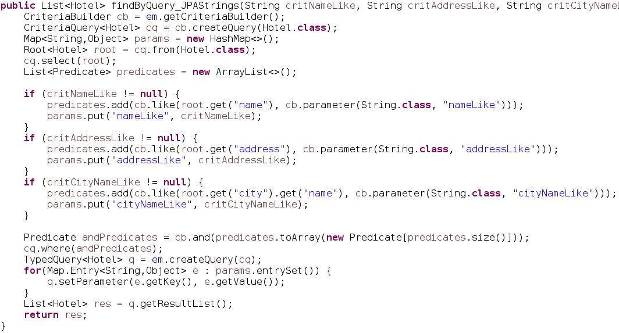
Dynamic Query using Bind-Variables

Slide 58
Dynamic Query …
String type checking?
Which one is correct???
Discover it by Exception on PROD !
cb.get(“addr”) // column name in Database
cb.get(“address”) // field name in java
cb.get(“adress”) // with a Typo
cb.get(“city_id”).get(“name”) // after refactoring db schema

Slide 59
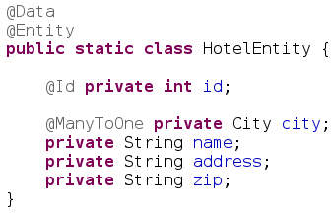
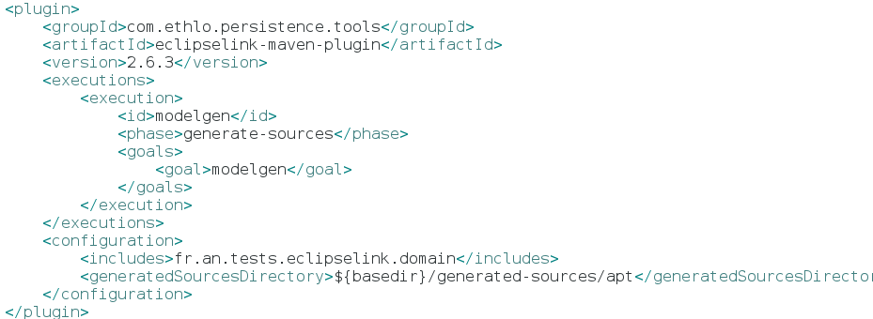
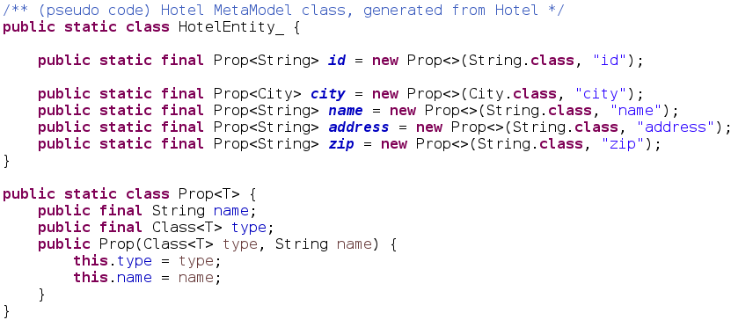
Generated *_ class MetaModel
+ Compile Type Check
Generate

Slide 60
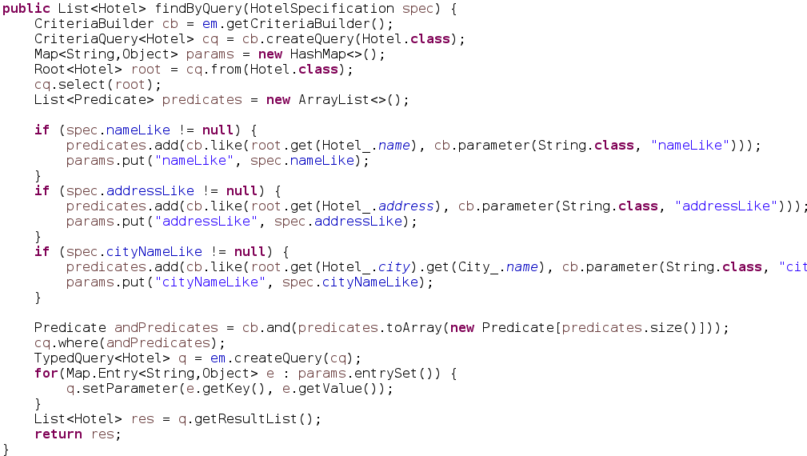
DynamicCriteria using MetaModel

Slide 61
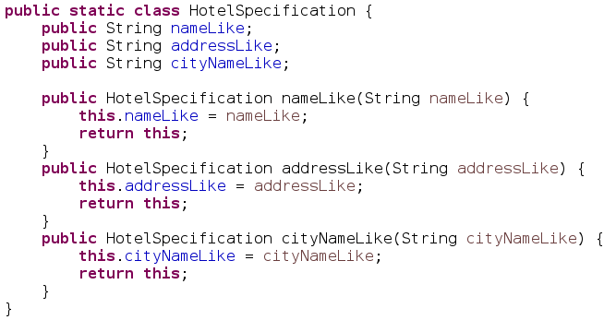
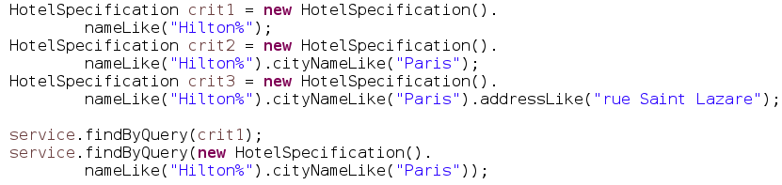
Search Parameters in Criteria class
(also called “Specification”)
Cascading Setters with “return this” for Fluent API

Slide 62
springboot data
Spring JPA
QueryDsl
Spring JDBC

Slide 63
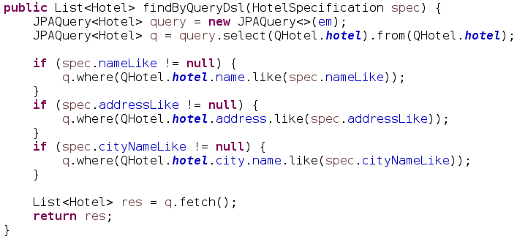
QueryDsl
++More Fluent than JPA

Slide 64
springboot data
Spring JPA
QueryDsl
Spring JDBC

Slide 65
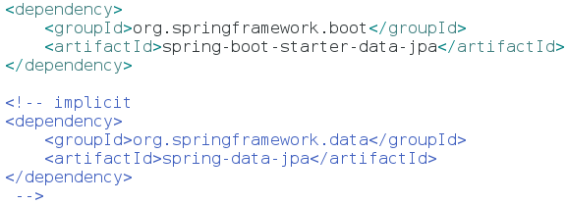

Slide 66
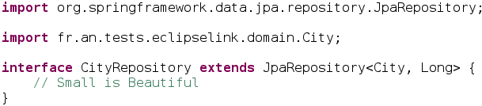
Repository

Slide 67
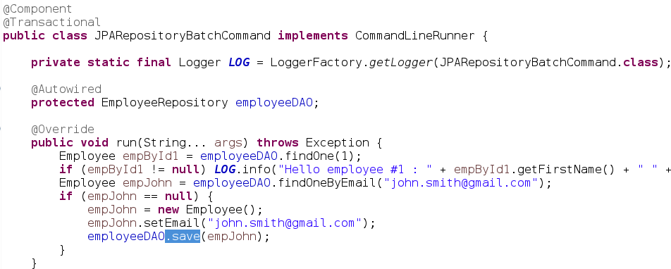
Sample Code using springboot-data Repository

Slide 68

Springboot hibernate… “JUST work”
CRUD …
select * from EMPLOYEE where …
insert into EMPLOYEE (..) values (..)

Slide 69

When/How/Where are my
“create Table ()” ???
Tables are created/updated at startup
Detected H2 Database SQL langage
Also create PK/FK indexes

Slide 70

extends JpaRepository

Slide 71


Small + Custom + Almost Complete
(see also next for QueryDsl)
By naming convention .. Equivalent to:
“Select * from EMPLOYEE where email=?”
Extends JpaRepository
built-in CRUD …
findAll, by Page, save, delete...
(no update, use Setters)

Slide 72

QueryDsl + Spring-Data

Slide 73

AngularJS + Springboot
In Jhipster … you have 100% springboot on server-side
… with Code Generator
And also Hipe code on client-side : Html / Css + AngularJS + ..

Slide 74

Java is Hipe
Make Jar nor WAR – NO PHP
NO NodeJS on server
20 years of Java
Just The Beginning
Its HIPE ...because of springboot
& open-source & java community

Slide 75

Conclusion
This document: http://arnaud-nauwynck.github.io/docs/Intro-CodeExtract-Db-Jdbc-JPA-SpringData.pdf

