Slide 1
arnaud.nauwynck@gmail.com
Maven
Introduction to Concepts:
POM, Dependencies, Plugins, Phases
This document:
http://arnaud-nauwynck.github.io/docs/Maven-Intro-Concepts.pdf

Slide 2
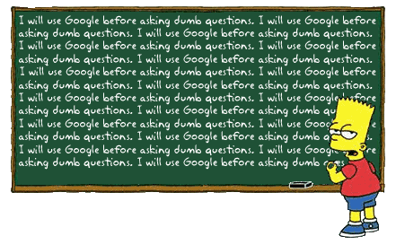
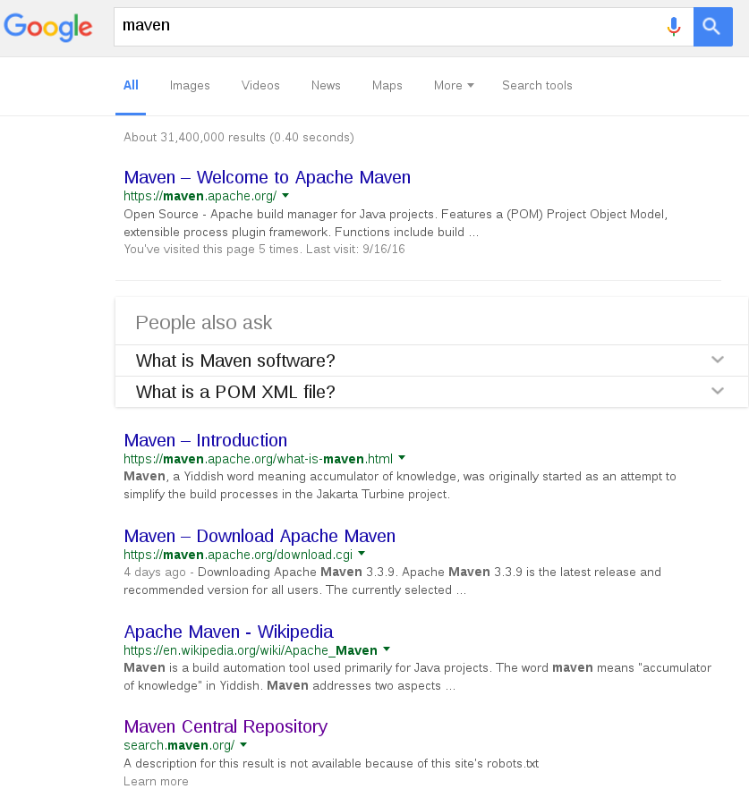
What is Maven ?
31 M !!

Slide 3
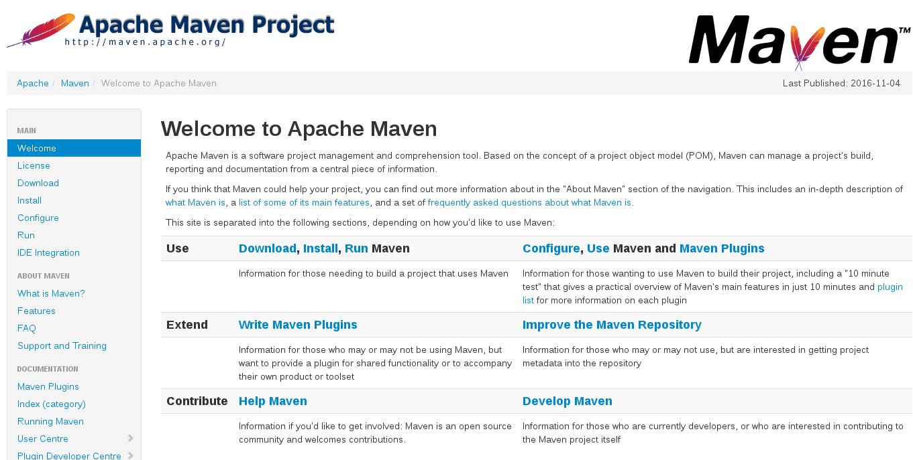
https://maven.apache.org/

Slide 4
A software project management and comprehension tool.
Based on a project object model (POM),
.. project's build, reporting and documentation..

Slide 5
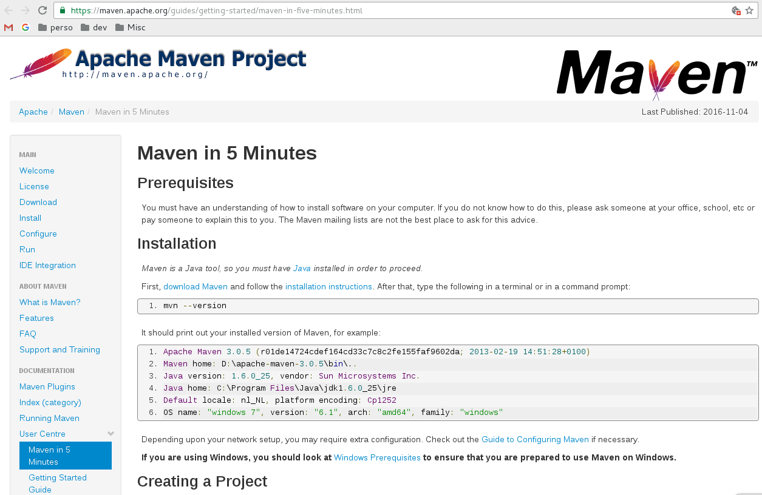
https://maven.apache.org/guides/getting-started/maven-in-five-minutes.html

Slide 6
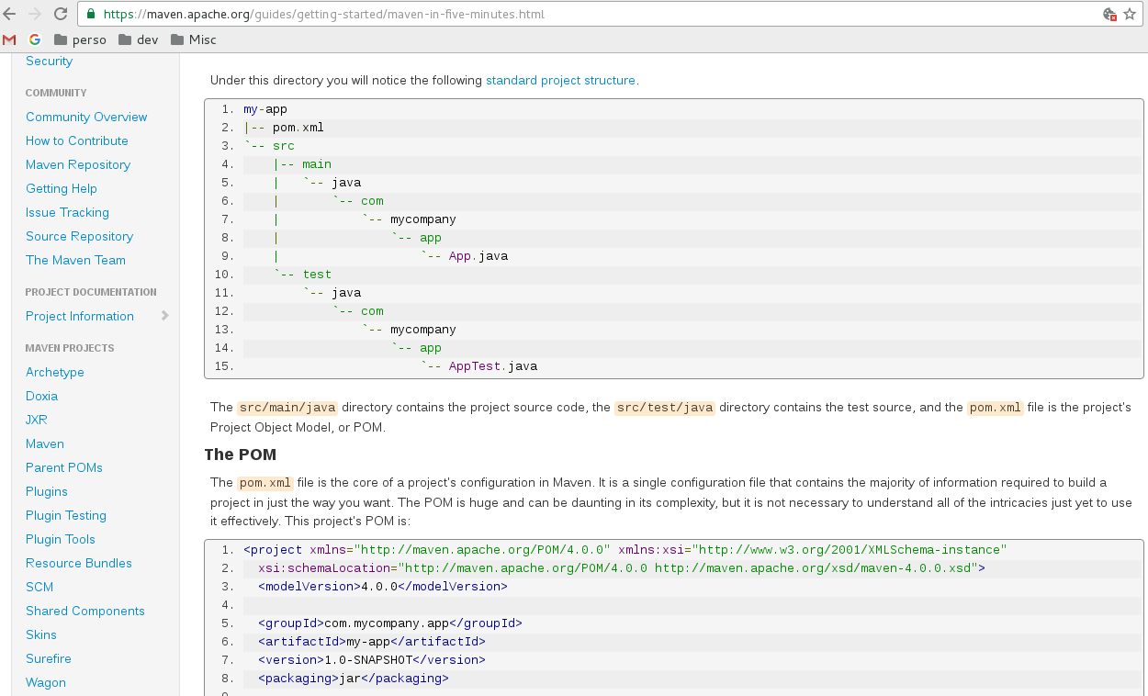
https://maven.apache.org/guides/getting-started/maven-in-five-minutes.html

Slide 7
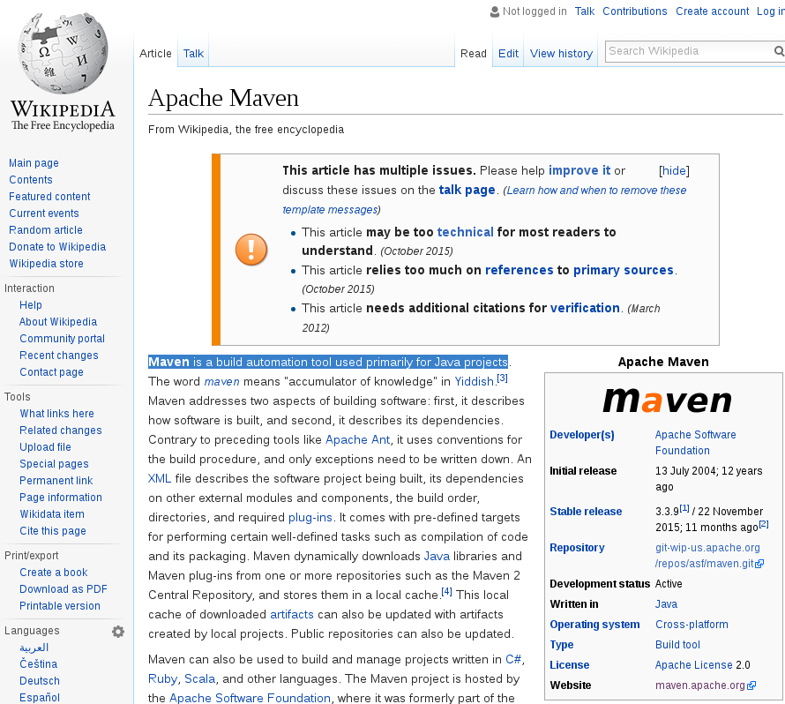
Wikipedia

Slide 8

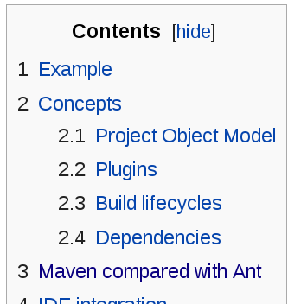
Maven is a Build Automation Tool
pom.xml
<dependencies>
<plugins>
<packaging> <phase>

Slide 9
1st, it describes
how software is built,
2nd, it describes
its dependencies.
… use conventions for build

Slide 10
Maven History
Makefile
Maven 1
Maven 2
Maven 3
Maven 5 ?
Ant
Gradle
1977
2000
2002
2005
2007
2010
2017 ?
Ant
= portable Make
in xml
for Javac, Jar, ..
Maven 1
= Ant + Jelly
= xml build tasks
+ scripts
(<if>, <var> ..)
+ rules / lifecycle…
Maven 2
= Java Mojo
pom.xml
Maven 3
= better & compatible
optional .mvnw
=> pom in
yaml, groovy, ..
( not widespread )
?? Split
pom vs build
Yaml / groovy

Slide 11

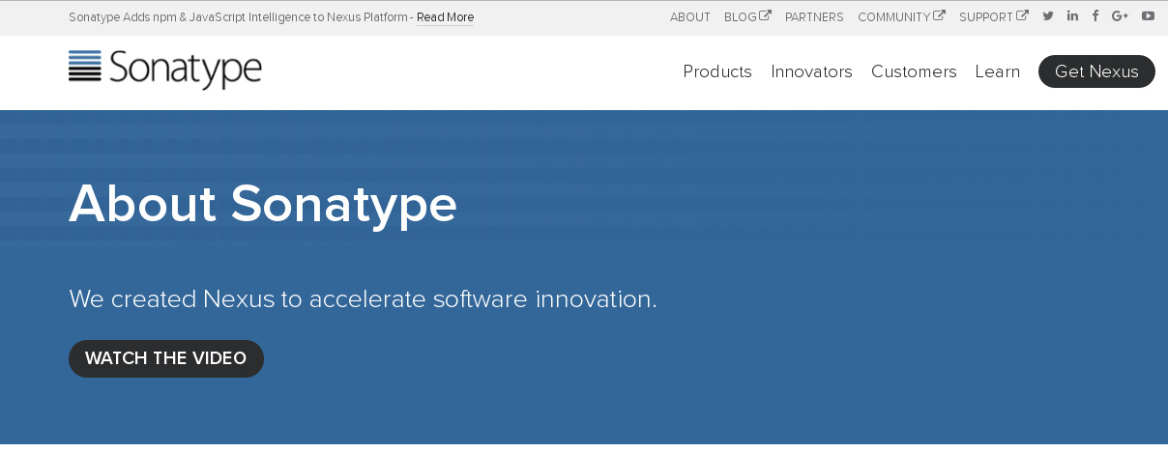


Authors, Company, Community
Jason Van Zyl
Sonatype Company
( core Contributor + Product = Nexus )
Apache Fondation
= Open Source Community
Worked on Turbine
Author of
- Velocity
- Maven
founder of Sonatype
PMC Chair / Member / Contributor / Plugin-Developpers / Users

Slide 12
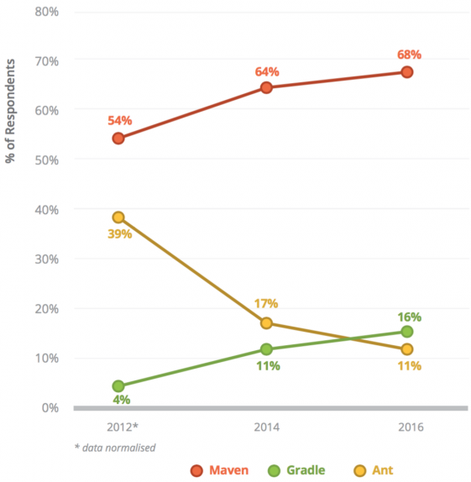
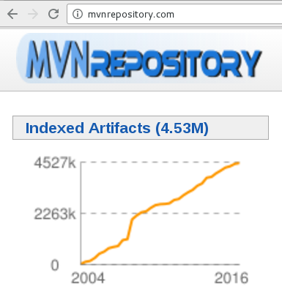
Maven Adoption
68% uses maven
It JUST Work !!
4.5 Millions published
artifacts (=jars)

Slide 13
Yet Another Build Tool
Makefile, Imake, Cmake,
Ant, Maven, Gradle,
MsBuild, Sbt, Gulp, Grunt,
...

Slide 14
Declarative vs Imperative
Describe WHAT … not HOW

Slide 15
Imperative
Do 1/ This,
Then 2/ That,
Then 3/ Also That
…
And N/ You have finished you want to restart ?

Slide 16
Implicit
Convention over Configuration
Given standards
When You follow them
Then it just works

Slide 17
Implicit
Convention over Configuration
a Java Program is src/*.java files compiled in classes/*.class using javac + classpath assembled in jar file tested with Junit test bla bla bla

Slide 18
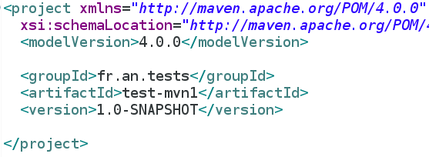


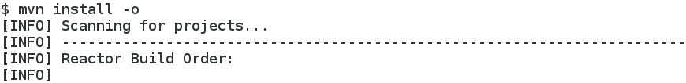
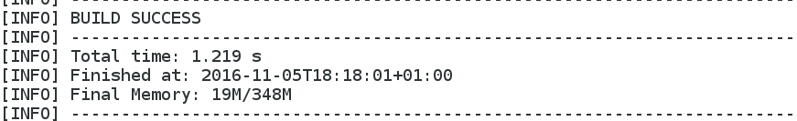
Implicit + Declarative
= Surprising Magic ...

Slide 19
Maven Core Concepts 1 :
(declarative) Project Object Model

Slide 20

Mandatory GAV Declaration
Unique ID : GAV = Group / Artifact / Version
Group = like dns domain name, reverse
com.<<company>>, org.<<...>>, <<country>>.<<...>>. ...
Artifact = name of the final jar
naming convention: some-library-name
Version = major.minor.fix (-SNAPSHOT)?

Slide 21
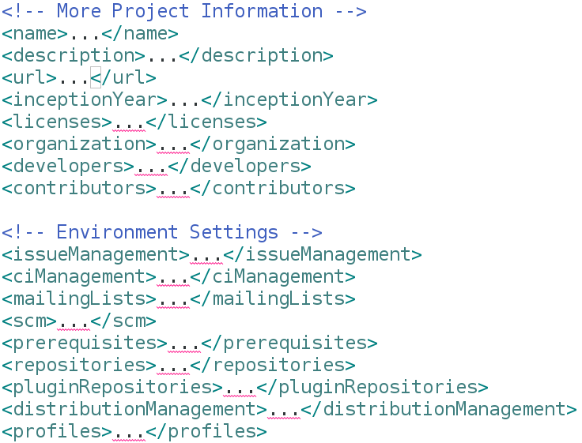
Optional Project Information

Slide 22
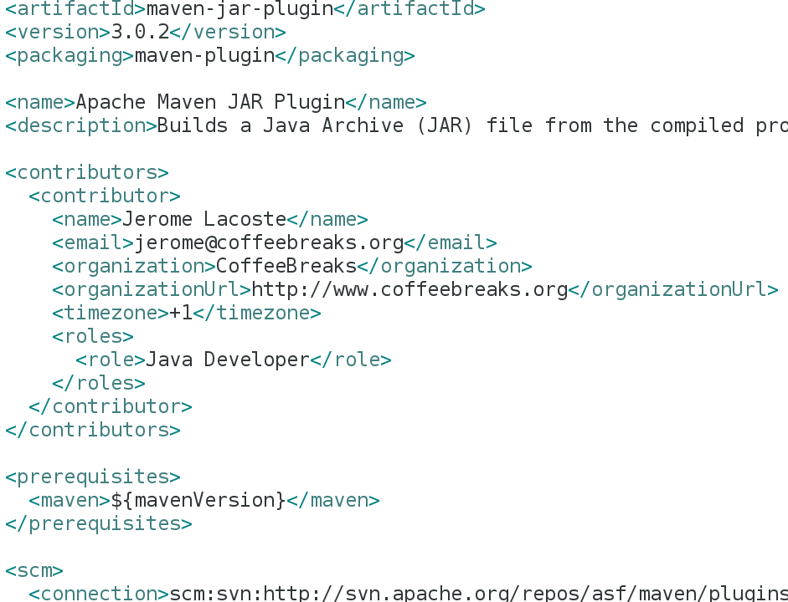
Example Project Information

Slide 23
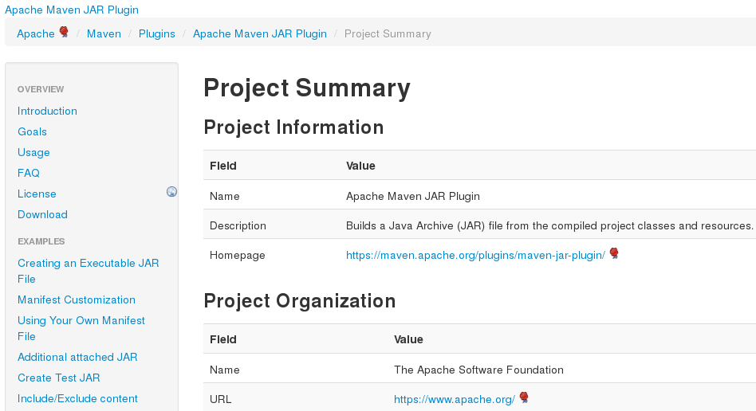
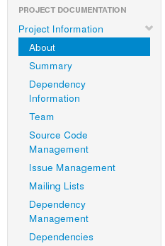
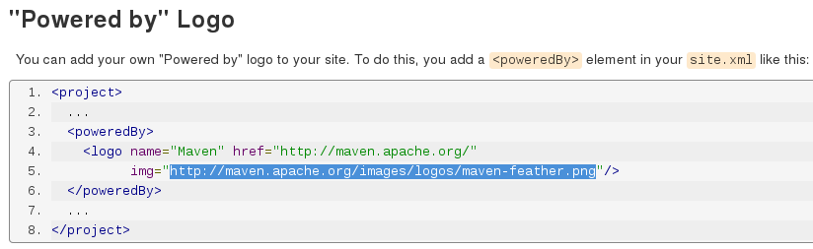
Typical Maven Generated Site
Then you
recognise
pom infos
Menu when
you see
this logo
Logo comes from maven
(maven-site-plugin )

Slide 24
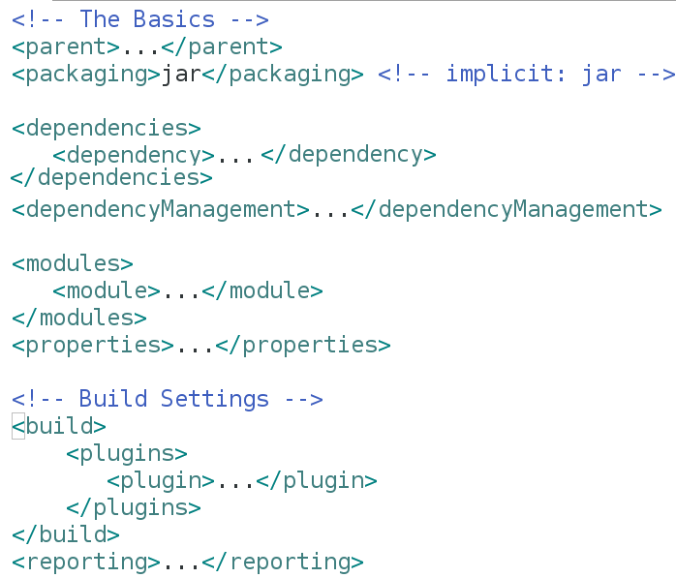
Basic Declarations

Slide 25

Maven Core Concepts 2 :
Dependencies

Slide 26
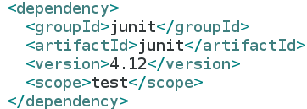

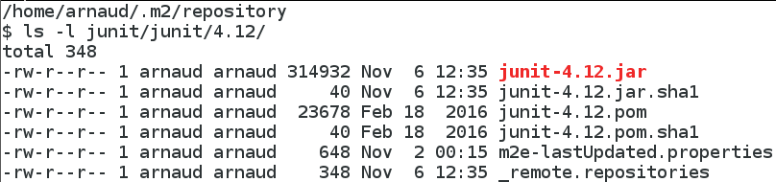
Dependency Declaration
Describe WHAT
Not HOW
First execution:
Download
Next execution:
reuse local repository file

Slide 27
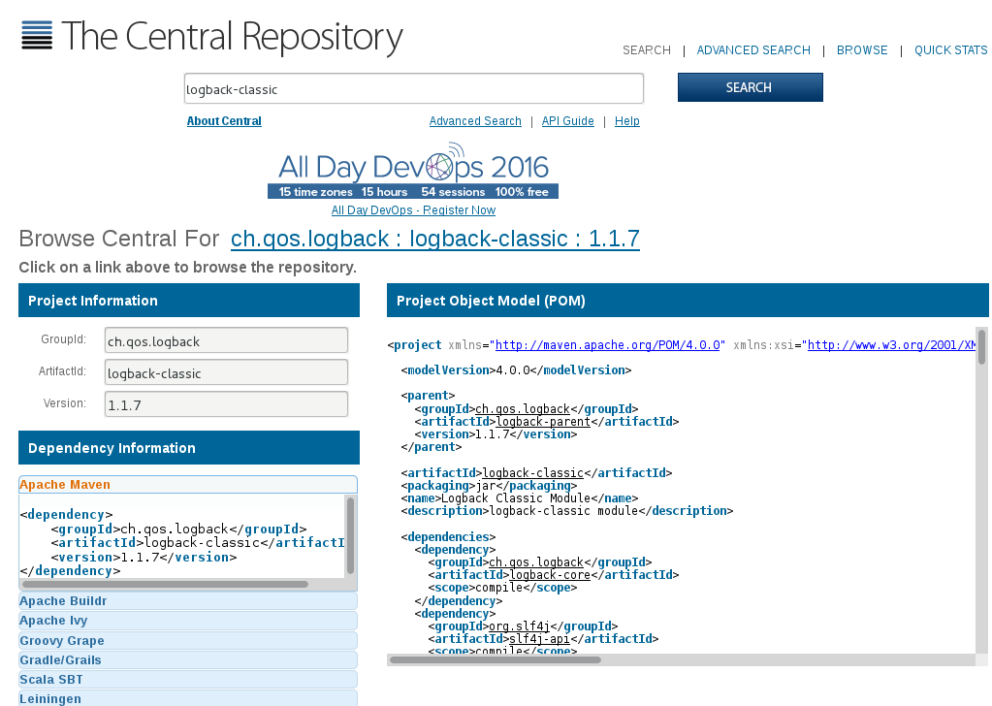
http://maven.search.org
WHERE ?

Slide 28

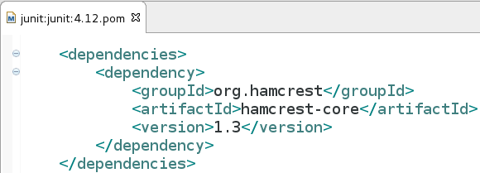

Transitive Dependencies
Transitive Relation Definition:
A → B and B → C .. then A → C

Slide 29
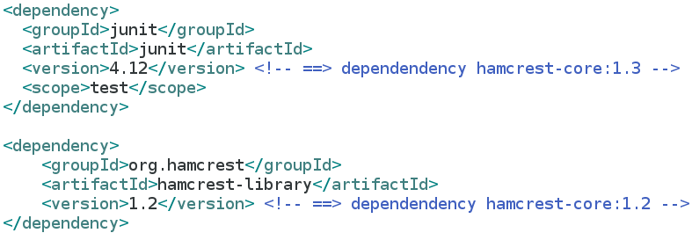
Transitive Dependencies Conflicts
B
D version1
A
C
D version2 != 1

Slide 30
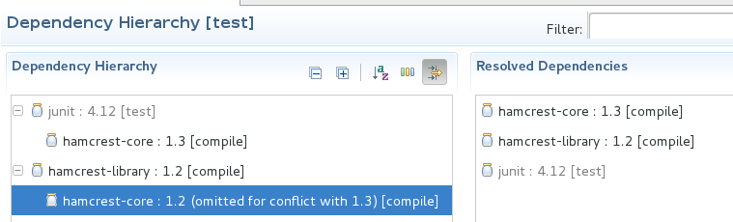
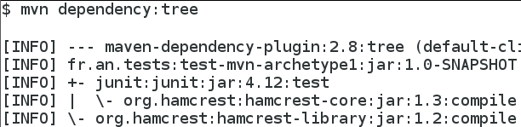
Dependencies Omitted for Conflict
Given Java ClassLoader load once each class
When you have conflict
Then 1 jar on 2 would be useless,
Maven omit oldest jar version

Slide 31
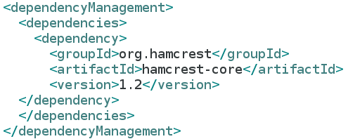
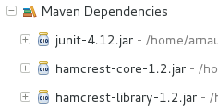
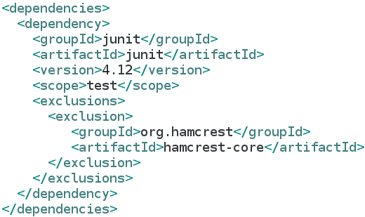

Can Override default configuration
Override to use specific version
Override to exclude dependency

Slide 32

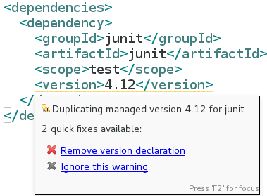
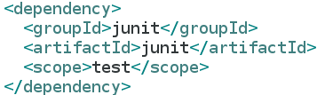
DependencyManagement avoid duplicate version, use parent

Slide 33
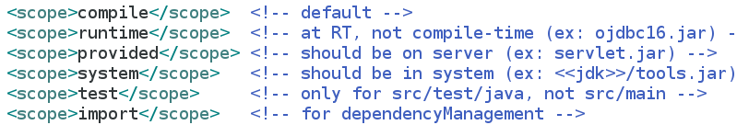
Dependency Scopes
compile *.jar
system *.jar
provided *.jar
Compile
Provided
*.jar
Runtime
src/
main/java/**.java
target/
classes/**.class
target/
*.jar
src/
test/java/**.java
Test
target/
test-classes/**.class

Slide 34
Dependency Summary
Would be more concise than xml: “junit:junit:4.12:test”
Use dependencyManagement versions in parent only don't be too verbose transitive dependencies => implicit don't be too implicit use exact versions, not *

Slide 35
Example
Getting Started with Mvn & Eclipse

Slide 36



Maven Tools Usages
In Command Line
In IDE Eclipse
Buit-in support
In CI Server Jenkins..
Built-in support

Slide 37
Maven Tools Usages
In Command Line
In IDE Eclipse
Buit-in support
In CI Server Jenkins..
Built-in support

Slide 38
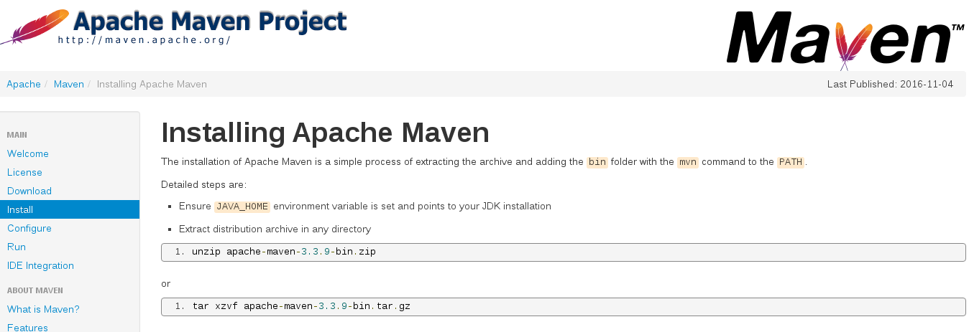
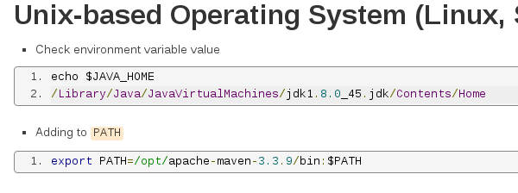
Installation= Unzip + export PATH
1: Unzip
2: export JAVA_HOME & PATH

Slide 39

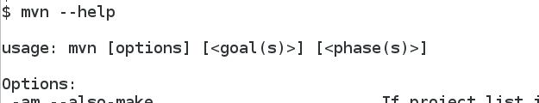
Mvn command line
mvn install

Slide 40
Typical Commands
mvn clean install
Simple phases
mvn install -f ../pom.xml
-o -DskipTests -Pprofile...
With options
mvn springboot:run
Plugin Goals

Slide 41
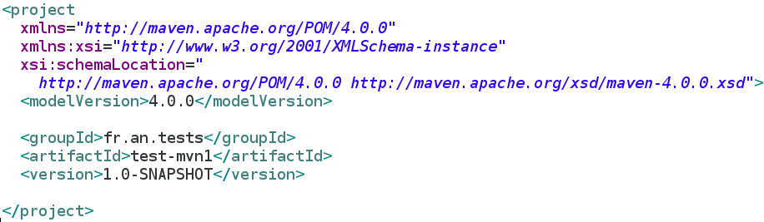
Start Edit a Pom.xml manually ?
XML = Langage for Computers
… not for Humans
You only need this identity card :
GAV = group / artifact / version

Slide 42
New Maven Project
Copy & Paste
mvn archetype:generate
New Project... >
Type: Maven Project
mvn install
mvn install
Choose archetype...
Import existing project … >
Type : maven
mvn install

Slide 43
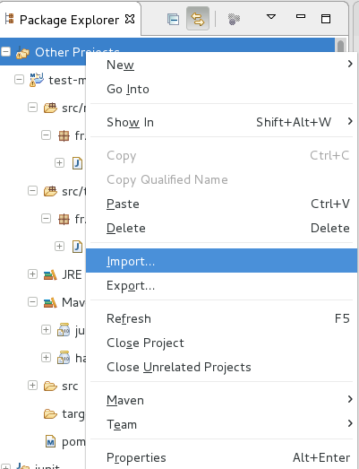
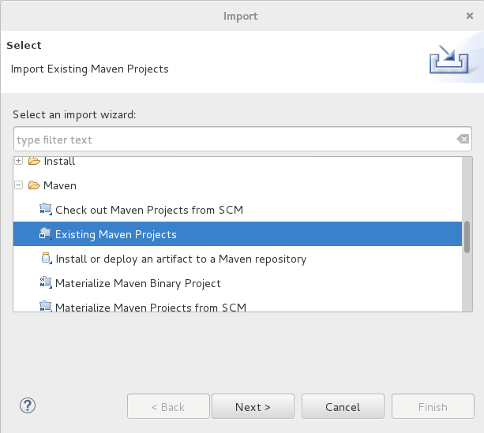
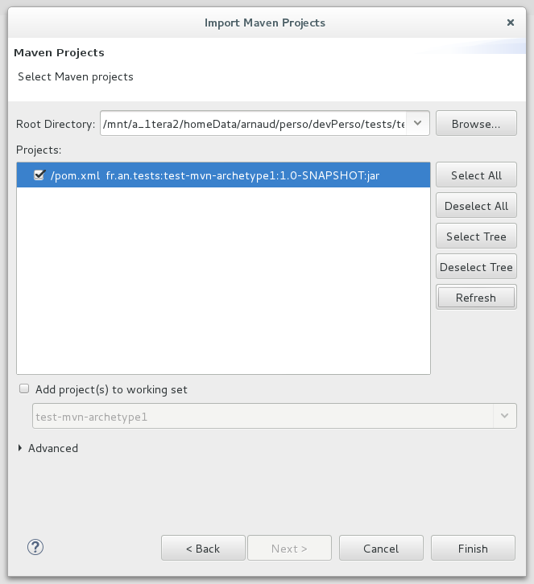
Eclipse
Import Existing Maven Project

Slide 44
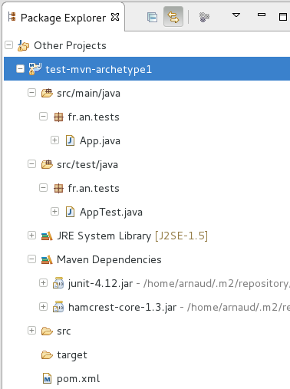
First Maven Project in Eclipse

Slide 45
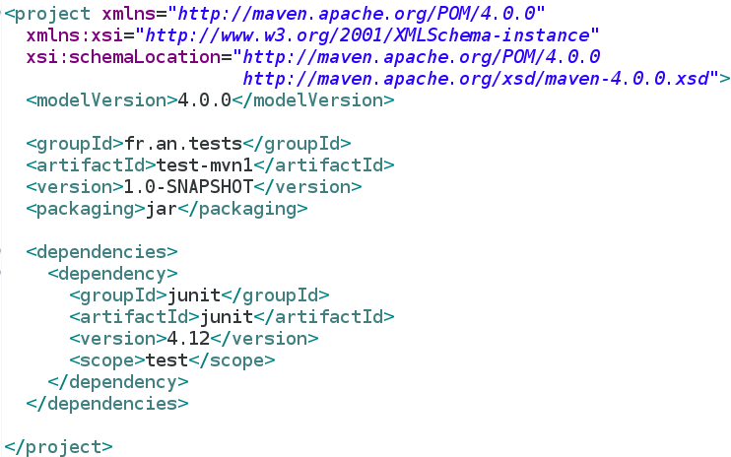
Pom.xml

Slide 46
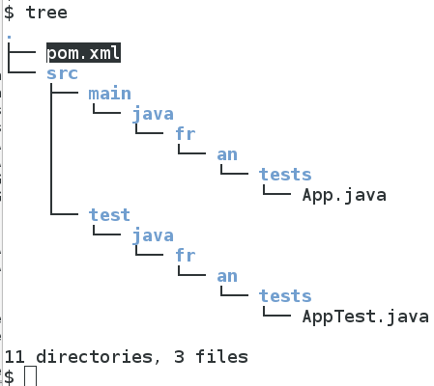
Standard Source Project Layout

Slide 47
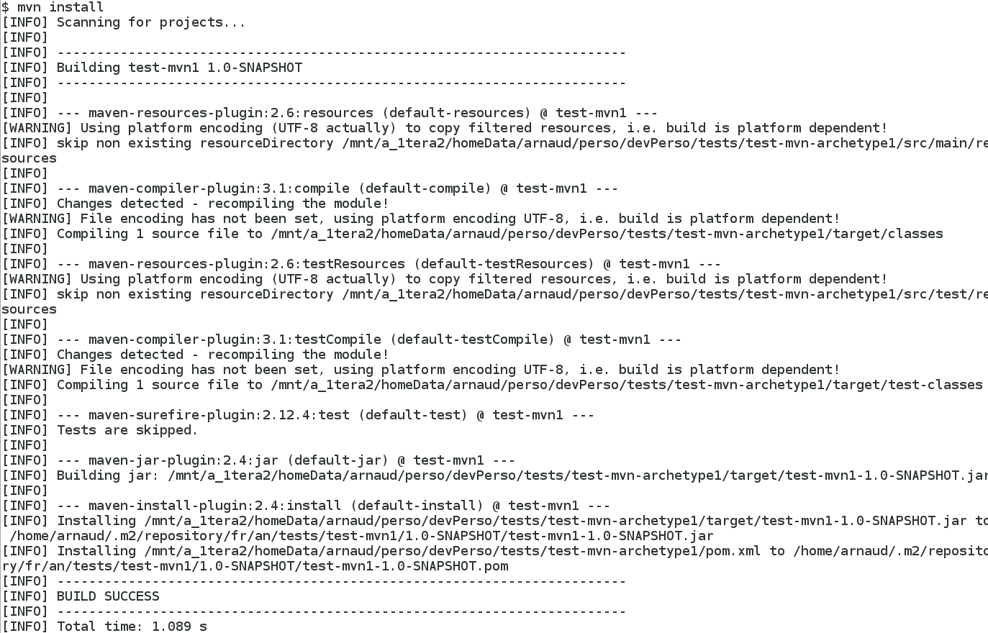
Mvn compile (or install)

Slide 48
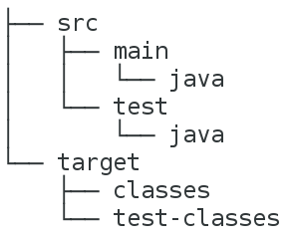
src → target directories
compile
src
src/main/java → target/classes
compile-test
target
src/test/java → target/test-classes
jar
target/classes → target/*.jar
install
target/*.jar → ~/.m2/repository/...
groupId/artifactid/version/*.jar
deploy
.m2/repository/.. .jar → http://nexus-repo/...
groupId/artifactid/version/*.jar

Slide 49
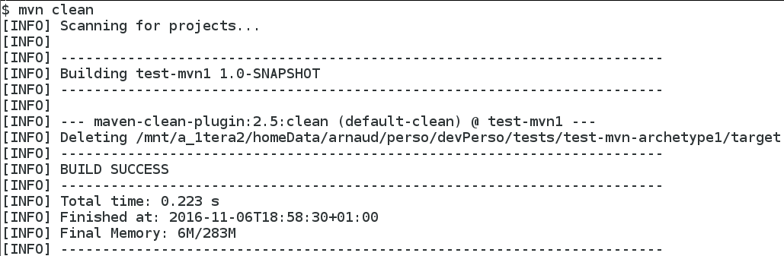
Mvn clean src vs target + .gitignore

Slide 50
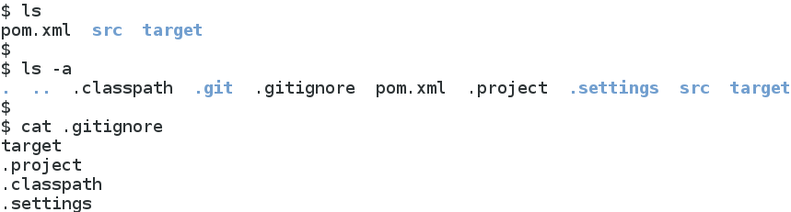
Typical .gitignore for target/, .project, .classpath, ...

Slide 51
Project Layout Explained by Dichotomy Questions
src/**
+ pom.xml + .gitignore
Dir / File
Stored In SCM
or Generated
(or ignored) ?
target/**
.git/**
.classpath
.project
.settings

Slide 52
Project Layout Explained (bis)
src/main/**
src/**
Main
or test ?
Dir / File
src/test/**
target/**

Slide 53
Project Layout Explained (ter)
java
src/main
Lang?
resources
src
python
doc
Dir / File
src/test
webapp
target

Slide 54
Maven Core Concepts 3 :
Plugins – Goals

Slide 55
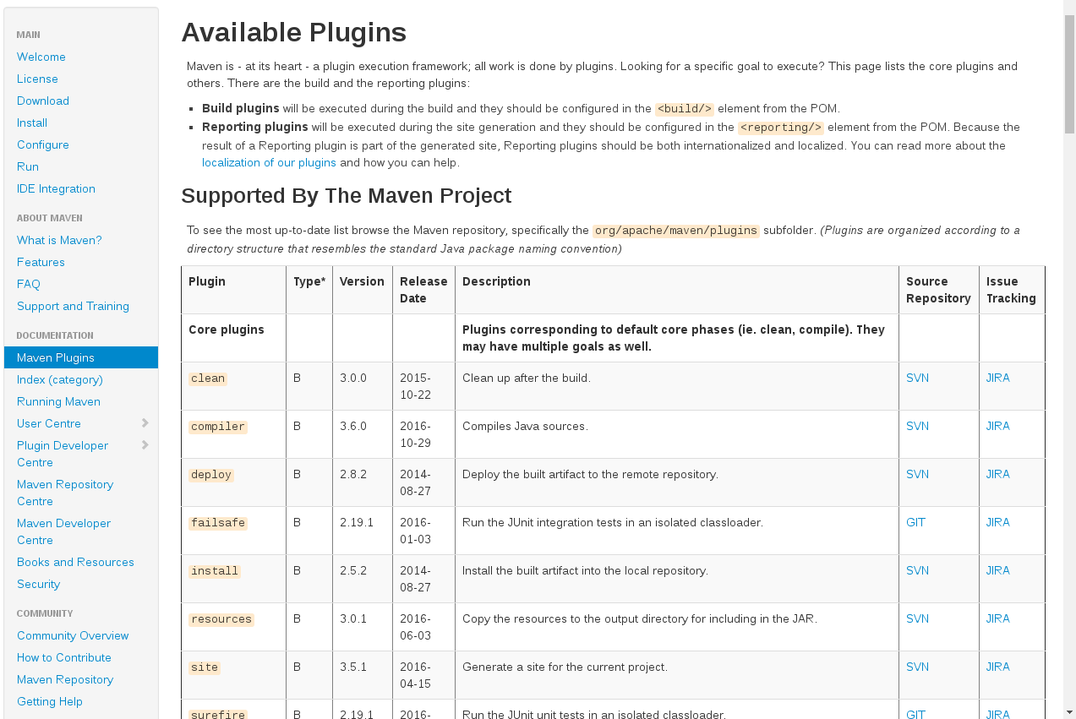
https://maven.apache.org/plugins/
Scroll for 100 more

Slide 56
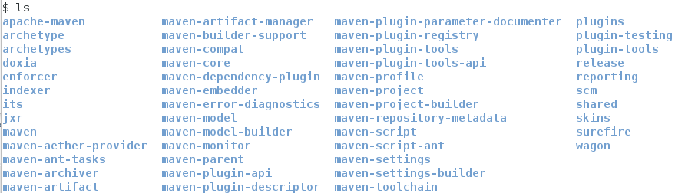
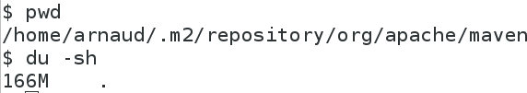
.m2/repository/org/apache/maven
First launch mvn … will download ~150Mo ...
Plugins ...

Slide 57
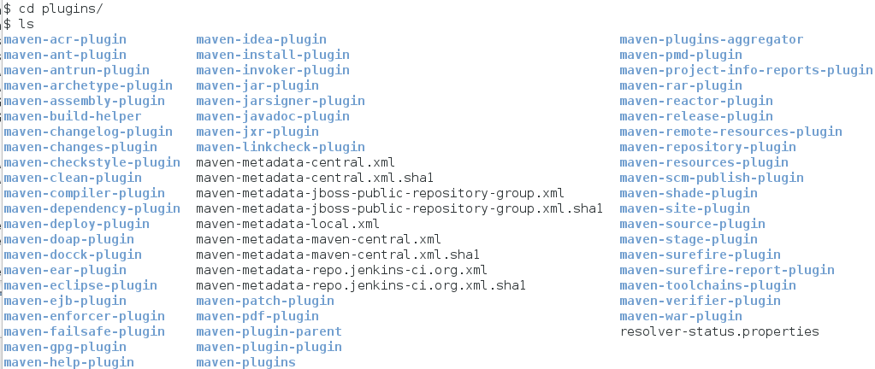
Maven .m2/repository/ …/plugins standard plugins in local repository

Slide 58

Use build/plugins
Use
plugin
Use
Another
Declare plugin Dependencies … with GAV
( as “build dependencies” but in section plugins)
=> Plugin will register itself in build lifecycle
see next for configuring..

Slide 59

Plugin <configuration>
Override
plugin
configuration
<source> = “-source” for javac compiler …
list of options => cf next

Slide 60

Eclipse Auto-Completion for Plugin Configuration

Slide 61


Maven Plugin Doc Site https://maven.apache.org/plugins
See Plugin Goals & Usage
In 2016
default value to change
for jdk8 !!

Slide 62


Configuration Override Properties
Project
properties

Slide 63

Properties Override Hierarchy (bis)
User ~/.m2/settings.xml
override
Project properties
override
Command Line arguments

Slide 64

plugins/executions
When processing
lifecycle phase
Then call plugin goal
1 execution
With this parameter
Can add others
...

Slide 65

Plugin Execution Override
Project
properties
override
plugin
configuration
override
Execution
configuration

Slide 66

Command Line
Explicit Plugin Goal Execution
Call build lifecycle 1..* phase(s)
=> sequence of plugin goals
Call explicit 1..* plugin goal(s)

Slide 67

Example of Plugin Goals

Slide 68

Plugin Internal “Mojo” Classes
as simple as a “main()”
executed within a project build context

Slide 69

Run Mojo Hello World ...

Slide 70

Mojo Context Injection @Parameter
Inject from <configuration><sources>..
default properties for values
Inject the FAMOUS pom

Slide 71
Maven Core Concepts 4 :
Build Lifecycle - Phases

Slide 72

Maven Phases

Slide 73



Register Goals Execution in Phases
Explicit
Goal Execution
per <phase>
Implicit
Goal Execution
per Phase

Slide 74


Project Type→LifeCycle
→Phases →Plugins Mojo
repository/org/apache/maven/plugins/
Maven-jar-plugin-3.0.2.jar
META-INF/plexus/components.xml

Slide 75
Conclusion
Questions ?
arnaud.nauwynck@gmail.com
Only a “Short”
Introduction to Concepts...
other docs:
http://arnaud-nauwynck.github.io/
http://arnaud.nauwynck.free.fr/
This document:
http://arnaud-nauwynck.github.io/docs/Maven-Intro-Concepts.pdf

