Slide 1
arnaud.nauwynck@gmail.com
This document: http://arnaud-nauwynck.github.io/docs/Intro-Html-JS-DOM.pdf
Introduction to HTML / JavaScript / DOM

Slide 2
Agenda
Introduction to Client-Side Web Technologies
  HTML = Elements / Custom Elements
  CSS
  JavaScript
The DOM … how JavaScript interact
JavaScript framework(s)
  AngularJS, binding principles

Slide 3
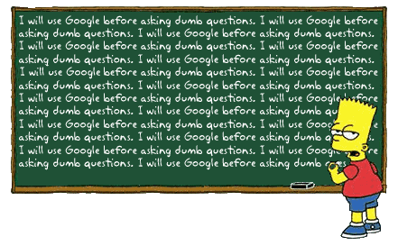
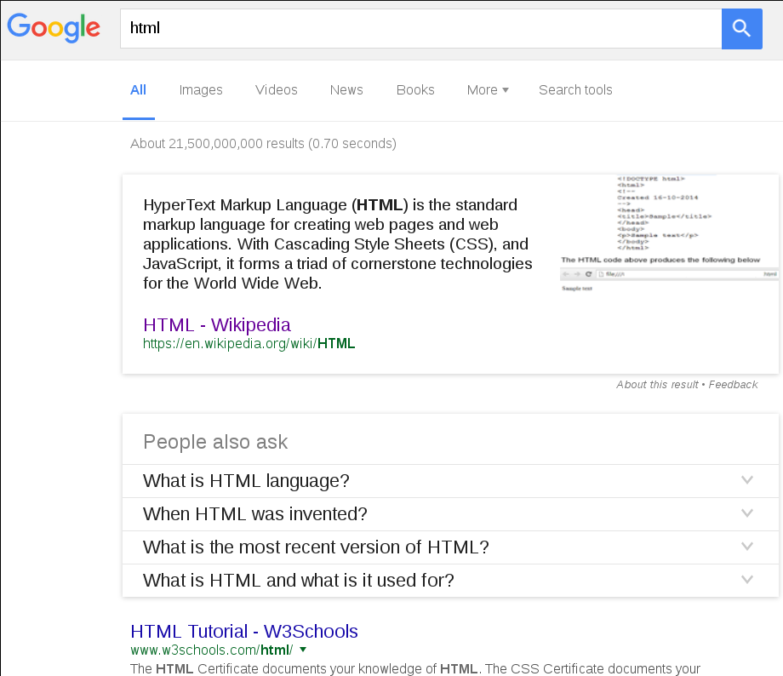
21 Billions...
Rank#1 : w3scools (not Wikipedia?)

Slide 4
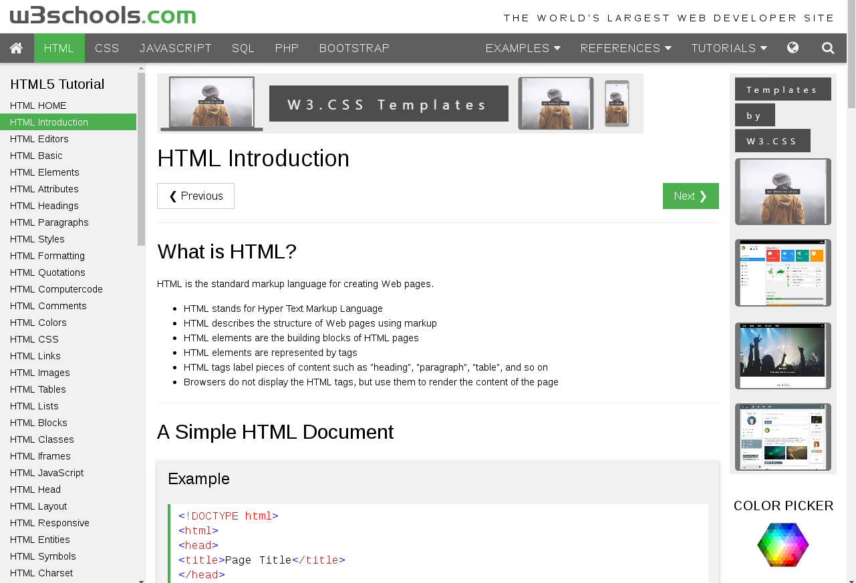

Slide 5
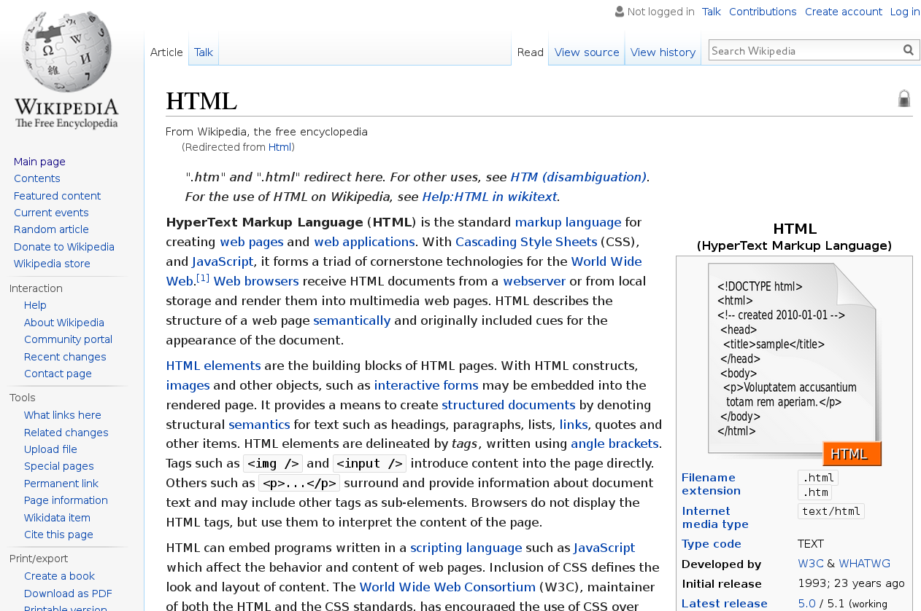
HyperText Markup Langage

Slide 6

1989 : HTTP + HTML
Tim Berners-Lee

Slide 7

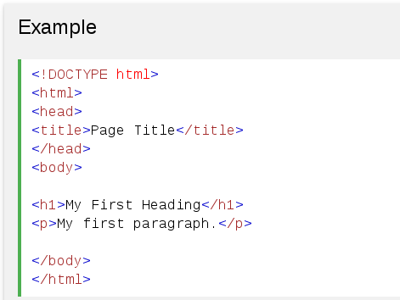
HyperText Markup Language (HTML)
is the standard markup language
for creating web pages and web applications.

Slide 8
With Cascading Style Sheets (CSS), and JavaScript,
it forms a triad of cornerstone technologies
for the World Wide Web
HTML
WWW
W3C Technologies =
CSS
JavaScript

Slide 9
Client(Html+CSS+JS) – Protocol(Http) - Server(*)
Client-Side
Server-Side
expose IP<TCP<HTTP port
HTTP Request (GET,POST,..) URL
headers
body
HTML
8080
8443
CSS
JavaScript
HTTP Response (20x,30x,40x,50x)
headers
body
WebSocket events

Slide 10

Client-Side = Browser
= Security Sandbox
https://site3
HTML
https://site2
CSS
JavaScript
https://site1
Cookie site3.com
Cookie site2.com
Cookie / LocalStorage site1.com

Slide 11
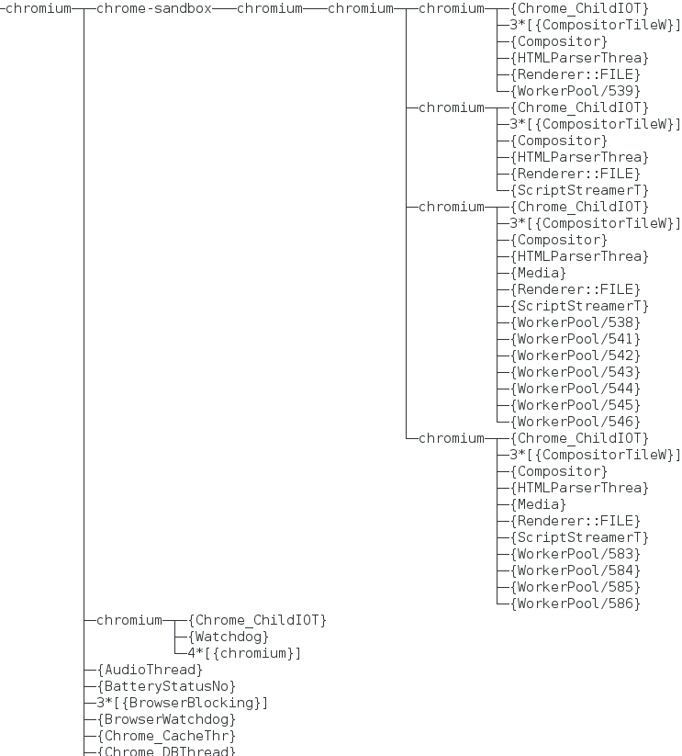
Site Navigation Isolation …
Example on Chrome:
1 separate Process
per navigation Tab !!!
Shared processes
(chrome launcher)

Slide 12
On Client-Side = ONLY
Html / CSS / (Limited) JavaScript
Amazing WebGL, Canvas, SVG rendering
using video card !!
W3C API for
Mouse (swipe..)
Scrollbar
KeyBoard
Micro
...
HTML
JS limited to 2 Threads
and Few Connections
per site
CSS
JavaScript
JavaScript access to
global “Window” (current frame)
NO access to C:\*, D:\*
only “Save As” to D:\Downloads
+ OpenFileDialog for upload

Slide 13
1/ HTML ~ XML elements for Hyper Text
contains Data
1/ HTML
2/ CSS
3/ JavaScript

Slide 14
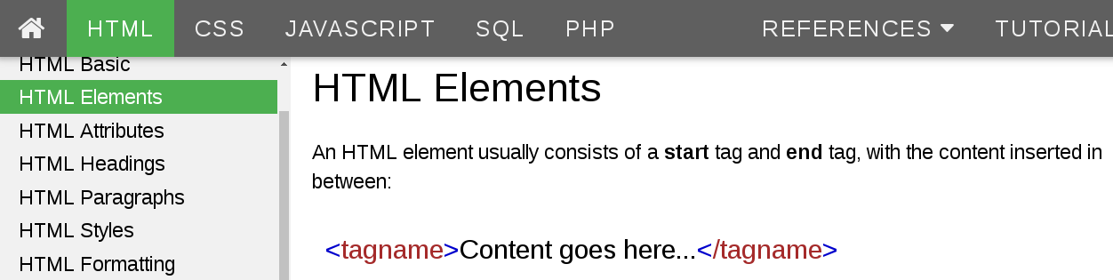
Element = <tagName> ... </tagName>

Slide 15
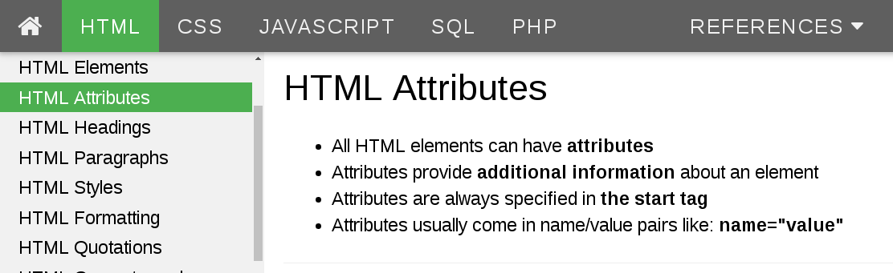
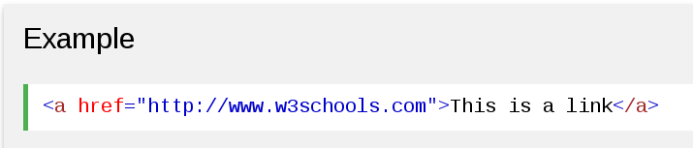
<elt attribute1=”value1” attribute2 ../>

Slide 16
Standard W3c Tags
Basic Structure
Hyper Link..
<A href=”..”>
<img src=”..”>
<video >
<script >
<iframe>
<h1>Header 1</h1>
<h2>..</h2>
<h3>..<h3>
<h4>..</h4>
<p>paragraph</p>
<br/>
Text Formatting
<pre> - pre-formatted
<b> - Bold text
<strong> - Important text
<i> - Italic text
<em> - Emphasized text
<mark> - Marked text
<small> - Small text
<del> - Deleted text
<ins> - Inserted text
<sub> - Subscript text
<sup> - Superscript text
Other..
<table> <tr><td>
<ul> <li>
<>
<>...
…
...

Slide 17
Html 1.0 … a simple MarkupLangage for Text
=> many specific tags for text formatting

Slide 18
Only 2 families of tag layout: Blocks & Inline
=> technically no “needs” to add more
than <div>&<span>
with CSS & JS everywhere

Slide 19
<div> and <span> ..
<div> = blocks
<span> = inline

Slide 20
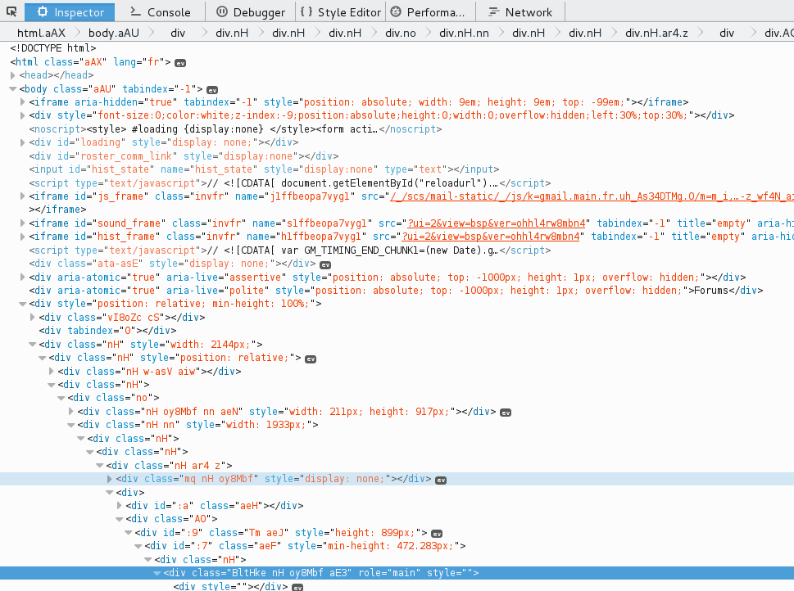
Html = soup of <div><div><div> (example: gmail)

Slide 21
Code quality with Only technical <div>&<span> ?
Need more semantic tags for web applications

Slide 22

CustomElement
Define your own application specific tags:
<your-custom-tag>
<your-menu> <your-view> <your-object>

Slide 23
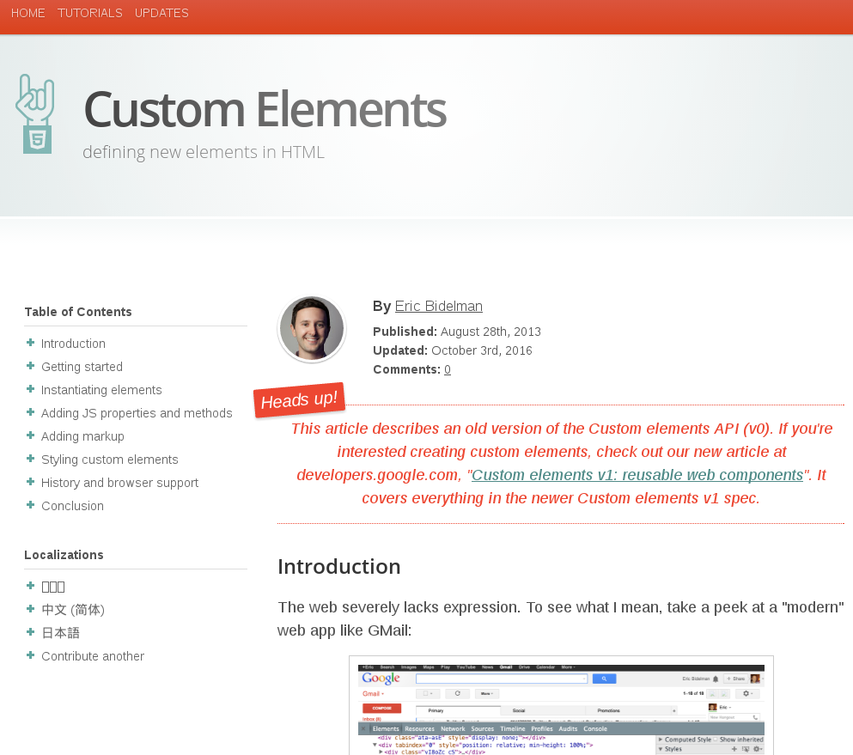
Eric Bidelman's article https://www.html5rocks.com/en/tutorials/webcomponents/customelements/

Slide 24
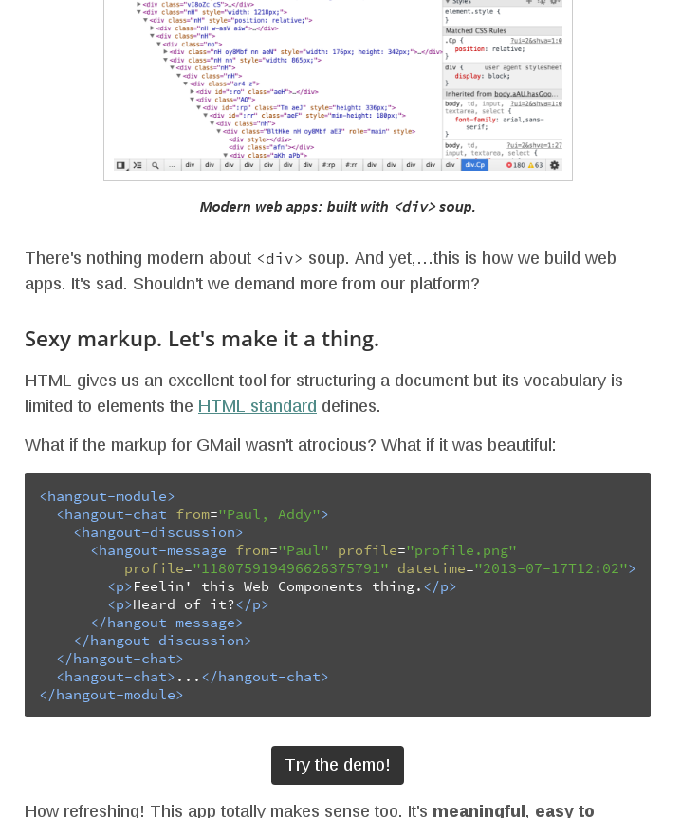

Slide 25
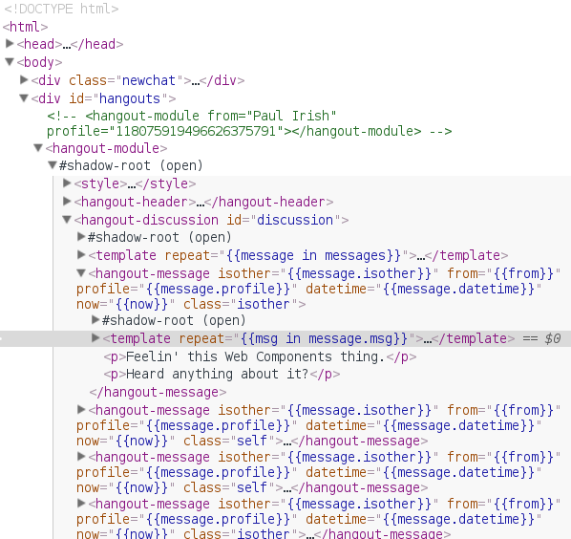
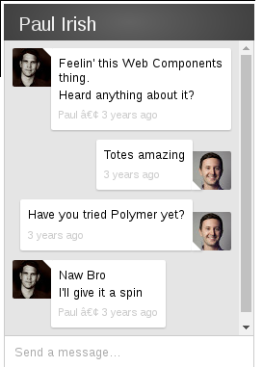
Example Demo : http://html5-demos.appspot.com/hangouts

Slide 26
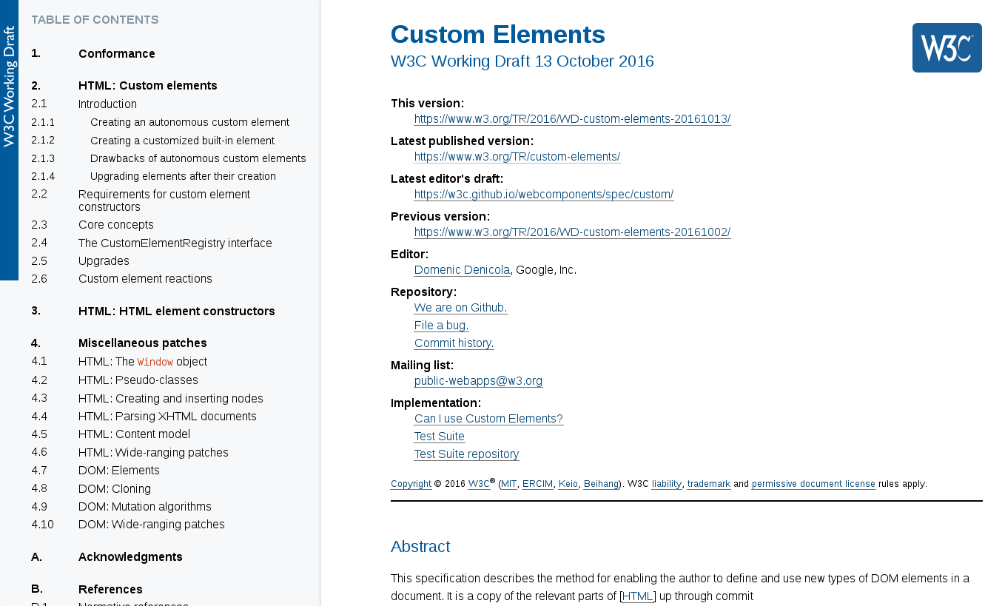

Slide 27
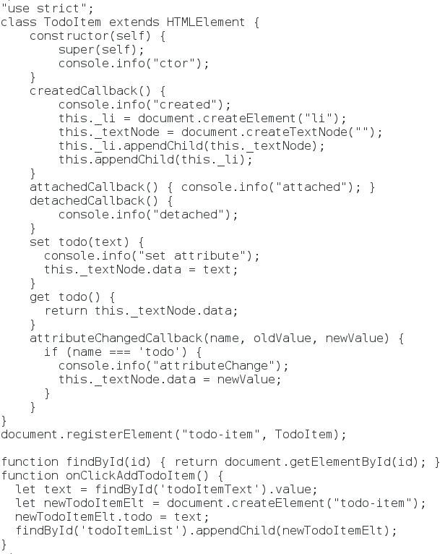
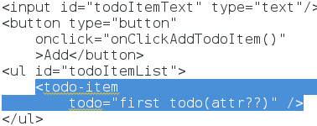
Custom Elt

Slide 28
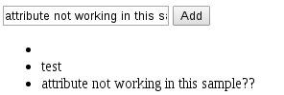
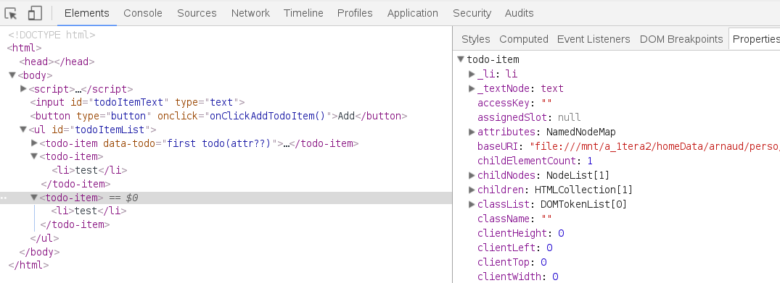
Custom Elements ...

Slide 29
WebComponent
… Simplify CustomElement
Goals :
1) simplify Javascript ...replace by Html
<dom-module><template>
2) supports old browser via PolyFill
3) use Template + ShadowDom

Slide 30


Slide 31
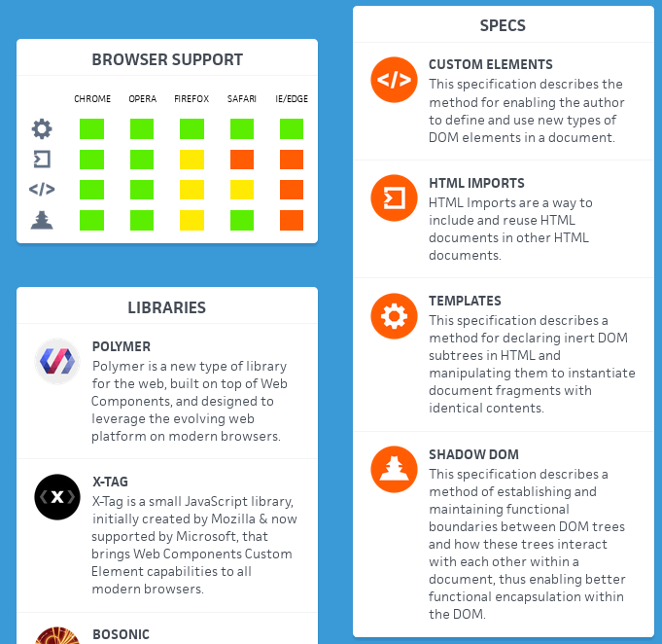
WebComponents = 4 w3c specs
= CustomElement + Import + Template + ShadowDom

Slide 32

www.polymer-project.org
= Google Library of WebComponents

Slide 33
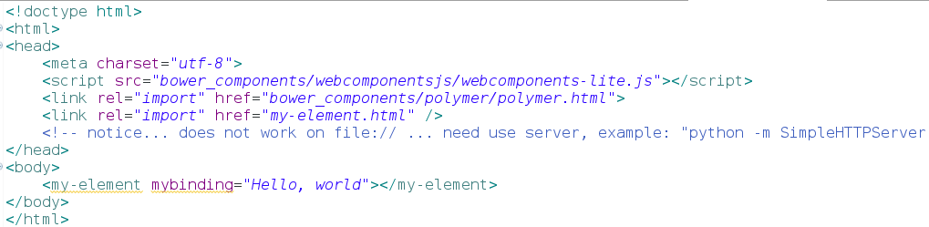
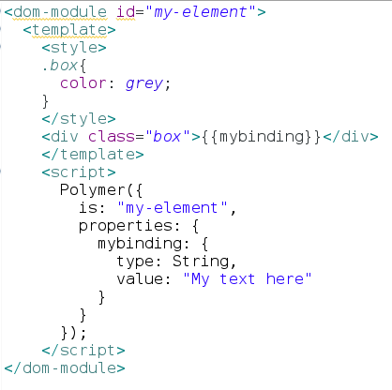
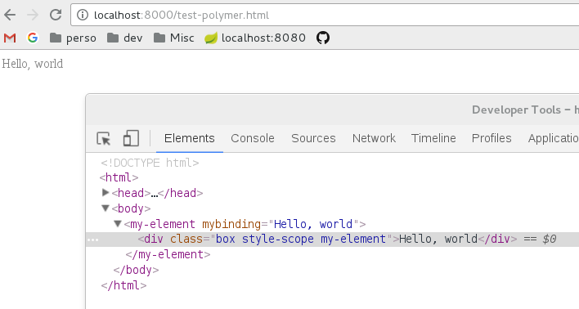
Polymer example
File “my-element.html”

Slide 34
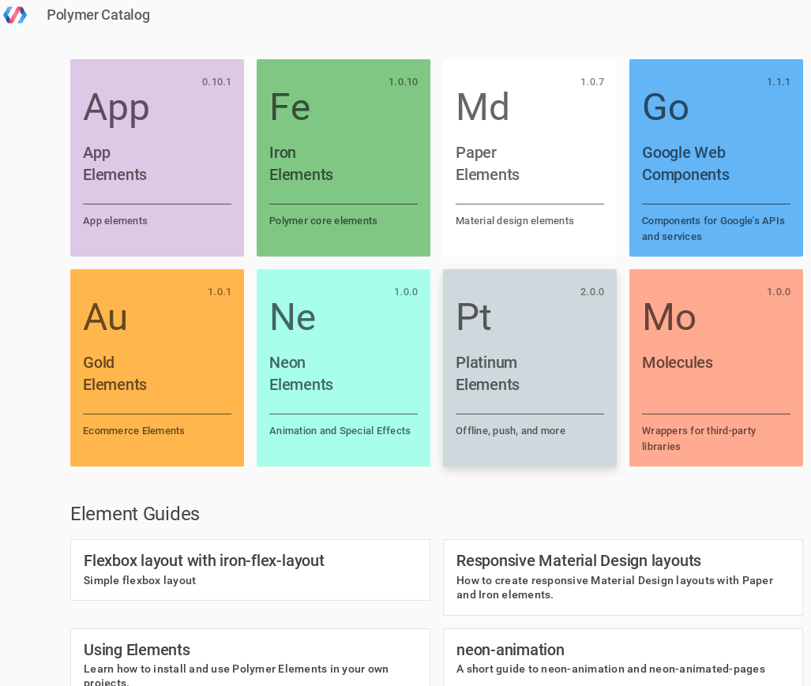
Polymer custom elements catalog

Slide 35
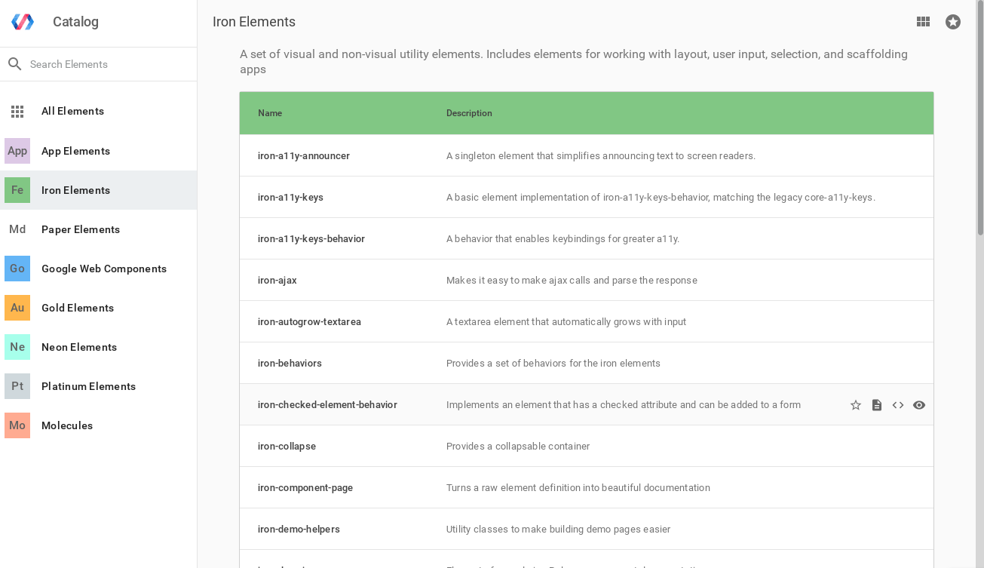
Polymer Core Elements : Fe (Iron)

Slide 36
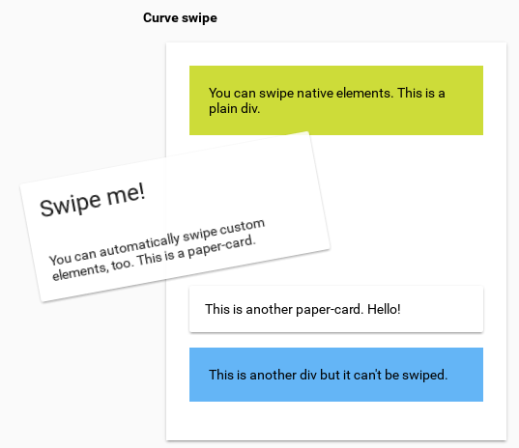
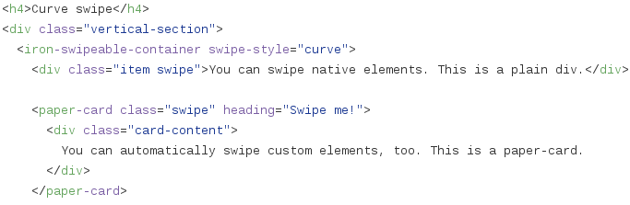
Iron example
<iron-swipeable-container>
https://github.com/PolymerElements/
Iron-swipeable-container/
blob/master/demo/index.html

Slide 37
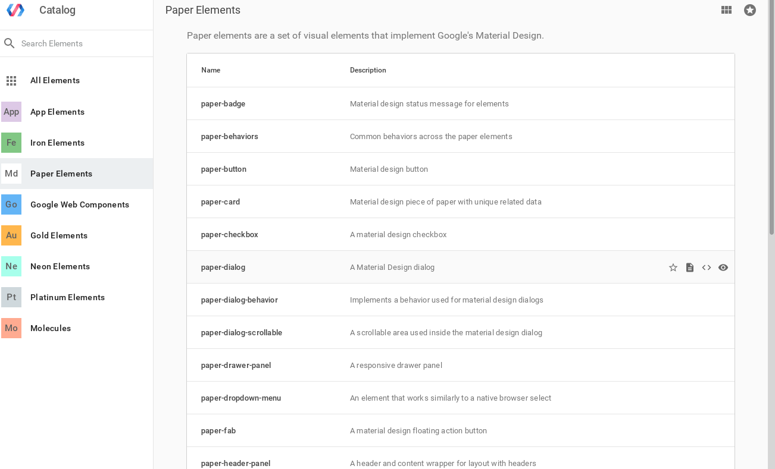
Material Design : Md (Paper)

Slide 38
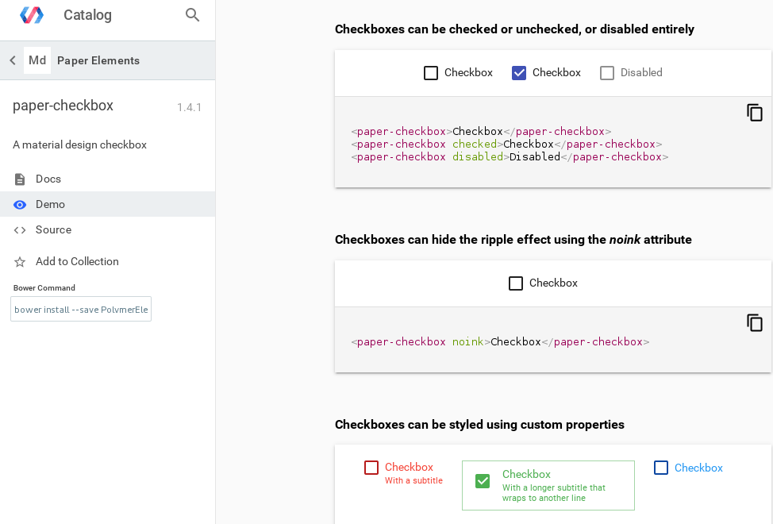
Md Paper Example

Slide 39
1/ HTML
2/ CSS
3/ JavaScript
2/ CSS ~ size,border,colors,fonts
contains Style

Slide 40
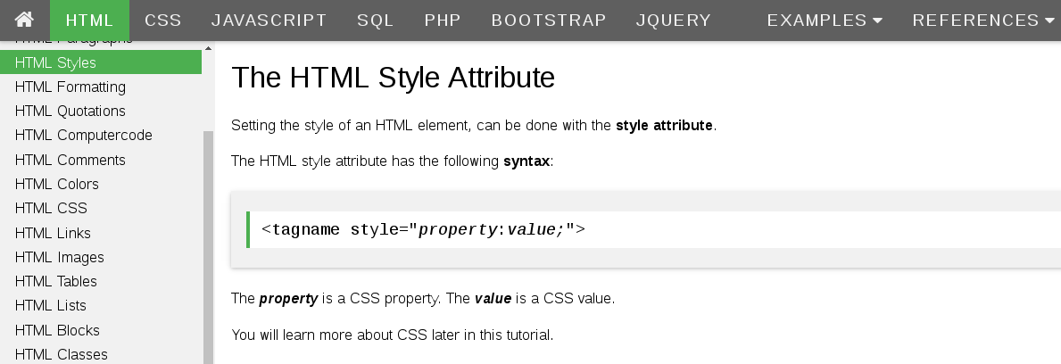
style=” …inlined CSS property:value;”

Slide 41
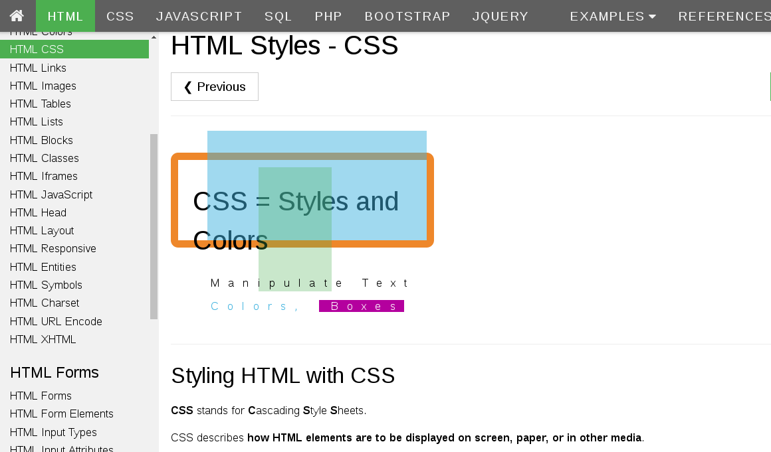
Styles … using CSS files

Slide 42
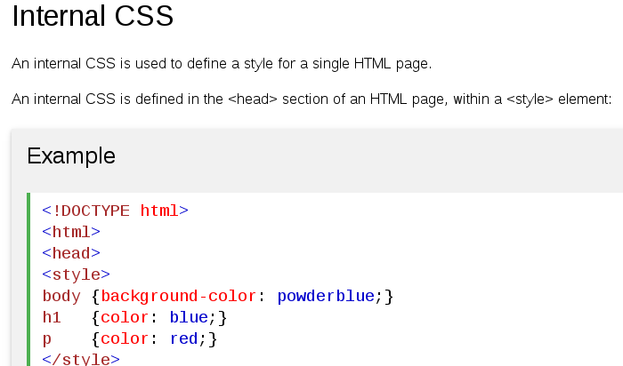
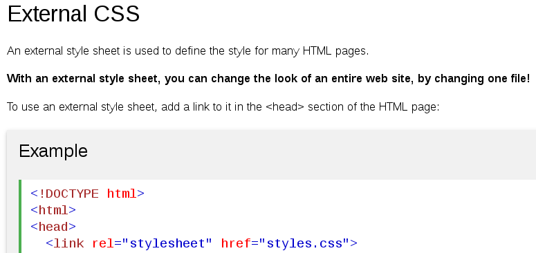
Internal / External CSS

Slide 43
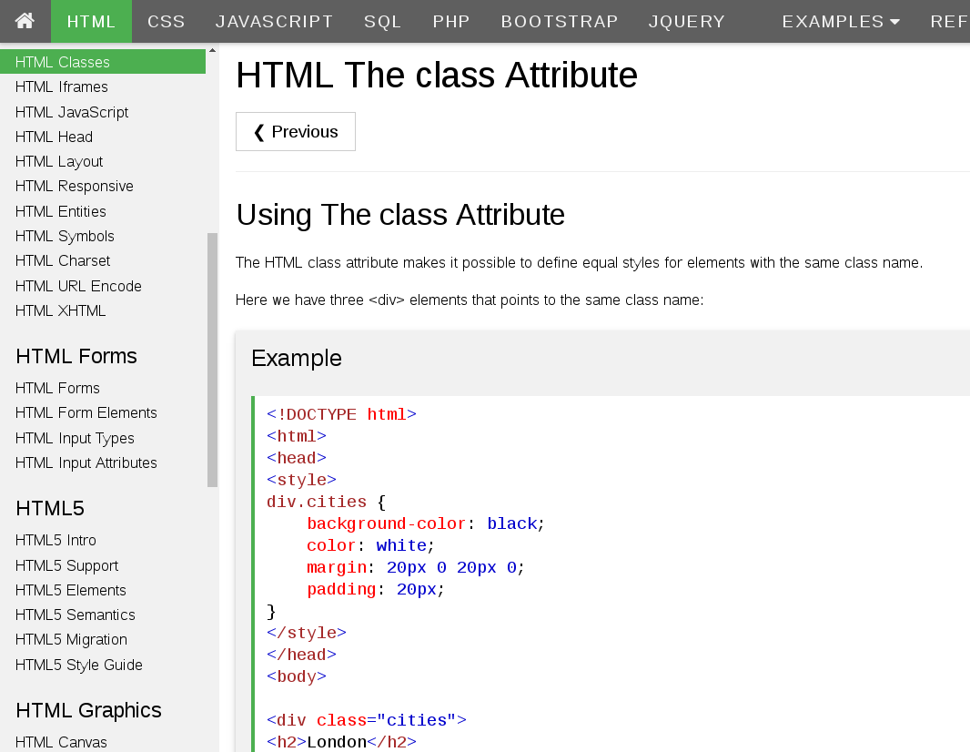
Style with < class=”..”>

Slide 44
1/ HTML
2/ CSS
3/ JavaScript
3/ Script
contains actions,events,behavior

Slide 45
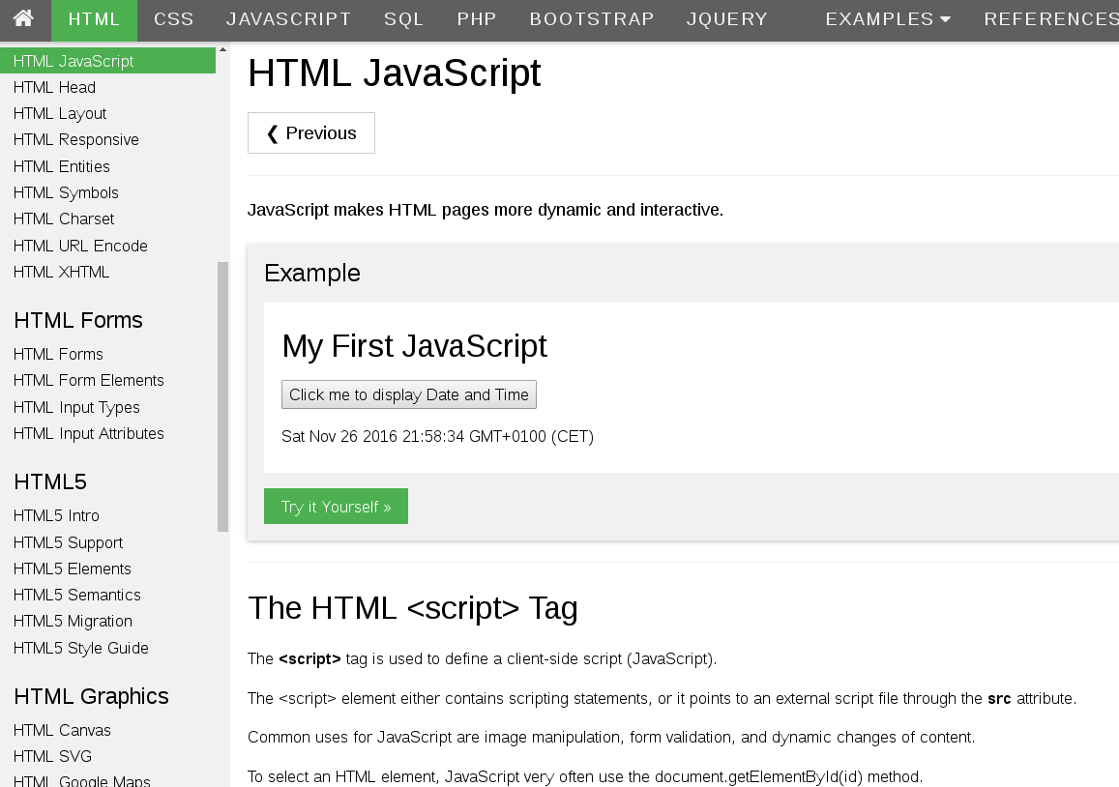
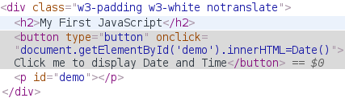

Slide 46
Html / CSS / JavaScript Interactions
New Add Remove Set
element/attr
(=DOM )
Affect
renderer
<style>..</style>
attr style=””
<link rel="stylesheet"
Link <script>
onDocumentLoad
onClick
onXX events
1/ HTML
2/ CSS
3/ JavaScript
Css update
Add/remove class attribute
(=DOM )

Slide 47
DOM = Document Object Model
Window
0..1
parent
Document
Node
(Abstract class)
0..*
childNodes
URL, ..
Element
Attribute
Text
Comment
0..*
attr
Body
<H1>
<div>
<fe-*>, <paper-*>,
Header
<p>
<span>
<your-custom-element>
<A href >

Slide 48
DOM = Class Hierarchy
public abstract class Node {
private Node parent;
..
public Node getParent() { .. }
}
public abstract class Element extends Node {
private List<Node> childList;
private List<Attribute> attributes;
..
}

Slide 49
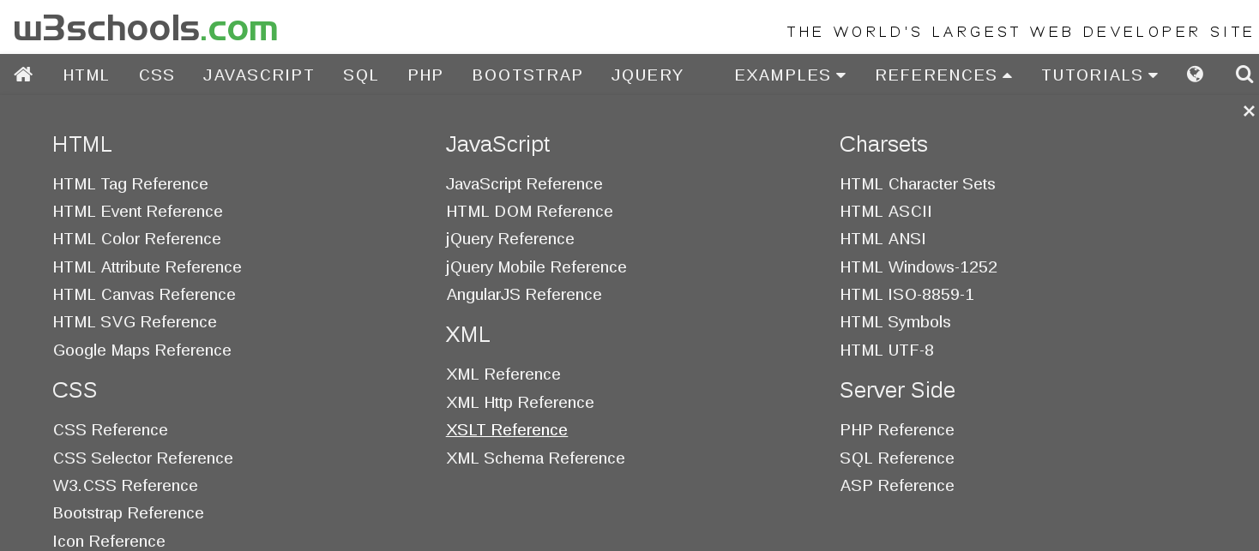
DOM Reference

Slide 50
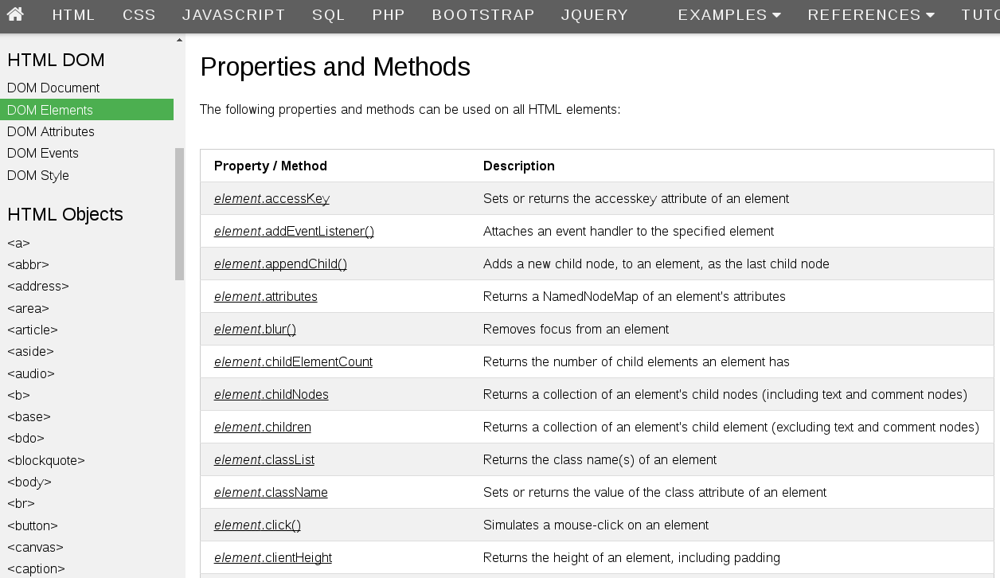
DOM Elements Properties,Method,Events

Slide 51
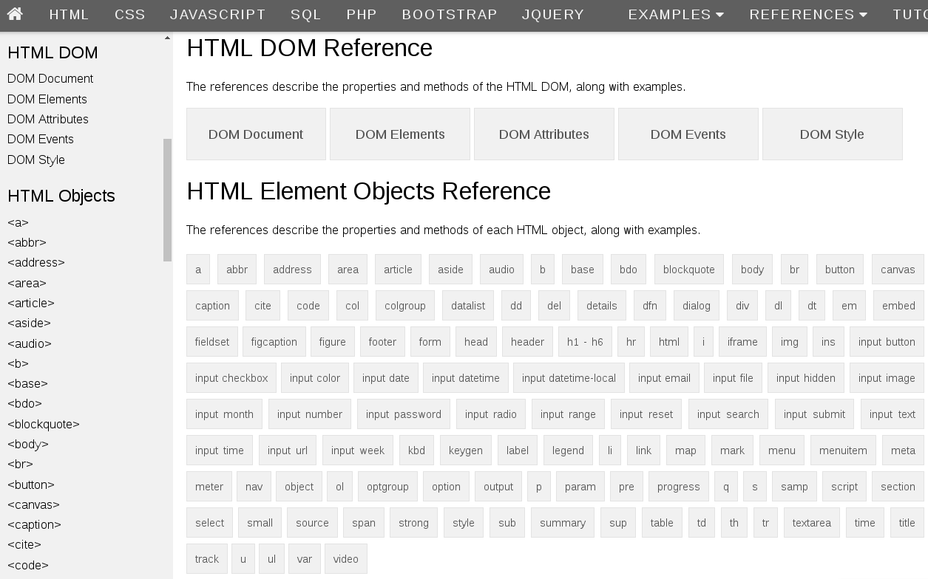
DOM Elements Reference

Slide 52
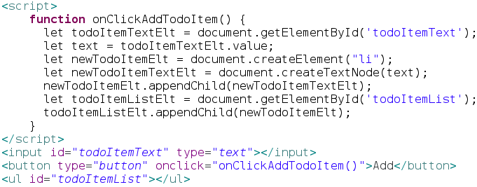
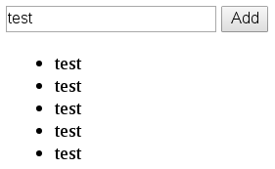
Typical JS Code to Find & Edit Elts
Find:
Document
.getElementById()
Create:
Document
.createElement(“li”)
.createTextNode()
...
Update:
element.appendChild()
value = element.attribute
element.attribute = value
Element.innerHTML
...

Slide 53
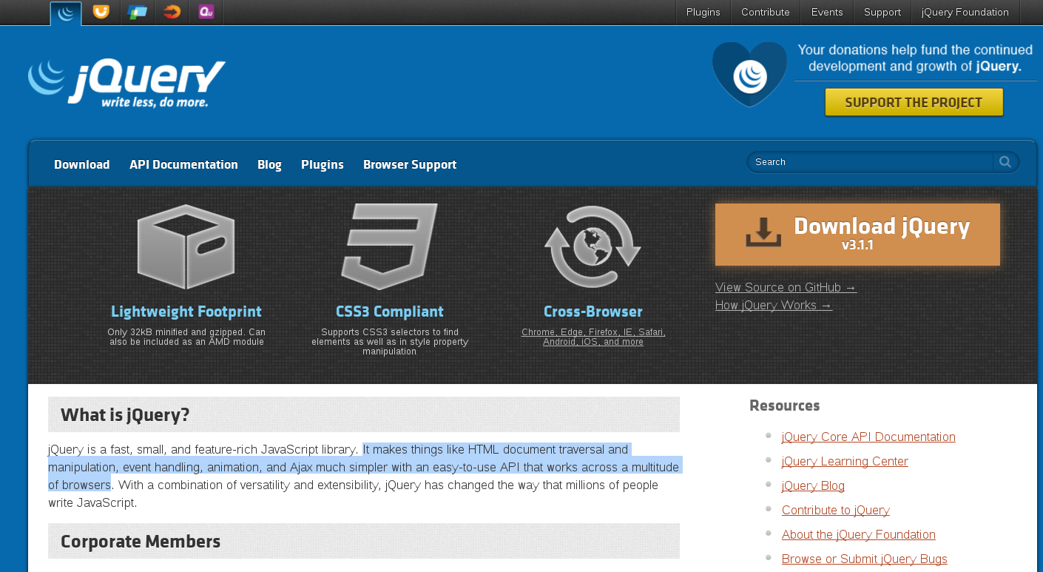
JQuery for Portable/Concise
DOM Manipulation?
Make DOM manipulation,event,...
“simpler” ...

Slide 54
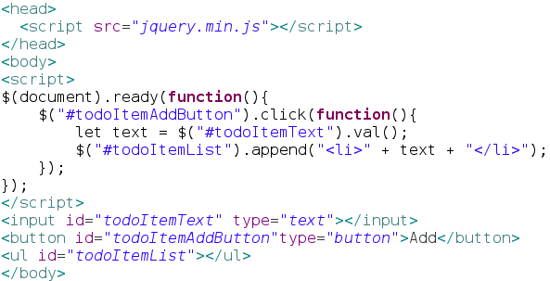
Same TodoItem example using JQuery

Slide 55
Jquery $() : wrapper for Document.getElementBy..(..)
Code is smaller ??
by including “<script src=”jquery.min.js”></script>
Well ... If you use only 1 method of Jquery...
You could have use “jqueryLight”
or even
function my$(id) {
return Document.getElementById(id);
}

Slide 56
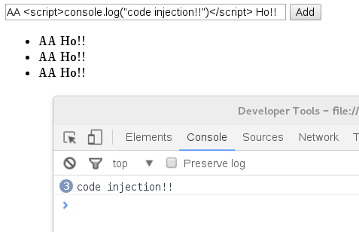
Jquery Risk… Script Code Injection!
Example in previous example :
append(“<li>” + text + “</li>”)
… text can contain html script!!

Slide 57
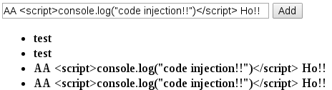
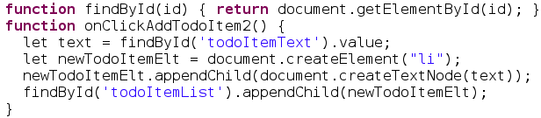
Jquery vs DOM
Naive retrial after google it
… same pb !!
This one works ...
Compare with Explicit DOM
+ findById

Slide 58
Jquery Bashing in 2016 ...
$() code not simple ! … not “typed”
JQuery is a very low-level framework
… for writing mostly imperative code
Or applying plugins
No easy bi-direction Binding
Better use Richer Framework, like AngularJS
Browser Portability no more an issue in 2016?

Slide 59
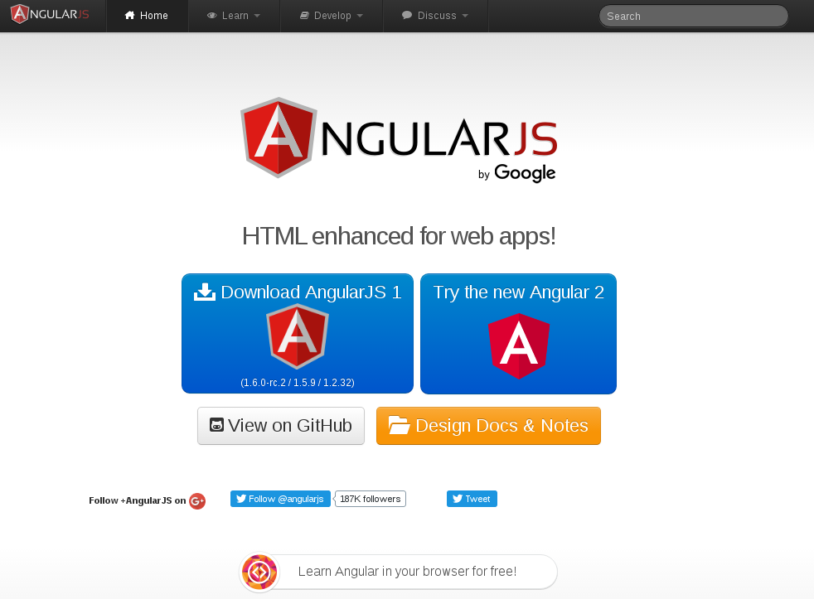

Slide 60
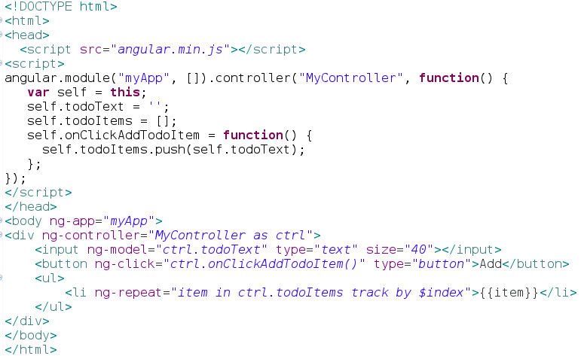
Same TodoItem example using AngularJS-1.x

Slide 61


DOM vs Jquery vs AngularJS
AngularJS code ~ 25 lines / jquery ~ 21 lines
AngularJS code much more readable
Imperative code
Direct DOM manipulation
NO Binding, Events
events history required
Declarative code
MVC : Model-View-Controller
Bi-Directionnal Binding
(no events required, only Model)

Slide 62
Much more to say on Angular
MVC Binding...
very handy writing quick web app
not very efficient having 1000 objects in scope
...digest() loop is horrible
Angular 2.x is complete rewrite of 1.x
...still not very clean code (digest zone?)
Model should be controlled.. and fire chg Event
ReactJs, Aurelia, ..
… JS Word = “1 fwk a day, the doctor away”?

Slide 63
Conclusion
This document: http://arnaud-nauwynck.github.io/docs/Intro-Html-JS-DOM.pdf
Only a “very short” introduction to Html-Js-Dom
I Hope you feel
  “I Did not know all this before”
  “I am happy I have learned something”
  “I want to learn more”

