Slide 1
Introduction to Cryptography
arnaud.nauwynck@gmail.com

Slide 2
Communications
Point - to - Point
Broadcast
Destination
Address
Dual Channel Communication
...example for Request - Response

Slide 3
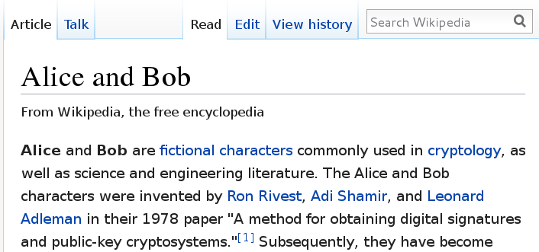
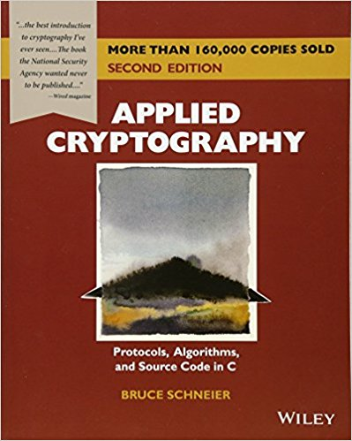
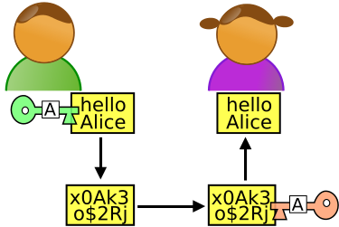
Who are Alice, Bob,
Eve, Malory, & Trent .. ?

Slide 4
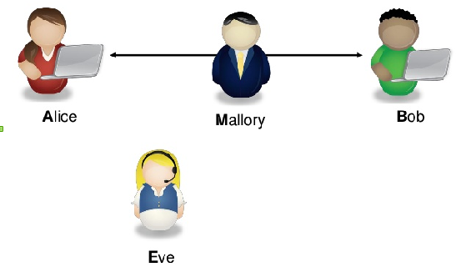
Eve (E=Environment … or Evil) and Malory (M=Malicious)
Mallory intercept + modify data
… Eve does't not

Slide 5



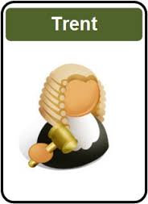
In Trent you (may) Trust

Slide 6

M = Malory = Malicious User
Man-In-The-Middle

Slide 7
Man-In-The-Middle Weapons
For Mallory only
Modification
Interruption
Fabrication
Replay
For Eve
& Mallory
Passive
Interception

Slide 8
A (Secured?) Chat
Allo Bob ? Alice speaking
Hi Alice
I have a secret to tell you
I will tell you only if ...
Ok, I will do/pay/.. it
Secret = bla bla

Slide 9
What's (Possibly) Wrong ?
Be Paranoiac !!
By Default, Everything is wrong
Proofs next ...

Slide 10
Possibly Wrong
Authentication
Data Leak
Authentication
Confidentiality
Data Replay
Integrity
Predicatable guess
Authorisation
...
Password Crack

Slide 11
Authentication (Receiver)
Allo Bob ? Alice speaking
Hi Alice
(imitating Bob's voice)
Oh.. Where is my phone?

Slide 12
Authentication (Sender)
Allo Bob ? Alice speaking
(imitating Bob's voice)
Hi Alice
Oh.. Where is my phone?

Slide 13
… Social Engineering
Allo Bob ? I am a friend of Alice
She asked me to tell you..
Hi
Sure, go ahead
Bob is so naive

Slide 14
Authentication denied
Allo Bob ? Alice speaking
Your voice is strange
I don't recognize Alice's voice
Bye

Slide 15
Basic Authentication
Allo Bob ?
Alice speaking
proof I am Alice:
my password is ..
Hi Alice
(imitating Bob's voice)
Your password is OK
Allo Bob ?
Alice speaking
proof I am Alice:
my password is ..
Hi Alice
Your password is OK

Slide 16
Password Challenge
Allo Bob ?
Alice speaking
Really ?
Proove me your identity
I don't give my password
I can give you only a clue
you can check with Trent
OK, Send me you pass hashed by “X”
( .. Compute Y=hash(P,X) )
It is “Y”
Is it True that ?
“Y” ?= Alice pass hashed by “X”
OK Alice

Slide 17
Trusted Thirdparty...
Allo Bob ?
Alice speaking
Really ?
Proove me your identity
Please Attest I am Alice
(here is my password)
I (“Trent”) certify this token paper
was delivered to Alice on jun 2017:
XADS4FSQ3RTXF
Bob: Ask “Trent” … he prooved my identity by token XADS4FSQ3RTXF
Is it true this token was given to Alice:
XADS4FSQ3RTXF ?
OK Alice
Yes (And Alice did not complain yet being stolen)

Slide 18

Problems With Thirdparties...
Hi ! Are you Trent ?
Are You Alice?

Slide 19
Physical Hand-Shake
... Exchange Shared Key
Bob, here is a secret “key” for talking to you in 6 monthes
Hi Bob
Let us use our private shared key
(remember I gave you last 6 monthes)
..
** Switch Encrypted **
SDFG23456RGQEST43

Slide 20
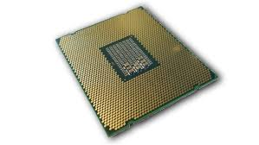
“Key” recomputed from Data ...
Encrypt using “Key”
Decrypt using “Key”
SFWXV
34TSQS
“Hi ...”
***
blabla
***
“Regards”
“Hi ...”
Test all possible “Key”
Knowing that message “SFWXV..”
matches “Hi*”

Slide 21
“Key” inversion from Predicatable Data
WARN : do NOT use TOO many data …
AND NO predicatable data …
otherwise “Key” could be recomputed by Eve...
Thow “Key” at end of communication
Famous during World War 2 :
Alan Turing decrypted German Submarine “Enigma” Messages
… partly because all messages ended with “Hi Hitler”

Slide 22
Encrypted … & Still Weak
Authentication
Data Leak
Authentication
Confidentiality
Data Replay
Integrity
Predicatable guess
Authorisation
...
Password Crack

Slide 23
(Partial) Data Leak
Example : Modulo - Hashes
Challenge response (1)
My password modulo 1000 is 4
Challenge response (2)
My password modulo 6421 is 2
Challenge response (3)
My password modulo 9482 is 7

Slide 24
Partial Data Leak
Padding – Delay...
Try password1..
Wrong password
(answer after 10ms)
Try password2..
Wrong password
(answer after 11ms)
Try password9..
Wrong password
(answer after 20ms)
Seems to finish by “9”
… it tooks more time to compute all

Slide 25
Encrypted … Data Replay
Encrypted credit card number: “XDFGZFG”
Encrypted credit card number:
“XDFGZFG”

Slide 26


Using Shared Key for
Exchanging TMP SessionKey ONLY
Hi Bob
Let us use our private shared key
(remember I gave you last 6 monthes)
.. ONLY TO EXCHANGE A NEW Random Key!
** Switch encrypted (shared key) **
( sessionKey=) SDFG23456RGQEST43
Generate
new Random Key
** Switch encrypted (new session key) **
( secret =) G2HA0QEG3HHF5SSG.....
Delete temporary session key

Slide 27
Fast Crypt using XOR
+ Session Key Random Generator
** Switch encrypted (shared key) **
( seed =) G2HA0QEG3HHF5SSG.....
Generate
new Seed Random Generator
( encrypt seed =) G2HA0QEG3
(seed) ….
(seed) ….
….. → 1 0 1 0
….. → 1 0 1 0
** Switch encrypted (XOR seed generator mode) **
...
Secret message blabla ….
Seed gen
Seed gen
..
0 1 0 1 1 1 0 1 1 ..
..
0 1 0 1 1 1 0 1 1 ..
1 0 1 0 0 1 0 1 0
1 0 1 0 0 1 0 1 0
Secret message blabla ….

Slide 28
Family of Cryptographic Functions
Problem Solving
Proof Of Work
One-Way (Irreversible)
Hashing
2-Way (Reversible)
Permutation
XOR
Hide/Extract
(Steganography)
Key Encrypt-Decrypt
Symmetric Key
Shared
Assymmetric Key
Public-Private
Randomization
Entropy
Generator
Pseudo Random
Generator

Slide 29
Family of Cryptographic Functions
Problem Solving
Proof Of Work
One-Way (Irreversible)
Hashing
2-Way (Reversible)
Permutation
XOR
Hide/Extract
(Steganography)
Key Encrypt-Decrypt
Symmetric Key
Shared
Assymmetric Key
Public-Private
Randomization
Entropy
Generator
Pseudo Random
Generator

Slide 30
XOR ...
VERY VERY Fast
Works Great with “Good” Pseudo Random Generators
Secret message blabla ….
Xor MASK
XOR MASK
0 1 0 1 1 1 0 1 1 ..
0 1 0 1 1 1 0 1 1 ..
1 0 1 0 0 1 0 1 0
1 0 1 0 0 1 0 1 0
Secret message blabla ….

Slide 31
Permutations
P: [1..N] → [1..N]
P is a permutation if it is inversible (all elts are reached once)
b1 b2 b3 … bN
P
bp(1) bp(2) bp(3) … bp(N)
-1
P
b1 b2 b3 … bN

Slide 32
Family of Cryptographic Functions
Problem Solving
Proof Of Work
One-Way (Irreversible)
Hashing
2-Way (Reversible)
Permutation
XOR
Hide/Extract
(Steganography)
Key Encrypt-Decrypt
Symmetric Key
Shared
Assymmetric Key
Public-Private
Randomization
Entropy
Generator
Pseudo Random
Generator

Slide 33
Combining XOR & Permutations
& Add
b1 b2 b3 … bN
Step 1
XOR Mask1
m1 m2 m3 … mN
b1 b2 b3 … bN
Step 2
Permut
P2
1Round
Step 3 :
Add Key
b1 b2 b3 … bN
b1 b2 b3 … bN
Key1 Key2 … keyK
Step 4 :
XOR Mask4
m1 m2 m3 … mP
b1 b2 b3 … bN bN+1 … bP
Step 5
Permut
P
Repeat N Rounds...

Slide 34
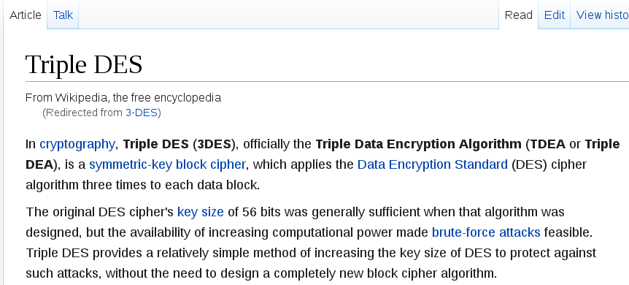
Example : AES, 3-DES, ...

Slide 35
Family of Cryptographic Functions
Problem Solving
Proof Of Work
One-Way (Irreversible)
Hashing
2-Way (Reversible)
Permutation
XOR
Hide/Extract
(Steganography)
Key Encrypt-Decrypt
Symmetric Key
Shared
Assymmetric Key
Public-Private
Randomization
Entropy
Generator
Pseudo Random
Generator

Slide 36
Assymetric Keys
Private
Public
Only “Priv” can encode
Everybody can decode (= check Signature)
Private
Public
msg
encrypted
msg
Every body can encode
Only “Priv”
can decode
Public
Private
msg
encrypted
msg

Slide 37
Public Keys – Private Keys...
Public
msg
transformed
Private
Keys define 2 operations : inverse of each others
Like +X → -X
*X → /X
^N →sqrt^N

Slide 38
But Deducing Keys
MUST Be Impossible/Difficult
Public
msg
transformed
Deducing Private Key
From Public Key
MUST Be Impossible
Private

Slide 39
Combining 2 Pairs of Pub-Priv Keys
PrivA
PrivB
PubA
PubB
Exchange Public Keys
PubA
PubB
Inverse
Inverse
PrivA
PubB
msg
intermediate
encrypted
PrivB
PubA
encrypted
intermediate
msg
Every body can encode
Only “Priv” can decode

Slide 40
Assymetric Keys For Secured
2-Way Channel
Only Alice can encode
Only Bob
can decode
Secure channel Alice to Bob
PrivA
PubB
msg
intermediate
Encrypted msg
Only Alice can decode
Only Bob
can encode
Secure channel Bob to Alice
PubA
PrivB
Encrypted resp
Int. resp
resp

Slide 41
Man In The Middle...
PrivE1
PrivE2
PrivA
PrivB
PubA
PubE1
PubE2
PubB
PubE1
PubE2
Interception of Pub Key Exchange … Alice<-> Bob
Alice trust “PubE1”
Bob trust “PubE2”
Instead of PubB
Instead of PubA
PrivE1
PubA
Re-encode
as-of “Bob”
PubE2
PrivB
Decode
as-of “Alice”

Slide 42
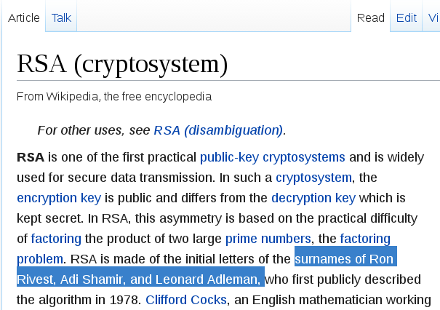
RSA : Rivest Shamir Adleman

Slide 43
Basic Math: Modulo definition
Remember Euclidian Division
Let N a number > 0
Every number divided by N
has a quotient and a remainder – also called modulo
x / n : for all x => there exist(uniq) q & r with 0<=r<n
x = q n + r
Modulo N function: x → x mod[n] = r

Slide 44
Algebra Operation on Modulos
(x + y ) mod [n] = ( x mod [n] + y mod [n] ) mod[n]
(x * y ) mod [n] = ( x mod [n] * y mod [n] ) mod[n]
Reasonning on equivalence classes, for equivalence relation “R”: a R b <=> a-b mod[n]=0

Slide 45
Example on modulo 9
Doing modulo 9 as a 9-year old boy at school
… sum digits to check operations
This works because 10 mod[9]=1 .. 100 mod[9]=1, 1000 mod[9]=1
so whatever X written in decimal format:

Slide 46
When p is prime
Z/pZ* is a multiplicative Group
Remember Group definition ?
G = { g0, g1, ...gN } a Set of elements
with an operation “.” (inside G)
Is a “group over .”
If it exists a neutral element “e”
every element has an inverse:
( b is unique and is the inverse of a : )

Slide 47
Example
Neutral
element
Inverse
of each others
Self Inverse

Slide 48
Consecutive Powers … (=Orbits)
Is inside finite set..
so is cyclic ...
let k2 index be the first repetition of already seen k1 elt:
Taking inverse
Proof next... that k2-k2=p-1

Slide 49
Orbits are all similar... all equals
whatever a, the orbit contains e... so orbits contains
For 2 elements a & b … orbits of a and b are identical, “scaled”
By a factor
b
So For any orbit, card Orbit = cst
If they are N orbits, they all cover the set
a
If p is a prime number … (sub-orbit N can not divide P prime)
… There is only 1 orbit, containing ALL elements !

Slide 50
Example
Start for example with a = 3
Compute a, a² ...

Slide 51
“Small Theorem” of Fermat

Slide 52
Relationship with Crypto? ...
For p1,p2 2 prime numbers...
encrypt
decrypt
Intuitively … Try decompose p1.p2 as a different product
of 2 key parts “e.d mod[..]” … but not as p1.p2 (too easy) !

Slide 53
RSA ...
Technically.. solve e and d...
Then
And also

Slide 54
Inverting Key
.. need Decomposing N in p1.p2
Choose 2 HUGE primes p1,p2
Multiply N=p1.p2
… give N to someone
and reward 1M$ IF he finds back p1 & p2

Slide 55
Naive Search...
Given N
Try decompose :
for ( BigInteger i = N; ; i = i-2 ) {
if (divides(i, N)) {
p1 = i; break;
}
}

Slide 56
How HUGE is HUGE enough?
1024
Example: choose p1 > 2
=2.2.2. …. (1024 times)
~ 1000 . 1000 …. (1014 times)
~ 1 000 000 000 … (3000 zeros)
In Theory : Decomposition Program finishes
In Practise :
- More than Atoms in Universe
- Slow... 1CPU => 1000...00000 centuries
- Energy : 1000...000 CPUS => requires more power
than 1000...000 solars

Slide 57
Possible to Find so HUGE Primes?
In Theory : infinite numbers of Primes
Storing all primes from [0, 2^1024] ??
... is even harder than counting them
Primes become rare : Count primes in [0, N] ~ log N
There always exist a prime in [k, 2k]

Slide 58
Find One Random (!) Huge Prime
Efficiently (?)
Given start = random number > 2^N-1 … with N~1024
for ( BigInteger i = start; ; i = i+2 ) {
if (isPrime(i)) {
p = i; break;
}
}

Slide 59
Need Efficient Primality Test
Choose any a, for example a=27
Compute
If != 1
p is NOT prime
If == 1
Probability 1/p that p is anyway not prime
Reapeat for b=43
Confirm .. or proba 1/p^2

Slide 60
Efficient Compute Powers..
Write in basis-2 (binary representation)
Then
square
square

Slide 61
Efficient (Enough?) Powers Compute
1024
P ~ 2
N=log2(p)=1024
Computable in o(2.N multiplications)
BUT Would be a HUGE number …
Computable in
o(2.N multiplications + 1.N modulo)
… quite FAST, with small memory need

Slide 62
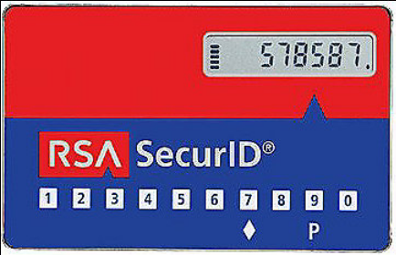

Not Efficient Enough For Video & High Traffic Network !!!
But OK for small DATA
~ 1ms on a CPU
Embeddable in RDA SecurID card ship
OK For Exchanging a Seed Pseudo Generator
… then using XOR encoding
Application : TLS protocol (ex SSL) , for example in

Slide 63
Family of Cryptographic Functions
Problem Solving
Proof Of Work
One-Way (Irreversible)
Hashing
2-Way (Reversible)
Permutation
XOR
Hide/Extract
(Steganography)
Key Encrypt-Decrypt
Symmetric Key
Shared
Assymmetric Key
Public-Private
Randomization
Entropy
Generator
Pseudo Random
Generator

Slide 64
Fast Pseudo-Random Generators
Back to Math : Doing Polynomials
… Polynomials over Z/2Z modulos, truncated to Rank N
… we are interrested not in X … put in P (in coefficients)
algebra of P : P1, P2, … P1.P2, P1+P2

Slide 65
Consecutive Powers of P
Consecutive (truncated) powers of P :
If “P” is chosen irreductible in Z/2Z[n]
… then orbit contains all polynoms!
(all coefficients of all polynoms)
Suppose N = 64 … then
.. a Pseudo-Random
generator HUGE cycle

Slide 66
Multiply (and Truncate) Polynoms

Slide 67
Efficient for P=1+X using Bit Shift, Bit And..
+
Bit Shift

Slide 68
Family of Cryptographic Functions
Problem Solving
Proof Of Work
One-Way (Irreversible)
Hashing
2-Way (Reversible)
Permutation
XOR
Hide/Extract
(Steganography)
Key Encrypt-Decrypt
Symmetric Key
Shared
Assymmetric Key
Public-Private
Randomization
Entropy
Generator
Pseudo Random
Generator

Slide 69

Hashing ...
Hashing is One-Way transformation
Hashing different product usually give different result
!=
!=

Slide 70
Hashing … must be equi-distributed minimise “Collisions”
A Hashing Collision
!=
==
Of course if can happen … example in java:
“public int hashCode()”
by default Object.hashCode = System.identityHashCode(x)
= … 64bits pointer (when first hashed) → hashed to 32 bits
= ( hashPtr64 ^ (hashPtr64 >>>32))

Slide 71
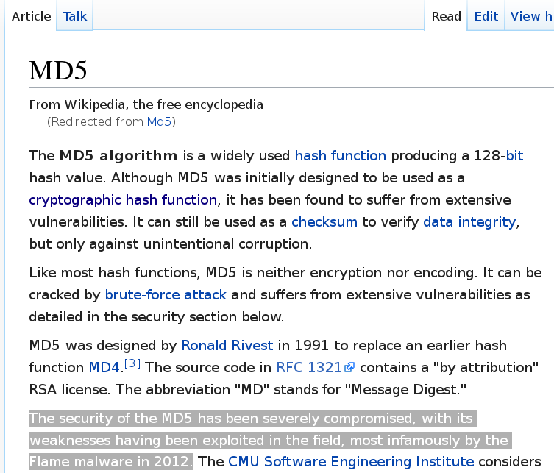
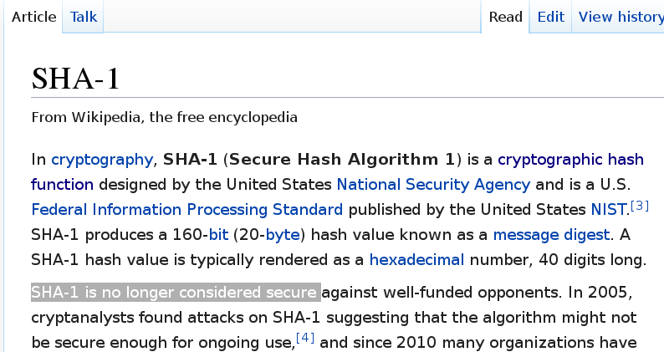
Hashing : MD5, SHA-1, SHA-256, SHA-512 ..

Slide 72
Hashing For Storing “Passwords”
Create Login Account
Hash
A password
Extra SALT
pass Hash
Check Password
Hash Again
Same HASH ?
(assume pass OK)
A password
Extra SALT
pass Hash

Slide 73
Hashing : Good for Signing
Hash to (example) 512 bits
A message to sign ….
Msg Hash
Private
A message to sign ….
encrypted(msg Hash)
Signed Message : clear text + extra signature (at bottom of page)
Check that a message signature is VALID :
Public
1: recompute Hash
2: decrypt signature
Msg Hash
Msg Hash
3: check equals

Slide 74

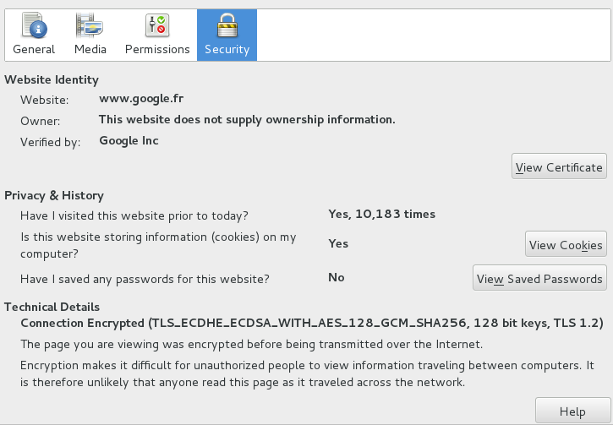
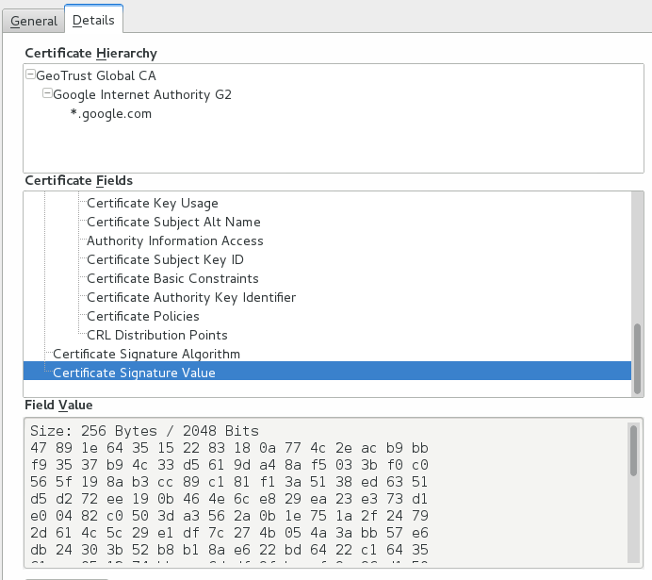
Certificates = Signed Public Keys
Certificate Public Key
Certificate Signature ...

Slide 75
Family of Cryptographic Functions
Problem Solving
Proof Of Work
One-Way (Irreversible)
Hashing
2-Way (Reversible)
Permutation
XOR
Hide/Extract
(Steganography)
Key Encrypt-Decrypt
Symmetric Key
Shared
Assymmetric Key
Public-Private
Randomization
Entropy
Generator
Pseudo Random
Generator

Slide 76
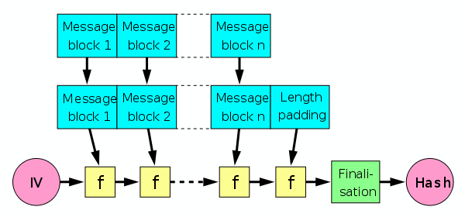
Hash a BitCoin Transactions Chain
BlockChain

Slide 77
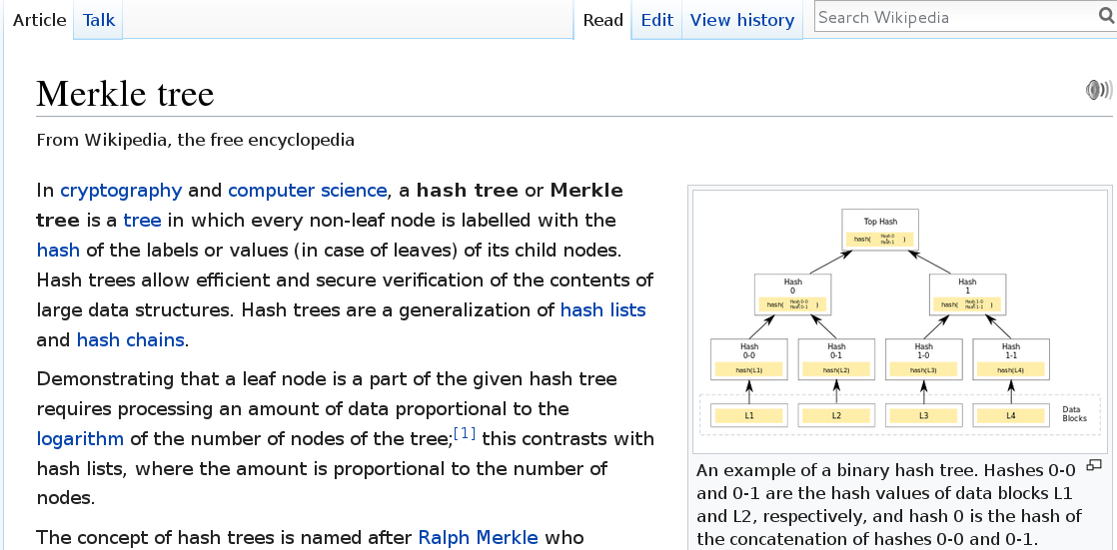
Merkle Tree

Slide 78
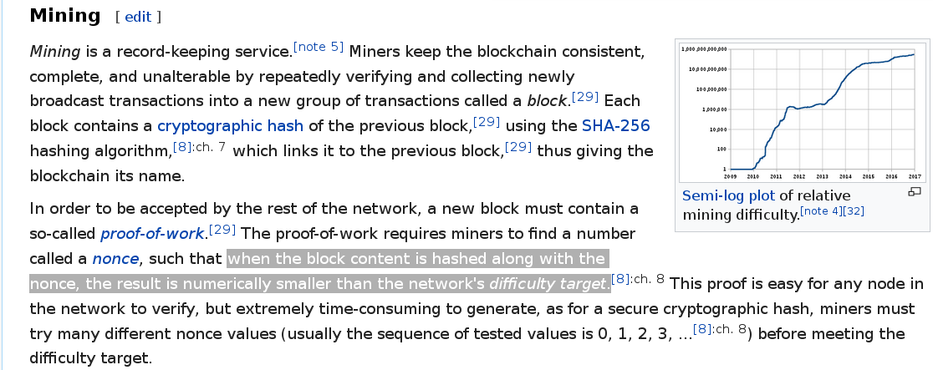
Proof Of Work, Mining

Slide 79
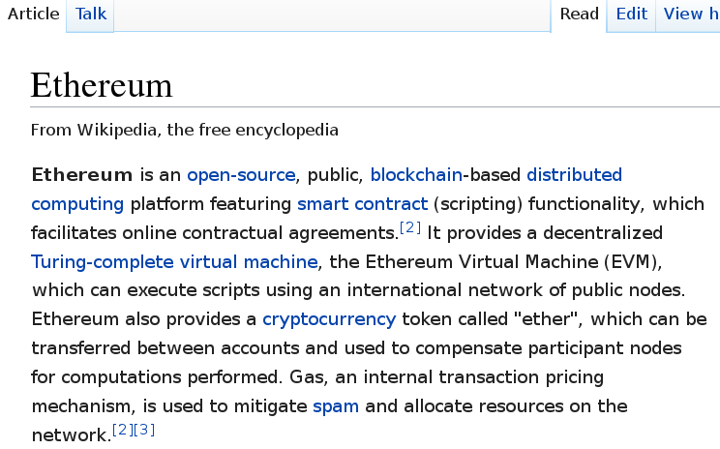
Other BlockChains
(for contracts, legal ownership, assurance, ..)

Slide 80
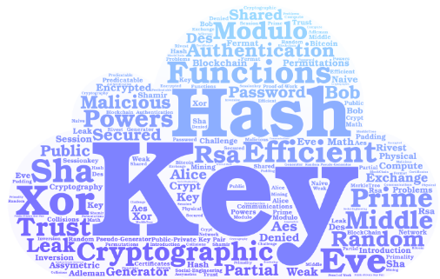
Conclusion

