Slide 1
Lesson – IUT Paris8 – march 2018
Short Introduction to Android
This document : https://arnaud.nauwynck.github.io/

Slide 2

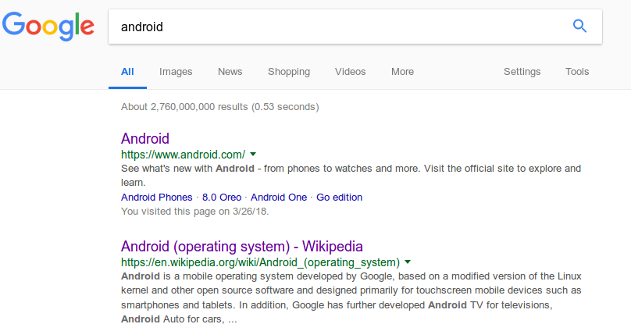
Android..

Slide 3
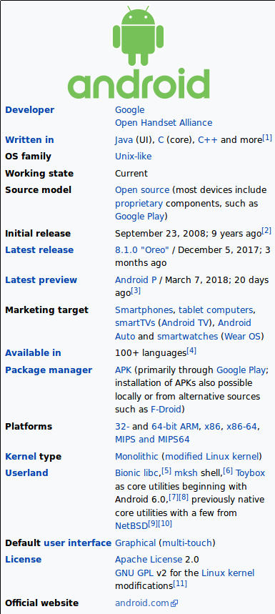

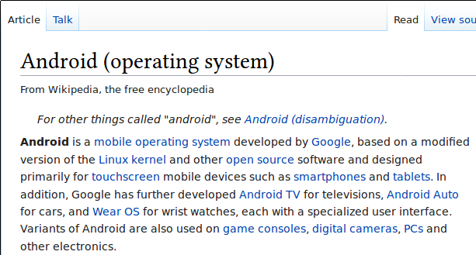

Slide 4
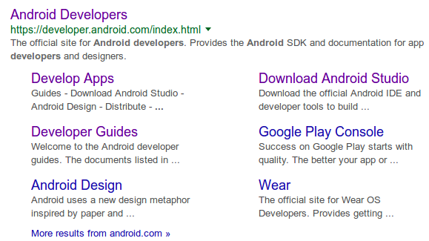
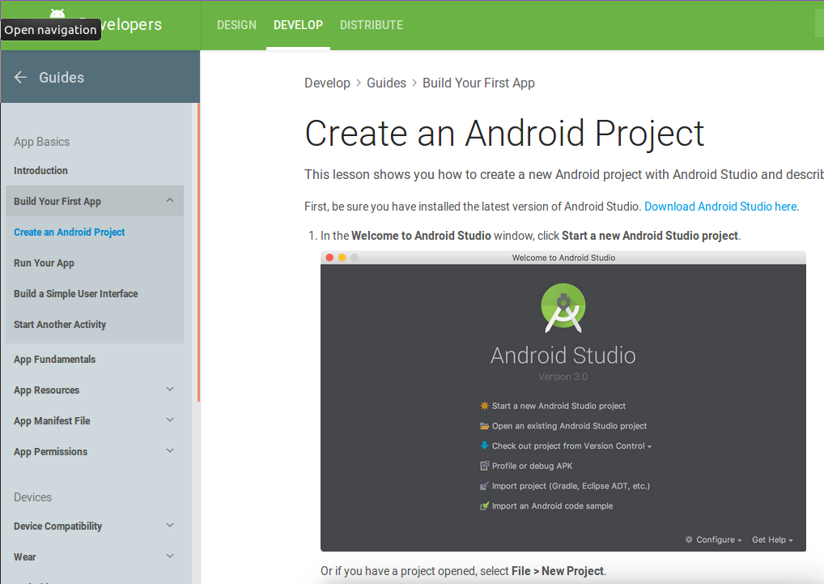
https://developer.android.com/

Slide 5
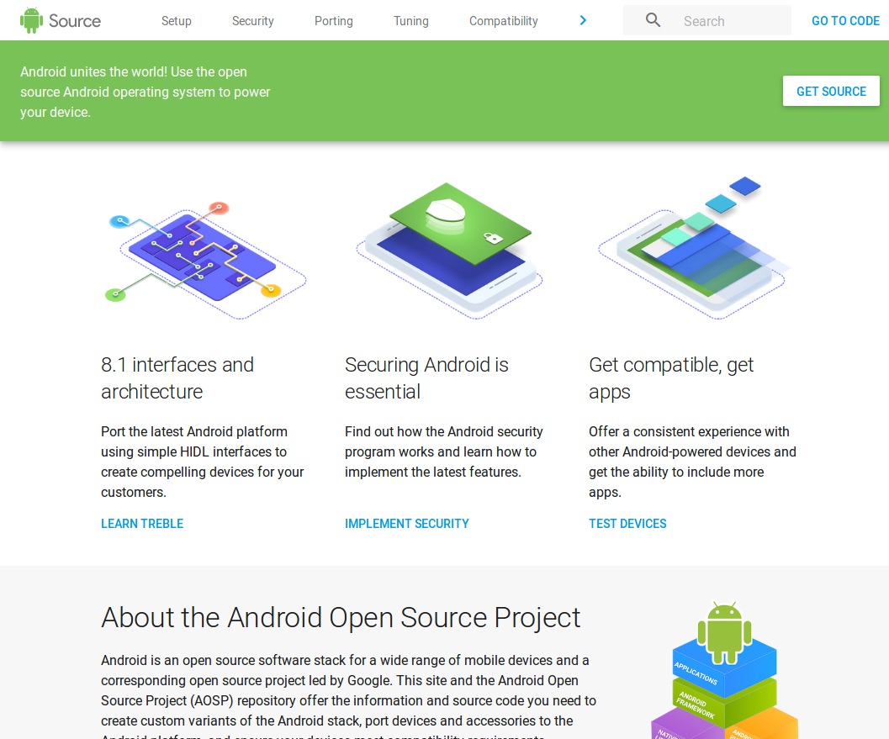
https://source.android.com

Slide 6
Training
https://developers.google.com/training/android/

Slide 7
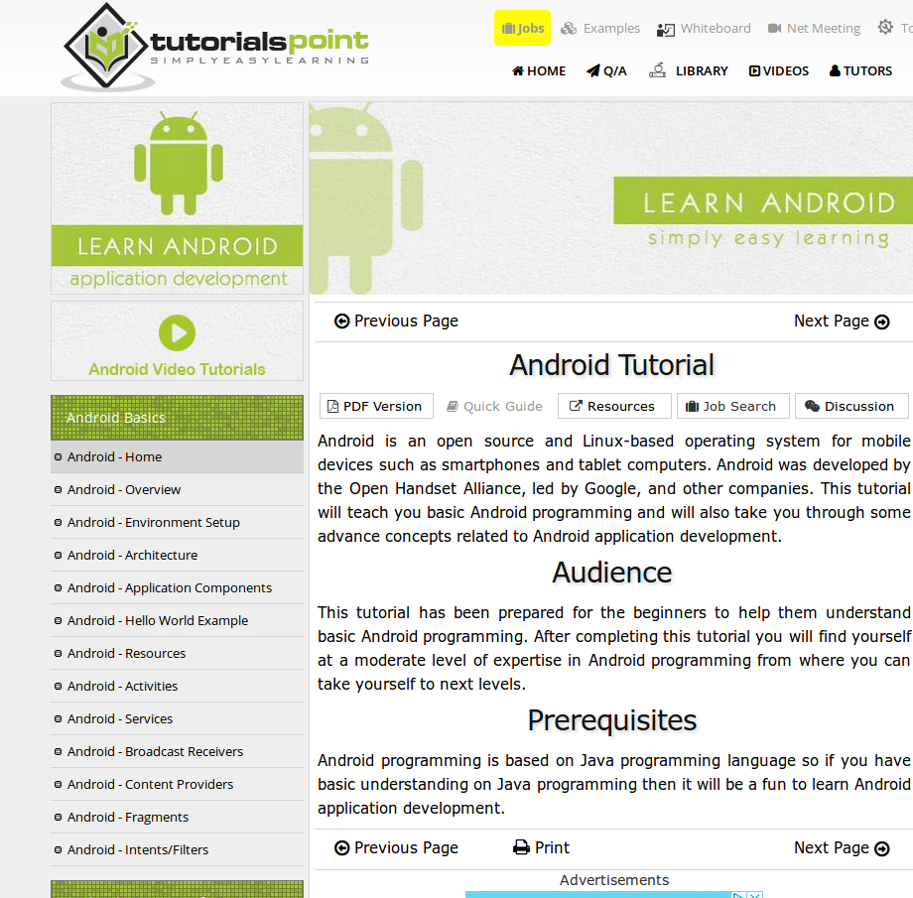
https://www.tutorialspoint.com/android

Slide 8
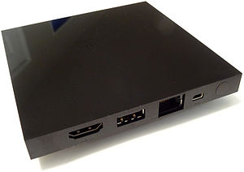


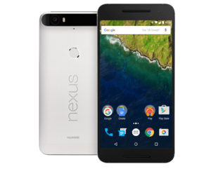
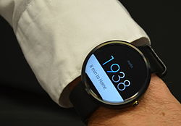

History
2003
Startup..
2003
Startup..
2005
bought by
Google
2010
Nexus
phone
2014
Android TV
Wear OS

Slide 9
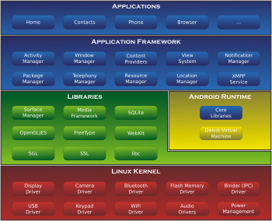
Architecture Overview

Slide 10
Core Concept 1 :

Slide 11

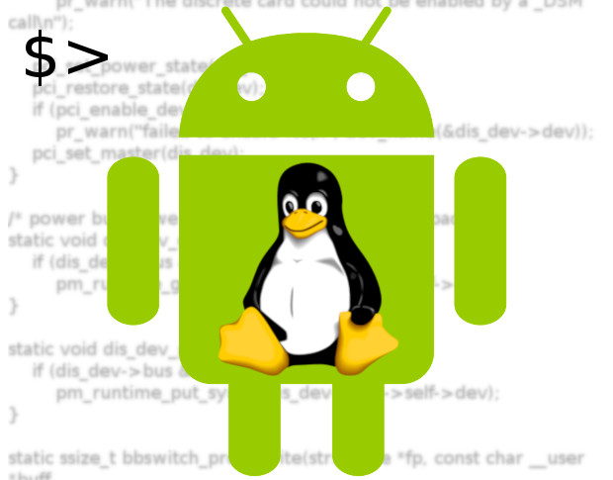
Linux

Slide 12

Base Linux Kernel Security
System User Account (uid/gid)
All app files are protected by unix chmod
All process run with current uid
Security Permission checked in System Calls
= standard kernel linux security
“Root” user 0 can do everything …
Only Android low-level services run as root

Slide 13
1 Running App = 1 Process
(Linux JVM)
Running JVM
Gracefull App Exit
or
Kill App
Start App

Slide 14
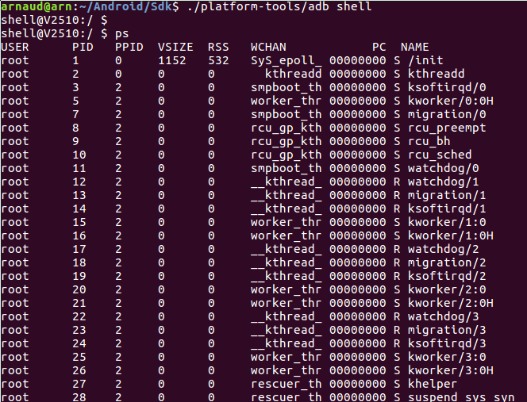
Adb Shell .. PS

Slide 15
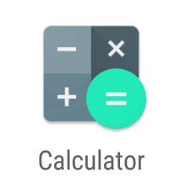
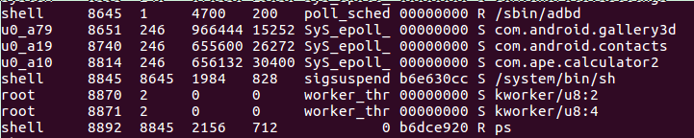
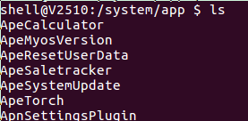
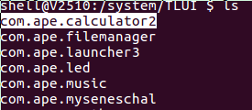
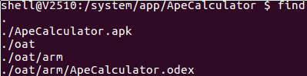
Sample User App (Calculator)
UID = u0_a10

Slide 16

1 Installed App = 1 UID
Install 1 App => create a new UID !!
Files owned by 1 App => files owned by UID
All Apps (Files) are ISOLATED
App1
App2
AppN
Files1
Files2
FilesN

Slide 17
No “Root” access
Apps are installed by “apk” / MarketStore
… similar to “sudo apt-get install ”
BUT
- forcing a new uid/gid for each app
- apps (files) are not owned to “root”
- no command “sudo”, no root acess
No apps can be root, only by jailbreaking your phone

Slide 18




Installing App = Accepting “Manifest” Permissions
Each App as a “Manifest” Permission required files
When You install = You accept permissions
App1
App2
AppN

Slide 19
Core Concept 2

Slide 20
Communications between Apps
Communication between Apps
= Using IPC Binder messages (service)
App1
App2
AppN
IPC Binder

Slide 21
Permissions + Communications between Apps
IPC Binder messages (service)
+ Permissions (Manifest file per App)
App1
App2
AppN
IPC Binder

Slide 22
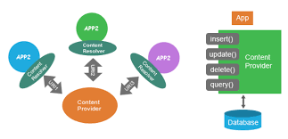
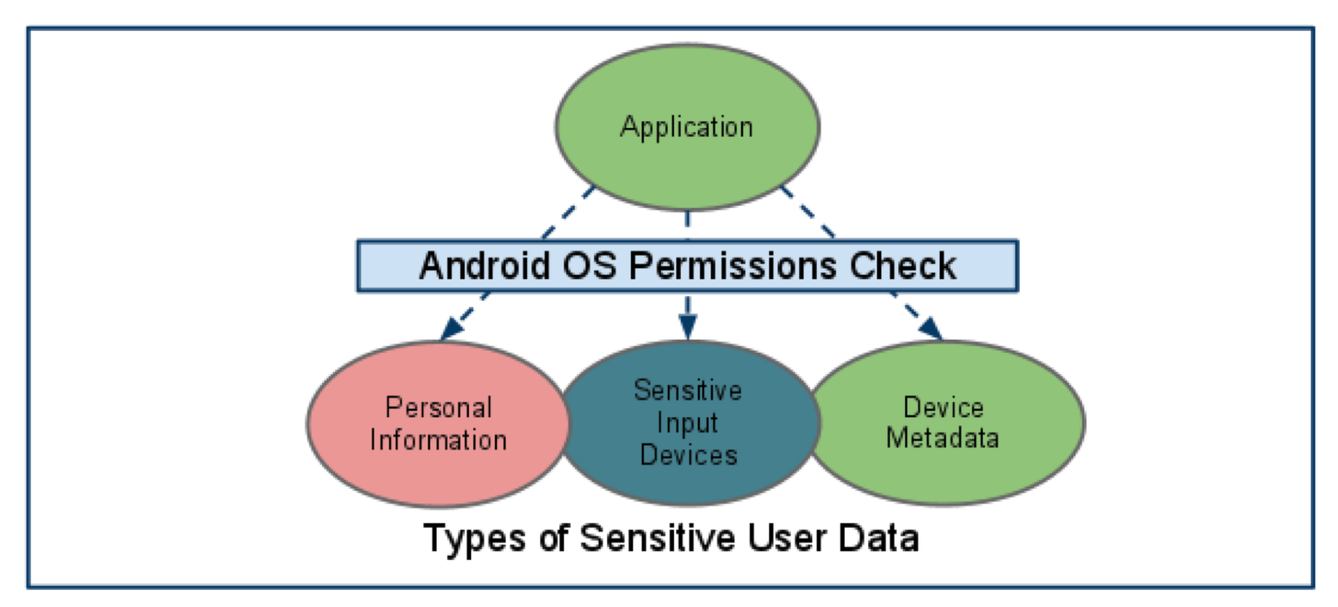
Apps Isolations / Data
Data Between Apps
System Data

Slide 23
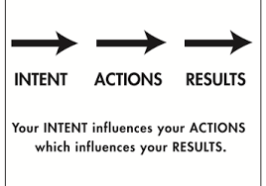
Core Concept 3 : Intent

Slide 24


Manifest – Intent Capabilities
App1
App2
AppN
Intent Filter => Action1
Intent Filter => Action2
(4) Result
(1) Intent
(2) Choose
(3) Result

Slide 25
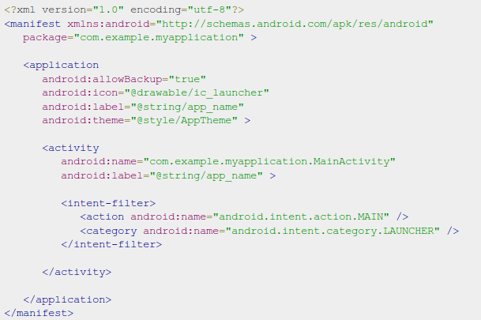
Manifest – Intent Filter

Slide 26
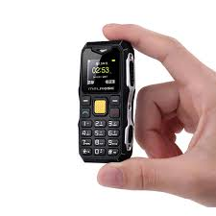
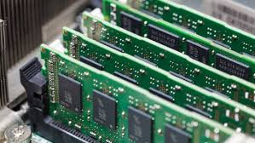
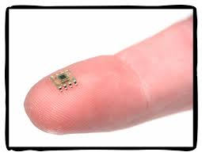
Core Concept 3 : RAM
Start / Kill / Resume App

Slide 27

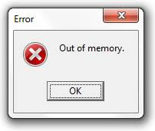
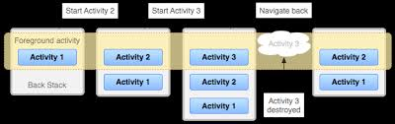
Multiple Activities – Small RAM ...

Slide 28
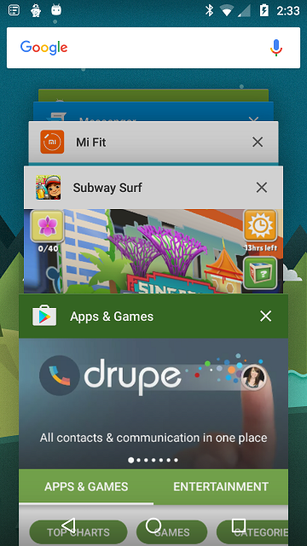

Activities Stack & Recent

Slide 29
Activities Stack
(Open Modal Dialog.. Return)
App3
App2
App2
App1
App1
App1
DB(3)
Open Activity2 For Result
example:
take photo
=> open “Photo” application
Open Activity3 For Result
example:
send.. select Contact
=> open “Contact” application
Data(3)
App2
Data(2)
App1
App1
Data(2)
Data(3)
DB(2)

Slide 30
Activity Memento
Run
… live data
Save Memento
Start App
Kill App
App1
App1
Resume...
(re)Start App
App1
App1

Slide 31
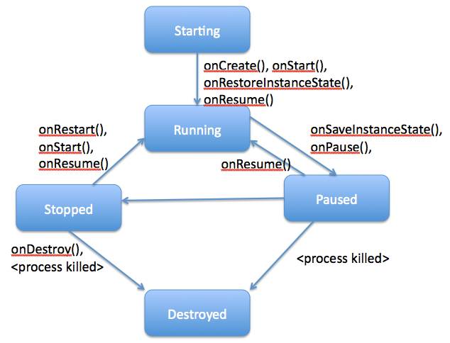
Activity State Diagram

Slide 32
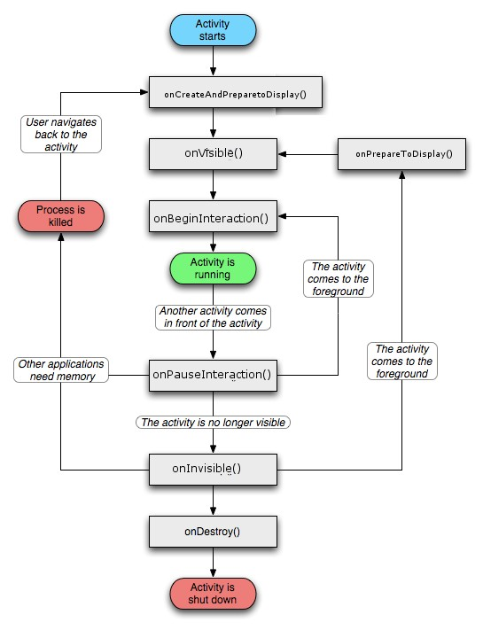
Visible Activity State Diagram ...

Slide 33
Fast JVM Start Time
Running JVM
Classical
Classical
Zigote JVM
(suspended)
Fork Linux Process
(FAST)
Android
Dalvik
Resume
Process
Load Class
+ call main()
Zigote JVM
(suspended)
Running JVM
Iphone
Cheating
Running Process
Display Screenshot

Slide 34
Core Concept : Framework / APIs

Slide 35
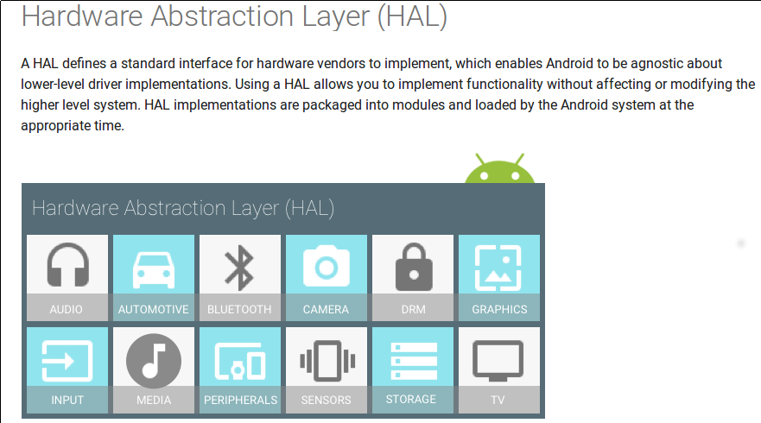
HAL = Hardware Abstraction Layer
https://source.android.com/devices/architecture/hal

Slide 36
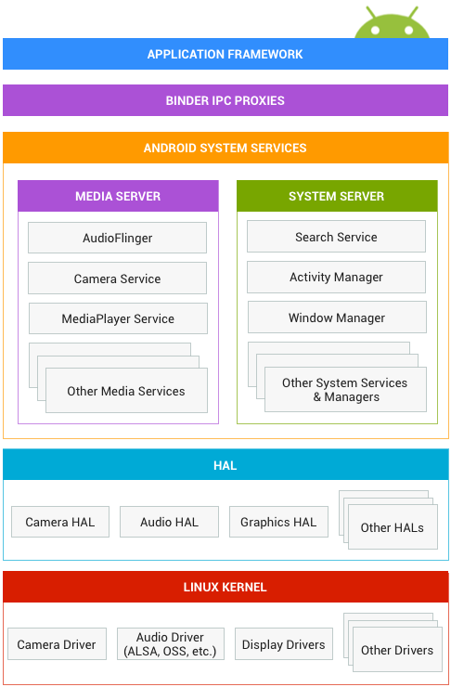
Kernel < HAL < API

Slide 37
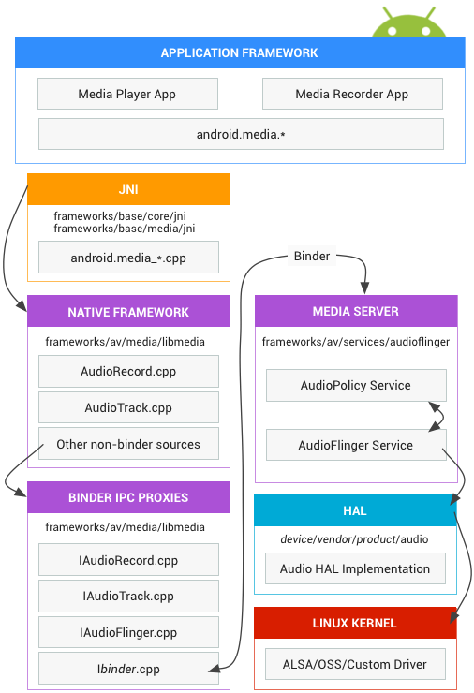
Example: Audio

Slide 38
Core Concept
API – Services

Slide 39
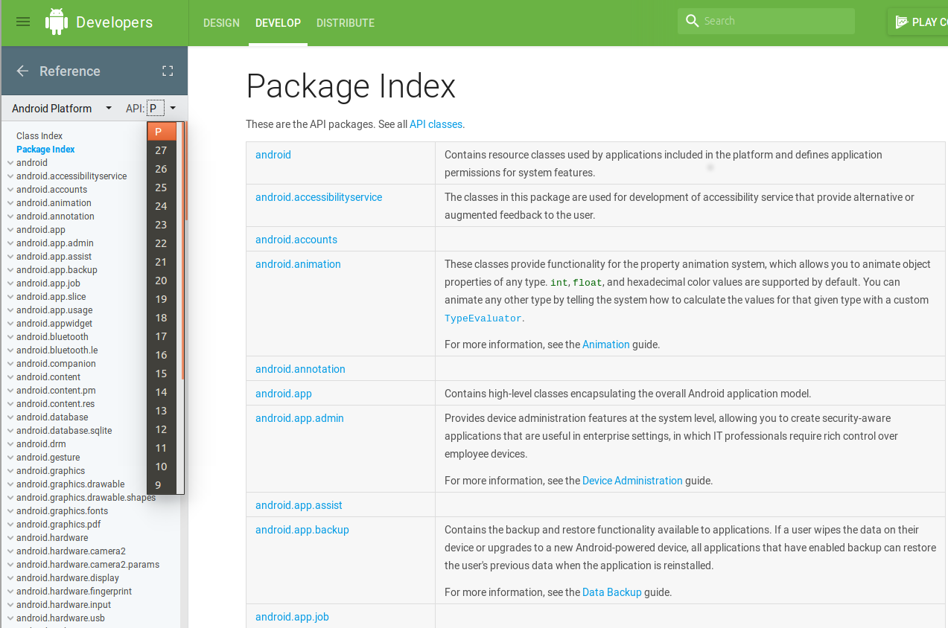
APIs … (current API level=27)
https://developer.android.com/reference/

Slide 40
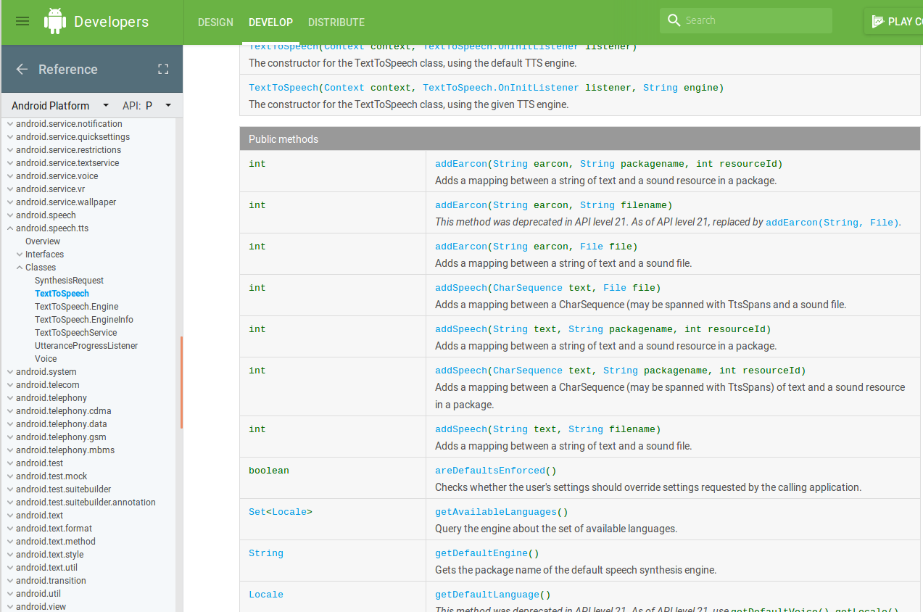
Example API : Text To Speech
https://developer.android.com/reference/android/speech/tts/TextToSpeech.html

Slide 41
Example TTS Code ..
TextToSpeech tts =
new TextToSpeech(getApplicationContext(),
new TextToSpeech.OnInitListener() {
@Override
public void onInit(int status) {
if(status != TextToSpeech.ERROR) {
t1.setLanguage(Locale.UK);
}
}
});
String toSpeak = “Hello Android”;
tts.speak(toSpeak, TextToSpeech.QUEUE_FLUSH, null);

Slide 42
Core Concept
Services / Job API – No Threads

Slide 43
Core Concept : UI
Resources
+ Layouts
+ Components
+ Fragments
+ ...

Slide 44

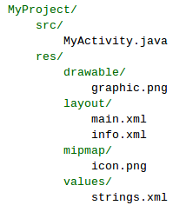
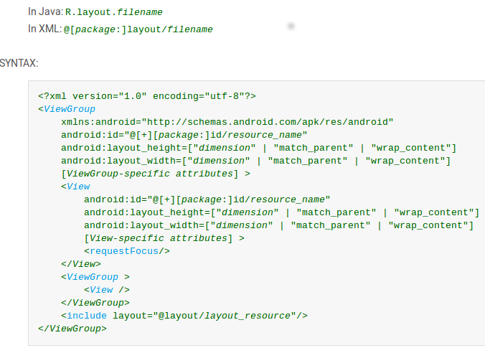
Defining UI Resources
Simple Resources
Layout Resources

Slide 45
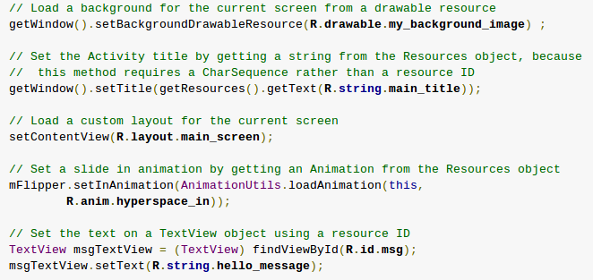
Using Resources in Java
[<package_name>.]R.<resource_type>.<resource_name>

Slide 46
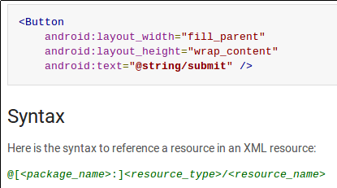
Using Resources in Xml

Slide 47
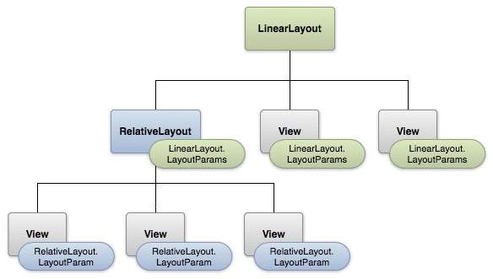
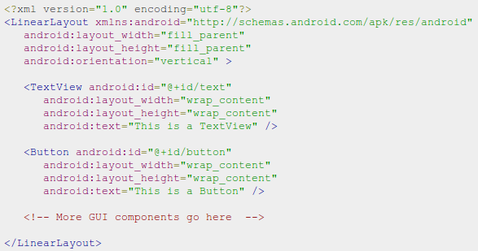
UI Layouts

Slide 48
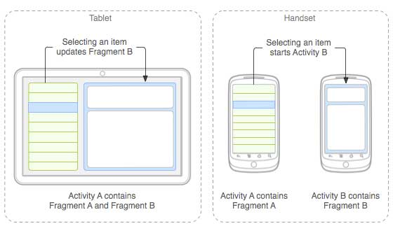
UI Fragments

Slide 49
Questions

