Slide 1
arnaud.nauwynck@gmail.com
This document: http://arnaud-nauwynck.github.io/docs/Intro-DB-Jdbc-JPA-SpringData.pdf
Introduction to Db - Jdbc - JPA - SpringData

Slide 2
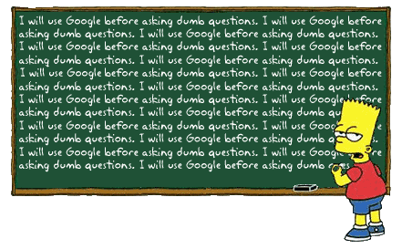
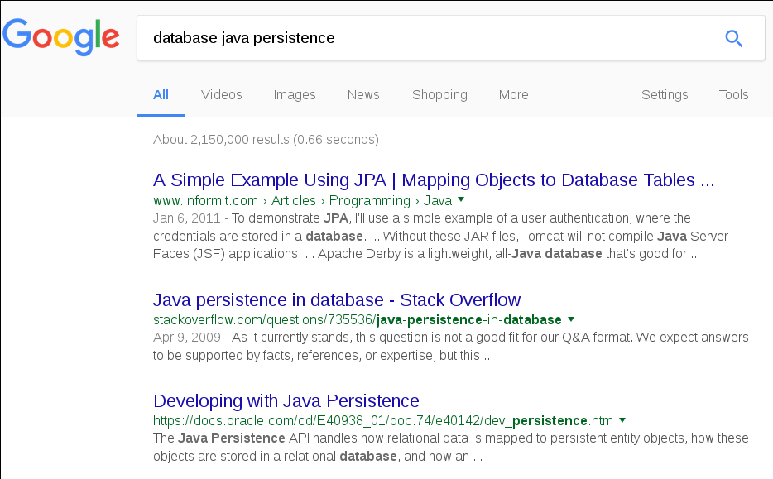

Slide 3




(4) < Spring Data
Spring JPA
QueryDsl
< JPA API - JPQL
(3) < Hibernate/EclipseLink
Spring JDBC
< JDBC API
(2) < Driver Impl.
SQL Client Driver
(1) < DataBase
< B-Tree File

Slide 4

Spring JPA
QueryDsl
Spring JDBC

Slide 5

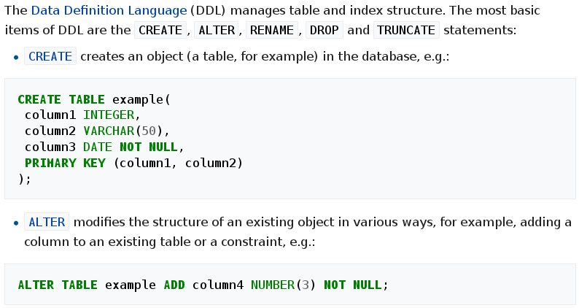
Structured Query Langage
SQL = DDL + DML

Slide 6
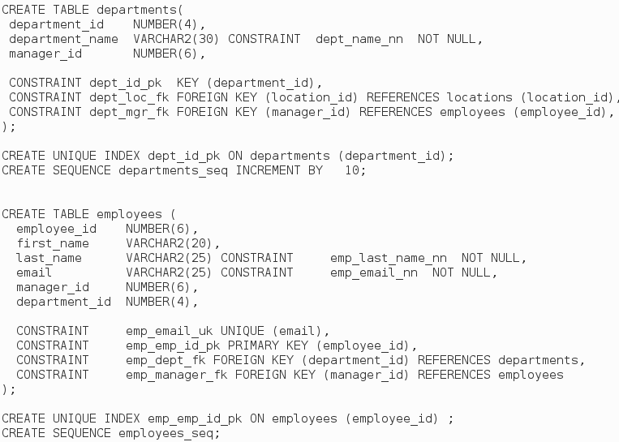
Oracle Sample DataBase https://github.com/oracle/db-sample-schemas/human_resources/hr_cre.sql

Slide 7
UML Employee - Department
* employees
0..1 dept
Employee
Department
0..1 deptManager
0..1 manager

Slide 8
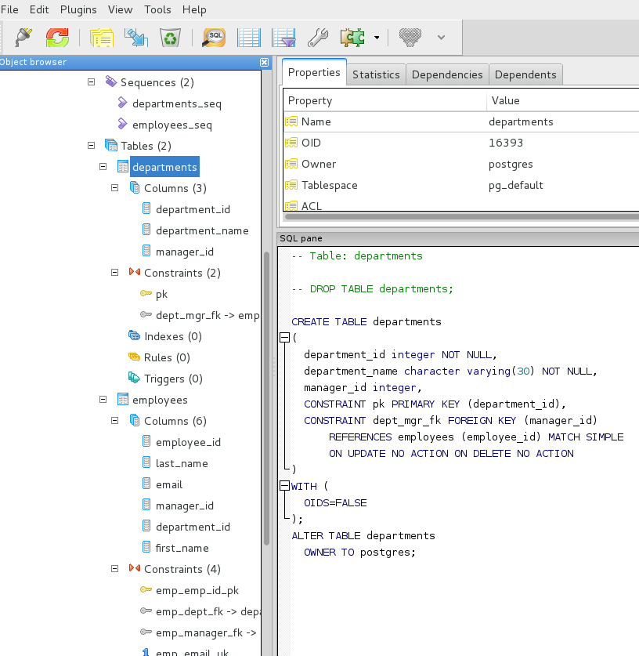
Example using PGAdmin3

Slide 9
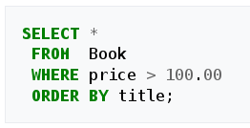
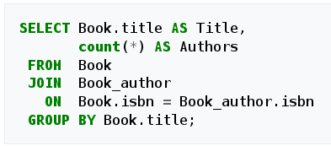
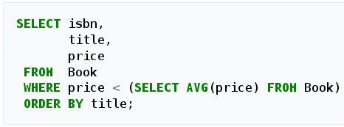
SQL SELECT
Simple
(with WHERE clause)
With “JOIN .. ON”
(and GROUP BY)
With SubQueries

Slide 10
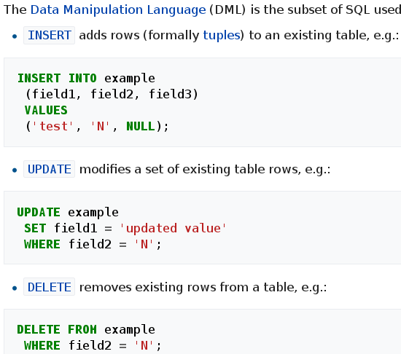
SQL DML

Slide 11
Detailed CRUD
CRUD =
Create
Read
Update
Delete
INSERT into <Table..> (col1, col2, …)
VALUES (?0, ?1, 123, ..)
SELECT * from <Table..> where <expr..>
UPDATE col1=value1, col2=…
from <Table..> where <expr..>
DELETE from <Table..>
where <expr..>

Slide 12
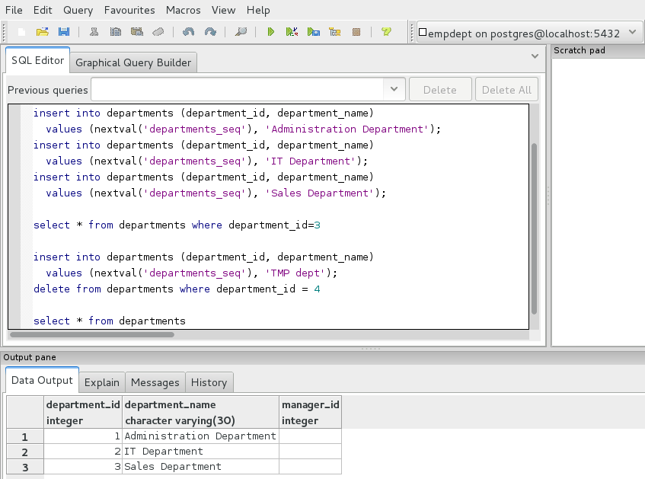
Emp-Dept CRUD Sample

Slide 13
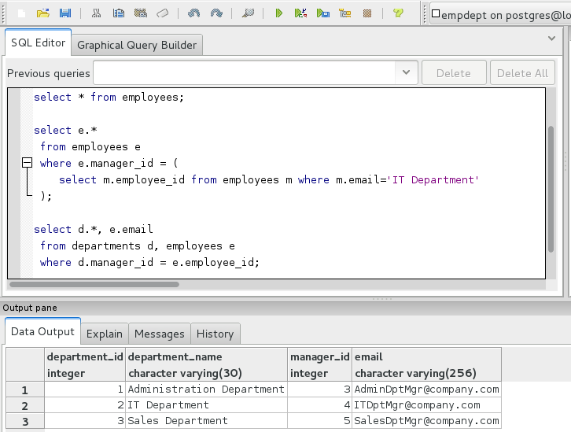
Emp-Dept Queries

Slide 14
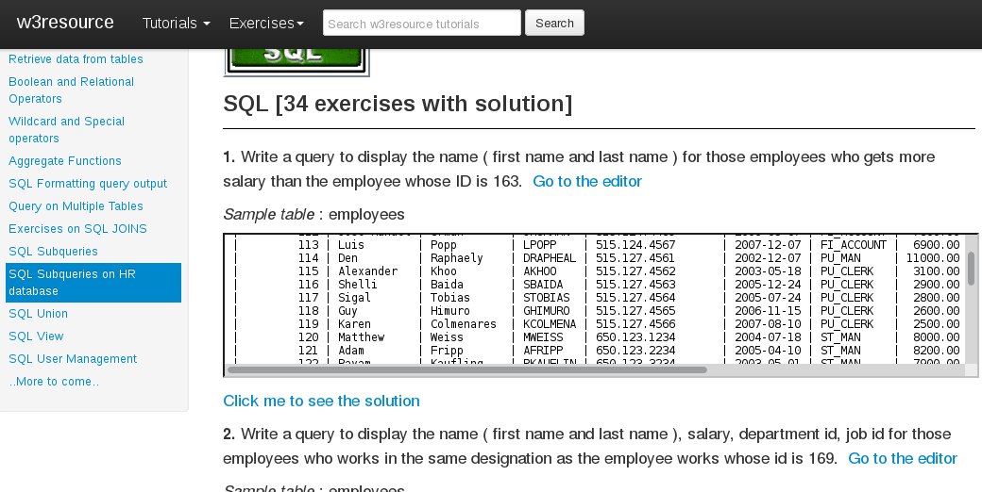
SQL Exercises http://www.w3resource.com/sql-exercises/sql-subqueries-exercises.php

Slide 15
Spring JPA
QueryDsl
Advanced SQL
Spring JDBC

Slide 16
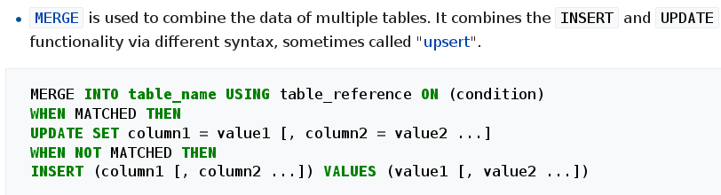
SQL Merge (=Upsert)

Slide 17
Simple SELECT Query
[ With Col1, Col2 from Table1... ]
select /*+HINT */
Col1,
Col2 as prettyName,
function(col3,col4)
from Table1 alias1, Table2 alias2,
(inner/outer..) join Table3 alias3 on ..
where
Col1 = 123 - - Literal Value
and Col2 = ?0 - - Bind-Variable … ?0=123
and Col3 = Col4
and alias1.Col1 = alias2.Col2 – explicit JOIN with alias
[ limit .. firstRows .. cf also rownum ]
Order by Col2 asc, Col3 desc

Slide 18
Aggregate Query
select C1, C2, count(*), avg(Col3), min(Col4) ..
from Table ..
where
...
Group by C1, C2
Having ..
Order by ...

Slide 19
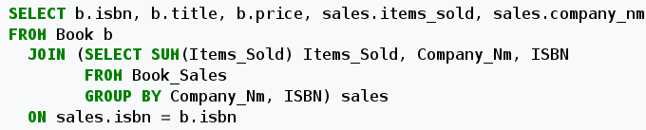
SQL Nested Queries
Example 2:
select .. from (select .. where ..) where .. not in (select ..where )

Slide 20
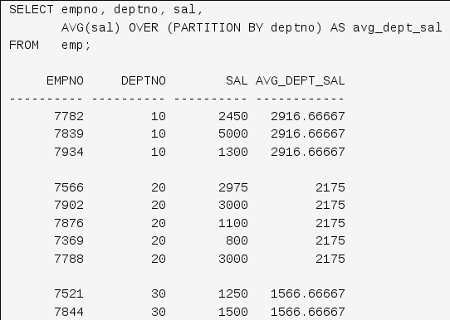
Analytical Query Functions
select …
analyticalFunc[first,last,nth,min,max,avg,..](..)
OVER (PARTITION BY ..)
from …
where ..

Slide 21
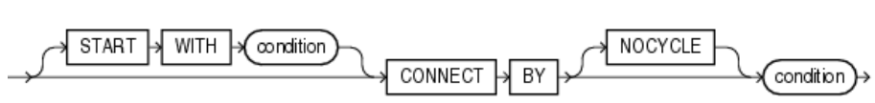
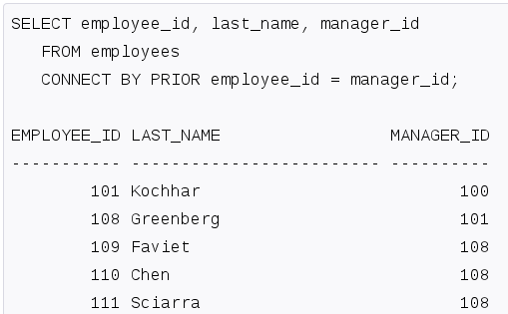
Hierarchical Queries
Exemple: clause “where” using Hierarchy

Slide 22
Advanced Bulk Update
with PL/SQL + Array
CREATE OR REPLACE PROCEDURE ..(a ARRAY) IS
CURSOR c IS select .. from TABLE(CAST(a ..))
BEGIN
OPEN c;
LOOP FETCH c BULK COLLECT INTO ...;
END

Slide 23
Spring JPA
QueryDsl
Advanced Databases
Spring JDBC

Slide 24
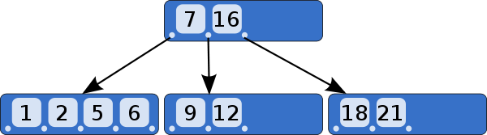
B-Tree = Balanced-Tree
(not only Binary Tree)

Slide 25
B-Tree
a self-balancing tree data structure
that keeps data sorted
and allows searches,
sequential access,
insertions, and deletions
in logarithmic time.

Slide 26
Sort/Compare Rows – Columns ?
(col1, col2, col3, col4, col5)
<?
== ?
> ?
(col1, col2, col3, col4, col5)
( 123, “Hello”, FALSE, +1e3, 'b' )
( 123, “Text2”, FALSE, +1e3, 'b' )
Choose columns …
exemple:
Sort (col1)
Sort (col3,col5,col2)

Slide 27
Lexicographical Compare Rows
1 Row = N Columns
Compare row by Col1,Col2,ColK :
if (a.col1 < a.col1) => -1
else if (a.col1 > a.col1) => +1
else {
if (a.col2 < b.col2) … => ..
.. { … => 0
} }

Slide 28
B-Tree on (Col1,Col2...) = INDEX
Insert ROW = (ACID : Atomic) Insert Data
+ Insert Index1 + Insert Index2 + ….
PK INDEX : col (ID)
INDEX2 : (Col2,Col3,ID)
INDEX3 : (Col3,Col2,Col6)

Slide 29
Select .. where ID = ?
Execution Plan
Step 1: Index Lookup (Unique) by ID
Log(N) logical reads
=> get “rowId” (=address)
Step 2: table lookup by RowId (=O(1))
=> get other columns

Slide 30
Select .. where C2=? and C3=? ..
… with INDEX (C2,C3,otherC...)
Execution Plan
Step 1: Index Range Scan
lookup = Log(N) logical reads
+ scan non unique
=> foreach.. get “rowId” (=address)
Loop Step 2: table lookup by RowId (=O(1))
=> get other columns

Slide 31
Applicable Index(es) ? for “.. where Col2=? And Col5=?”
PK INDEX : col (ID)
Applicable =
Allow Lexicographical
Top->Down Search
INDEX (Col2,Col6,Col5)
INDEX (Col2,Col5,Col6)
INDEX (Col5,Col2,Col7)
INDEX (Col1,Col2,Col5)

Slide 32
Select C3,C4 where C1=?,C2=?
With INDEX(C1,C2,..C3,C4)
Optim = Index Coverage
Execution Plan
Step 1: Index Lookup by ID
Log(N) logical reads ...unique/scan
=> read Col3,Col4 value from INDEX
.. NO need table lookup by rowid

Slide 33

Query Execution Engine
“Select ..
from ..
where .. col1='val1'
and col2=123“
Execute Query
Result : Tabular Data Format = “ResultSet”

Slide 34
Huge Result .. Server-Side “Cursor”
Begin “Execute” Query
Result = Partial Data
+ Cursor (= handle of server-side Partial Data+ Iterator)
Fetch next page
Fetch next page
Fetch next page
CLOSE CURSOR !!

Slide 35
SoftParse – HardParse … PrepareQuery + BindVariable
Compute
Execution Plan
First Seen ?
HARD Parse
“Select ..
from ..
where .. col1=?0
and col2=?1“
Put in Cache
BindVariable:
set(0, “val1”)
set(1, 1234)
Already Seen ?
SOFT Parse
= create Cursor

Slide 36
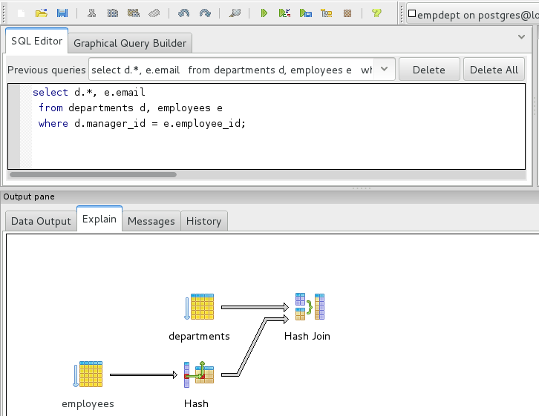
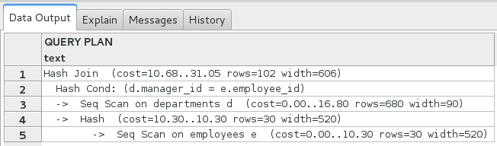
Explain Execution Plan

Slide 37
Query / Prepared Query Execution
Select ..
from ..
where .. col1=?0
and col2=?1
Prepare (SQL)
PreparedStatement
BindVariable:
set(0, “val1”)
set(1, 1234)
ExecuteQuery
ResultSet (page1)
Next row
get col1, get col2 …
next row
...
Fetch next page

Slide 38
… = JDBC API Explained

Slide 39

Spring JPA
QueryDsl
Spring JDBC

Slide 40
import java.sql.*;
DataSource
Connection
PreparedStatement
ResultSet

Slide 41
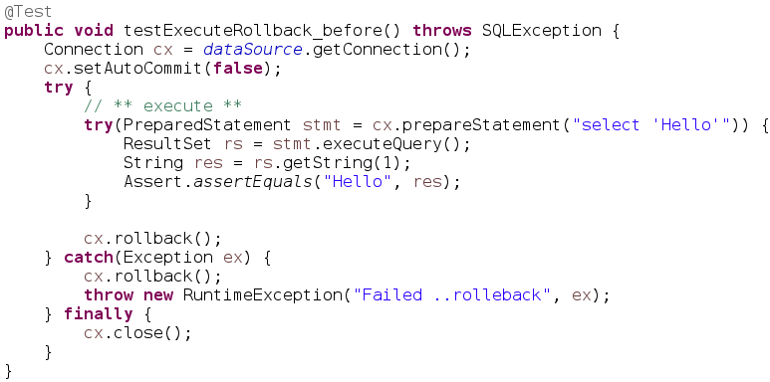
Sample Jdbc (Test with Rollback)

Slide 42
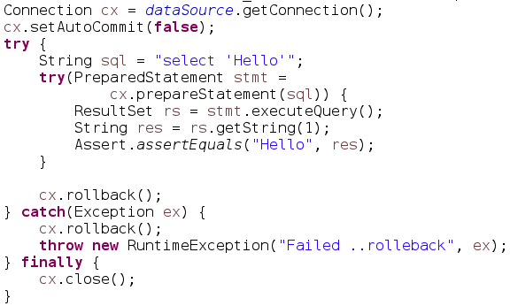
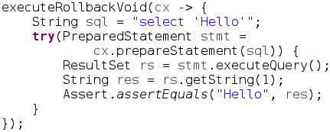
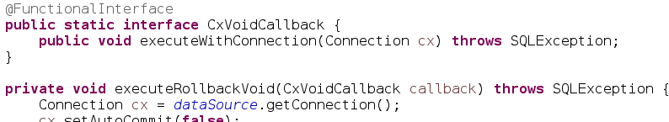
Refactored (1/2)

Slide 43
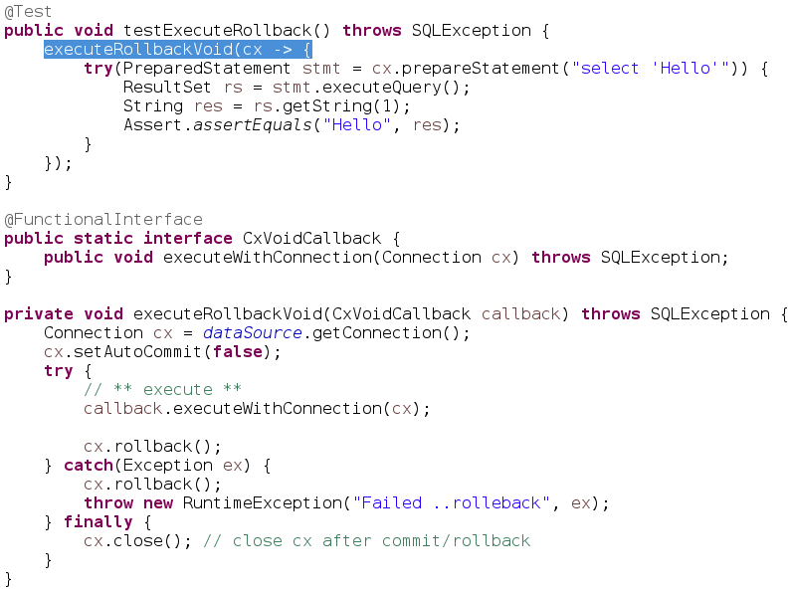
Refactored (2/2)
“Template” + Callback
Code to
run with Cx
+ rollback
Common
Template
Framework
.. similar to
Spring
Template

Slide 44
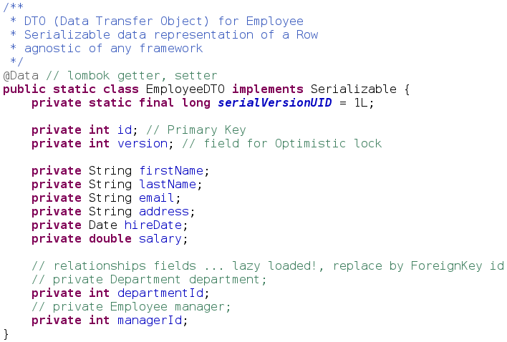
Data Transfer Object for CRUD

Slide 45
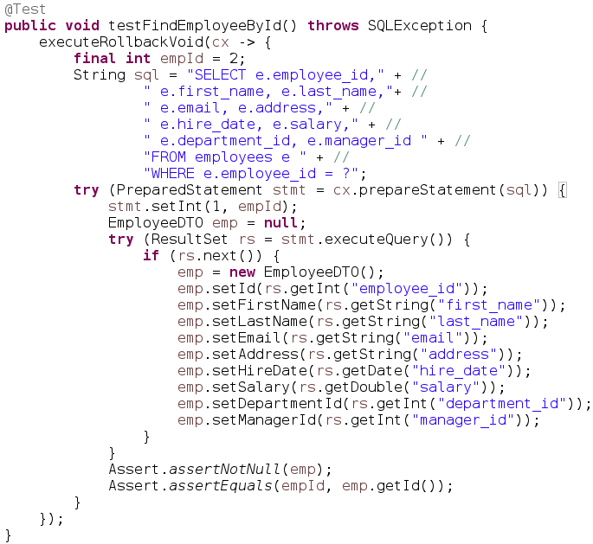
CRUD 1 / 4 : SELECT

Slide 46
Jdbc is As Verbose as Easy ...
Is it DRY ?
D don't
R repeat
Y yourself

Slide 47
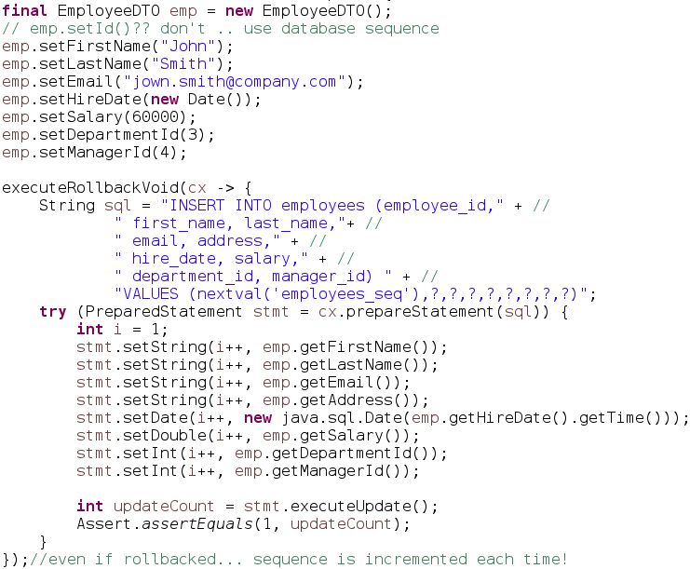
CRUD 2 / 4 : INSERT

Slide 48
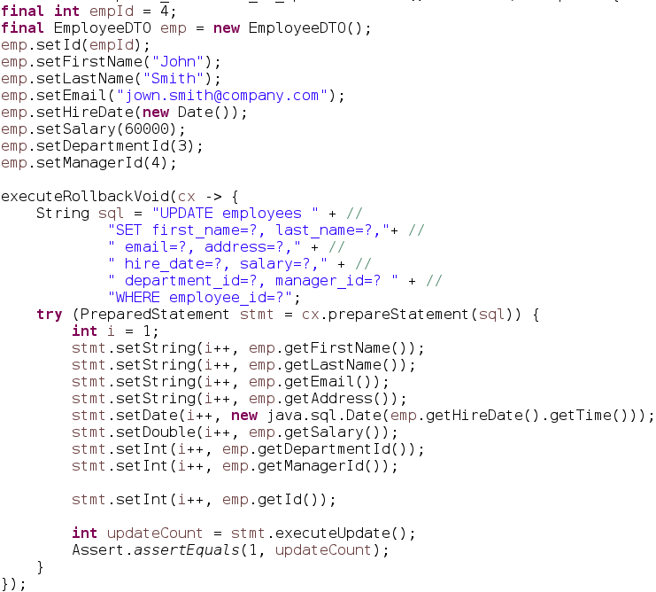
CRUD 3 / 4 : UPDATE (All columns)

Slide 49
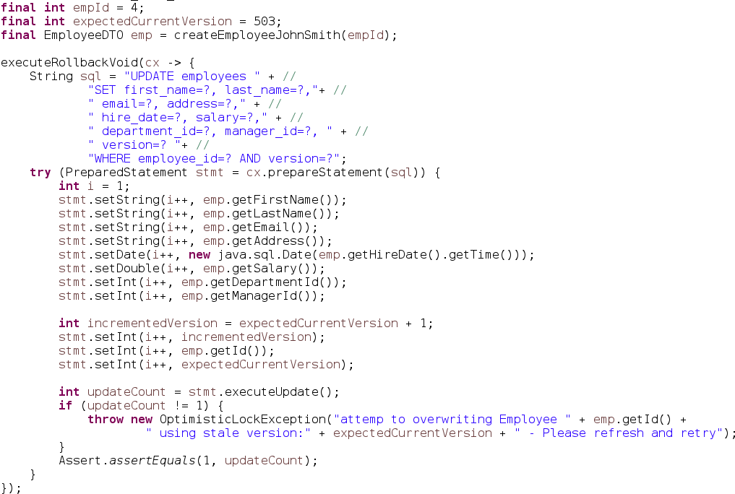
UPDATE with Versioning

Slide 50
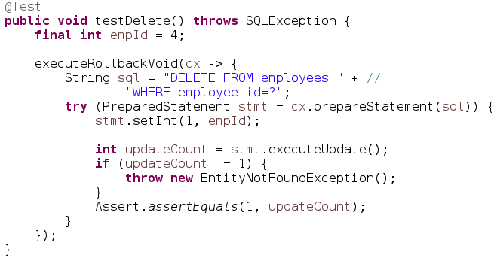
CRUD 4 / 4 : DELETE

Slide 51
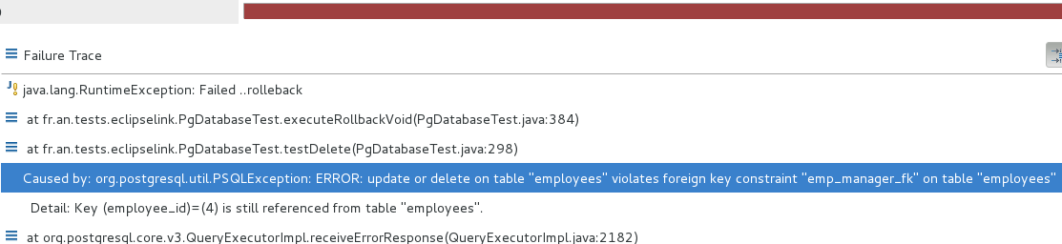
Check my Foreign Keys …
Looks the simplest code to DELETE ? …
It is the hardest to execute safely !!
Because you must clear
all incoming Foreign Keys to this PK first

Slide 52

And What About INSERT...
Chicken & Egg
How to ?
INSERT CHICKEN .. FK to EGG ID (not exist yet)
INSERT EGG .. FK to CHICKEN ID (not exist yet)
Solution 1/
INSERT nextval(..)… CHICKEN … NULL FK) => newChickenID
INSERT nextval(..)… EGG … CHICKEN_ID => newEggID
UPDATE CHICKEN set EGG_ID = newEggID
Solution 2/ … use Database Deferred Constraint Check
Select nextval(..) => newChickenID
Select nextval(..) => newEggId
INSERT … CHICKEN … newChickenID –-- no exist yet .. deferred check!
INSERT … EGG … newEggID

Slide 53
Spring JPA
QueryDsl
JDBC Api
Spring JDBC

Slide 54
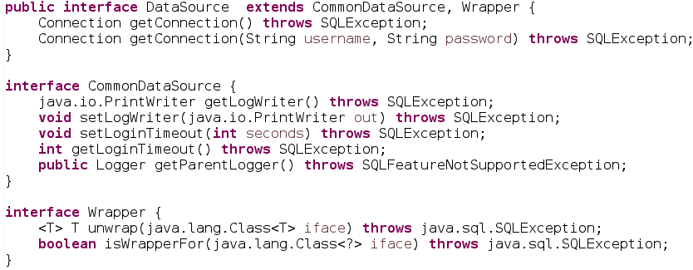
javax.sql.DataSource
(remark: javax.* not java.* )
DataSource
Connection

Slide 55
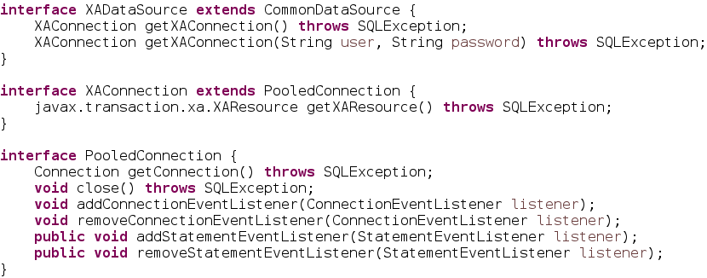
javax.sql.XADataSource
Connection
XAResource
XADataSource
XAConnection

Slide 56
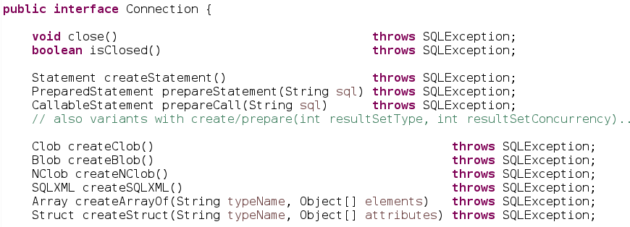
java.sql.Connection (1/3)
Connection
Statement
PreparedStatement
CallableStatement
Blob
Clob
Array
Struct
create*
Statement
create*
Data

Slide 57
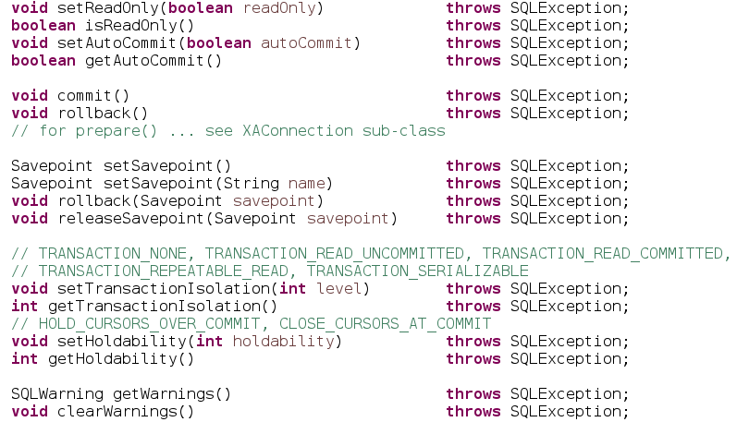
java.sql.Connection (2/3)
Connection
TransactionManager
SavePoint
transaction

Slide 58
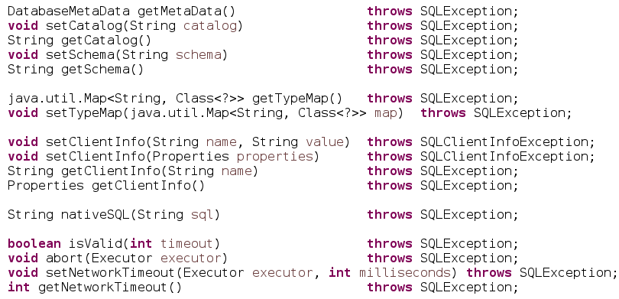
java.sql.Connection (3/3)
DatabaseMetaData
Connection
metadata

Slide 59
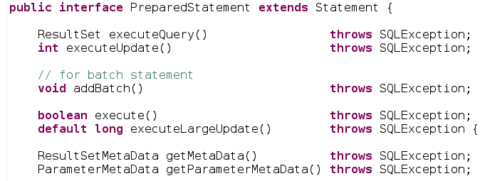
java.sql.PreparedStatement (1/2)
Statement
ResultSetMetaData
PreparedStatement
ResultSet
execute*
metadata
Set parameters (cf next)

Slide 60
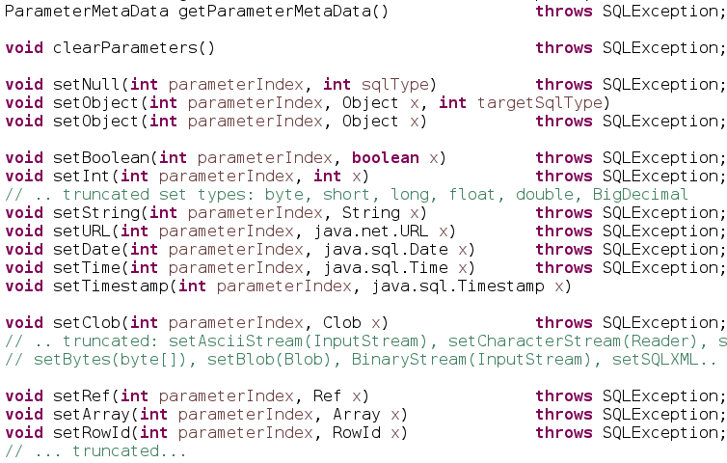
PreparedStatement (2/2)
ParameterMetaData
PreparedStatement
metadata
clear
set*

Slide 61
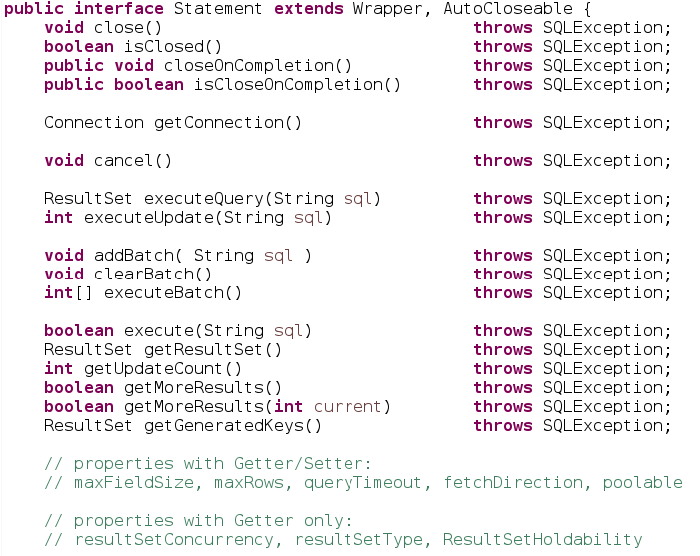
java.sql.Statement
Connection
Statement
ResultSet

Slide 62
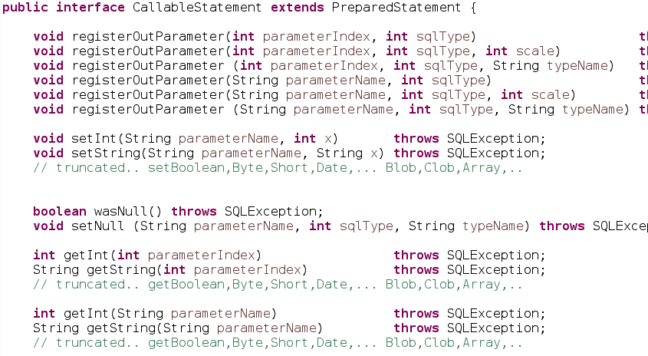
java.sql.CallableStatement
Statement
PreparedStatement
CallableStatement

Slide 63
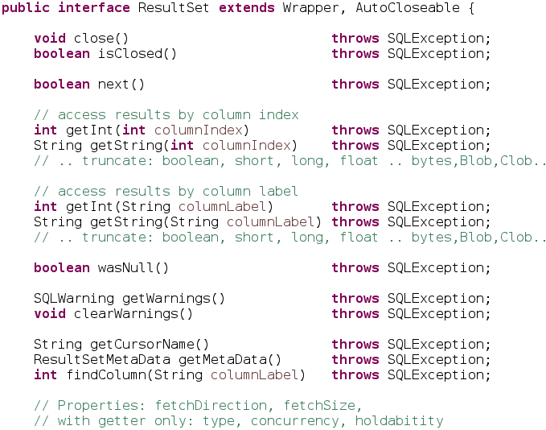
java.sql.ResultSet (1/2)
ResultSetMetaData
ResultSet

Slide 64
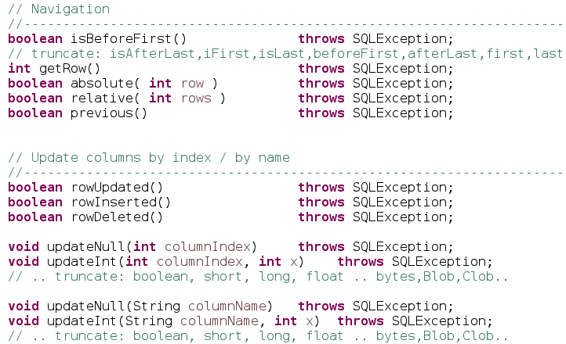
java.sql.ResultSet (2/2)

Slide 65
import java.sql.*; (full)
DatabaseMetaData
ParameterMetaData
ResultSetMetaData
DataSource
Connection
Statement
ResultSet
PreparedStatement
Driver
CallableStatement
XAResource
XADataSource
XAConnection
Blob
Clob
Array
Struct

Slide 66

Jdbc Database App

Slide 67
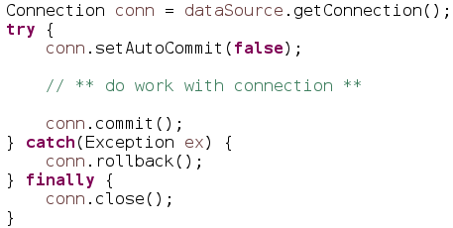


DataSource Code Sample
Using
explicit Transaction
+ commit/rollback
Using try-close
Rule for ALL Resources :
If You Open It => You Close It

Slide 68

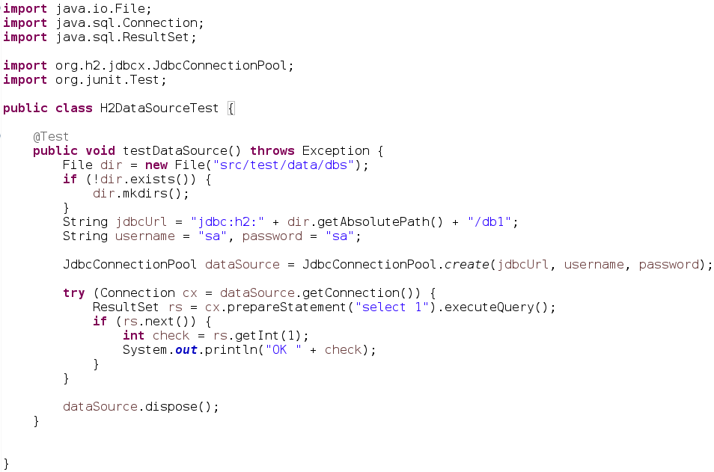
H2 DataSource HelloWorld

Slide 69

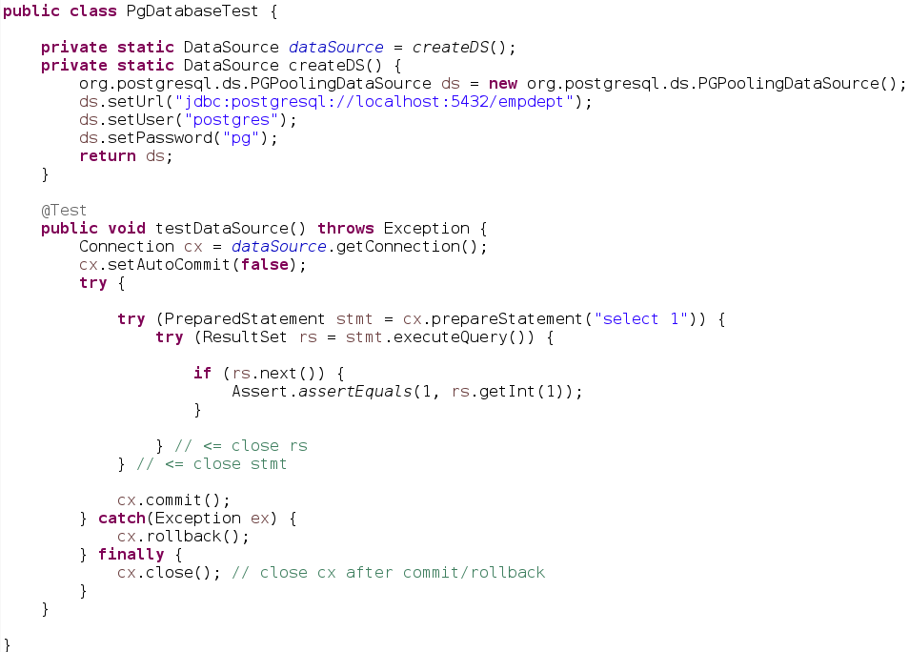
Postgresql Hello

Slide 70
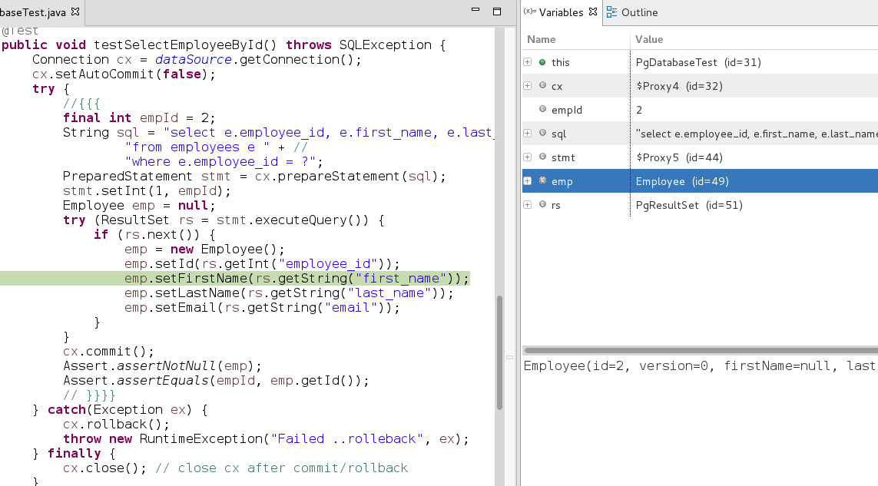
PreparedStatement Sample

Slide 71
Spring JPA
QueryDsl
Spring JDBC

Slide 72
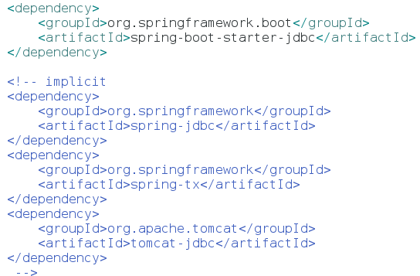
Spring-Jdbc Database App

Slide 73
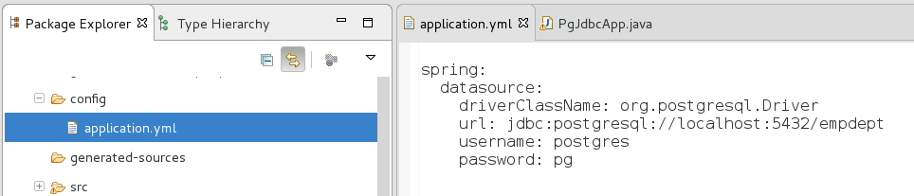
Springboot config/application.yml

Slide 74


Springboot JDBC… “JUST work”

Slide 75
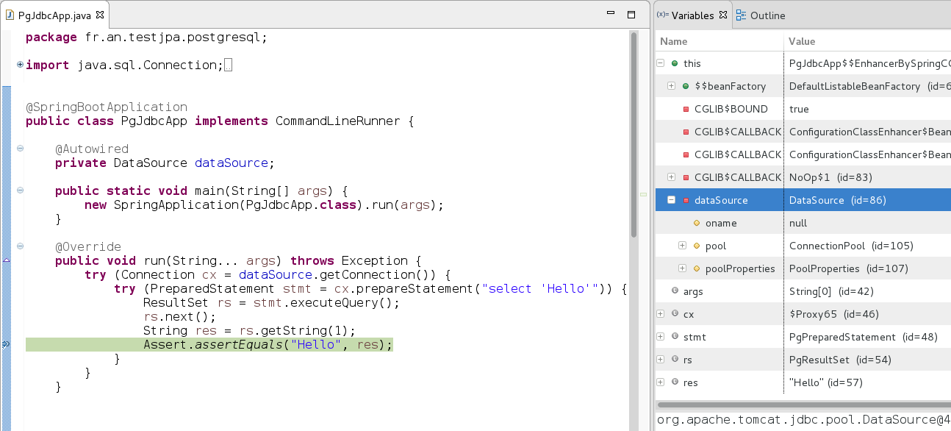
Springboot Jdbc main()
Start Spring
+ inject DataSource
Pooled DataSource injected

Slide 76

Springboot JUnit
Pooled DataSource injected
DataSource in injected
Start Spring
+ inject DataSource

Slide 77

SpringBoot … explicit DataSourceAutoConfiguration

Slide 78

Explicit @Bean
(example for Multi DataSources)

Slide 79
(Reminder) DataSource
Try-Finally Close
Using
explicit Transaction
+ commit/rollback
Using try-close
2n execution … different connection
Rule for ALL Resources :
If You Open It => You Close It

Slide 80

Same using Template Spring-Jdbc
Equivalent
try-finally
Same with Lambda syntax
2n execution … different connection

Slide 81

PooledConnection + Transaction
= Thread-Locked : reuse
Thread-12
Conn
XA ..
XA commit/rollback
=> connection commit/rollback
THEN repool

Slide 82

(Reminder) try-finally Connection
+ try-finally Statement

Slide 83

JdbcTemplate(dataSource)

Slide 84

Run Jdbc App

Slide 85

Springboot built-in supports JTA @Transactional

Slide 86

@Transactional JUST Works

Slide 87
Spring JPA
QueryDsl
Spring JDBC

Slide 88

JPA (with springboot data)

Slide 89

EntityManager (1/2)

Slide 90

EntityManager (2/2)

Slide 91

What is an “Entity” ?
A class with @Entity
And an @Id

Slide 92






Javax.persistence.* Annotations

Slide 93

How many java.persistence.* Annotations ?
$ cd src/main/java/javax/persistence
$ find . -name \*.java -exec grep -H '@Retention' {} \;
$ find . -name \*.java -exec grep -H '@Retention' {} \; \
| cut -d: -f1 | sed 's|\./\(.*\)\.java|\1|g' | wc -l
90

Slide 94
Sufficient @Annotations to know?
@Entity
@Inheritance
Sub-
Classes
Base
@Id
@GeneratedValue
@SequenceGenerator
@DiscriminatorColumn
@Table
@Version
Custom
@Column
@ManyToOne
For relationships
FK (*) → (1) PK
PK (*) ← (*) FK
@JoinTable
@OneToMany
@JoinColumn

Slide 95

Why putting @Column & @Table ?

Slide 96
@Id with Sequence Generator
SQL:
CREATE SEQUENCE employees_seq INCREMENT BY 10;
Detailed JPA:

Slide 97
@Version ?
whenever overwriting modified value without reading
=>
version=1
(1) (2):
Get data version:1
(5):
REDO fetch
+ update
Wait...
(6):
Save
(on version=2)
OK
(3):
Mofify + Save (on version 1)
OK => increment version=2
(4):
Mofify + Save (on version 1?)
=> OptimisticLockException .. version=2 !

Slide 98


@Entity Employee-Department
Database table “EMPLOYEE”
id (PK), version, first_name, last_name, …. department_id (FK department.id)
manager_id (FK employee.id)
Database table “DEPARTMENT”
id (PK), version, name,
department_manager_id (FK employee.id)

Slide 99

For real with @Column ...

Slide 100

FindById with JPA

Slide 101

CRUD with JPA

Slide 102

Dynamic Query
( java.persistence.CriteriaBuilder )

Slide 103

Dynamic Query using Bind-Variables

Slide 104
Dynamic Query …
String type checking?
Which one is correct???
Discover it by Exception on PROD !
cb.get(“addr”) // column name in Database
cb.get(“address”) // field name in java
cb.get(“adress”) // with a Typo
cb.get(“city_id”).get(“name”) // after refactoring db schema

Slide 105


Generated *_ class MetaModel
+ Compile Type Check
Generate

Slide 106

Real MetaModel ..
(Real? … see javac processor)

Slide 107

Pom.xml MetaModel plugin
(example for eclipselink)

Slide 108

DynamicCriteria using MetaModel

Slide 109

Search Parameters in Criteria class
(also called “Specification”)

Slide 110

Cascading Setters with “return this” for Fluent API

Slide 111
springboot data
Spring JPA
QueryDsl
Spring JDBC

Slide 112


Slide 113

Pom.xml QueryDsl plugin

Slide 114

QueryDsl Generated Q* class similar but richer than *_ class

Slide 115

QueryDsl
++More Fluent than JPA

Slide 116

QueryDsl + Bind-Variables !
(not a clean API for parameters!!)

Slide 117

QueryDsl Predicate (no bind-var!)

Slide 118
springboot data
Spring JPA
QueryDsl
Spring JDBC

Slide 119


Slide 120

Repository

Slide 121

extends JpaRepository

Slide 122

Repository with extra Finders findBy XXX And YYY

Slide 123


Small + Custom + Almost Complete
(see also next for QueryDsl)
By naming convention .. Equivalent to:
“Select * from EMPLOYEE where email=?”
Extends JpaRepository
built-in CRUD …
findAll, by Page, save, delete...
(no update, use Setters)

Slide 124

Sample Code using springboot-data Repository

Slide 125



Springboot @JPA configuration
springboot dark magic
not even 1 line .. all optional !!!
Useless equivalent
2 implicit lines
Optional
for debug (see next)

Slide 126

Springboot hibernate… “JUST work”
CRUD …
select * from EMPLOYEE where …
insert into EMPLOYEE (..) values (..)

Slide 127

When/How/Where are my
“create Table ()” ???
Tables are created/updated at startup
Detected H2 Database SQL langage
Also create PK/FK indexes

Slide 128

How??
Which call JPA..
→ Hibernate...
→ JDBC
Call springboot-data
JpaRepository
You code
calls a generated
Proxy..

Slide 129

JPA Dyn Criteria + Spring-Data
= Specification
( != querydsl Predicate !)

Slide 130

Spring-Data + Specification..

Slide 131

Sample spring-data Specification

Slide 132

Better.. QueryDsl + Spring-Data

Slide 133

AngularJS + Springboot
In Jhipster … you have 100% springboot on server-side
… with Code Generator
And also Hipe code on client-side : Html / Css + AngularJS + ..

Slide 134

Java is Hipe
Make Jar nor WAR – NO PHP
NO NodeJS on server
20 years of Java
Just The Beginning
Its HIPE ...because of springboot
& open-source & java community

Slide 135

Conclusion

Slide 136
Conclusion
This document: http://arnaud-nauwynck.github.io/docs/Intro-Db-Jdbc-JPA-SpringData.pdf
Only a (not so short) introduction to
Databases < JDBC < JPA < Spring-Data

