Slide 1
Junit
Presentation & Tools
(Eclipse, Maven, Mockito, Spring)
arnaud.nauwynck@gmail.com
This document:
http://arnaud.nauwynck.free.fr/

Slide 2
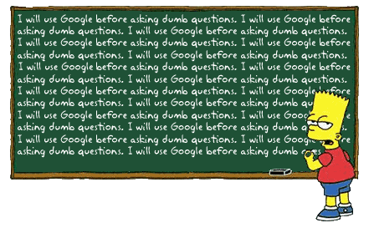
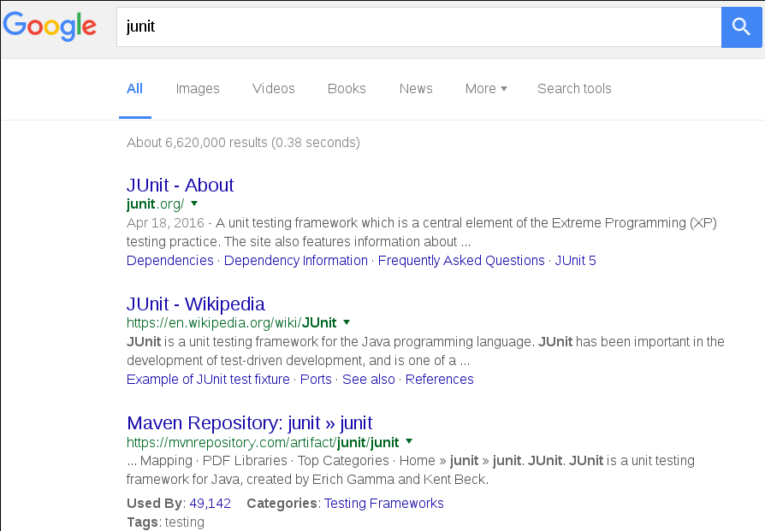
What is Junit ?

Slide 3
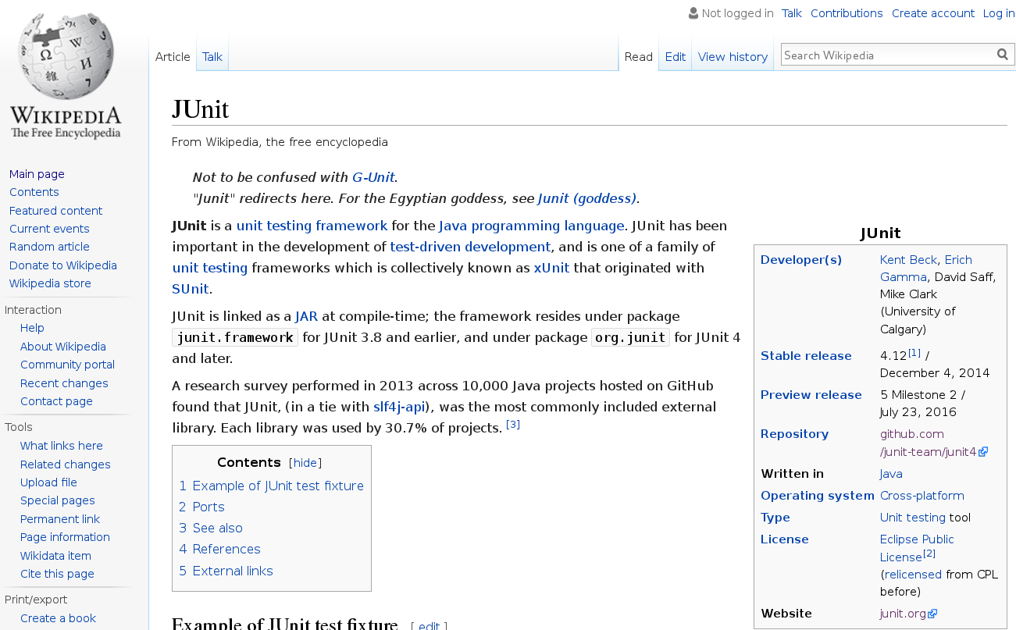
Wikipedia JUnit

Slide 4


Junit birth
Mid-90's
Kent Beck developed xUnit test tool for Smalltalk
1997
Beck and Gamma (authors of design patterns “Gof”)
developed JUnit
… on a flight from Zurich to Washington, D.C.
Written in few hours => The code is small, simple

Slide 5
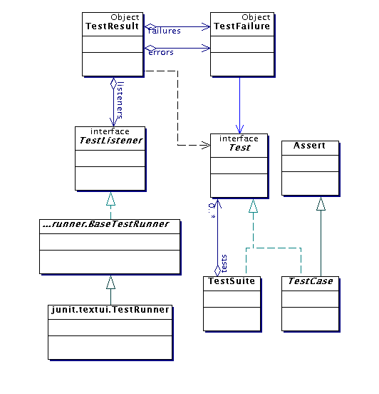
How Small is Junit ?
~200 java source files
$ git clone https://github.com/junit-team/junit4.git
$ cd junit4
$ find src/main/java -name \*.java | wc -l
204
$ find src/main/java -name \*.java | xargs cat | wc -l
18136
$ … | grep -v '^\s*\*' | grep -v '^\s*/\*' | wc -l
11958
~12 000 lines of code
+ 6 000 lines of javadoc

Slide 6
Junit History : 3 < 4 < 5
The code has not changed for years (annotation with Java 5)
1997
Junit
2002
Junit 3.8.2
2005
java5
2006
Junit 4
2015
java8
2016
Junit 3
class MyTest extends TestCase {
public void testFoo() {
Assert.assertEquals(...);
}
}
Junit 4
supports Java 5
Annotations
@Test
public void foo() {
}
No extends TestCase
Junit5 in alpha version

Slide 7

Small but Powerfull
“Never in the field of software development was so much
owed by so many to so few lines of code.”
Martin Fowler

Slide 8
De Facto Standard
Used by ~30% major
Github projects
Integrated in ALL Tools

Slide 9
Junit impacts .. eXtreme Programing, TDD, BDD, Refactoring, Clean Code,
Mock, IOC Injection ...
1997
1999
2000
2001
2002
2005
Extreme Programming
Junit in Eclipse
Springframework
JUnit
TDD
BDD Behavor Driven
Refactoring
Junit.org
Continuous Integration, Maven
Mock Objects - library
http://www.martinfowler.com/bliki/Xunit.html
http://wiki.c2.com/?TenYearsOfTestDrivenDevelopment

Slide 10
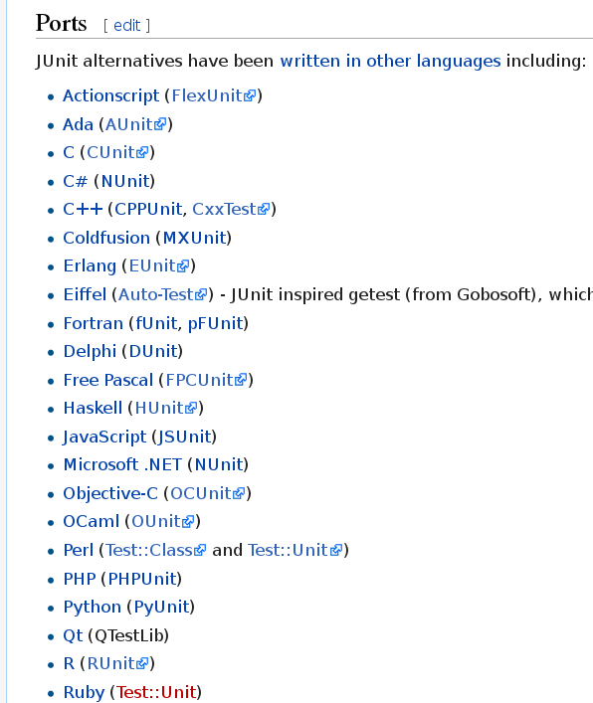
xUnit
Junit … J=Java
but not only Java …
xUnit = ports in all langages
Standard in ALL langages

Slide 11
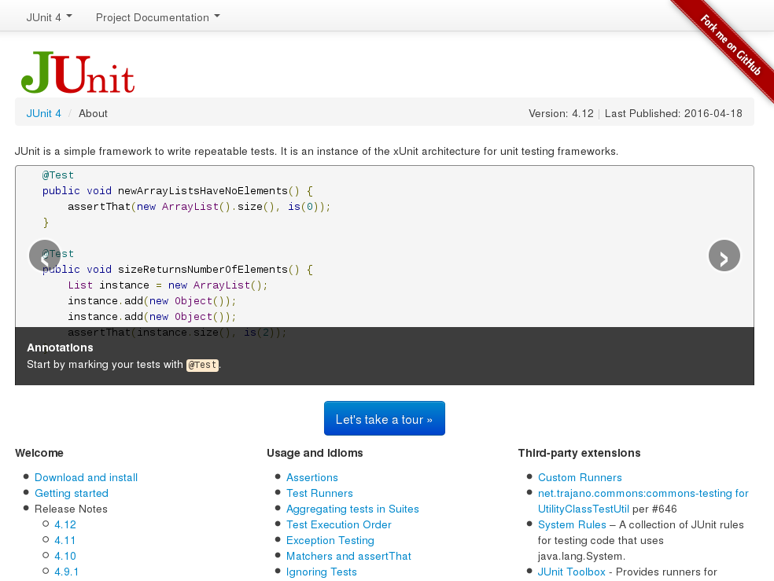
http://junit.org/junit4/

Slide 12
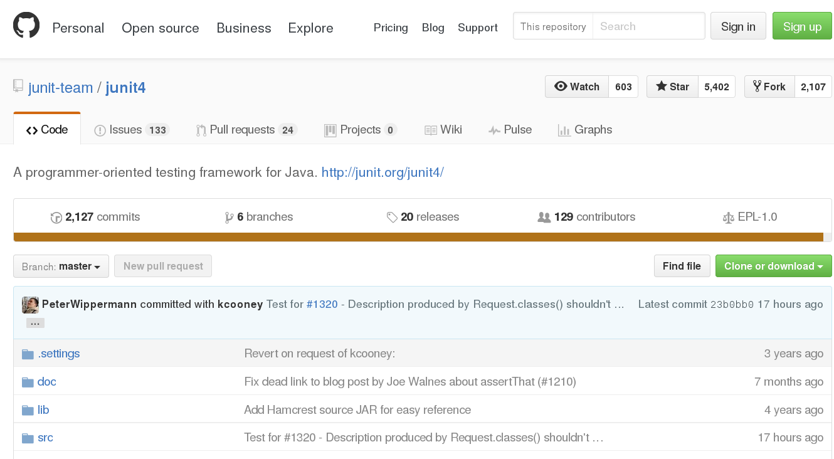
https://github.com/junit-team/junit4

Slide 13
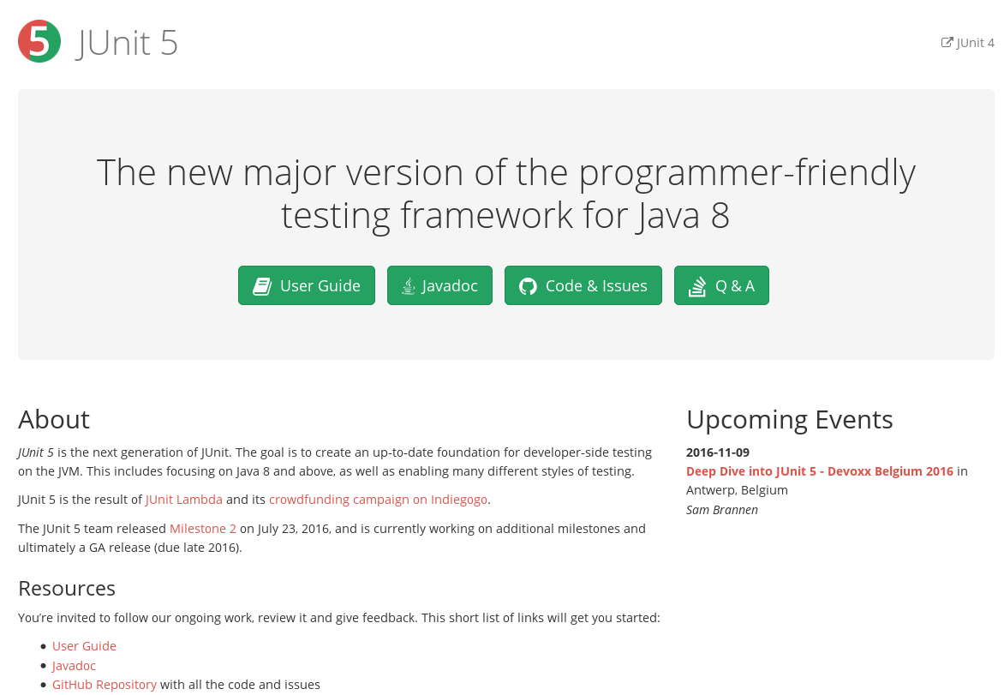
http://junit.org/junit5/

Slide 14
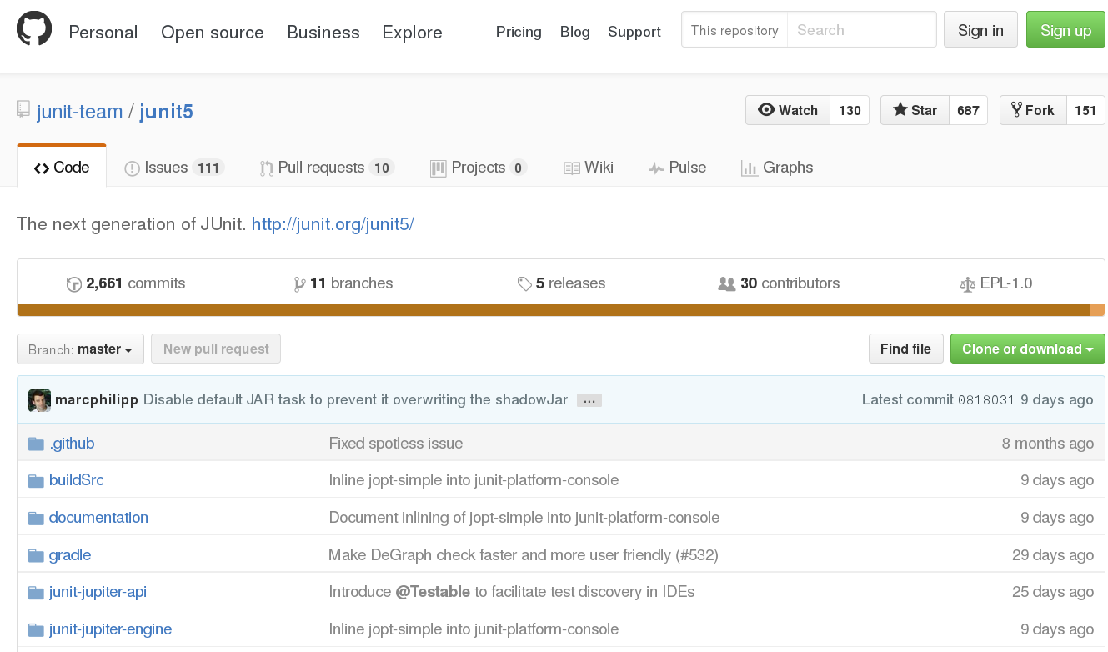
https://github.com/junit-team/junit5

Slide 15
Getting Started : New Project
Eclipse + Maven

Slide 16
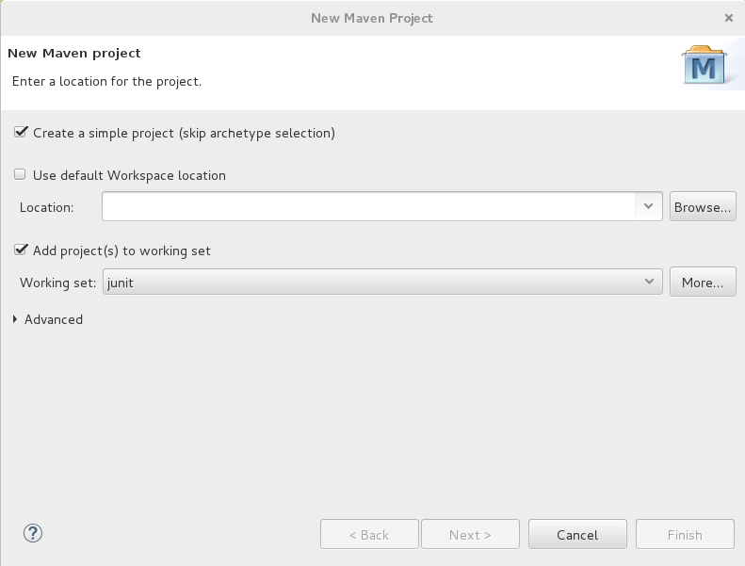
New Maven Project

Slide 17
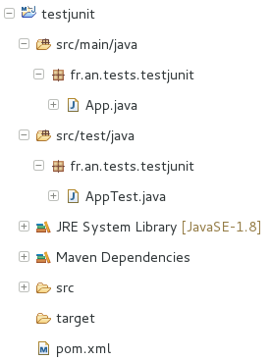
Blank Junit Project
source in src/main/java
tests in src/test/java

Slide 18
JUnit = Unitary Class Test
1 class => 1 Test Class
1 method => 1 Test method
SUT = System Under Test

Slide 19
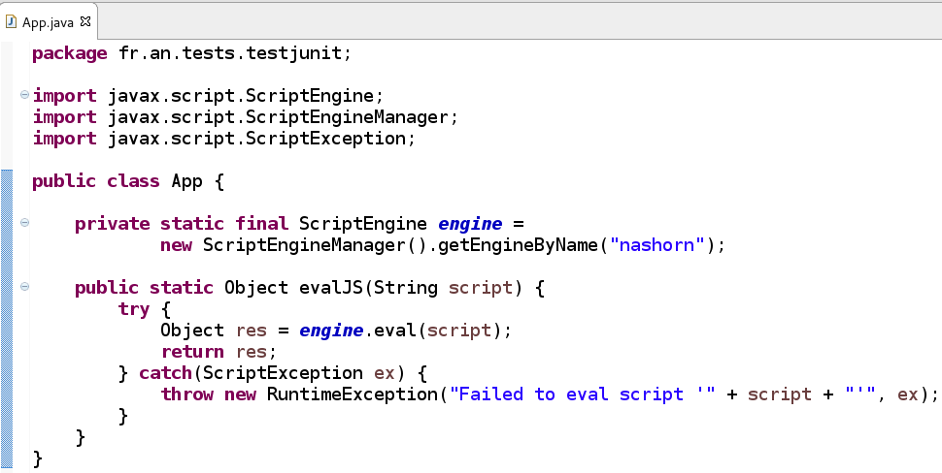
Example of System Under Test
This method is supposed to eval any JavaScript from JRE
Does it work ??

Slide 20
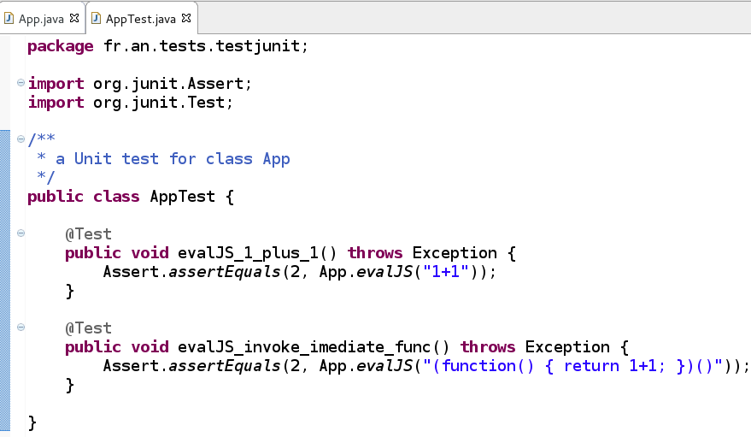
Let's Test It – Start Small, Trivial
At least, it should not break
(but it could be anything else than JavaScript)
It looks Ugly
It looks real JavaScript

Slide 21
Junit in Eclipse

Slide 22
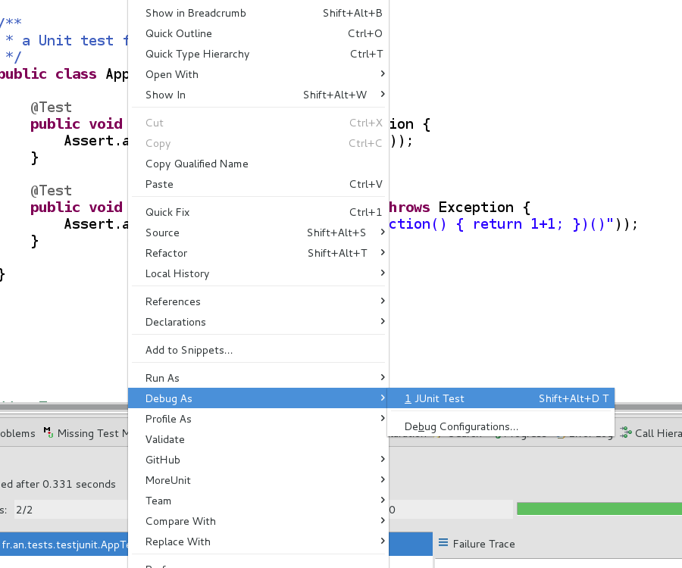
Let's Run It

Slide 23
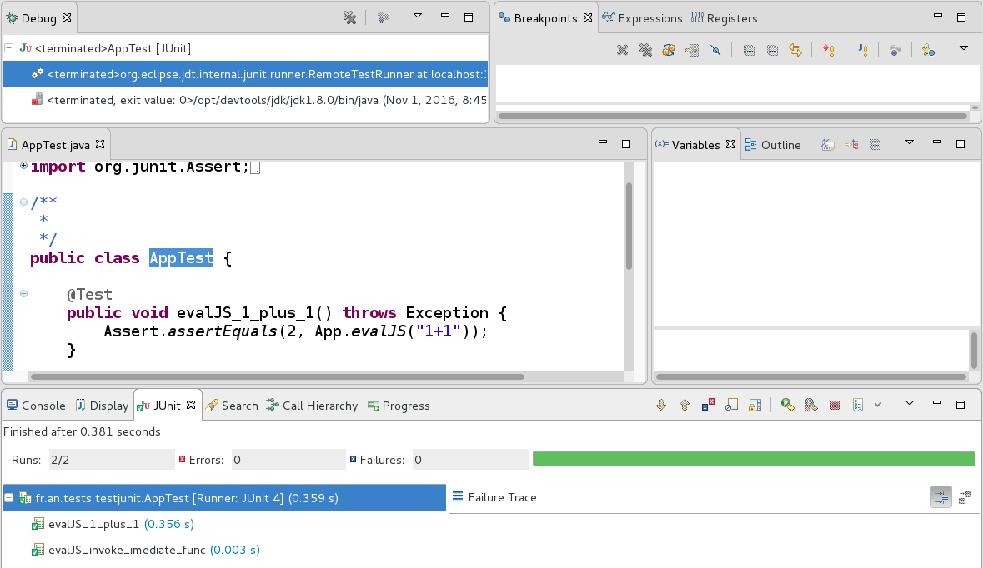
Junit Result View

Slide 24
Launch Shortcuts in Eclipse
F11 = execute
(On test, on main, on launch target..)
Shift+Alt+D T (=debug test)
CTRL + R (see next: MoreUnit)

Slide 25
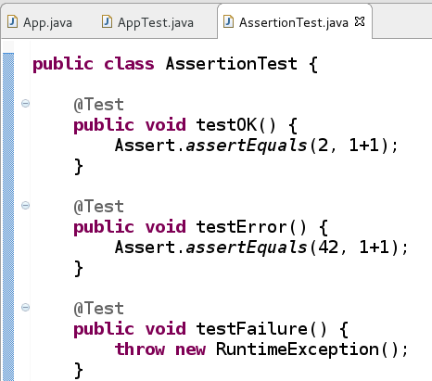
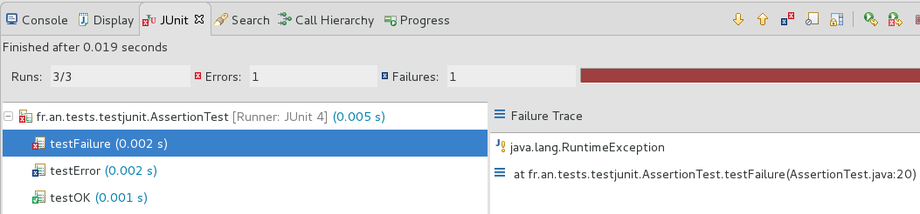
Junit Results – OK / Assert / Failure

Slide 26
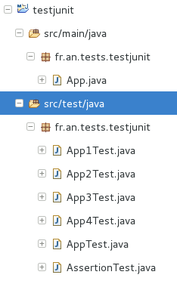
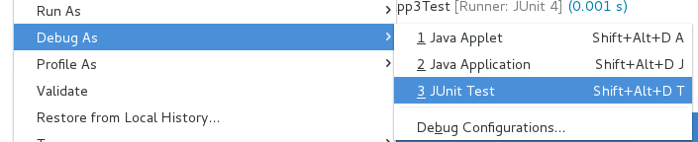
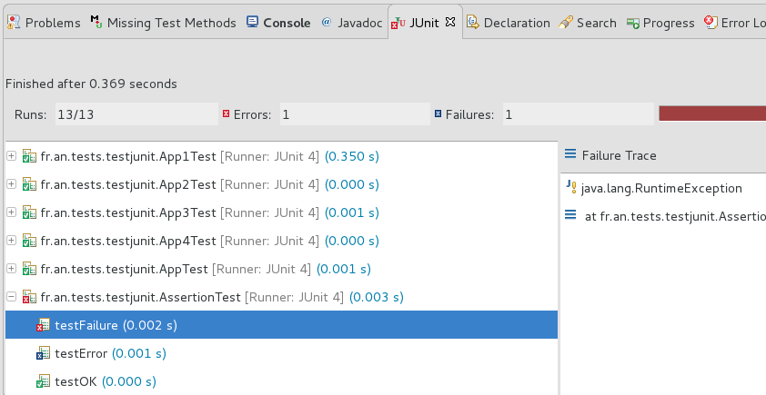
Run All package Tests

Slide 27
Junit in Maven

Slide 28
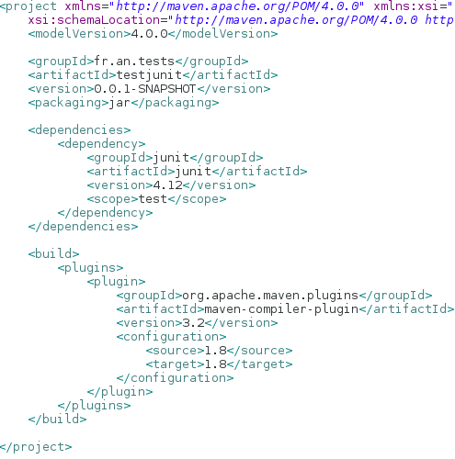
Junit dependency in Maven pom.xml
“jar” project => built-in supports for
compile +
compile-test + test +
jar ...
Junit.jar test compile dependency

Slide 29
Junit = built-in in Maven
$ mvn install
# test only:
$ mvn test

Slide 30
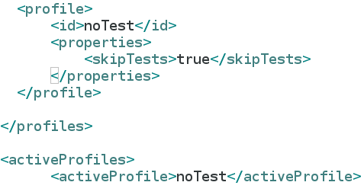
Skip Tests in Maven
# all but test:
$ mvn install -DskipTests
In ~/.m2/
settings.xml

Slide 31
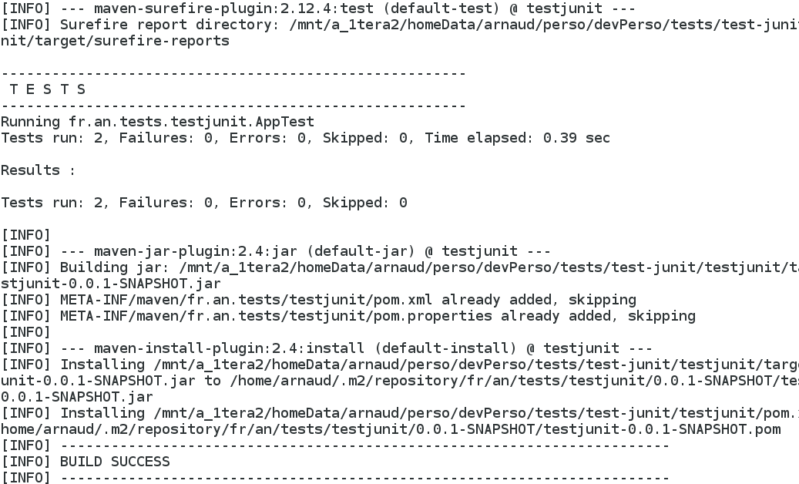
Test Phase in Maven
Phases:
- resources
- compile
- compile -test
- test
- jar
-install

Slide 32
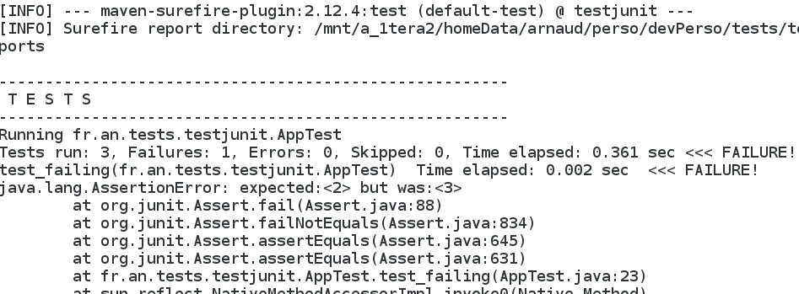
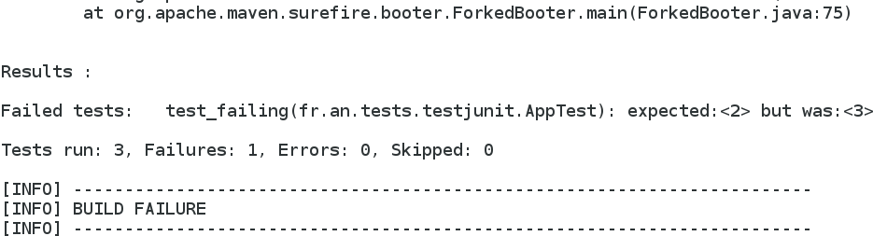
Junit error => Build Failure
… (truncated )

Slide 33
MoreUnit Eclipse Plugin

Slide 34
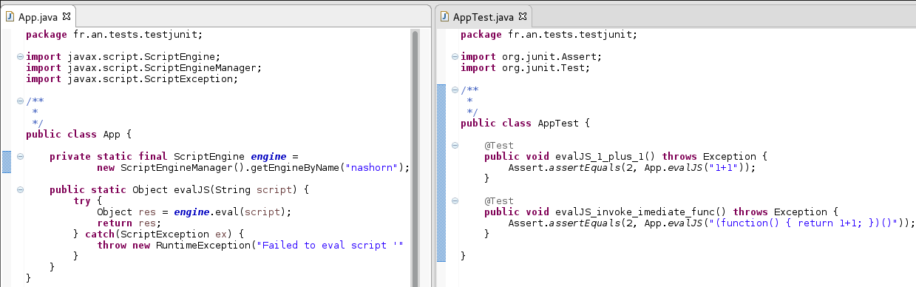
Junit Naming Conventions
A class “App” in package “a.b.c”
in src/main/java
“AppTest” in same package “a.b.c”
in src/test/java

Slide 35
Eclipse .. Switching from src to test
CTRL + U
(first to generate)
src/main
src/test
CTRL + J

Slide 36
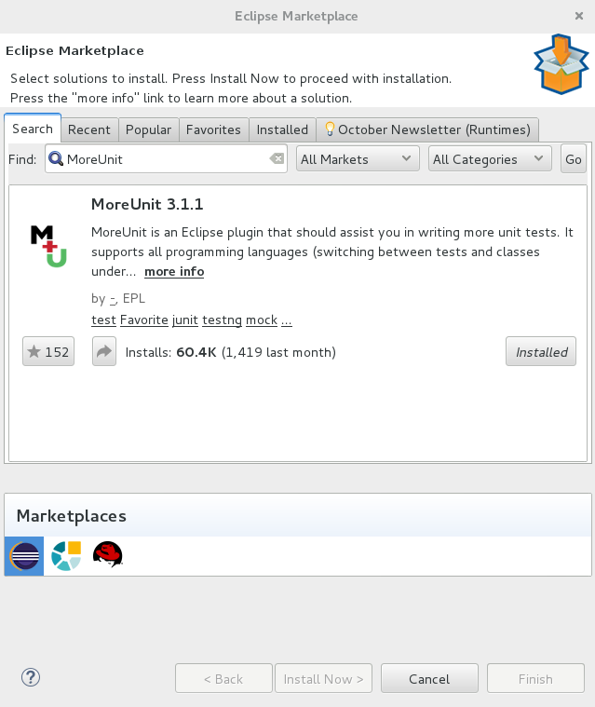
Install Eclipse MoreUnit

Slide 37
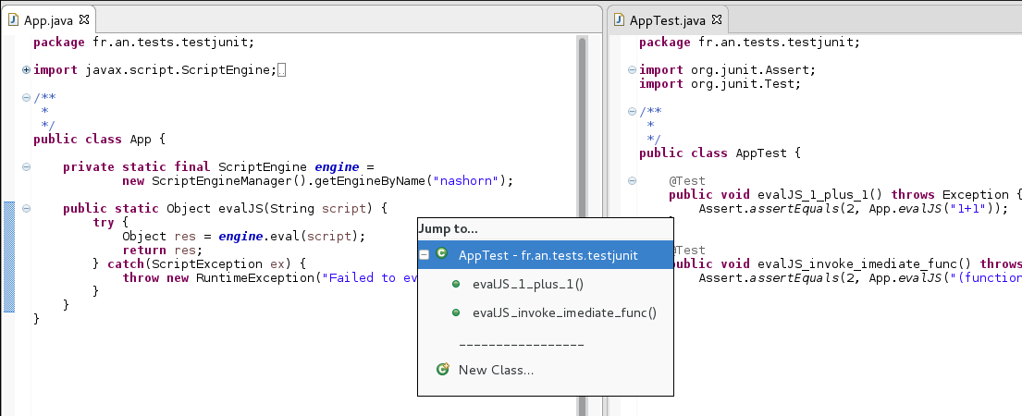
Eclipse MoreUnit plugin
CTRL + J

Slide 38
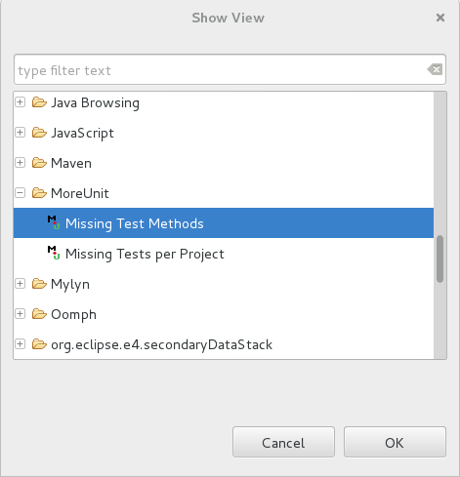

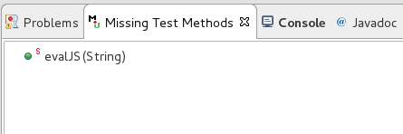
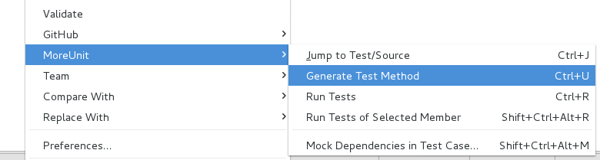
MoreUnit – Missing Tests Methods
CTRL + U

Slide 39
InfiniTest Eclipse Plugin

Slide 40
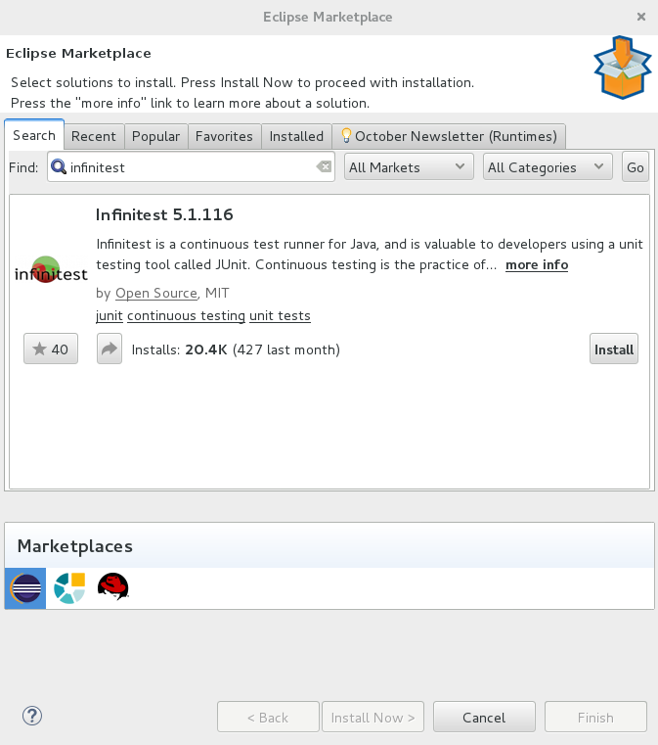
InfiniTest Installation

Slide 41
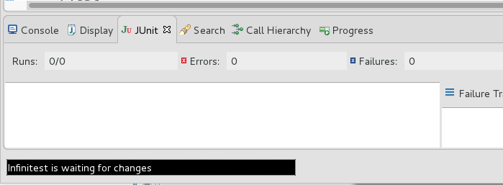



InfiniTest Status Bar
InfiniTest Status Bar

Slide 42
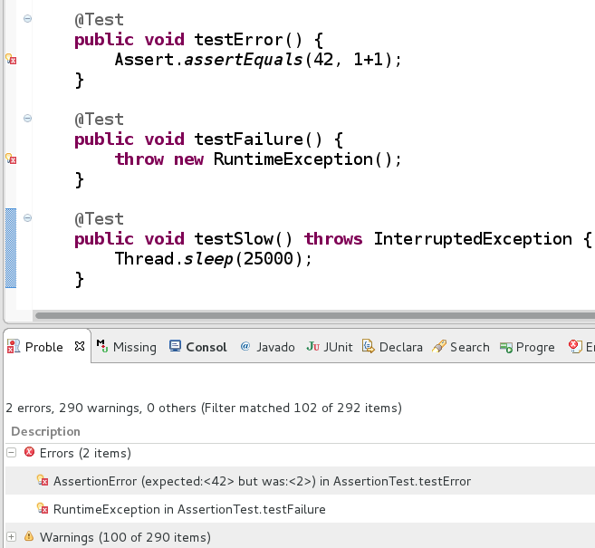
Save => InfiniTest runs Tests
Test Fails = Compile Error

Slide 43
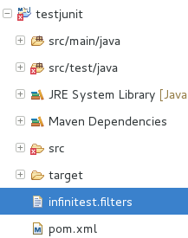
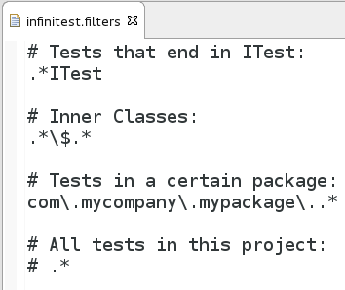
Slow Test => infinitest.filters

Slide 44
EclEma Eclipse Plugin

Slide 45
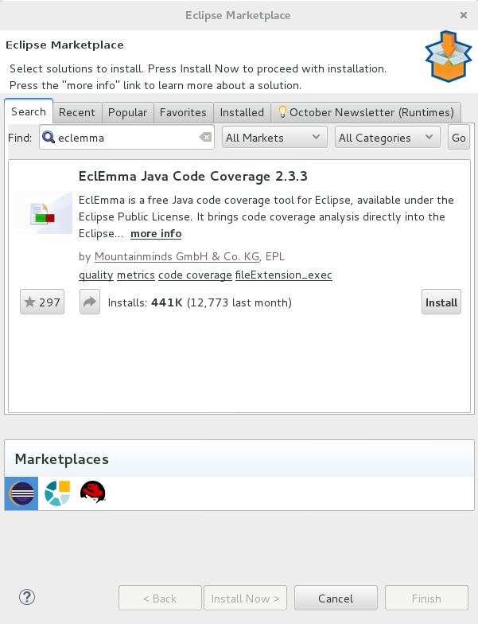
EclEmma Installation

Slide 46

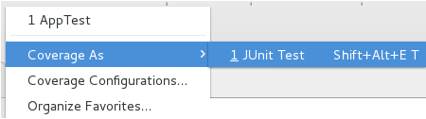
Ecl Emma = Code Coverage
Run with Coverage
Shift+Alt+E T

Slide 47
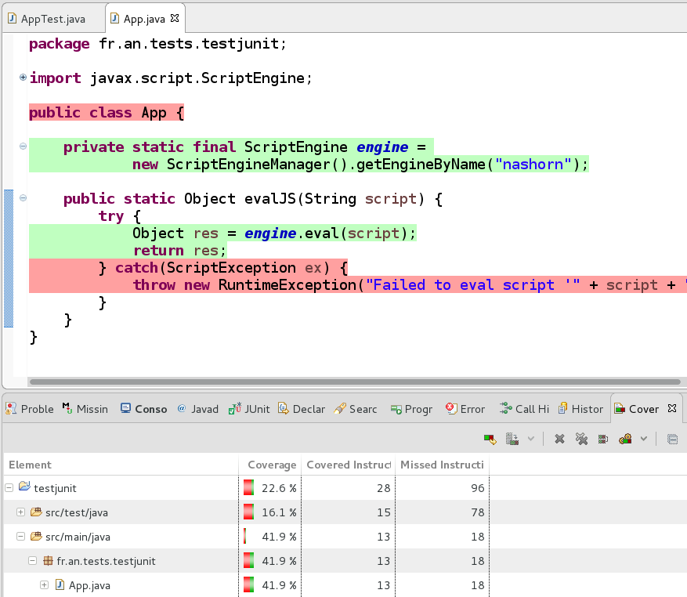
Code Coverage %

Slide 48
Testability Principles

Slide 49
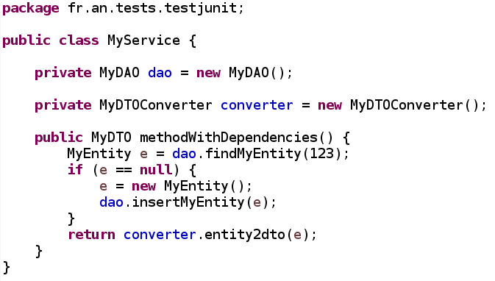
How to Unit Test a System with Dependencies ?

Slide 50
“Unit” Test = Isolated Unitary Test
Dependency1
System Under Test
Dependency2
Test that only
Not that ...

Slide 51
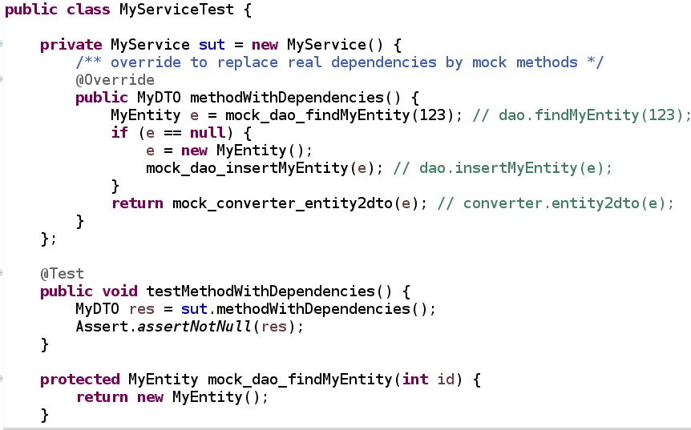
… Difficult to Test … use @Override if not final

Slide 52
Use MockObjects
Dependency1
MockDependency1
System Under Test
Dependency2
Test that only
MockDependency2
Replace by Mock
for Testing...

Slide 53
Testability Principles
IOC = “Inversion Of Control”
/ DI = Dependency Injection
No hard-coded dependencies
No “new”
No “Static”
No “final”
No explicit implementation dependencies
Hollywood principle: “don't call me, I will call you”
Inversion of Control
I need your interface only

Slide 54
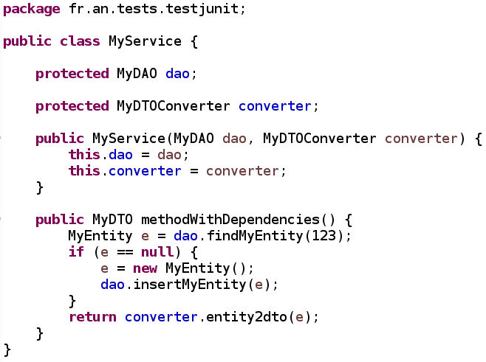
Use Dependency Injection by Constructor

Slide 55
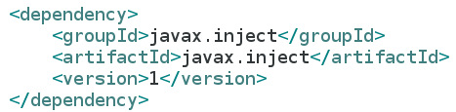
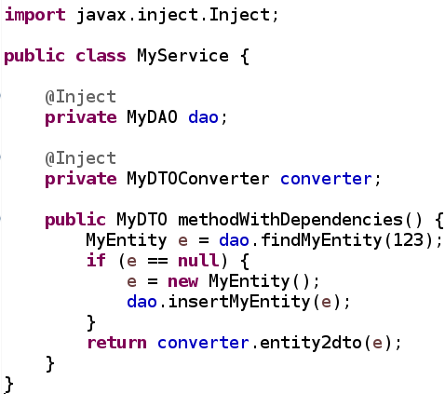
Or Field Injection by Annotation

Slide 56
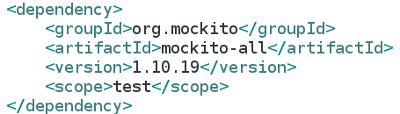
Mockito Library

Slide 57
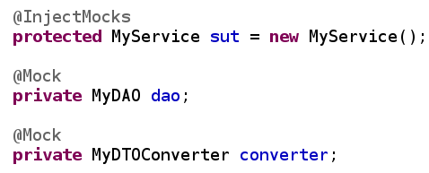
@Mock + @InjectMocks
The SUT is injected its dependencies
with @InjectMocks
Each Mocked dependency is created
with @Mock
… equivalent to “Mockito.mock(MyXX.class)”

Slide 58
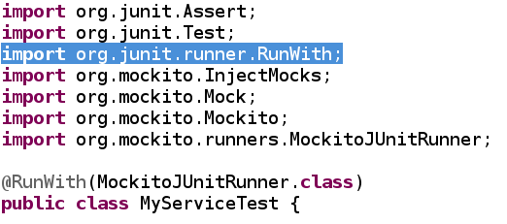
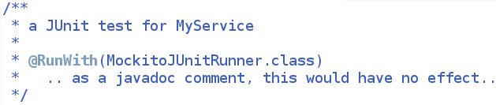
@RunWith(MockitoJUnitRunner.class)
Where the magic starts … (from Junit runner)
Junit understand to start
a Mockito Test
Otherwise ..
Unless interpreted, annotation are just as javadoc

Slide 59
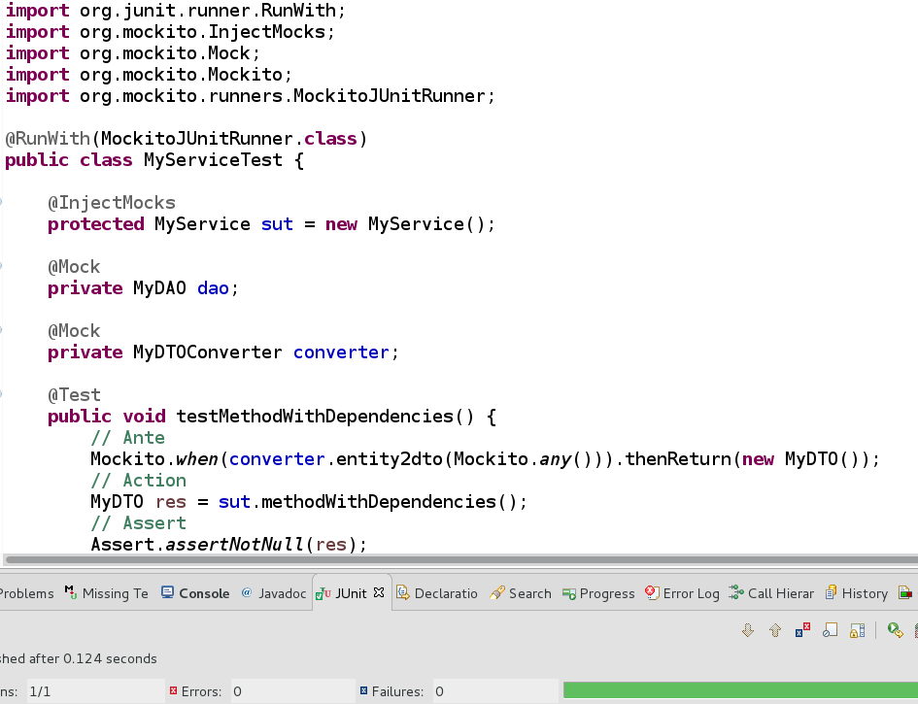
Mockito Test Example

Slide 60
Springframework Test Library

Slide 61
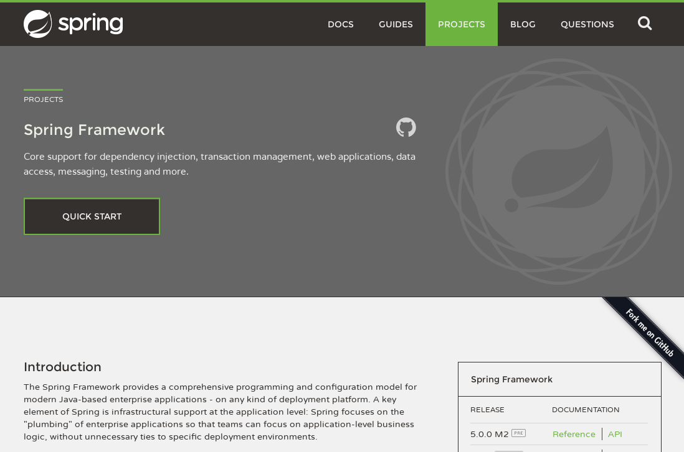
Spring = THE IOC Library for Java
DE FACTO Standard for IOC in Java
Others impementations:
  Guice, Plexus, EJB (seriously?), ...

Slide 62




Upgrade code to Springframework
1/ Add springboot-parent + spring-* pom.xml
2/ Add @Component to managed bean classes
3/ Add @Configuration (with @ComponentScan)

Slide 63

@Inject SUT
(with real Dependencies...)
The SUT is injected its dependencies
with @Inject
There is NO Mock here !!
This is an Integration Test, not a Unit test

Slide 64


@RunWith(SpringJUnit4Runner.class)
Where the magic starts … (from Junit runner)
Junit understand to start
a Spring Test
Springframework understand
its configuration
Otherwise ..
Unless interpreted, annotation are just as javadoc
… like Mockito

Slide 65

Run Test with Spring

Slide 66
Conclusion

Slide 67
Conclusion
Junit ecosystem is amazing
  Junit, Maven, Eclipse, Mockito, SpringFramework
  all works together
  TDD - For better code
Questions ?
  Arnaud.nauwynck@gmail.com
This document:
http://arnaud.nauwynck.free.fr/

