Slide 1
Introduction to Image Analysis
arnaud.nauwynck@gmail.com
This document: http://arnaud-nauwynck.github.io/

Slide 2
Outline
Linear Filter
Non-Linear Filter : Mathematical Morphology
Erode/Dilate, Open/Close
Visual Cortex – bio mimetism
Illusory shapes
Object Recognition, Segmentation, Optical Flow, ..
Deep Neural Networks

Slide 3
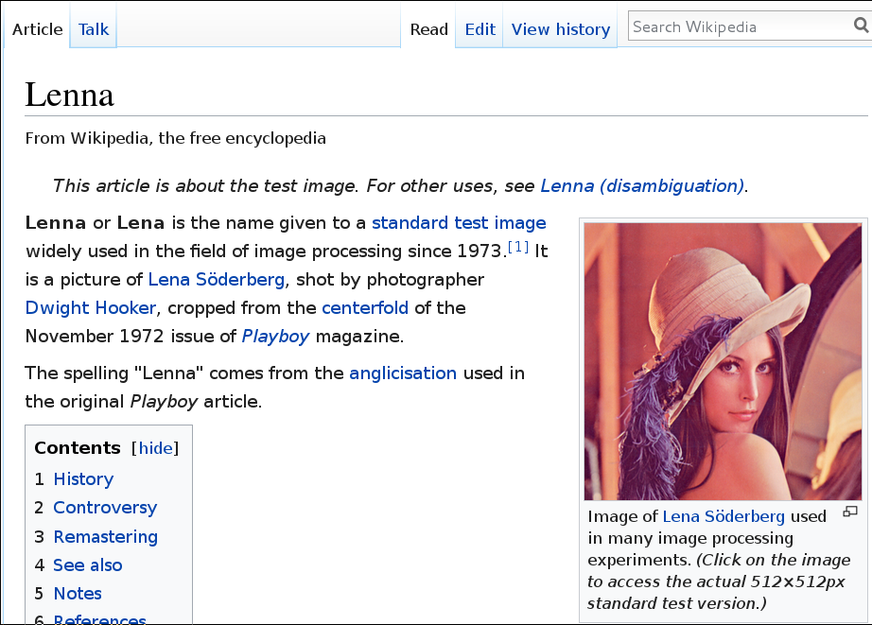
Who's She?

Slide 4
Outline
Linear Filter
Non-Linear Filter : Mathematical Morphology
Erode/Dilate, Open/Close
Visual Cortex – bio mimetism
Object Recognition, Segmentation, Optical Flow, ..
Deep Neural Networks

Slide 5
Linear Combination of Filters
Definition of Linear:
Filter is determined by images of 1 pixel i,j
Indeed, decomposing
There are N² Fij matrix … and each Fij is a N² matrix image

Slide 6
Invariant by Translation
Filter is invariant by translation
when coefficients Fij(x,y) do NOT depend of ij
K is called the Kernel of the linear transformation
it is the coefficient applied uniformely (by translation) to all points
This is possible except on borders of image
(translate Kernel reaches outside of image)

Slide 7

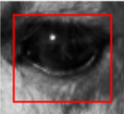
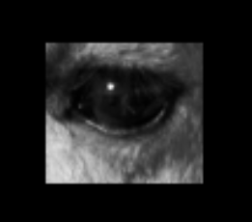
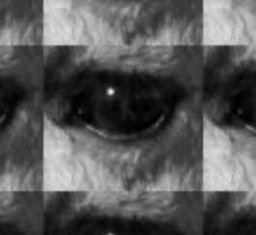
What to do at the Boundary ?
Crop ?
Extend ?
Pad 0 ?
Wrap ?
http://www.coe.utah.edu/~cs4640/slides/Lecture5.pdf

Slide 8
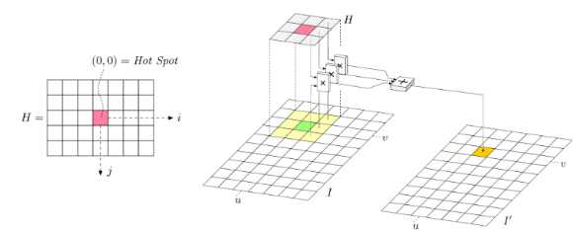
Kernel with small neighborhood only
Example : Kernel with 1 neighbor = matrix 1x1
Kernel with 2 neighbors = matrix 5x5

Slide 9
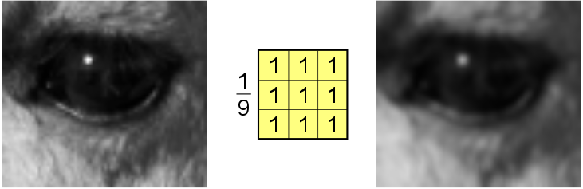
Example : Average Kernel
For all pixel = take average of all neighbours
Smooth every value
Make border fuzzy
Remove noise of single isolated pixel

Slide 10
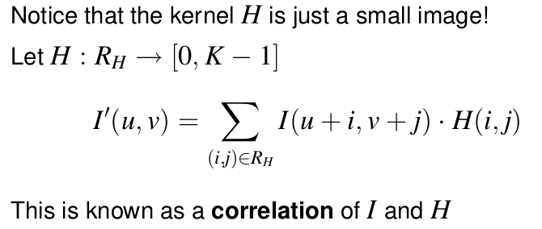
2D Kernel Filter = Correlation
http://www.coe.utah.edu/~cs4640/slides/Lecture5.pdf

Slide 11
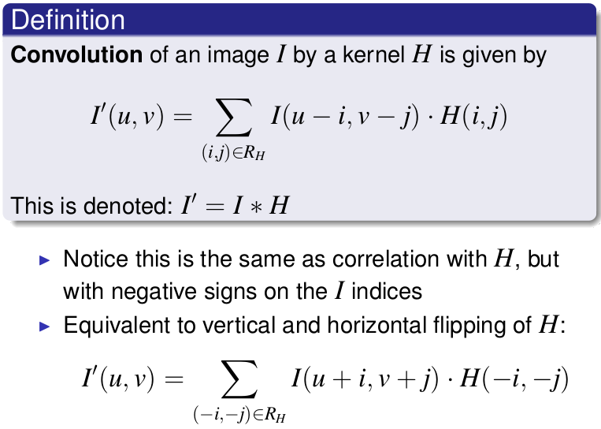
Correlation ~ Convolution
(Symmetric Image)
http://www.coe.utah.edu/~cs4640/slides/Lecture5.pdf

Slide 12
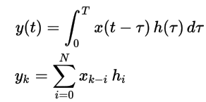
Comparison with 1D Time Filter

Slide 13
Properties of Convolutions ...
Img * K = K * Img
we can leave the image fixed and slide
the kernel or leave the kernel fixed and slide the image.
Img * (aK1+bK2 ) = a Img * K1 + b Img * K2
Combine linear convolutions..
( Img * K1 ) * K2 = Img * (K1 * K2)
Instead of applying K1 to Img then K2 to result,
We can compute (K1*K2) and apply it to Img

Slide 14
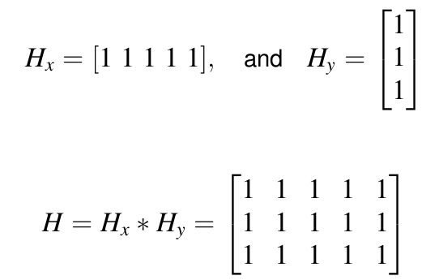
Properties of Separation x/y
Instead of applying H … it is faster applying Hx then Hy

Slide 15
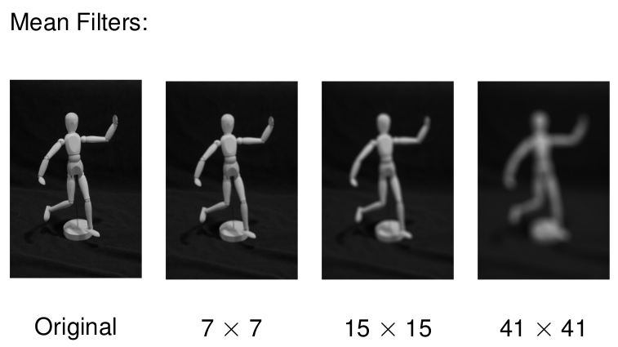
Repeated Smoothing
Effect of Filter Size
Repeat 7 times 3x3 Kernel = 3 times 7x7 Kernel ...
http://www.coe.utah.edu/~cs4640/slides/Lecture5.pdf

Slide 16
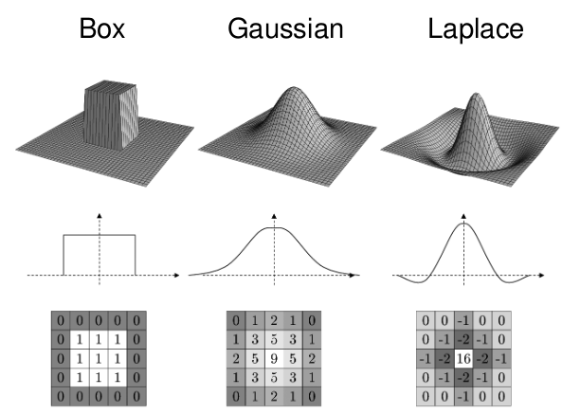
Box, Gaussian, Laplacian (=Gaussian Derivative 1), ...

Slide 17
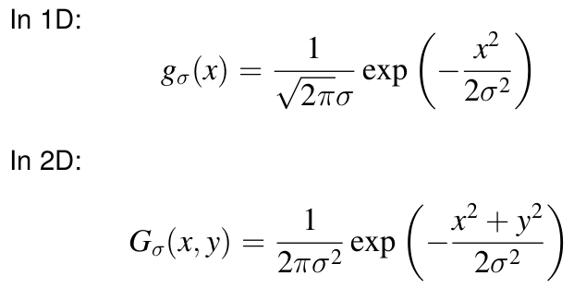

Gaussian..
( A 2-D Gaussian Filter is the product of 2 1-D gaussian )

Slide 18
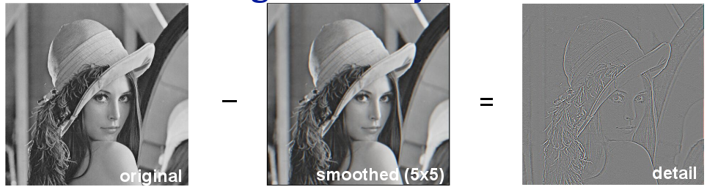
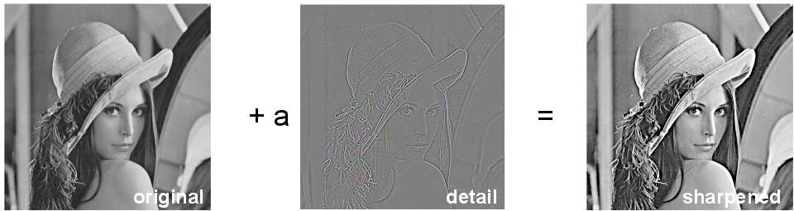
Blurr = Identity - Smooth

Slide 19
Gradient = Derivatives...
Correlation = Detect changes
Correlation = Detect changes

Slide 20
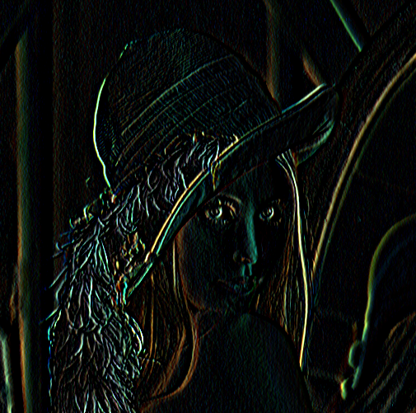
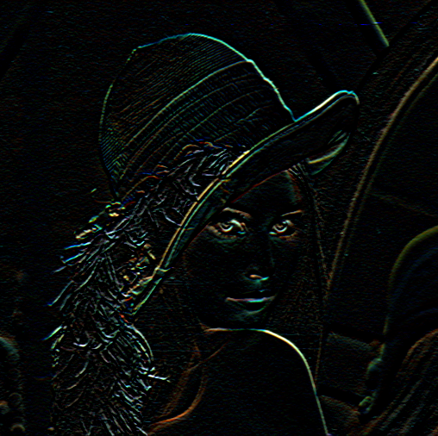
GradX .. GradY
GradX
=> detect Vertical Edges
GradY
=> detect Horizontal Edges

Slide 21
Look Closely ..
Horizontal Lines bigger
in Right image
Vertical Lines bigger
in Left image

Slide 22
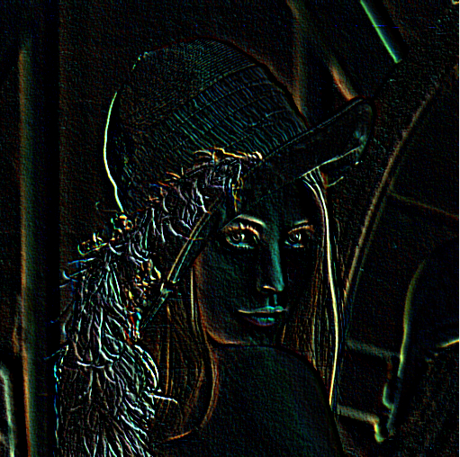
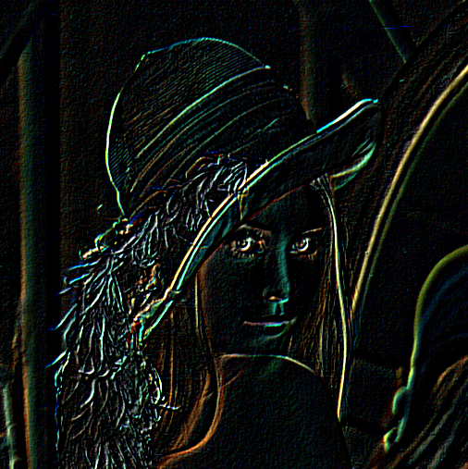
Grad at different Orientations

Slide 23
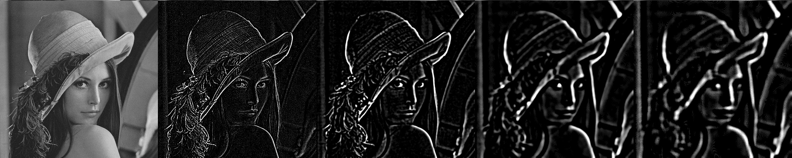
Gradient X (increasing Scale)
Detection of Vertical Edges
Small Scale :
Precise vertical edges position
Many small vertical edges
lot of Noise
Big Scale :
Imprecise edges position
Missed small vertical edges
lower Noise

Slide 24
Sobel Operator ( ~ Gradient)

Slide 25
Second Derivatives ...
Correlation = Detect changes
Correlation = Detect changes

Slide 26
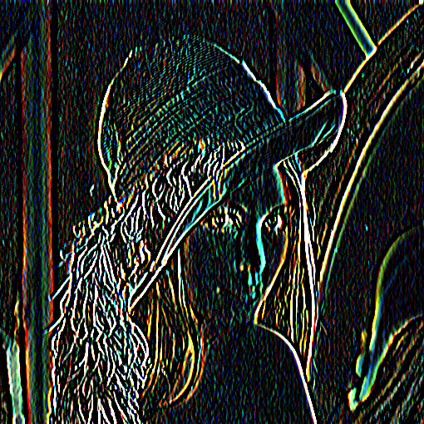
Second Derivative Filters
Example..

Slide 27
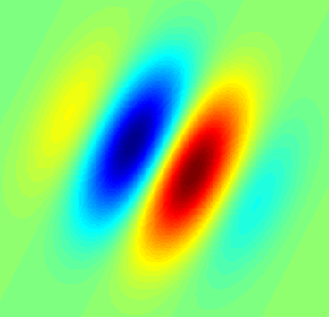
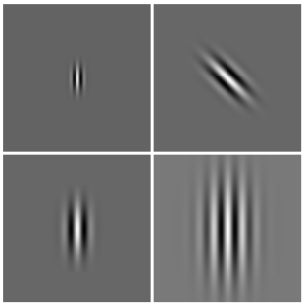
Gabor Filter
Gabor filters are a “local” way of getting image frequency content
( idem Fourier coefficient... but local )
( idem Wavelet)

Slide 28
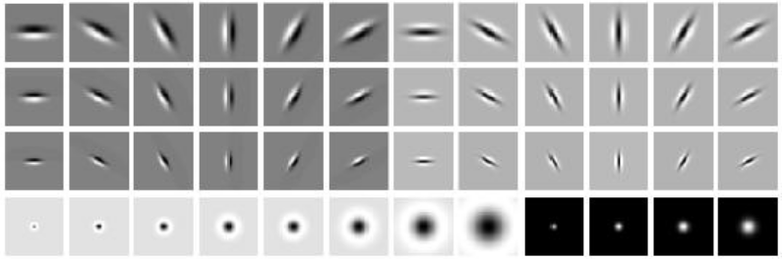
Familly of Gaussian Filters
( Leung-Malik Filter)
Cf next … Same as Visual Cortex in Biology !

Slide 29
Outline
Linear Filter
Non-Linear Filter : Mathematical Morphology
Erode/Dilate, Open/Close
Visual Cortex – bio mimetism
Illusory shapes
Object Recognition, Segmentation, Optical Flow, ..
Deep Neural Networks

Slide 30
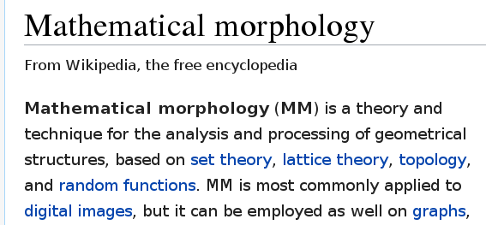
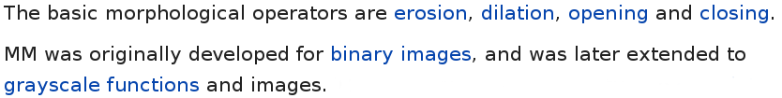
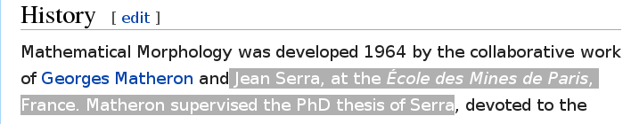
Applying Min , Median, Max ...instead of Linear Sums

Slide 31
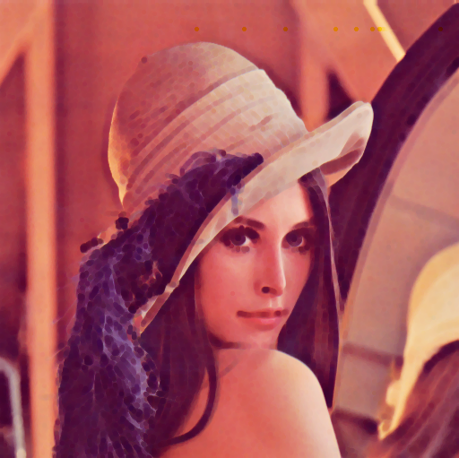
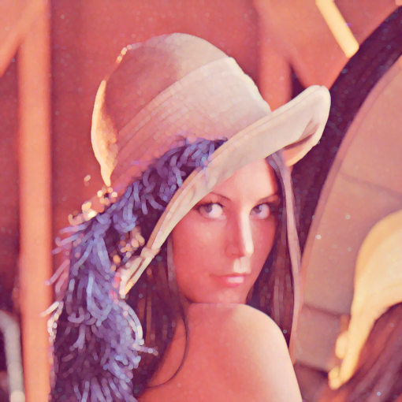
Min (Dilate Black - Erode White)
/ Max(Dilate White – Erode Black)

Slide 32
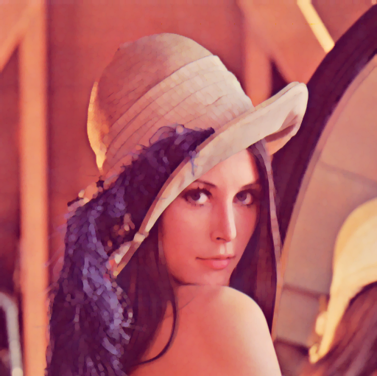
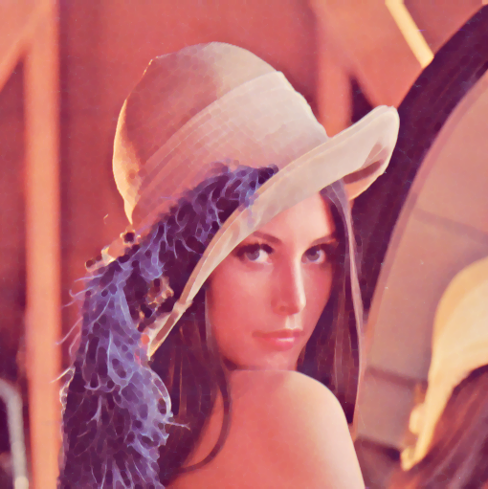
Min-then-Max != Max-then-Min
Min-then-Max
Max-then-Min

Slide 33
Filtering Out All Noise !!
Both OPEN and CLOSE Filter out small noise pixels
The image is looks similar to original...
(cf next for details)

Slide 34
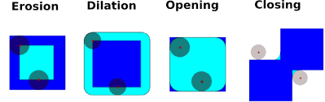
Interpreting Kernel As Point Touching/Within Figure
Source image
Transformed image

Slide 35
Dilatation (Kernel = Disk)
Dilatation
Erosion and Dilatation Kernel do not behave same on small Wholes and Bumps

Slide 36
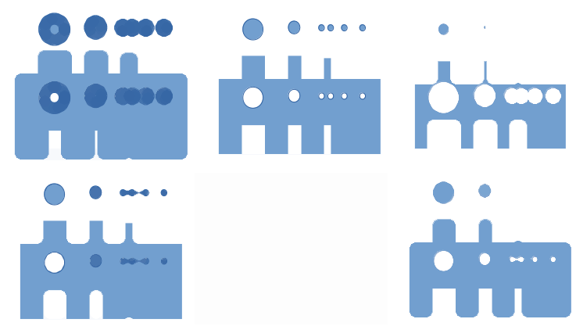
Dilate-then-Erode != Erode-then-Dilate
Dilatation (Min)
Erosion(Max)
Erosion
(Max)
Dilatation
(Min)
Dilatation-then-Erosion
= Close
Erosion-Then-Dilatation
= Open
It closes wholes
It keep wholes
round corner, remove small noises

Slide 37
Using Kernel Shape segment != disk
OK For detecting “filled” area
(… Whatever the direction )
OK For detecting Horyzontal segments!
(… very sensitive to direction )
Similar to GradY Detection for Linear Filters

Slide 38
Example: Opening With Segment
Image

Slide 39
Kernel Shapes Orientation

Slide 40
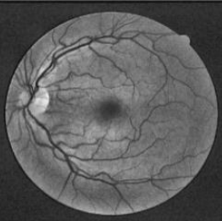
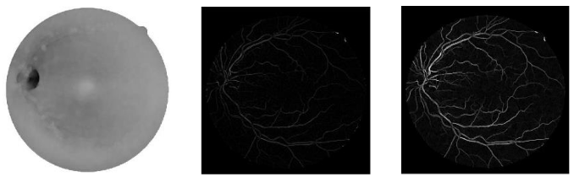
Example : Medical Image
Blood Vessels (image of Eye)
Opening
Image-Opening
Reconstruction by Erosion
summing All Segment Erosions
...

Slide 41
Outline
Linear Filter
Non-Linear Filter : Mathematical Morphology
Erode/Dilate, Open/Close
Visual Cortex – bio mimetism
Illusory shapes
Object Recognition, Segmentation, Optical Flow, ..
Deep Neural Networks

Slide 42
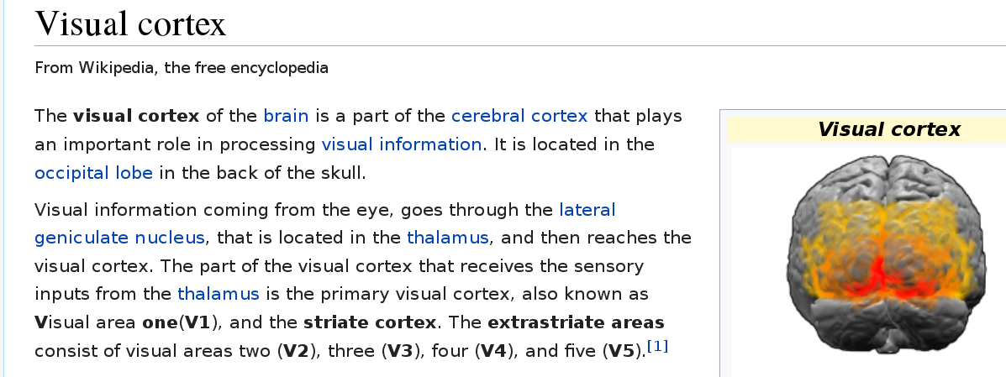
Primary Visual Cortex V1

Slide 43
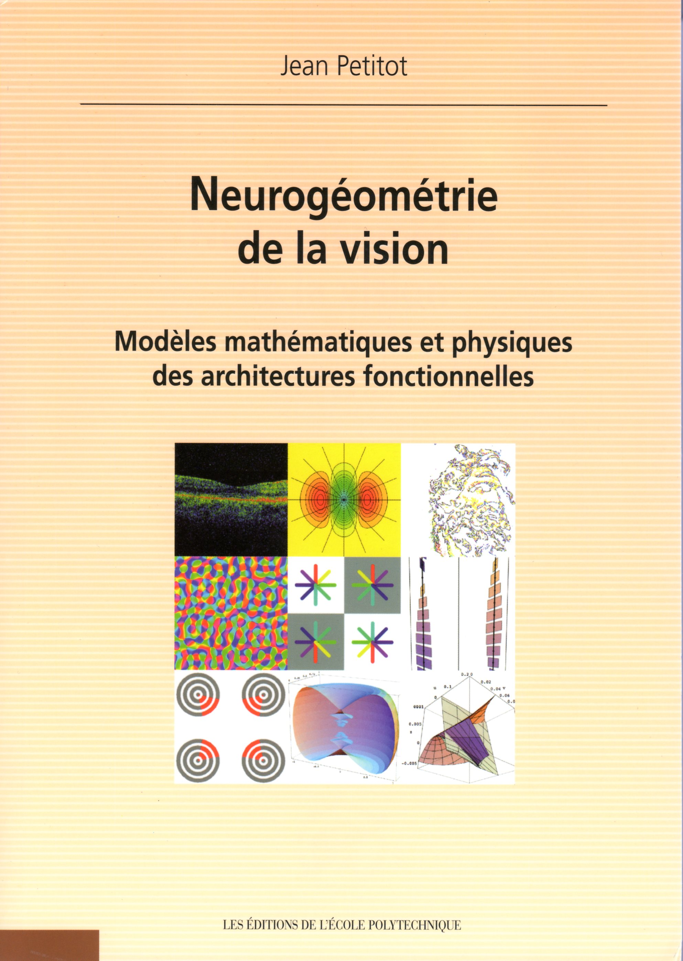
Book: NeuroGeometry of Vision
Jean Petitot
http://jean.petitot.pagesperso-orange.fr/NGV.html
http://jeanpetitot.com/ArticlesPDF/Petitot_NGV_2008.pdf

Slide 44
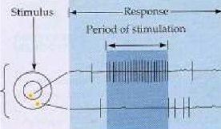
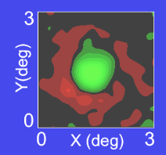
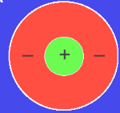
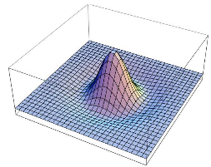
Measuring Response of Neuron
Experiment (on a cat...)
Idealised
Response fonction
Measured
Response fonction
Math
Model (Gabor / Gaussian)
Wavelet

Slide 45
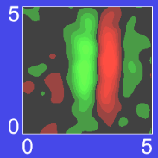
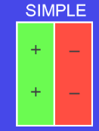
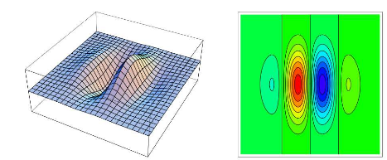
Other Neurons..
Measured
Response fonction
Idealised
Response fonction
Math
Model (Gabor / Gaussian)
Wavelet

Slide 46
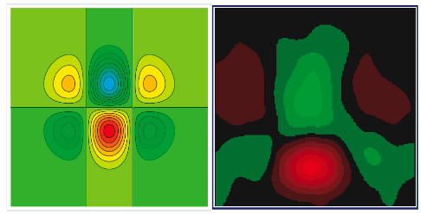
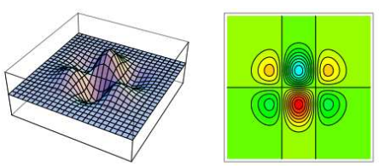
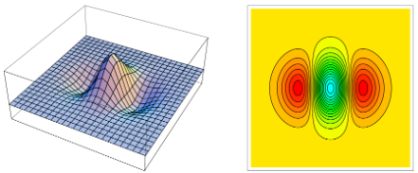
Other Neurons ...

Slide 47
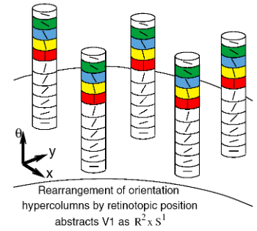
Visual Cortex = Parallel Computing
For Wavelets...

Slide 48
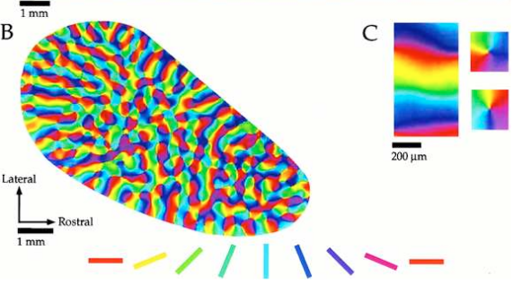
Visual Cortex 2D+Direction
“Bio-Hardware implementation”

Slide 49
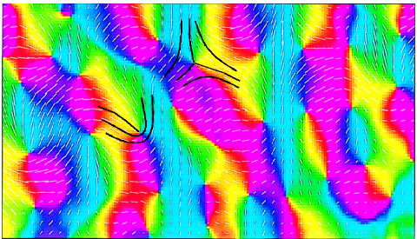
Oerientation Of PinWheels

Slide 50


Detection for Special Points
“End-Point” / “Corner” Point
Recognized patterns:

Slide 51


Co-Activation / Inhibition of Neurons
Bad continuation
=> Inhibition
Good continuation
=> activation

Slide 52

Example of Neuron Co-Activation
“good continuation” criteria
Do you see a Line ?

Slide 53

Neon Effect
The inside is perfectly white …
But it looks ilighted by red

Slide 54


Illusory Contours
Impression of 3D (shape over other)

Slide 55



Illusory Kaniksa Triangles
Illusory “Triangle” over circles
Illusory “Curved” square over circles

Slide 56

Illusory Kanizsa Triangle
...Up to limit Angle

Slide 57

Illusory Kaniksa squares..

Slide 58

Kaniksa illusories re-inforced by lines

Slide 59


Illusory Line
Illusory “Circle” or “Square”
(oscillating)

Slide 60
Outline
Linear Filter
Non-Linear Filter : Mathematical Morphology
Erode/Dilate, Open/Close
Visual Cortex – bio mimetism
Object Recognition, Segmentation, Optical Flow, ..
Deep Neural Networks

Slide 61
Pattern Matching

Slide 62
Optimise Pattern Matching
= Find Max Correlation

Slide 63
Correlation using Combinations of Rectangular Masks

Slide 64
Integral Image

Slide 65
FAST Compute Correlation for Rectangular Maks

Slide 66
Viola Jones Algorithm

Slide 67
Outline
Linear Filter
Non-Linear Filter : Mathematical Morphology
Erode/Dilate, Open/Close
Visual Cortex – bio mimetism
Object Recognition, Segmentation, Optical Flow, ..
Deep Neural Networks

Slide 68

Conclusion

