Slide 1
Reverse Engineering Jhipster SpringBoot Security
arnaud.nauwynck@gmail.com this presentation:

Slide 2

Links..
https://garnier.wf/spring-security-workshop-slides/

Slide 3
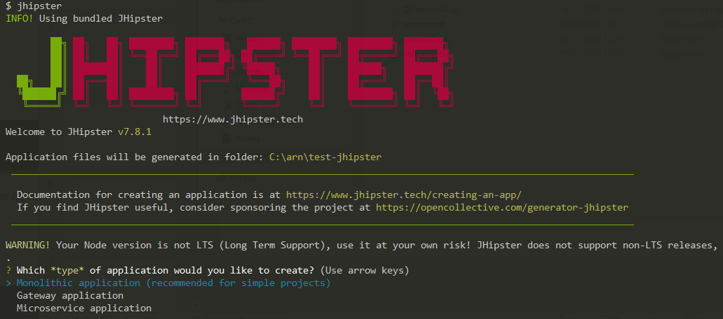
Step 1: create Jhipster app

Slide 4
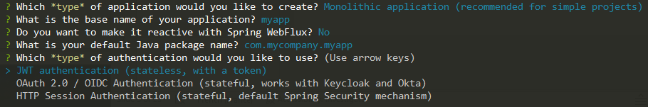
Choose App Type > Security Type

Slide 5
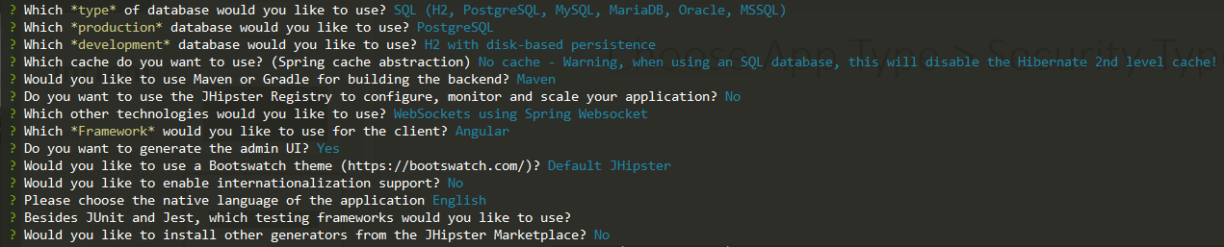
End Choices (Db, Angular, Maven, ..)

Slide 6
Start Generating
Generating a RSA Key pair, for exposing https instead of http
( but self-signed certificate )

Slide 7
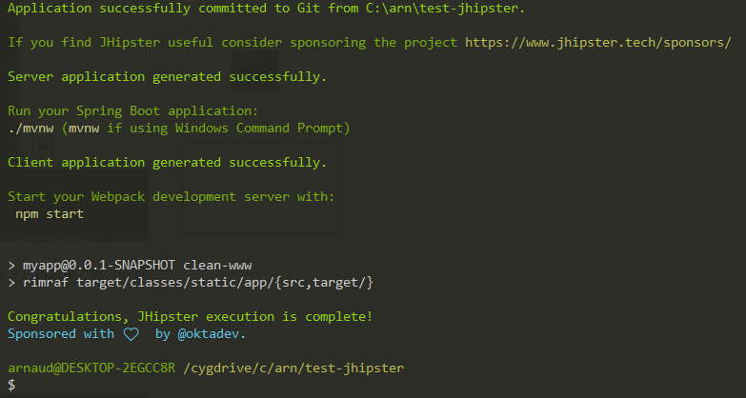
Finished Generating

Slide 8
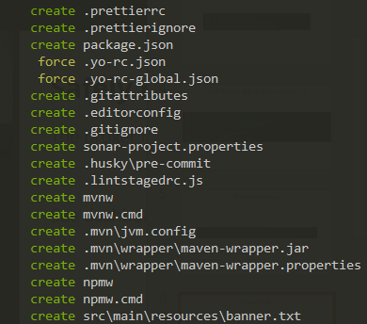

Created Files
( truncated … ) total files :

Slide 9
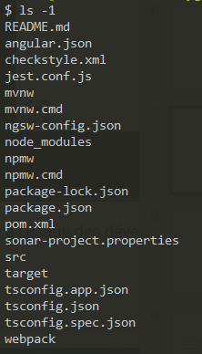

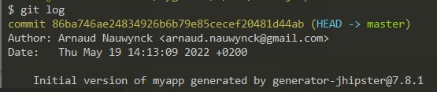
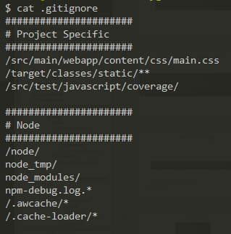
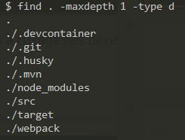
Lot of npm files (in node_modules/**) … but ok .gitignore

Slide 10
Src Files
$ find src/main/java | wc -l
92
$ find src/main/webapp | wc -l
322 $ find src/main/resources | wc -l
29
$ find src/main/docker | wc -l
20
$ find src/main | wc -l
464

Slide 11
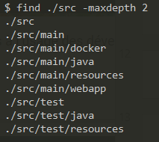
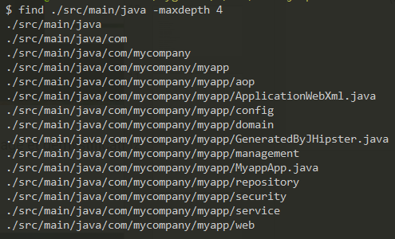
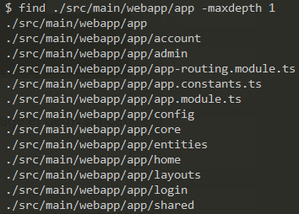
Created Files - Categories
src/ (in git)
src/main (in artifact delivery)
src/test (during test only)
Technical layers organization:
aop, config, domain, managment, security, service, web
Technical layers organization:
account, admin, config, core, entities, home, layouts, login, shared
src/main/webapp
src/mainjava

Slide 12
Created Files, src/main/java

Slide 13
Created Files, src/main/java

