Slide 1
Basic Data-Structures & Algorithms Complexity
This document:
https://

Slide 3
ArrayList<T>

Slide 4
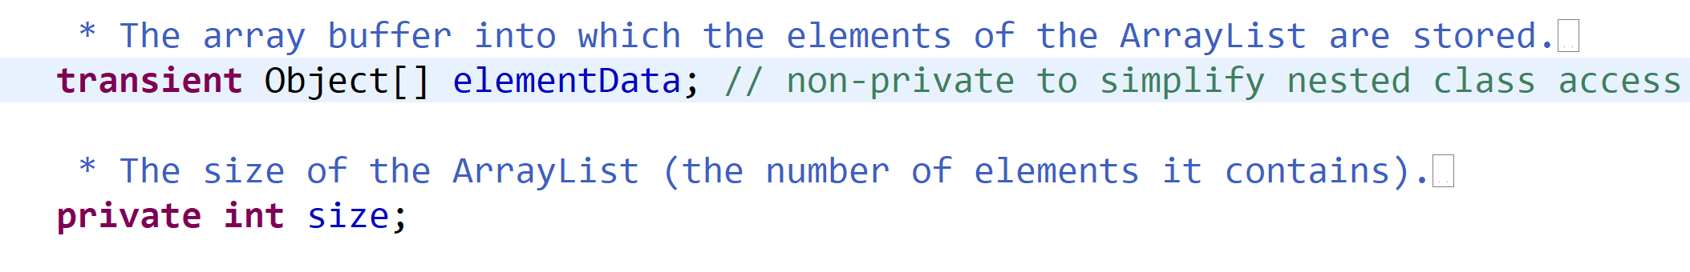
ArrayList
data.length
( > size)
ArrayList
elementData
[0] [1] [2] [3] … [size-1]
size
Free count =
data.length- size
elementI
element0
element1
element2

Slide 5
ArrayList.add(element) If Fast case : enough allocated len
elementData[size] = element
ArrayList
elementData
[0] [1] [2] [3] … [size-1]
[size]
size
Free count =
data.length- size
size++
element
Complexity = O(1) … 1 logical operation
( Math def « f(x) is O(F) » = upper bound to K*F when x is great enough )

Slide 6
ArrayList.add(element) If Slow case : NOT enough allocated len
[0] [1] [2] [3] … [size-1]
ArrayList
arrayCopy(elementData, 0,
newData, 0, size)
newData[size] = element
new T[newSize]
elementData
size
[0] [1] [2] [3] … [size-1]
[size]
elementData=newData
New Free count =
newData.length- size
size++
element
Complexity = O(size) … need copy all existing element pointers

Slide 7
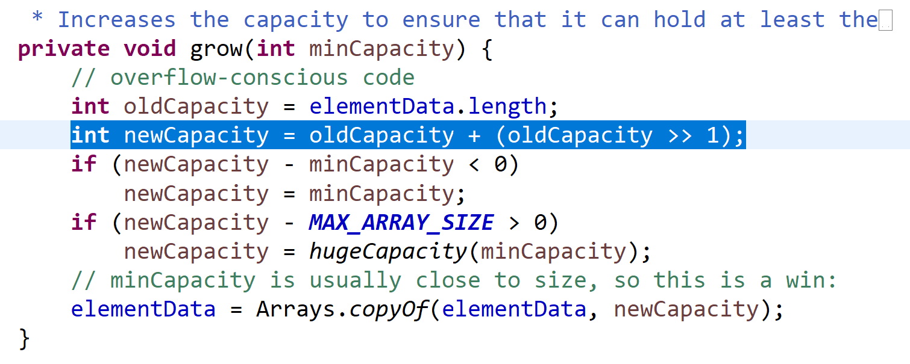
How much to allocate in advance?
compromize
+1 +2 +3 … +size/2 +… ???
Bad compromize:
Need copy every time adding
Bad compromize:
Lot of wasted memory if no more add
Memory preference
Compute preference

Slide 8
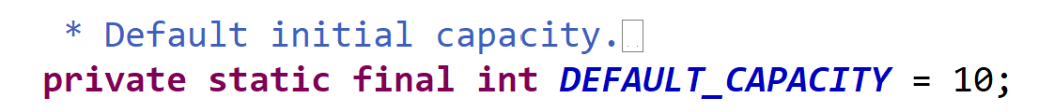
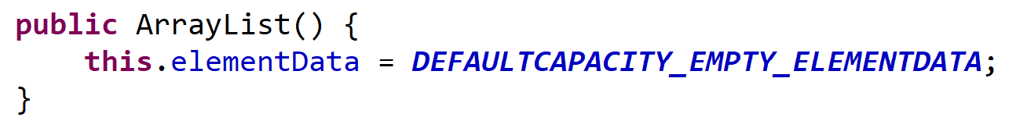
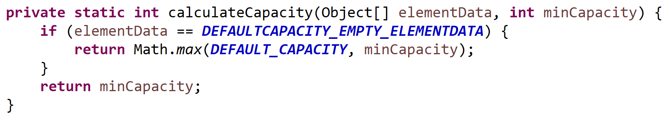
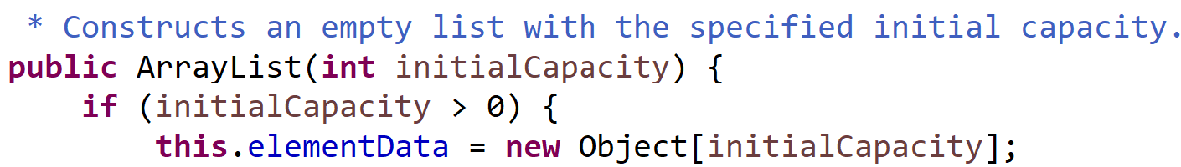
ArrayList initialCapacity : 0 .. then 10
Use explicit if known size

Slide 9
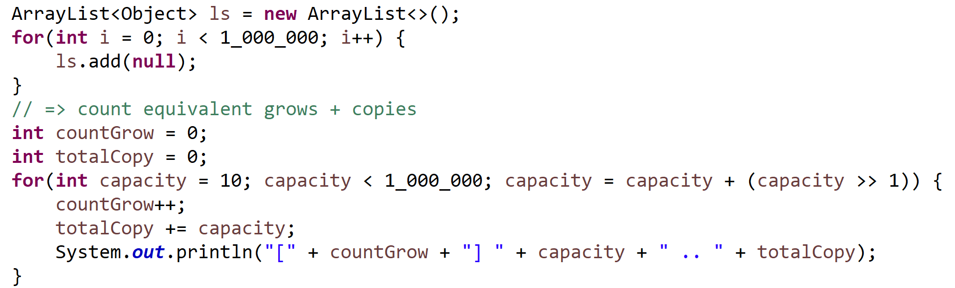
Loop … add(element) => How many waste copies / times ?
Grow capacity occcured at:
Count : 1 2 3 4 5 6 28 29
Capacity : 10 15 22 33 49 73 …. 540217 810325
Total Copies: 10 10+15= 25 25+22=47 80 129 202 1620647 2430972
Total : 2.4 Million copies
To add 1 Million values

Slide 10
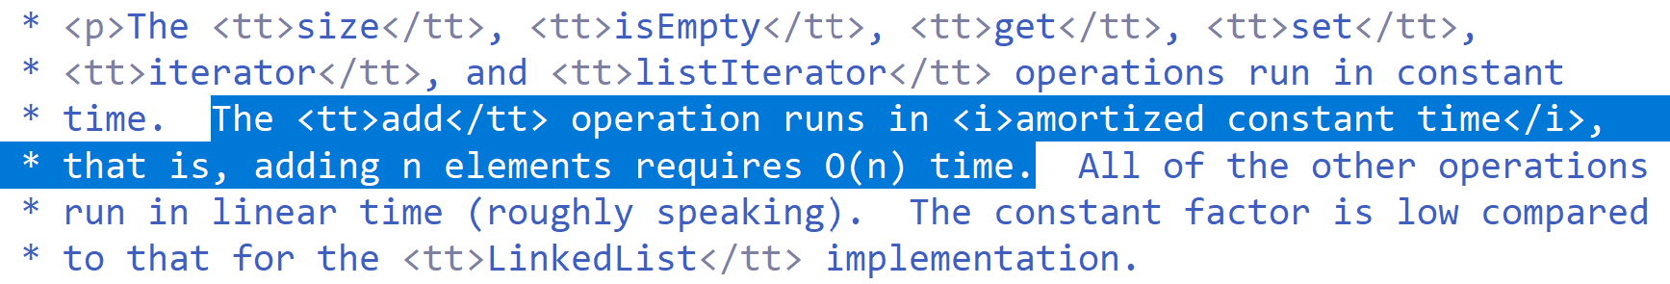
Average Cost
Total copies = O(N) …. 2.4 * N for 1M
Number of reallocations: O(log N)

Slide 11
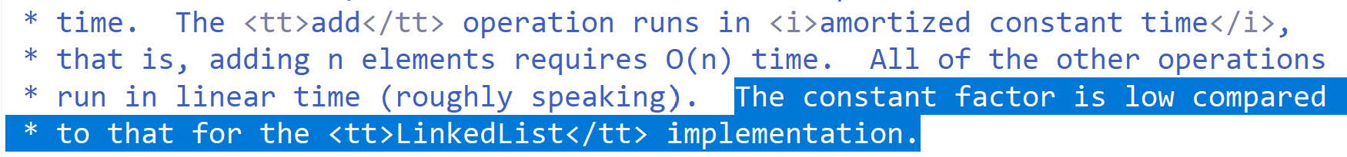
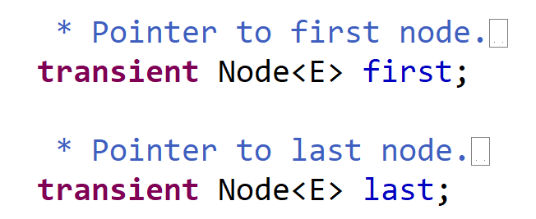
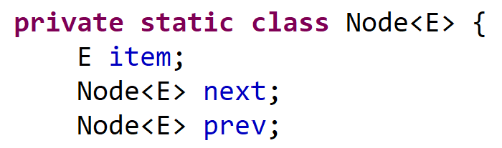
LinkedList … even worse !
LinkedList
Node
Node
Node
first
item
item
item
last

Slide 12
Problem … « RAM » Random Access Memory … cache L1, L2
Typical access time :
RAM is ~100 nanos … 1000 x SLOWER than L1
But Typical capacity :
L1 is ~15 Ko … 1M x SMALLER than Ram ( ~100 Go)
Algorithm cost is driven by Cache misses + Look Aheads

Slide 13
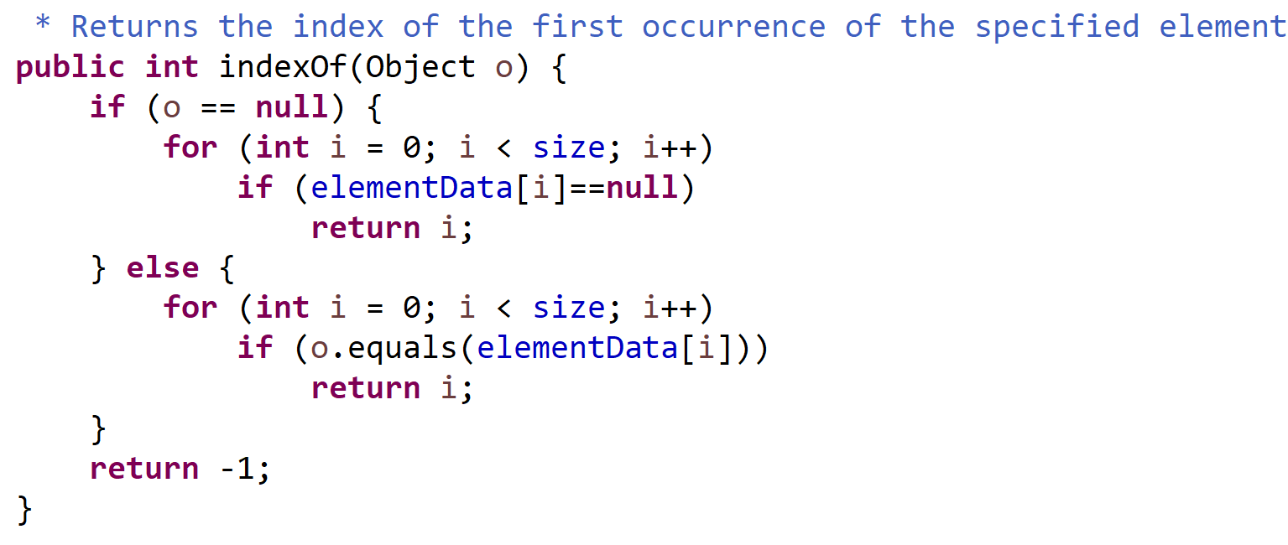
ArrayList.indexOf(element)

Slide 14
Average Cost indexOf()
Positive find => … return break loop maybe at position 1, or 2, … or N
1+2+3+ … + N
(N+1) * N
N+1
= half scan in average
N
=
2 N
=
2
Negative find => … always full scan
=
N

Slide 15
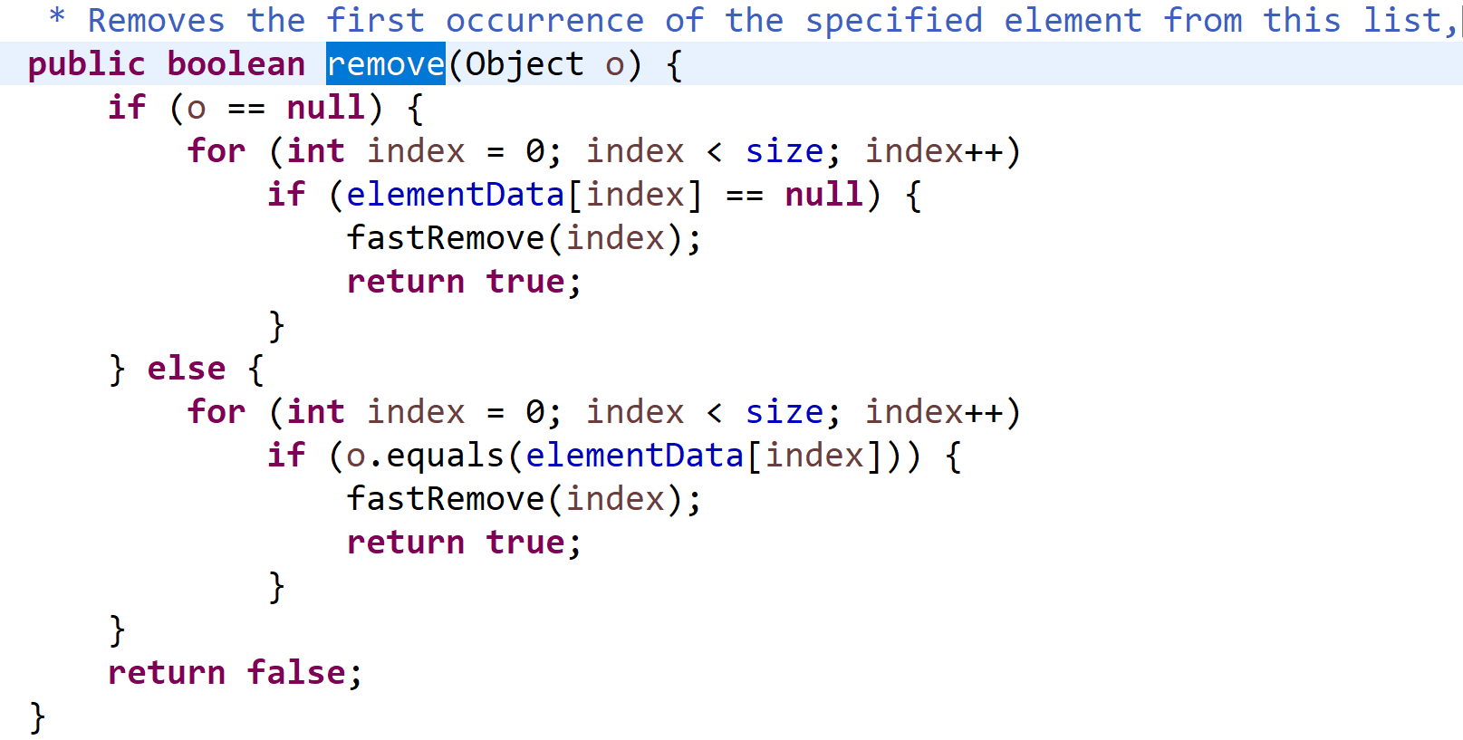
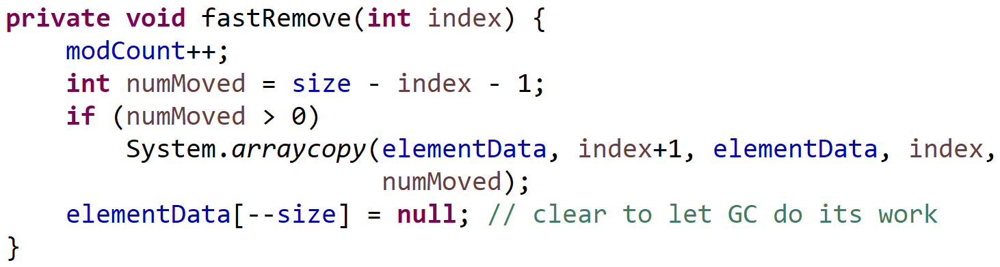
ArrayList.remove(element) = indexOf + fastRemove by index
arrayCopy(…)
data[--size] = null
ArrayList
elementData
[0] [1].. [index-1] [index] … [size-1]
[size]
size
Average : O(size/2 + size / 2) = O(N)
Size--
search
remove

Slide 16
ArrayList.remove(index)
list.remove(0)
WORSE CASE !!! O(N)
Need shifting ALL elements
list.remove(list.size()- 1)
OK… O(1)
Always prefer treating « removing »
elements at end

Slide 17
HashMap<K,V>

Slide 18
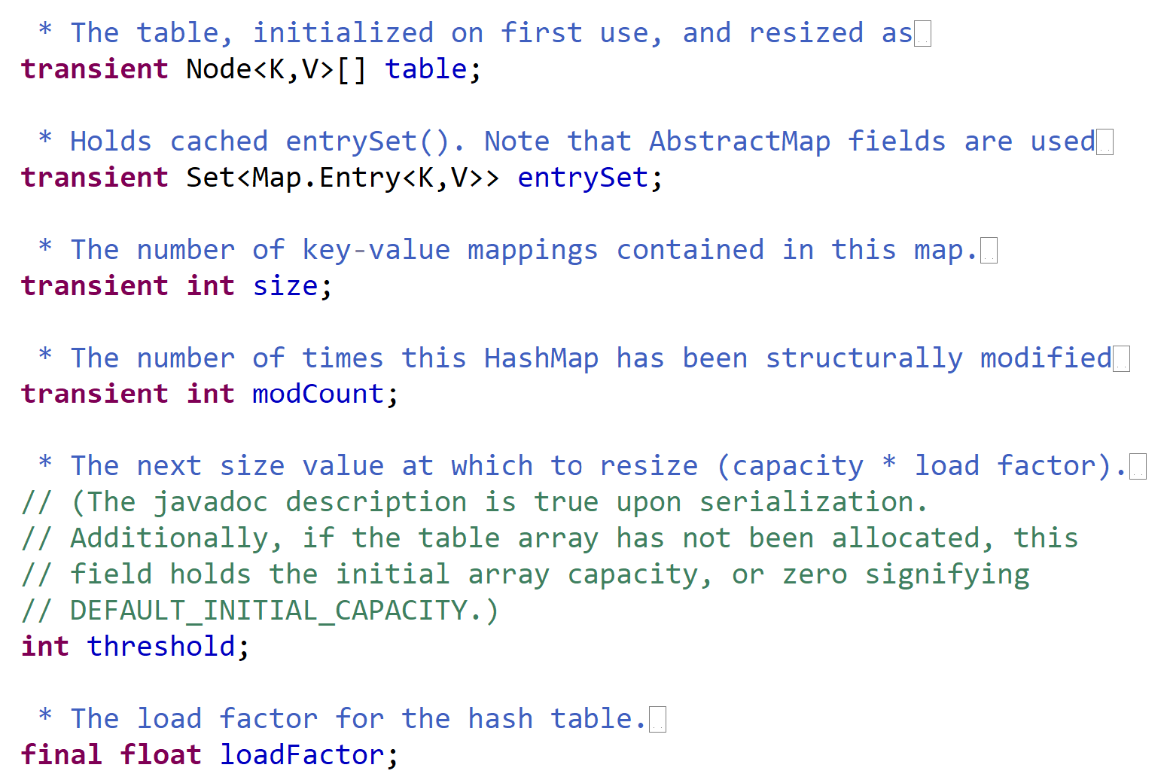
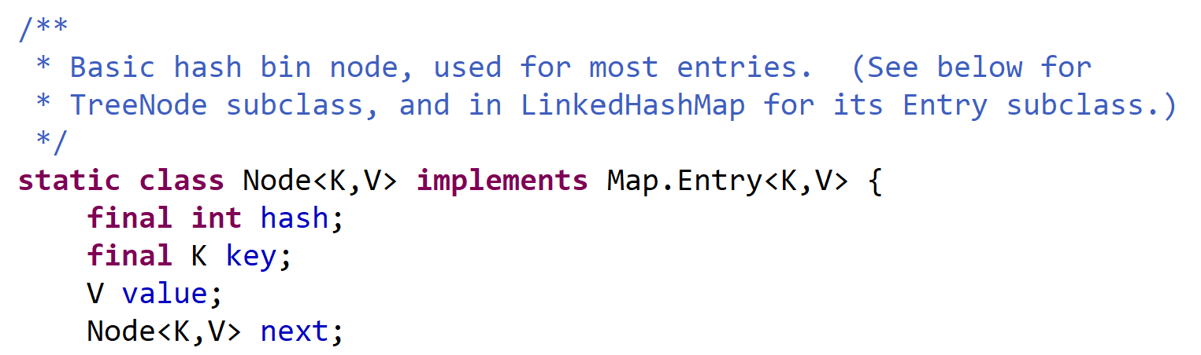
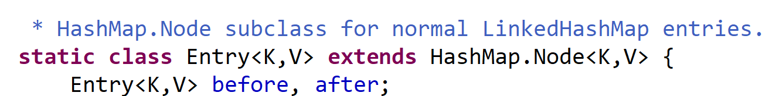
HashMap<K,V>
… LinkedHashMap<K,V>

Slide 19
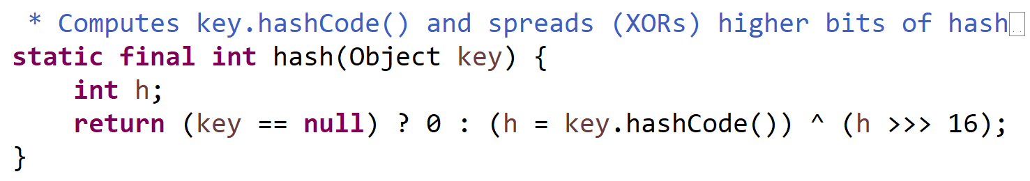
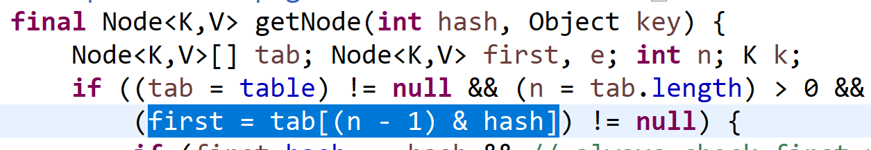
Hashing Function, then Modulo « % » or Bitwise « ^ » « & »

Slide 20
.. Mostly equivalent to « modulo Prime »
hash = Key.hashCode()
… « int » in range [-2^31, +2^31]
hash2 = Math.abs(hash)
… in [0, +2^31] .. Lost 1 bit
index = hash2 % M
Randomly distributed
… in range [ 0, size-1 ]
OK to lookup in array « table[size] »

Slide 21
Same « hashCode()%M » .. collisions
index = Key.hashCode() % M
HashMap
table
[hash%M=0] [hash%M=1] … [hash%M]=M-1
size
Node
Node
Node
hash,key,value
next
hash,key,value
next
hash,key,value
next
Node
hash,key,value
next
Empty slot
Key not found
Key uniquely found
(no collision)
Collision :
2 different keys
with same hash%M
Too many collisions !!
Cf next ( Tree )

Slide 22
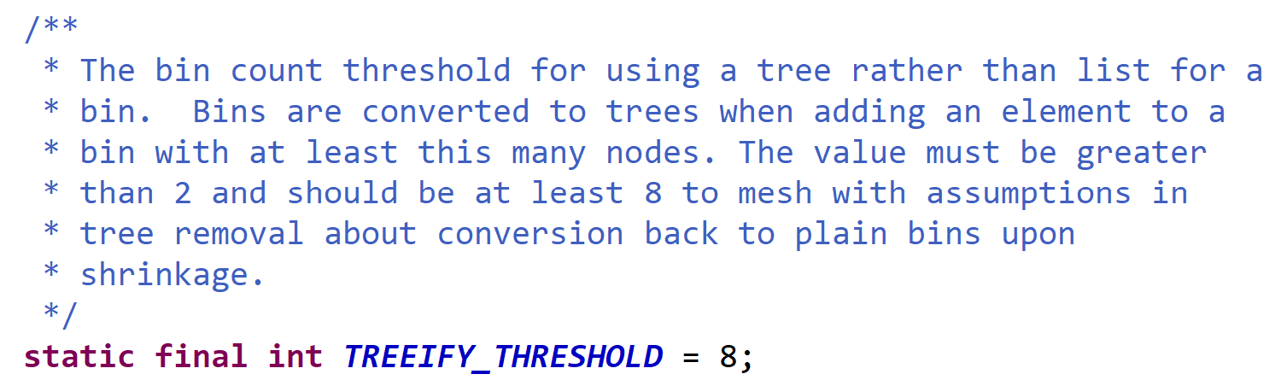
LinkedList to Tree … >= 8

Slide 23
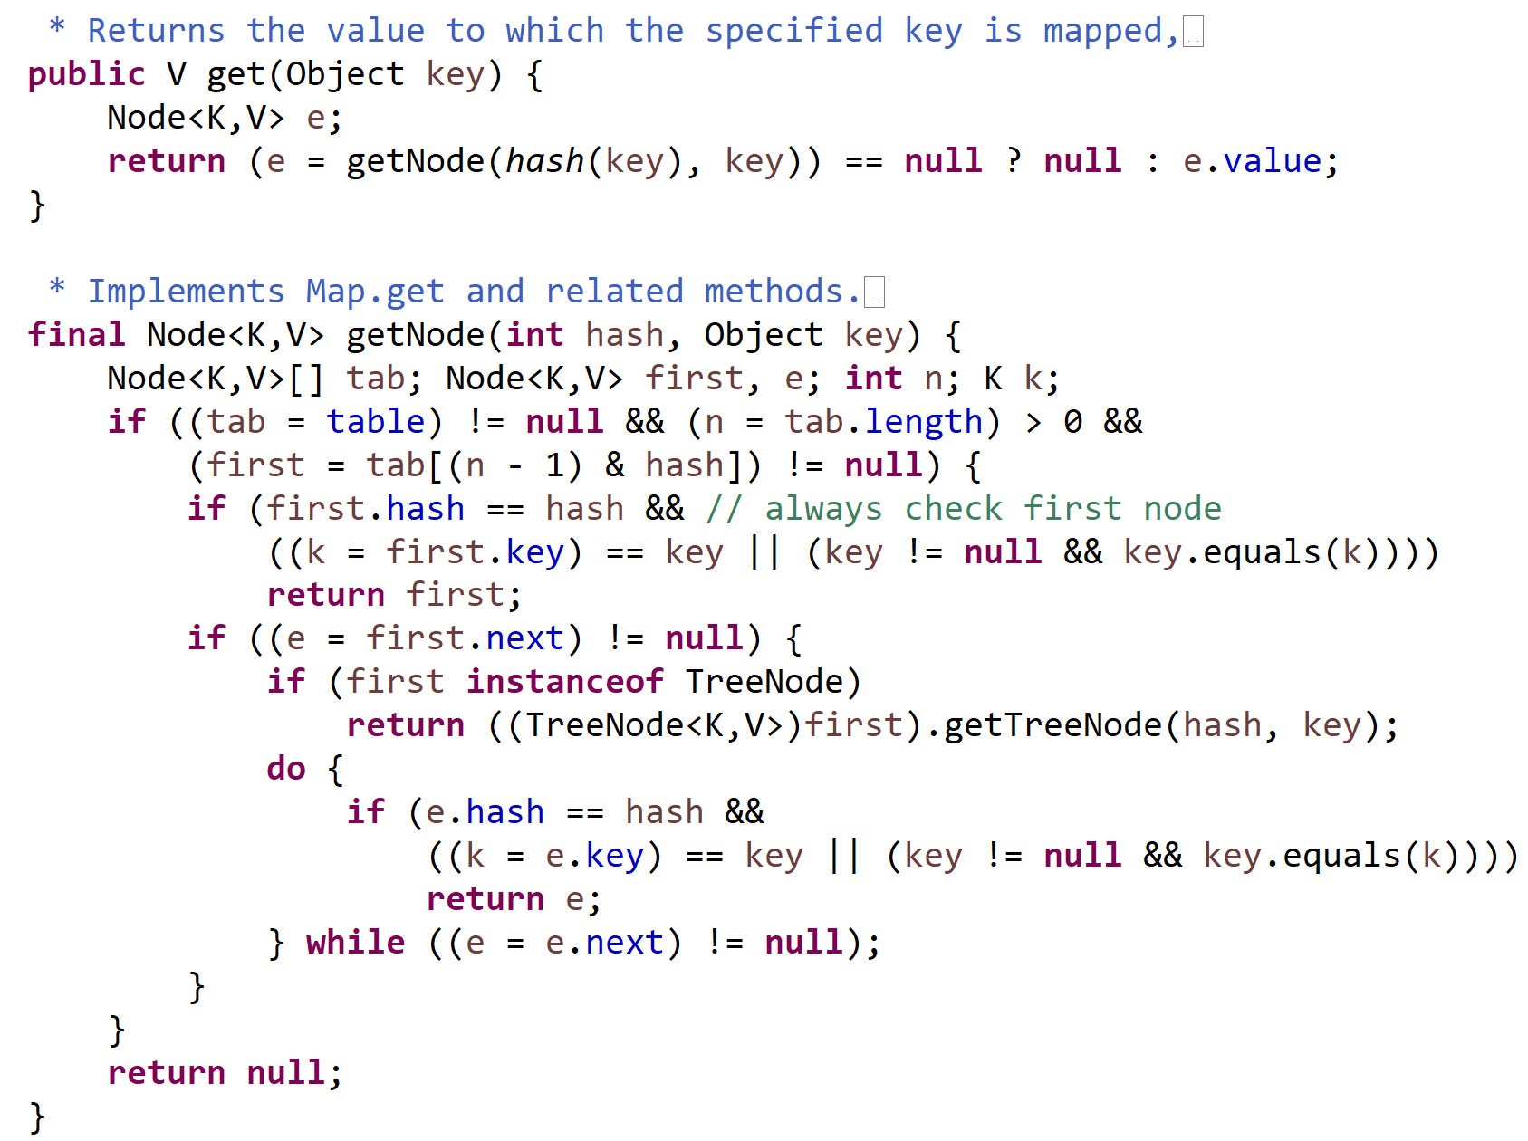
HashMap.get(key) … O(1)
Fast path
O(1) …no collision
many collisions
O(log(C)) …
medium path
O(8/2) …few collision(s)

Slide 24
TreeMap<K,V>

Slide 26
PriorityQueue<T>

Slide 27
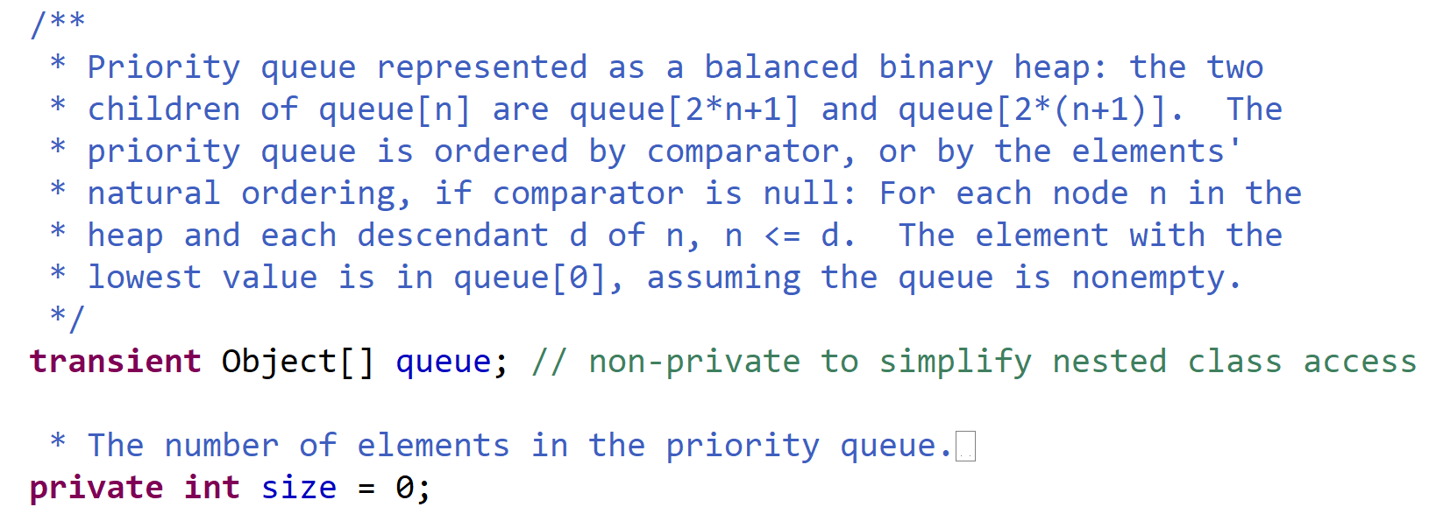
PriorityQueue … Balanced Binary Heap as Array

