Slide 1
Introduction to BigData Processing (Distributed Operations on Spark Datasets)
cours 2024
arnaud.nauwynck@gmail.com
This document: https://github.com/Arnaud-Nauwynck/Presentations/bigdata/ 1-Introduction-Spark-Distributed-Dataset-Operations

Slide 2
Outline
from List<T> to distributed Dataset<T>
Immutability, Functional API
processing workflow: Input -> Transformations -> Output
narrow operations (=per partitions)
wide operations (=shuffled)

Slide 3


Distributed Processing Goal : Handle Tera << Peta Bytes << ... of Data but on Commodity hardwares cluster (Giga of RAM)
RAM
= Giga Bytes
RAM Compute Resources
to process
in Giga Bytes
Disk
= Giga(SSD) / Tera Bytes
Storage Files to process
in Giga/Tera Bytes
Data Lake
= Peta Bytes

Slide 4
What are the Top #4 Challenges ?

Slide 5
Challenge #1 (most difficult) = Manage Failures (be Safe/Resilient) in a Fragile Distributed Sub-Systems

Slide 6
Challenge #2 (most obvious) = Scale to Huge Data limits even with restricted Resources

Slide 7
Challenge #3 (most differenciating) = Be Fast / Efficient at using & sharing resources Scale to CPUs at clusters level Make compromises CPU/RAM/Network/Disk

Slide 8
Challenge #4 ( for success ) = Keep Things Simple Architecture for Open / Powerfull / Wide / Simple become a Standard

Slide 9
Traditional Databases vs BigData
Traditional OLTP Databases
BigData Processing
Interactive
ACID Transactions
Batches
NO "per-row" Transactions (NO Update/Delete)
Use SAN disks
mostly Scale vertically
expensive single hardware
Use HDFS (distributed storage),
Scale Horyzontally
cluster of N x commodity hardwares
Tables = optimized structures by DB
B-Tree
avoid full scans, use cache
proprietary binary storage format
Single Server, Closed - SPOF
Tables = basic directory + files
basic Lists (i.e. Datasets)
no cache but parallelize reads
parquet "columnar" file format
Distributed & Open

Slide 10

How can you eat an Elephant ?

Slide 11
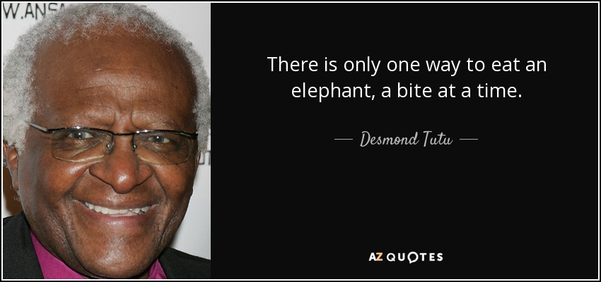
https://www.azquotes.com/quote/529521 ( African Proverb)

Slide 12
split into pieces (partitions), and then iterate one partition at a time (or parallelize + iterate if possible)

Slide 13
Outline
from List<T> to distributed Dataset<T>
Immutability, Functional API
processing workflow: Input -> Transformations -> Output
narrow operations (=per partitions)
wide operations (=shuffled)

Slide 14
java.util.ArrayList<T>
T[] array
size
T objects (=rows)
List<T> ls =
row 0
row 1
...
row N-1

Slide 15
List<T> Java VM Restrictions
Restriction 1/ array are indexed by "int" (32 bits)
number of elements : N < 2 ^32 - 1 ~ 2 Billions
Restriction 2/ objects are in heap memory (-Xmx) total memory size (in bytes) < -Xmx
(ex: -Xmx128g)
N < 2Billions
...
memory < -Xmx

Slide 16
Splitting List<T> in sub-list List<Partition<T>>
Partition=
T[] array
T objects (=rows)
List<Partition<T>> ls =
partition 0
...
partition 1
...
...
partition P
...

Slide 17
List< Partition<T> > restrictions
NO MORE Restriction on number of elements
rows are indexed by [partitionIndex][indexWithinPartition]
can be > 2^32
STILL Restriction 2/ objects are in heap memory (-Xmx) total memory size (in bytes) < -Xmx
(ex: -Xmx128g)

Slide 18
Practical API for Iterating on List<List<T>> ?
Object-Oriented Style
using Iterator pattern
Functional Style
using Lambda, callbacks
Old-School Imperative Code Style
int partitionCount = ds.partitionCount();
for( int i = 0; i < partitionCount; i++) {
List<T> currPartition = ds.partition(i);
int currPartitionLen = currPartition.size();
for (int j = 0; j < currPartitionLen; j++) {
T row = currPartition.rowAt(j);
someUserFunction( row );
}
}
ds.forEach( someUserFunction );
// lambda equivalent
ds.forEach(x => someUserFunction(x));
Iterator<T> iter = ds.iterator();
while(iter.hasNext() {
T row = iter.next();
someUserFunction( row )
}
BAD ... UGLY, INNEFICIENT
Does not scale on distributed code
NOT even on Multi-Threads
BAD
Does not scale on distributed code
NOT even on Multi-Threads
OK
( callbacks must be serializable )

Slide 19
Sample Easy Parallelizable Operations: dataset.count()
dataset
.count() ??
partition 0
...
partition0 count
partition 1
...
partition1 count
dataset.count
= Sum partition_i count
...
partition P
...
partitionP count

Slide 20
Sample Easy Parallelizable Operations: dataset .count() .find() .first() .min() .max() .sample()
partition0 partialResult
partition1 partialResult
dataset.globalResult
= reduce( partition_i partialResult)
partitionP partialResult
step 1/2 : "mapper" side
step 2/2 : shuffle "reducer" side

Slide 21
(Hadoop) Map-Reduce ... legacy
LAKE Big Data
Input Files
in HDFS
Output Files
in HDFS
Map()
Reduce()
Map()
Reduce()
Map()
Map Task Intermediate Results
in HDFS

Slide 22
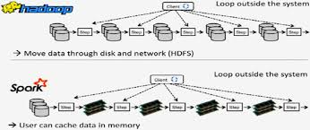
Spark Faster save Intermediate Tasks Results
WRONG schema !!
Urban Legend : Spark would be faster because it caches shuffle data in-memory ???
WRONG !!!!
Spark save all shuffle files to Local Disk
.. even maybe several File writes per shuffle ("Spill To Disk")
=> faster than Hdfs, but Less tolerant to failures

Slide 23

Split: Distribute on Multi JVMs Cluster
JVM = "executor 1"
main JVM = "driver"
partition 0
...
Cluster
JVM = "executor 2"
partition 0
...
...
JVM = "executor N"
partition 0
...

Slide 24
Distributed in-memory Dataset<T> restrictions
Dataset NO more limited by
- number of elements
- single host node RAM
STILL Restrictions :
partition(s) memory size < RAM of a executor holding partition(s)
total memory size < total RAM of cluster
Dataset must be"equally split and distributed" (not skewed)

Slide 25
Swap Partition RAM to Local Disk
JVM = "executor"
...
in RAM
partition
either
swap
(="Spill")
write to disk
reload
from disk
on Disk
File path

Slide 26
Parallelize on cluster : use N(>=100) CPUs ?
How to process with multi-threads ? (use CPU cores )
How many partitions can be processed concurrently ?

Slide 27
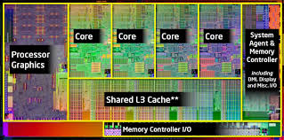
1 Partition on 1 Thread = 1 Task
Applicative TreadPool
+ FIFO Task Queue
= Task executions service
Physical CPU (Core)
1 Task = 1 Partition processed by 1 Thread
for(row : rows) {
process(row)
}
pending
...
enqueue
Partition to Process
(=Task)
dispatch
1 Partition Task
on
1 free Thread

Slide 28
Life of a Task
for(row : rows) {
process(row)
}
receive
program
bytecode
(from driver)
load
partition
data
in-memory
process partition
by Thread
write
result
either
either
already cached in-memory
(FAST)
network shuffle fetch
from other executor(s)
(to local disk)
in-memory
network shuffle fetch
to other executor(s)
read from local disk
write to local disk

Slide 29
How Many Concurrent Threads ?
Compromise:
- use as many as possible? thread need cpu threads ~= vcore
avoid unused iddle CPU while waiting for In-Out
in general threads = vcore = 2 x core - 1
- can't use too much concurrently:
each task need RAM memory, so
threads * taskMemory < total RAM

Slide 30
Successive Tasks Timeline for 1 Thread
timeline
for(row : rows) {
process(row)
}
process part 0
by Thread T
load
partition 0
from disk
write
result 0
to disk
for(row : rows) {
process(row)
}
for(row : rows) {
process(row)
}

Slide 31
Timeline for N(100) Partitions - P(4) Threads
timeline
at start time,
first 4 partitions are processessed
by Threads 1,2,3,4
end time
during "full" processing,
at any time t, there are
exactly 4 partitions
being processed
during "tail processing",
there are < 4 partitions
being processed
the total end time
is the "last + longest"
task end time

Slide 32
Distributed in-memory Dataset<T> restrictions
Dataset NO more limited by
- number of elements
- single host node RAM
- total RAM of cluster
STILL Restrictions :
- Dataset must be "equally split and distributed" (not skewed)
- dependent of local disk(s) of each nodes
- no ephemeral executor / nodes (compute linked to storage)

Slide 33
persistent Disk attached to Host / always served by Executor ...
How to handle Failures (Disk/Executor/Host) ?
How to dynamically scale Up & Down ??

Slide 34
ShuffleService: to re-Read from Disk when Executor is gone / lost
Cluster Node (Host)
Cluster Node (Host)
executor
NO executor
case 2:
reload
from disk
via Shuffle
Service
Shuffle Service
case 1:
(with exec)
reload
from disk
Shuffle Service

Slide 35
Distributed Dataset<T> restrictions
with dynamicAllocation : executor can scale up&down
=> allows to share resources in cluster
STILL Restrictions :
hosts and disks can still NOT scale no ephemeral nodes (compute linked to storage)

Slide 36
Current Developments in Spark... using Local Disk + Object Storage: "Remote Shuffle Service"
write to BOTH
local disk and Remote Storage
Cluster Node (Host)
executor
read case 1:
(with exec)
reload
from local disk
read case 2:
reload
from Remote Storage

Slide 37
DynamicAllocation & Using Ephemeral Compute Resources (Kubernetes)
Node
Node
executor
executor
Node
Node
executor --
executor --
Spark Scale Down
Node
Node
Spark Scale Up
0 executor
0 executor
Node Scale Down
Node--
Node++
Node Scale Up

Slide 38
Dataset<T> Restrictions Summaries
Dataset NOT limited by
- number of elements
- single host node RAM
- total RAM of cluster
- local disk(s) of each nodes
- dynamicAllocation: executor can be scale up/down
- compute resource: node can be scale up/down
STILL Restrictions :
Dataset must be "equally split and distributed" (not skewed)
NOT all partitions can be processed simultaneously
Cpu <-> Memory <-> Disk IO <-> Network are trade-off

Slide 39
Outline
from List<T> to distributed Dataset<T>
Immutability, Functional API
processing workflow: Input -> Transformations -> Output
narrow operations (=per partitions)
wide operations (=shuffled)

Slide 40
Immutability : getter(s), new, NO setter
instead of modifying existing objects
just create new ones !

Slide 41
Functional API
NO Iterative Code
ds2 = new ..; for(int i =0; i <N; i++) { ds2.add(ds1.get(i));}
use Functions (Lambda)
ds2 = dataset1.map(row -> new Row(...))
.filter(), .flatMap(), .mapPartition(), .reduceByKey(), etc.

Slide 42
Example of CRUD API Replacements "C" = Create
No ds=new Dataset()
for(..) { ds.addRow( row); }
use ds=spark.createDataset( list)
or ds=spark.read.format(...).load("path/files/")
or ds=spark.sql("SELECT * FROM .. WHERE ..")

Slide 43
Example of CRUD API Replacements "R" = Read
No for(int i=0; i<ds.partitionCount(); i++) {
for(int j=0; j< ds.part(i).count(); j++) {
ds.getRow( i, j ); } }
use ds.map(row -> {.. })
or ds.mapPartitions(rowIter -> { while(rowIter.hasNext() { .. } })

Slide 44
Example of CRUD API Replacements NO "U" = Update !!
No
ds.setRow(row); row.set(col, value)
Sql "UPDATE TABLE .. SET .. WHERE .."
use
ds2 = ds1.map(row -> new Row(copy with ..));
or install Iceberg or DeltaLake Extension
"UPDATE ..", "UPSERT ..", "SELECT asof version"

Slide 45
Example of CRUD API Replacements NO "D" = Delete !!
No ds.removeRow()
Sql "DELETE FROM TABLE .. WHERE .."
just use
ds2 = ds1.filter(row -> { true/false });
or install Iceberg or DeltaLake Extension
"DELETE.."

Slide 46
Outline
from List<T> to distributed Dataset<T>
Immutability, Functional API
processing workflow: Input -> Transformations -> Output
narrow operations (=per partitions)
wide operations (=shuffled)

Slide 47
External Input - Internal Dataset API - External Output
dataset = spark.createDataset( inMemoryList )
inMemoryList = dataset.collectAsList()
SMALL data only !
SMALL data only !
INTERNAL API
Dataset Transformations
dataset = spark.read() ... .load(filePath)
dataset = spark.sql("SELECT * FROM ..")
ds2 = ds1.<<transform>>(..)
dataset.write() ... .save(filePath)
spark.sql("INSERT.. SELECT..")
Hdfs File Inputs
or other IO reads
Hdfs File Outputs
or other IO writes

Slide 48
Challenge for Distributed Programming
How to ?
- Distributed read Input files ?
- Distributed write result files ?
- transform ?
Concurrency between threads & nodes (Dataset Immutable => OK)
result on 1 node memory is not "available" on other nodes => need network copy + sync
all "iterative style" programming is impossible

Slide 49
Inputs : Distributed Read Files
[2/3] assign Tasks
(who process files)
executors
Driver
[1/3] list dirs & files
(metadata only)
[3/3] read Files = create Dataset Partitions
Distributed File Storage
examples:
Hadoop HDFS
Amazon S3
Azure AdlsGen2

Slide 50
Sample Spark ".read()" Code
Dataset<Row> ds = sparkSession
.read()
.format("parquet")
.option("compression", "snappy")
.load("hdfs://path/dir")
Dataset<Row> ds = sparkSession
.sql("SELECT * FROM .. WHERE ..");

Slide 51
Read dir, not files ?
sparkSession.read() ..
.load("hdfs://path/dir") // implicitly "**/*.parquet" files
Spark will discover all sub-dirs
filter out all "_*" and ".*" considered as Hidden files
example: "_SUCCESS", ".part-*.crc" are excluded
Dirs should contain only homogeneous files type

Slide 52
Outputs: Distributed Write Files
[2/3] assign write Tasks
executors
Driver
[1/3] knows
Dataset partitions
[3/3] write Files = 1 per dataset partition
... can be efficiently parallelized
BUT can lead to problem
"Too many Small files"

Slide 53
Sample Spark ".write()" Code
Dataset<Row> ds = ...
ds.write()
.format("parquet")
.option("compression", "snappy")
.save("hdfs://path/dir")
sparkSession
.sql("INSERT ... SELECT .. ");

Slide 54
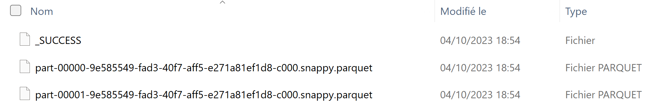
Write ... UUID Generated filenames 1 File per Partition
to write in a Distributed way, Spark generates random UUID filename,
and "part-000xx" index for each partition
"_SUCCESS" is an empty marker file
example:

Slide 55
(Input ->) Transformations (-> Outputs)
[2/3] assign Tasks
executors
Driver
[1/3] knows
Dataset partitions
[3/3] transformation Tasks
can change partitions topology (change count/size)
can redistribute data on cluster

Slide 56
Outline
from List<T> to distributed Dataset<T>
Immutability, Functional API
processing workflow: Input -> Transformations -> Output
narrow operations (=per partitions)
wide operations (=shuffled)

Slide 57
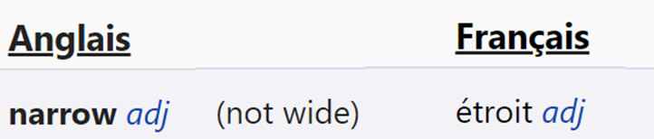
"Narrow" ?
https://www.wordreference.com/enfr/narrow
wide
narrow

Slide 58
Narrow Transformations
ds2 = ds1.narrowTransform(..)
locally independent (parallelisable)
transformations
for each partition
ds1-partition[0]
ds2-partition[0]
ds1-partition[1]
ds2-partition[1]
not necessarily "row by row",
but partition by partition
ds1-partition[n]
ds2-partition[n]
NO network data movement
between partition

Slide 59
Narrow Transformation
[2/4] assign Tasks
executors
Driver
[1/4] knows
Dataset partitions
[3/4] transformation Tasks
on each executor,
if there were N src partition(s),
=> there will be N result partition(s)
[4/4] wait result status
.. register new dataset

Slide 60
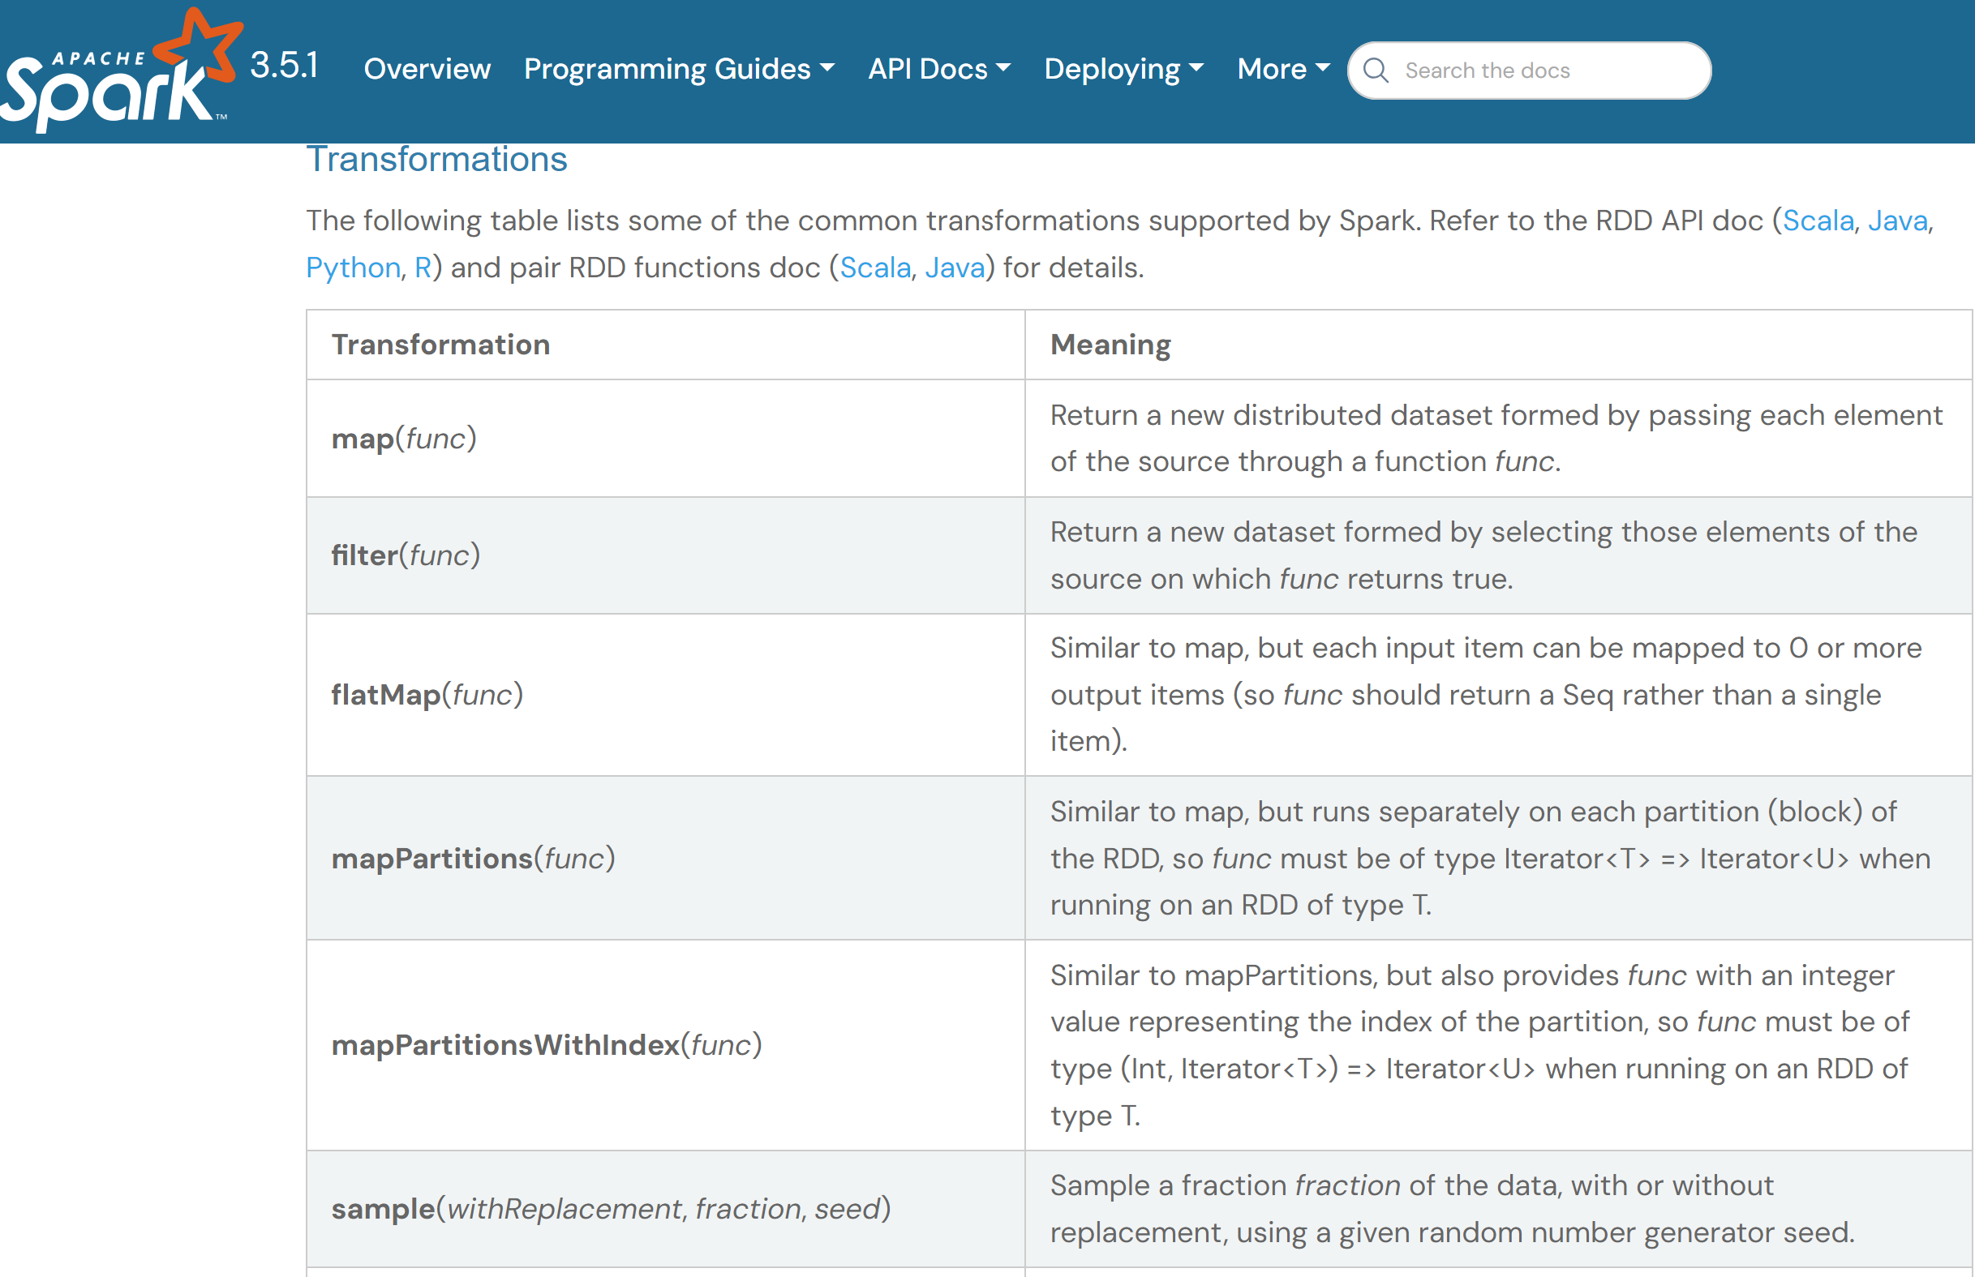
Narrow Transformations
https://spark.apache.org/docs/latest/rdd-programming-guide.html#rdd-operations

Slide 61
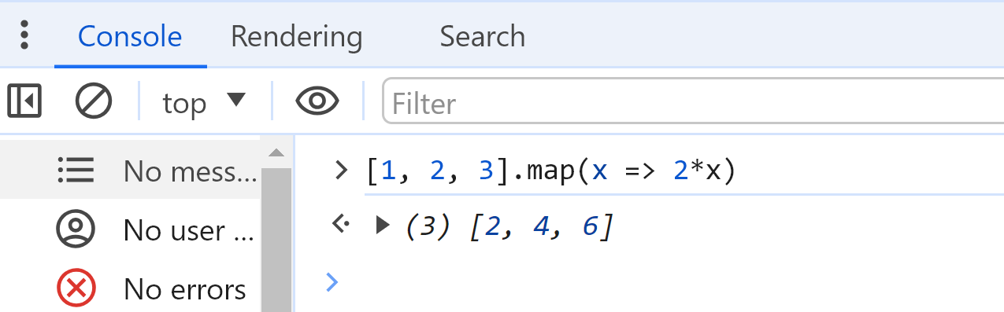
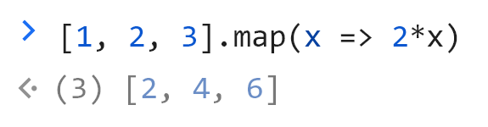
.map( x => f(x) )
as in any functional langage
example in JavaScript (use Chrome DevTools: F12)

Slide 62
dataset.map( rowFunction : T => U)
Dataset<T> ds = ...
def f (row: T): U = { ... }
Dataset<U> mappedDs = ds.map( row => f(row) )
// idem = ds.map(f)
ds
.map(f)
mappedDs
f : Function T -> U
f()

Slide 63
.map() Row columns <=> sql: "SELECT <...>" columns managment
Dataset<T> ds = ...
Dataset<U> mappedDs = ds.map(f)
when T=U=Row .. columns
ds.select("col1", col2", "colX")
.withColumn("computed", ...expr)
.withColumnRename("computed", "col3"
.drop("colX")
SELECT col1, col2, colX,
...expr as computed,
computed as col3,
FROM ...

Slide 64
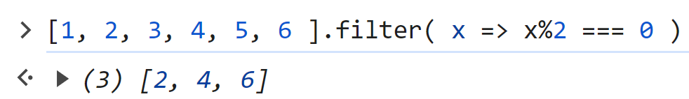
.filter( row => booleanFunc(row) )
as in any functional langage
example in JavaScript (use Chrome DevTools: F12)

Slide 65
dataset.filter( rowPredicate : T => boolean)
Dataset<T> ds = ...
def f (row: T): boolean = { ... }
Dataset<T> filteredDs = ds.filter( row => f(row) )
// idem = ds.filter(f)
ds
.filter(f)
filteredDs
f : Function T -> boolean
f()
true/false

Slide 66
dataset.filter( sqlWhere : String) dataset.filter( columnExpr : Column)
Dataset<T> ds = ...
Dataset<T> filteredDs = ds.filter( "col = 123" ) // in SQL
// ~ ds.filter( ds.col("col").eq(lit(123) ) // Column api
predicate-push-down
filteredDs
ds
.filter(f)
Directories/
File Blocks
Optim: Avoid reading useless Dir / Files/ blocks

Slide 67
.filter() <=> sql: "WHERE <...>"
SELECT *
FROM ...
WHERE col1 = 1
and col1 = 2
and ... ??
ds .filter("col1 == 1")
.filter( col("col2").eq (lit(2))
.filter(x => pred(x))

Slide 68
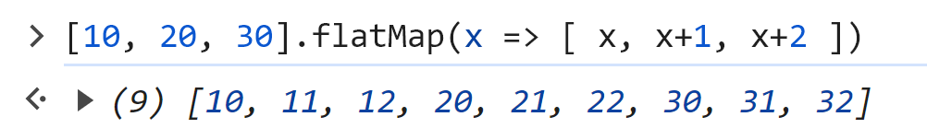
.flatMap( row => listFunc(row) )
as in any functional langage
example in JavaScript (use Chrome DevTools: F12)

Slide 69
dataset.flatMap( rowFunction : T => Iterator<U>)
Dataset<T> ds = ...
def f (row: T): Iterator<U> = { ... }
Dataset<U> flatMappedDs = ds.flatMap( row => f(row) )
// idem = ds.flatMap(f)
.flatMap(f)
flatMappedDs
f : Function T -> U
ds
[ ]
f()
[ ]
[ ]
[ ]
[ ]

Slide 70
dataset.mapPartitions( rowIter => f(rowIter))
Dataset<T> ds = ...
def f (iter: Iterator<T>): Iterator<U> = { ... }
Dataset<T> mappedDs = ds.mapPartitions(f)
ds
.mapPartitions(f)
mappedDs
f : Iterator<T> -> Iterator<U>
[ ]
f()
[ ]

Slide 71
Remarks on mapPartitions() vs .flatMap(), .map(), .filter()
Both .map() and .filter() can be implemented using .flatMap
.map(f) <==> .flatMap( row => [ f(row) ] )
.filter(pred) <==> .flatMap( row => pred(row)? [ row] : [ ] )
Even .flatMap() can be implemented using .mapPartitions()

Slide 72
Outline
from List<T> to distributed Dataset<T>
Immutability, Functional API
processing workflow: Input -> Transformations -> Output
narrow operations (=per partitions)
wide operations (=shuffled)

Slide 73
Wide Transformations
ds2 = ds1.wideTransform(..)
Shuffle are all inter-dependent
ds1-partition[0]
ds2-partition[0]
not necessarily preserving
partition topology (count/sizes)
ds1-partition[1]
ds2-partition[n]
network data movements
between mapped/reduced partitions
ds1-partition[n]

Slide 74
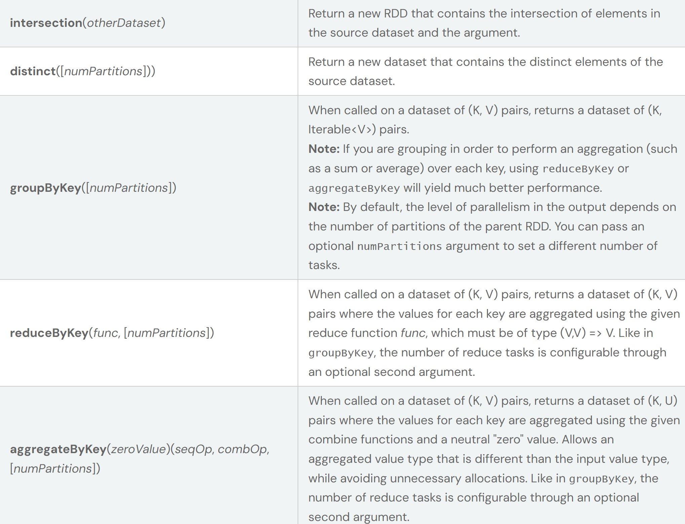
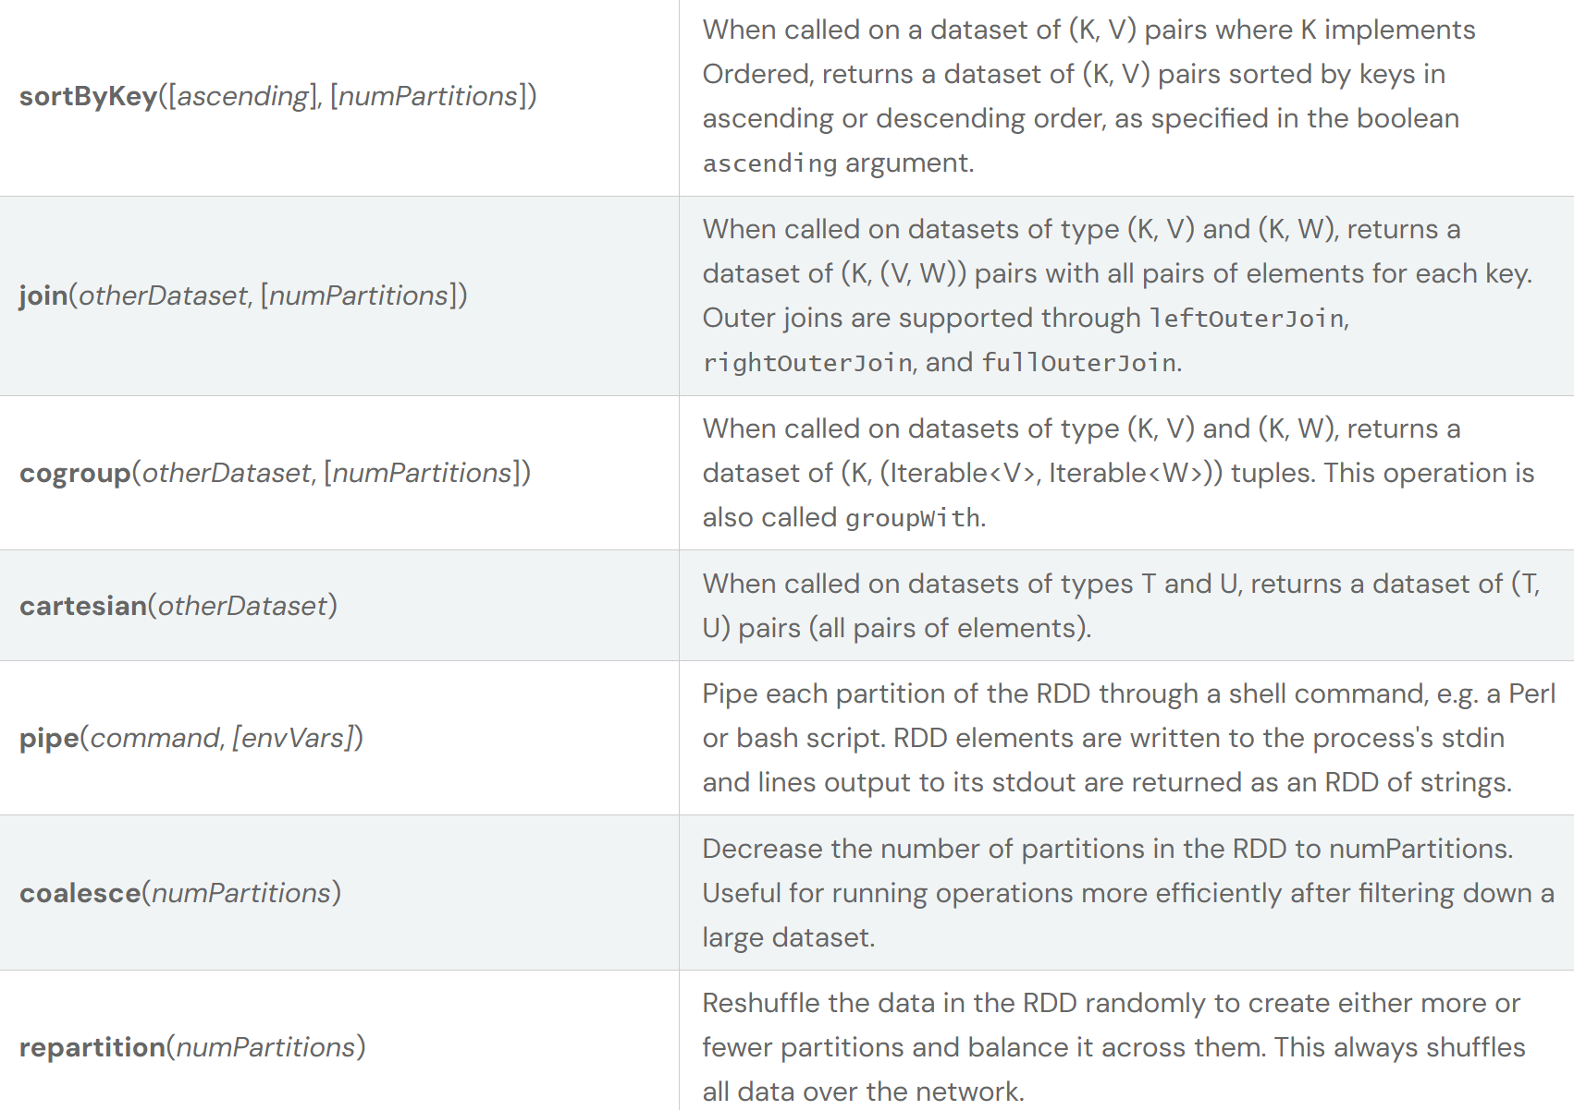
Wide Transformations
https://spark.apache.org/docs/latest/rdd-programming-guide.html#rdd-operations

Slide 75
Wide Transformations... focus on
.sortByKey( [col1, col2.. ] )
.repartition( N )
.repartition( [col1,col2..], N)
.join( otherDataset, joinedCols)

Slide 76
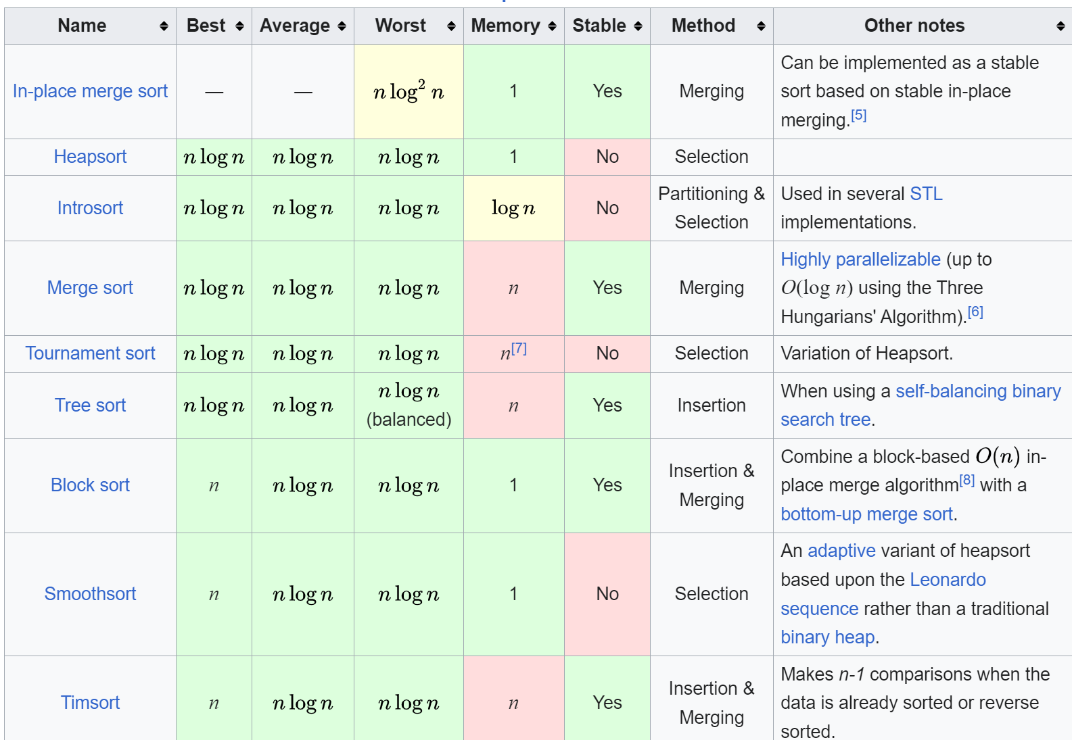
Local Sorting
non-distributed sorting algorithms are classical
best "local" complexity = N x log(N) ops / N memory size
ex: QuickSort, TimSort, MergeSort, CountingSort, RadixSort, ...
Problem : how to distribute ?
https://en.wikipedia.org/wiki/Sorting_algorithm

Slide 77
Dataset Sort
example values:
example split output values:
( 2 partitions, split at .. < 4 <= .. )
5,
1,
3,
7
ds1-partition[0]
1,
2,
3
ds2-partition[0]
6,
7,
2
ds1-partition[1]
sort = fully ordered
ds2-partition[n]
4,
5,
6,
7,
7
ds1-partition[n]
4

Slide 78
!= Narrow (Local) .sortWithinPartitions()
example values:
output values: (same partition topology)
5,
1,
3,
7
ds1-partition[0]
ds1-partition[0]
1,
3,
5,
7
sort = locally ordered
6,
7,
2
ds1-partition[1]
ds1-partition[1]
2,
6,
7
ds1-partition[n]
ds1-partition[n]
4
4

Slide 79
API: .sort(col1, ... colN) synonym: .orderBy()
Dataset<T> ds1 = ...
Dataset<T> ds2 = ds1.sort("col1", "col2");
equivalent: .orderBy("col1", "col2")
.sort( col("col1"), col("col2") )
see also
.orderBy( col("col1").ascending, col("col2").descending)
.orderBy( col("col1").ascending.null_first, col("col2").descending.null_last)
NOTICE: no lambda, nor "comparator" objects

Slide 80
Internal Sort Algorithm = Sampling values + Determine Split limits + Repartition by Range + TimSort
collect
+ determine split
example values:
local
TimSort
sampling(1%)
map
splits at = .. < 4 <= ..
reduce
5,
1,
3,
7
ds1-partition[0]
3,
7
part1=[1, 3],
part2=[5, 7]
reduce=[1, 3],
[2],
[]
1,
2,
3
6,
7,
2
ds1-partition[1]
part1=[2],
part2=[6, 7]
2
4,
5,
6,
7,
7
reduce=[5, 7],
[6, 7],
[4]
part1=[],
part2=[4]
4
4

Slide 81
.sort() - SQL: "ORDER BY" (!= "SORT BY")
ds .sort(col("col1"),
col("col2").descending )
SELECT *
FROM ...
ORDER BY col1, col2 DESC
( Standard SQL )
ds .sortWithinPartitions("col3")
SELECT *
FROM ...
SORT BY col3
NON-standard
!! SQL Extension !!

Slide 82

.repartition(N) Round-Robin Repartition
same as Dealing Cards to N players
(repeated in parallel from P heaps)
source dataset
partitions 0,1, ..
dest partition[0]
source dataset
partition[P]
modulo 0
modulo 1
dest partition[1]
modulo N
dest partition[N-1]

Slide 83
.repartition(N) = round-robin Map + Reduce
example values:
shuffle
map-side
reduce-side
5,
1,
3,
7
ds1-partition[0]
5,
3,
6,
2,
4
[5, 3]
[1, 7]
ds2-partition[0]
[5, 3 ]
[6, 2]
[4]
6,
7,
2
ds1-partition[1]
[6, 2]
[7]
ds2-partition[n]
[1, 7]
[7]
[ ]
1,
7,
7
ds1-partition[n]
[4]
[ ]
4

Slide 84



.repartition( columns ) groupBy
.repartition ( cardFamily ) => 4
.repartition ( cardColor [red/black] ) => 2
.repartition ( cardValue[1,2,3..] ) => 13
.repartition ( cardFamily, cardValue ) => 52 = 4*13
.repartition ( [cardFamily, cardValue], 20) => 20

Slide 85
.repartition(column) = Mapper groupBy - Reduce
foreach row
compute
partitionioner
example: "%2"
example values:
map
reduce
5,
1,
3,
7
ds1-partition[0]
1,
1,
1,
1
part1=[],
part2=[5,1,3,7]
reduce=[],
[6,2],
[4]
6,
2,
4
6,
7,
2
ds1-partition[1]
part1=[6,2],
part2=[7]
0,
1,
0
5,
1,
3,
7,
7
reduce=[5,1,3,7]
[7],
[]
part1=[4],
part2=[]
4
0

Slide 86
.repartition(col) <=> sql: "GROUP BY <...>"
SELECT col1, col2,
sum(*),count(*),min(*), distinct
<<analytical>>(..)
FROM ...
GROUP BY col1, col2
ds .repartition("col1", "col2")
.mapPartitions(..)

Slide 87
.repartition( col1..colP, hashModuloN )
when col1,col2,..colP give too many repartition groups (millions of groups ?)
=> spark will compute hashCode, then modulo default=200
You can change globally "spark.shuffle.partitions" (200)
or specifically by call
.repartition(col1, col2)
equivalent: .repartition(col1, col2, N=200)
partitioner function:
func(row) { abs( hash(row.col1 ^ row.col2 ) ) % N }

Slide 88
Transformations to Skewed or Well-Balanced Partitions ?
Skewed
Well Balanced / Equi-Distributed

Slide 89
Transformations to Skewed or Well-Balanced Partitions ?
.sort() => sampling randomness might produce unbalanced data
but generally ok
.repartition(N) => exactly N x equi-distributed +/-1 x P rows
.repartition( col1, col2 ) => most probably SKEWED DATA !!
( must choose [col1,col2] carefully )
.repartition( highCardinalityCol, N ) => most probably N x equi-distributed
.repartition( highCardinalityCol ) => most probably 200 x equi-distributed

Slide 90

Joins
Dataset<T> ds1 = ...
Dataset<U> ds2 = ...
Dataset<Pair<T,U>> joinedDs = ds1.join( ds2, joinExpr, joinType)

Slide 91
Join - SQL "FROM .. JOIN .. ON .."
Typical Star(*) Schema: 1 Big Fact table, N small Dimensions Tables
Dataset<Row> sellDs = .. // FACT table (big) has foreign key to "productId"
Dataset<Row> productDs = .. // Dimension table (small) .. has primaryKey "id"
Dataset<Row> sellEnrichedDs = sellDs.join(productDs,
sellDs.col("productId") == productDs.col("id"),
"left-outer");
SELECT s.*, p.*
FROM Sell s
LEFT OUTER JOIN Product p ON s.productId = p.id
SQL:

Slide 92
Local Join Algorithm using right HashMap
ds1
ManyToOne relationship
"productId" like pointer to PK "id"
ds2
Step 1/2: prepare index all ds2 rows by id in HashMap
ds2HashMap = new HashMap<int,T2>();
for(e : ds2) {
ds2HashMap.put(e.id, e);
}
map
Step 2/2: foreach item in ds1, lookup corresponding ds2 row by joinId
res = new ArrayList<Pair<T,U>>();
for(e : ds1) {
res.add(new Pair(e, ds2HashMap.get(e.joinId) ) );
}

Slide 93
Spark .. BroadcastHashJoin
dataset2 (SMALL)
dataset1 (BIG)
executor1
Step 1/3: collect ALL ds2 values on driver
executor2
Step 2/3: Broadcast (copy) of ds2 to all executors
.. build "HashMap" full local copies
executorN
Step 3/3: foreach item in ds1, lookup corresponding ds2 in HashMap by joinId

Slide 94
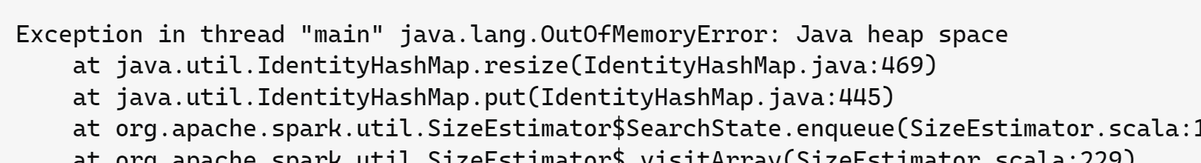

Problem ... How to Join 2 Big Datasets ?
can NOT collect data to a single driver
so can not broadcast
& can not have copy of data on each N x executors
spark conf:

Slide 95
Sort Merge Join Algorithm
ds1
ds2
(slow) FUll sort
(slow) FUll sort
iterator in both ds1 AND ds2
simultaneously:
if (iter1 > iter2) iter1.next()
else if (iter1 < iter2) iter2.next()
else { join..
iter1.next(); iter2.next()
}
sorted ds1 (by joinId)
sorted ds2 (by id)
= sorted merged join: ds1.join(ds2)

Slide 96
(Distributed) Sort Merge Join
Step 1/3: sort
ds1-partition[0]
sorted ds1-partition[0]
ds1-partition[1]
Step 2/3: shuffle (co-group)
Step 3/3: merge-join
sorted ds1-partition[n]
ds1-partition[n]
ds2-partition[0]
sorted ds2-partition[0]
ds2-partition[1]
sorted ds2-partition[n]
ds2-partition[n]

Slide 97
Outline
from List<T> to distributed Dataset<T>
Immutability, Functional API
processing workflow: Input -> Transformations -> Output
narrow operations (=per partitions)
wide operations (=shuffled)
Conclusion, Next Steps

Slide 98
Conclusion
Only a "Short" Introduction to "Big Data" Distributed operations challenges
Dataset = distributed List on a cluster, the sky is the limit
Immutable and using Functional API
implements basic operators (narrow and wide)
The core fondamentals of Spark for processings

Slide 99
Next Steps
cf Lessons 2, 3
- Spark Architecture
- Parquet file Format (Dir & Files, partitions, columnar, Optims..)
- ...

