Slide 1
Installing Jupyter Notebook for Spark
Arnaud.nauwynck@gmail.com

Slide 2
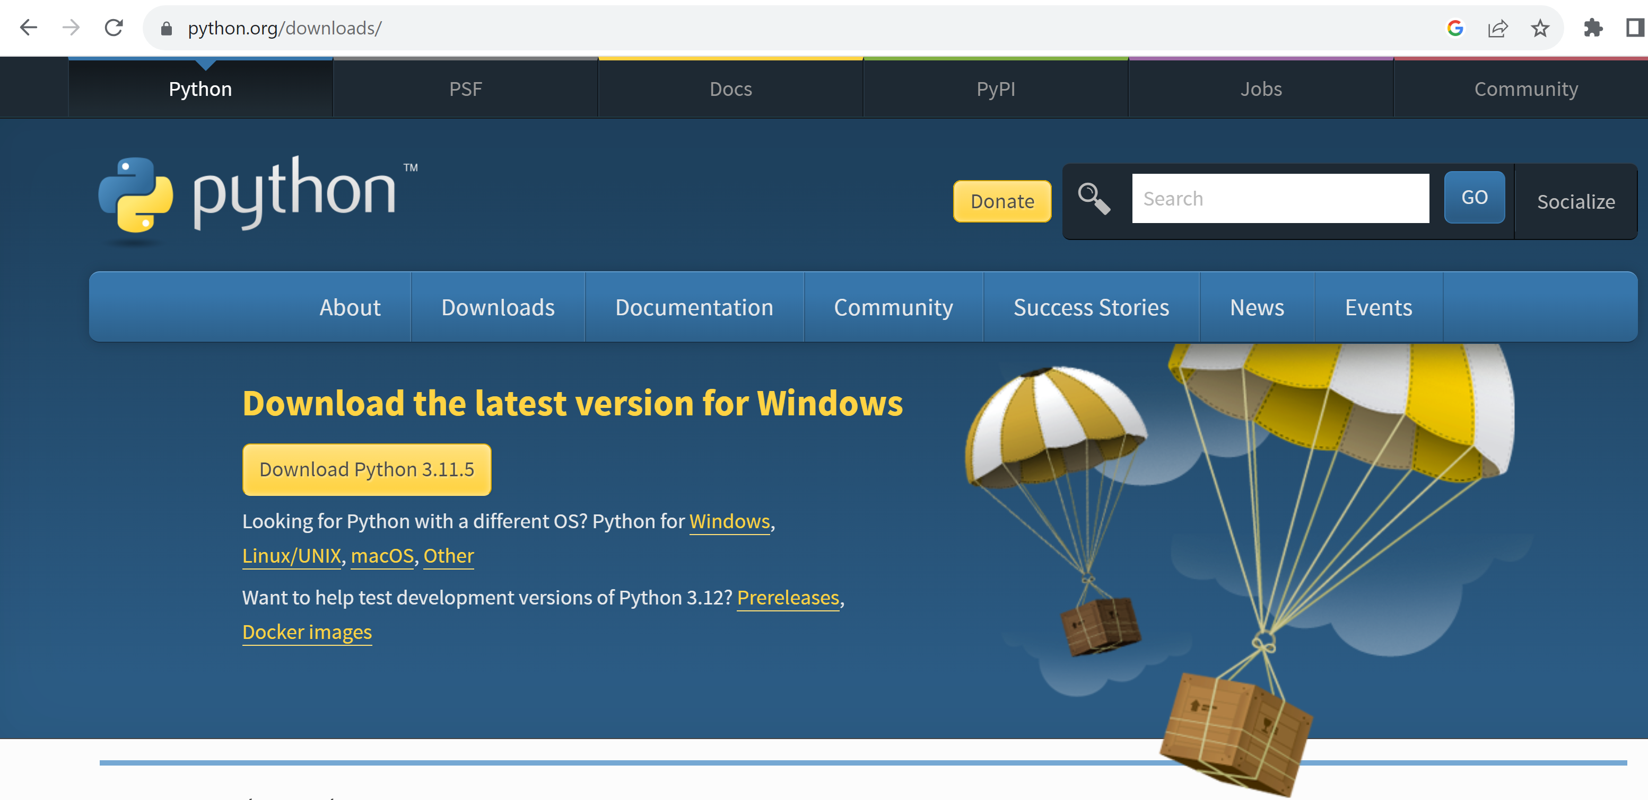
Step 1 : install python (simplest method, not using AnaConda)

Slide 3
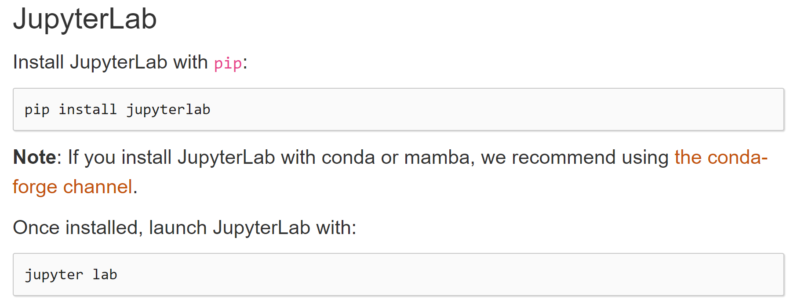
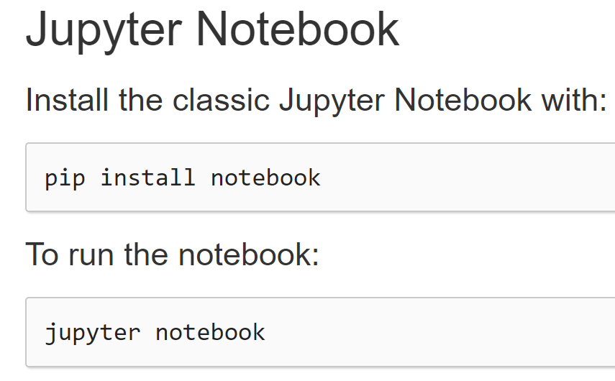
Step 2 : install jupyter
Choose class Jupyter Notebook… OK

Slide 4
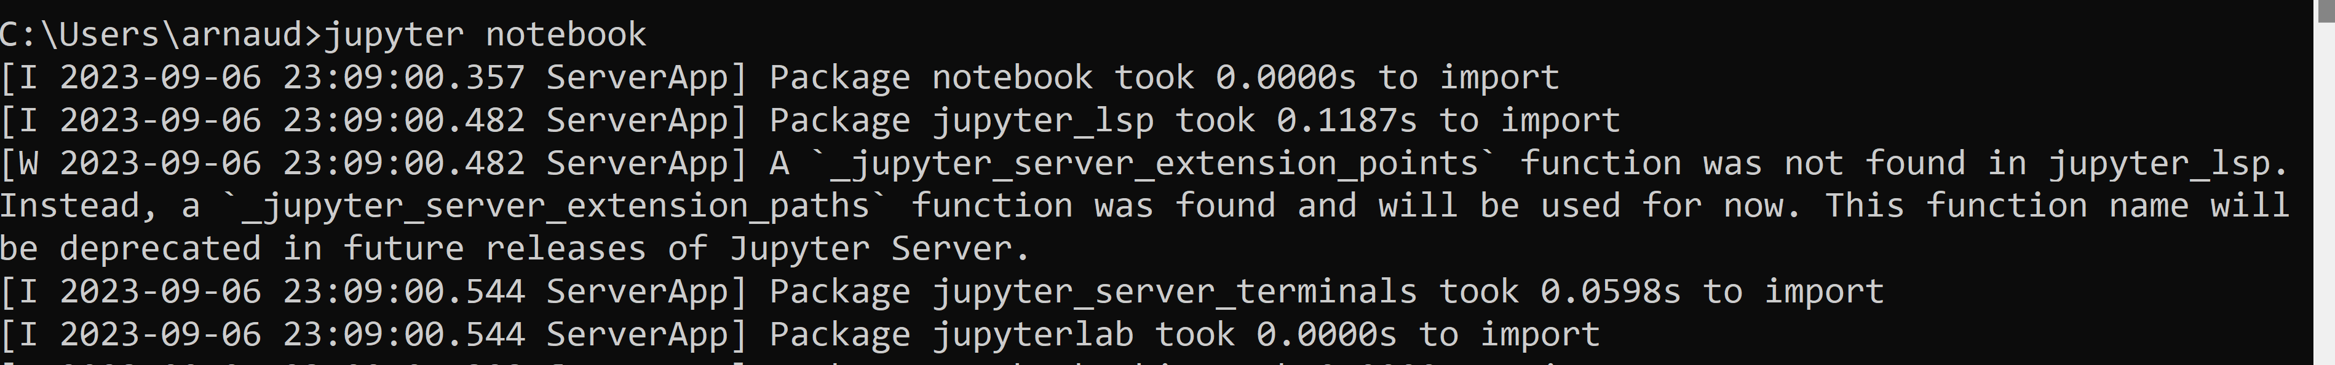
Star Jupyter Notebook
jupyter notebook
[[truncated logs …. Also contains errors?? ]]

Slide 5
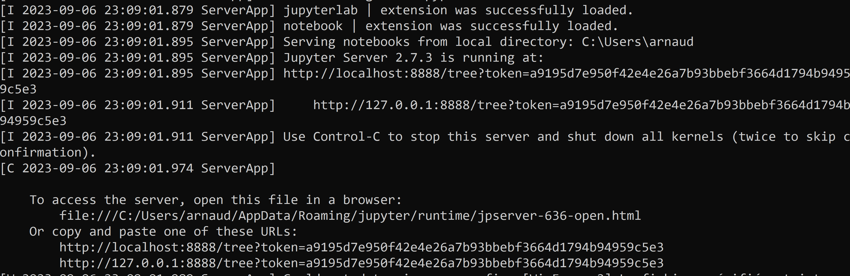
Jupyter Notebook ..

Slide 6
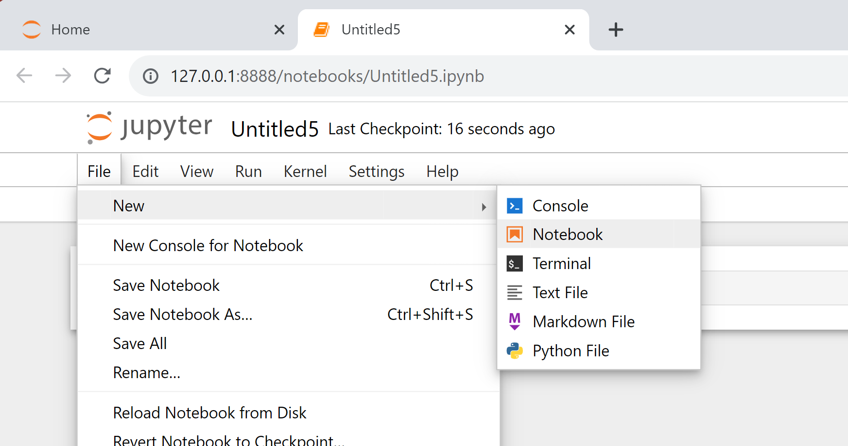
Creating a new notebook

Slide 7
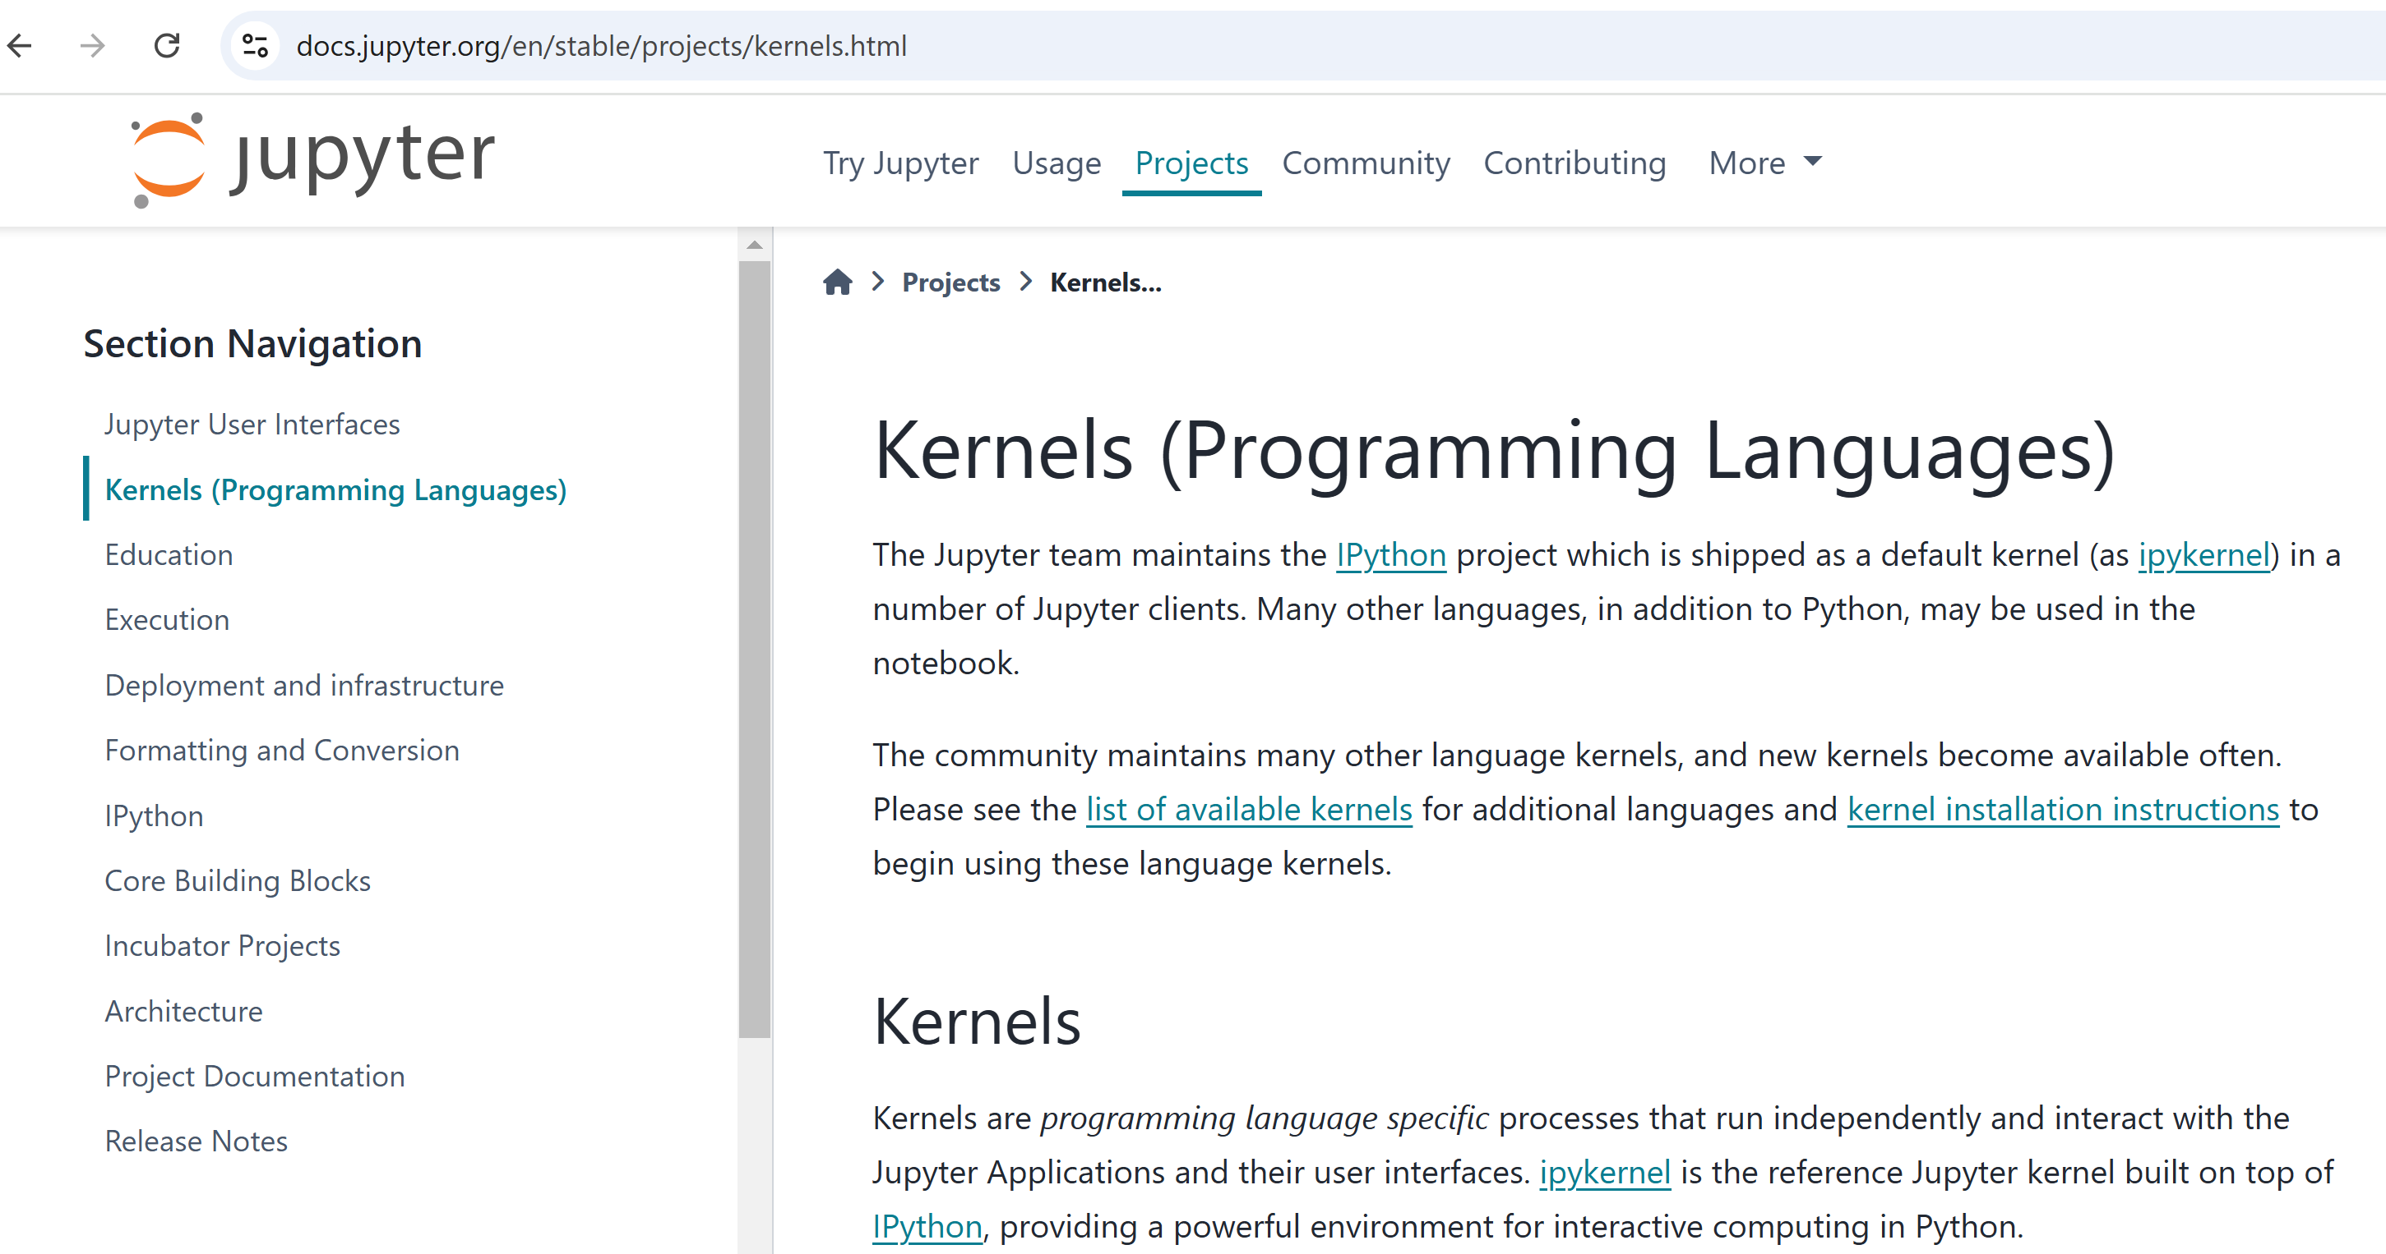
Step 3: jupyter needs kernels

Slide 8
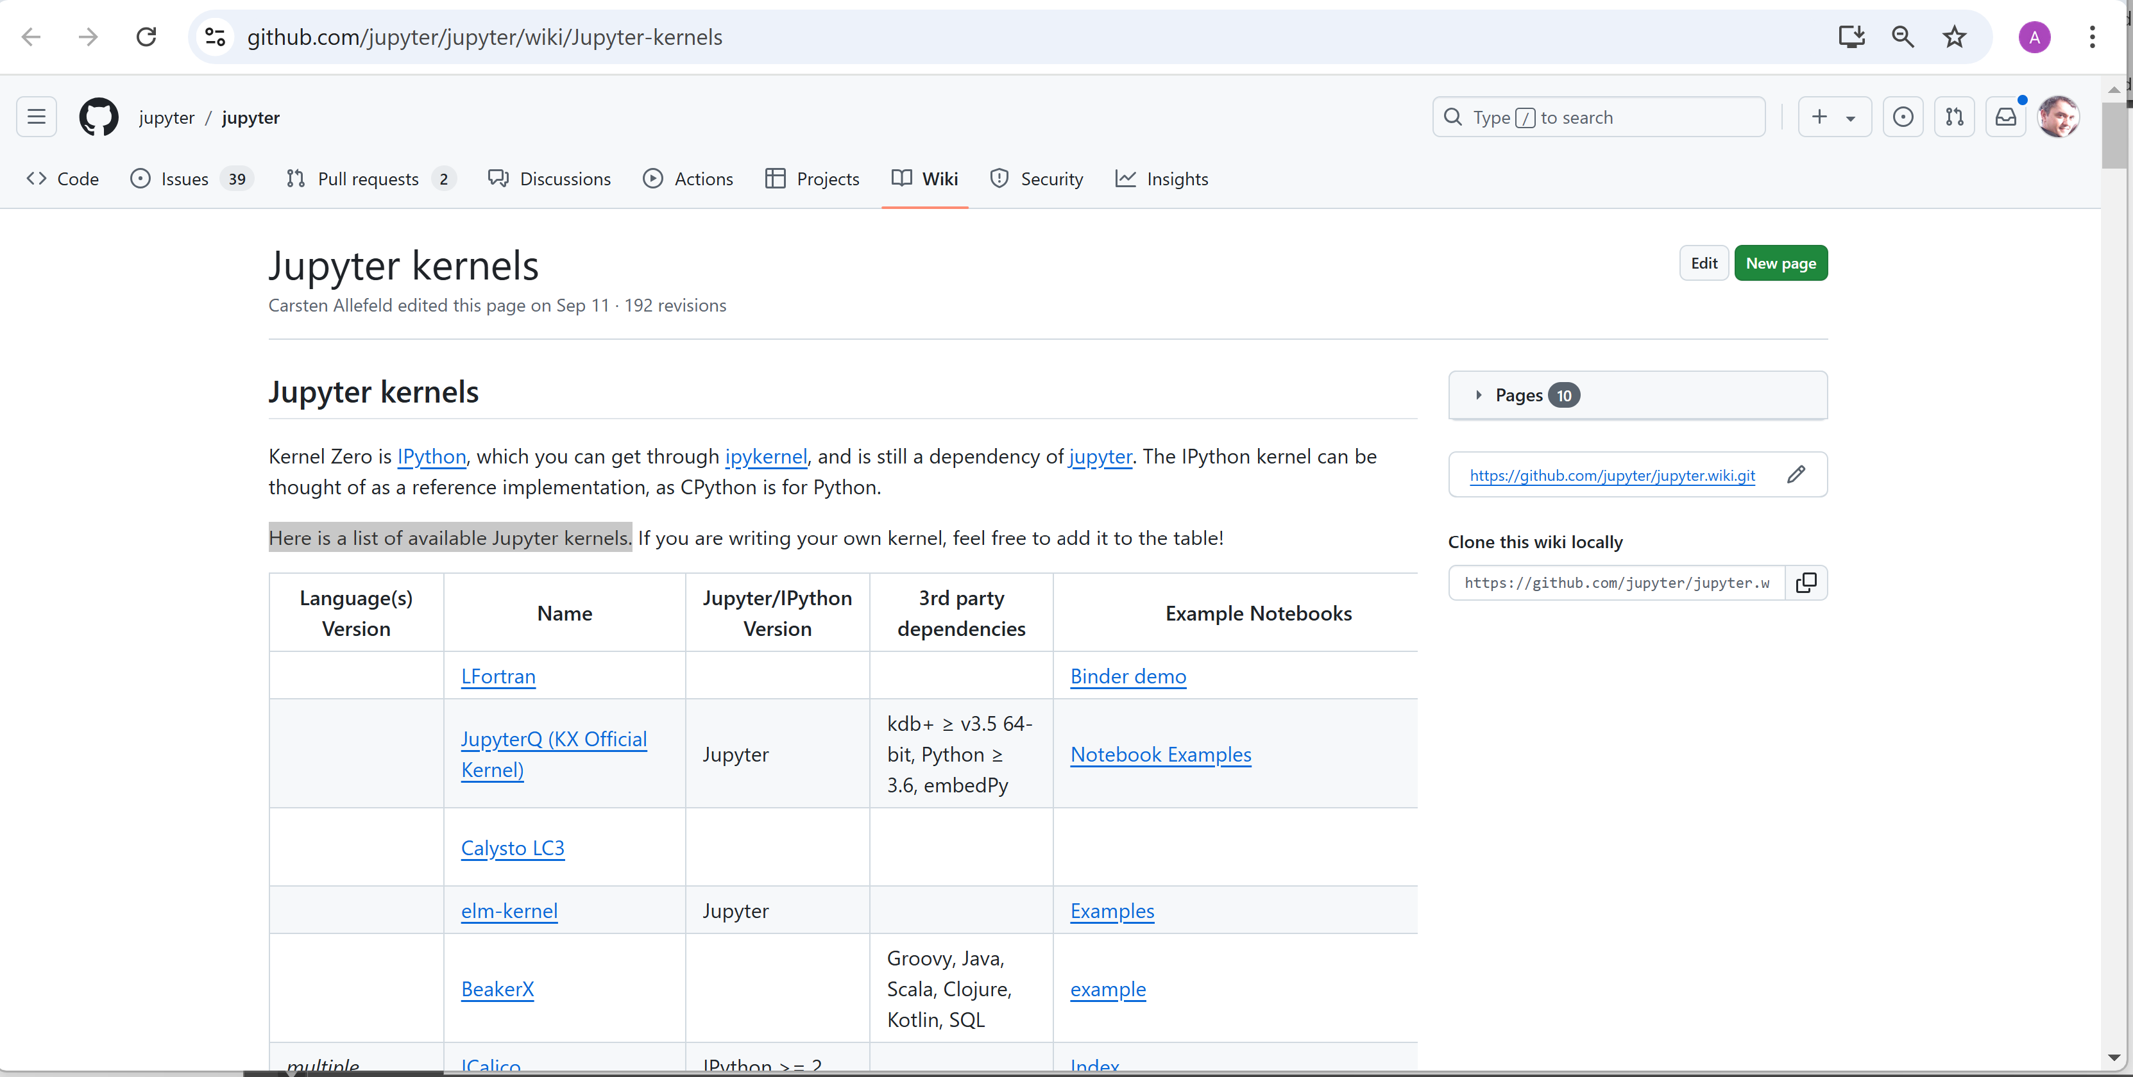
Step 3: list of community jupyter-kernels

Slide 9

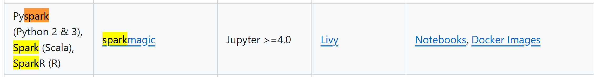
Jupyter Kernels "*spark*"

Slide 10
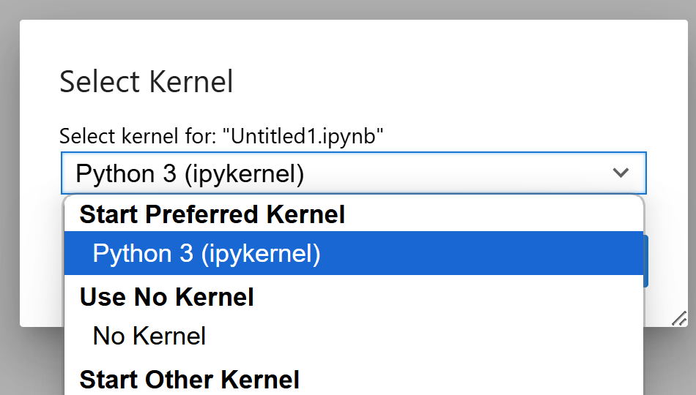
Jupyter Kernel(s)
to execute python
>>> 1+1
to execute spark python code
>>> spark.sql("...")
to execute spark scala code
scala> spark.sql("...")
to execute scala (no spark)
scala> 1+1
spylon kernel
(deprecated?)
almond kernel
ipykernel (built-in)
pyspark ...
to execute spark scala code
scala> spark.sql("...")
almond kernel + module "almound-spark"

Slide 11
Step 3 alternative : almond kernel + "almound-spark" module for using spark with scala langage

Slide 12

http://almond.sh

Slide 13
TODO ... WORK IN PROGRESS

Slide 14
Step 3 alternative : spylon kernel for spark + scala

Slide 15
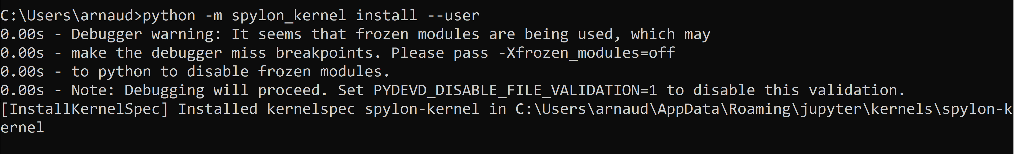
Step 3 alternative : install jupyter spylon_kernel (for using Spark with Scala langage)
python –m spylon_kernel install --user
(or pip install spylon_kernel –user )

Slide 16
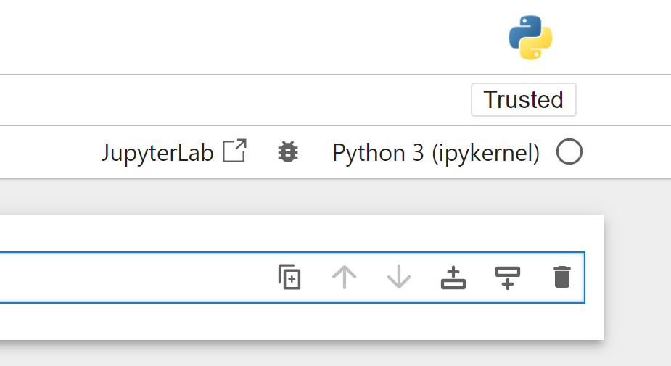
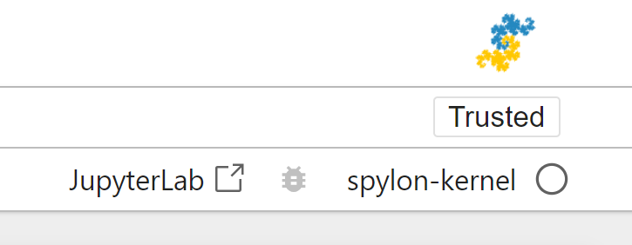
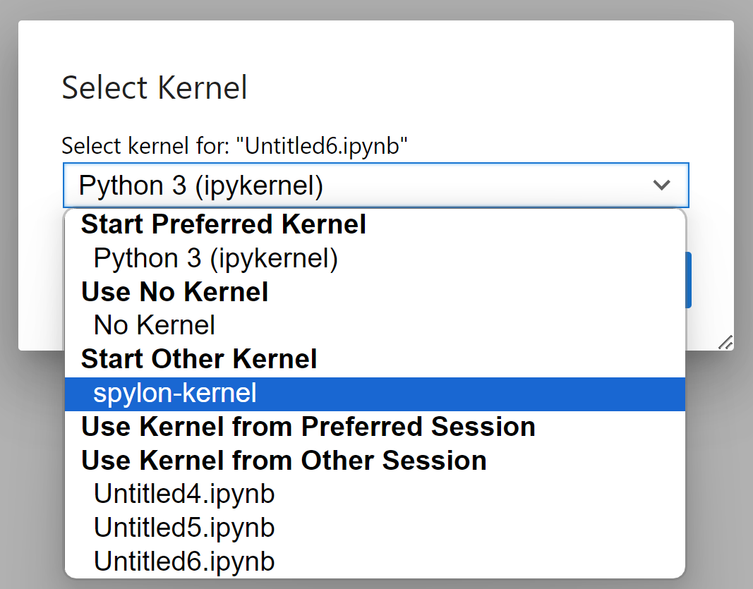
Step 3 … testing spylon

Slide 17
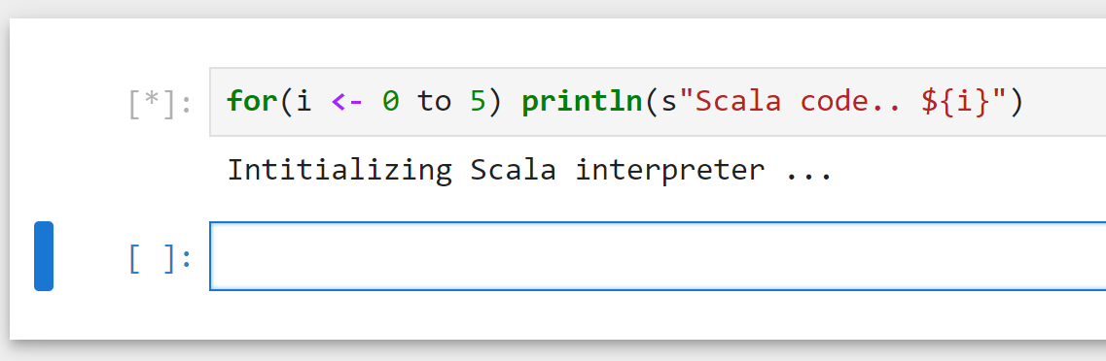
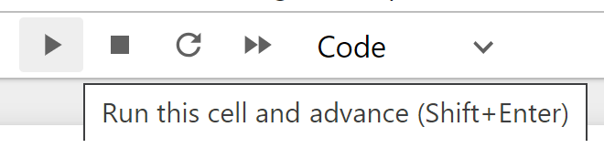
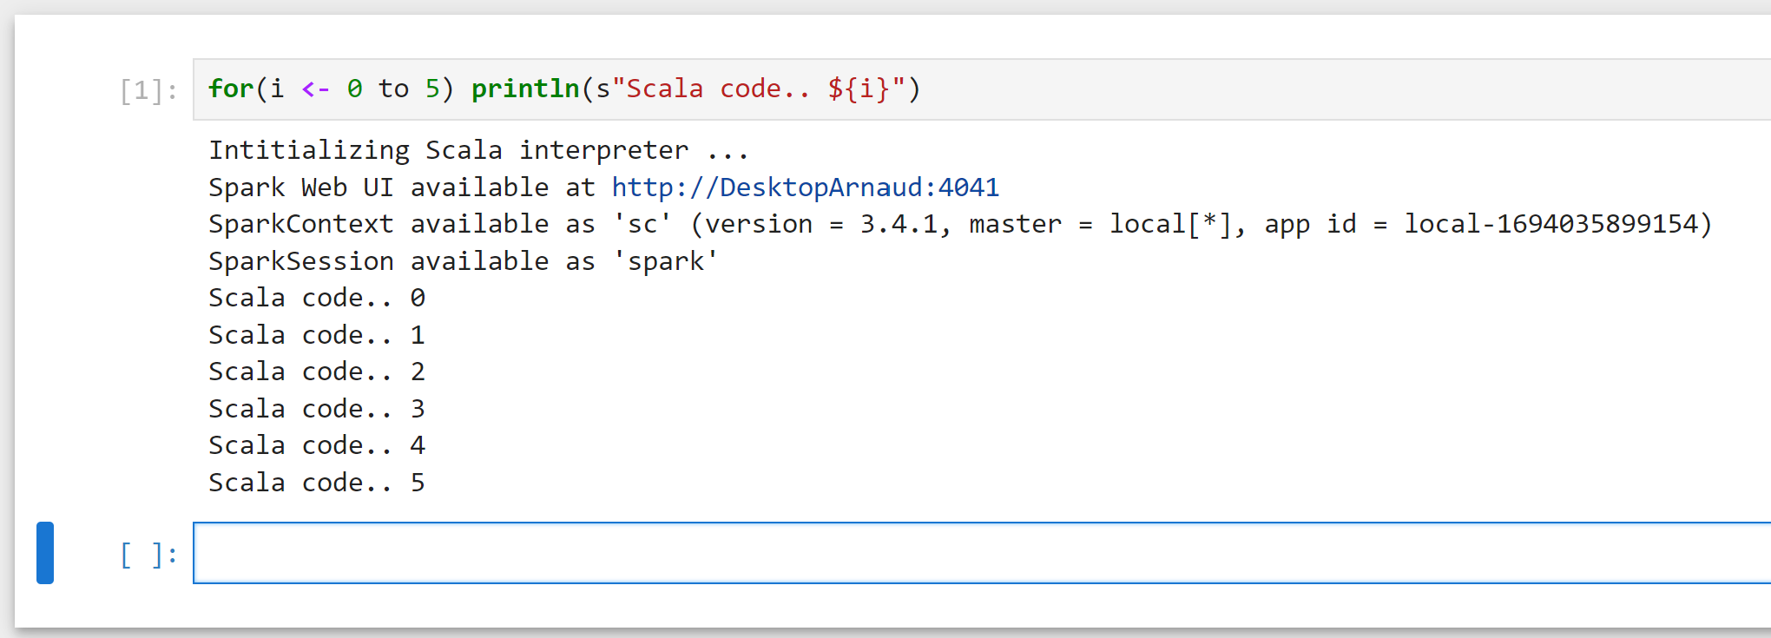
Step 3 … Testing Spylon .. Write Scala
Type SCALA code … Shift+Enter
Get Spark process (Scala interpreter)

Slide 18
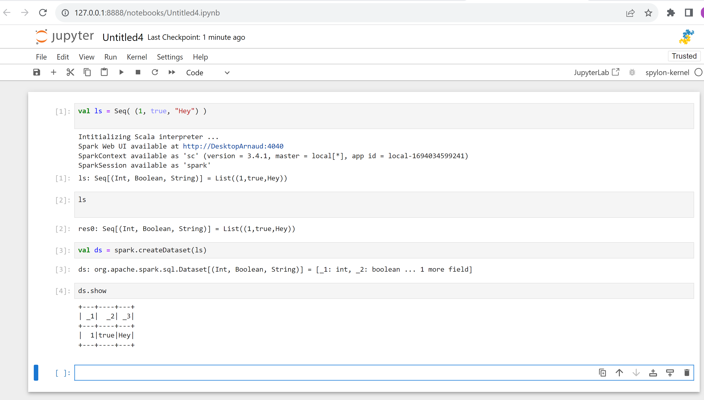
Step 3 … Testing Spylon .. Write Scala

Slide 19
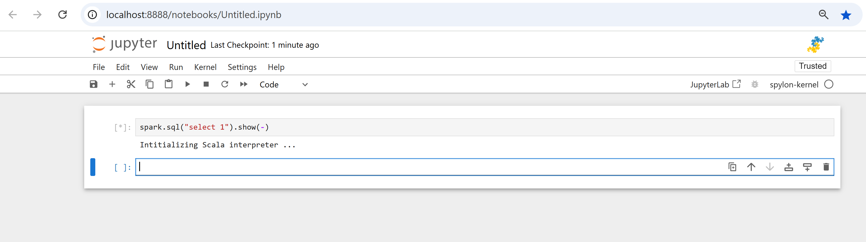
Spark SQL "Hello World"
may take 1 minute to start ... spark is starting

Slide 20
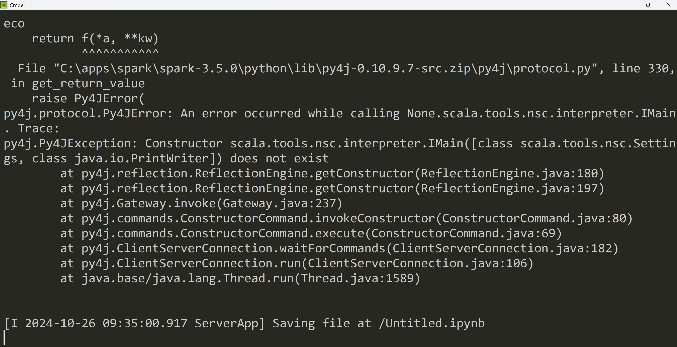
TroubleShooting ???

Slide 21
Step 3 alternative : kernel for pyspark (for using PySpark with Python langage)

