Slide 1
Part 4 : Rest Json to DTO Class
arnaud.nauwynck@gmail.com
Json, Mapping Json to Java class, Jackson
Mapping Rest http to springboot Controller methods
This document:
http://github.com/arnaud-nauwynck/Presentations/java/ Architecture-Design-part4-RestJsonToDTO.pdf

Slide 2
Design code for several protocols / versionned APIs
API(s) Server
gRPC protocol
gRPCSkelImpl
Common High-Level Service
(Validation, Security Checks, ..)
@Transactional
thrift protocol
ThriftServerImpl
XAService
/api/v1/
http REST (legacy)
V0RestController
LowLevelService
/api/v2/
http REST (current)
V1RestController
JPA Repository
Reminder
Code Specific to protocol
Message <-> internal DTO
writeMsgTo() / parseFrom()
(SOLID = protocol mapping)
Shared business facade
map DTO <-> Entity
within Transaction
dto2entity / entity2dto
(SOLID = XA boundary)
Low-level business code
work on Entity classes, SQL

Slide 3
Message / Api DTO != Internal DTO
API(s) Server
gRPC protocol
gRPCSkelImpl
=> No specific protocol Message in code
( clean code rule)
01010101
Message scope
Internal DTO
( in/out for XAService )
/api/v1/
http REST (legacy)
V0RestController
{ JSON }
DTO scope : all the JVM (no restriction)
@Transactional
XAService
LowLevelService
Entity scope : in XA
<=No XA
XA=>
JPA Repository
SQL
Custom Query DTO (sql)

Slide 4
gRPC .. Sample protocol efficient Marshalling supporting evolutivity / backward compatibility
Reminder

Slide 5
Binary (protobuf,..) with Schema = OK What about JSON ? Schema-Less / No code generator

Slide 6
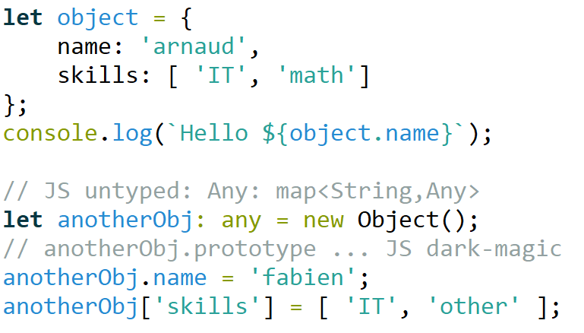
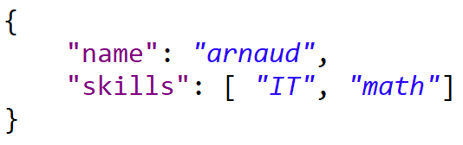
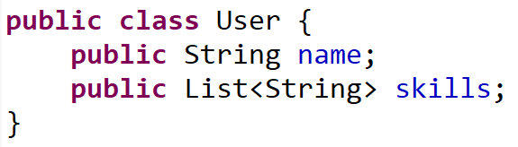




JavaScript <-> Json (JavaScript Object Notation) <-> Java
Script (untyped interpreter)
DATA format (no schema)
Langage (typed)
Web Front-End
Network
encoding
Back-end

Slide 7








http JSON : Open & DeFacto Standard for Portability, Simplicity, Frameworks
Web Front-End
API Front-End (app-to-app)
Network
connection+encoding
Back-end

Slide 8
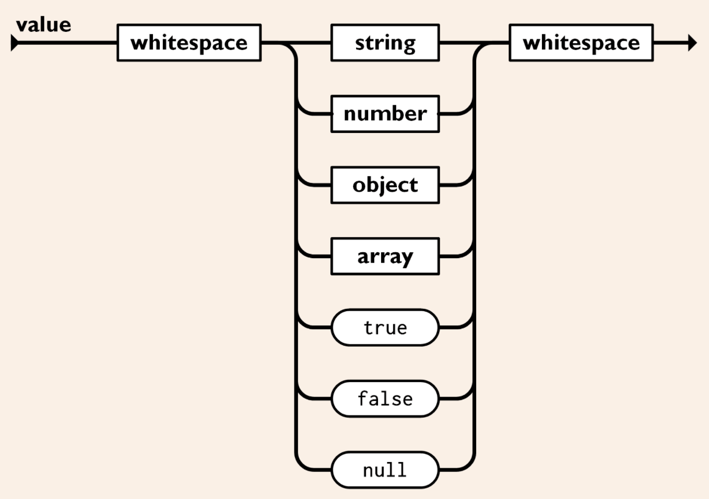
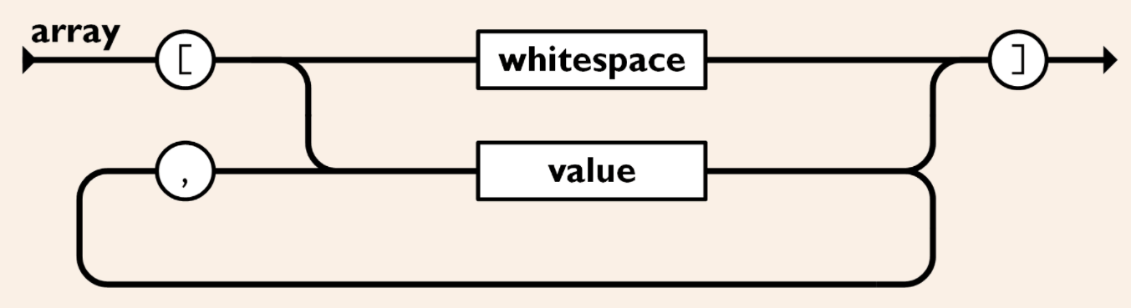
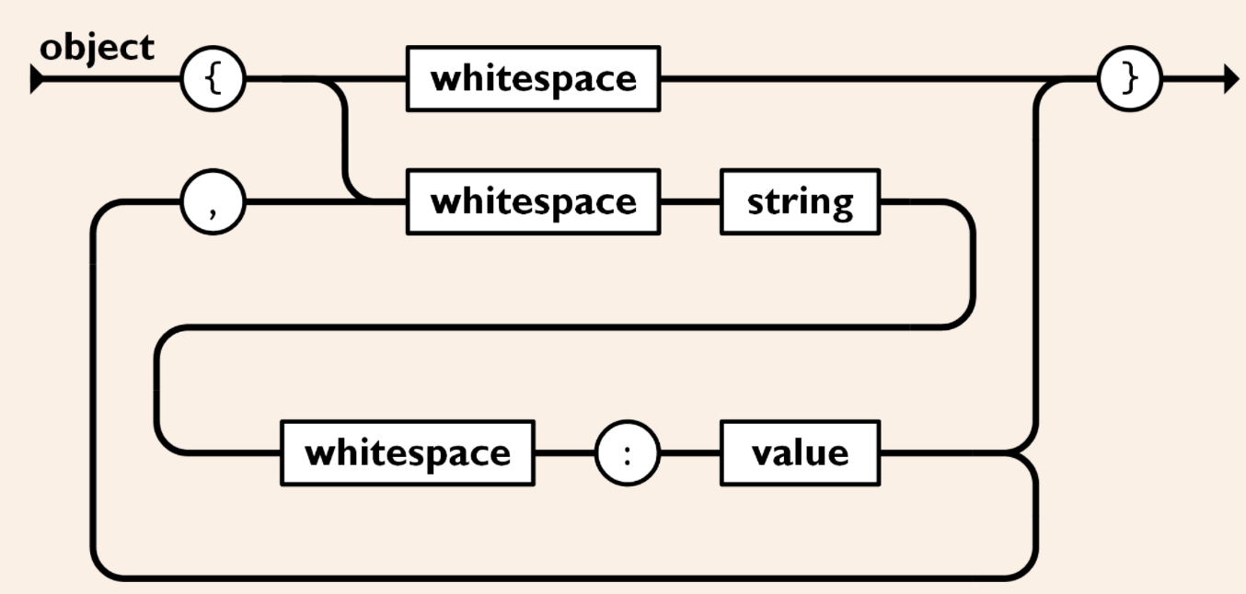
Grammar of JSON https://www.json.org/
Literal value (terminal)
Array / Object composition

Slide 9
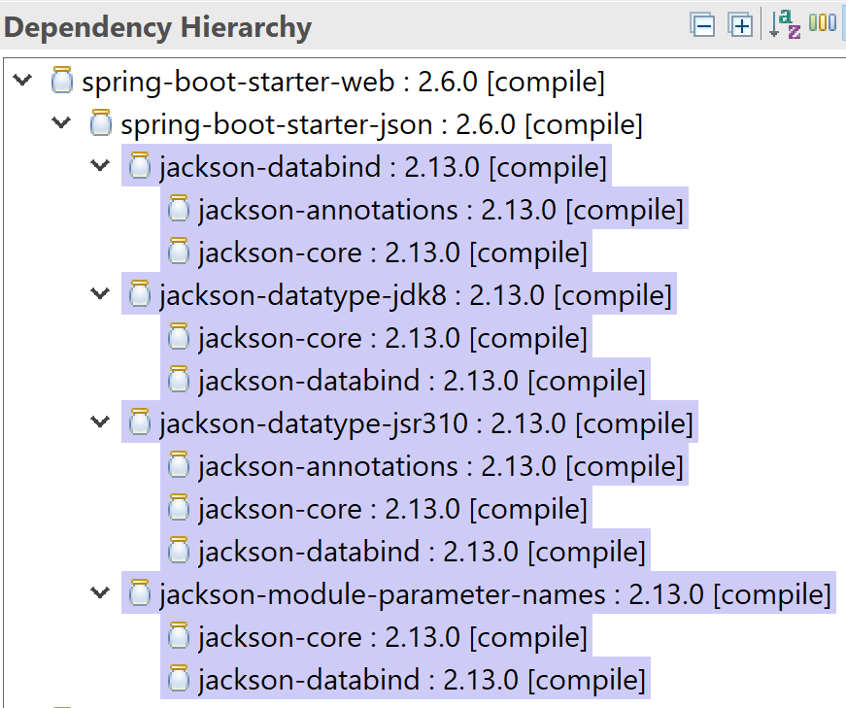
Jackson ( default dependencies from spring )

Slide 10

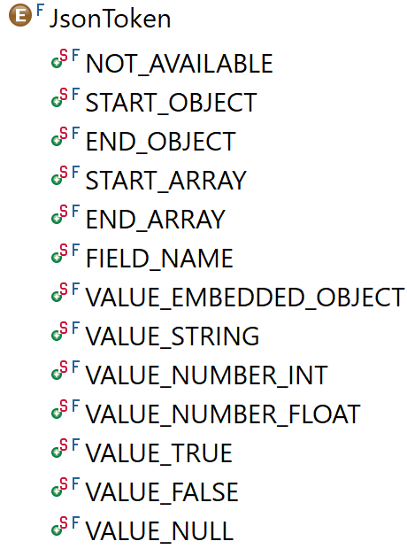
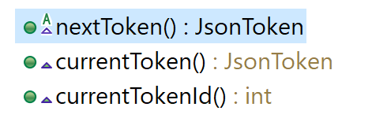
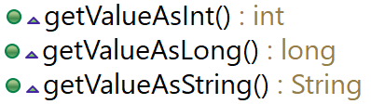
Jackson-Core: Json Streaming api for Parsing
JsonFactory
byte[]
InputStream
String
InputReader
create
JsonParser
..

Slide 11
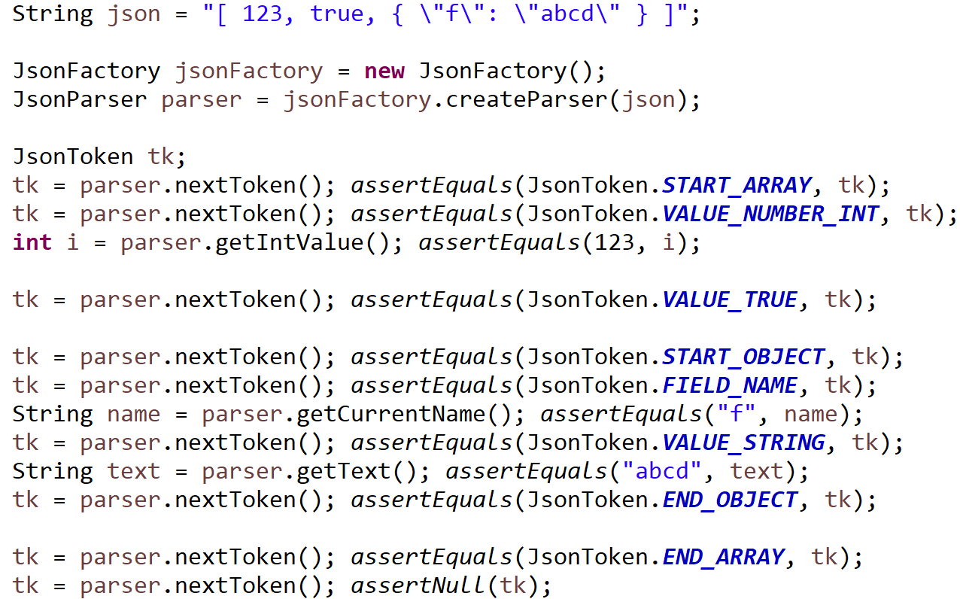
Sample Json Streaming Parsing

Slide 12

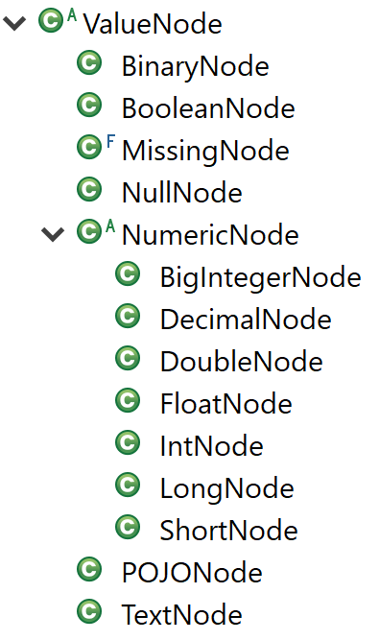
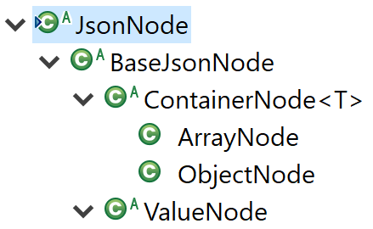
Jackson-databind : JsonNode Class Hierarchy
AST Class Hierarchy <-> Json Grammar
[ 1, 2 ..]
{"field1" : 1, .. }
"value"
true|false
1.234
null

Slide 13
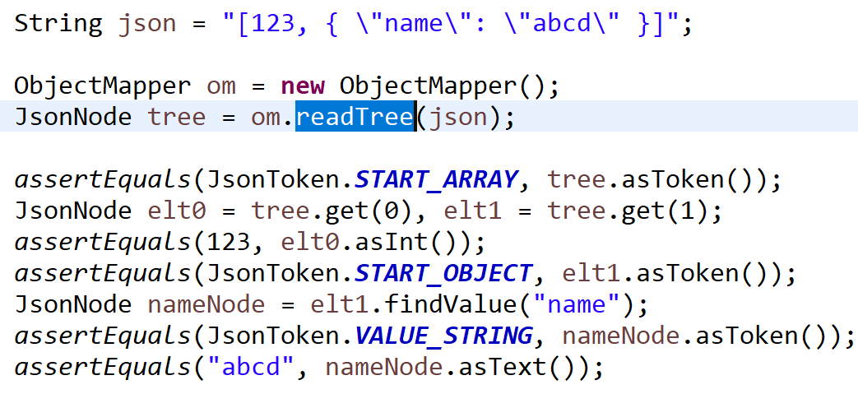
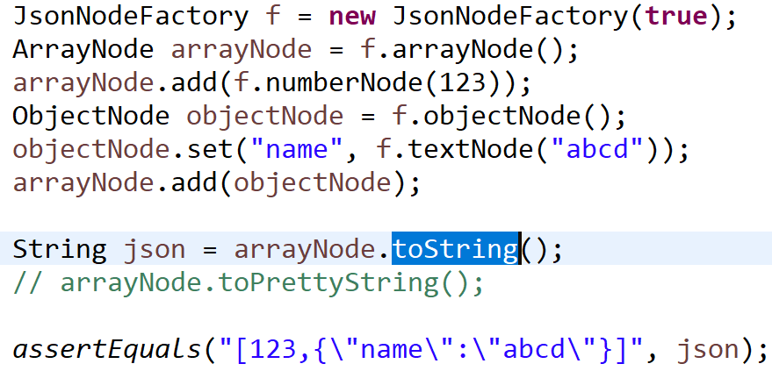
Parsing Json to in-memory Tree ( no user-defined class)
{ JSON}
JsonNode Tree
JsonNode Tree
{ JSON}
Could not use typed List<T>
.. only List<JsonNode>

Slide 14
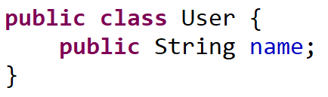
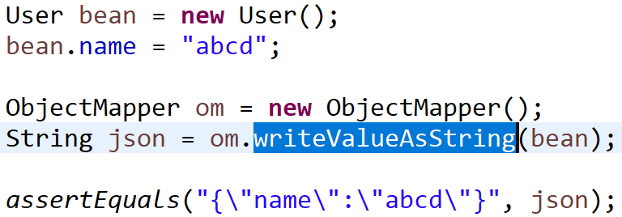
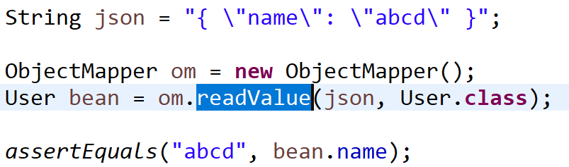
Jackson-databind: ObjectMapper
{ JSON}
Object
Object
{ JSON}

Slide 15
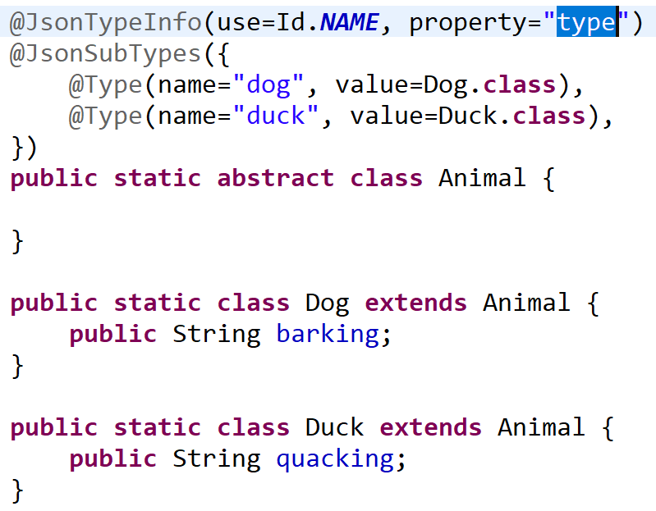
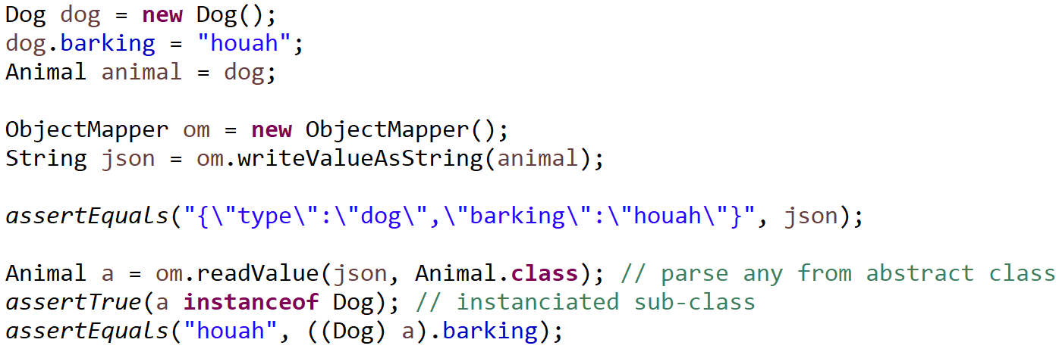
Type discriminant for « class / sub-classes »
JSON
{"type":"dog", "barking":"houah"}
{"type":"duck", "quacking":"coin"}

Slide 16
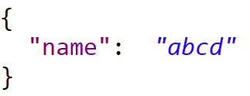
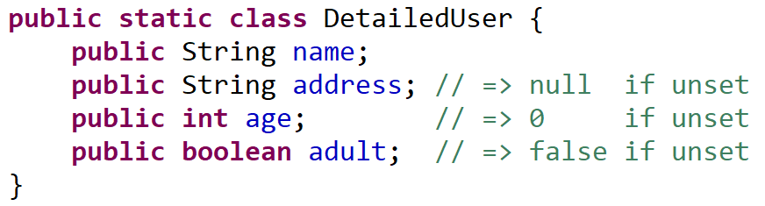
Field not set (not in JSON) => 0, false, null (in Java)
null
0
false

Slide 17
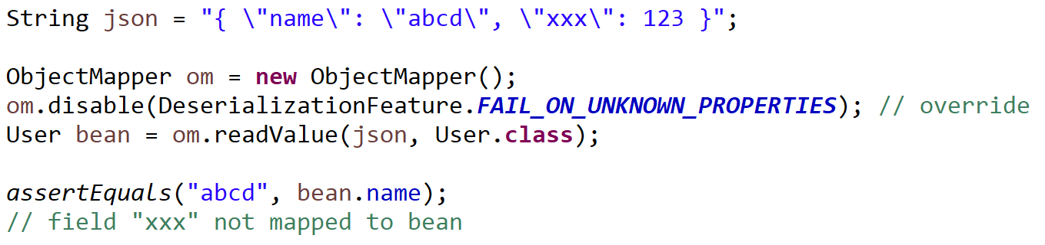
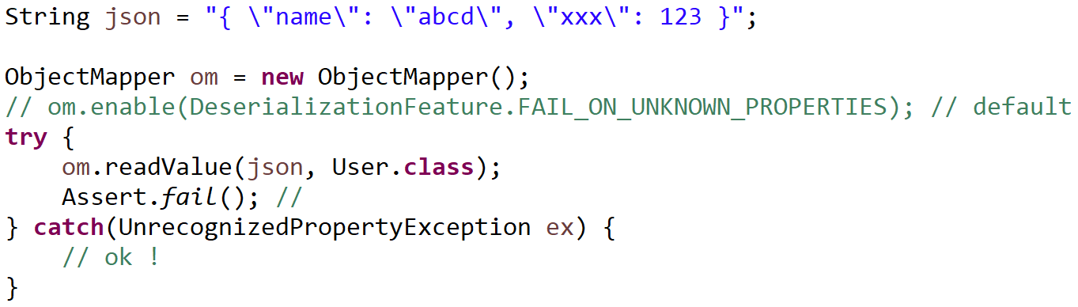
disable FAIL Unknown properties

Slide 18
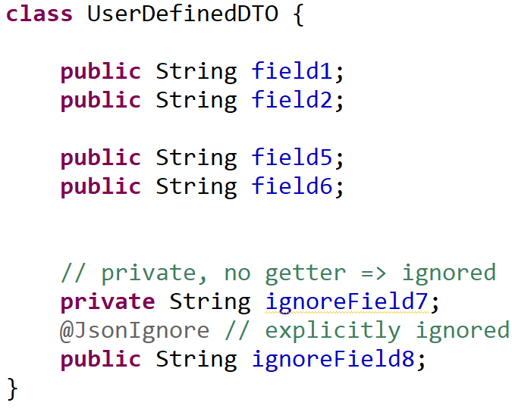
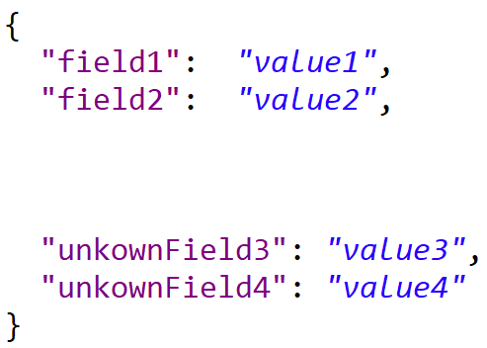
Ignored / Unset / Unknown fields
(not in Json) UNSET… 0
UNKOWN (not in Java)
Ignored in java

Slide 19
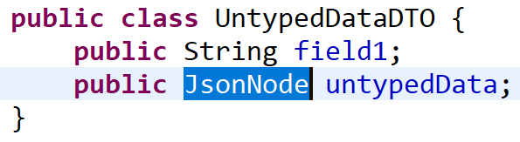
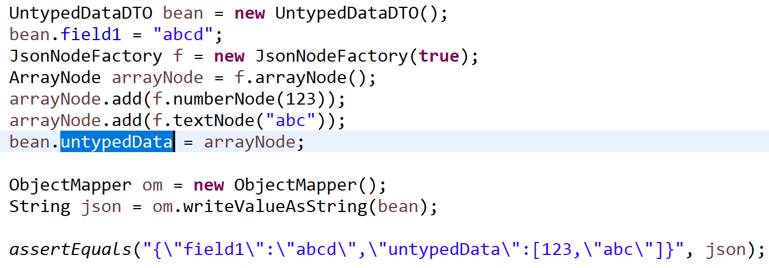
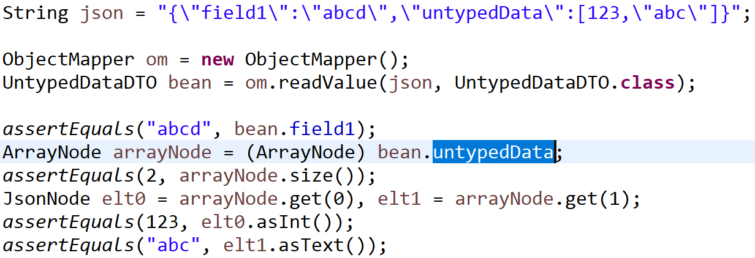
Mixing Generic JsonNode in Type-safe DTO
{ JSON}
DTO with JsonNode
DTO with JsonNode
{ JSON}

Slide 20
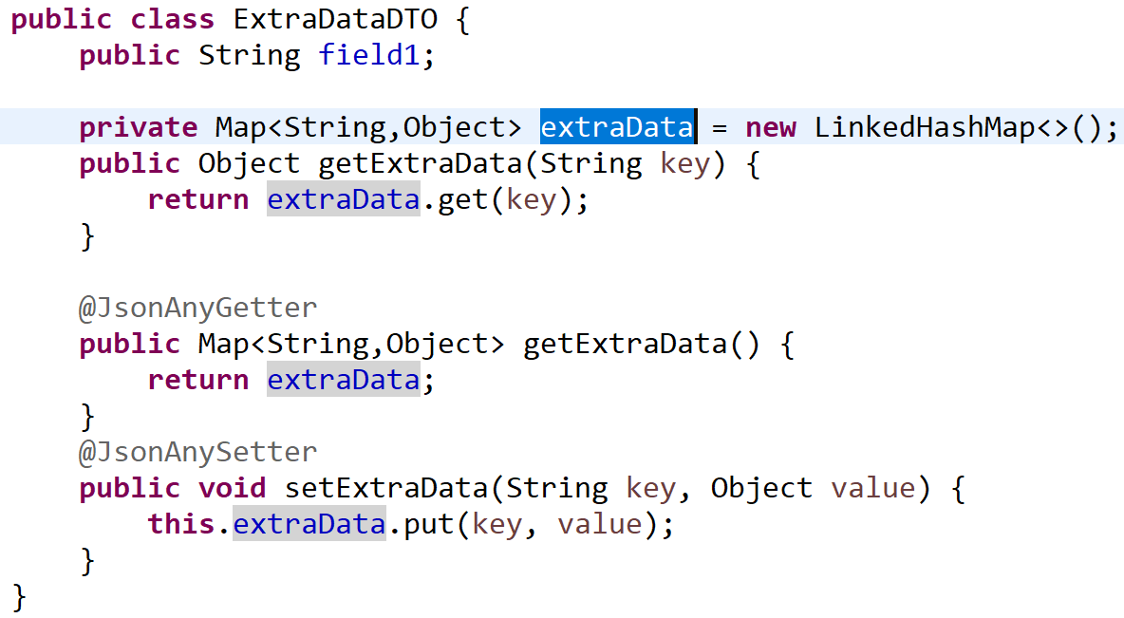
Support for Any Getter/Setter Properties
Known properties
GO here
All others
unknown properties
GO here

Slide 21
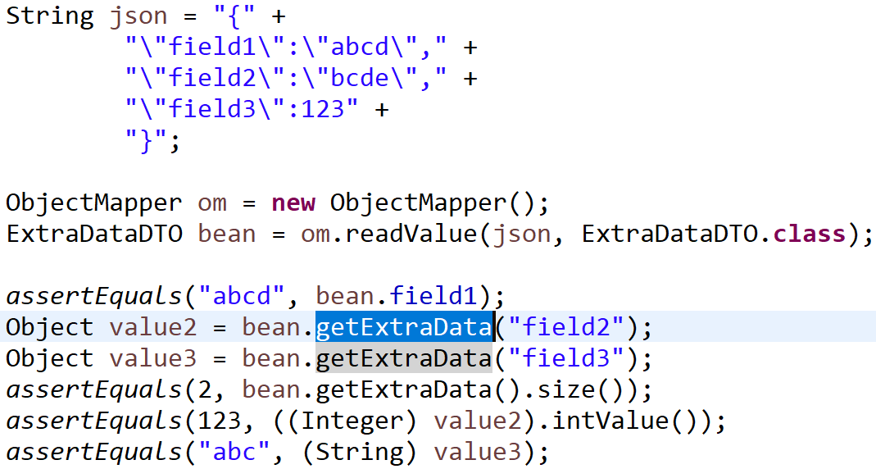
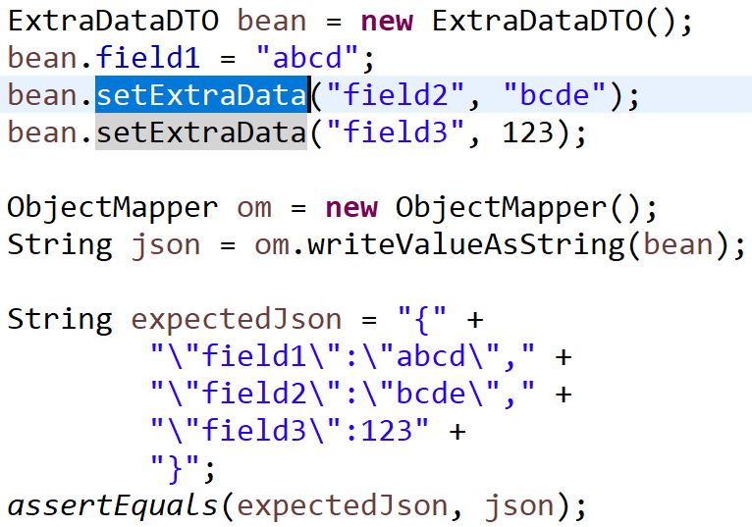
Any Getter/Setter Properties … preserve future Unknown
{ JSON}
DTO with Any Property
DTO with Any Property
{ JSON}

Slide 22
JSON : schema-less well integrated in Java (Jackson) even more portable than protobuf but much more verbose…

Slide 23
Mapping Rest Request <-> server Method Call

Slide 24
Http Json Request <-> Java method + Object param
http Server Thread (Tomcat, Netty, ..)
DispatcherServlet.handle( httpServletRequest, httpServletResponse)
http 2.0 VERB /path
header=value
.
{ json body }
Socket.read
{json}
Unmarshalling: JSON -> Java Object
(RequestBody -> method param)
java Object
http / TCP-IP Socket
Application code called by introspection
@RequestMapping
Output method(Input..) { …}
Java Object
Marshalling: Java Object -> JSON
(method return -> ResponseBody)
Socket.write
http 200
header=value
.
{ json body }
{json}

Slide 25
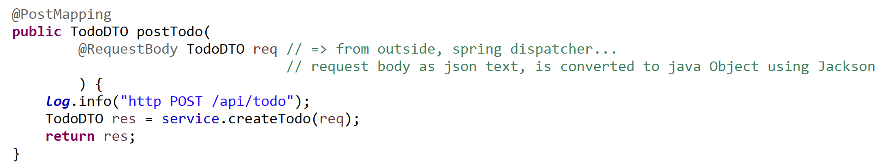
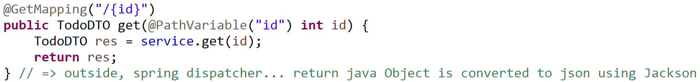
Http Request <-> Spring Java Mappings @RequestMapping, @{Get|Post|..}Mapping, @RequestBody ..

Slide 26
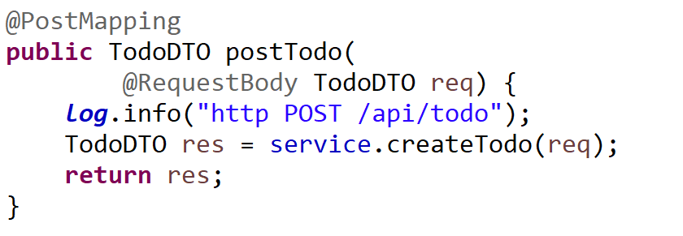
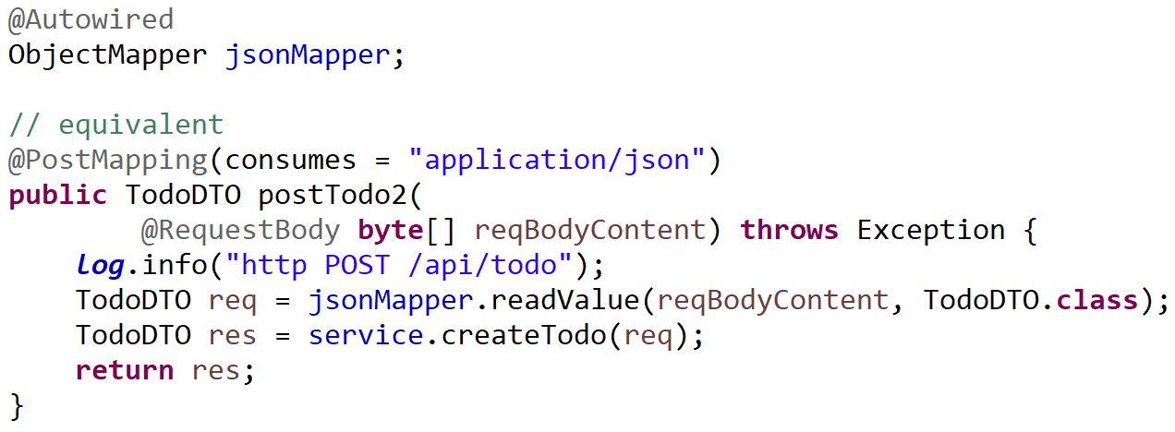
Equivalent Explicit Json Unmarshalling

Slide 27
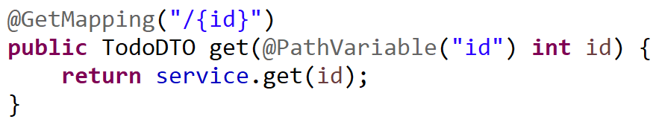
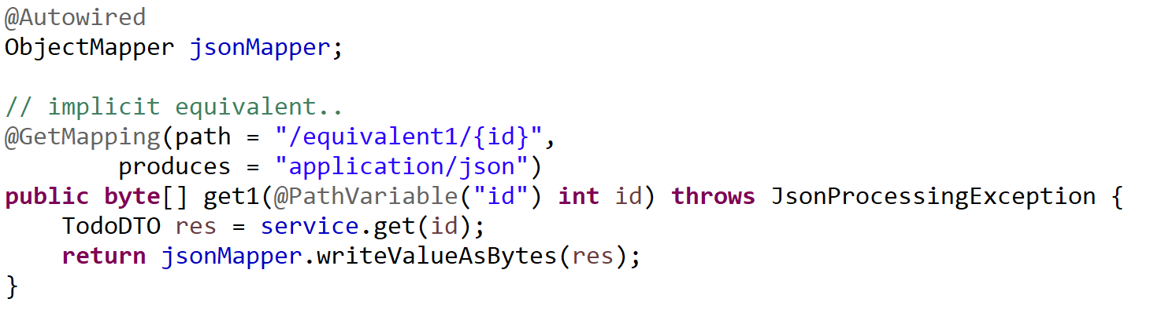
Equivalent Explicit Json Marshalling

Slide 28
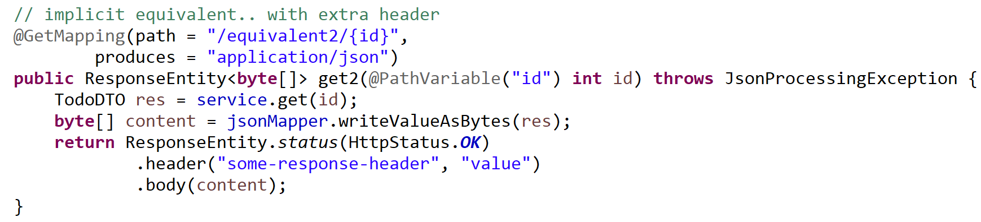
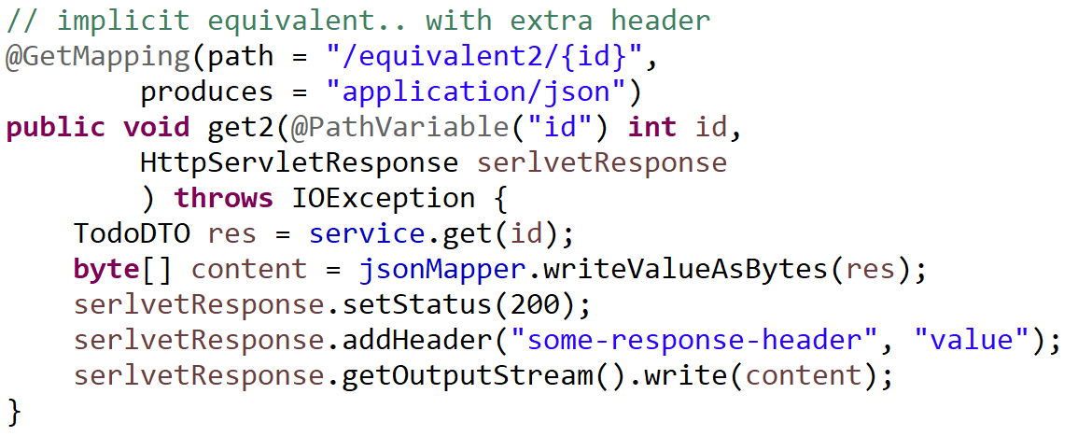
Explicit Equivalent, with http Status + Headers

