Slide 1
Spark Dataset Lineage Evaluation, Caching & Checkpoint
arnaud.nauwynck@gmail.com
This document:
https://github.com/arnaud-nauwynck/Presentation/big-data/ 10-dataset-lineage-eval-caching

Slide 2
Compose RDD Functions
Rdd1 =f1()
Rdd2 =f2()
Rdd3 = rdd1.join( rdd2 )
Creation
Func
Transformation
Func
Action
Func
Signature:
(SparkSession, …) -> RDD
Rdd4 = rdd2.f3()
(RDD, …) -> RDD
(RDD, …) -> other
rdd4 .action();
Void, or List<SomethingElse> … NO More RDD

Slide 3
RDD Declarations / Expressions / DAG
RDD Code Declaration
(SSA: Single State Assignement)
Algebraic
Expressions
rdd1=..
rdd2=.. rdd3=..
[ f1() .join(f2()) ].f3()
DAG (Directed Acyclic Graph)
rdd1
rdd3
rdd2

Slide 4
Intermediate (un-named) RDDs using Functionnal API
Rdd4 = rdd1.f2() .f3() .f4()
named local var rdd4
Unamed rdd[3]
Unamed rdd[2]

Slide 5


RDD: Lazy Transformations … then Action
Rdd1 =f1()
Defined, but lazy
=> nothing computed
Rdd2 = rdd1.f2()
=> nothing computed
Rdd3 = rdd2.f3()
=> nothing computed
rdd3 .action();
=> Compute all : f3( f2 ( f1() ) )

Slide 6
Compute Backward the Dependency Lineage
Rdd1 =f1()
need
eval 1
Rdd2 = rdd1.f2()
need
eval 2
Rdd3 = rdd2.f3()
need
eval 3
rdd3 .action();
=> Compute all : f3( f2 ( f1() ) )

Slide 7
Every re-executions of RDD => re-trigger Full Lineage Recomputation
Rdd1 =f1()
re-eval again RDD1
Rdd2 = rdd1.f2()
need
eval 2
re-eval again RDD2
Rdd3 = rdd2.f3()
need
eval 3
re-eval again RDD3
rdd3 .action();
rdd3 .action();

Slide 8
.cache() to Avoid Recomputing
Rdd1 =f1()
Rdd2 = rdd1.f2()
computed on first evaluation
then cached
Rdd3 = rdd2.f3()
return cached on following
rdd3.cache()
rdd3 .action3();
rdd3 .action3();

Slide 9
RDD Shared & Lazy … not necessarily "efficient"
Rdd1 =f1()
Computed TWICE
Rdd2 = rdd1.f2()
Rdd3 = rdd2.f3()
Rdd4 = rdd2.f4()
rdd3 .action3();
rdd4 .action4();
=> Compute all : f3( f2 ( f1() ) )
=> Compute all : f4( f2 ( f1() ) )

Slide 10
Cache common intermediate RDD result
Rdd1 =f1()
Rdd2 = rdd1.f2()
Force (non-lazy)
Computed ONCE
computed on first seen
then cached
rdd2.cache()
Rdd3 = rdd2.f3()
Rdd4 = rdd2.f4()
rdd3 .action3();
rdd4 .action4();
=> Compute all : f3( cached2 )
=> Compute all : f4( cached2 )

Slide 11
".cache()" synonym of ".persist()" is special exception in Spark APIs
".cache()" or ".persist() are VERY SPECIAL among all Spark APIs
- RDD/Dataset are immutable
- API return a new transformed RDD/Dataset
BUT ".cache()" is THE exception :
- it modifies a field flag in the RDD
- cache() does not create or return a new object, it reuses the same

Slide 12
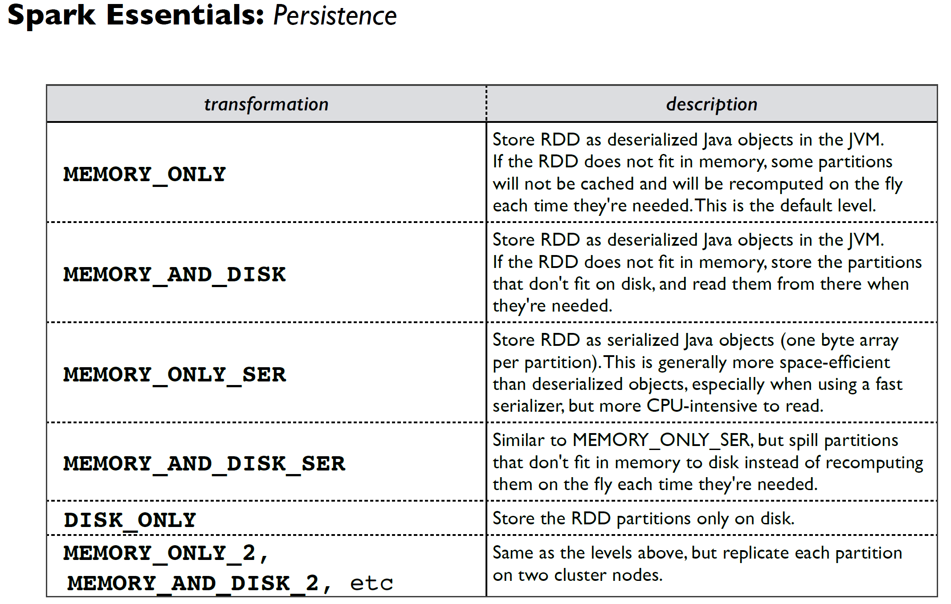

Slide 13
Memory (and Disk) are very Limited Executor Resources
you can not cache "too much" data.
Do only when re-using may be faster than recomputing.
when not enough MEMORY => will use "DISK"
Disk may be slower than recomputing / re-fetching the source itself
Memory and Disk are per executors (per block files)
{
val ds = ... ;
ds.cache()
.. usage1(ds)
.. usage2(ds)
}
spark executor 1
spark Driver
spark executor 2

Slide 14
Do you need to ".unpersist()" ? What if you don't ?
spark executor 1
{
val ds = ... ;
ds.cache()
.. usage1(ds)
.. usage2(ds)
}
spark Driver
spark executor 2
thread variable "ds" is NOT more accessible after "}"
The JVM GarbageCollector can reclaim "ds" memory on driver
=> spark will automatically release corresponding blocks (MEMORY / DISK) on all executors
PROBLEM: this is GC on driver-side. The driver may have plenty of free memory, so GC might not be triggered soon !
... BUT executor may be short of memory

Slide 15
When choosing explicitly ".unpersist()", when to do it ?
val ds = ....
ds.persist();
try {
ds.action1();
ds.action2();
} finally {
ds.unpersist();
}
ds.action3();
OK
ds is cached inside
try-finally code
Problem !!
ds is not cached anymore
action will re-compute FULL Lineage

Slide 16
Difficulty Tracking "hidden" Dependency References in Code
Dataset transformedDs;
{
val ds = ....
ds.persist();
try {
ds.action1();
transformedDs = ds.map(..);
transformedDs.action();
} finally {
ds.unpersist();
}
} // OK, ds not visible outside of method code
// code would not compile
return transformedDs; // use later
Looks OK
ds is cached inside
try-finally code
Problem !!
transformedDs refers to ds,
which is not cached anymore
action will re-compute FULL Lineage

Slide 17
Caching - Display Result in Spark UI
when using
dataset.cache()
The FULL Dag Lineage is still displayed in Spark UI > Query
Some Job have 0 Stage, marked as "Skipped"

Slide 18

Caching - Display Result in Spark UI

Slide 19
Using .localCheckpoint() instead of cache()
when using
Dataset replacedDs = dataset.localCheckpoint()
equivalent to use cached block in-memory & files
The Dag Lineage is CUT in Spark UI > Query.
the source is displayed as "InMemoryRDD"
=> much easier to read (even if not named/labelled correctly)

Slide 20
Using .checkpoint()
when using
Dataset replacedDs = dataset.checkpoint()
equivalent to use saved files in persistent Hadoop storage
The Dag Lineage is CUT in Spark UI > Query.
the source is displayed as "FileScanRDD"
=> much easier to read (even if not named/labelled correctly)

Slide 21
Questions ?

